Slide 1
A better Allbirds homepage
Audit, concept redesign and delivery plan for Allbirds
Prepared 2026-10-25 · Samsung digital engineering

Slide 2
Your site today: 63/100 (D)
Measured on your live homepage, not a template
SPEED
41 · F
Lighthouse mobile score 41; main content in 24.0s, blocking time 583 ms.
MOBILE
87 · B
12 of 84 tap targets are too small on mobile.
A11Y
70 · C
3 accessibility rules failed (2 serious or critical).
UX
56 · D
Weakest area: visual hierarchy (2/5).
GEO
65 · C
No structured data; llms.txt present.

Slide 3
What is costing you customers
Top fixes, ranked by severity
Blocking shipping modal hides the hero and primary content on first load
Visitors decide in seconds; unclear hierarchy and actions send them to a competitor.
Hero headline and CTAs have weak contrast and are visually secondary
Visitors decide in seconds; unclear hierarchy and actions send them to a competitor.
Main content takes 24.0s to appear on mobile
Every extra second of load time costs conversions; slow pages also rank lower in search.
Reduce unused JavaScript: about 2.8s to gain
Faster pages convert better and rank higher.
Buttons must have discernible text
Inaccessible sites exclude users, invite legal risk (ADA / EAA) and lose search visibility.

Slide 4
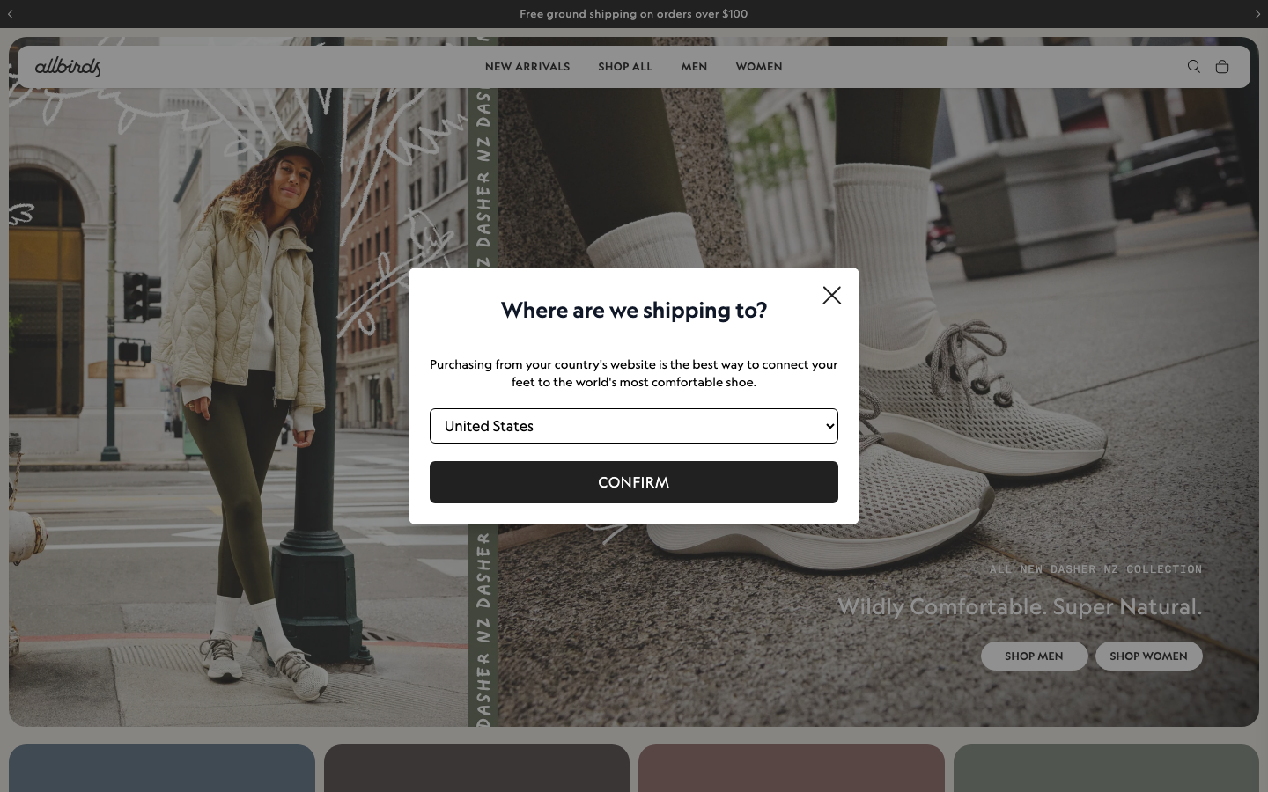
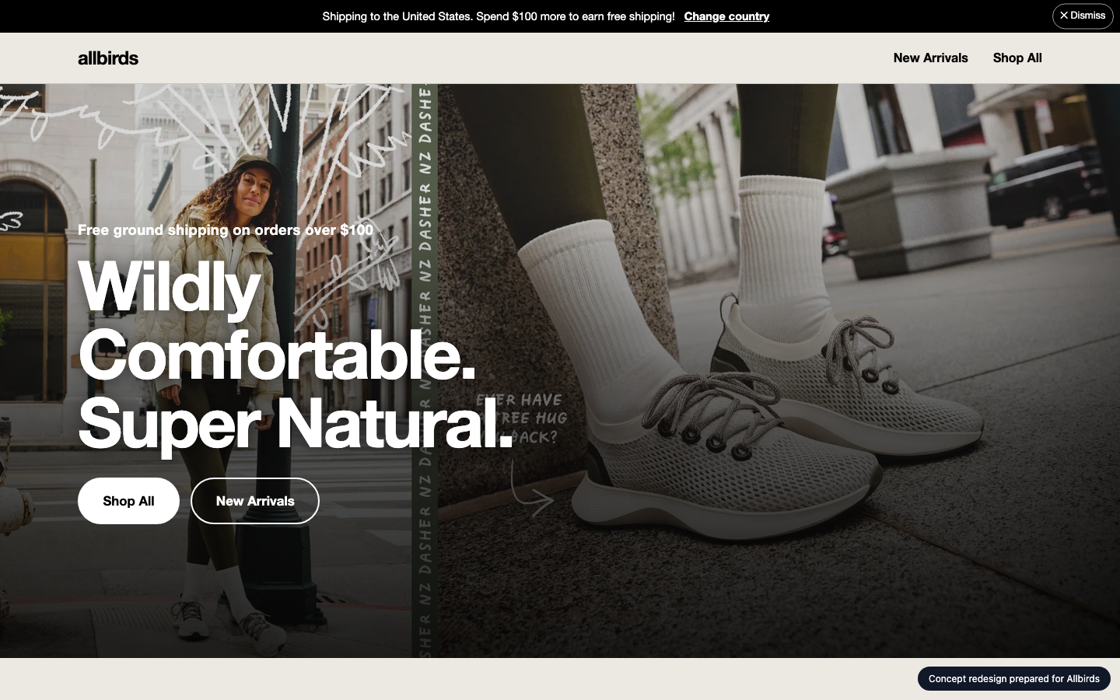
Your homepage, before and after
Concept built from your own brand colours, fonts and content
BEFORE
AFTER (concept)

Slide 5
What changed, and the proof
Same inspectors, run on the new prototype
A11Y
MOBILE
GEO
UX
70 → 96
87 → 100
65 → 62
56 → 60
Blocking shipping modal hides the hero and primary content on first load: Replace the modal with a dismissible top banner or a country suggestion inside the header. If a modal has to stay, preselect the country from geo-IP and show it only to visitors whose location differs from the store. Never block the hero for US visitors.
Hero headline and CTAs have weak contrast and are visually secondary: Add a dark gradient overlay or move the copy to a calmer area of the image. Make the headline larger and white with a heavier weight. Style the primary CTA as a solid, high-contrast button, such as white fill with dark text, and make the secondary CTA an outline. Increase the eyebrow size and weight.
Main content takes 24.0s to appear on mobile: Compress and preload the hero image, defer non-critical scripts, serve via a CDN.
Reduce unused JavaScript: about 2.8s to gain: Address "Reduce unused JavaScript".

Slide 6
Plan: 4 weeks, 110 person-days
Effort by workstream
Homepage rebuild (design + front end)
15 d
Performance engineering
18 d
Responsive & mobile fixes
8 d
Accessibility remediation
18 d
UX & conversion redesign
21 d
Structured data & AI-search
7 d
QA & launch
14 d
Delivery management
9 d

Slide 7
Why us: 92/100 organisation match
Named people, free to start soon
Aarav Mehta · Senior Frontend Engineer
fit 100%
nextjs, responsive-ui, web-performance · free from 2026-11-02
Dev Malhotra · Senior Frontend Engineer
fit 100%
nextjs, responsive-ui, web-performance · free from 2026-11-09
Vikram Das · Design Systems Engineer
fit 89%
design-systems, nextjs, responsive-ui · free from 2026-11-02
Ananya Rao · UX Designer
fit 80%
ux-design, design-systems · free from 2026-11-02
Isha Patel · QA Automation Engineer
fit 80%
qa-testing, a11y · free from 2026-11-09
Zoya Ali · Accessibility Specialist
fit 78%
a11y, qa-testing, responsive-ui · free from 2026-11-02
No skill gaps for this scope.

Slide 8
Investment
A range until discovery is complete
₹11,43,000 – ₹14,61,000
Homepage and key templates only; no new backend features
Client provides brand assets and timely feedback
Blended day rate 8250 with a 40% margin
Estimate is +/- range until discovery is complete

Slide 9
Next steps
30-minute walkthrough of the prototype with your team
Discovery week to confirm scope and price
Team starts 2026-11-02

