Slide 1
A better Stripe homepage
Audit, concept redesign and delivery plan for Stripe
Prepared 2026-10-25 · Samsung digital engineering

Slide 2
Your site today: 69/100 (C)
Measured on your live homepage, not a template
SPEED
43 · F
Lighthouse mobile score 43; main content in 4.7s, blocking time 1310 ms.
MOBILE
70 · C
103 of 180 tap targets are too small on mobile.
UX
76 · C
Weakest area: cta clarity (3/5).
GEO
90 · A
Structured data found; llms.txt present.

Slide 3
What is costing you customers
Top fixes, ranked by severity
Main content takes 4.7s to appear on mobile
Every extra second of load time costs conversions; slow pages also rank lower in search.
Page is unresponsive for 1.3s while loading
Taps and scrolls feel broken while scripts run, so visitors leave before they act.
103 tap targets are too small
Mis-taps frustrate users right where you want them to act.
Headline text collides with the colorful gradient artwork
Visitors decide in seconds; unclear hierarchy and actions send them to a competitor.
Primary CTA competes with header CTAs and is vague
Visitors decide in seconds; unclear hierarchy and actions send them to a competitor.

Slide 4
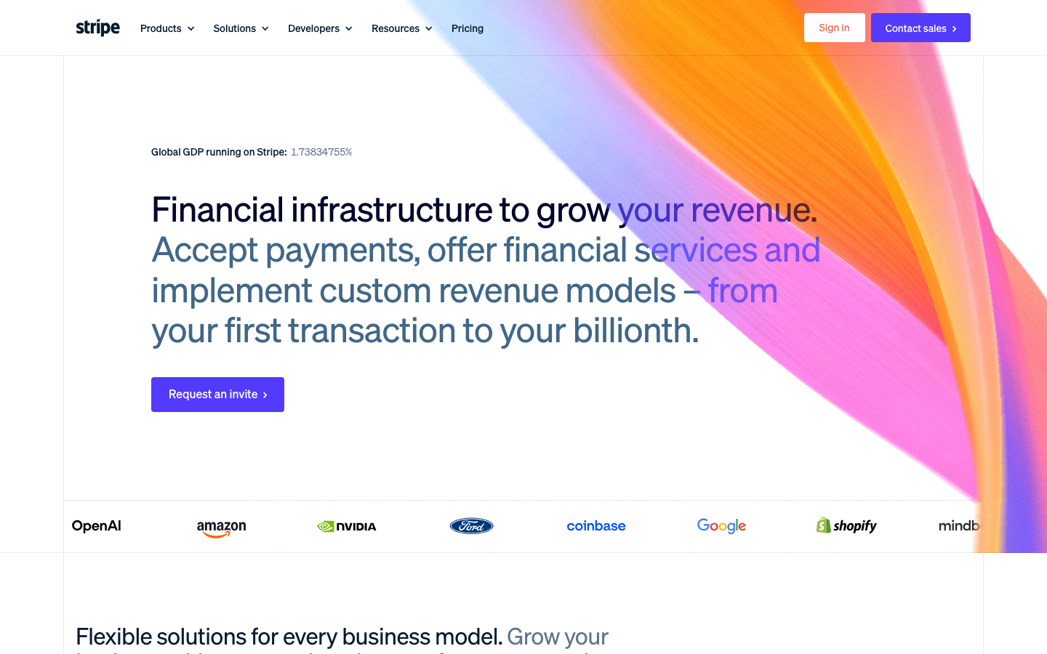
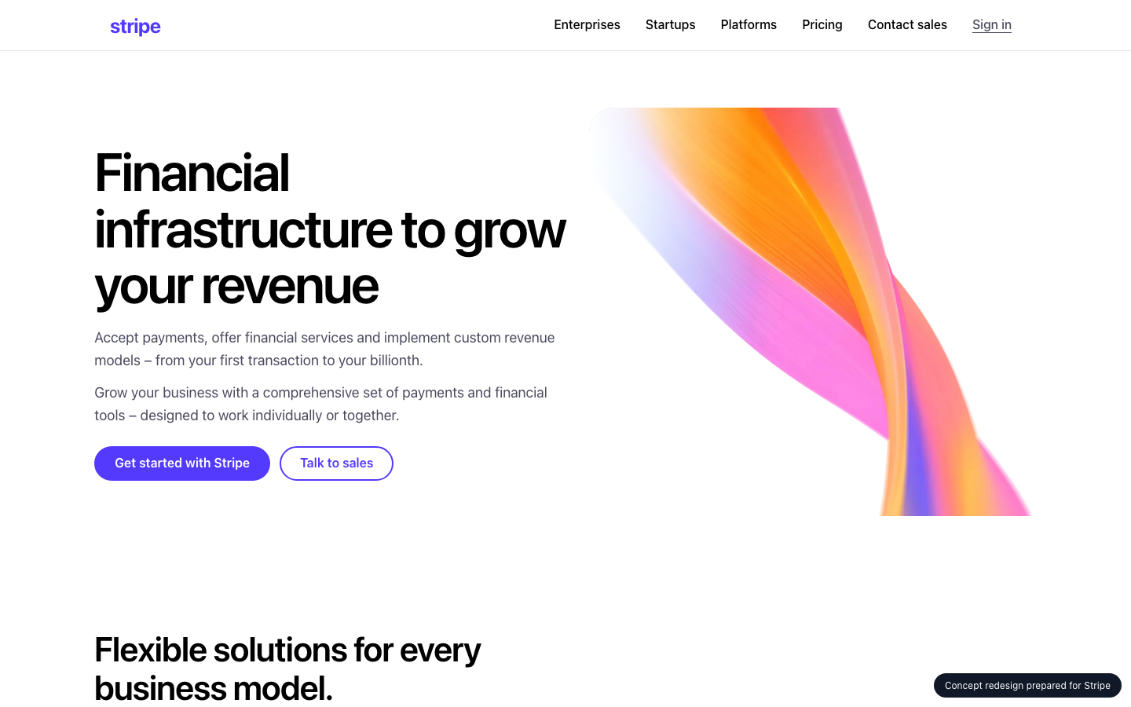
Your homepage, before and after
Concept built from your own brand colours, fonts and content
BEFORE
AFTER (concept)

Slide 5
What changed, and the proof
Same inspectors, run on the new prototype
MOBILE
UX
70 → 100
76 → 76
Main content takes 4.7s to appear on mobile: Compress and preload the hero image, defer non-critical scripts, serve via a CDN.
Page is unresponsive for 1.3s while loading: Split and defer JavaScript, remove unused third-party scripts.
103 tap targets are too small: Make interactive elements at least 44x44px with spacing between them.
Headline text collides with the colorful gradient artwork: Shift the ribbon artwork right or lower, or keep the text column clear of it. Alternatively, add a white-to-transparent gradient behind the text, or keep the headline text colors consistent and high-contrast.

Slide 6
Plan: 3 weeks, 61 person-days
Effort by workstream
Homepage rebuild (design + front end)
15 d
Performance engineering
14 d
Responsive & mobile fixes
7 d
UX & conversion redesign
12 d
QA & launch
8 d
Delivery management
5 d

Slide 7
Why us: 96/100 organisation match
Named people, free to start soon
Aarav Mehta · Senior Frontend Engineer
fit 100%
nextjs, responsive-ui, web-performance · free from 2026-11-02
Dev Malhotra · Senior Frontend Engineer
fit 100%
nextjs, responsive-ui, web-performance · free from 2026-11-09
Ananya Rao · UX Designer
fit 89%
ux-design, design-systems · free from 2026-11-02
Vikram Das · Design Systems Engineer
fit 89%
design-systems, nextjs, responsive-ui · free from 2026-11-02
Diya Nair · Frontend Engineer
fit 73%
nextjs, responsive-ui · free from 2026-11-02
Isha Patel · QA Automation Engineer
fit 56%
qa-testing · free from 2026-11-09
No skill gaps for this scope.

Slide 8
Investment
A range until discovery is complete
₹6,21,000 – ₹7,94,000
Homepage and key templates only; no new backend features
Client provides brand assets and timely feedback
Blended day rate 8083 with a 40% margin
Estimate is +/- range until discovery is complete

Slide 9
Next steps
30-minute walkthrough of the prototype with your team
Discovery week to confirm scope and price
Team starts 2026-11-02

