Slide 1
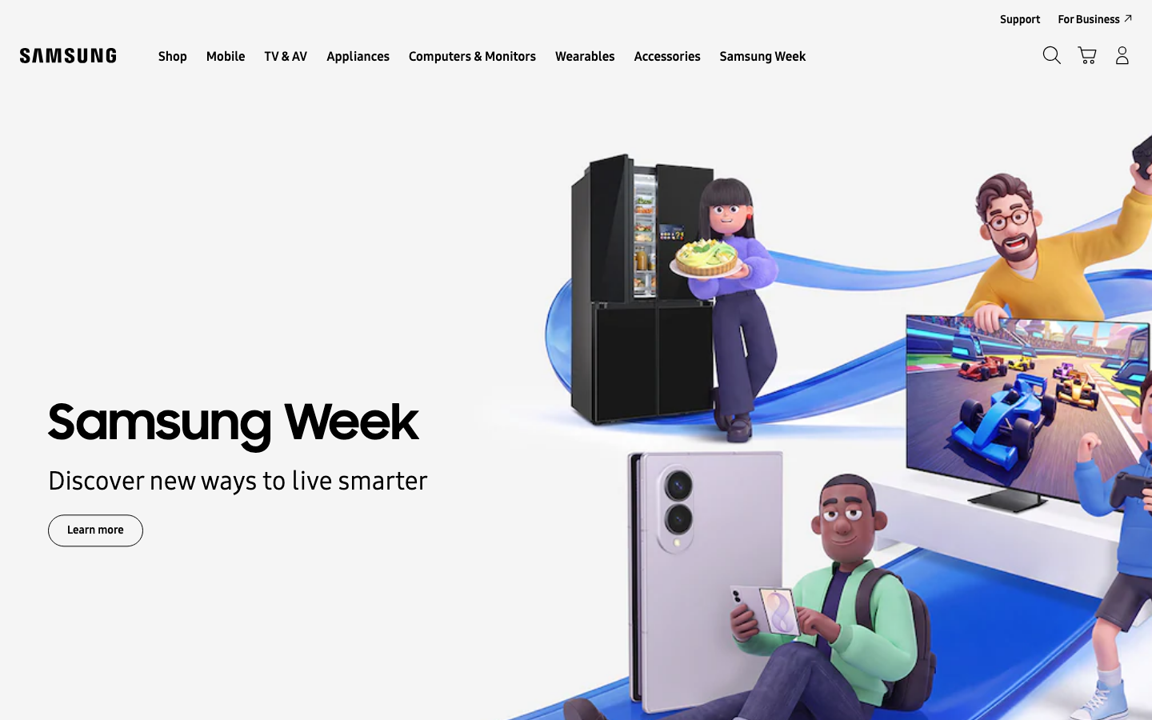
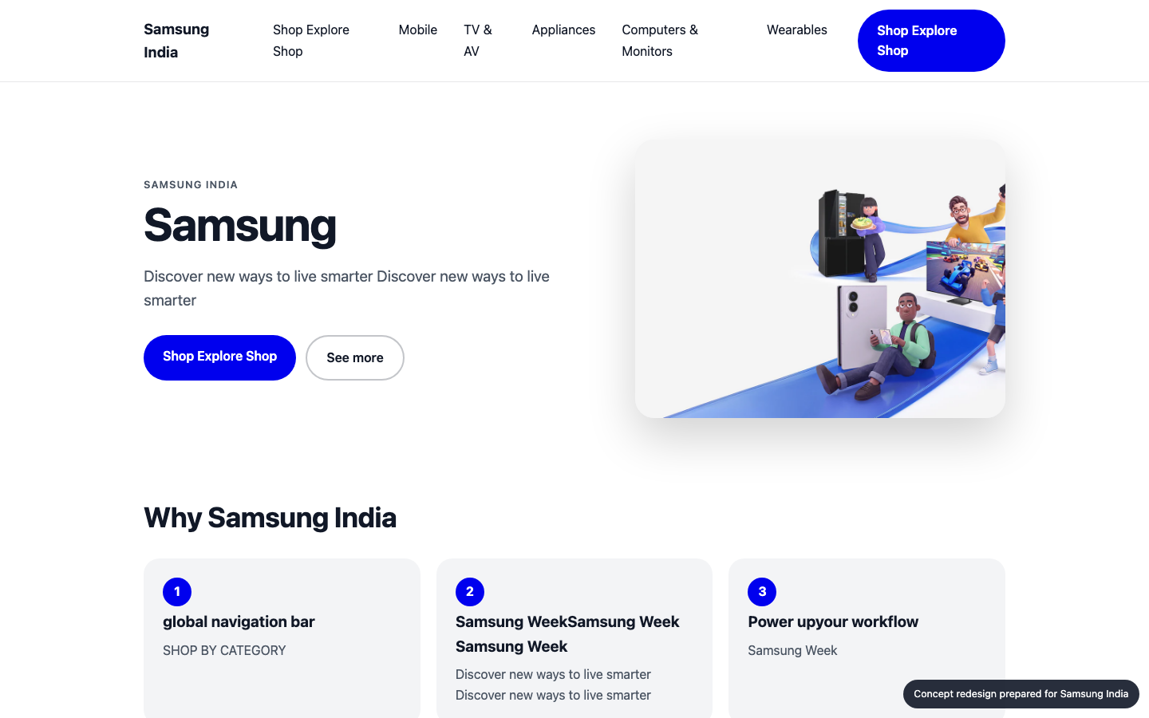
SAMSUNG
SDS
WEBSITE IMPROVEMENT PROPOSAL
A better Samsung India homepage
Samsung India today
CONCEPT
Audit, technology review, concept redesign and delivery plan for Samsung India
samsung.com
Prepared 2026-10-25 by Samsung SDS · Digital Engineering
Notes:
Cover. This proposal is for Samsung India (samsung.com). The left side names the engagement; the right shows their homepage today and the concept redesign.

Slide 2
EXECUTIVE SUMMARY
SAMSUNG
SDS
Where you stand, and what we recommend
THE BIGGEST OPPORTUNITIES
1
Certain ARIA roles must contain particular children
73
Inaccessible sites exclude users, invite legal risk (ADA / EAA) and lose search visibility.
2
Certain ARIA roles must be contained by particular parents
Inaccessible sites exclude users, invite legal risk (ADA / EAA) and lose search visibility.
3
Navigation has 8 items
out of 100 · grade C
samsung.com today
Visitors decide in seconds; unclear hierarchy and actions send them to a competitor.
11
93/100
6 people
3 weeks
₹7.3–9.3 lakh
Technologies found
Organisation match
Team
Timeline
Investment
Samsung India · Prepared by Samsung SDS
2
Notes:
Overall score 73 out of 100, grade C. The three biggest opportunities are on the right.

Slide 3
THE AUDIT
SAMSUNG
SDS
How Samsung India scores today
Speed
Mobile
Accessibility
UX
AI search
93
81
35
68
97
Grade A
Grade B
Grade F
Grade C
Grade A
Main content shows in 0.8s; 2.1 MB over 95 requests.
19 of 268 tap targets are too small on mobile.
5 accessibility rules failed (5 serious or critical).
Weakest area: navigation (2/5).
Structured data found; llms.txt present.
LCP
Horizontal overflow
Rules failed
Visual hierarchy
JSON-LD blocks
0.8s
0px
5
4
3
CLS
Small tap targets
Critical
CTA clarity
Schema types
0.074
19/268
2
3
WebSite, WebP…
Page weight
Tiny text blocks
Serious
Navigation
llms.txt
2.1 MB
21
3
2
yes
Overall 73/100, grade C: speed 20%, mobile 20%, accessibility 20%, UX 25%, AI search 15%.
Samsung India · Prepared by Samsung SDS
3
Notes:
Each score is measured: Lighthouse for speed, axe-core for accessibility, a phone-sized browser for mobile, a vision model for UX and tool checks plus a model judgement for AI search. Findings and evidence follow.

Slide 4
THE AUDIT · FINDINGS AND EVIDENCE
SAMSUNG
SDS
What we found (1 of 2)
AREA | FINDING | EVIDENCE | RECOMMENDED FIX | IMPACT
Accessibility | Certain ARIA roles must contain particular children | aria-required-children: 2 element(s), e.g. .nv00-gnb-v4__l0-menu-list--left | Fix the flagged elements and add automated a11y checks to CI. | High
Accessibility | Certain ARIA roles must be contained by particular parents | aria-required-parent: 17 element(s), e.g. .nv00-gnb-v4__l0-menu-link[an-la="L0_2_shop"][h… | Fix the flagged elements and add automated a11y checks to CI. | High
Accessibility | Elements must have their visible text as part of their accessible name | label-content-name-mismatch: 1 element(s), e.g. .footer-language-wrap > .footer-language… | Fix the flagged elements and add automated a11y checks to CI. | High
Accessibility | Links must be distinguishable without relying on color | link-in-text-block: 1 element(s), e.g. .footer-legal > a | Fix the flagged elements and add automated a11y checks to CI. | High
Mobile | 19 tap targets are too small | 19 of 268 links/buttons are under 32px | Make interactive elements at least 44x44px with spacing between them. | Medium
Mobile | Text is too small to read comfortably | 21 text blocks under 12px | Use a 16px base font size and a fluid type scale. | Medium
Samsung India · Prepared by Samsung SDS
4
Notes:
Every finding carries its evidence, the recommended fix and why it matters to the business.

Slide 5
THE AUDIT · FINDINGS AND EVIDENCE
SAMSUNG
SDS
What we found (2 of 2)
AREA | FINDING | EVIDENCE | RECOMMENDED FIX | IMPACT
UX | Navigation has 8 items | Shop Explore Shop · Mobile · TV & AV · Appliances · Computers & Monitors · Wearables · Ac… | Group into 5-7 top-level items with clear labels. | Medium
Samsung India · Prepared by Samsung SDS
5
Notes:
Every finding carries its evidence, the recommended fix and why it matters to the business.

Slide 6





TECHNOLOGY REVIEW
SAMSUNG
SDS
The technology behind samsung.com
11
83
48%
13
technologies detected
network requests
third-party requests
domains contacted
FRONTEND FRAMEWORK
jQuery
BUSIEST DOMAINS
CMS & EXPERIENCE
Adobe Experience Manager
samsung.com
ANALYTICS
Adobe Analytics
adobedtm.com
TAG MANAGER
Adobe Experience Platform Launch
go-mpulse.net
PERSONALIZATION & TESTING
Adobe Target
demdex.net
TRACKING PIXELS
Meta Pixel
Google Ads / DoubleClick
rubiconproject.com
MONITORING
Akamai mPulse
facebook.com
CDN & HOSTING
Akamai
Cloudflare
Border colour: our coverage (green strong, amber partial, red gap). Thin border: a single signal, so likely rather than confirmed.
Samsung India · Prepared by Samsung SDS
6
Notes:
Detected from 83 network requests, response headers, cookies, page markup and script globals. Each technology is coloured by how well our people cover it. Detection is a strong hint, not a certainty.

Slide 7

TECHNOLOGY REVIEW · OUR COVERAGE
SAMSUNG
SDS
How Samsung SDS supports your stack
TECHNOLOGY
CATEGORY
OUR SKILL
PEOPLE FREE
STATUS
AE
Adobe Experience Manager
CMS & experience
Adobe Experience Manager
3 of 8 · 2026-11-02
Strong
AA
Adobe Analytics
Analytics
Adobe Analytics / Launch
1 of 4 · 2026-11-16
Partial
AE
Adobe Experience Platform…
Tag manager
Adobe Analytics / Launch
1 of 4 · 2026-11-16
Partial
AT
Adobe Target
Personalization & tes…
Personalization & A/B testing
1 of 3 · 2026-11-16
Partial
Akamai
CDN & hosting
DevOps / CDN / cloud
2 of 6 · 2026-11-02
Strong
Cloudflare
CDN & hosting
DevOps / CDN / cloud
2 of 6 · 2026-11-02
Strong
PHP
Server & language
PHP
1 of 4 · 2026-11-09
Partial
77%
Strong: skilled and two or more people free. Partial: some capacity. Gap: nobody free, so we plan a partner or a hire.
of your platform stack we can staff now
Samsung India · Prepared by Samsung SDS
7
Notes:
We map each detected technology to our skills inventory. 77 percent of the platform stack has capacity today. Gaps are shown honestly with a plan to cover them. Skills data is sample data until connected to the real inventory.

Slide 8
CONCEPT REDESIGN
SAMSUNG
SDS
Your own homepage, improved
TODAY
CONCEPT
35 → 98
81 → 100
68 → 68
Same inspectors, run on the concept page. Speed and AI search are not re-measured on a local concept.
Accessibility score, re-checked on the concept
Mobile score, re-checked on the concept
UX score, re-checked on the concept
Samsung India · Prepared by Samsung SDS
8
Notes:
The concept is built from Samsung India's own colours, fonts and content, then re-checked by the same inspectors. It is a concept for discussion, not a final design.

Slide 9
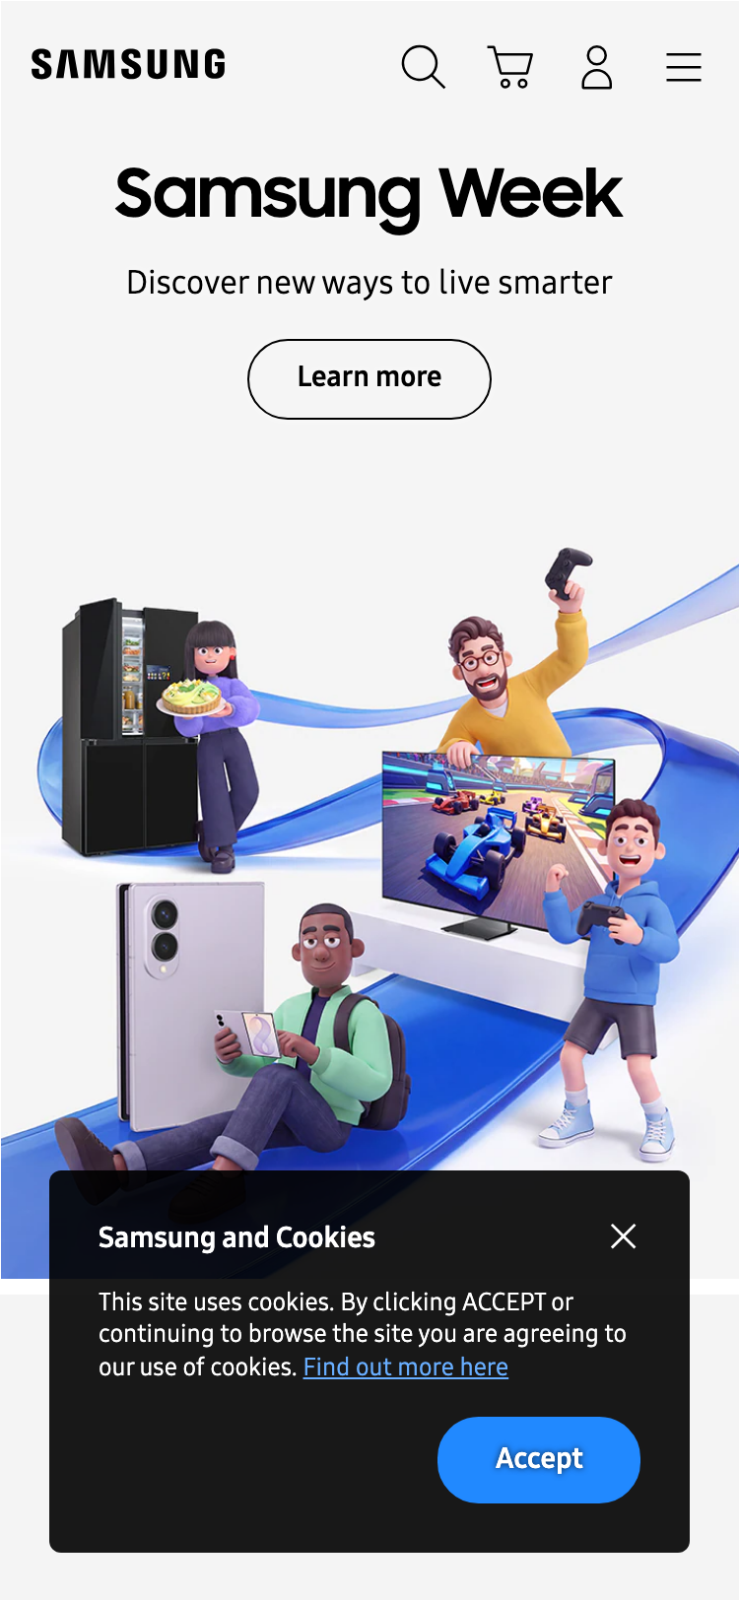
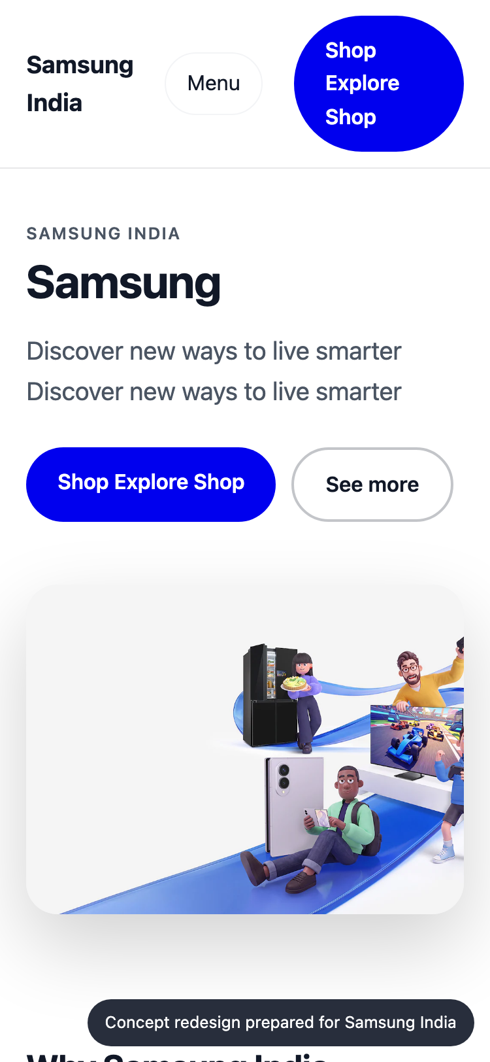
CONCEPT REDESIGN · MOBILE
SAMSUNG
SDS
On a phone
TODAY
CONCEPT
Mobile today
81/100 · grade B
19 of 268 tap targets are too small on mobile.
Horizontal overflow
0px
Small tap targets
19/268
Tiny text blocks
21
Viewport meta
yes
Samsung India · Prepared by Samsung SDS
9
Notes:
Most visitors arrive on a phone. These are phone-sized screenshots of the live site and of the concept.

Slide 10
CONCEPT REDESIGN · CHANGES
SAMSUNG
SDS
What changed, and why
Certain ARIA roles must contain particular children
→
Fix the flagged elements and add automated a11y checks to CI.
Certain ARIA roles must be contained by particular parents
→
Fix the flagged elements and add automated a11y checks to CI.
Navigation has 8 items
→
Group into 5-7 top-level items with clear labels.
19 tap targets are too small
→
Make interactive elements at least 44x44px with spacing between them.
Text is too small to read comfortably
→
Use a 16px base font size and a fluid type scale.
Samsung India · Prepared by Samsung SDS
10
Notes:
Each change in the concept answers a specific audit finding.

Slide 11
ORGANISATION MATCH
SAMSUNG
SDS
Why Samsung SDS fits this work
SKILL
FIT
PEOPLE FREE
QA / test automation
3 of 8
Strong
93
Accessibility (WCAG)
1 of 3
Partial
Next.js / React
5 of 12
Strong
Responsive / mobile UI
4 of 9
Strong
UX / UI design
2 of 6
Strong
organisation match
Adobe Experience Manager
3 of 8
Strong
Strengths
QA / test automation, Next.js / React, Responsive / mobile UI, UX / UI design
Gaps
None
PHP
1 of 4
Strong
Design systems
1 of 4
Strong
Delivery / project management
2 of 5
Strong
Samsung India · Prepared by Samsung SDS
11
Notes:
The organisation match score is 93 out of 100: how well our skills cover what this work needs, weighted by importance and availability. It uses the detected technology stack and the audit findings. Skills are sample data until connected to the real inventory.

Slide 12
PROPOSED TEAM
SAMSUNG
SDS
The team we would put on it
VD
Vikram Das
81%
AM
Aarav Mehta
80%
DM
Dev Malhotra
80%
Design Systems Engineer
fit
Senior Frontend Engineer
fit
Senior Frontend Engineer
fit
design-systems · nextjs · responsive-ui
nextjs · responsive-ui
nextjs · responsive-ui
Level 4/5 · available from 2026-11-02
Level 5/5 · available from 2026-11-02
Level 5/5 · available from 2026-11-09
Level 4/5 in design-systems, nextjs, responsive-ui; free from 2026-11-02. Needed for design-sy…
Level 5/5 in nextjs, responsive-ui; free from 2026-11-02. Needed for nextjs (weight 0.8).
Level 5/5 in nextjs, responsive-ui; free from 2026-11-09. Needed for responsive-ui (weight 0.7…
IP
Isha Patel
78%
ZA
Zoya Ali
78%
AR
Ananya Rao
67%
QA Automation Engineer
fit
Accessibility Specialist
fit
UX Designer
fit
qa-testing · a11y
a11y · qa-testing · responsive-ui
ux-design · design-systems
Level 4/5 · available from 2026-11-09
Level 3/5 · available from 2026-11-02
Level 4/5 · available from 2026-11-02
Level 4/5 in qa-testing, a11y; free from 2026-11-09. Needed for qa-testing (weight 1.0).
Level 3/5 in a11y, qa-testing, responsive-ui; free from 2026-11-02. Needed for a11y (weight 1.…
Level 4/5 in ux-design, design-systems; free from 2026-11-02. Needed for ux-design (weight 0.7…
Samsung India · Prepared by Samsung SDS
12
Notes:
Named people who are available. Fit blends their level and how much of the needed skill weight they cover. This is sample talent data until connected to the real roster.

Slide 13
ESTIMATE
SAMSUNG
SDS
The plan: effort and timeline
EFFORT BY WORKSTREAM (PERSON-DAYS)
Homepage rebuild (design + front end) · 15 d (21%)
Responsive & mobile fixes · 8 d (11%)
Accessibility remediation · 28 d (40%)
UX & conversion redesign · 4 d (6%)
QA & launch · 9 d (13%)
Delivery management · 6 d (9%)
INDICATIVE TIMELINE
Week 1
Week 2
Week 3
Homepage rebuild (design + front end)
Responsive & mobile fixes
Accessibility remediation
UX & conversion redesign
QA & launch
Delivery management
Samsung India · Prepared by Samsung SDS
13
Notes:
About 70 person-days over 3 weeks. The timeline is an indicative picture of the effort, to be fixed in discovery.

Slide 14
ESTIMATE · COMMERCIALS
SAMSUNG
SDS
Investment
ESTIMATED INVESTMENT
70
3 weeks
₹7,28,000 – ₹9,30,000
person-days
indicative duration
6
In discovery
₹7.3 lakh to ₹9.3 lakh · a range until discovery is complete
people on the team
final scope and price
ASSUMPTIONS
Homepage and key templates only; no new backend features
Client provides brand assets and timely feedback
Blended day rate 8250 with a 40% margin
Estimate is +/- range until discovery is complete
Terms: to be added by the account owner before this proposal is sent.
Samsung India · Prepared by Samsung SDS
14
Notes:
A price range until discovery is complete, with every assumption stated.

Slide 15
WORKING TOGETHER
SAMSUNG
SDS
Next steps
1
Walk through the concept
A 30-minute session with your team on Samsung India's homepage concept, the audit and the technology review.
2
Discovery week
We confirm scope, constraints and price, and fix the plan and the team.
3
Start building
The team starts 2026-11-02, with weekly demos and a launch plan.
Samsung India · Prepared by Samsung SDS
15
Notes:
Three simple steps. Nothing is sent or committed until a human approves.

Slide 16
SAMSUNG
SDS
Let's make Samsung India's website your strongest sales channel.
Samsung SDS · Digital Engineering
samsung.com · 2026-10-25
Notes:
Close. Thank the audience and agree the first step.

Slide 17
APPENDIX
SAMSUNG
SDS
How we measured
Speed
Mobile
Lighthouse 12, mobile profile with simulated throttling. Falls back to browser timings if Lighthouse cannot run.
The page reloaded at phone size with touch: viewport, overflow, tap targets, text size.
Accessibility
UX
axe-core run in a real browser; each rule weighted by impact.
A vision model scores a screenshot against a fixed rubric; findings must cite what is visible.
AI search
Technology
Structured data, llms.txt, AI-crawler rules and a model judgement of how clearly the page says what you do.
About 130 signatures over network requests, headers, cookies, markup and script globals. A hint, not a certainty.
Scores are for the homepage only, measured once. The bench roster, skills inventory and rates are sample data until connected to real systems.
Samsung India · Prepared by Samsung SDS
17
Notes:
Methods and limits, for anyone who wants to check our work.

