Slide 1
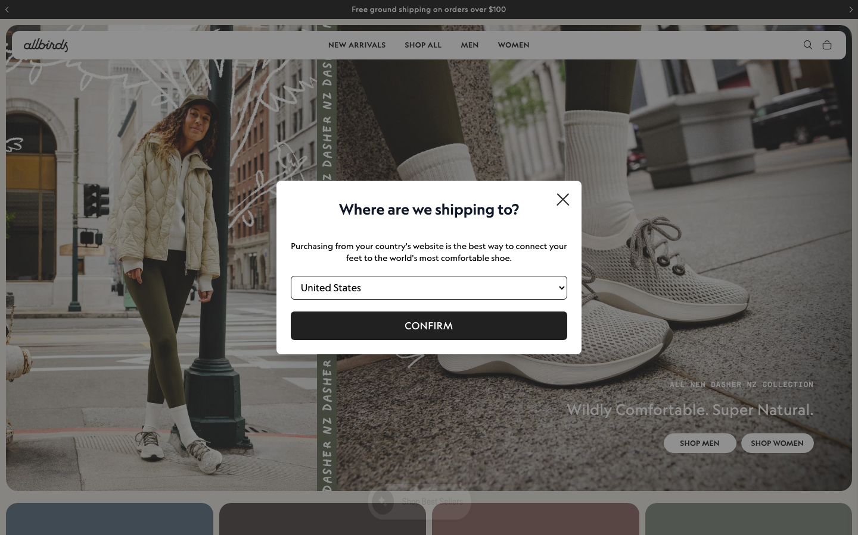
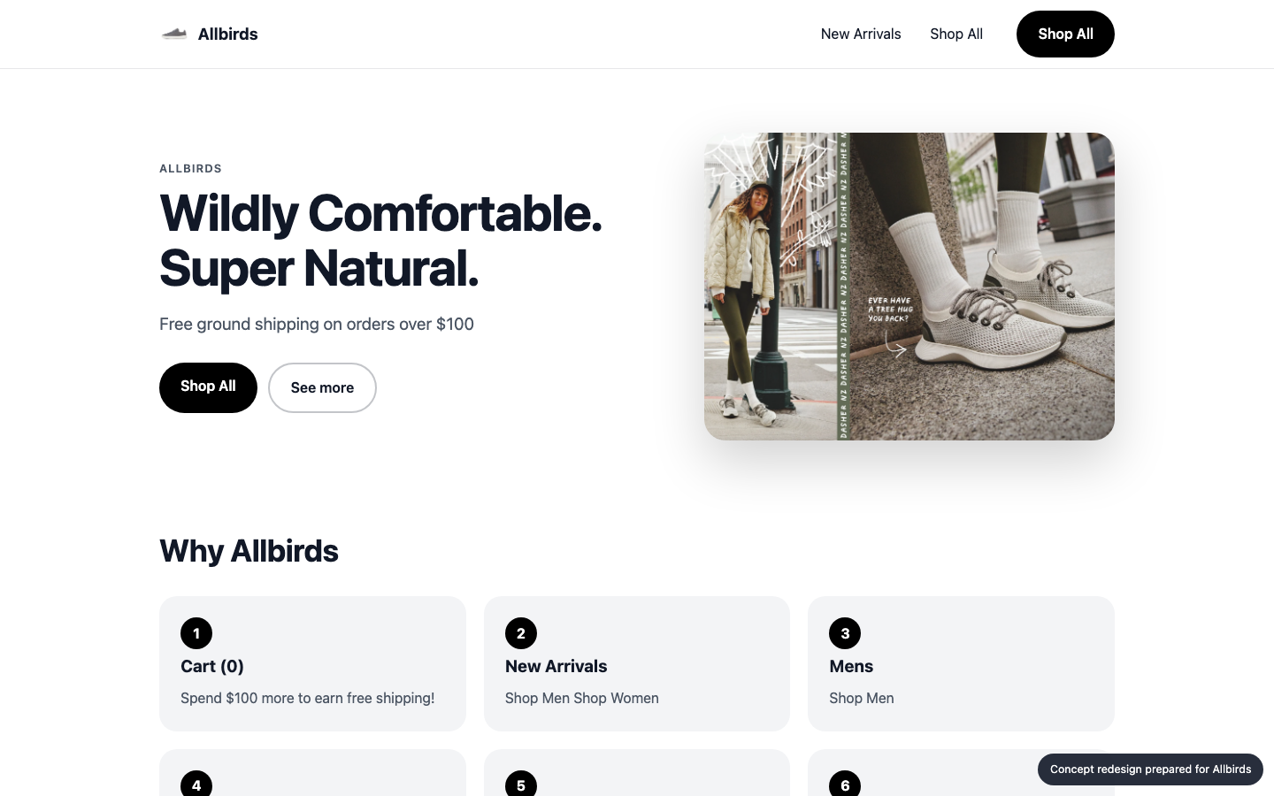
SAMSUNG
SDS
WEBSITE IMPROVEMENT PROPOSAL
A better Allbirds homepage
Allbirds today
CONCEPT
Audit, technology review, concept redesign and delivery plan for Allbirds
allbirds.com
Prepared 2026-10-25 by Samsung SDS · Digital Engineering
Notes:
Cover. This proposal is for Allbirds (allbirds.com). The left side names the engagement; the right shows their homepage today and the concept redesign.

Slide 2
EXECUTIVE SUMMARY
SAMSUNG
SDS
Where you stand, and what we recommend
THE BIGGEST OPPORTUNITIES
1
Main content takes 17.6s to appear on mobile
64
Every extra second of load time costs conversions; slow pages also rank lower in search.
2
Page is unresponsive for 0.8s while loading
Taps and scrolls feel broken while scripts run, so visitors leave before they act.
3
Buttons must have discernible text
out of 100 · grade D
allbirds.com today
Inaccessible sites exclude users, invite legal risk (ADA / EAA) and lose search visibility.
9
88/100
6 people
4 weeks
₹10.7–13.7 lakh
Technologies found
Organisation match
Team
Timeline
Investment
Allbirds · Prepared by Samsung SDS
2
Notes:
Overall score 64 out of 100, grade D. The three biggest opportunities are on the right.

Slide 3
THE AUDIT
SAMSUNG
SDS
How Allbirds scores today
Speed
Mobile
Accessibility
UX
AI search
38
87
70
60
65
Grade F
Grade B
Grade C
Grade D
Grade C
Lighthouse mobile score 38; main content in 17.6s, blocking time 776 ms.
12 of 84 tap targets are too small on mobile.
3 accessibility rules failed (2 serious or critical).
Weakest area: trust signals (2/5).
No structured data; llms.txt present.
Lighthouse score
Horizontal overflow
Rules failed
Visual hierarchy
JSON-LD blocks
38
0px
3
3
0
LCP
Small tap targets
Critical
CTA clarity
Schema types
17.6s
12/84
2
3
none
TBT
Tiny text blocks
Serious
Navigation
llms.txt
776 ms
2
0
4
yes
Overall 64/100, grade D: speed 20%, mobile 20%, accessibility 20%, UX 25%, AI search 15%.
Allbirds · Prepared by Samsung SDS
3
Notes:
Each score is measured: Lighthouse for speed, axe-core for accessibility, a phone-sized browser for mobile, a vision model for UX and tool checks plus a model judgement for AI search. Findings and evidence follow.

Slide 4
THE AUDIT · FINDINGS AND EVIDENCE
SAMSUNG
SDS
What we found (1 of 2)
AREA | FINDING | EVIDENCE | RECOMMENDED FIX | IMPACT
Speed | Main content takes 17.6s to appear on mobile | Lighthouse mobile LCP 17559 ms (target < 2500 ms), FCP 6276 ms | Compress and preload the hero image, defer non-critical scripts, serve via a CDN. | High
Speed | Page is unresponsive for 0.8s while loading | Total blocking time 776 ms (target < 200 ms) | Split and defer JavaScript, remove unused third-party scripts. | High
Speed | Reduce unused JavaScript: about 1.9s to gain | Lighthouse opportunity, estimated saving 1950 ms | Address "Reduce unused JavaScript". | High
Accessibility | Buttons must have discernible text | button-name: 2 element(s), e.g. .text-current.swiper-prev-button.left-0 | Fix the flagged elements and add automated a11y checks to CI. | High
Accessibility | Select element must have an accessible name | select-name: 1 element(s), e.g. .relative.w-full > select | Fix the flagged elements and add automated a11y checks to CI. | High
AI search | No structured data for search and AI engines | No schema.org JSON-LD found on the homepage | Add Organization, WebSite and Product/Service JSON-LD. | High
Allbirds · Prepared by Samsung SDS
4
Notes:
Every finding carries its evidence, the recommended fix and why it matters to the business.

Slide 5
THE AUDIT · FINDINGS AND EVIDENCE
SAMSUNG
SDS
What we found (2 of 2)
AREA | FINDING | EVIDENCE | RECOMMENDED FIX | IMPACT
Mobile | 12 tap targets are too small | 12 of 84 links/buttons are under 32px | Make interactive elements at least 44x44px with spacing between them. | Medium
Mobile | Text is too small to read comfortably | 2 text blocks under 12px | Use a 16px base font size and a fluid type scale. | Medium
Accessibility | All page content should be contained by landmarks | region: 8 element(s), e.g. .swiper-fade > .swiper-wrapper.relative | Fix the flagged elements and add automated a11y checks to CI. | Medium
UX | Blocking shipping modal hides the hero on first load | A white 'Where are we shipping to?' modal sits in the center of the viewport. A dark over… | Replace the modal with a non-blocking top banner or a footer country selector, and show it onl… | Medium
UX | Hero headline and CTAs have weak contrast and are visually buried | The 'Wildly Comfortable. Super Natural.' headline is in light gray-beige over a busy grav… | Add a gradient scrim or solid panel behind the text. Increase the headline size and weight. Us… | Medium
UX | Few trust signals and a generic promo bar | The only message above the fold is 'Free ground shipping on orders over $100' in a thin t… | Add a trust strip under the hero with a star rating and review count, a free returns or guaran… | Medium
Allbirds · Prepared by Samsung SDS
5
Notes:
Every finding carries its evidence, the recommended fix and why it matters to the business.

Slide 6







TECHNOLOGY REVIEW
SAMSUNG
SDS
The technology behind allbirds.com
9
381
49%
25
technologies detected
network requests
third-party requests
domains contacted
FRONTEND FRAMEWORK
Vue.js
BUSIEST DOMAINS
COMMERCE PLATFORM
Shopify
allbirds.com
ANALYTICS
Google Analytics 4
Microsoft Clarity
googletagmanager.com
TAG MANAGER
Google Tag Manager
getredo.com
TRACKING PIXELS
Meta Pixel
Google Ads / DoubleClick
azurefd.net
CDN & HOSTING
Cloudflare
Microsoft Azure
facebook.net
shopify.com
Border colour: our coverage (green strong, amber partial, red gap). Thin border: a single signal, so likely rather than confirmed.
Allbirds · Prepared by Samsung SDS
6
Notes:
Detected from 381 network requests, response headers, cookies, page markup and script globals. Each technology is coloured by how well our people cover it. Detection is a strong hint, not a certainty.

Slide 7
TECHNOLOGY REVIEW · OUR COVERAGE
SAMSUNG
SDS
How Samsung SDS supports your stack
TECHNOLOGY
CATEGORY
OUR SKILL
PEOPLE FREE
STATUS
Vue.js
Frontend framework
Vue / Nuxt
1 of 4 · 2026-11-09
Partial
Shopify
Commerce platform
Shopify / commerce
0 of 2
Gap
Google Analytics 4
Analytics
Web analytics & tag management
2 of 5 · 2026-11-02
Strong
Google Tag Manager
Tag manager
Web analytics & tag management
2 of 5 · 2026-11-02
Strong
Cloudflare
CDN & hosting
DevOps / CDN / cloud
2 of 6 · 2026-11-02
Strong
MA
Microsoft Azure
CDN & hosting
DevOps / CDN / cloud
2 of 6 · 2026-11-02
Strong
77%
Strong: skilled and two or more people free. Partial: some capacity. Gap: nobody free, so we plan a partner or a hire.
of your platform stack we can staff now
Allbirds · Prepared by Samsung SDS
7
Notes:
We map each detected technology to our skills inventory. 77 percent of the platform stack has capacity today. Gaps are shown honestly with a plan to cover them. Skills data is sample data until connected to the real inventory.

Slide 8
CONCEPT REDESIGN
SAMSUNG
SDS
Your own homepage, improved
TODAY
CONCEPT
70 → 96
87 → 70
60 → 72
Same inspectors, run on the concept page. Speed and AI search are not re-measured on a local concept.
Accessibility score, re-checked on the concept
Mobile score, re-checked on the concept
UX score, re-checked on the concept
Allbirds · Prepared by Samsung SDS
8
Notes:
The concept is built from Allbirds's own colours, fonts and content, then re-checked by the same inspectors. It is a concept for discussion, not a final design.

Slide 9
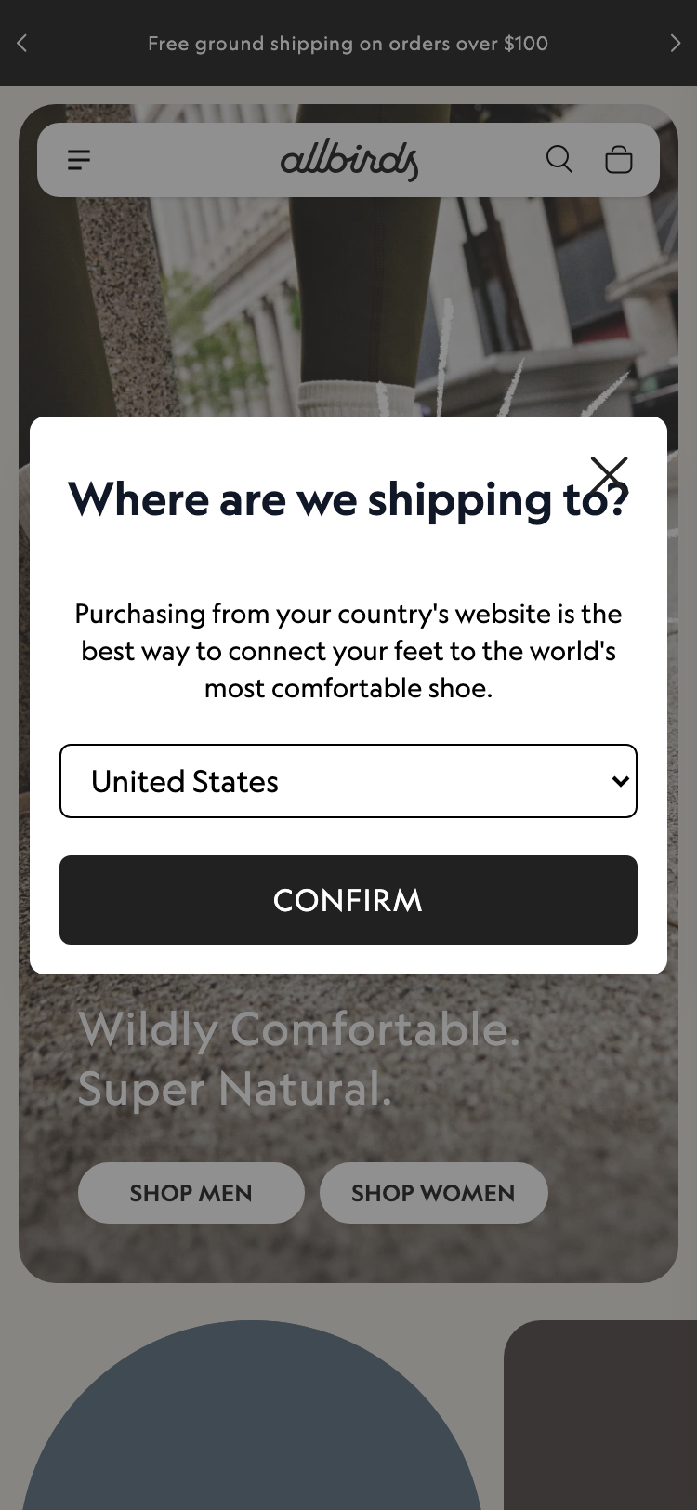
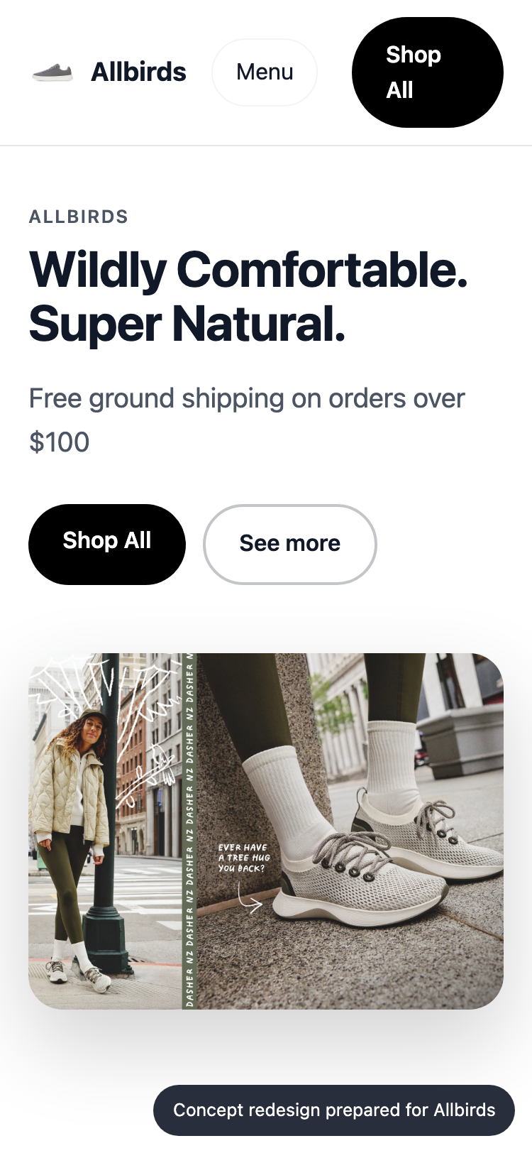
CONCEPT REDESIGN · MOBILE
SAMSUNG
SDS
On a phone
TODAY
CONCEPT
Mobile today
87/100 · grade B
12 of 84 tap targets are too small on mobile.
Horizontal overflow
0px
Small tap targets
12/84
Tiny text blocks
2
Viewport meta
yes
Allbirds · Prepared by Samsung SDS
9
Notes:
Most visitors arrive on a phone. These are phone-sized screenshots of the live site and of the concept.

Slide 10
CONCEPT REDESIGN · CHANGES
SAMSUNG
SDS
What changed, and why
Main content takes 17.6s to appear on mobile
→
Compress and preload the hero image, defer non-critical scripts, serve via a CDN.
Page is unresponsive for 0.8s while loading
→
Split and defer JavaScript, remove unused third-party scripts.
Buttons must have discernible text
→
Fix the flagged elements and add automated a11y checks to CI.
Select element must have an accessible name
→
Fix the flagged elements and add automated a11y checks to CI.
No structured data for search and AI engines
→
Add Organization, WebSite and Product/Service JSON-LD.
Allbirds · Prepared by Samsung SDS
10
Notes:
Each change in the concept answers a specific audit finding.

Slide 11
ORGANISATION MATCH
SAMSUNG
SDS
Why Samsung SDS fits this work
SKILL
FIT
PEOPLE FREE
Next.js / React
5 of 12
Strong
88
UX / UI design
2 of 6
Strong
QA / test automation
3 of 8
Strong
Web performance
2 of 4
Strong
Design systems
1 of 4
Partial
organisation match
Accessibility (WCAG)
1 of 3
Partial
Strengths
Next.js / React, UX / UI design, QA / test automation, Web performance
Gaps
Shopify / commerce
Responsive / mobile UI
4 of 9
Strong
Shopify / commerce
0 of 2
Gap
Delivery / project management
2 of 5
Strong
Allbirds · Prepared by Samsung SDS
11
Notes:
The organisation match score is 88 out of 100: how well our skills cover what this work needs, weighted by importance and availability. It uses the detected technology stack and the audit findings. Skills are sample data until connected to the real inventory.

Slide 12
PROPOSED TEAM
SAMSUNG
SDS
The team we would put on it
AM
Aarav Mehta
93%
DM
Dev Malhotra
93%
VD
Vikram Das
82%
Senior Frontend Engineer
fit
Senior Frontend Engineer
fit
Design Systems Engineer
fit
nextjs · responsive-ui · web-performance
nextjs · responsive-ui · web-performance
design-systems · nextjs · responsive-ui
Level 5/5 · available from 2026-11-02
Level 5/5 · available from 2026-11-09
Level 4/5 · available from 2026-11-02
Level 5/5 in nextjs, responsive-ui, web-performance; free from 2026-11-02. Needed for nextjs (…
Level 5/5 in nextjs, responsive-ui, web-performance; free from 2026-11-09. Needed for web-perf…
Level 4/5 in design-systems, nextjs, responsive-ui; free from 2026-11-02. Needed for design-sy…
AR
Ananya Rao
72%
IP
Isha Patel
72%
ZA
Zoya Ali
71%
UX Designer
fit
QA Automation Engineer
fit
Accessibility Specialist
fit
ux-design · design-systems
qa-testing · a11y
a11y · qa-testing · responsive-ui
Level 4/5 · available from 2026-11-02
Level 4/5 · available from 2026-11-09
Level 3/5 · available from 2026-11-02
Level 4/5 in ux-design, design-systems; free from 2026-11-02. Needed for ux-design (weight 1.0…
Level 4/5 in qa-testing, a11y; free from 2026-11-09. Needed for qa-testing (weight 1.0).
Level 3/5 in a11y, qa-testing, responsive-ui; free from 2026-11-02. Needed for a11y (weight 1.…
Allbirds · Prepared by Samsung SDS
12
Notes:
Named people who are available. Fit blends their level and how much of the needed skill weight they cover. This is sample talent data until connected to the real roster.

Slide 13
ESTIMATE
SAMSUNG
SDS
The plan: effort and timeline
EFFORT BY WORKSTREAM (PERSON-DAYS)
Homepage rebuild (design + front end) · 15 d (15%)
Performance engineering · 21 d (20%)
Responsive & mobile fixes · 8 d (8%)
Accessibility remediation · 18 d (17%)
UX & conversion redesign · 12 d (12%)
Structured data & AI-search · 7 d (7%)
QA & launch · 13 d (13%)
Delivery management · 9 d (9%)
INDICATIVE TIMELINE
Week 1
Week 2
Week 3
Week 4
Homepage rebuild (design + front end)
Performance engineering
Responsive & mobile fixes
Accessibility remediation
UX & conversion redesign
Structured data & AI-search
QA & launch
Allbirds · Prepared by Samsung SDS
13
Notes:
About 103 person-days over 4 weeks. The timeline is an indicative picture of the effort, to be fixed in discovery.

Slide 14
ESTIMATE · COMMERCIALS
SAMSUNG
SDS
Investment
ESTIMATED INVESTMENT
103
4 weeks
₹10,71,000 – ₹13,68,000
person-days
indicative duration
6
In discovery
₹10.7 lakh to ₹13.7 lakh · a range until discovery is complete
people on the team
final scope and price
ASSUMPTIONS
Homepage and key templates only; no new backend features
Client provides brand assets and timely feedback
Blended day rate 8250 with a 40% margin
Estimate is +/- range until discovery is complete
Terms: to be added by the account owner before this proposal is sent.
Allbirds · Prepared by Samsung SDS
14
Notes:
A price range until discovery is complete, with every assumption stated.

Slide 15
WORKING TOGETHER
SAMSUNG
SDS
Next steps
1
Walk through the concept
A 30-minute session with your team on Allbirds's homepage concept, the audit and the technology review.
2
Discovery week
We confirm scope, constraints and price, and fix the plan and the team.
3
Start building
The team starts 2026-11-02, with weekly demos and a launch plan.
Allbirds · Prepared by Samsung SDS
15
Notes:
Three simple steps. Nothing is sent or committed until a human approves.

Slide 16
SAMSUNG
SDS
Let's make Allbirds's website your strongest sales channel.
Samsung SDS · Digital Engineering
allbirds.com · 2026-10-25
Notes:
Close. Thank the audience and agree the first step.

Slide 17
APPENDIX
SAMSUNG
SDS
How we measured
Speed
Mobile
Lighthouse 12, mobile profile with simulated throttling. Falls back to browser timings if Lighthouse cannot run.
The page reloaded at phone size with touch: viewport, overflow, tap targets, text size.
Accessibility
UX
axe-core run in a real browser; each rule weighted by impact.
A vision model scores a screenshot against a fixed rubric; findings must cite what is visible.
AI search
Technology
Structured data, llms.txt, AI-crawler rules and a model judgement of how clearly the page says what you do.
About 130 signatures over network requests, headers, cookies, markup and script globals. A hint, not a certainty.
Scores are for the homepage only, measured once. The bench roster, skills inventory and rates are sample data until connected to real systems.
Allbirds · Prepared by Samsung SDS
17
Notes:
Methods and limits, for anyone who wants to check our work.

