Slide 1
A better Allbirds homepage
Audit, concept redesign and delivery plan for Allbirds
Prepared 2026-10-25 · Samsung digital engineering

Slide 2
Your site today: 64/100 (D)
Measured on your live homepage, not a template
SPEED
40 · F
Lighthouse mobile score 40; main content in 16.9s, blocking time 703 ms.
MOBILE
87 · B
12 of 84 tap targets are too small on mobile.
A11Y
70 · C
3 accessibility rules failed (2 serious or critical).
UX
60 · D
Weakest area: cta clarity (2/5).
GEO
62 · D
No structured data; llms.txt present.

Slide 3
What is costing you customers
Top fixes, ranked by severity
Main content takes 16.9s to appear on mobile
Every extra second of load time costs conversions; slow pages also rank lower in search.
Page is unresponsive for 0.7s while loading
Taps and scrolls feel broken while scripts run, so visitors leave before they act.
Buttons must have discernible text
Inaccessible sites exclude users, invite legal risk (ADA / EAA) and lose search visibility.
Select element must have an accessible name
Inaccessible sites exclude users, invite legal risk (ADA / EAA) and lose search visibility.
No structured data for search and AI engines
AI assistants and rich results rely on structured data to name and recommend the brand.

Slide 4
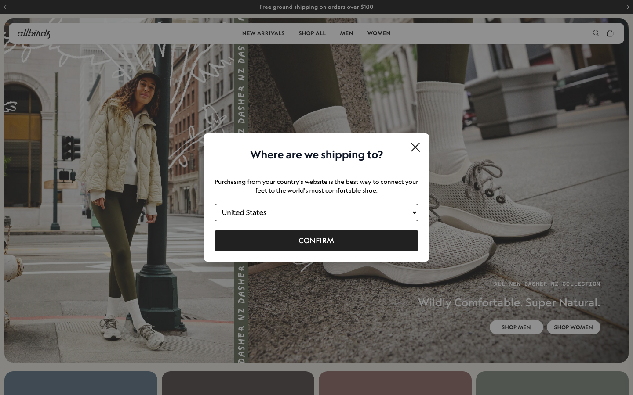
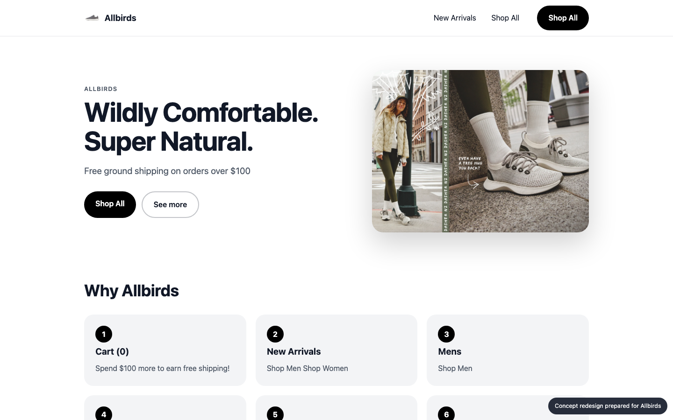
Your homepage, before and after
Concept built from your own brand colours, fonts and content
BEFORE
AFTER (concept)

Slide 5
What changed, and the proof
Same inspectors, run on the new prototype
A11Y
MOBILE
UX
70 → 98
87 → 100
60 → 60
Main content takes 16.9s to appear on mobile: Compress and preload the hero image, defer non-critical scripts, serve via a CDN.
Page is unresponsive for 0.7s while loading: Split and defer JavaScript, remove unused third-party scripts.
Buttons must have discernible text: Fix the flagged elements and add automated a11y checks to CI.
Select element must have an accessible name: Fix the flagged elements and add automated a11y checks to CI.

Slide 6
Plan: 4 weeks, 97 person-days
Effort by workstream
Homepage rebuild (design + front end)
15 d
Performance engineering
21 d
Responsive & mobile fixes
8 d
Accessibility remediation
18 d
UX & conversion redesign
8 d
Structured data & AI-search
7 d
QA & launch
12 d
Delivery management
8 d

Slide 7
Why us: 88/100 organisation match
Named people, free to start soon
Aarav Mehta · Senior Frontend Engineer
fit 93%
nextjs, responsive-ui, web-performance · free from 2026-11-02
Dev Malhotra · Senior Frontend Engineer
fit 93%
nextjs, responsive-ui, web-performance · free from 2026-11-09
Vikram Das · Design Systems Engineer
fit 82%
design-systems, nextjs, responsive-ui · free from 2026-11-02
Ananya Rao · UX Designer
fit 72%
ux-design, design-systems · free from 2026-11-02
Isha Patel · QA Automation Engineer
fit 72%
qa-testing, a11y · free from 2026-11-09
Zoya Ali · Accessibility Specialist
fit 71%
a11y, qa-testing, responsive-ui · free from 2026-11-02
Gaps we will cover with partners: Shopify / commerce

Slide 8
Investment
A range until discovery is complete
₹10,08,000 – ₹12,88,000
Homepage and key templates only; no new backend features
Client provides brand assets and timely feedback
Blended day rate 8250 with a 40% margin
Estimate is +/- range until discovery is complete

Slide 9
Next steps
30-minute walkthrough of the prototype with your team
Discovery week to confirm scope and price
Team starts 2026-11-02

