Slide 1
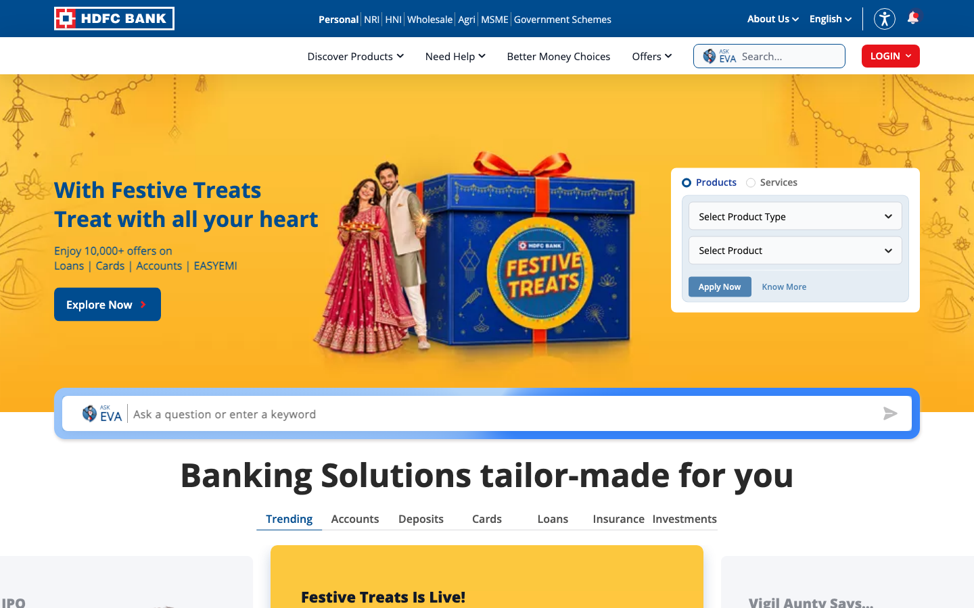
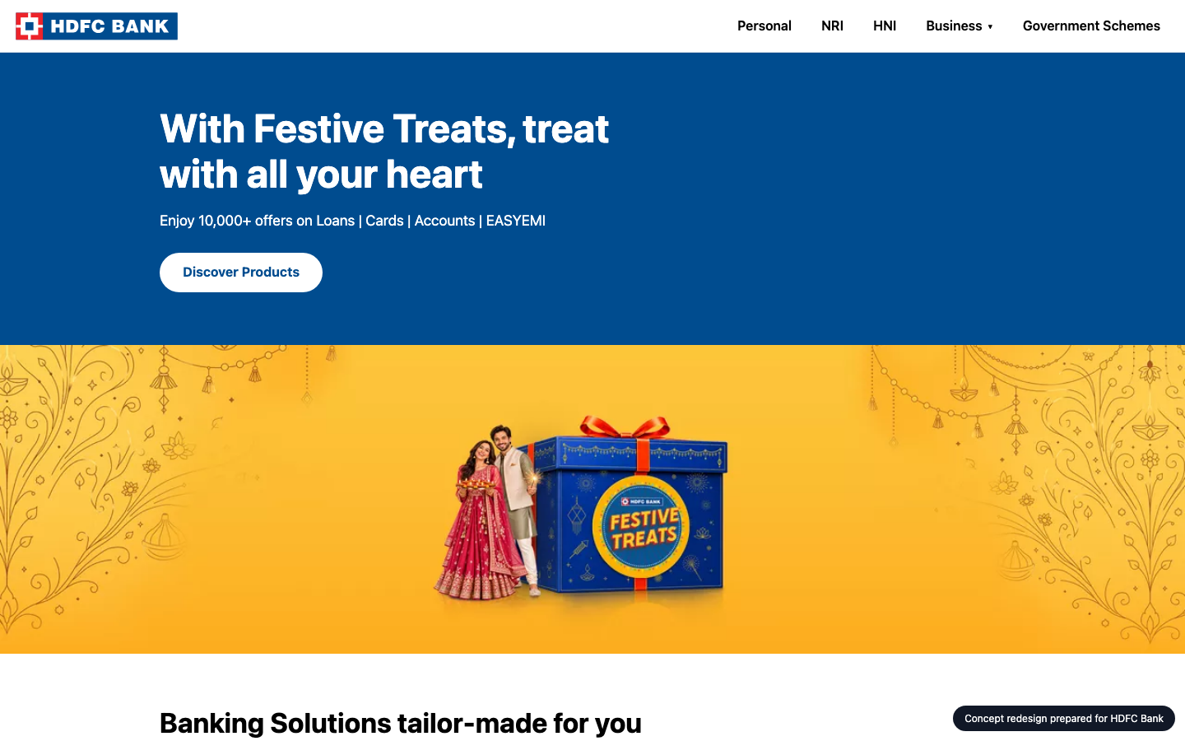
SAMSUNG
SDS
WEBSITE IMPROVEMENT PROPOSAL
A better HDFC Bank homepage
HDFC Bank today
CONCEPT
Audit, technology review, concept redesign and delivery plan for HDFC Bank
hdfc.bank.in
Prepared 2026-10-26 by Samsung SDS · Digital Engineering
Notes:
Cover. This proposal is for HDFC Bank (hdfc.bank.in). The left side names the engagement; the right shows their homepage today and the concept redesign.

Slide 2
EXECUTIVE SUMMARY
SAMSUNG
SDS
Where you stand, and what we recommend
THE BIGGEST OPPORTUNITIES
1
Main content takes 4.1s to appear on mobile
79
Every extra second of load time costs conversions; slow pages also rank lower in search.
2
Layout jumps while loading
Shifting layouts cause mis-clicks and make the brand feel unreliable.
3
92 tap targets are too small
out of 100 · grade C
hdfc.bank.in today
Mis-taps frustrate users right where you want them to act.
11
95/100
6 people
3 weeks
₹7.3–9.3 lakh
Technologies found
Organisation match
Team
Timeline
Investment
HDFC Bank · Prepared by Samsung SDS
2
Notes:
Overall score 79 out of 100, grade C. The three biggest opportunities are on the right.

Slide 3
THE AUDIT
SAMSUNG
SDS
How HDFC Bank scores today
Speed
Mobile
Accessibility
UX
AI search
68
81
87
68
100
Grade C
Grade B
Grade B
Grade C
Grade A
Lighthouse mobile score 68; main content in 4.1s, blocking time 233 ms.
92 of 289 tap targets are too small on mobile.
3 accessibility rules failed (1 serious or critical).
Weakest area: navigation (2/5).
Structured data found; llms.txt present.
Lighthouse score
Horizontal overflow
Rules failed
Visual hierarchy
JSON-LD blocks
68
0px
3
4
6
LCP
Small tap targets
Critical
CTA clarity
Schema types
4.1s
92/289
0
3
ItemList, Sit…
TBT
Tiny text blocks
Serious
Navigation
llms.txt
233 ms
0
1
2
yes
Overall 79/100, grade C: speed 20%, mobile 20%, accessibility 20%, UX 25%, AI search 15%.
HDFC Bank · Prepared by Samsung SDS
3
Notes:
Each score is measured: Lighthouse for speed, axe-core for accessibility, a phone-sized browser for mobile, a vision model for UX and tool checks plus a model judgement for AI search. Findings and evidence follow.

Slide 4
THE AUDIT · FINDINGS AND EVIDENCE
SAMSUNG
SDS
What we found (1 of 2)
AREA | FINDING | EVIDENCE | RECOMMENDED FIX | IMPACT
Speed | Main content takes 4.1s to appear on mobile | Lighthouse mobile LCP 4081 ms (target < 2500 ms), FCP 1681 ms | Compress and preload the hero image, defer non-critical scripts, serve via a CDN. | High
Speed | Layout jumps while loading | Lighthouse CLS 0.257 (target < 0.1) | Reserve space for images, ads and embeds; avoid late-injected banners. | High
Mobile | 92 tap targets are too small | 92 of 289 links/buttons are under 32px | Make interactive elements at least 44x44px with spacing between them. | High
Accessibility | <html> element must have a lang attribute | html-has-lang: 1 element(s), e.g. html | Fix the flagged elements and add automated a11y checks to CI. | High
Accessibility | Document should have one main landmark | landmark-one-main: 1 element(s), e.g. html | Fix the flagged elements and add automated a11y checks to CI. | Medium
Accessibility | All page content should be contained by landmarks | region: 3 element(s), e.g. h1 | Fix the flagged elements and add automated a11y checks to CI. | Medium
HDFC Bank · Prepared by Samsung SDS
4
Notes:
Every finding carries its evidence, the recommended fix and why it matters to the business.

Slide 5
THE AUDIT · FINDINGS AND EVIDENCE
SAMSUNG
SDS
What we found (2 of 2)
AREA | FINDING | EVIDENCE | RECOMMENDED FIX | IMPACT
UX | Navigation has 8 items | NRI · HNI · Wholesale · Agri · MSME · Government Schemes · Discover Products · Need Help | Group into 5-7 top-level items with clear labels. | Medium
HDFC Bank · Prepared by Samsung SDS
5
Notes:
Every finding carries its evidence, the recommended fix and why it matters to the business.

Slide 6





TECHNOLOGY REVIEW
SAMSUNG
SDS
The technology behind hdfc.bank.in
11
246
72%
24
technologies detected
network requests
third-party requests
domains contacted
FRONTEND FRAMEWORK
jQuery
BUSIEST DOMAINS
CMS & EXPERIENCE
Adobe Experience Manager
bank.in
ANALYTICS
Google Analytics 4
Adobe Analytics
Adobe Experience Platform Web SDK
scene7.com
TAG MANAGER
Google Tag Manager
Adobe Experience Platform Launch
googletagmanager.com
TRACKING PIXELS
Meta Pixel
Google Ads / DoubleClick
brightcovecdn.com
CDN & HOSTING
Amazon CloudFront
boltdns.net
MARKETING & CAMPAIGN
Adobe Audience Manager
brightcove.net
Border colour: our coverage (green strong, amber partial, red gap). Thin border: a single signal, so likely rather than confirmed.
HDFC Bank · Prepared by Samsung SDS
6
Notes:
Detected from 246 network requests, response headers, cookies, page markup and script globals. Each technology is coloured by how well our people cover it. Detection is a strong hint, not a certainty.

Slide 7
TECHNOLOGY REVIEW · OUR COVERAGE
SAMSUNG
SDS
How Samsung SDS supports your stack
TECHNOLOGY
CATEGORY
OUR SKILL
PEOPLE FREE
STATUS
AE
Adobe Experience Manager
CMS & experience
Adobe Experience Manager
3 of 8 · 2026-11-02
Strong
Google Analytics 4
Analytics
Web analytics & tag management
2 of 5 · 2026-11-02
Strong
AA
Adobe Analytics
Analytics
Adobe Analytics / Launch
1 of 4 · 2026-11-16
Partial
Google Tag Manager
Tag manager
Web analytics & tag management
2 of 5 · 2026-11-02
Strong
AE
Adobe Experience Platform…
Tag manager
Adobe Analytics / Launch
1 of 4 · 2026-11-16
Partial
AC
Amazon CloudFront
CDN & hosting
DevOps / CDN / cloud
2 of 6 · 2026-11-02
Strong
AA
Adobe Audience Manager
Marketing & campaign
Adobe Analytics / Launch
1 of 4 · 2026-11-16
Partial
AE
Adobe Experience Platform…
Analytics
Adobe Analytics / Launch
1 of 4 · 2026-11-16
Partial
80%
Strong: skilled and two or more people free. Partial: some capacity. Gap: nobody free, so we plan a partner or a hire.
of your platform stack we can staff now
HDFC Bank · Prepared by Samsung SDS
7
Notes:
We map each detected technology to our skills inventory. 80 percent of the platform stack has capacity today. Gaps are shown honestly with a plan to cover them. Skills data is sample data until connected to the real inventory.

Slide 8
CONCEPT REDESIGN
SAMSUNG
SDS
Your own homepage, improved
TODAY
CONCEPT
87 → 98
81 → 100
68 → 68
Same inspectors, run on the concept page. Speed and AI search are not re-measured on a local concept.
Accessibility score, re-checked on the concept
Mobile score, re-checked on the concept
UX score, re-checked on the concept
HDFC Bank · Prepared by Samsung SDS
8
Notes:
The concept is built from HDFC Bank's own colours, fonts and content, then re-checked by the same inspectors. It is a concept for discussion, not a final design.

Slide 9
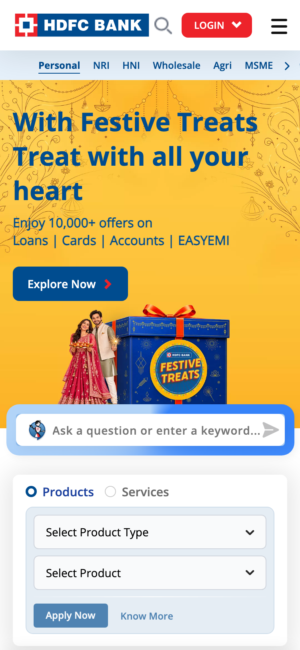
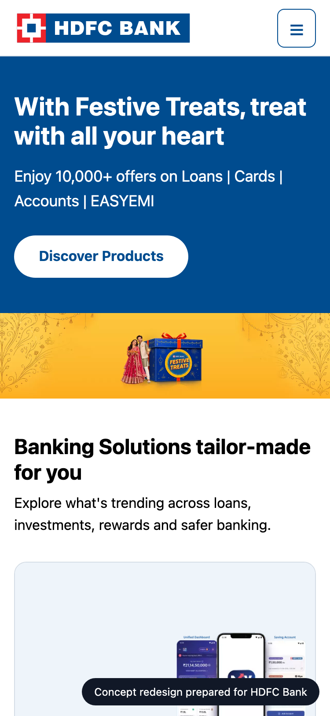
CONCEPT REDESIGN · MOBILE
SAMSUNG
SDS
On a phone
TODAY
CONCEPT
Mobile today
81/100 · grade B
92 of 289 tap targets are too small on mobile.
Horizontal overflow
0px
Small tap targets
92/289
Tiny text blocks
0
Viewport meta
yes
HDFC Bank · Prepared by Samsung SDS
9
Notes:
Most visitors arrive on a phone. These are phone-sized screenshots of the live site and of the concept.

Slide 10
CONCEPT REDESIGN · CHANGES
SAMSUNG
SDS
What changed, and why
Main content takes 4.1s to appear on mobile
→
Compress and preload the hero image, defer non-critical scripts, serve via a CDN.
Layout jumps while loading
→
Reserve space for images, ads and embeds; avoid late-injected banners.
92 tap targets are too small
→
Make interactive elements at least 44x44px with spacing between them.
<html> element must have a lang attribute
→
Fix the flagged elements and add automated a11y checks to CI.
Navigation has 8 items
→
Group into 5-7 top-level items with clear labels.
HDFC Bank · Prepared by Samsung SDS
10
Notes:
Each change in the concept answers a specific audit finding.

Slide 11
ORGANISATION MATCH
SAMSUNG
SDS
Why Samsung SDS fits this work
SKILL
FIT
PEOPLE FREE
Responsive / mobile UI
4 of 9
Strong
95
QA / test automation
3 of 8
Strong
Web performance
2 of 4
Strong
Accessibility (WCAG)
1 of 3
Partial
UX / UI design
2 of 6
Strong
organisation match
Next.js / React
5 of 12
Strong
Strengths
Responsive / mobile UI, QA / test automation, Web performance, UX / UI design
Gaps
None
Adobe Experience Manager
3 of 8
Strong
Adobe Analytics / Launch
1 of 4
Strong
Delivery / project management
2 of 5
Strong
HDFC Bank · Prepared by Samsung SDS
11
Notes:
The organisation match score is 95 out of 100: how well our skills cover what this work needs, weighted by importance and availability. It uses the detected technology stack and the audit findings. Skills are sample data until connected to the real inventory.

Slide 12
PROPOSED TEAM
SAMSUNG
SDS
The team we would put on it
AM
Aarav Mehta
99%
DM
Dev Malhotra
99%
ZA
Zoya Ali
78%
Senior Frontend Engineer
fit
Senior Frontend Engineer
fit
Accessibility Specialist
fit
nextjs · responsive-ui · web-performance
nextjs · responsive-ui · web-performance
a11y · qa-testing · responsive-ui
Level 5/5 · available from 2026-11-02
Level 5/5 · available from 2026-11-09
Level 3/5 · available from 2026-11-02
Level 5/5 in nextjs, responsive-ui, web-performance; free from 2026-11-02. Needed for responsi…
Level 5/5 in nextjs, responsive-ui, web-performance; free from 2026-11-09. Needed for web-perf…
Level 3/5 in a11y, qa-testing, responsive-ui; free from 2026-11-02. Needed for a11y (weight 1.…
VD
Vikram Das
77%
IP
Isha Patel
75%
AR
Ananya Rao
62%
Design Systems Engineer
fit
QA Automation Engineer
fit
UX Designer
fit
design-systems · nextjs · responsive-ui
qa-testing · a11y
ux-design · design-systems
Level 4/5 · available from 2026-11-02
Level 4/5 · available from 2026-11-09
Level 4/5 · available from 2026-11-02
Level 4/5 in design-systems, nextjs, responsive-ui; free from 2026-11-02. Needed for nextjs (w…
Level 4/5 in qa-testing, a11y; free from 2026-11-09. Needed for qa-testing (weight 1.0).
Level 4/5 in ux-design, design-systems; free from 2026-11-02. Needed for ux-design (weight 0.8…
HDFC Bank · Prepared by Samsung SDS
12
Notes:
Named people who are available. Fit blends their level and how much of the needed skill weight they cover. This is sample talent data until connected to the real roster.

Slide 13
ESTIMATE
SAMSUNG
SDS
The plan: effort and timeline
EFFORT BY WORKSTREAM (PERSON-DAYS)
Homepage rebuild (design + front end) · 15 d (21%)
Performance engineering · 14 d (20%)
Responsive & mobile fixes · 7 d (10%)
Accessibility remediation · 15 d (21%)
UX & conversion redesign · 4 d (6%)
QA & launch · 9 d (13%)
Delivery management · 6 d (9%)
INDICATIVE TIMELINE
Week 1
Week 2
Week 3
Homepage rebuild (design + front end)
Performance engineering
Responsive & mobile fixes
Accessibility remediation
UX & conversion redesign
QA & launch
Delivery management
HDFC Bank · Prepared by Samsung SDS
13
Notes:
About 70 person-days over 3 weeks. The timeline is an indicative picture of the effort, to be fixed in discovery.

Slide 14
ESTIMATE · COMMERCIALS
SAMSUNG
SDS
Investment
ESTIMATED INVESTMENT
70
3 weeks
₹7,28,000 – ₹9,30,000
person-days
indicative duration
6
In discovery
₹7.3 lakh to ₹9.3 lakh · a range until discovery is complete
people on the team
final scope and price
ASSUMPTIONS
Homepage and key templates only; no new backend features
Client provides brand assets and timely feedback
Blended day rate 8250 with a 40% margin
Estimate is +/- range until discovery is complete
Terms: to be added by the account owner before this proposal is sent.
HDFC Bank · Prepared by Samsung SDS
14
Notes:
A price range until discovery is complete, with every assumption stated.

Slide 15
WORKING TOGETHER
SAMSUNG
SDS
Next steps
1
Walk through the concept
A 30-minute session with your team on HDFC Bank's homepage concept, the audit and the technology review.
2
Discovery week
We confirm scope, constraints and price, and fix the plan and the team.
3
Start building
The team starts 2026-11-02, with weekly demos and a launch plan.
HDFC Bank · Prepared by Samsung SDS
15
Notes:
Three simple steps. Nothing is sent or committed until a human approves.

Slide 16
SAMSUNG
SDS
Let's make HDFC Bank's website your strongest sales channel.
Samsung SDS · Digital Engineering
hdfc.bank.in · 2026-10-26
Notes:
Close. Thank the audience and agree the first step.

Slide 17
APPENDIX
SAMSUNG
SDS
How we measured
Speed
Mobile
Lighthouse 12, mobile profile with simulated throttling. Falls back to browser timings if Lighthouse cannot run.
The page reloaded at phone size with touch: viewport, overflow, tap targets, text size.
Accessibility
UX
axe-core run in a real browser; each rule weighted by impact.
A vision model scores a screenshot against a fixed rubric; findings must cite what is visible.
AI search
Technology
Structured data, llms.txt, AI-crawler rules and a model judgement of how clearly the page says what you do.
About 130 signatures over network requests, headers, cookies, markup and script globals. A hint, not a certainty.
Scores are for the homepage only, measured once. The bench roster, skills inventory and rates are sample data until connected to real systems.
HDFC Bank · Prepared by Samsung SDS
17
Notes:
Methods and limits, for anyone who wants to check our work.

