Slide 1
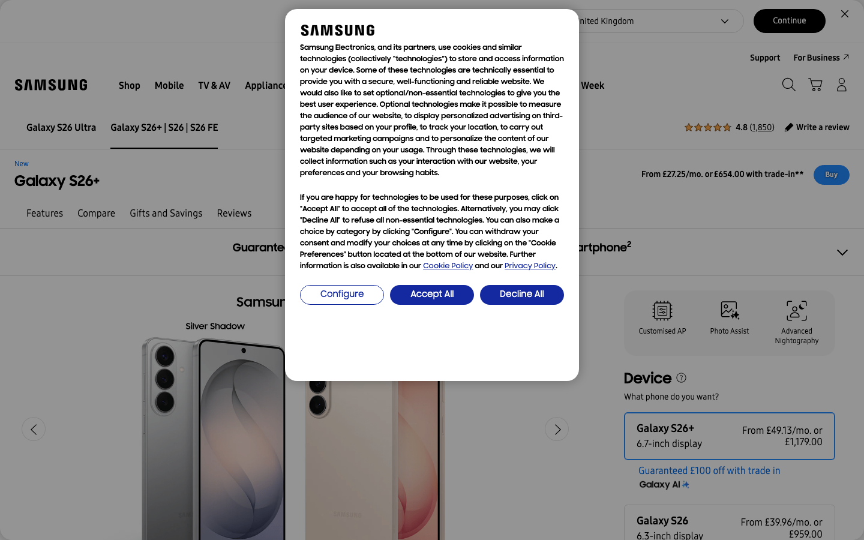
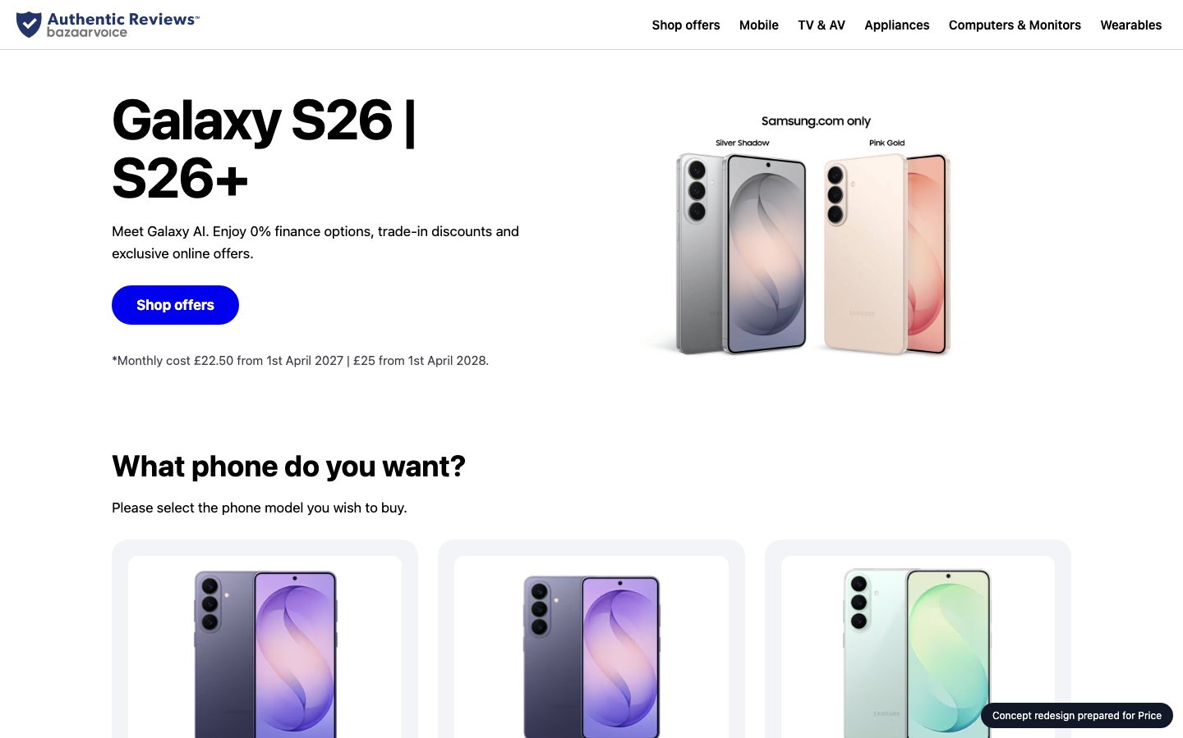
SAMSUNG
SDS
WEBSITE IMPROVEMENT PROPOSAL
A better Samsung UK homepage
Samsung UK today
CONCEPT
Audit, technology review, concept redesign and delivery plan for Samsung UK
samsung.com
Prepared 2026-10-26 by Samsung SDS · Digital Engineering
Notes:
Cover. This proposal is for Samsung UK (samsung.com). The left side names the engagement; the right shows their homepage today and the concept redesign.

Slide 2
EXECUTIVE SUMMARY
SAMSUNG
SDS
Where you stand, and what we recommend
THE BIGGEST OPPORTUNITIES
1
Main content takes 19.7s to appear on mobile
46
Every extra second of load time costs conversions; slow pages also rank lower in search.
2
Page is unresponsive for 2.6s while loading
Taps and scrolls feel broken while scripts run, so visitors leave before they act.
3
302 tap targets are too small
out of 100 · grade F
samsung.com today
Mis-taps frustrate users right where you want them to act.
10
94/100
6 people
5 weeks
₹13.2–16.8 lakh
Technologies found
Organisation match
Team
Timeline
Investment
Samsung UK · Prepared by Samsung SDS
2
Notes:
Overall score 46 out of 100, grade F. The three biggest opportunities are on the right.

Slide 3
THE AUDIT
SAMSUNG
SDS
How Samsung UK scores today
Speed
Mobile
Accessibility
UX
AI search
23
58
0
60
97
Grade F
Grade D
Grade F
Grade D
Grade A
Lighthouse mobile score 23; main content in 19.7s, blocking time 2576 ms.
302 of 664 tap targets are too small on mobile.
13 accessibility rules failed (10 serious or critical).
Weakest area: visual hierarchy (2/5).
Structured data found; llms.txt present.
Lighthouse score
Horizontal overflow
Rules failed
Visual hierarchy
JSON-LD blocks
23
0px
13
2
6
LCP
Small tap targets
Critical
CTA clarity
Schema types
19.7s
302/664
6
3
ProductGroup,…
TBT
Tiny text blocks
Serious
Navigation
llms.txt
2576 ms
61
4
3
yes
Overall 46/100, grade F: speed 20%, mobile 20%, accessibility 20%, UX 25%, AI search 15%.
Samsung UK · Prepared by Samsung SDS
3
Notes:
Each score is measured: Lighthouse for speed, axe-core for accessibility, a phone-sized browser for mobile, a vision model for UX and tool checks plus a model judgement for AI search. Findings and evidence follow.

Slide 4
THE AUDIT · FINDINGS AND EVIDENCE
SAMSUNG
SDS
What we found (1 of 2)
AREA | FINDING | EVIDENCE | RECOMMENDED FIX | IMPACT
Speed | Main content takes 19.7s to appear on mobile | Lighthouse mobile LCP 19668 ms (target < 2500 ms), FCP 12596 ms | Compress and preload the hero image, defer non-critical scripts, serve via a CDN. | High
Speed | Page is unresponsive for 2.6s while loading | Total blocking time 2576 ms (target < 200 ms) | Split and defer JavaScript, remove unused third-party scripts. | High
Speed | Eliminate render-blocking resources: about 3.8s to gain | Lighthouse opportunity, estimated saving 3750 ms | Address "Eliminate render-blocking resources". | High
Speed | Reduce unused JavaScript: about 3.2s to gain | Lighthouse opportunity, estimated saving 3240 ms | Address "Reduce unused JavaScript". | High
Mobile | 302 tap targets are too small | 302 of 664 links/buttons are under 32px | Make interactive elements at least 44x44px with spacing between them. | High
Accessibility | Certain ARIA roles must contain particular children | aria-required-children: 8 element(s), e.g. .nv00-gnb-v4__l0-menu-list--left | Fix the flagged elements and add automated a11y checks to CI. | High
Samsung UK · Prepared by Samsung SDS
4
Notes:
Every finding carries its evidence, the recommended fix and why it matters to the business.

Slide 5
THE AUDIT · FINDINGS AND EVIDENCE
SAMSUNG
SDS
What we found (2 of 2)
AREA | FINDING | EVIDENCE | RECOMMENDED FIX | IMPACT
Accessibility | Certain ARIA roles must be contained by particular parents | aria-required-parent: 23 element(s), e.g. .nv00-gnb-v4__l0-menu-link[an-la="L0_2_shop"][h… | Fix the flagged elements and add automated a11y checks to CI. | High
Accessibility | ARIA attributes must conform to valid values | aria-valid-attr-value: 1 element(s), e.g. #payment-tab-2 | Fix the flagged elements and add automated a11y checks to CI. | High
Accessibility | ARIA attributes must conform to valid names | aria-valid-attr: 6 element(s), e.g. #tab-panel-0 | Fix the flagged elements and add automated a11y checks to CI. | High
Speed | Layout jumps while loading | Lighthouse CLS 0.117 (target < 0.1) | Reserve space for images, ads and embeds; avoid late-injected banners. | Medium
Mobile | Text is too small to read comfortably | 61 text blocks under 12px | Use a 16px base font size and a fluid type scale. | Medium
UX | Cookie consent modal blocks the page and competes with the main conte… | A large white modal covers the center of the viewport. It holds about 20 lines of dense l… | Use a compact bottom banner or a smaller modal. Put a short summary at the top, give the butto… | Medium
Samsung UK · Prepared by Samsung SDS
5
Notes:
Every finding carries its evidence, the recommended fix and why it matters to the business.

Slide 6



TECHNOLOGY REVIEW
SAMSUNG
SDS
The technology behind samsung.com
10
257
50%
9
technologies detected
network requests
third-party requests
domains contacted
FRONTEND FRAMEWORK
jQuery
BUSIEST DOMAINS
COMMERCE PLATFORM
SAP Commerce Cloud (Hybris)
samsung.com
CMS & EXPERIENCE
Adobe Experience Manager
bazaarvoice.com
TAG MANAGER
Adobe Experience Platform Launch
audioeye-services.com
MONITORING
Akamai mPulse
adobedtm.com
CDN & HOSTING
Akamai
trustarc.com
SERVER & LANGUAGE
Java (servlet / JSP)
go-mpulse.net
REVIEWS & FEEDBACK
Bazaarvoice
Border colour: our coverage (green strong, amber partial, red gap). Thin border: a single signal, so likely rather than confirmed.
Samsung UK · Prepared by Samsung SDS
6
Notes:
Detected from 257 network requests, response headers, cookies, page markup and script globals. Each technology is coloured by how well our people cover it. Detection is a strong hint, not a certainty.

Slide 7
TECHNOLOGY REVIEW · OUR COVERAGE
SAMSUNG
SDS
How Samsung SDS supports your stack
TECHNOLOGY
CATEGORY
OUR SKILL
PEOPLE FREE
STATUS
SAP Commerce Cloud (Hybri…
Commerce platform
SAP Commerce Cloud (Hybris)
2 of 6 · 2026-11-09
Strong
AE
Adobe Experience Manager
CMS & experience
Adobe Experience Manager
3 of 8 · 2026-11-02
Strong
AE
Adobe Experience Platform…
Tag manager
Adobe Analytics / Launch
1 of 4 · 2026-11-16
Partial
Akamai
CDN & hosting
DevOps / CDN / cloud
2 of 6 · 2026-11-02
Strong
J(
Java (servlet / JSP)
Server & language
Java / Spring
7 of 20 · 2026-11-02
Strong
AE
Adobe Experience Platform…
Analytics
Adobe Analytics / Launch
1 of 4 · 2026-11-16
Partial
87%
Strong: skilled and two or more people free. Partial: some capacity. Gap: nobody free, so we plan a partner or a hire.
of your platform stack we can staff now
Samsung UK · Prepared by Samsung SDS
7
Notes:
We map each detected technology to our skills inventory. 87 percent of the platform stack has capacity today. Gaps are shown honestly with a plan to cover them. Skills data is sample data until connected to the real inventory.

Slide 8
CONCEPT REDESIGN
SAMSUNG
SDS
Your own homepage, improved
TODAY
CONCEPT
0 → 98
58 → 100
60 → 72
Same inspectors, run on the concept page. Speed and AI search are not re-measured on a local concept.
Accessibility score, re-checked on the concept
Mobile score, re-checked on the concept
UX score, re-checked on the concept
Samsung UK · Prepared by Samsung SDS
8
Notes:
The concept is built from Samsung UK's own colours, fonts and content, then re-checked by the same inspectors. It is a concept for discussion, not a final design.

Slide 9
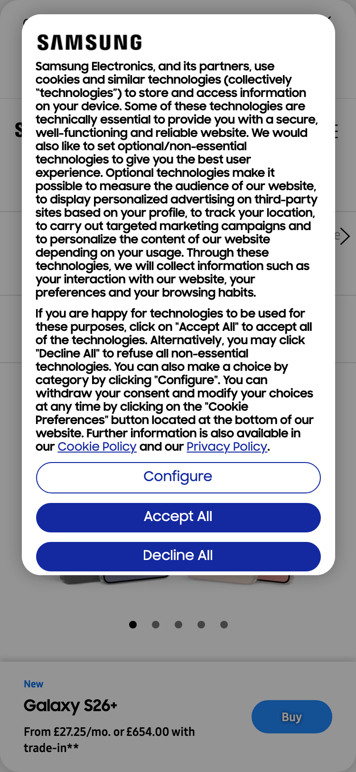
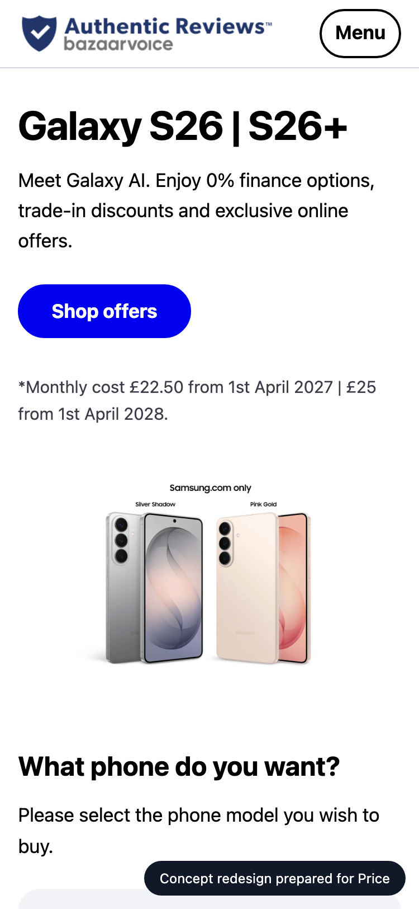
CONCEPT REDESIGN · MOBILE
SAMSUNG
SDS
On a phone
TODAY
CONCEPT
Mobile today
58/100 · grade D
302 of 664 tap targets are too small on mobile.
Horizontal overflow
0px
Small tap targets
302/664
Tiny text blocks
61
Viewport meta
yes
Samsung UK · Prepared by Samsung SDS
9
Notes:
Most visitors arrive on a phone. These are phone-sized screenshots of the live site and of the concept.

Slide 10
CONCEPT REDESIGN · CHANGES
SAMSUNG
SDS
What changed, and why
Main content takes 19.7s to appear on mobile
→
Compress and preload the hero image, defer non-critical scripts, serve via a CDN.
Page is unresponsive for 2.6s while loading
→
Split and defer JavaScript, remove unused third-party scripts.
302 tap targets are too small
→
Make interactive elements at least 44x44px with spacing between them.
Certain ARIA roles must contain particular children
→
Fix the flagged elements and add automated a11y checks to CI.
Certain ARIA roles must be contained by particular parents
→
Fix the flagged elements and add automated a11y checks to CI.
Samsung UK · Prepared by Samsung SDS
10
Notes:
Each change in the concept answers a specific audit finding.

Slide 11
ORGANISATION MATCH
SAMSUNG
SDS
Why Samsung SDS fits this work
SKILL
FIT
PEOPLE FREE
Next.js / React
5 of 12
Strong
94
Responsive / mobile UI
4 of 9
Strong
UX / UI design
2 of 6
Strong
QA / test automation
3 of 8
Strong
Web performance
2 of 4
Strong
organisation match
Design systems
1 of 4
Partial
Strengths
Next.js / React, Responsive / mobile UI, UX / UI design, QA / test automation
Gaps
None
Accessibility (WCAG)
1 of 3
Partial
SAP Commerce Cloud (Hybris)
2 of 6
Strong
Adobe Experience Manager
3 of 8
Strong
Samsung UK · Prepared by Samsung SDS
11
Notes:
The organisation match score is 94 out of 100: how well our skills cover what this work needs, weighted by importance and availability. It uses the detected technology stack and the audit findings. Skills are sample data until connected to the real inventory.

Slide 12
PROPOSED TEAM
SAMSUNG
SDS
The team we would put on it
AM
Aarav Mehta
94%
DM
Dev Malhotra
94%
VD
Vikram Das
83%
Senior Frontend Engineer
fit
Senior Frontend Engineer
fit
Design Systems Engineer
fit
nextjs · responsive-ui · web-performance
nextjs · responsive-ui · web-performance
design-systems · nextjs · responsive-ui
Level 5/5 · available from 2026-11-02
Level 5/5 · available from 2026-11-09
Level 4/5 · available from 2026-11-02
Level 5/5 in nextjs, responsive-ui, web-performance; free from 2026-11-02. Needed for nextjs (…
Level 5/5 in nextjs, responsive-ui, web-performance; free from 2026-11-09. Needed for responsi…
Level 4/5 in design-systems, nextjs, responsive-ui; free from 2026-11-02. Needed for design-sy…
KS
Karan Shah
75%
AR
Ananya Rao
70%
IP
Isha Patel
70%
Performance Engineer
fit
UX Designer
fit
QA Automation Engineer
fit
web-performance · devops-cdn · nextjs
ux-design · design-systems
qa-testing · a11y
Level 4/5 · available from 2026-11-02
Level 4/5 · available from 2026-11-02
Level 4/5 · available from 2026-11-09
Level 4/5 in web-performance, devops-cdn, nextjs; free from 2026-11-02. Needed for web-perform…
Level 4/5 in ux-design, design-systems; free from 2026-11-02. Needed for ux-design (weight 1.0…
Level 4/5 in qa-testing, a11y; free from 2026-11-09. Needed for qa-testing (weight 1.0).
Samsung UK · Prepared by Samsung SDS
12
Notes:
Named people who are available. Fit blends their level and how much of the needed skill weight they cover. This is sample talent data until connected to the real roster.

Slide 13
ESTIMATE
SAMSUNG
SDS
The plan: effort and timeline
EFFORT BY WORKSTREAM (PERSON-DAYS)
Homepage rebuild (design + front end) · 15 d (12%)
Performance engineering · 32 d (26%)
Responsive & mobile fixes · 11 d (9%)
Accessibility remediation · 28 d (23%)
UX & conversion redesign · 12 d (10%)
QA & launch · 15 d (12%)
Delivery management · 10 d (8%)
INDICATIVE TIMELINE
Week 1
Week 2
Week 3
Week 4
Week 5
Homepage rebuild (design + front end)
Performance engineering
Responsive & mobile fixes
Accessibility remediation
UX & conversion redesign
QA & launch
Delivery management
Samsung UK · Prepared by Samsung SDS
13
Notes:
About 123 person-days over 5 weeks. The timeline is an indicative picture of the effort, to be fixed in discovery.

Slide 14
ESTIMATE · COMMERCIALS
SAMSUNG
SDS
Investment
ESTIMATED INVESTMENT
123
5 weeks
₹13,17,000 – ₹16,83,000
person-days
indicative duration
6
In discovery
₹13.2 lakh to ₹16.8 lakh · a range until discovery is complete
people on the team
final scope and price
ASSUMPTIONS
Homepage and key templates only; no new backend features
Client provides brand assets and timely feedback
Blended day rate 8500 with a 40% margin
Estimate is +/- range until discovery is complete
Terms: to be added by the account owner before this proposal is sent.
Samsung UK · Prepared by Samsung SDS
14
Notes:
A price range until discovery is complete, with every assumption stated.

Slide 15
WORKING TOGETHER
SAMSUNG
SDS
Next steps
1
Walk through the concept
A 30-minute session with your team on Samsung UK's homepage concept, the audit and the technology review.
2
Discovery week
We confirm scope, constraints and price, and fix the plan and the team.
3
Start building
The team starts 2026-11-02, with weekly demos and a launch plan.
Samsung UK · Prepared by Samsung SDS
15
Notes:
Three simple steps. Nothing is sent or committed until a human approves.

Slide 16
SAMSUNG
SDS
Let's make Samsung UK's website your strongest sales channel.
Samsung SDS · Digital Engineering
samsung.com · 2026-10-26
Notes:
Close. Thank the audience and agree the first step.

Slide 17
APPENDIX
SAMSUNG
SDS
How we measured
Speed
Mobile
Lighthouse 12, mobile profile with simulated throttling. Falls back to browser timings if Lighthouse cannot run.
The page reloaded at phone size with touch: viewport, overflow, tap targets, text size.
Accessibility
UX
axe-core run in a real browser; each rule weighted by impact.
A vision model scores a screenshot against a fixed rubric; findings must cite what is visible.
AI search
Technology
Structured data, llms.txt, AI-crawler rules and a model judgement of how clearly the page says what you do.
About 130 signatures over network requests, headers, cookies, markup and script globals. A hint, not a certainty.
Scores are for the homepage only, measured once. The bench roster, skills inventory and rates are sample data until connected to real systems.
Samsung UK · Prepared by Samsung SDS
17
Notes:
Methods and limits, for anyone who wants to check our work.

