Slide 1


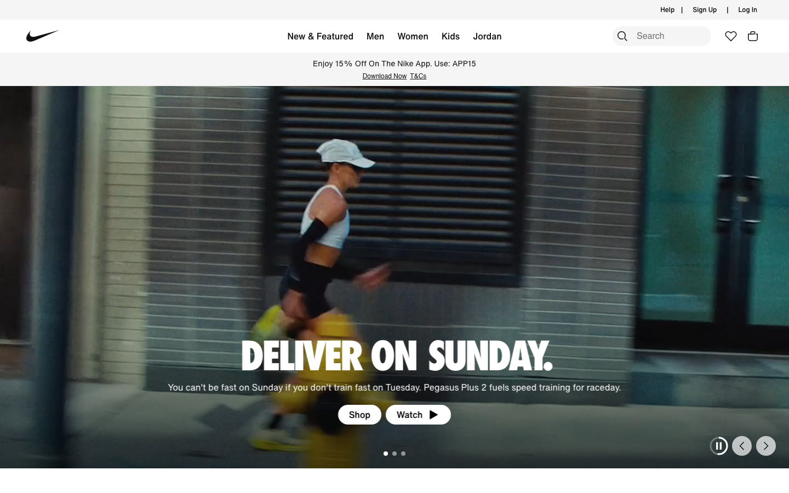
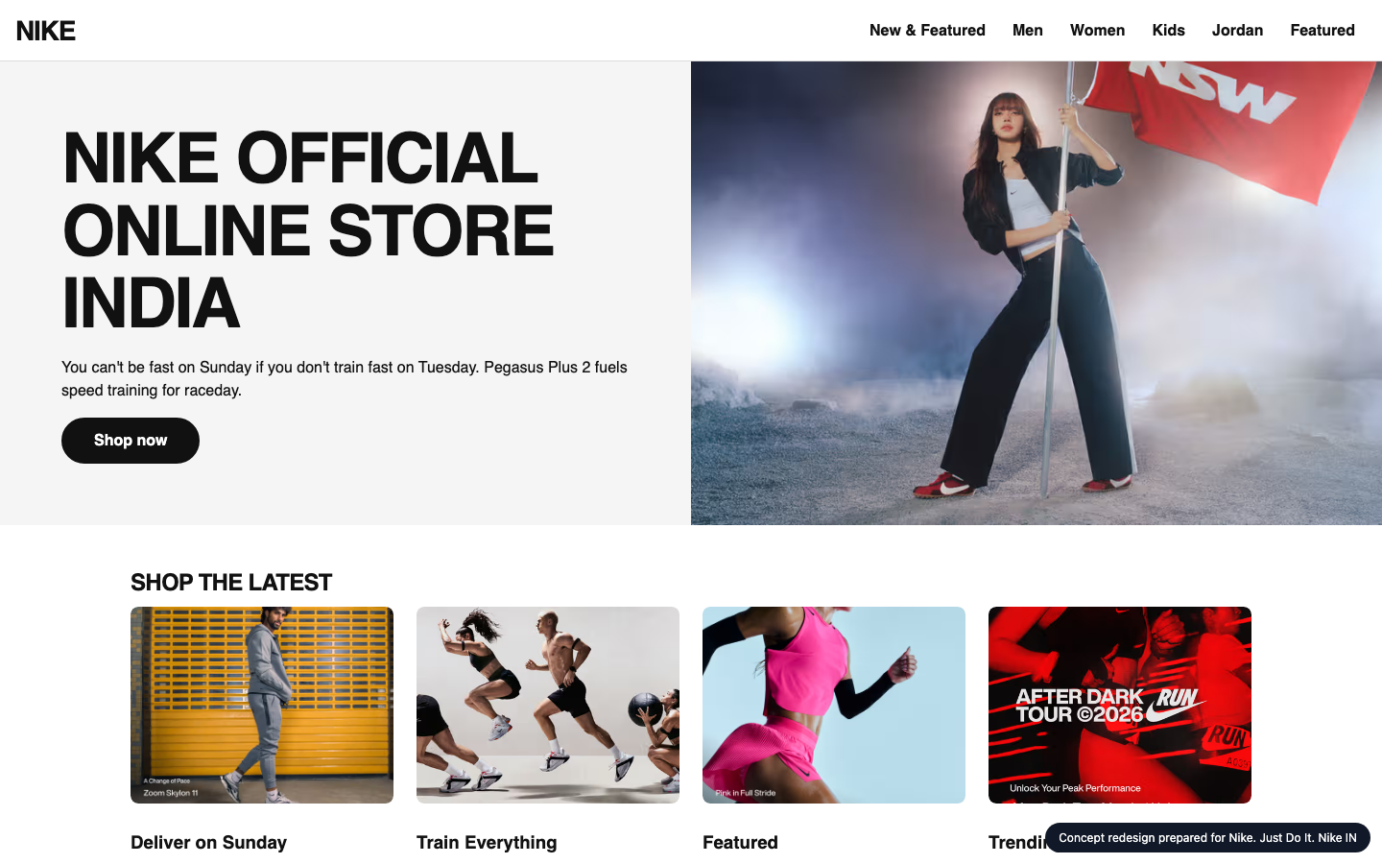
WEBSITE IMPROVEMENT PROPOSAL
A better Nike. Just Do It. Nike IN homepage
Nike. Just Do It. Nike IN today
CONCEPT
Audit, technology review, concept redesign and delivery plan for Nike. Just Do It. Nike IN
nike.in
Prepared 2026-10-26 by Samsung SDS · Digital Engineering
Notes:
Cover. This proposal is for Nike. Just Do It. Nike IN (nike.in). The left side names the engagement; the right shows their homepage today and the concept redesign.

Slide 2

EXECUTIVE SUMMARY
Where you stand, and what we recommend
THE BIGGEST OPPORTUNITIES
1
Main content takes 16.9s to appear on mobile
60
Every extra second of load time costs conversions; slow pages also rank lower in search.
2
Page is unresponsive for 1.3s while loading
Taps and scrolls feel broken while scripts run, so visitors leave before they act.
3
64 tap targets are too small
out of 100 · grade D
nike.in today
Mis-taps frustrate users right where you want them to act.
9
91/100
6 people
4 weeks
₹11.5–14.7 lakh
Technologies found
Organisation match
Team
Timeline
Investment
Nike. Just Do It. Nike IN · Prepared by Samsung SDS
2
Notes:
Overall score 60 out of 100, grade D. The three biggest opportunities are on the right.

Slide 3
THE AUDIT
How Nike. Just Do It. Nike IN scores today
Speed
Mobile
Accessibility
UX
AI search
37
70
45
68
85
Grade F
Grade C
Grade F
Grade C
Grade B
Lighthouse mobile score 37; main content in 16.9s, blocking time 1263 ms.
64 of 87 tap targets are too small on mobile.
6 accessibility rules failed (3 serious or critical).
Weakest area: trust signals (2/5).
Structured data found; no llms.txt.
Lighthouse score
Horizontal overflow
Rules failed
Visual hierarchy
JSON-LD blocks
37
0px
6
4
2
LCP
Small tap targets
Critical
CTA clarity
Schema types
16.9s
64/87
0
3
Corporation,…
TBT
Tiny text blocks
Serious
Navigation
llms.txt
1263 ms
0
3
4
no
Overall 60/100, grade D: speed 20%, mobile 20%, accessibility 20%, UX 25%, AI search 15%.
Nike. Just Do It. Nike IN · Prepared by Samsung SDS
3
Notes:
Each score is measured: Lighthouse for speed, axe-core for accessibility, a phone-sized browser for mobile, a vision model for UX and tool checks plus a model judgement for AI search. Findings and evidence follow.

Slide 4
THE AUDIT · FINDINGS AND EVIDENCE
What we found (1 of 2)
AREA | FINDING | EVIDENCE | RECOMMENDED FIX | IMPACT
Speed | Main content takes 16.9s to appear on mobile | Lighthouse mobile LCP 16894 ms (target < 2500 ms), FCP 3059 ms | Compress and preload the hero image, defer non-critical scripts, serve via a CDN. | High
Speed | Page is unresponsive for 1.3s while loading | Total blocking time 1263 ms (target < 200 ms) | Split and defer JavaScript, remove unused third-party scripts. | High
Speed | Reduce unused JavaScript: about 2.4s to gain | Lighthouse opportunity, estimated saving 2360 ms | Address "Reduce unused JavaScript". | High
Mobile | 64 tap targets are too small | 64 of 87 links/buttons are under 32px | Make interactive elements at least 44x44px with spacing between them. | High
Accessibility | Elements must only use permitted ARIA attributes | aria-prohibited-attr: 3 element(s), e.g. .css-1kexv9i | Fix the flagged elements and add automated a11y checks to CI. | High
Accessibility | <ul> and <ol> must only directly contain <li>, <script> or <template>… | list: 5 element(s), e.g. #\36 95780a4108b98bd4b9d2756 > .css-1qertln > .edgetoedgetextare… | Fix the flagged elements and add automated a11y checks to CI. | High
Nike. Just Do It. Nike IN · Prepared by Samsung SDS
4
Notes:
Every finding carries its evidence, the recommended fix and why it matters to the business.

Slide 5
THE AUDIT · FINDINGS AND EVIDENCE
What we found (2 of 2)
AREA | FINDING | EVIDENCE | RECOMMENDED FIX | IMPACT
Accessibility | <li> elements must be contained in a <ul> or <ol> | listitem: 5 element(s), e.g. #\36 95780a4108b98bd4b9d2756 > .css-1qertln > .edgetoedgetex… | Fix the flagged elements and add automated a11y checks to CI. | High
Speed | Eliminate render-blocking resources: about 0.5s to gain | Lighthouse opportunity, estimated saving 519 ms | Address "Eliminate render-blocking resources". | Medium
Accessibility | Heading levels should only increase by one | heading-order: 1 element(s), e.g. .css-1pbcgmn:nth-child(1) > .css-7ftx9x > .css-ikd9jw >… | Fix the flagged elements and add automated a11y checks to CI. | Medium
UX | Hero CTAs are generic and compete with each other | The hero has two equal white pill buttons, 'Shop' and 'Watch ▶', with no indication of wh… | Label the primary CTA with its destination ('Shop Pegasus Plus 2') and style it as the clear p… | Medium
UX | Almost no trust signals above the fold | The page shows no visible delivery or returns information, no payment or security cues, n… | Add a slim benefits strip with free delivery, easy returns and secure payment. Add review rati… | Medium
UX | Hero text contrast, carousel controls and small utility text hurt leg… | The grey subcopy 'You can't be fast on Sunday…' sits over a mottled, blurred background w… | Add a darker gradient scrim behind the text, or move the copy to a calmer area of the image. E… | Medium
Nike. Just Do It. Nike IN · Prepared by Samsung SDS
5
Notes:
Every finding carries its evidence, the recommended fix and why it matters to the business.

Slide 6









TECHNOLOGY REVIEW
The technology behind nike.in
9
180
66%
17
technologies detected
network requests
third-party requests
domains contacted
FRONTEND FRAMEWORK
React
BUSIEST DOMAINS
ANALYTICS
Google Analytics 4
Mixpanel
nike.in
TAG MANAGER
Google Tag Manager
nykaa.com
TRACKING PIXELS
Meta Pixel
Google Ads / DoubleClick
googletagmanager.com
MONITORING
New Relic
facebook.net
CDN & HOSTING
Akamai
cloudfront.net
SERVER & LANGUAGE
PHP
newrelic.com
Border colour: our coverage (green strong, amber partial, red gap). Thin border: a single signal, so likely rather than confirmed.
Nike. Just Do It. Nike IN · Prepared by Samsung SDS
6
Notes:
Detected from 180 network requests, response headers, cookies, page markup and script globals. Each technology is coloured by how well our people cover it. Detection is a strong hint, not a certainty.

Slide 7
TECHNOLOGY REVIEW · OUR COVERAGE
How Samsung SDS supports your stack
TECHNOLOGY
CATEGORY
OUR SKILL
PEOPLE FREE
STATUS
React
Frontend framework
Next.js / React
5 of 12 · 2026-11-02
Strong
Google Analytics 4
Analytics
Web analytics & tag management
2 of 5 · 2026-11-02
Strong
Mixpanel
Analytics
Web analytics & tag management
2 of 5 · 2026-11-02
Strong
Google Tag Manager
Tag manager
Web analytics & tag management
2 of 5 · 2026-11-02
Strong
Akamai
CDN & hosting
DevOps / CDN / cloud
2 of 6 · 2026-11-02
Strong
PHP
Server & language
PHP
1 of 4 · 2026-11-09
Partial
93%
Strong: skilled and two or more people free. Partial: some capacity. Gap: nobody free, so we plan a partner or a hire.
of your platform stack we can staff now
Nike. Just Do It. Nike IN · Prepared by Samsung SDS
7
Notes:
We map each detected technology to our skills inventory. 93 percent of the platform stack has capacity today. Gaps are shown honestly with a plan to cover them. Skills data is sample data until connected to the real inventory.

Slide 8
CONCEPT REDESIGN
Your own homepage, improved
TODAY
CONCEPT
45 → 98
70 → 100
68 → 60
Same inspectors, run on the concept page. Speed and AI search are not re-measured on a local concept.
Accessibility score, re-checked on the concept
Mobile score, re-checked on the concept
UX score, re-checked on the concept
Nike. Just Do It. Nike IN · Prepared by Samsung SDS
8
Notes:
The concept is built from Nike. Just Do It. Nike IN's own colours, fonts and content, then re-checked by the same inspectors. It is a concept for discussion, not a final design.

Slide 9
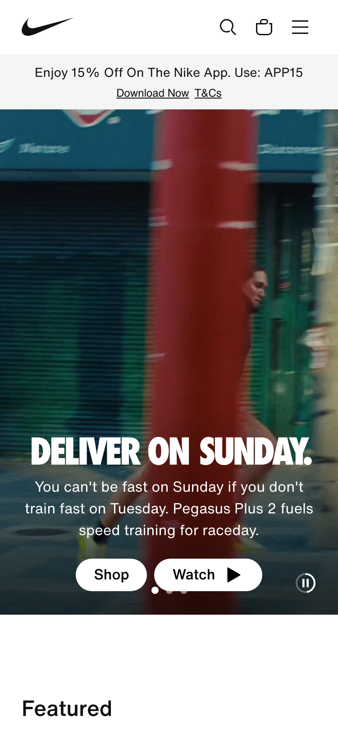
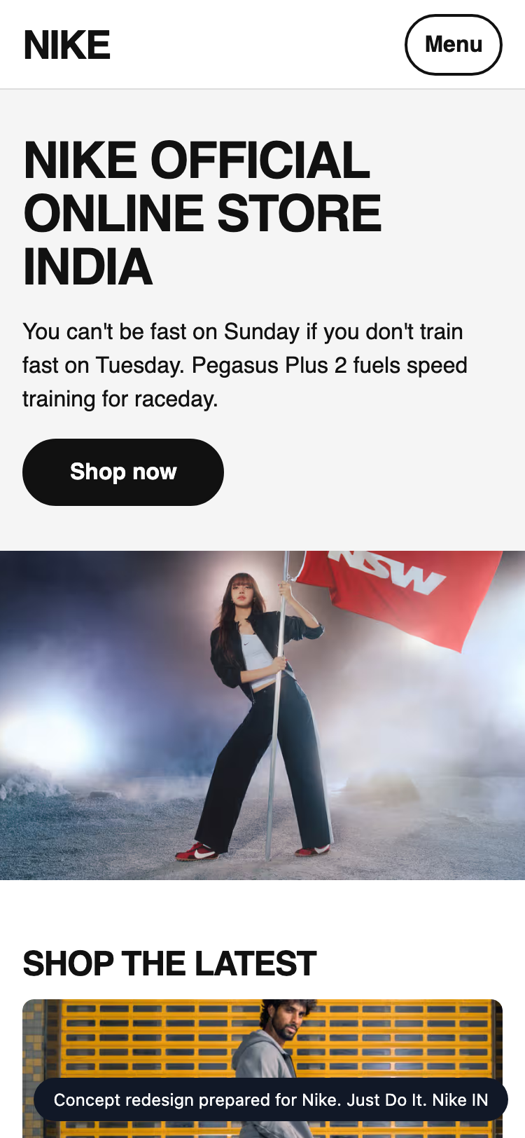
CONCEPT REDESIGN · MOBILE
On a phone
TODAY
CONCEPT
Mobile today
70/100 · grade C
64 of 87 tap targets are too small on mobile.
Horizontal overflow
0px
Small tap targets
64/87
Tiny text blocks
0
Viewport meta
yes
Nike. Just Do It. Nike IN · Prepared by Samsung SDS
9
Notes:
Most visitors arrive on a phone. These are phone-sized screenshots of the live site and of the concept.

Slide 10
CONCEPT REDESIGN · CHANGES
What changed, and why
Main content takes 16.9s to appear on mobile
→
Compress and preload the hero image, defer non-critical scripts, serve via a CDN.
Page is unresponsive for 1.3s while loading
→
Split and defer JavaScript, remove unused third-party scripts.
64 tap targets are too small
→
Make interactive elements at least 44x44px with spacing between them.
Elements must only use permitted ARIA attributes
→
Fix the flagged elements and add automated a11y checks to CI.
<ul> and <ol> must only directly contain <li>, <script> or <template> elements
→
Fix the flagged elements and add automated a11y checks to CI.
Nike. Just Do It. Nike IN · Prepared by Samsung SDS
10
Notes:
Each change in the concept answers a specific audit finding.

Slide 11
ORGANISATION MATCH
Why Samsung SDS fits this work
SKILL
FIT
PEOPLE FREE
Next.js / React
5 of 12
Strong
91
UX / UI design
2 of 6
Strong
QA / test automation
3 of 8
Strong
Web performance
2 of 4
Strong
Accessibility (WCAG)
1 of 3
Partial
organisation match
Design systems
1 of 4
Partial
Strengths
Next.js / React, UX / UI design, QA / test automation, Web performance
Gaps
None
Responsive / mobile UI
4 of 9
Strong
PHP
1 of 4
Strong
Delivery / project management
2 of 5
Strong
Nike. Just Do It. Nike IN · Prepared by Samsung SDS
11
Notes:
The organisation match score is 91 out of 100: how well our skills cover what this work needs, weighted by importance and availability. It uses the detected technology stack and the audit findings. Skills are sample data until connected to the real inventory.

Slide 12
PROPOSED TEAM
The team we would put on it
AM
Aarav Mehta
94%
DM
Dev Malhotra
94%
VD
Vikram Das
83%
Senior Frontend Engineer
fit
Senior Frontend Engineer
fit
Design Systems Engineer
fit
nextjs · responsive-ui · web-performance
nextjs · responsive-ui · web-performance
design-systems · nextjs · responsive-ui
Level 5/5 · available from 2026-11-02
Level 5/5 · available from 2026-11-09
Level 4/5 · available from 2026-11-02
Level 5/5 in nextjs, responsive-ui, web-performance; free from 2026-11-02. Needed for nextjs (…
Level 5/5 in nextjs, responsive-ui, web-performance; free from 2026-11-09. Needed for web-perf…
Level 4/5 in design-systems, nextjs, responsive-ui; free from 2026-11-02. Needed for design-sy…
AR
Ananya Rao
73%
IP
Isha Patel
73%
ZA
Zoya Ali
72%
UX Designer
fit
QA Automation Engineer
fit
Accessibility Specialist
fit
ux-design · design-systems
qa-testing · a11y
a11y · qa-testing · responsive-ui
Level 4/5 · available from 2026-11-02
Level 4/5 · available from 2026-11-09
Level 3/5 · available from 2026-11-02
Level 4/5 in ux-design, design-systems; free from 2026-11-02. Needed for ux-design (weight 1.0…
Level 4/5 in qa-testing, a11y; free from 2026-11-09. Needed for qa-testing (weight 1.0).
Level 3/5 in a11y, qa-testing, responsive-ui; free from 2026-11-02. Needed for a11y (weight 1.…
Nike. Just Do It. Nike IN · Prepared by Samsung SDS
12
Notes:
Named people who are available. Fit blends their level and how much of the needed skill weight they cover. This is sample talent data until connected to the real roster.

Slide 13
ESTIMATE
The plan: effort and timeline
EFFORT BY WORKSTREAM (PERSON-DAYS)
Homepage rebuild (design + front end) · 15 d (14%)
Performance engineering · 25 d (23%)
Responsive & mobile fixes · 7 d (6%)
Accessibility remediation · 25 d (23%)
UX & conversion redesign · 12 d (11%)
Structured data & AI-search · 4 d (4%)
QA & launch · 14 d (13%)
Delivery management · 9 d (8%)
INDICATIVE TIMELINE
Week 1
Week 2
Week 3
Week 4
Homepage rebuild (design + front end)
Performance engineering
Responsive & mobile fixes
Accessibility remediation
UX & conversion redesign
Structured data & AI-search
QA & launch
Nike. Just Do It. Nike IN · Prepared by Samsung SDS
13
Notes:
About 111 person-days over 4 weeks. The timeline is an indicative picture of the effort, to be fixed in discovery.

Slide 14
ESTIMATE · COMMERCIALS
Investment
ESTIMATED INVESTMENT
111
4 weeks
₹11,54,000 – ₹14,74,000
person-days
indicative duration
6
In discovery
₹11.5 lakh to ₹14.7 lakh · a range until discovery is complete
people on the team
final scope and price
ASSUMPTIONS
Homepage and key templates only; no new backend features
Client provides brand assets and timely feedback
Blended day rate 8250 with a 40% margin
Estimate is +/- range until discovery is complete
Terms: to be added by the account owner before this proposal is sent.
Nike. Just Do It. Nike IN · Prepared by Samsung SDS
14
Notes:
A price range until discovery is complete, with every assumption stated.

Slide 15
WORKING TOGETHER
Next steps
1
Walk through the concept
A 30-minute session with your team on Nike. Just Do It. Nike IN's homepage concept, the audit and the technology review.
2
Discovery week
We confirm scope, constraints and price, and fix the plan and the team.
3
Start building
The team starts 2026-11-02, with weekly demos and a launch plan.
Nike. Just Do It. Nike IN · Prepared by Samsung SDS
15
Notes:
Three simple steps. Nothing is sent or committed until a human approves.

Slide 16
Let's make Nike. Just Do It. Nike IN's website your strongest sales channel.
Samsung SDS · Digital Engineering
nike.in · 2026-10-26
Notes:
Close. Thank the audience and agree the first step.

Slide 17
APPENDIX
How we measured
Speed
Mobile
Lighthouse 12, mobile profile with simulated throttling. Falls back to browser timings if Lighthouse cannot run.
The page reloaded at phone size with touch: viewport, overflow, tap targets, text size.
Accessibility
UX
axe-core run in a real browser; each rule weighted by impact.
A vision model scores a screenshot against a fixed rubric; findings must cite what is visible.
AI search
Technology
Structured data, llms.txt, AI-crawler rules and a model judgement of how clearly the page says what you do.
About 130 signatures over network requests, headers, cookies, markup and script globals. A hint, not a certainty.
Scores are for the homepage only, measured once. The bench roster, skills inventory and rates are sample data until connected to real systems.
Nike. Just Do It. Nike IN · Prepared by Samsung SDS
17
Notes:
Methods and limits, for anyone who wants to check our work.

