Slide 1
Predicting the effects of Drought on olive oil yield in Spain
Student: Mhd Raslan Altinawi
Supervisor: Long Tran-Thanh

Slide 2
Motivation
Drought pose a serious challenge to agriculture.
Studying its relation to crop yield will help us understand the future of agriculture with climate change.

Slide 3
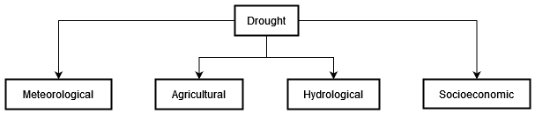
Drought definition
Drought is defined as a prolonged period of low rainfall leading to a shortage of water.
Notes:
Meteorological Drought: This occurs when an area experiences significantly less rainfall than normal over a period of time. It's essentially a dry weather pattern that persists long enough to be noticeable compared to the usual weather patterns of that area.
Agricultural Drought: This type of drought happens when there isn't enough moisture in the soil to meet the water needs of crops.
Hydrological Drought: This occurs when low water supply becomes evident, particularly in streams, reservoirs, and groundwater levels.
Economic Drought: This happens when the effects of meteorological, agricultural, or hydrological drought start to affect the economy.

Slide 4
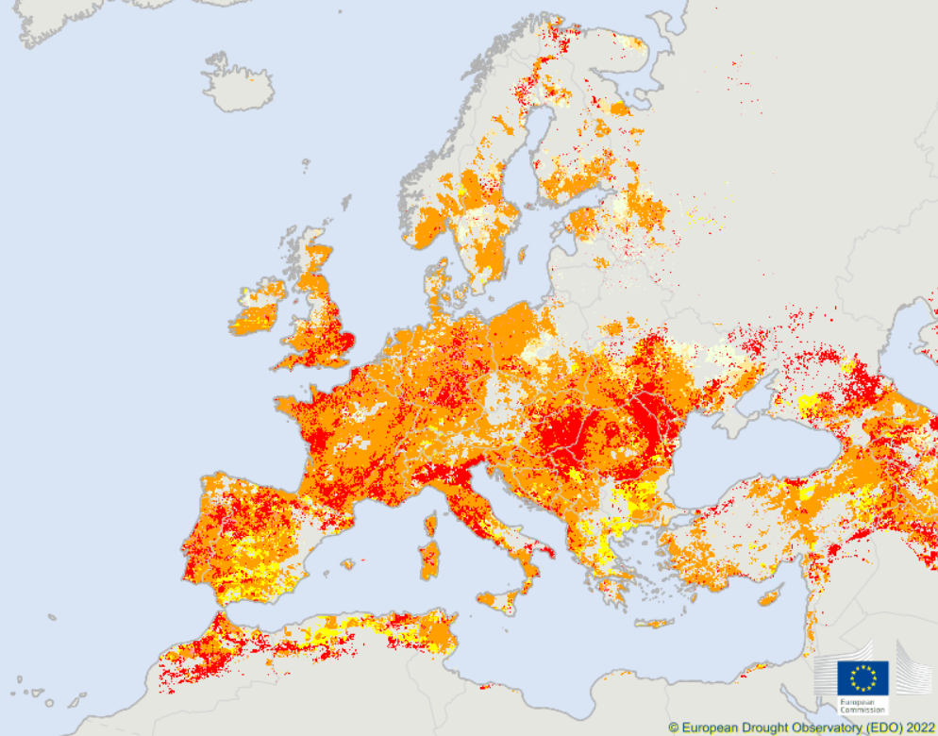
Recent drought in Europe
Notes:
2022 European drought
Drought alerts in Europe
Drought accompanied be heatwave.
Drought: low rainfall
Heatwave: increase temperature

Slide 5
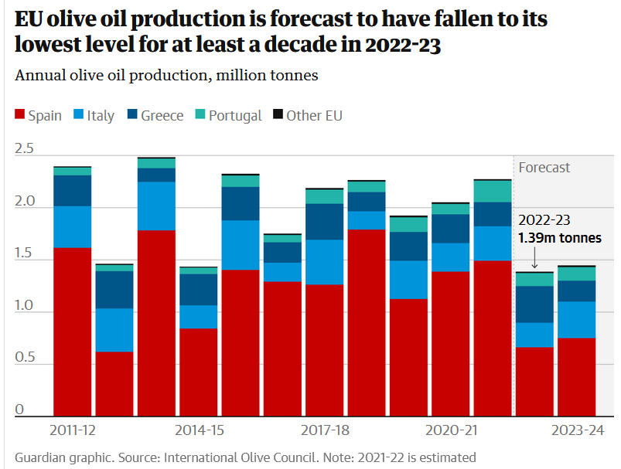
EU Olive oil production
Notes:
It’s apparent that olive oil is in low trend.
This will increase prices
Spain is the major producer of olive oil

Slide 6
Effects of Drought on Agriculture
Shortage of water needed for crop growth.
Soil degradation affecting land fertility.
Notes:
Lack of sufficient water leads to reduction in crop yields.
Extreme drought affects the soil, this in turns affects fertility of the land.

Slide 7
The problem
Can we model the causal relation between drought and olive oil yield?
Notes:
Can we predict the drought and how it will affect the yield of olive oil?
Can we predict drought accurately and predict its effects on olive oil production?

Slide 8
Drought indices
A drought index is a numerical tool used to measure and monitor the severity and extent of drought conditions based on various data sources such as rainfall, temperature, and soil moisture. Common indices include:
Standardized Precipitation Index (SPI): use precipitation to measure wetness and dryness.
Standardized Precipitation-Evapotranspiration Index (SPEI): improve on SPI by incorporating temperature and evapotranspiration.
Notes:
What is a drought index?
In literature, SPEI is used for predicting drought using traditional ML algorithms such as SVM
We choose SPEI because

Slide 9
Current progress
Data:
Spain olive yield data
SPEI drought data
Notes:
So far, we have collected data about the variables of interests: olive oil and drought index.

Slide 10
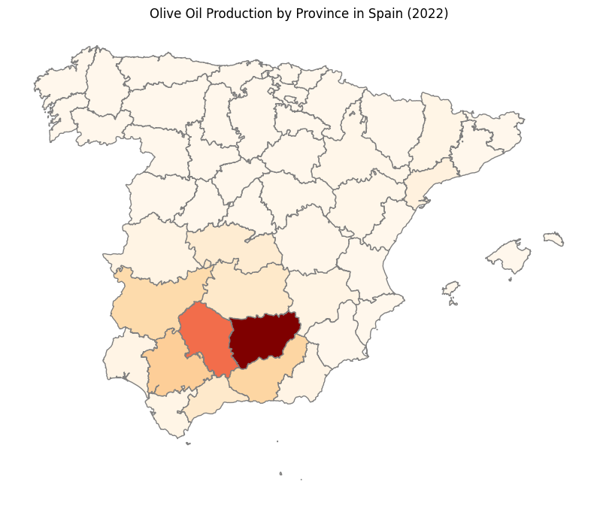
Spain olive oil data
Notes:
Yearly data about olive oil production at the province level from the Spanish Ministry of Agriculture, Fisheries and Food.

Slide 11
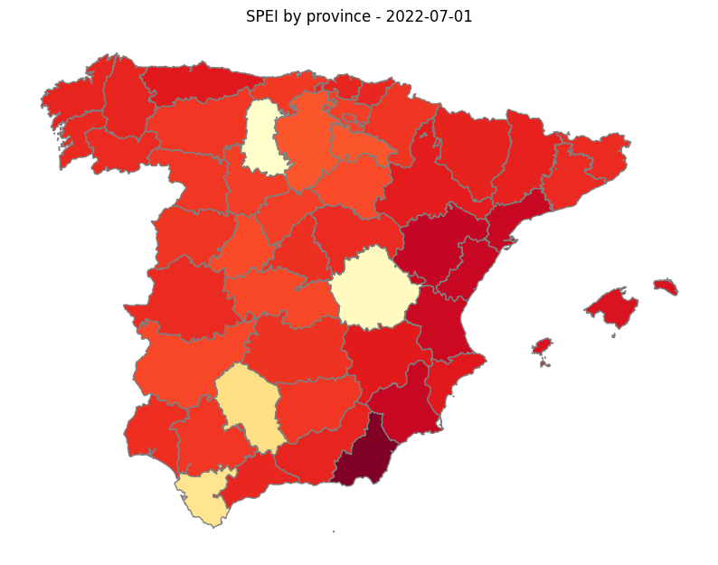

SPEI data
Notes:
Calculating the index is more challenging
Need to use data about precipitation and potential evapotranspiration
Deal with satellite data
Data availability is monthly

Slide 12
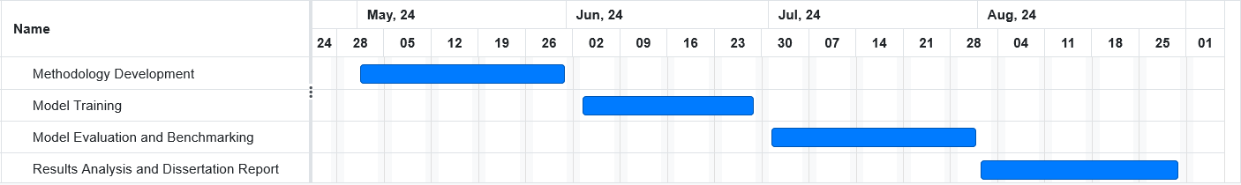
Future plan

Slide 13
Q&A

