Slide 1
科学计算 NumPy

Slide 2
NumPy (pronounced /ˈnʌmpaɪ/ (NUM-py) or sometimes /ˈnʌmpi/ (NUM-pee)) is a library for the Python programming language, adding support for large, multi-dimensional arrays and matrices, along with a large collection of high-level mathematical functions to operate on these arrays.

Slide 3
万物皆向量

Slide 4
NumPy快速入门

Slide 5
为什么使用NumPy
Python objects: | high-level number objects: integers, floating point containers: lists (costless insertion and append), dictionaries (fast lookup)
NumPy provides: | extension package to Python for multi-dimensional arrays memory-efficient container that provides fast numerical operations (efficiency) designed for scientific computation (convenience) Also known as array oriented computing

Slide 6

NumPy
获取帮助
http://docs.scipy.org/
使用NumPy
例子

Slide 7
数组 Array
手动创建数组
使用函数创建数组

Slide 8
基本数据类型
Common | int64 float64
Complex: | d = np.array([1+2j, 3+4j, 5+6*1j]) d.dtype dtype('complex128')
Bool: | e = np.array([True, False, False, True]) e.dtype dtype('bool')
Strings: | f = np.array(['Bonjour', 'Hello', 'Hallo',]) f.dtype # <--- strings containing max. 7 letters dtype('S7')
Much more: | int32 int64 uint32 uint64

Slide 9
索引与切割
保留了Python中索引切割操作
加入了额外针对多维数组的索引与切割功能

Slide 10
轴, 维度和形状
在NumPy中多维数组中, 维度(dimensionality), 轴(axis)和形状(shape) 是三个关系紧密的概念

Slide 11
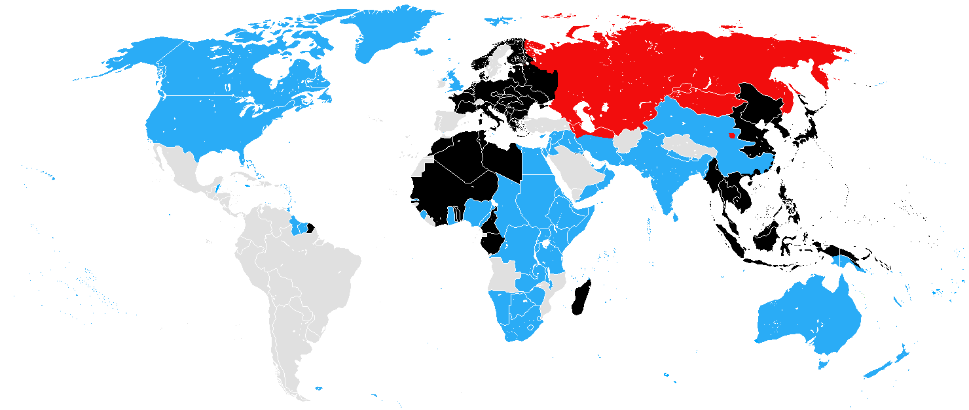
Axis?
1942 June, in black are territories controlled by the Axis

Slide 12
轴/axis/axes 和 维度/dimensionality
数学和物理中, 维度/dimensionality可理解为在某个空间里表示一个点所需的最少坐标个数
在 Numpy 中, 按照 numpy doc, 轴/axis/axes即是维度, 轴的数量即是秩rank, 注意, 此处的rank有别于rank在线性代数中的定义
a.ndim # num of dimensions/axes, *Mathematics definition of dimension*

Slide 13
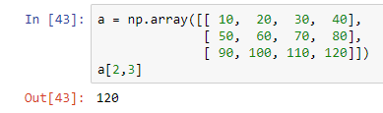
轴/axis/axes
a[2,3]
索引a在第0轴上的第3个元素, 和第1轴上的第2个元素.

Slide 14
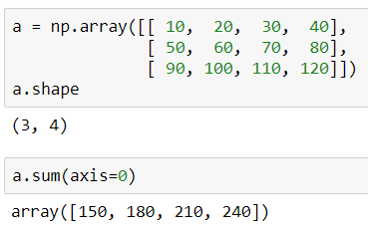
轴/axis/axes
a.sum(axis=0)
沿着a的第0轴求sum
i.e. a的第0轴有3个长度为4的向量, 对这3个向量求sum

Slide 15
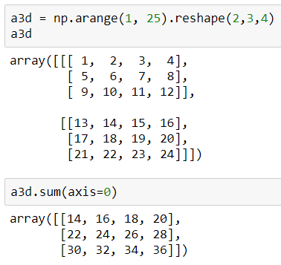
轴/axis/axes
a.sum(axis=0)
沿着a的第0轴求sum
i.e. a的第0轴有2个3x4矩阵, 对这2个3x4矩阵求sum

Slide 16
Static Functions and Object Functions
Module function - function defined in your module
defined without self
np.sum(a, axis=0)
Method - function that is a class attribute and thus belongs to an object
defined with self
a.sum(axis=0)

Slide 17
NumPy Axis
In Mathematics/Physics, dimension or dimensionality is informally defined as the minimum number of coordinates needed to specify any point within a space.
But in Numpy, according to the numpy doc, it's the same as axis/axes:
In Numpy dimensions are called axes. The number of axes is rank.
a.ndim # num of dimensions/axes, *Mathematics definition of dimension*

