Slide 1

Automatic Segmentation of COVID-19 CT Images Based on MIScnn
By Chen ZHU, Heng GU

Slide 2
1. Introduction
Our segmentation approach is based on 3D U-Net and MIScnn.
The method focused on the on-the-fly generation of unique and random image patches for training by exploiting heavy preprocessing and extensive data augmentation.
Thus, it is possible to handle limited dataset size which acts as a variant database.
We adopt the standard 3D U-Net.

Slide 3
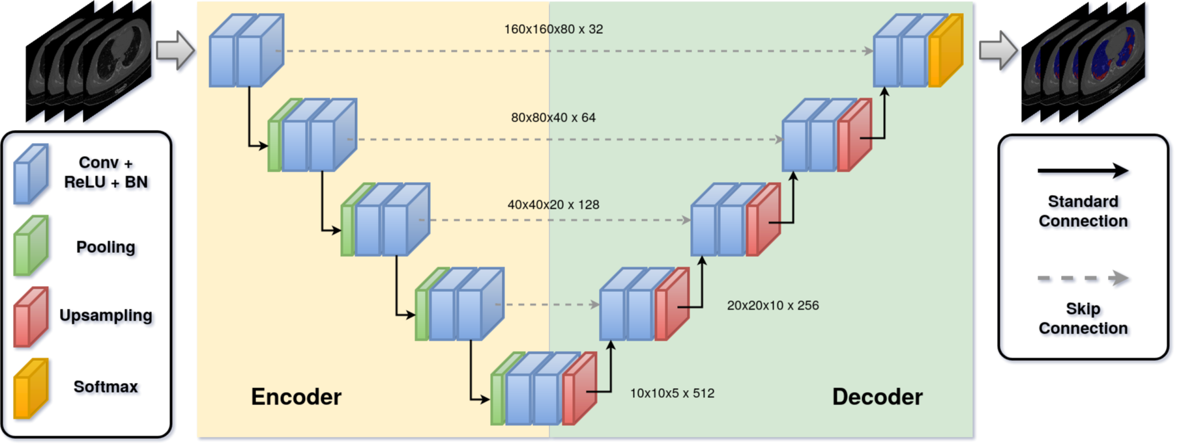
2. Method

Slide 4
2. Method
The pipeline is based on MIScnn, which is an in-house developed open-source framework to setup complete medical image segmentation pipelines with convolutional neural networks and deep learning models on top of TensorFlow/Keras⁠.
The framework supports extensive preprocessing, data augmentation, the latest learning models, and diverse evaluation techniques.

Slide 5
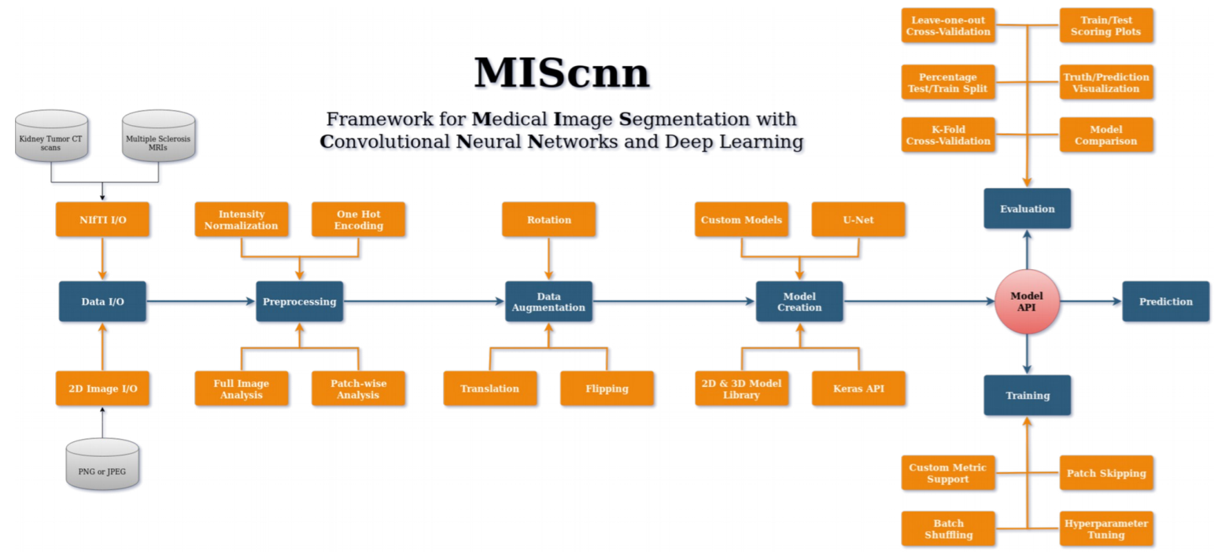
3. MIScnn

Slide 6
3. MIScnn
MIScnn provides several core features:
2D/3D medical image segmentation for binary and multi-class problems
Data I/O, preprocessing and data augmentation for biomedical images
Patch-wise and full image analysis
State-of-the-art deep learning model and metric library
Intuitive and fast model utilization (training, prediction)
Multiple automatic evaluation techniques (e.g. cross-validation)
Custom model, data I/O, pre-/postprocessing and metric support
Based on Keras with Tensorflow as backend

Slide 7
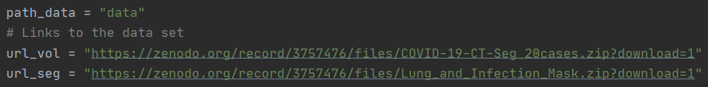

4. Data Preprocessing
Download Data
Download CT volumes and segmentations
Extract the sample list from the ZIP file
Extract each sample from the ZIP files

Slide 8
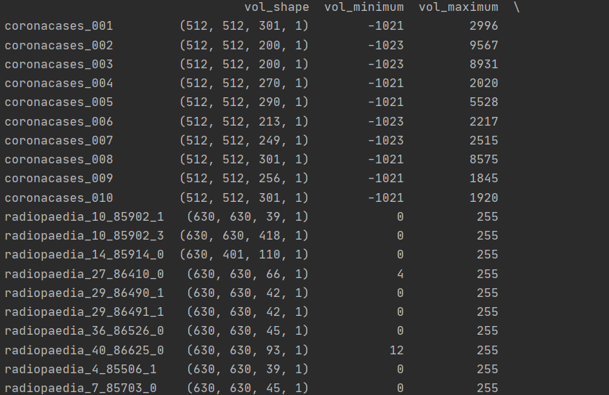
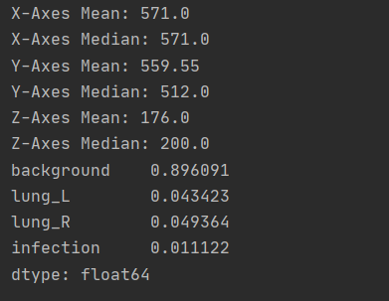
5. Data Exploration
Obtain the volume shape and the minimum and maximum volume intensity
Store the voxel spacing, identify and category distribution
The mean and median of the shape, the average category frequency

Slide 9

6. Sample Processing
Divide the sample into four categories: background, left lung, right lung, and COVID-19
Divide the sample into five folds

Slide 10
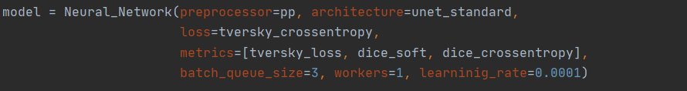
7. Neural Network Training
Use 4 classifications to train the neural network
Set the epoch of the neural network to 15
Set the number of iterations to 150

Slide 11
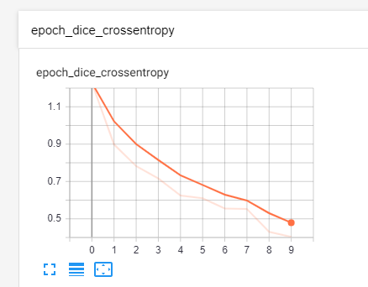
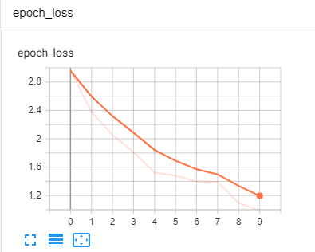
8. Result

Slide 12
References
[1] Dominik Müller and Frank Kramer. (2019). MIScnn: A Framework for Medical Image Segmentation with Convolutional Neural Networks and Deep Learning.
[2] Jun Ma, Cheng Ge, Yixin Wang, Xingle An, Jiantao Gao, Ziqi Yu, Minqing Zhang, Xin Liu, Xueyuan Deng, Shucheng Cao, Hao Wei, Sen Mei, Xiaoyu Yang, Ziwei Nie, Chen Li, Lu Tian, Yuntao Zhu, Qiongjie Zhu, Guoqiang Dong, Jian He. (2020). COVID-19 CT Lung and Infection Segmentation Dataset (Version 1.0) [Data set]. Zenodo.

