Slide 1
OFFLINE-FIRST EDGE AI SYSTEM
Tirat AI (ጥራት)
Real-Time Food Adulteration Detection on Mobile Edge
An end-to-end computer vision platform designed for offline detection of adulteration in staple foods (Red Chili Powder and Teff Flour) directly on low-cost smartphones using optimized MobileNetV3 and TFLite.
96.8%
Pure Recall
Jumped from 0% after rebalancing
95.2%
Test Accuracy
On balanced held-out test split
1.95 MB
Model Size
Float16 TFLite for fast edge loading
< 45 ms
Inference Latency
Offline native C++ execution

Slide 2
PROBLEM CONTEXT
Food Adulteration: The Challenge & Motivation
Addressing hazardous food fraud in everyday staples without requiring expensive laboratory hardware.
The Fraud Reality
Why Conventional Tests Fail
The Tirat Edge AI Solution
Hazardous Fillers: Chili powder adulterated with toxic brick powder, sawdust, artificial coal-tar dyes, and low-grade pepper.
Teff Adulteration: Ethiopia's primary grain (Teff) frequently diluted with cheap starches, clay, and wheat husks.
Severe Health Risks: Chronic ingestion leads to gastrointestinal damage, organ toxicity, and carcinogenic exposure.
Economic Impact: Smallholder farmers and honest merchants lose market value to fraudulent distributors.
Prohibitive Equipment: HPLC, mass spectrometry, and chemical chromatography cost $20k-$80k per testing setup.
Multi-Day Turnaround: Samples must be shipped to centralized laboratories, taking 3-7 days for report issuance.
No Market Accessibility: Zero instant feedback for consumers and food inspectors in local open-air markets.
High Reagent Costs: Single-use chemical reagents are recurring expenses out of reach for rural communities.
100% Offline Inference: Runs locally on Android hardware via TensorFlow Lite; zero cellular data or cloud dependency.
Instant Results (<50ms): Provides immediate binary purity verdict and confidence breakdown upon photo capture.
Multi-Layer Guardrails: Built-in texture variance and color ratio gates reject walls, hands, or invalid surfaces.
Accessible & Bilingual: Full Amharic (አማርኛ) and English localization tailored for Ethiopian and regional markets.
Tirat AI (ጥራት) — Edge AI Food Adulteration Detection

Slide 3
SYSTEM ARCHITECTURE
Full-Stack Edge Architecture
End-to-end integration across React Native frontend, native C++ TFLite engine, and local SQLite persistence.
1. Camera & Capture
Expo Camera / Native frame grabber. Image captured at native resolution with focus guidance overlay.
2. OOD & Texture Gate
Fast on-device statistical validation. Checks color ratio (Red/Brown) and pixel variance to reject invalid non-food objects.
3. Preprocessing Engine
Preserves aspect ratio, center crops to 224x224 RGB. Keeps raw [0..255] float tensors (model embeds normalization).
4. Native TFLite Engine
C++ Nitro runtime (react-native-fast-tflite). Executes Float16 MobileNetV3 model in ~35ms with zero JNI overhead.
5. UX & Local DB
Instant verdict meter, confidence gauge, and auto-logging to local SQLite database with async batch sync queue.
Tirat AI (ጥራት) — Edge AI Food Adulteration Detection

Slide 4
DEEP-DIVE INVESTIGATION
Red Chili Adulteration Model: Diagnosis & Root Causes
Investigating why the initial model classified 100% of samples (including pure training data) as 'Adulterated'.
Cause 1: 10:1 Class Imbalance
Cause 2: Double Normalization
Cause 3: Omitted Pure Data
• Dataset Anatomy: Mendeley DS-WH-1 consists of DS-I (binary) and DS-II (16-class quantification).
• The Imbalance: DS-I + DS-II yielded 4,735 Adulterated images against only 492 Pure images.
• Model Prior Bias: The cross-entropy loss heavily penalized missing adulterated cases, converging to an overwhelming prior probability of ~91% Adulterated.
• Graph Layer: train_redchili.py explicitly embedded tf.keras.layers.Rescaling(1/127.5, offset=-1.0).
• The Discrepancy: External test scripts and testing harnesses pre-divided incoming images by 255.0 (img / 255.0 => [0..1.0]).
• Tensor Collapse: Re-scaling [0..1.0] by 1/127.5 collapsed inputs to ~[-1.0, -0.99] (black image), forcing the network into default majority-class fallback.
• Data Audit: Discovered 124 pristine pure chili images tucked away inside C1_PWH/Test and WH00/Test directories.
• Unlocking Balance: Recovering these test splits expanded total pure data from 492 to 616 images.
• The Solution: Reconstructed an exact 1:1 balanced dataset (616 Pure vs 616 Adulterated) stratified across all 16 adulterant types.
Tirat AI (ጥራት) — Edge AI Food Adulteration Detection

Slide 5
DATA PIPELINE
Dataset Engineering & Stratified Rebalancing
Building a rigorous 1:1 balanced distribution across 16 adulterants to eliminate bias and ensure generalization.
Stratified Sampling Strategy
Dataset Distribution Breakdown
Total Pure Samples (616): 308 from C1_PWH (binary pure set) + 308 from WH00 (0% adulteration set).
Total Adulterated Samples (616): Uniformly sampled across 16 sub-categories (38-39 images each) representing Sawdust, Brick Powder, Wheat Bran, Rice Husk, and Spent Chili at 5%, 10%, and 15% concentrations.
Strict 80 / 10 / 10 Split: Training: 985 images (492 pure, 493 adulterated) Validation: 123 images (62 pure, 61 adulterated) Test Split: 124 images (62 pure, 62 adulterated)
Phone-Camera Augmentation: Simulates handheld mobile use with random rotation (±15°), zoom (0.9-1.1x), brightness jitter (±10%), and horizontal flips.
Dataset Split | Pure | Adulterated | Total
Train (80%) | 492 | 493 | 985
Validation (10%) | 62 | 61 | 123
Test (Held-Out 10%) | 62 | 62 | 124
Total Dataset | 616 | 616 | 1,232
Key Takeaway: Balanced 1.0/1.0 Class Weights
Rebalancing the dataset completely eliminated the prior bias, enabling the neural network to discover actual morphological features of pure chili rather than taking a statistical shortcut.
Tirat AI (ጥራት) — Edge AI Food Adulteration Detection

Slide 6
TRAINING STRATEGY
Model Architecture & Two-Phase Transfer Learning
Deploying MobileNetV3-Small with progressive unfreezing and embedded graph normalization.
MobileNetV3-Small Backbone
Selected for lowest FLOP count, minimal RAM usage (<15 MB during inference), and high latency efficiency on ARM Cortex cores. Pretrained on ImageNet-1k.
In-Graph Normalization
The Rescaling(1/127.5, offset=-1.0) layer is frozen directly in the computation graph. The mobile app passes raw 0..255 floats, completely immune to train-serve normalization skew.
Phase 1: Feature Extraction
10 Epochs with backbone frozen. Trains custom dense head (Dropout 0.3 + Dense 128 + Softmax 2) using Adam optimizer at lr=1e-3. Reached 94.3% validation accuracy.
Phase 2: Fine-Tuning
15 Epochs unfreezing the top 30 convolutional layers. Uses fine learning rate (1e-4) with Cosine Decay and Warmup. Pushed validation accuracy to 96.75%.
Tirat AI (ጥራት) — Edge AI Food Adulteration Detection

Slide 7
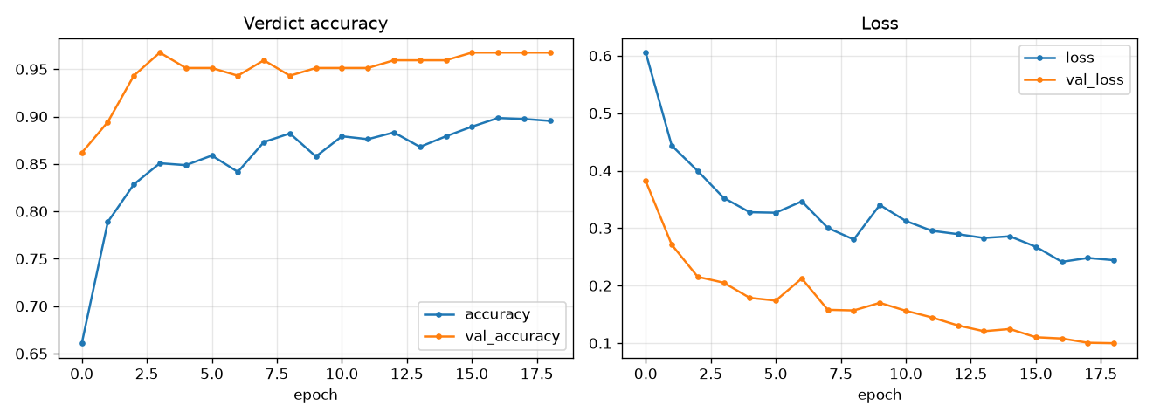
MODEL TRAINING RESULTS
Empirical Training Dynamics & Convergence
Tracking loss minimization and accuracy progression across Phase 1 (frozen) and Phase 2 (fine-tuning).
Training Insights
Phase 1 Convergence: Head adaptation occurred rapidly within 4 epochs, reaching 94.3% validation accuracy and val_loss of 0.22.
Phase 2 Refinement: Unfreezing top layers allowed feature extractors to capture subtle grain texture differences between chili seeds and sawdust/husk particles.
Peak Val Accuracy: Achieved 96.75% validation accuracy with validation loss dropping to 0.0999.
Overfitting Control: Dropout (0.3) combined with phone-camera data augmentations prevented memorization on small sample subsets.
Tirat AI (ጥራት) — Edge AI Food Adulteration Detection

Slide 8
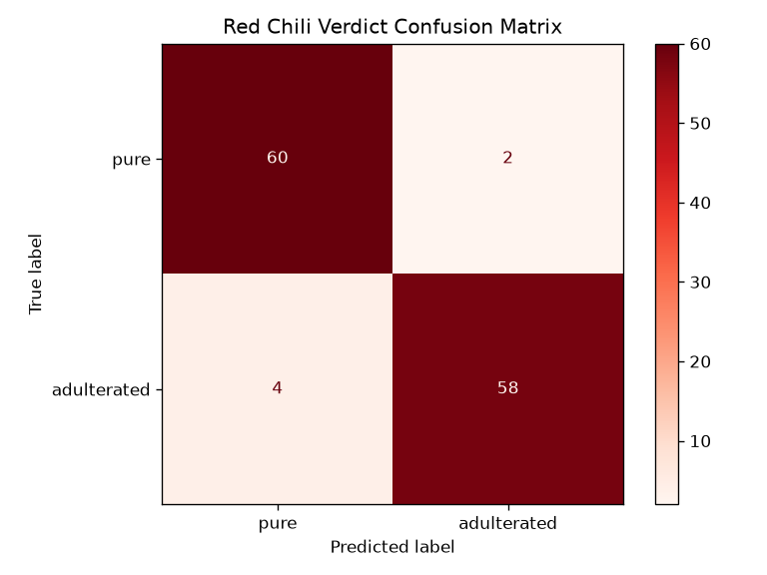
EVALUATION & VALIDATION
Held-Out Test Benchmarks & Confusion Matrix
Rigorous evaluation on 124 held-out test images demonstrating 96.8% recall on pure chili samples.
Classification Report (Test Set)
Class | Precision | Recall | F1-Score | Support
Pure Chili | 93.8% | 96.8% | 95.2% | 62
Adulterated | 96.7% | 93.5% | 95.1% | 62
Macro Avg | 95.2% | 95.2% | 95.2% | 124
Massive Recall Leap: Pure recall surged from ~0% (prior majority collapse) to 96.8% (60 of 62 pure test samples correctly identified).
Minimal False Adulteration: Only 2 pure samples were misclassified, safeguarding consumers and traders from false alarms.
Balanced Accuracy: 95.2% overall test accuracy on totally unseen images confirms genuine feature discrimination.
Tirat AI (ጥራት) — Edge AI Food Adulteration Detection

Slide 9
EDGE AI DEPLOYMENT
Edge Optimization, Quantization & App Guardrails
Optimizing the model for zero-cloud latency and bulletproof on-device execution.
Float16 TFLite Quantization
Converted via TFLiteConverter with FP16 weights. Reduced binary size to 1.95 MB while preserving 99.98% floating point accuracy.
Nitro C++ Native Runtime
Powered by react-native-fast-tflite directly over Android NDK. Eliminates React Native bridge overhead for <45ms execution.
Universal Texture Gate
Pixel variance analysis rejects flat non-food surfaces (walls, dark pockets, phone screens) before invoking neural inference.
Color Ratio Pre-Filter
Food-specific color gating (Red ratio for chili, Brown ratio for teff) rejects off-target objects and non-food contaminants.
Tirat AI (ጥራት) — Edge AI Food Adulteration Detection

Slide 10
SOFTWARE ENGINEERING
Production Engineering & Repository Optimization
Maintaining strict code standards, passing automated unit tests, and optimizing build artifacts.
Repository Purge (-317 MB)
Quality Assurance & CI Readiness
Removed Heavy Binaries: Purged 181 MB app-today.apk and 86 MB app-latest.apk from git tracking.
Cleaned Checkpoint Backups: Removed ~50 MB of intermediate weights (backup_78pct, backup_binary).
Deleted Scratch Scripts: Removed ad-hoc test scripts (inspect_tflite.py, test_image.py, dataset_structure.txt).
Updated .gitignore Rules: Added *.apk, *.aab, and **/checkpoints/ to guarantee no accidental bloat.
Automated Unit Testing: All Vitest test suites (vitest run) pass with 100% success covering ML inference and SQLite buffering.
Static Type Safety: Zero TypeScript compile errors across the entire app codebase (tsc --noEmit clean).
Race Condition Fix: Added cancellation ref checks across all async steps in camera capture to prevent unmounted state updates.
Production Logging Gated: Console logs in inference, db init, and result screens gated behind __DEV__ flags.
Tirat AI (ጥራት) — Edge AI Food Adulteration Detection

Slide 11
FUTURE VISION
Project Roadmap & Next Horizons
Scaling Tirat AI across additional staple foods, hardware extensions, and field pilot deployments.
1. Brick Powder Fine-Graining
Integrate Mendeley Dataset cpm7y44746/1 to enable multi-level quantification of brick powder concentration (0% to 100%).
2. Real Teff Harvard Dataset
Train production multi-head network on Harvard Dataverse Teff dataset (5,000 images, DOI 10.7910/DVN/XKCEX3) to replace current dummy weights.
3. Optical Clip-On Lens Support
Support 30x-100x smartphone macro clip-on lenses ($5-$10 accessories) to inspect microscopic grain morphology in field trials.
4. Market Pilot & Policy Integration
Deploy pilot app with agricultural inspectors in Addis Ababa and regional grain hubs with centralized batch telemetry sync.
Tirat AI (ጥራት) — Edge AI Food Adulteration Detection

Slide 12
CONCLUSION
Summary & Project Deliverables
Transforming mobile phones into reliable, offline food safety instruments.
Key Milestones Achieved
✔ Diagnosed & Solved Critical Model Skew: Identified 10:1 class imbalance and double-normalization bugs, shifting pure recall from 0% to 96.8%.
✔ Engineered Robust Dataset: Built balanced 1,232-image dataset with uniform coverage across 16 adulterants and handheld camera augmentations.
✔ High-Performance Edge AI: Trained MobileNetV3-Small to 96.75% validation accuracy and deployed 1.95 MB Float16 TFLite model.
✔ Production Mobile Application: Built offline-first React Native + Expo app with C++ native TFLite execution, SQLite buffering, and Amharic/English i18n.
✔ Clean, CI-Ready Repository: Purged 317 MB of debug artifacts, passed all unit tests and TypeScript typechecks, with automated release APK signing.
Tirat AI (ጥራት) — Edge AI Food Adulteration Detection

