Slide 1
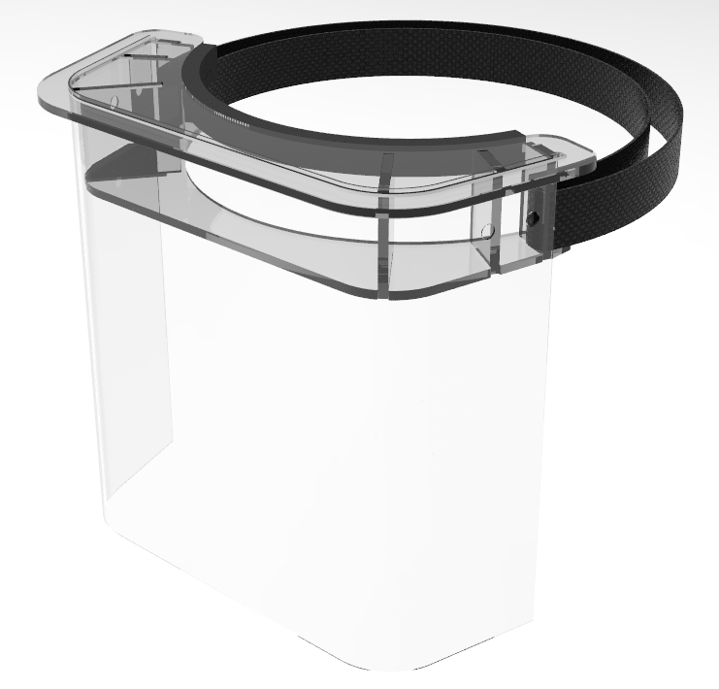
LOW COST EMERGENCY FACE SHIELD
LASER CUT 1/8” ACRYLIC
HOLDER FRAME
ELASTIC BAND
ADHESIVE BACKED FOAM CUSHION
HOLES TO SECURE SHEET WITH ZIP TIE
THIN PLASTIC SHEET
Mass (est) = 100g

Slide 2
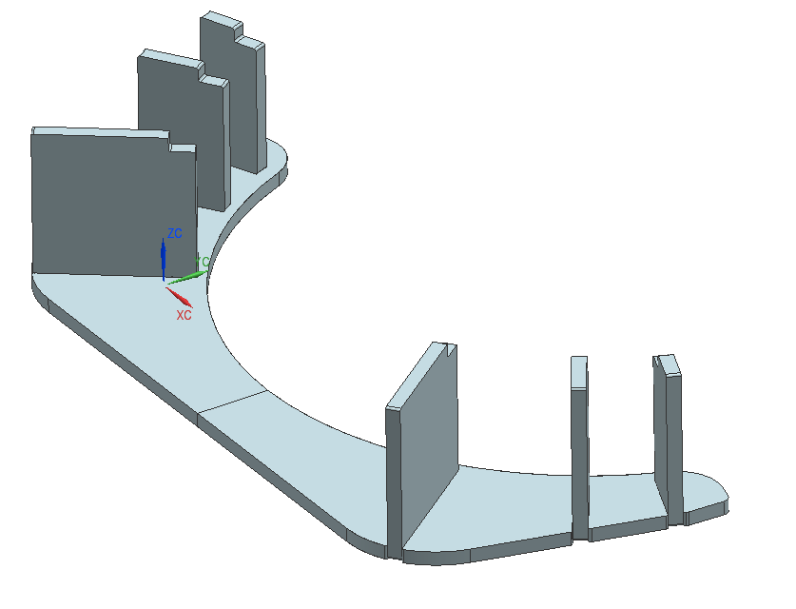
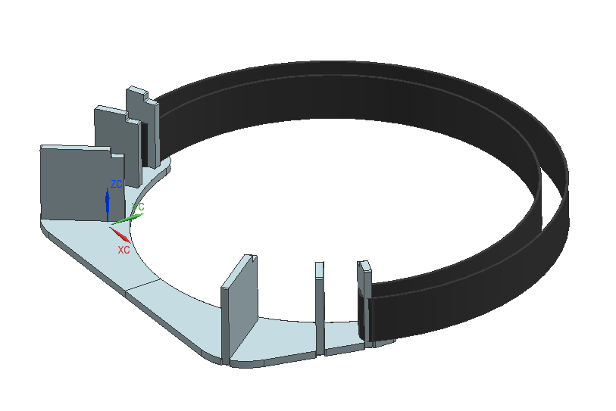
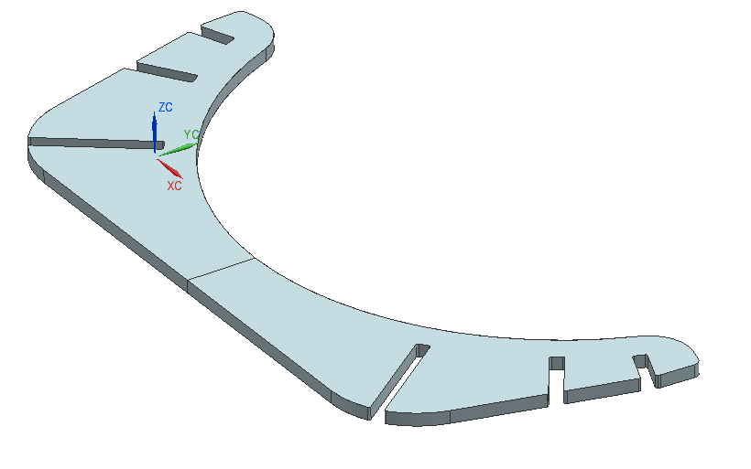
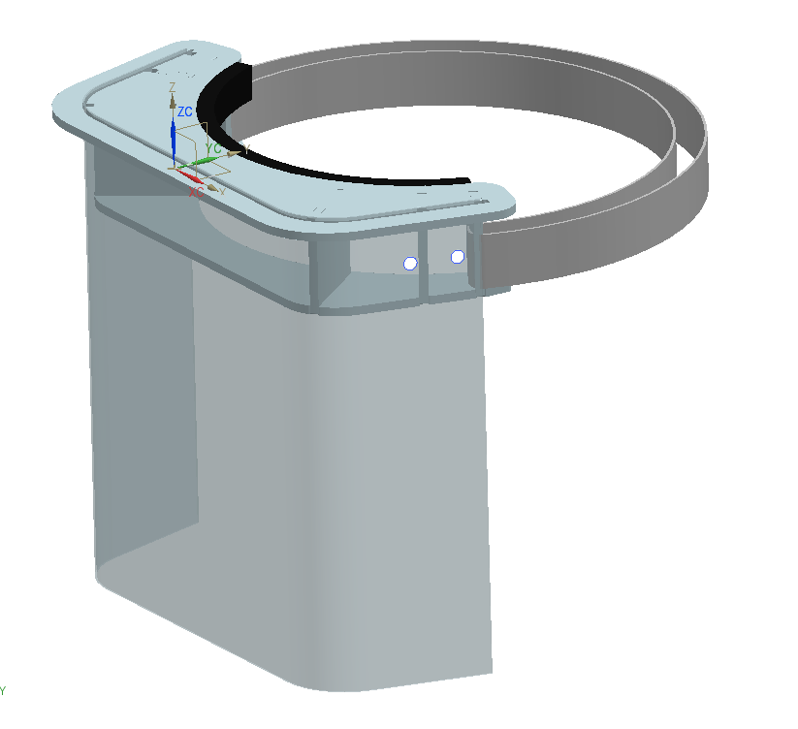
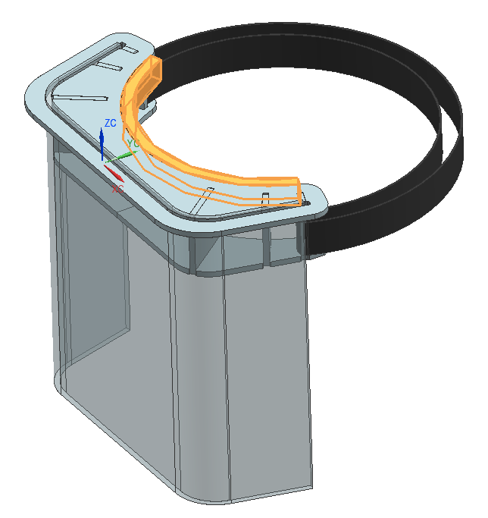

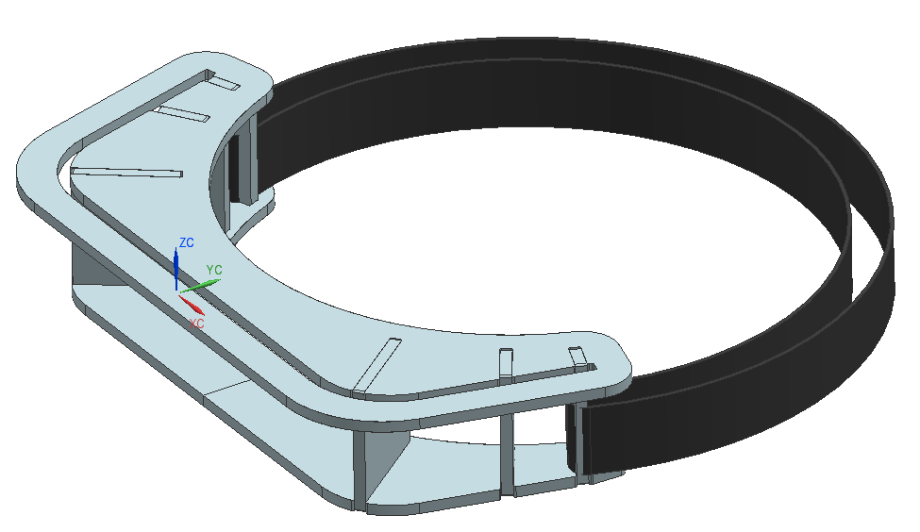
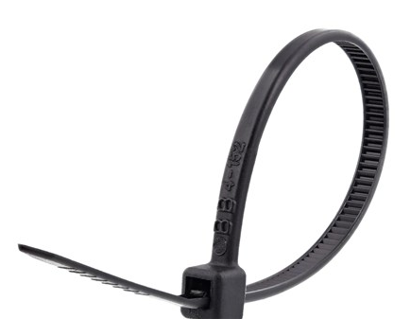
1
2
3
START WITH BOTTOM
SOLVENT WELD OR GLUE SLITS
ASSEMBLE ELASTIC STRAP
4
5
6
SLIDE PLASTIC SHEET IN, SECURE WITH ZIP TIE
APPLY FOAM WITH ADHESIVE BACK
SOLVENT WELD OR GLUE TOP PART

Slide 3
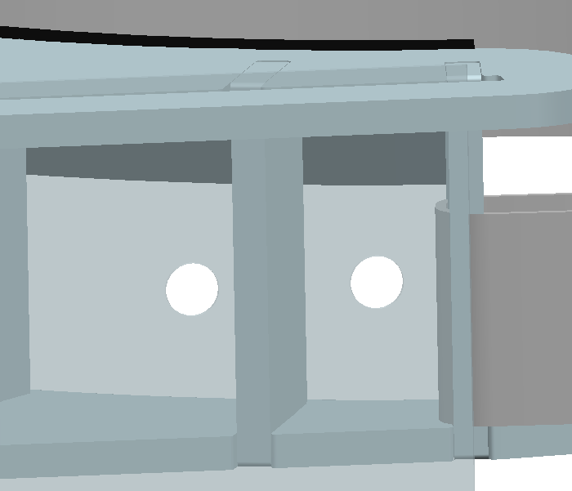
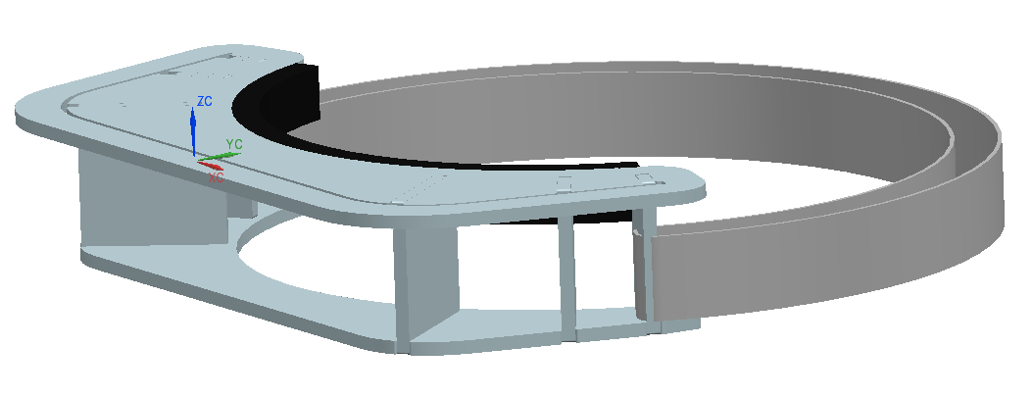
Cleaning The Shield
Remove the zip tie
Slide the shield out
Thoroughly wipe the shield with 99% isopropyl alcohol
Dunk plastic frame into water/alcohol solution, let dry
If necessary, replace the adhesive foam

Slide 4
PART | QTY
HOLDERFRAME_BOTTOM_REV0.dxf | 1 | LASER CUT 1/8” ACRYLIC
HOLDERFRAME_TOP_REV0.dxf | 1 | LASER CUT 1/8” ACRYLIC
SHIELDPIECE_REV0.dxf | 1 | 1/8” POLYCARBONATE (CAN CUT BY HAND WITH RAZOR) BENT TO SHAPE WITH HEAT GUN OVER EDGE OF A TABLE
SLIT_A_REV0.dxf | 2 | LASER CUT 1/8” ACRYLIC
SLIT_B_REV0.dxf | 2 | LASER CUT 1/8” ACRYLIC
SLIT_C_REV0.dxf | 2 | LASER CUT 1/8” ACRYLIC
Elastic Strap | 1 | Experiment to find a suitable elastic
Adhesive Foam | 1 | ¼ inch Foam with Adhesive Back (e.g Home Depot Draft Seal Foam) https://www.amazon.com/Weather-Stripping-Density-Sliding-Strips/dp/B07H5948V4/ref=sr_1_2?dchild=1&keywords=draft+seal+foam+1%2F4+inch&qid=1584792766&s=industrial&sr=1-2
Solvent Weld or Glue | 1 | Weld On Acrylic Adhesive or Similar https://www.amazon.com/Weld-Acrylic-Adhesive-Applicator-Bottle/dp/B0096TWKCW
Zip Tie | 2

