Slide 1
Restaurant Cateogry

Slide 2
Category
Fast Food
Hamburger
Pizza
Fast Casual
(Staff make food from existing ingredient, customer just only order the desired food)
Ethnic (food base on country)
Asian
European
Japanese
Casual Dining
Barbecue
Brasserie and bistro (For relax)

Slide 3
Category
Vegetarian
Non-Vegetarian
Sushi
Buffet
Seafood
Steak House
Cafeteria (Starbuck…)
Pub

Slide 4
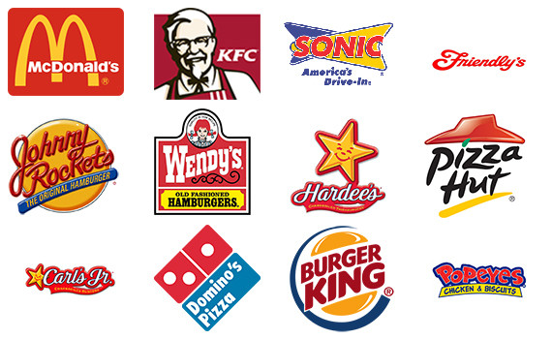
Fast Food

Slide 5
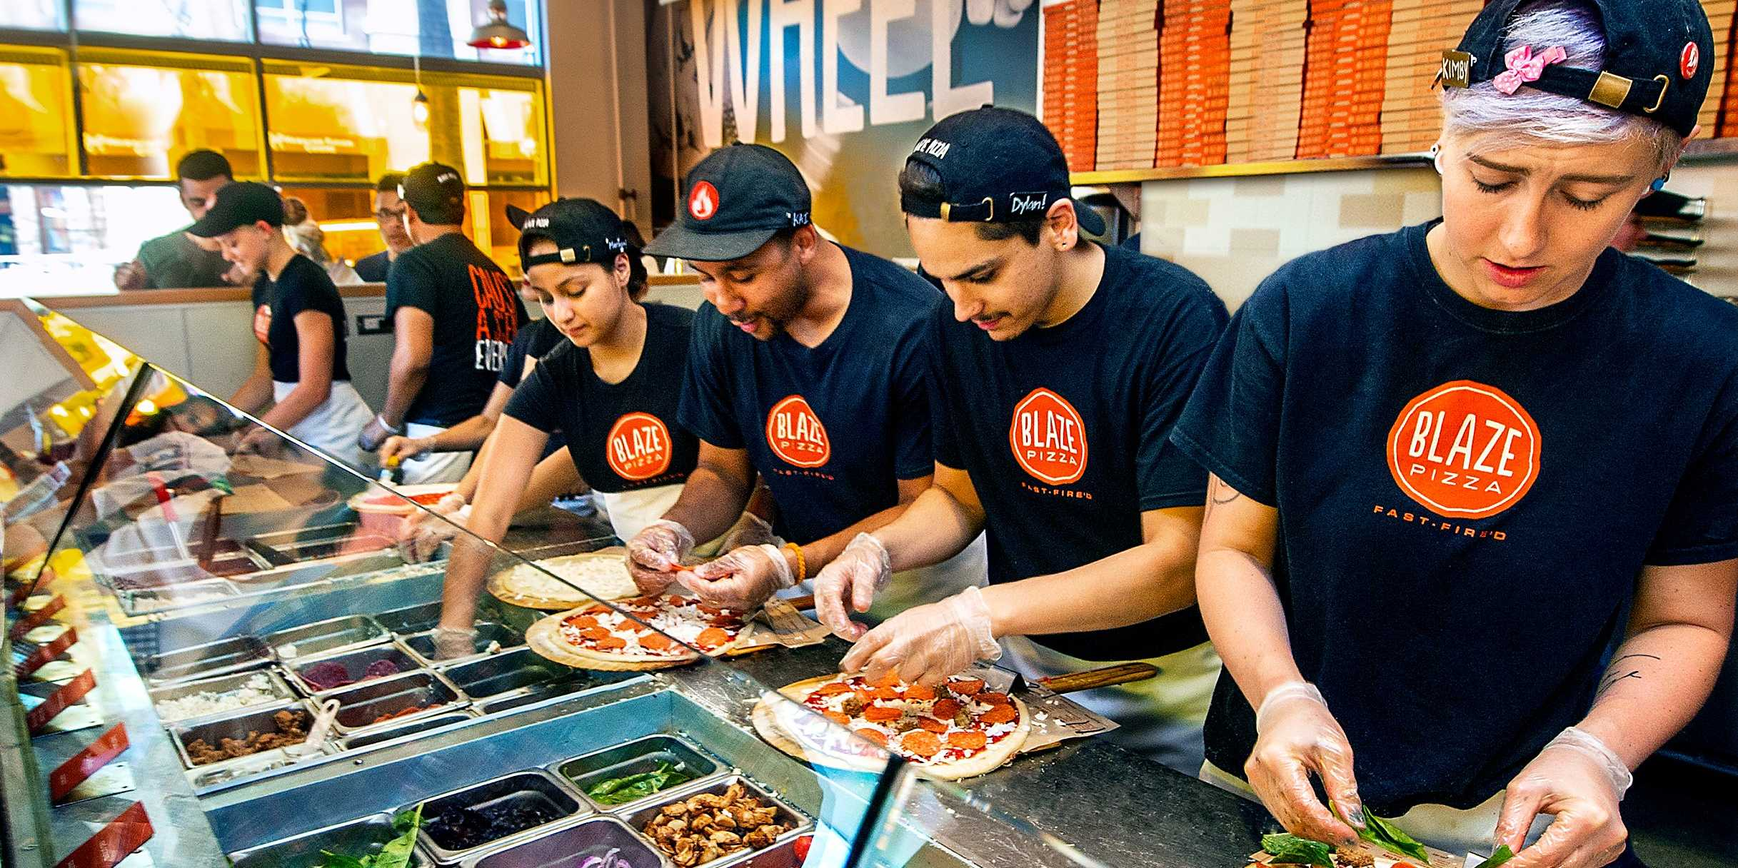
Fast Casual

Slide 6
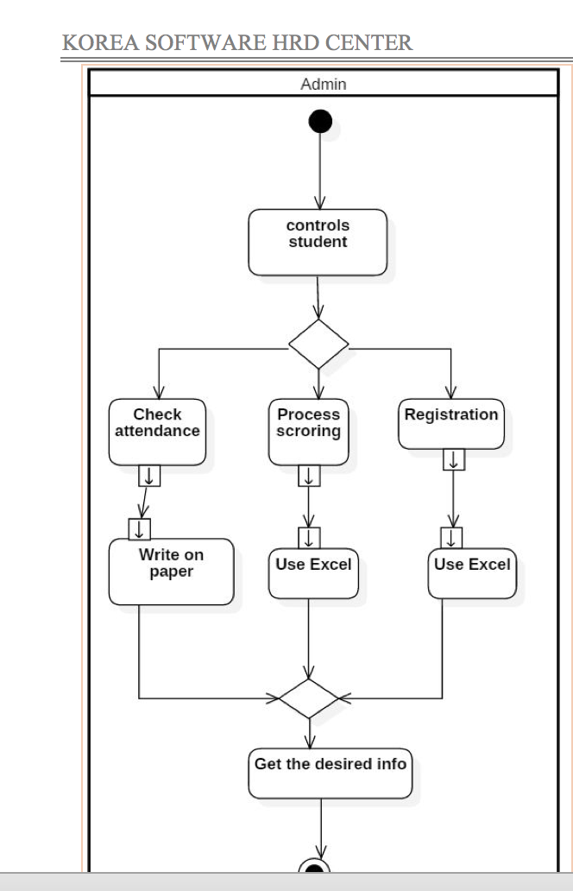
What does it mean

Slide 7
Visitor
Want to get restaurant and
food information
Check restaurant menu Webpage
Get information they needed

Slide 8
Normal Member
Want to order product
Check restaurant menu Webpage
Check restaurant owner page
Order the product

Slide 9
Restaurant Owner
Create their own page
Post their product
Manage order
Manage their page
Get desire Information

Slide 10
Admin
Manage Restaurant Owner
Manage Normal Member
Manage Visitor
Get desire information

Slide 11
Visitor
View food & Restaurant
Search food or Restaurant
Save Location or Food
Manage User
Send Feedback
Admin
Normal member
Manage Restaurant Location
Order products
Login
Create Page
Manage & Update Database
Restaurant Owner
Post their Product
Manage notification
Manage their product

