Slide 1
Taming the Python
Python Workshop organized by Computer Society of India, NITC Chapter

Slide 2

Govind Maheswaran
www.thegovind.com
govind_m120432cs@nitc.ac.in
facebook.com/govindmaheswaran
twitter.com/RestlessMystic
github.com/RestlessMystic

Slide 3

What..?
A programming language with the following properties
Multi Paradigm
Dynamic
Script

Slide 4

Who..? When..? Where..?
Started as a weekend hobby Project
At “Centrum Wiskunde & Informatica”
Inception : 1980’s
Based on ABC
Initial Major Release 1991
Guido van Rossum
Benevolent Dictator For Life

Slide 5
Why..?
Bloody Simple
Easy to Learn
More Readable
Enormous Extension Options
Powerful
Platform-agnostic

Slide 6
How..?

Slide 7
http://github.com/RestlessMystic/TamingthePython

Slide 8
2 modes of execution
Interpreter mode
Type in python command into the python interpreter
Script mode
Use the text editor of your choice to write python script
Save it
Run the script in the python interpreter.
prog01.py

Slide 9
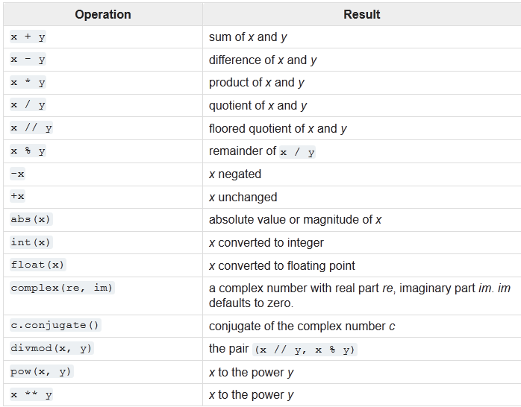
Going Further
Simple arithmetic operations
Simple Variable operations
Simple Input/output operations
prog02a.py, prog02b.py, prog02c.py

Slide 10
Control Flow
Conditional Control Flow
If-Then-Else
Iterative Control Flow
while
for
in Python, loops have else part.
break and continue
prog03
Let’s make a calculator now
prog04
Let’s make a BETTER calculator now

Slide 11
Let’s get Coding….
Express a number in abcd in the form a*1000 + b*100 + c*10 + d.
Write a program to find the number of solutions of a quadratic equation.
Covert a number to corresponding Roman Numeral.

Slide 13
Some Interesting Data Structures
STRING
String
‘abcd’, “abcd” or “““ abcd ”””
immutable
lots of powerful functions
capitalize()
encode()
find(sub, start, end) in isalpha()
isdecimal()
join()
split()

Slide 14
List
Similar to Array
[ ]
Index by number
Lot of functions to explore
list ( (1,2,3))
sort()
append()
in
extend()
count()
reverse()
del()

Slide 15
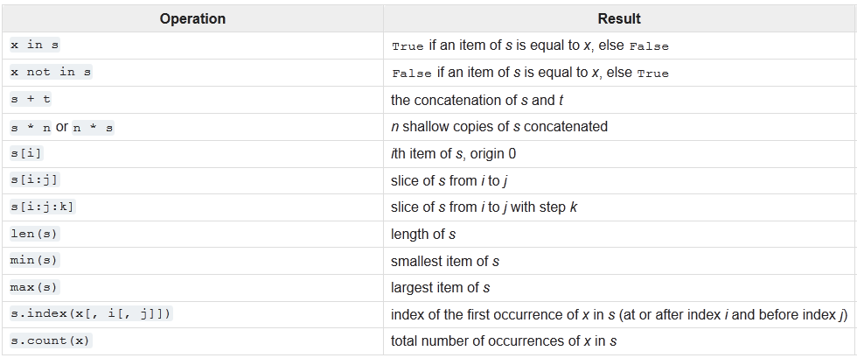

Slide 16
Tuple
Similar to list, BUY
immutable
heterogeneous

Slide 17
Sets
Sets in Maths
No duplicates
Useful in certain cases

Slide 18
Dictionary
Name : Telephone number
{ }

Slide 19
Functions
Named set of instructions
def keyword is used to define function
arguments, return value

Slide 20
Modules
The real power of python
set of functions and variables grouped together
import <name>, from <name> import <functionname>, from <name> import *

