Slide 1
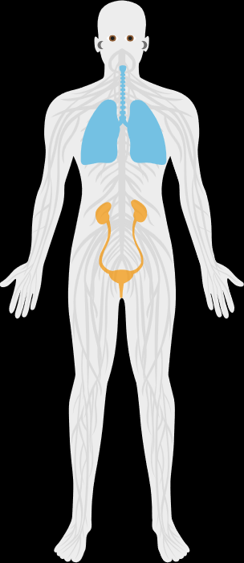
The disease is a rare, progressive disorder and can be life threatening¹
Rare
Progressive
The disease affects 4 in 10,000 people, meeting the definition of a rare disease¹
The disease is a progressive disorder that mainly impacts the respiratory organs and can be life threatening ^{1,2}
Prevalence:
Characteristics of progressive disease:^{1,2,6}
30–150
per million³
Impact on respiratory tract
Annual incidence rates:
2.8–16.4
per million³
Thickening of lung tissue
1. Jones et al 2022: Smith et al 2020 Rheum Dis 2019;

