Slide 1

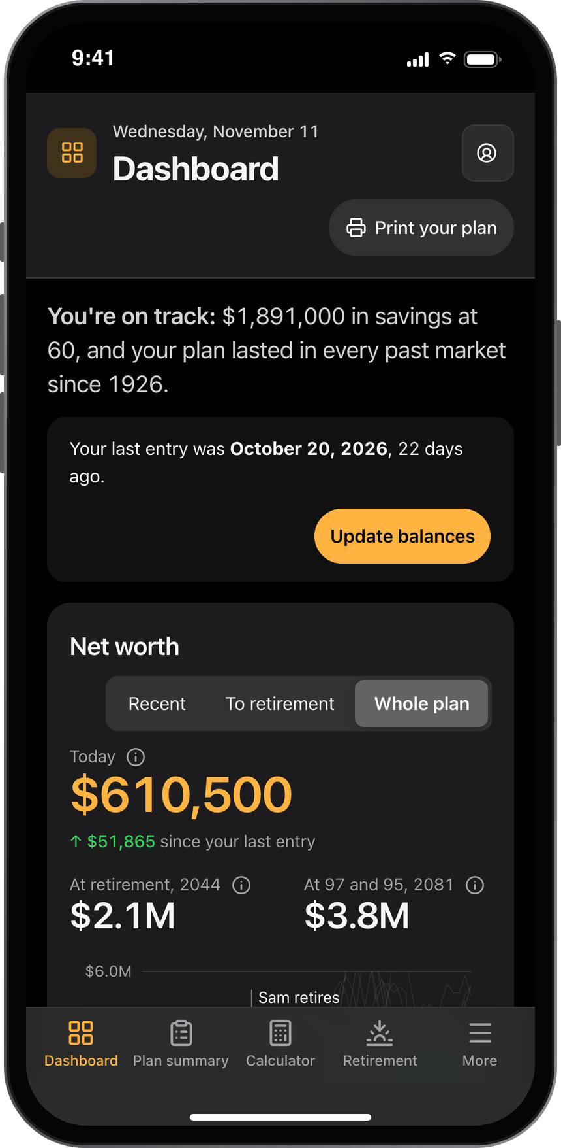
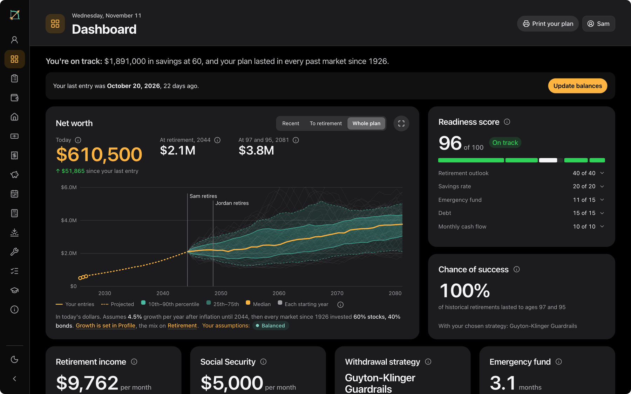
RetCalc
MY DASHBOARD
One place for your money
and your retirement plan.
A free personal financial hub: net worth, pay, taxes, spending, saving and retirement, worked out from one profile and tested against every market since 1926.
Free account
No bank logins
No ads
retcalc.app/dashboard
Notes:
This is My Dashboard, the part of RetCalc that keeps a household's whole financial picture in one place. You set it up once from one profile, and every tab, from net worth to retirement, is worked out from it. It needs a free account, there are no bank logins and no ads. Everything you will see is a made-up household: Sam, 42, and Jordan, 40, with a daughter, Nora, in Illinois.

Slide 2
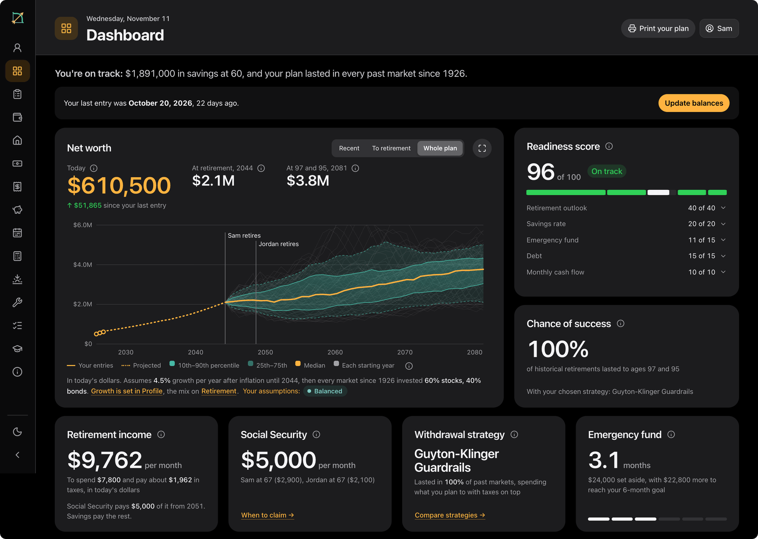
Your whole picture, in one place
WHAT IT IS
Net worth, pay, taxes, spending, saving and retirement, kept together and worked out from one profile. You come back each month or quarter, update your balances and see where you stand.
WHO IT'S FOR
One person, or a couple planning together
Anyone who wants every account in one view
Anyone who would rather not link a bank
15
14
$0
The Dashboard tab for the sample household, Sam and Jordan
tabs, one profile
tools inside it
free account
Notes:
The Dashboard is for people who want their money in one place rather than one calculator at a time. Setup asks a few questions, and from then on you visit each month or quarter: update balances, see what moved. This is the home tab for the sample household: on track, about $1.9 million at Sam's retirement in 2044, a readiness score of 96 and a plan that lasted in every past market since 1926.

Slide 3
One profile behind every tab
HOW IT FITS TOGETHER
Dashboard
where you stand
Plan summary
the whole plan
Net worth
balances by date
Your home
Mortgage Calculator
Set once
Each figure is set in one place. Other tabs show it as a fact with a link to where it's set, so two tabs can't disagree.
The report
Print your plan
Your profile
Income
Social Security pay history
Household and ages · where you live · pay · savings and accounts · spending · home · children · assumptions · Social Security · strategy · changes ahead
One change, every tab
Learn
your numbers in lessons
Spending
the Budget
Change a retirement age on Profile and the net worth chart, the chance of success and the next steps all move.
Next steps
ranked by effect
+ your dated balances from Net worth
Taxes & Savings
the Paycheck tab
Tools on your numbers
Tabs outlined in amber run one of RetCalc's tools on your plan. What you change there is saved to it.
Tools
all 14, filled in
Retirement
Drawdown Simulator
Calculator
Advanced Calculator
Year by year
every year ahead
Notes:
Everything on the Dashboard is worked out from one profile: the household, pay, savings, spending, home, children and assumptions, plus the dated balances from Net worth. Every tab reads it, and so does the printable report. A figure is typed in one place only; anywhere else it appears as a fact with a link back, so the tabs never disagree. Six tabs, outlined in amber, run one of the site's own tools on your numbers: the Mortgage Calculator, the Budget and its Paycheck tab, the Social Security pay history, the Advanced Calculator, and the Drawdown Simulator with the Bridge and the Healthcare Cost Planner.

Slide 4



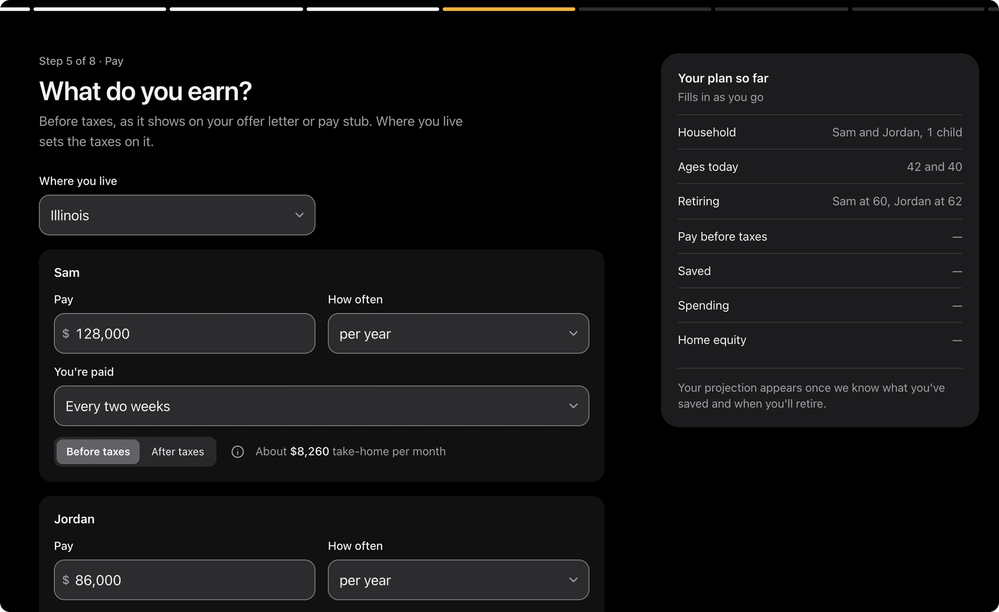
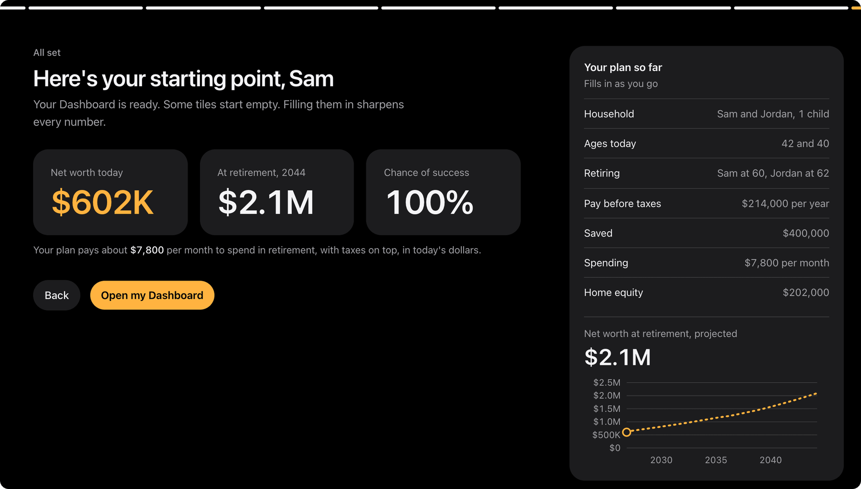
Set up in up to eight short steps
GETTING STARTED
1 Household
2 About you
3 Children
4 Retirement
5 Pay
6 Savings
7 Spending
8 Home
Saved as it's typed
Leave partway with Save and finish later.
Skip anything
The Dashboard asks for it later, on Profile.
Birth month and year
Not ages, so every age stays right.
Step 5: pay, with "Your plan so far" filling in beside it
The finish: your starting point
Notes:
Setup is a full-screen walk through up to eight steps: who the plan is for, birth months and years, children, retirement ages, pay, savings, spending and the home. The children step drops out when there are none. Every answer is saved as it is typed and any step can be skipped. Beside the questions, "Your plan so far" fills in as you go, and the finish screen gives a starting point: net worth today, savings at retirement and the chance of success.

Slide 5
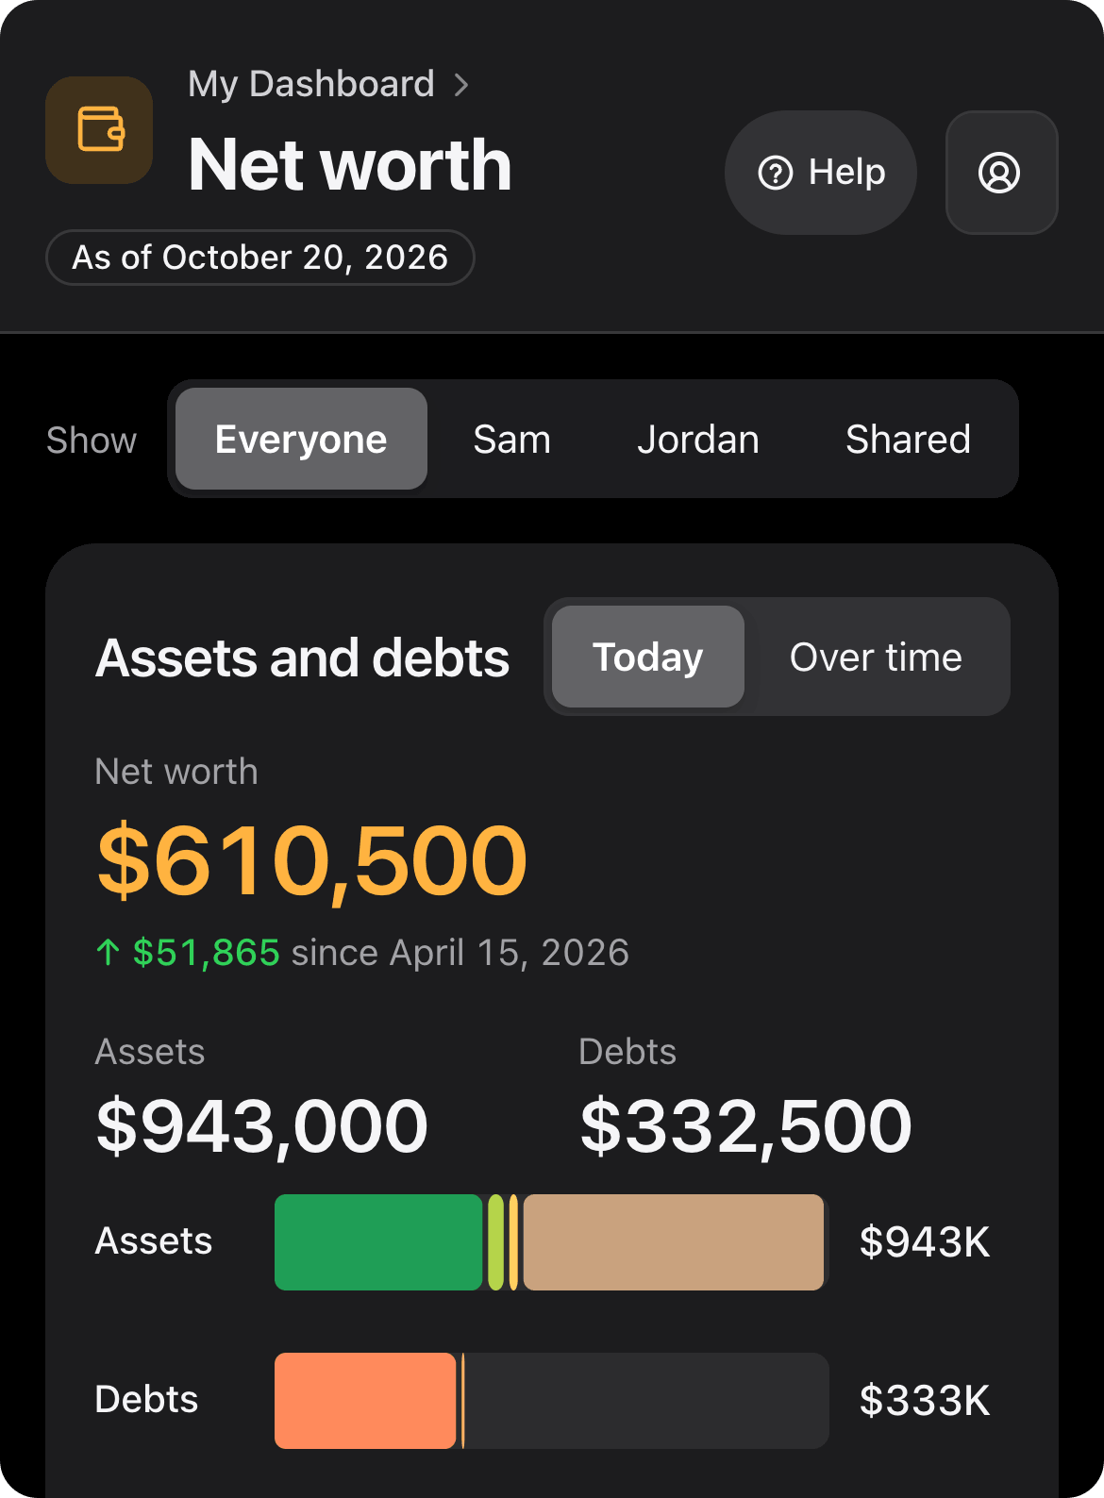
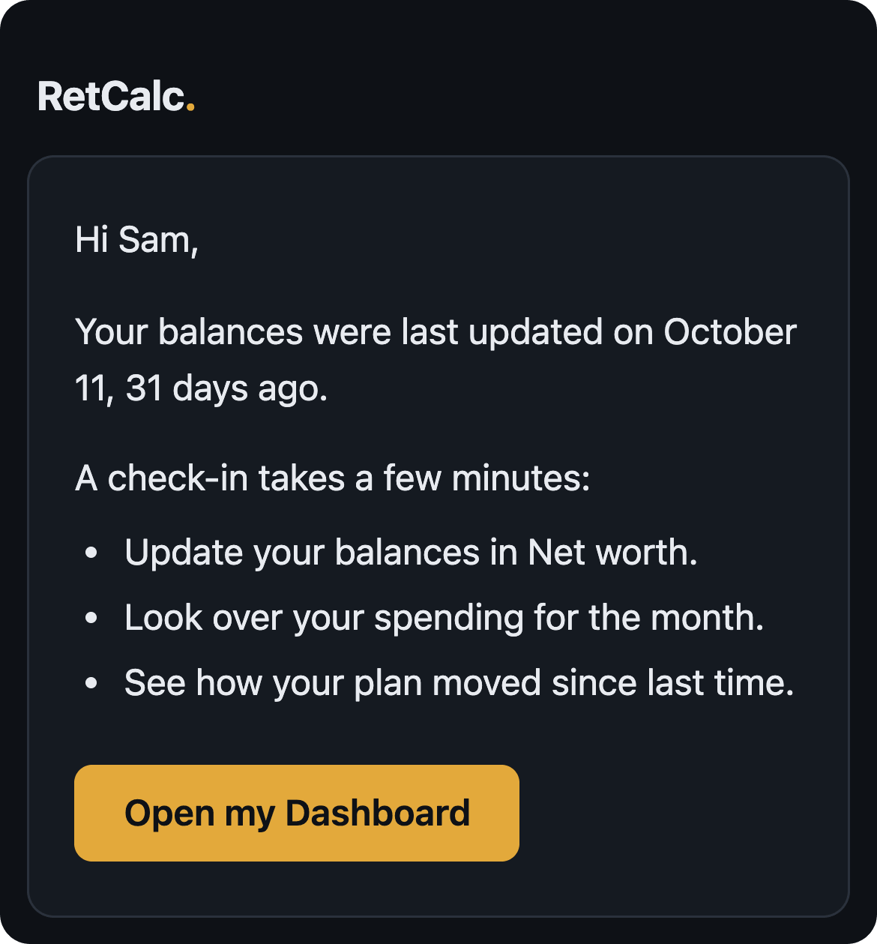
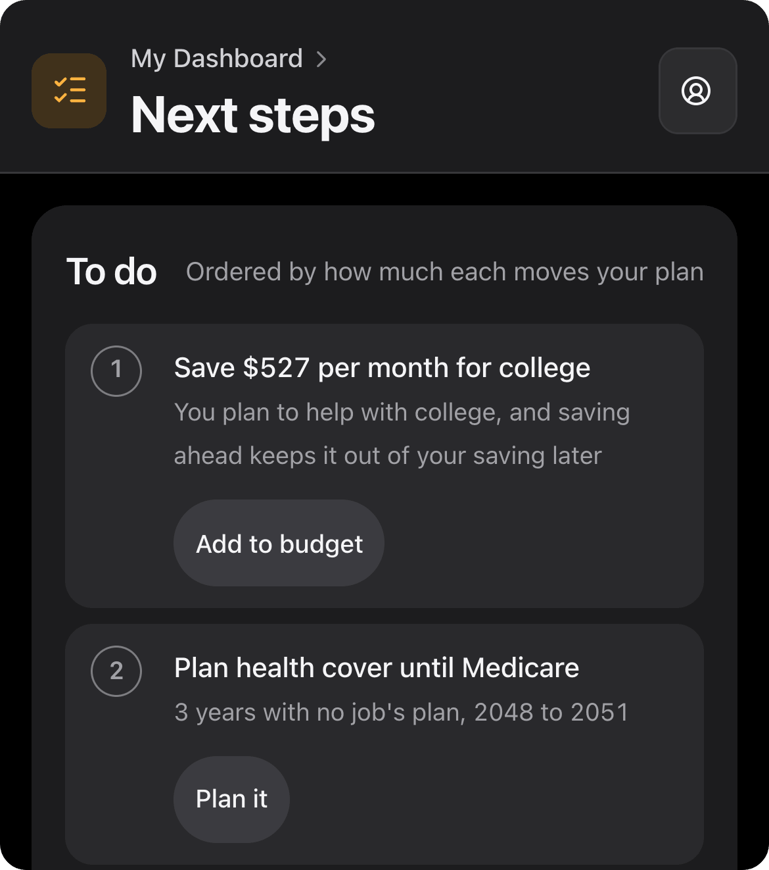
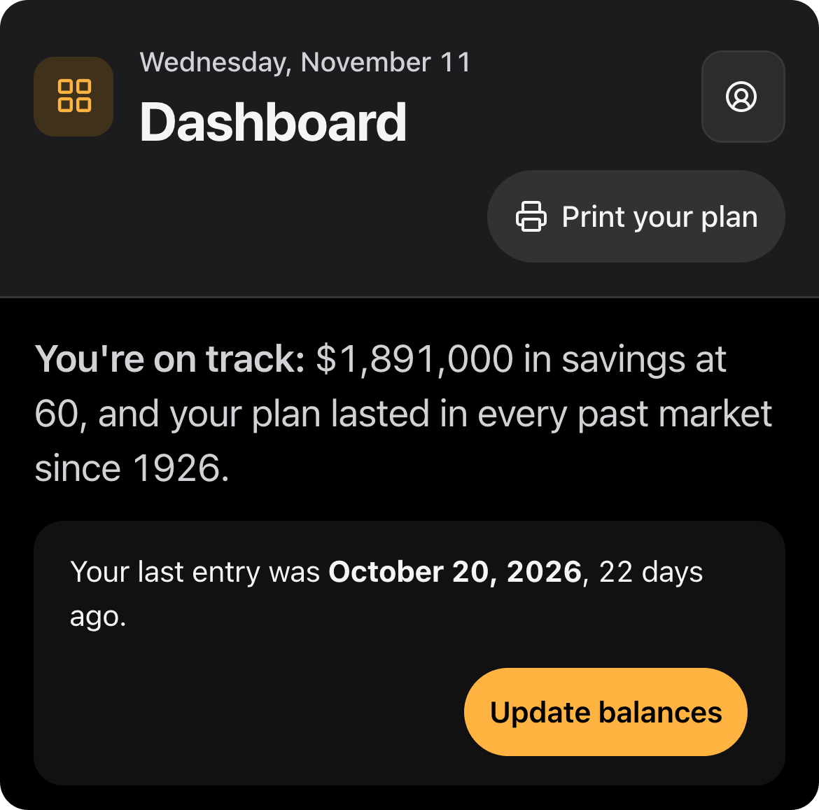
A month in the life of a plan
HOW PEOPLE USE IT
1
2
3
4
The check-in email
Update balances
See where you stand
Take the next step
Arrives only when your balances are 30 or more days old. No figures in it, just a nudge and a link.
Type today's balances on Net worth. Each save adds a dated point to your net worth line.
The plan reruns from the new entry: savings at retirement, readiness, the chance of success.
Next steps are ordered by how much each moves your plan, with a button to the tab that does it.
Notes:
The Dashboard is built to be revisited, and it works the same on a phone, as here. When your balances are a month old, a short check-in email arrives. It never carries figures: those are only ever worked out in your browser. You open Net worth, press Update balances and type today's numbers. The plan reruns from that entry, so the home tab shows where you stand, and Next steps lists what to do, ordered by how much each would move the plan.

Slide 6
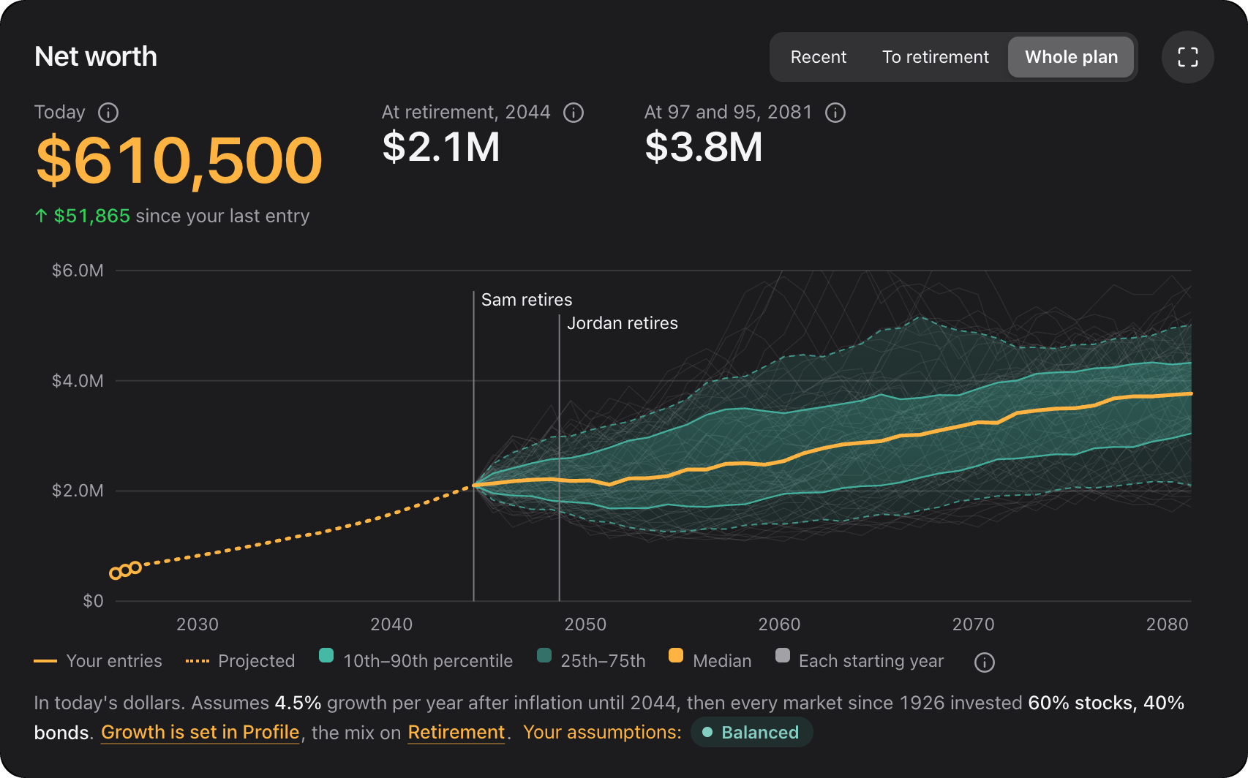
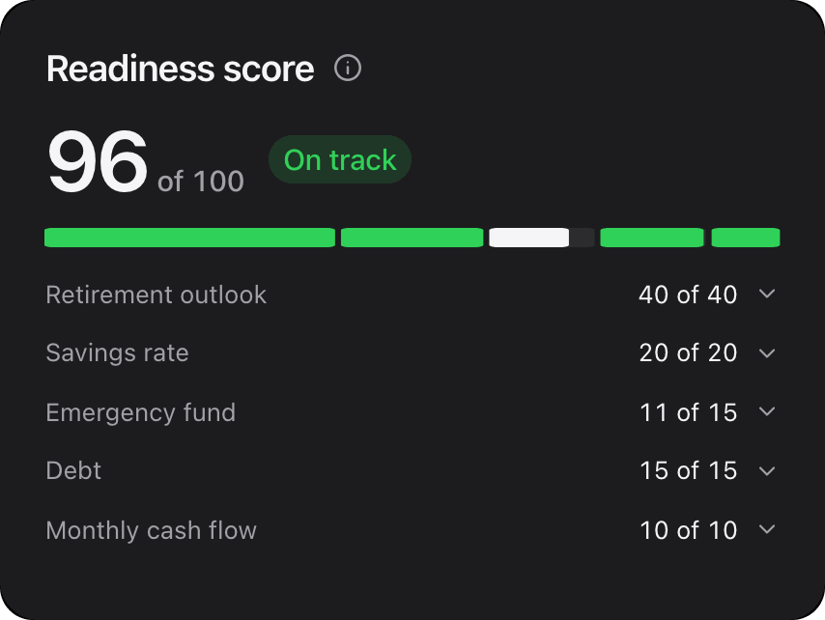
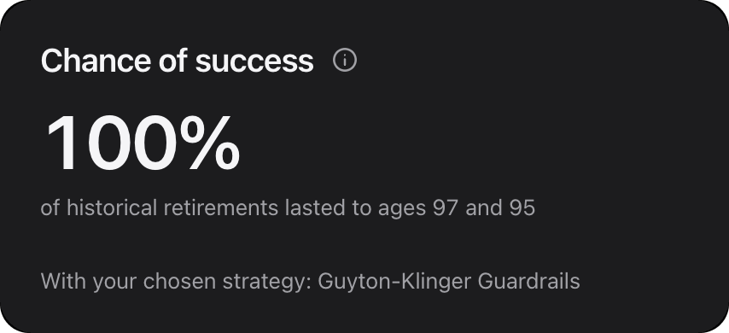
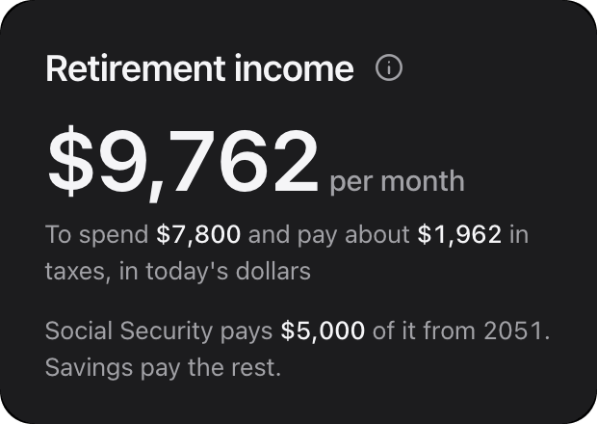
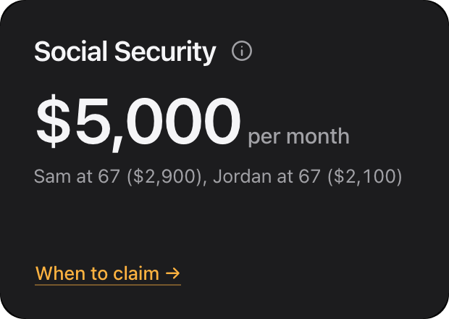
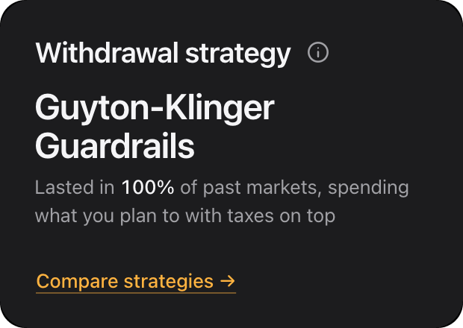
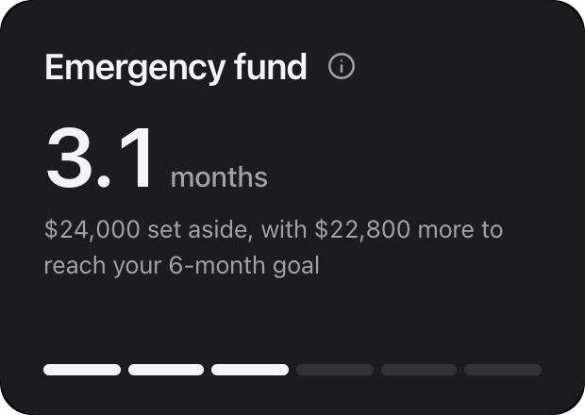
Dashboard
TAB BY TAB · DASHBOARD
Where do we stand today?
A one-line answer
"You're on track", or "Not there yet" with the first fix: save more, retire later or spend less.
Net worth, past and ahead
Your dated entries, the projection to retirement, then every market since 1926 after it.
Readiness and chance of success
A score out of 100 across five areas, and the share of past retirements that lasted.
Retirement income, at a glance
Income per month, Social Security, your withdrawal strategy and the emergency fund.
Notes:
The home tab answers the first question in one line. For the sample it reads: you're on track, $1,891,000 in savings at 60, and the plan lasted in every past market since 1926. The net worth chart joins the entries you have typed to the projection, and from retirement on it shows the Retirement tab's own run through history, with a band for the middle eight in ten markets. Readiness is 96 of 100; the chance of success is 100%. Empty tiles are dashed and offer the one action that fills them.

Slide 7
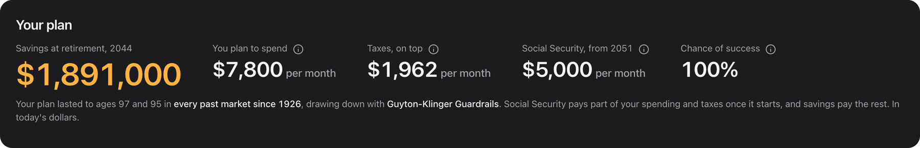
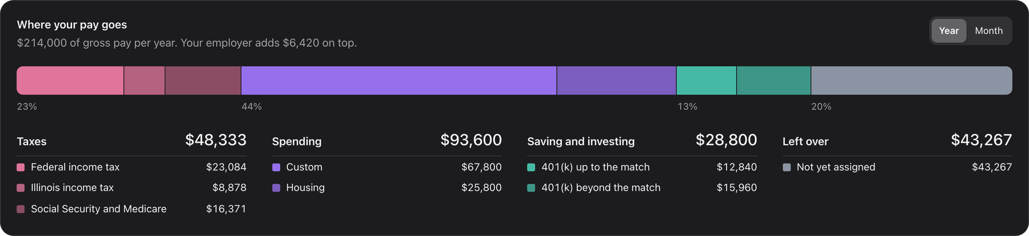
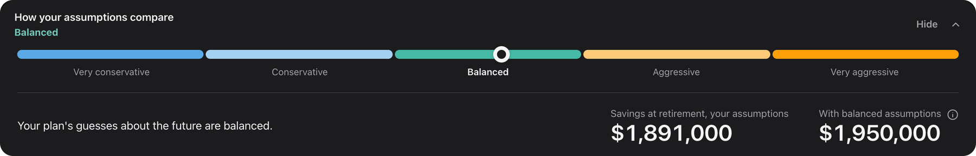
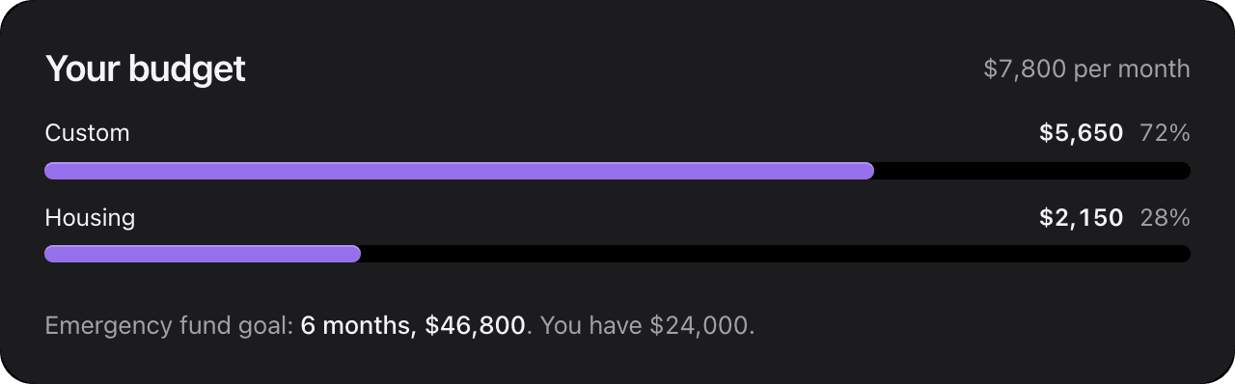
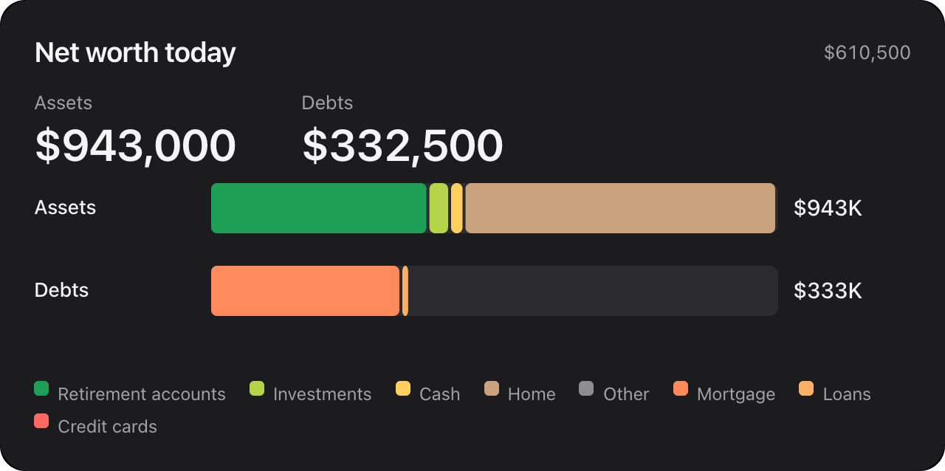
Plan summary
TAB BY TAB · PLAN SUMMARY
What does the whole plan add up to?
Your plan in one row
Savings at retirement, what you plan to spend, taxes on top, Social Security and the chance of success.
Where your pay goes
Gross pay split into taxes, spending and saving, per year or per month.
How your assumptions compare
Your guesses about the future rated from very conservative to very aggressive.
The rest, folded
Saving to retirement, what the children cost, readiness and the timeline open in place.
Notes:
Plan summary is the plan on one page. For the sample: $1,891,000 at retirement in 2044, $7,800 per month to spend with $1,962 per month of taxes on top, Social Security of $5,000 per month from 2051, and a 100% chance of success. The assumption rating sits here too, and Print your plan in the title bar turns the whole Dashboard into a report.

Slide 8
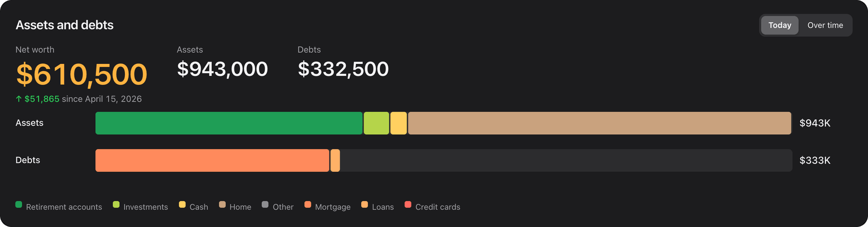
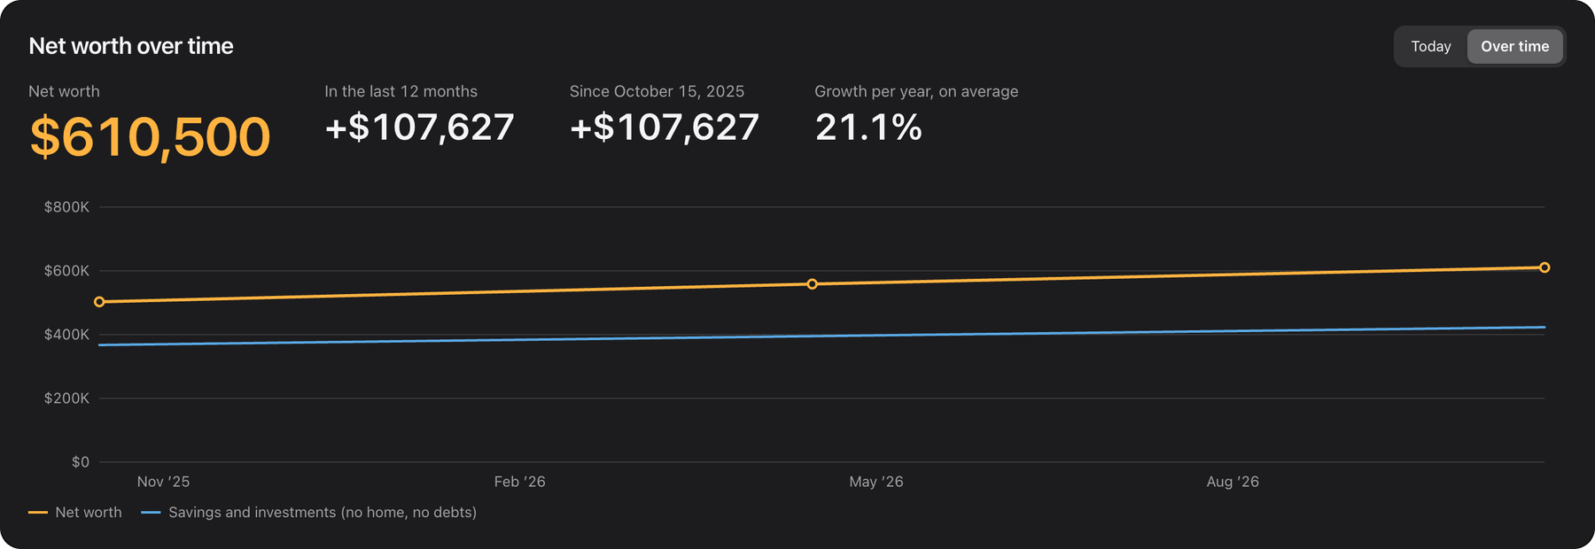
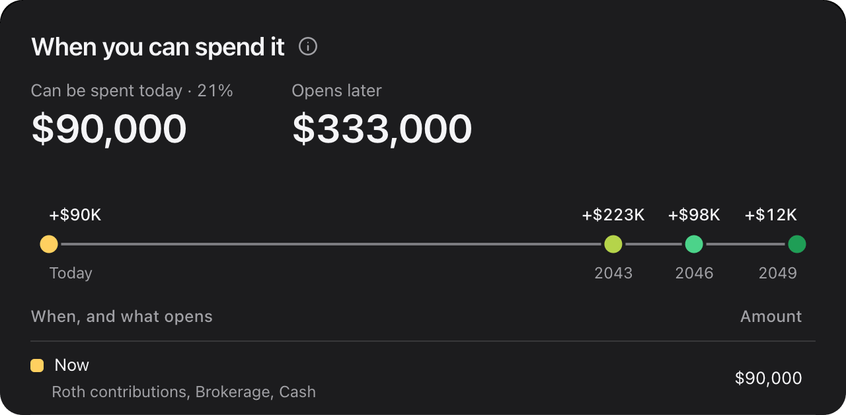
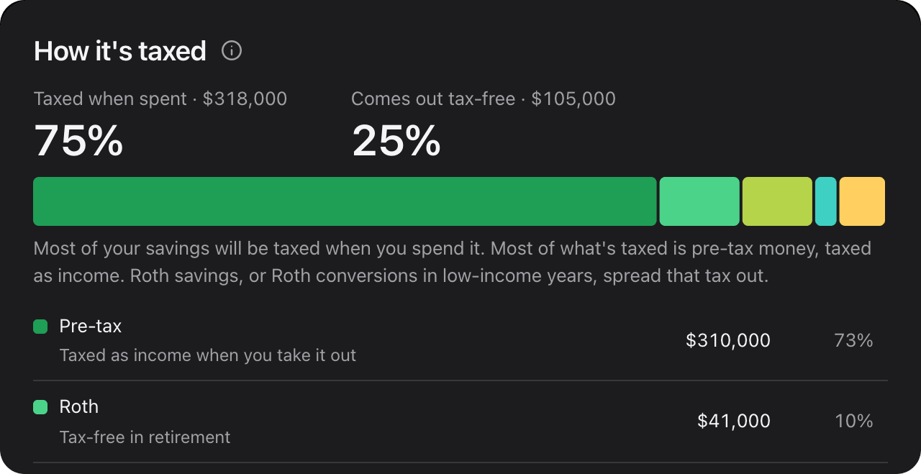
Net worth
TAB BY TAB · NET WORTH
What do we own, what do we owe, and how is it moving?
Balances by date
Update balances saves a dated entry. The plan always starts from the latest one.
9 kinds of assets, 5 of debts
From 401(k)s, Roth IRAs and HSAs to the home, car loans and credit cards.
Whose it is
Couples filter every picture by Everyone, either name, or Shared.
When you can spend it
Which dollars are free of the 10% penalty now, at 59½ or at 65, and how each is taxed.
Notes:
Net worth is read-only until you press Update balances. Then you type each balance, pick the date, and save a new entry; one entry per day. The sample shows $610,500 today: $943,000 of assets and $332,500 of debts, up $51,865 since the last entry. Over time draws the line through every entry. Two tips explain which dollars you can spend without the 10% penalty, and when, and how much of it will be taxed when spent.

Slide 9
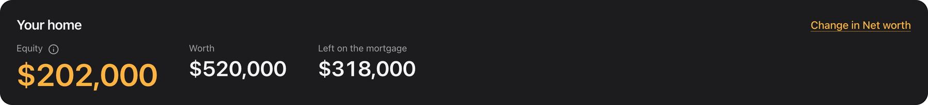
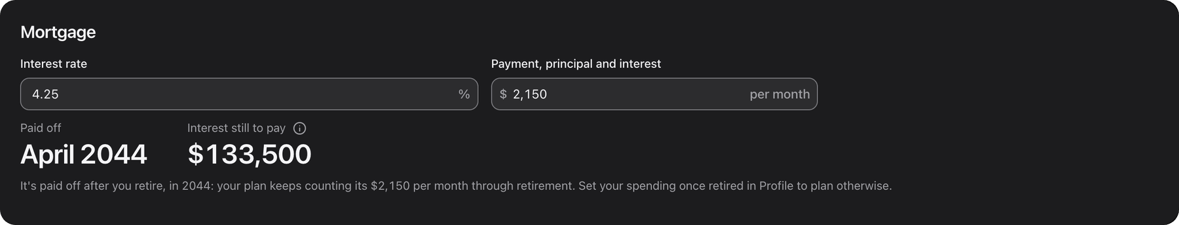

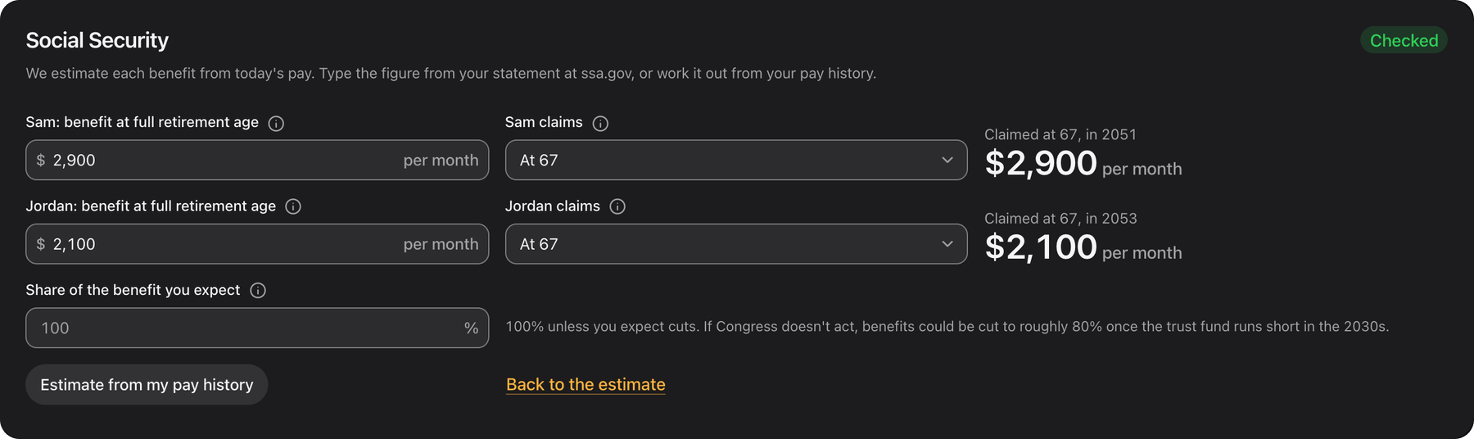
Your home and Income
TAB BY TAB · HOME, INCOME
What does the house cost, and what is coming in?
The home and its mortgage
Equity, the payoff date and interest still to pay, with the Mortgage Calculator on your own loan. Renters get Rent vs. Buy on their rent.
Pay and the match
Each person's pay, the employer 401(k) match and any other income.
Social Security
Estimated, typed from your statement or built from your pay history; claim at 62 to 70.
Notes:
Your home depends on whether you own or rent. Owners see equity, the mortgage and what owning costs: the Mortgage Calculator on their own loan, where property tax, insurance and upkeep become the budget's housing lines. The sample home is worth $520,000 with $318,000 left, paid off in April 2044. Income lists pay, the employer match and other income, and Social Security, where the claiming ages here are shared with the Retirement tab.

Slide 10
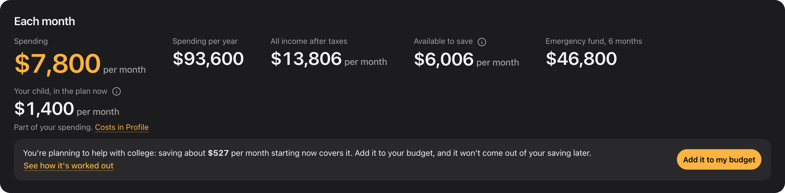
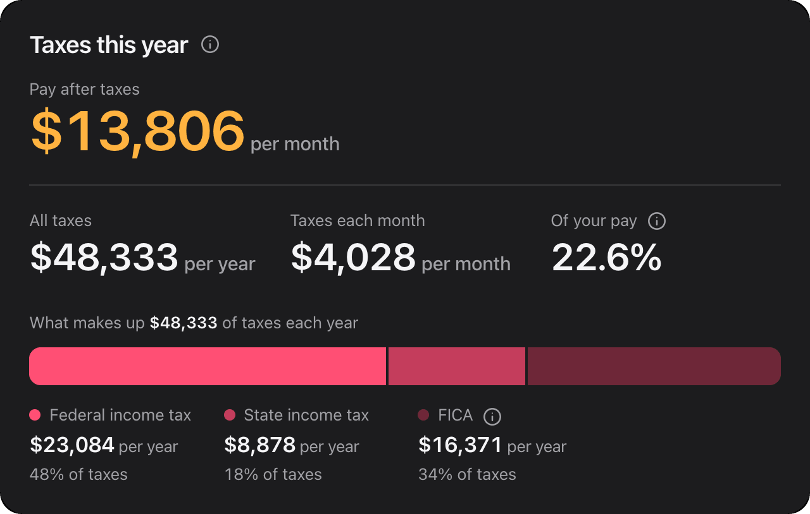
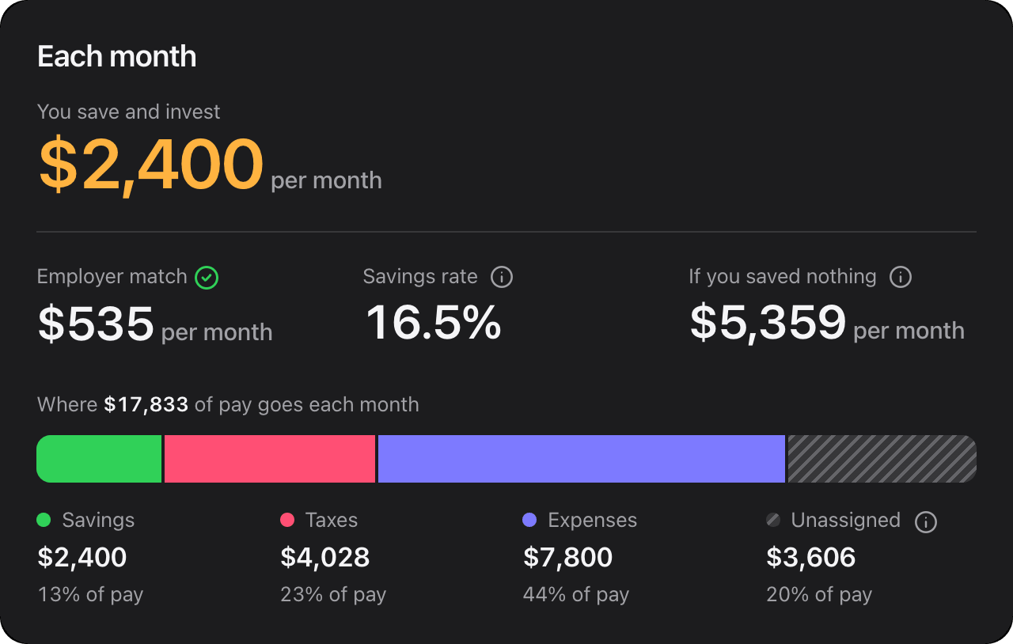
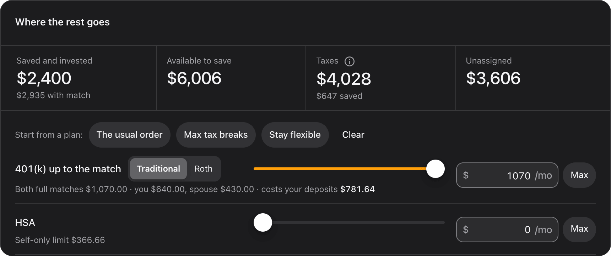
Spending, taxes and saving
SPENDING · TAXES & SAVINGS
Where does each paycheck go?
A budget that is the plan
The Budget tool's total is spending on every tab, with an emergency fund sized on it.
Taxes this year
Federal, state, local where there is one, and FICA, for all 50 states and DC.
Where the rest goes
Sliders for the 401(k) match, HSA, IRA, more 401(k) and brokerage, with three starting plans.
Taxes move as you save
Pre-tax lines lower the taxes above them as the sliders move.
Notes:
Spending hosts the Budget tool. Its total is the spending figure everywhere on the Dashboard: $7,800 per month for the sample. Taxes & Savings hosts the Budget's Paycheck tab, the household's one tax calculator: $48,333 of taxes per year, 22.6% of pay. Below it, where the rest goes: the 401(k) up to the match, an HSA, an IRA and brokerage, each a slider with Max, and three plans to start from: the usual order, max tax breaks, or stay flexible.

Slide 11
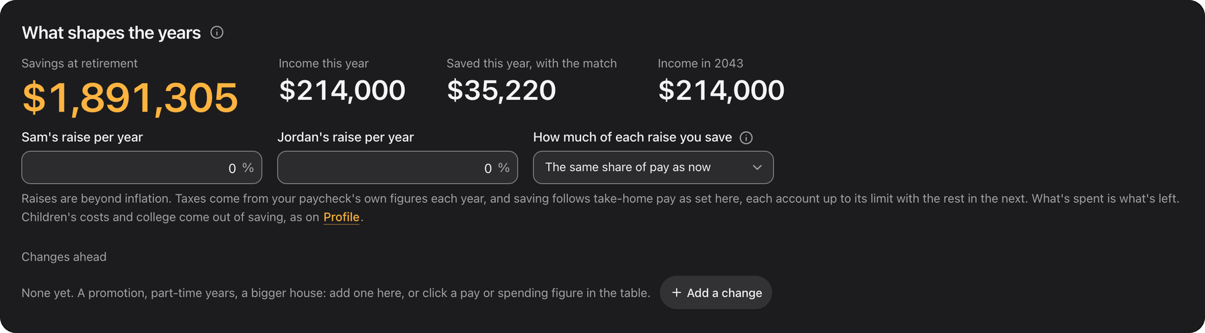
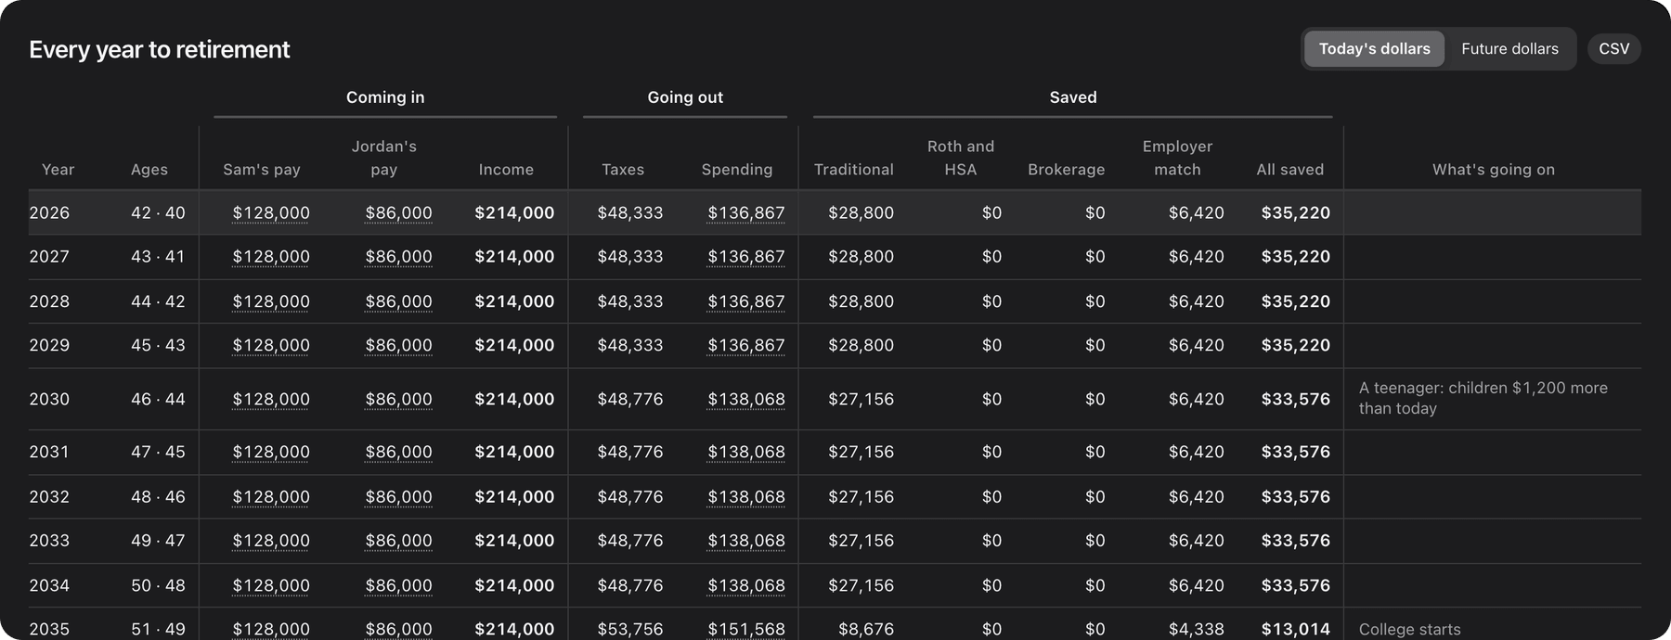
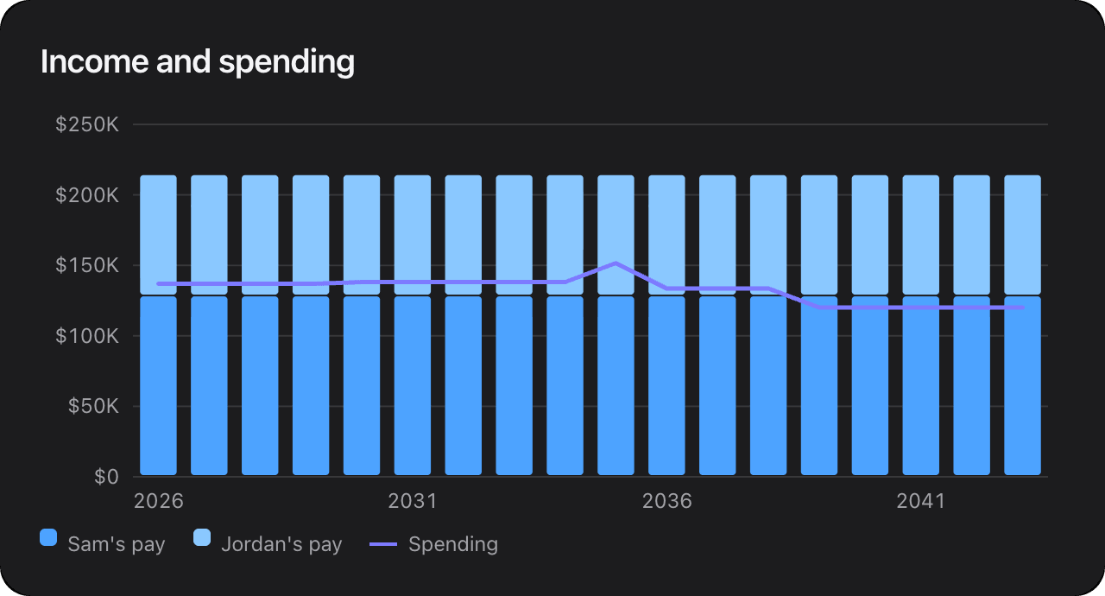
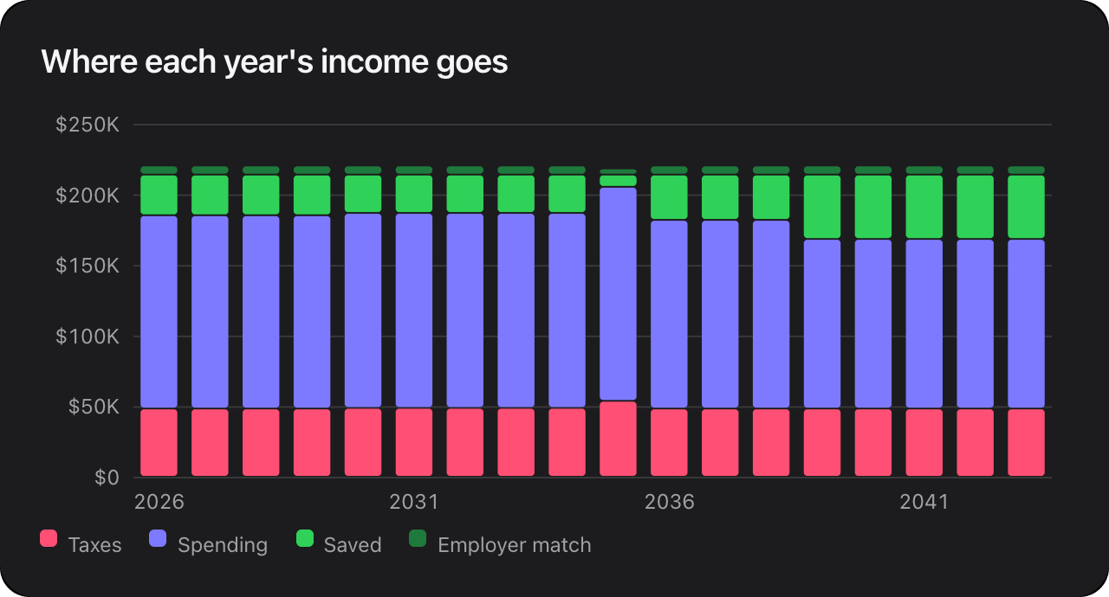
Year by year
TAB BY TAB · YEAR BY YEAR
What happens in each year between now and retirement?
Raises, and how much you keep
A raise beyond inflation for each of you, and how much of each raise you save.
Type your own figure
Click any pay or spending figure to set it for one year or until retirement.
Changes ahead
Pay changes, spending more or less, saving less: switch each on or off.
Today's dollars or future dollars
One switch for the whole table, with a CSV download.
Notes:
Year by year is the engine room. Every year to retirement has its pay, taxes from the paycheck calculator, spending, and saving by account up to each account's limit. The plan's savings at retirement on every tab are built from these years: $1,891,305 for the sample. You can type your own figure for any year, set raises, and add changes ahead.

Slide 12
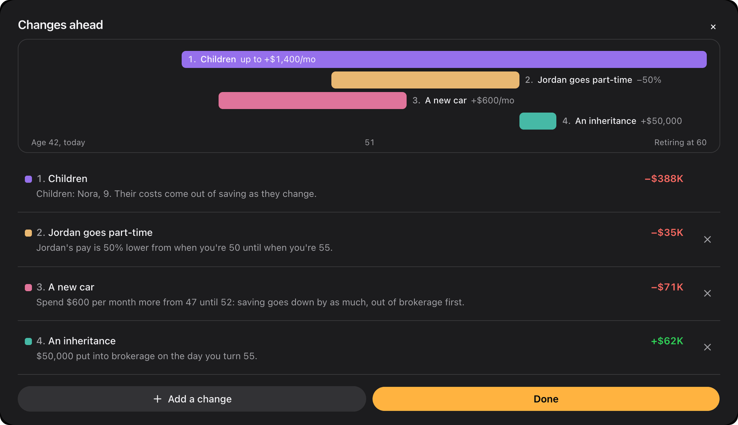
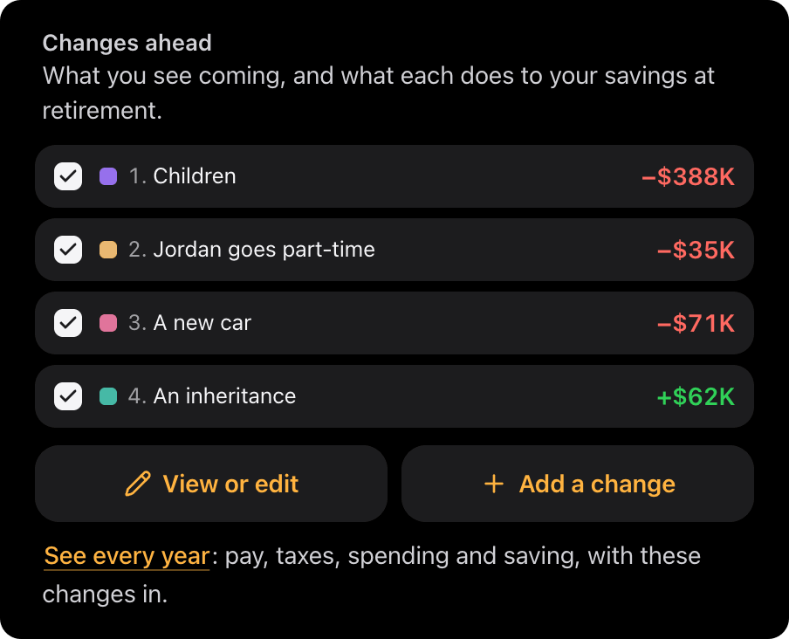
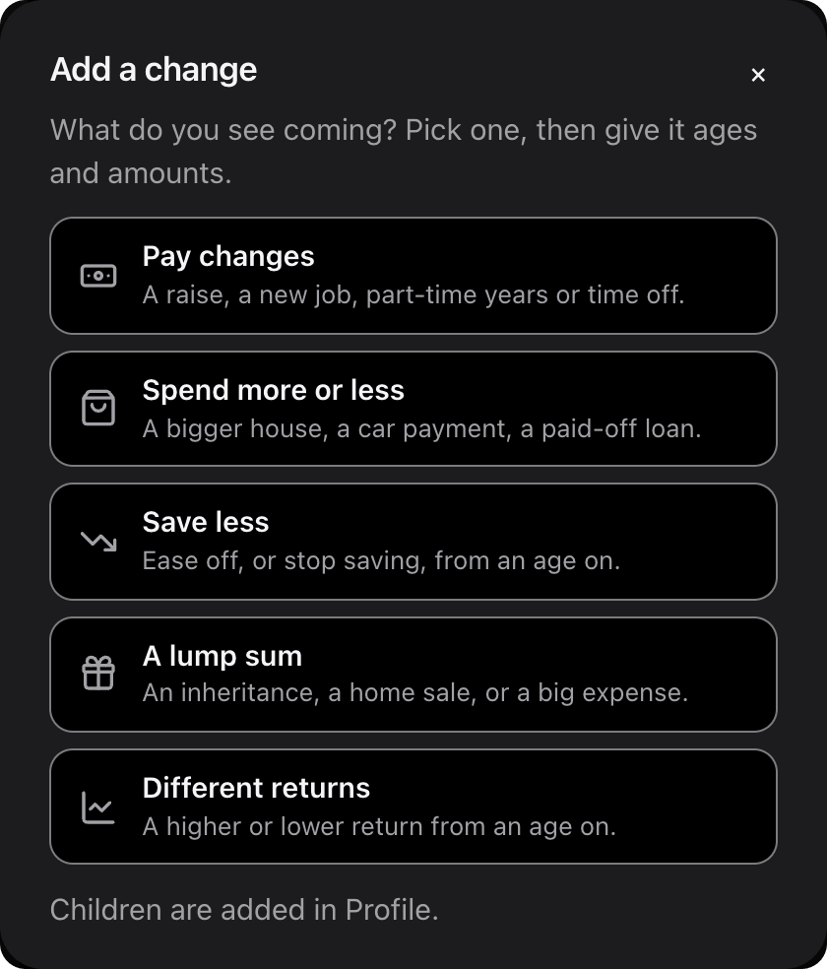
Calculator and changes ahead
TAB BY TAB · CALCULATOR
What will we have, with the changes we see coming?
Five kinds of change
Pay, spending, saving less, a lump sum and different returns, each in plain words with ages.
The effect of each
Every change shows what it does to savings at retirement, and switches off without deleting.
When you could stop saving
The earliest age you could stop and still reach your target, one click to add.
Tested three ways
A rate band, every historical window since 1926, or 5,000 Monte Carlo runs.
The sample with three changes added: part-time years, a car, an inheritance
Notes:
The Calculator is the Advanced Calculator, run on the plan. Changes ahead is where you write down what you see coming. Here the sample has three: Jordan going part-time from 50 to 55, a new car at 47, and a $50,000 inheritance at 55. Each row shows its effect on savings at retirement; the children's row is there because the profile has a child. All of them follow through every tab, and any can be switched off to compare.

Slide 13
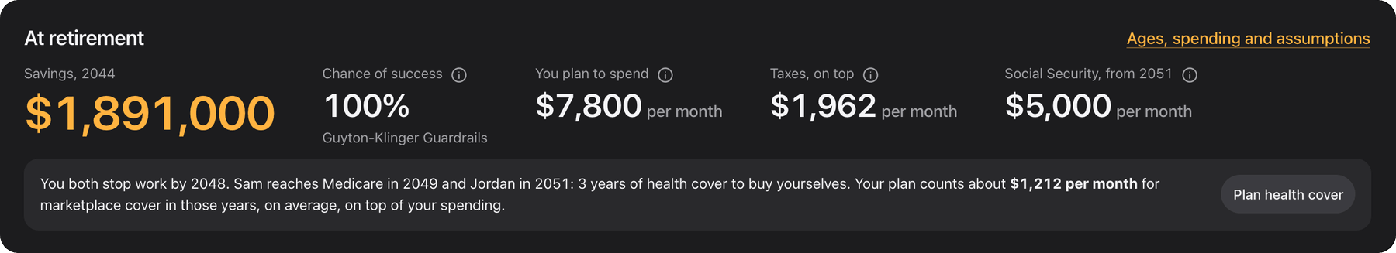
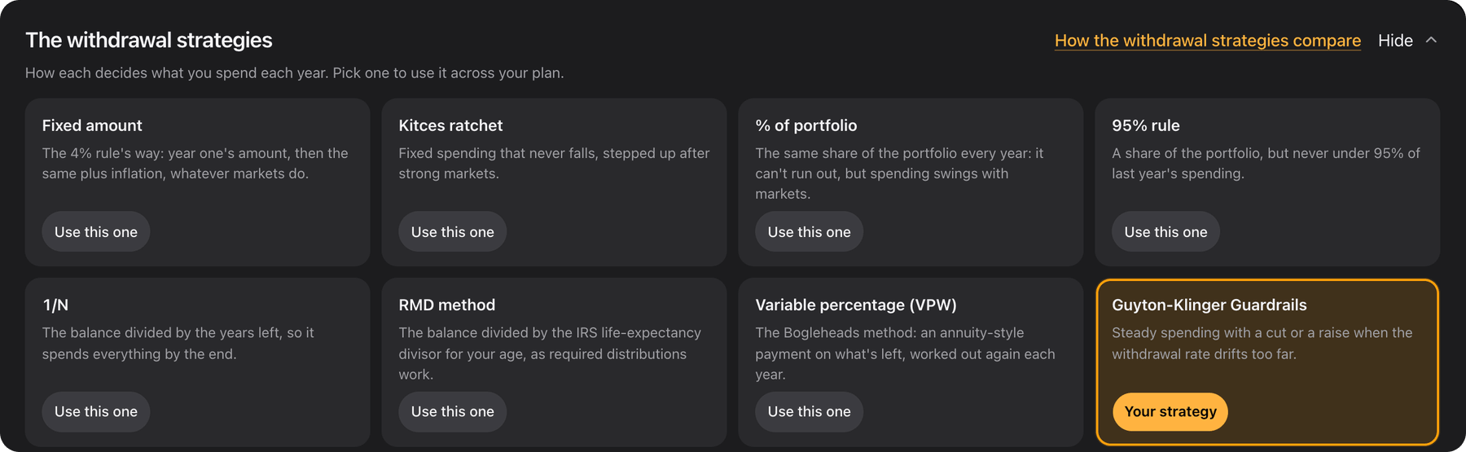
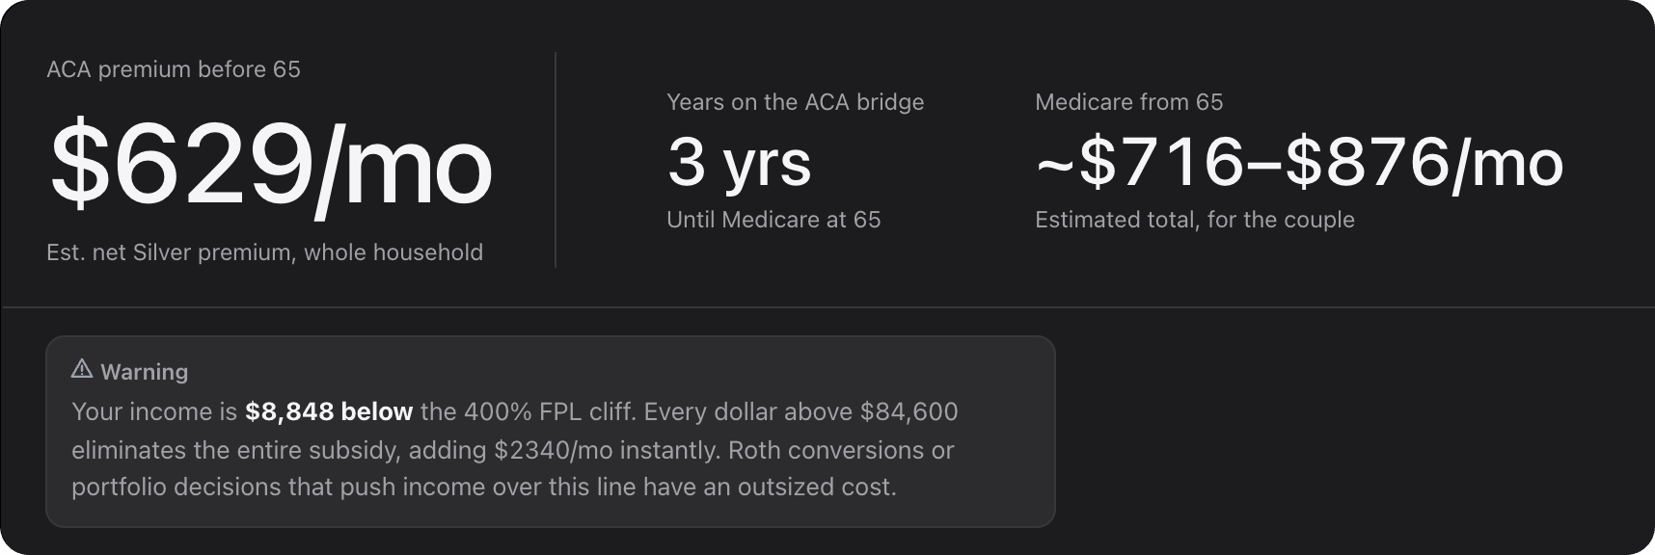
Retirement
TAB BY TAB · RETIREMENT
Will it last, and how do we get there?
15 withdrawal strategies
Each with a one-line blurb and Use this one. Your choice is the plan's chance of success.
The Drawdown Simulator, on your plan
Savings, ages and Social Security come in as facts; the mix and strategy settings are saved.
Three views
Drawdown, Bridge to 59½ when someone retires early, and Health cover until Medicare.
The years before 65
ACA premiums before Medicare, then Part B, Part D and IRMAA after.
Notes:
Retirement opens with the plan at retirement, then a switch between three views. Drawdown is the Drawdown Simulator on the plan, with all 15 strategies one click away; the sample uses Guyton-Klinger Guardrails. Bridge to 59½ appears when someone retires before 59½. Health cover runs the Healthcare Cost Planner: the sample stops work in 2048 and needs three years of marketplace cover before Medicare.

Slide 14
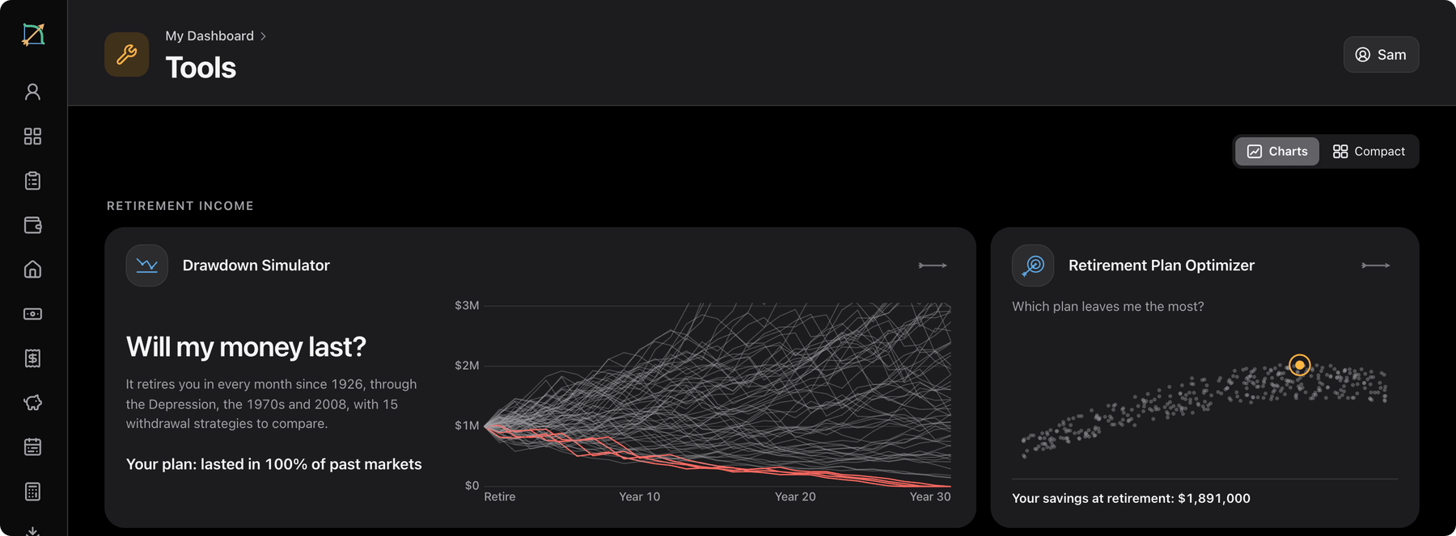
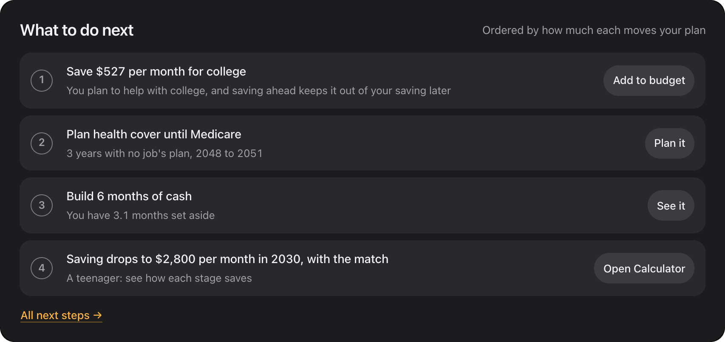
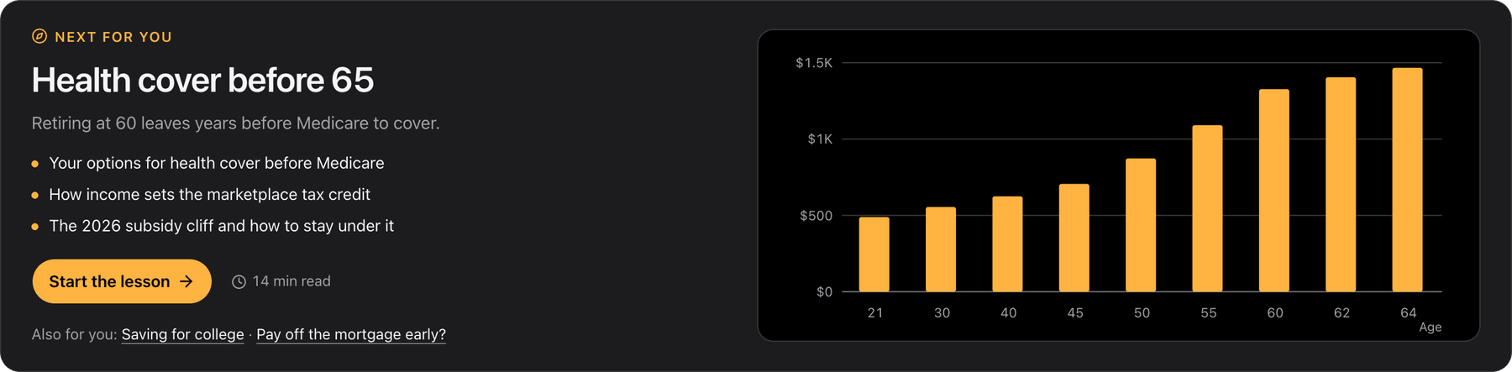
Tools, next steps and Learn
TOOLS · NEXT STEPS · LEARN
What else can we try, and what should we do next?
14 tools, filled in
Each opens inside the Dashboard with your numbers, to try things on without changing the plan.
Next steps, ranked
Ordered by how many readiness points each would add, each with a button to the right tab.
66 lessons in 8 tracks
"Next for you" picks a lesson from your plan, and lessons show your own numbers.
Notes:
Tools lists all 14 of the site's tools, each with a line from your plan, like "Your plan: lasted in 100% of past markets". A tool opens with everything known filled in; changes there are a sandbox and never touch the plan, except College Savings' Apply to my plan. Next steps ranks what to do by how much it moves the plan. Learn holds the site's 66 lessons, picks one for you, and shows your own figures inside them.

Slide 15
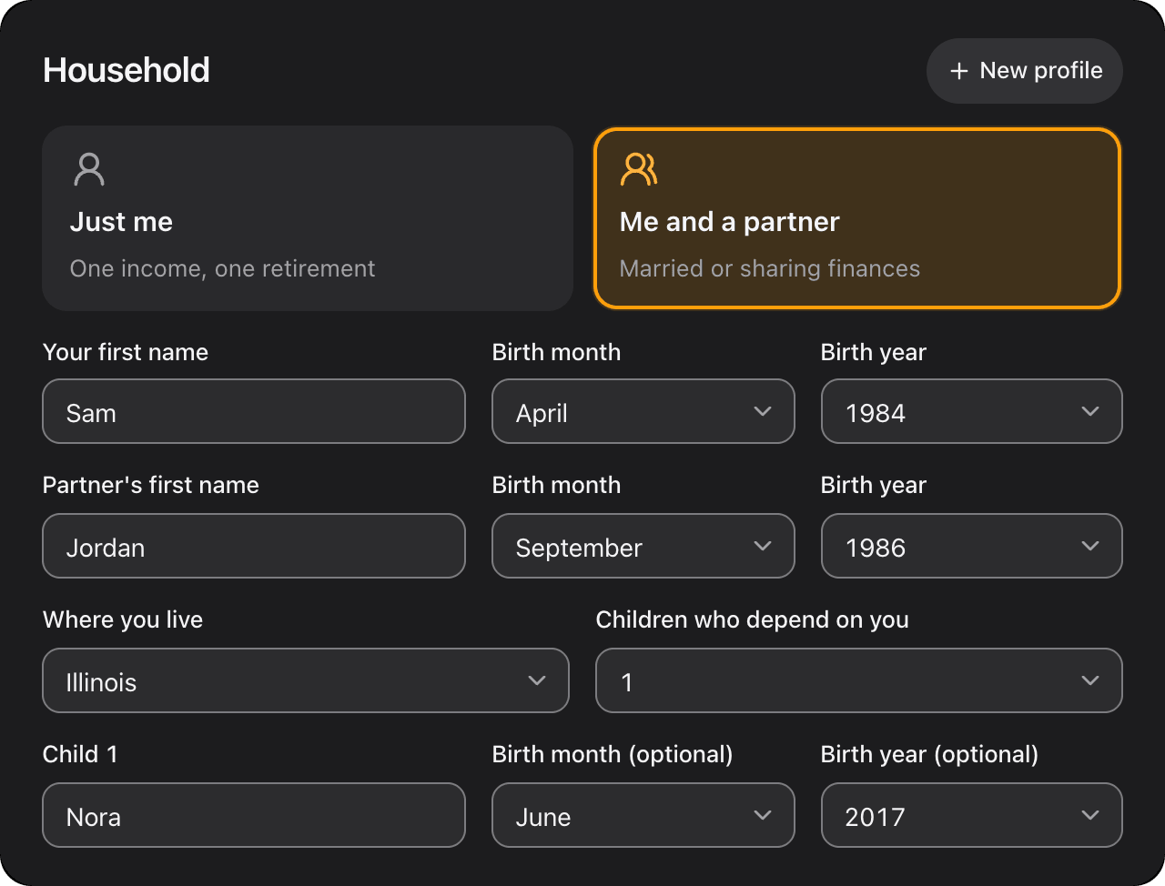
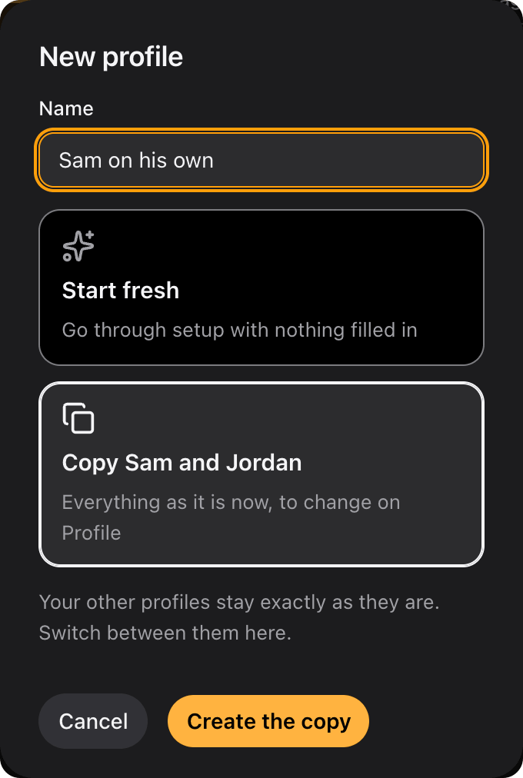
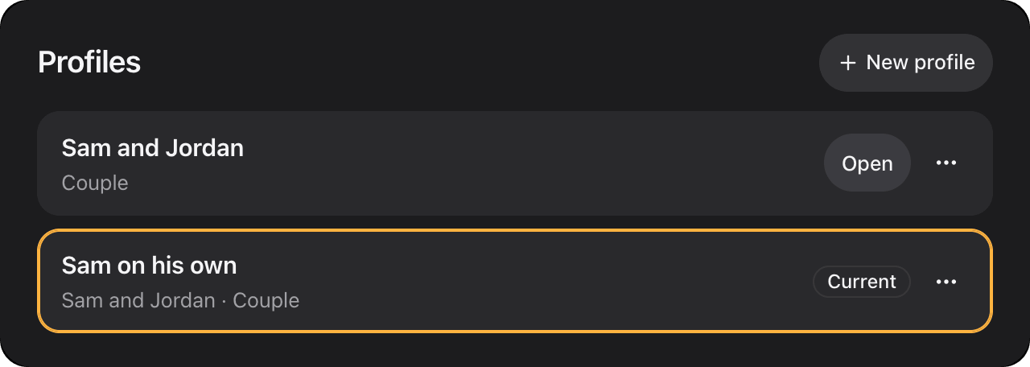
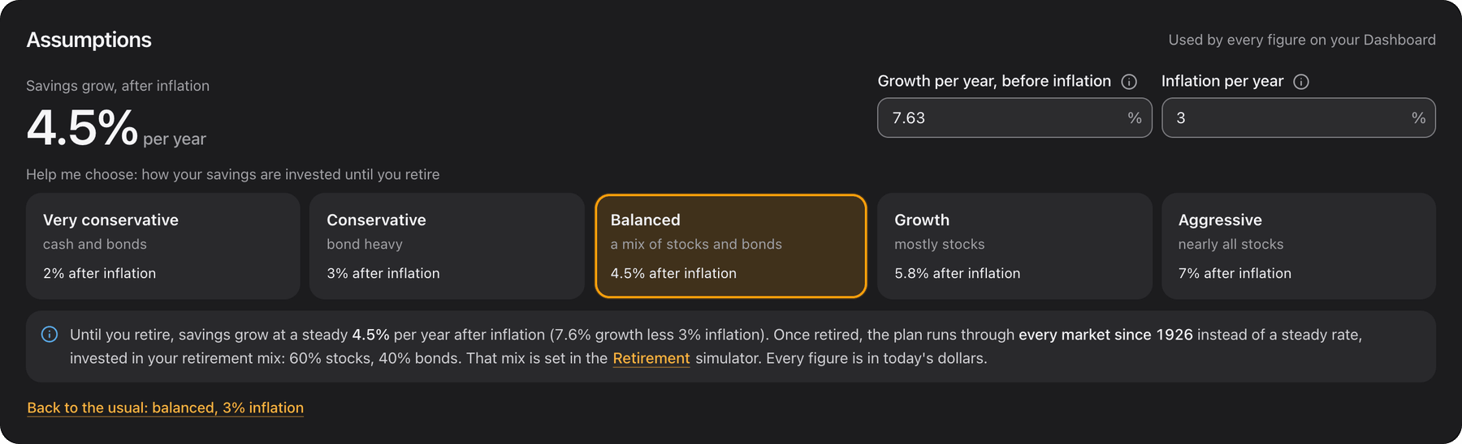
Profile and profiles
TAB BY TAB · PROFILE
Where is everything set, and can we try another plan?
Every answer, editable in place
Edits save as you type, and a bar says what changed and what it did to the plan, with Undo.
Assumptions
Growth and inflation, with five presets from very conservative to aggressive.
Several profiles
A couple's plan and a solo one, for example: start fresh, or copy the one you have.
Notes:
Profile holds every setup answer, each editable where it stands, and the plan's assumptions: 4.5% growth after 3% inflation by default. After any edit a bar says what changed and what it did, for example to the chance of success, with Keep and Undo. An account can hold several profiles: here a copy of Sam and Jordan's plan for Sam on his own. Which one is open is remembered per device, and every profile syncs.

Slide 16








What is inside the Dashboard
IN NUMBERS
15
14
15
100
tabs, every one worked out from one profile
tools that open with your numbers filled in
withdrawal strategies to test your plan with
years of monthly market history: every starting month since 1926
66
24
53
5
lessons in 8 tracks, with 39 interactive widgets
Help guides: 10 for the tabs, 14 for the tools
plain-language tips on what a figure is and why
kinds of change to plan ahead with
Notes:
Fifteen tabs, all from one profile. The fourteen tools of the main site open inside it with your numbers. Fifteen withdrawal strategies. A hundred years of monthly market history, so a plan is tested from every starting month since 1926. The 66 lessons of Learn, with 39 interactive widgets. Twenty-four step-by-step Help guides and 53 plain-language tips. And five kinds of change to plan ahead with.

Slide 17
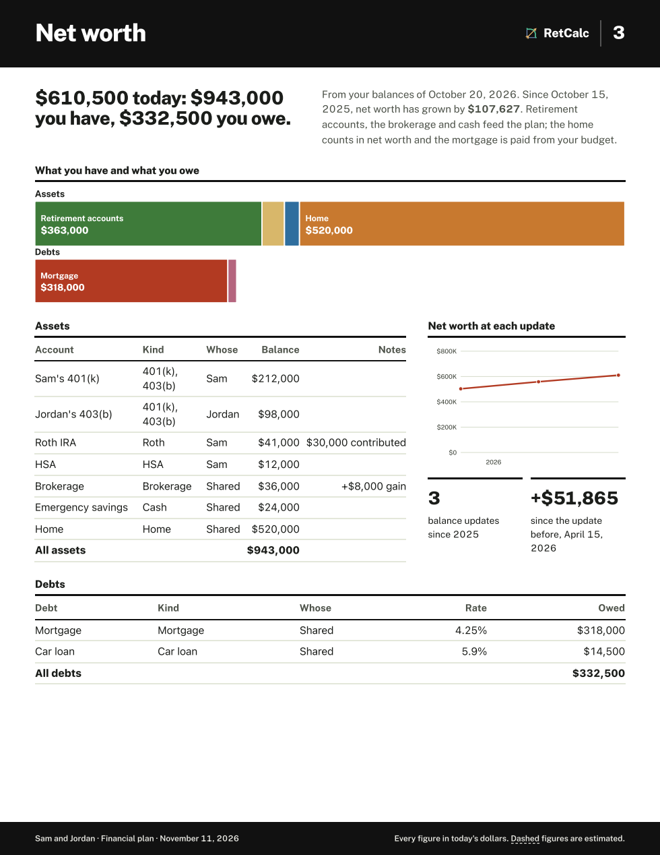





On paper, and a reminder once a month
BEYOND THE SCREEN
Print your plan
The monthly check-in email
The whole Dashboard as US Letter pages: 14 standard ones plus up to 7 that fit the household, like Your child or Getting to 59½. Built in the browser; nothing is sent anywhere to make it.
Sent only when balances are 30 or more days old, at most about once per month. No dollar figures and no plan results. One click turns it off.
Notes:
Print your plan builds the whole Dashboard as a report in the browser: the sample's runs to 19 pages, from a cover to every year of retirement, ready to print or save as a PDF. The monthly check-in email, on by default once the Dashboard is set up, goes out only when balances are a month old. It says when you last updated, lists what a check-in is, and links to the Dashboard. It carries no figures, because figures are only ever worked out in your browser.

Slide 18


Help where the questions come up
EXPLAINED AS YOU GO
How your assumptions compare
Help guides and tips
Growth, inflation, raises, Social Security, how long the plan runs and more, each rated from very conservative to very aggressive, with what it does to savings at retirement. No score, just where each guess sits.
24 step-by-step guides open beside the page and point at each part in turn. 53 "?" tips say what a figure is and how the plan uses it.
Notes:
How your assumptions compare rates each guess about the future against balanced middles: growth, inflation, raises, the children's costs, Social Security and how long the plan runs. The sample rates balanced overall, with its zero raises rated conservative. And on the tabs, Help opens a step-by-step guide in a side panel that highlights each part in turn; here it is on Net worth.

Slide 19




Every tab works on a phone
ON A PHONE
Dashboard: the answer first
Net worth, updated on the go
Taxes & Savings: the paycheck
Retirement, on the plan
More opens every other tab
Notes:
Everything works on a phone. The rail becomes a bottom tab bar with the Dashboard, Plan summary, Calculator and Retirement, and More opens every other tab with the theme switch. The bar slides away as you scroll down and comes back on the way up. Charts read out with tap-and-drag, wide tables scroll inside their box, and the Dashboard can be added to the home screen and opens full screen like an app.

Slide 20

Where your numbers live, and what it costs
PRIVACY AND COST
Your account
A synced copy, so the Dashboard is on every device you sign in on. Only you can read it. The server stores it and never computes with it.
$0
Your browser
syncs
Free, with a free account. Sign in with Google or a code emailed to you; no passwords.
Your Dashboard
saved here first, as you type
0
Every calculation
the plan, history, taxes and scores run here
The check-in email
Knows your email, first name and the date of your last balances. No figures.
bank logins: you type your own numbers
The printable report
built here from your data
0
ads. Your data is never sold or shared with advertisers.
Your figures
leave it only to sync to your account
Never connected
Bank logins, advertisers, anyone buying data
Download my data, or delete the account and everything in it, any time.
Notes:
Where the numbers live. Everything is worked out in your browser: the plan, the history runs, taxes, the scores and the report. The Dashboard is saved there first and synced to your account so it is on every device you sign in on; database rules mean only you can read it, and the server stores it without computing anything. The check-in email knows only your email, first name and when you last updated balances. There are no bank connections and no advertisers. It is free; an account just needs Google or a 6-digit code by email. You can download your data or delete the account at any time.

Slide 21


RetCalc
Set up your
Dashboard.
One profile, every tab, tested against every market since 1926. Free, with no bank logins and no ads.
retcalc.app/dashboard
Create a free account: Google, or a 6-digit code emailed to you.
Appendix: each tab in more depth, and how the Dashboard works.
Notes:
That is My Dashboard: one profile, fifteen tabs, a report on paper and a nudge once a month. It is at retcalc.app/dashboard, and a free account is all it takes. The appendix that follows has a deeper look at several tabs and the full story of how it works.

Slide 22
Each tab in depth, and how it works
APPENDIX
THE TABS IN DEPTH
23 Every tab at a glance
24 The home tab, below the fold
25 Net worth, in depth
26 The paycheck, line by line
27 Every year to retirement
28 The projection
29 Fifteen ways to spend it
30 Before 59½ and before 65
31 The readiness score
32 The report, page by page
33 Phones, more tabs
HOW IT WORKS
34 The architecture
35 One record, one model
36 Storage, sync and sign-in
37 The report and the email
38 Testing
39 Code size
Every screenshot is a made-up household: Sam (42) and Jordan (40), daughter Nora, in Illinois.

Slide 23










Fifteen tabs, in the order of the sidebar
AT A GLANCE
1 Profile
Every answer in one place, editable where it stands, and your profiles
6 Income
Pay, the employer match, other income and Social Security
11 Retirement
Drawdown, the bridge to 59½ and health cover, on your plan
2 Dashboard
Where you stand: the one-line answer, net worth, readiness, chance of success
7 Spending
Your budget, which is spending everywhere, and the emergency fund
12 Tools
All 14 tools, filled in from your plan, to try things on
3 Plan summary
The whole plan on one page, with the assumption rating and Print your plan
8 Taxes & Savings
This year's taxes and where each paycheck goes, line by line
13 Next steps
What to do, ordered by how much each moves your plan
4 Net worth
Assets and debts by date, whose they are, and when you can spend them
9 Year by year
Every year to retirement: raises, typed figures and changes ahead
14 Learn
66 lessons in 8 tracks, with your own numbers where they fit
5 Your home
Equity, the mortgage and what owning costs; or rent against buying
10 Calculator
The Advanced Calculator on your plan, with changes ahead
15 About
How every tab works, the methods and where the numbers come from

Slide 24


The home tab, below the fold
DASHBOARD
What to do next, what is filled in, and the years ahead
WHAT TO DO NEXT
The top four steps, ordered by how much each moves the plan
YOUR PROFILE
Ten sections, each with a check or Fill in
YOUR TIMELINE
A lane per person: work, retirement, Medicare at 65, Social Security
A lane per child, and one for the mortgage

Slide 25



Net worth, in depth
NET WORTH
When can we spend it, and how much is taxed?
WHEN YOU CAN SPEND IT
Now: cash, brokerage, Roth contributions
At 59½: 401(k)s, IRAs and Roth growth
At 65: the HSA; a 457(b) when its owner leaves work
HOW IT'S TAXED
Taxed when spent against tax-free, as shares
By pre-tax, Roth, brokerage, HSA and cash
YOUR ENTRIES
Every dated entry, with its change and a CSV

Slide 26


The paycheck, line by line
TAXES & SAVINGS
Every dollar of pay, given a place
The household's one tax calculator. Its taxes are "pay after taxes" on every tab.
START FROM A PLAN
The usual order
Max tax breaks
Stay flexible
A SLIDER PER LINE
401(k) up to the match, HSA, emergency fund
IRA (Traditional or Roth), 401(k) beyond the match, brokerage

Slide 27

Every year to retirement
YEAR BY YEAR
The years the plan is built from
COLUMNS
Coming in: each person's pay, other income
Going out: taxes and spending
Saved: Traditional, Roth and HSA, brokerage, emergency fund, the match
TYPE YOUR OWN
Click a pay or spending figure
For just this year, or until retirement
"Use the plan's figure" undoes it

Slide 28


The projection
CALCULATOR
Rate band, history or Monte Carlo
ON THE CHART
Ages on the axis and a mark where each change starts
A historical mix: US stocks, small-cap value, bonds and cash
Full screen, milestones and stage by stage, with a CSV
WHEN YOU COULD STOP SAVING
The earliest age you could stop outright and still reach the target
One click adds it to your changes
5,000
Monte Carlo runs on every redraw

Slide 29

Fifteen ways to spend it
RETIREMENT
Pick a strategy; the plan follows
FROM
A fixed amount rising with prices
Shares of the portfolio: % of portfolio, 95% rule, 1/N, RMD, VPW
Guardrails, floors and ceilings, Vanguard, Yale
Hebeler Autopilot II, sensible withdrawals, CAPE-based
THEN
"How the withdrawal strategies compare" side by side
The chosen one is the chance of success on every tab

Slide 30


Before 59½ and before 65
RETIREMENT
The bridge, and health cover until Medicare
BRIDGE TO 59½
Shown when someone retires before 59½
The Early Retirement Bridge on the plan, with the strategy's withdrawals
5 markets from history: 90th, 75th, median, 25th, 10th
Use this bridge plan saves it to the plan
HEALTH COVER
The Healthcare Cost Planner on the plan
ACA premiums before 65; Part B, Part D and IRMAA after
Top: the sample with Sam retiring at 55 instead of 60. Bottom: the sample as it is.

Slide 31
A readiness score out of 100, in five areas
DASHBOARD
40
20
15
15
10
Retirement outlook
40 points
Savings rate
20 points
Emergency fund
15 points
Debt
15 points
Monthly cash flow
10 points
THE WORD BESIDE THE SCORE
Each area opens to say why it scored as it did and what would raise it, with a button to the tab that does it. The readiness score and the chance of success are different things: one rates the whole household, the other is the share of past retirements that lasted.
On track
85 and up
Nearly there
70 to 84
Getting there
50 to 69
Needs work
under 50

Slide 32







The sample's report: 19 pages, built in the browser
PRINT YOUR PLAN
Twelve of the 19 pages. The report keeps its own light look, so it prints well.

Slide 33



More tabs on a phone
ON A PHONE
Plan summary
Spending
Year by year
Tools, in the compact view
Learn

Slide 34
Browser first: the engine runs on your device
HOW IT WORKS
IN THE BROWSER
ON SERVERS
Dashboard pages
Next.js App Router and React: 15 tabs, setup, the report, tools and Learn; rendered client-side behind a signed-in check
Vercel
serves the pages; no API route between you and your data
One profile record
per profile: the profile, dated balance entries and setup progress
Browser storage, first
every write lands here before it syncs
Supabase
Postgres with row-level security, called from the browser; sign-in by Google or an emailed code
Calculation engine
plain JavaScript math modules: projections, historical and Monte Carlo runs, the Drawdown Simulator, the bridge, taxes and benefits, with 100 years of market data. Heavy tool jobs can run in a Web Worker.
A daily scheduled function
sends the check-in email through Resend
The site's tools, hosted
loaded on demand only when opened; seeded from the profile, edits kept to it (or not, in the Tools sandbox)
Sentry
errors only, production only; inputs, addresses after ? or #, and user details stripped
Notes:
For a technical audience. The Dashboard is pages in a Next.js app, rendered client-side behind a signed-in check. Everything that computes runs in the browser: one record per profile, saved to browser storage first, and the same calculation engine as the public tools. The servers store and deliver: Vercel serves the pages, Supabase holds each person's synced data behind row-level security, a daily function sends the check-in email, and Sentry receives stripped error reports. Nothing is computed on a server.

Slide 35
One record in, every tab out
HOW IT WORKS
The profile record
household, people, pay, budget, home, assumptions, Social Security, strategy, changes, children, each tool's choices
model.ts
turns the profile and the latest entry into the engine's inputs
The engine
savings at retirement, the Drawdown run over every historical start, readiness, take-home
Every tab
reads it through one hook; a change on one tab reruns the plan everywhere
UNDERNEATH
cover.ts
builds the plan year by year: pay with raises, taxes from the paycheck calculator, saving by account up to limits
scenarios.ts
compiles the changes ahead, written in plain words, into those years
calc.ts
builds the Calculator's stages from those years
flows.ts
maps the profile to and from each hosted tool's inputs
host.tsx: a tool inside the Dashboard
Runs any of the site's tools in a scope: seeded from the profile, with locked fields listed as facts linking to where they are set, and a keep hook that writes edits back into the profile. The Tools tab passes no keep hook, so a tool opened there is a sandbox. Nothing on the Dashboard changes the public site's tools or their saved household.

Slide 36
Local first, then synced to the account
HOW IT WORKS
You change a figure
on any tab
Browser storage
written at once; it works when the account service is down
Pushed to the account
shortly after, one JSON document per synced item
Merged both ways
on sign-in and when the tab regains focus
THE MERGE
SIGNING IN
LEAVING, AND BACKUPS
A three-way merge against the last synced copy
Deleted profiles are tracked, so one can't come back from another device
Signing out removes synced data from that browser; the account keeps it
Google, or a 6-digit code emailed to you; no passwords
Supabase Auth with the PKCE flow
An optional first name, asked once
Row-level security: each person reaches only their own data
Download my data as JSON, any time
Delete my account: a server-side function ends every session first, then erases everything
A scheduled job keeps encrypted backups of the database

Slide 37
The report and the email
HOW IT WORKS
THE PRINTABLE REPORT: BUILT IN THE BROWSER
THE MONTHLY CHECK-IN EMAIL: KNOWS LITTLE
Gather
a report model collects the figures from the plan in the browser
A database function
finds who is due: balances 30 or more days old, none sent in 28 days
Lay out
US Letter sheets with their own charts; crowded sheets zoom to fit, down to 80%
A daily serverless function
builds the email and sends it through Resend
Print
the browser's own print dialog, to paper or PDF
One-click turn-off
a link signed with a server-side secret; the page turns it off on a button press, not on opening
Nothing is sent anywhere to make it. Its pages follow the household: 14 standard ones, plus up to 7 such as Your child or Health cover before Medicare, each saying why it is there.
What it reads: the email address, first name, the date of the latest balance entry and when the last check-in went out. No dollar figures and no plan results.

Slide 38
How the Dashboard is tested
HOW IT WORKS
33
41
13
1,322
Dashboard unit tests in 5 files: changes ahead, assumption benchmarks, the bridge budget and more
sync tests across sync, merge and the account layer, including a whole sync against a fake account
recorded Dashboard plans rerun and compared: savings at retirement, the share that lasts, saving year by year
checks in 62 groups of engine math tests, which gate every commit and CI
ALSO IN CI
Not covered by the browser suite
The end-to-end browser specs cover the public tools, not the signed-in Dashboard. Dashboard screens were checked by hand and with screenshot scripts.
The site's numbers baseline and the Guide baseline
Guide, Budget, Tax and Advanced unit tests: a change that changes nothing must give the same figures to the cent
The check-in email and the database access rules
Lint and a production build

Slide 39
About 12,600 lines of Dashboard code
HOW IT WORKS
66
files of Dashboard code: 55 components and 11 routes
6,774
lines in the calculation engine it runs on, plus 1,326 of data
30,822
lines in all the site's tools, which the Dashboard hosts
1
engine: the Dashboard's figures come from the same one as the public tools

