Slide 1

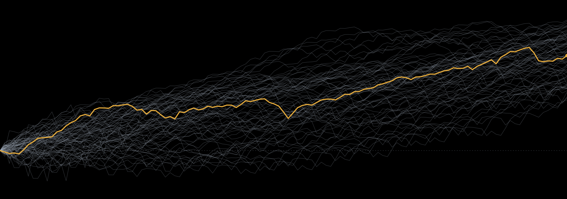
RetCalc
PRODUCT OVERVIEW
The complete
retirement planning
toolkit.
A calculator, two guided walkthroughs and fourteen planning tools, each tested against every market since 1926.
Every 30-year stretch since 1926 for a 60/40 portfolio, after inflation. The amber line is the middle one.
retcalc.app
Notes:
RetCalc is a free retirement planning toolkit at retcalc.app. The art on this slide is real: every 30-year stretch of a 60/40 portfolio since 1926, after inflation, from the same data the tools use. The amber line is the middle outcome. That spread is the whole point of the site: plans are tested against all of those paths, not one average.

Slide 2
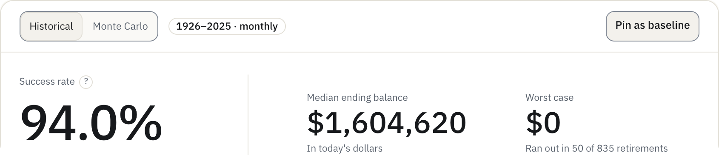
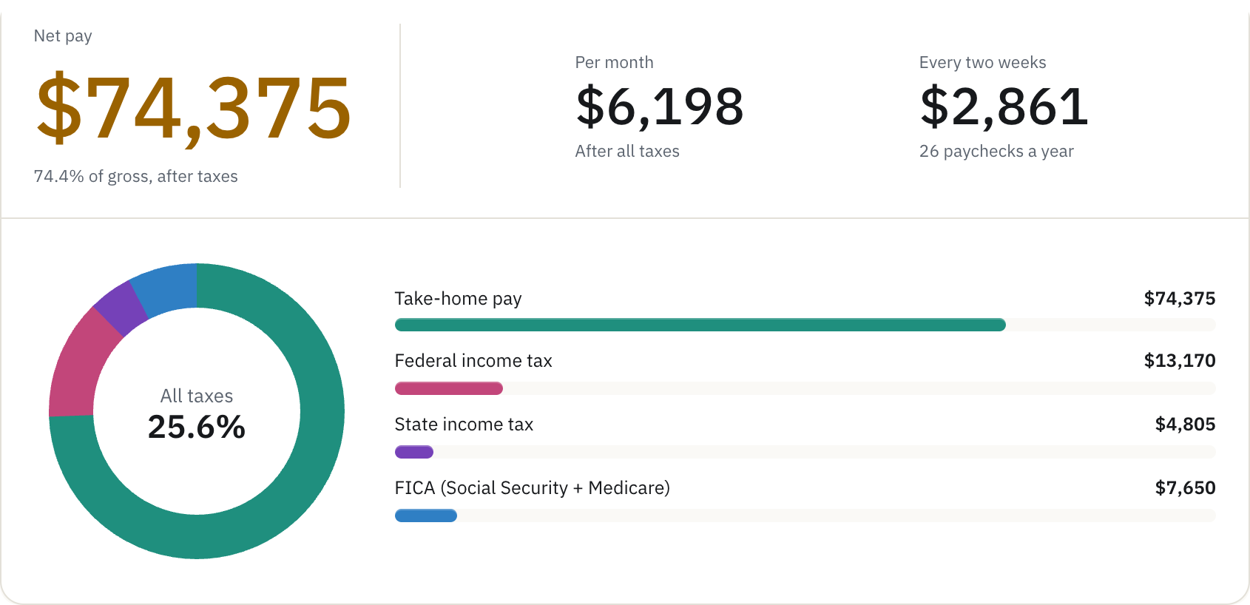
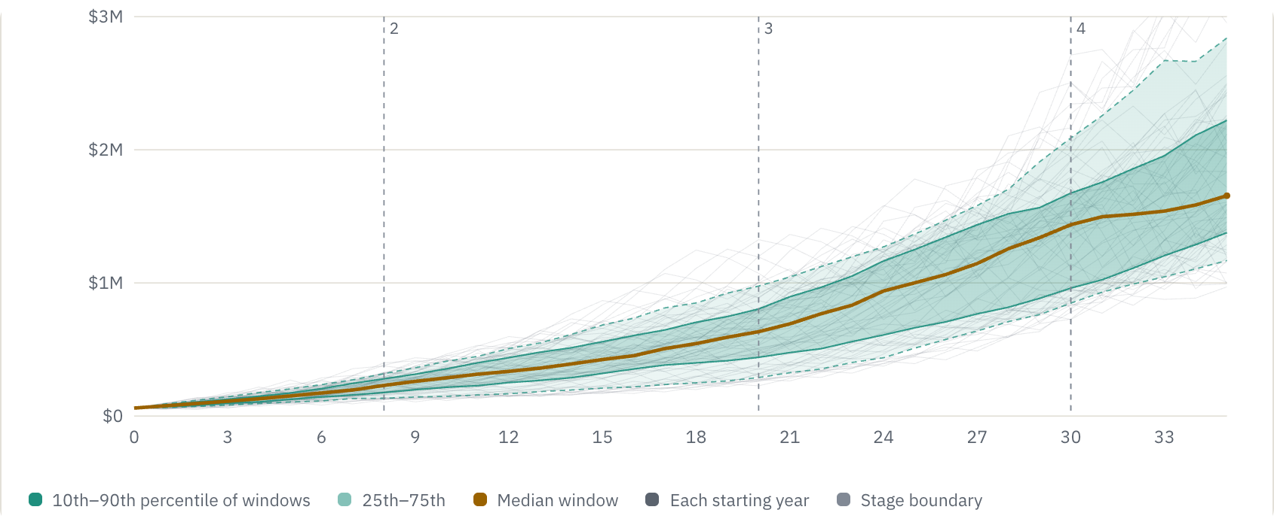
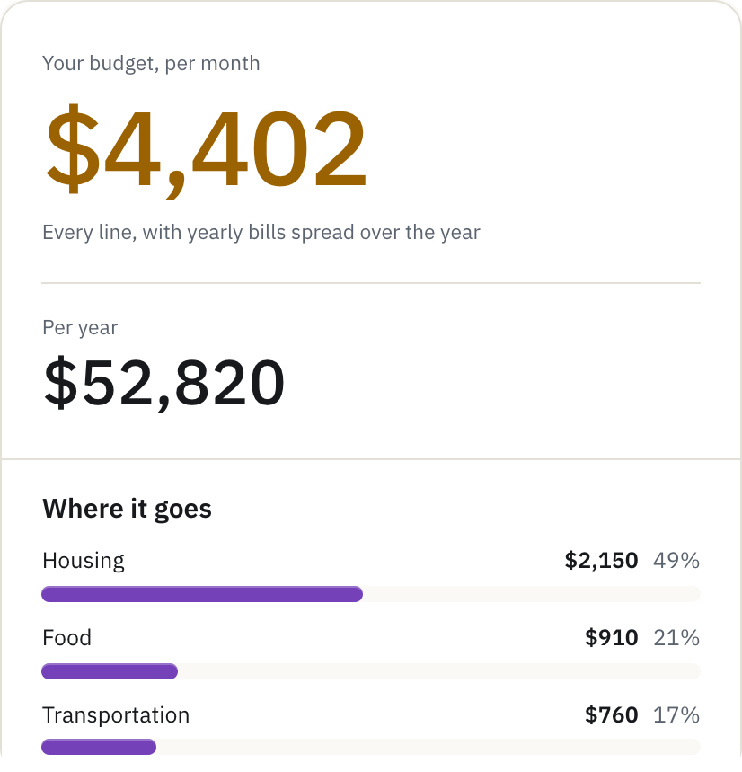
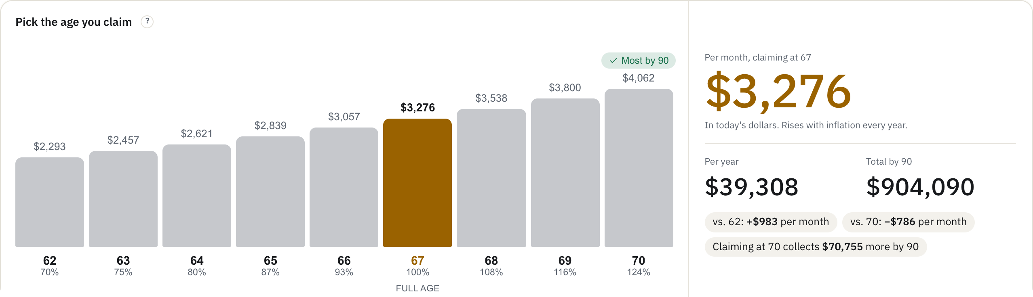
A whole retirement plan, in one place
WHAT IT IS
From a first paycheck to a last withdrawal: what to save, where to put it, whether it will last, what it costs in tax and health insurance, and when to claim Social Security.
14
3
planning tools
calculators
2
100 yrs
guided walkthroughs
of monthly market data
$0
no ads, no account needed
Notes:
These are real results from the live site: the Drawdown Simulator, Income Tax, the Stages calculator against history, the Budget, and Social Security. The whole site runs in the visitor's browser and covers the full arc, from saving to drawing it down. 14 tools, 3 calculators and 2 guided walkthroughs, all free, with no ads and no account required.

Slide 3



Three ideas run through every page
HOW IT WORKS
01
02
03
One household, every tool
Tested against history
Private by default
Ages, state, savings, income and spending are entered once and fill in everywhere, and each tool hands its results to the next.
One average return hides the order returns come in, and that order decides whether a retirement lasts. Every plan is replayed through each starting month since January 1926.
Every calculation runs in the visitor's own browser. An optional account only keeps a household, saved scenarios and the Guide in step across devices.
Your household
"Nothing leaves your browser unless you sign in to save it."
Notes:
Three ideas. One: the household is entered once and every tool reads it, and tools hand results to each other. Two: plans are tested against real market history, month by month since 1926, not a single average return. Three: privacy. The math runs in the browser; an account only syncs saved inputs.

Slide 4
A hundred years of markets, every month of it
TESTED AGAINST HISTORY
$1,140
What that dollar grew to by the end of 2025, after inflation, with dividends reinvested.
THE STRETCHES THAT DECIDE A RETIREMENT
−77%
The Great Depression
1929–32, after inflation
−50%
Stagflation
1973–74, after inflation
−45%
The dot-com bust
2000–03, after inflation
−50%
The 2008 crash
2007–09, after inflation
Notes:
This is the data every tool tests against: 1,200 months of stock, bond and inflation history from January 1926 to December 2025, from Robert Shiller at Yale and the BLS. A dollar grew to about $1,140 after inflation, but the falls on the right are what break retirements. A plan that only sees the average never meets them; RetCalc replays every one.

Slide 5
A tool for every stage of the road
WHERE TO START
Today
Get the basics right
Saving years
Grow it
Getting close
Plan the handoff
Retired
Make it last
Income Tax
Calculator Basic · Advanced · Stages
Social Security Calculator
Drawdown Simulator
Budget
FIRE Calculator
Healthcare Cost Planner
Roth Conversion Calculator
Debt Payoff
Portfolio Backtest
Early Retirement Bridge
Healthcare Cost Planner
Mortgage Calculator
College Savings
Roth Conversion Calculator
Rent vs. Buy
Retirement Plan Optimizer
Most people start with the Calculator, or with a guide: the Readiness Guide and Paycheck to Retirement open the right tools along the way.
Notes:
The tools follow the order life brings the questions: the basics today, growing savings, planning the handoff, and making it last. Two walkthroughs stitch them together for people who would rather be guided.

Slide 6
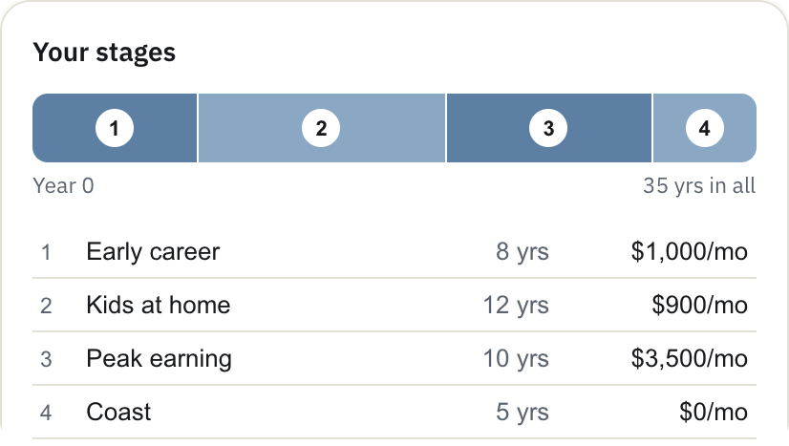
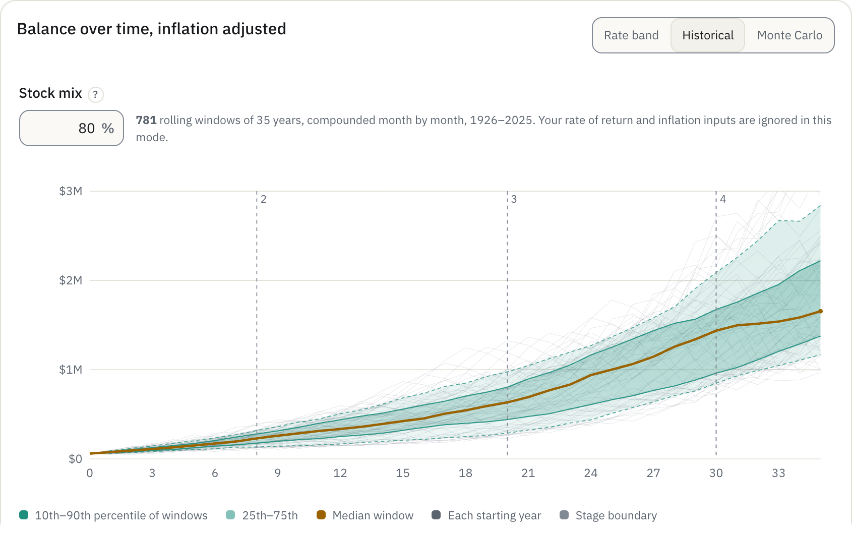
Stages calculator
CALCULATORS
Sample plan: early career, kids at home, peak earning, then coasting
What if my saving changes over the years?
Any number of stages
Each with its own saving, raises, return, volatility and account split, chained into one projection.
Built around children
Planning for kids rebuilds the stages around the children you have or plan.
Tested three ways
A rate band, every rolling window since 1926, or 5,000 Monte Carlo runs.
Notes:
Stages is the calculator for real life, where saving changes: early career, kids at home, peak earning, coasting. Each stage has its own numbers, and the kids builder can create the stages for you. The chart shows the sample plan against every historical window since 1926, with dashed lines where each stage begins. Basic and Advanced are in the appendix.

Slide 7
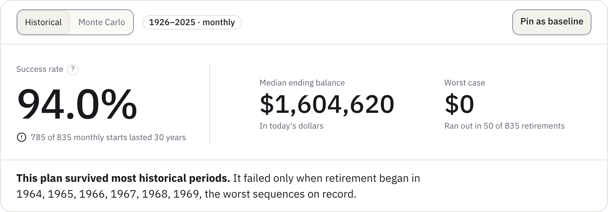
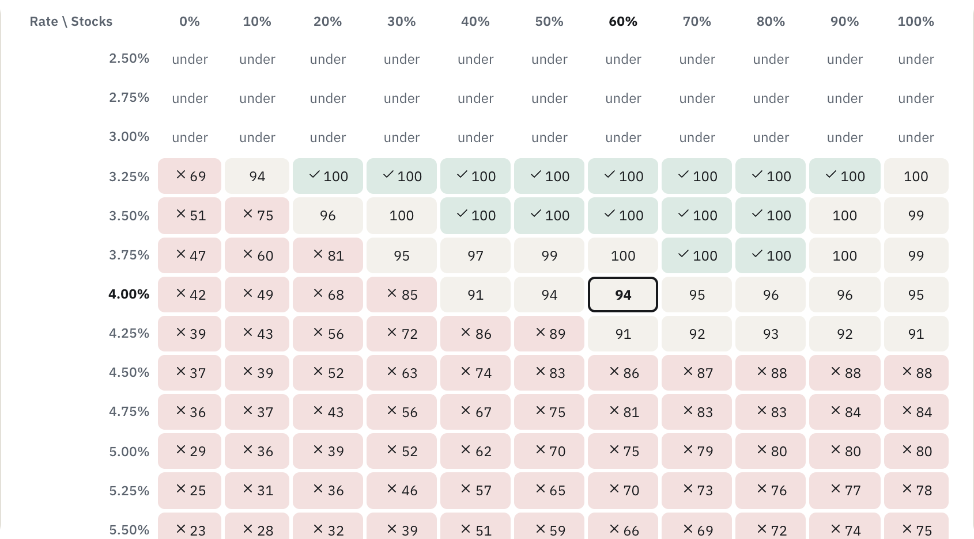
Drawdown Simulator
RETIREMENT INCOME
Will my money last?
15 strategies
From the 4% rule to guardrails, VPW and the Yale endowment rule, in five families.
Success grid: withdrawal rate against stock share, each cell the share of history that lasted
835 real retirements
Every monthly start since 1926, each run for 30 years, with Social Security and pensions.
Ranked at equal risk
The strategy showdown tunes all 15 to the same risk, then compares what each spends.
Notes:
Most calculators ask how much you will have. This asks whether it lasts once spending starts. The sample here, a million dollars at 4%, lasted in 785 of 835 historical starts; it failed only for retirements beginning in the late 1960s. The success grid on the right shows every withdrawal rate against every stock share.

Slide 8
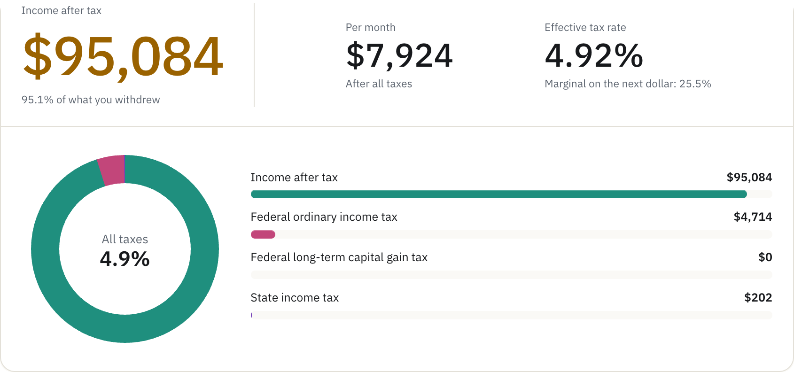
Income Tax
EVERYDAY MONEY
How much tax will I owe?
50 states and DC
2026 federal, state and FICA tax, with every state's retirement-income rules in plain English.
A retirement mode
Withdrawals, gains and Social Security stacked the way the return really does it.
A true marginal rate
Found by rerunning the whole return with $1,000 more.
Top: a $100,000 salary, single, Illinois. Bottom: $100,000 in retirement from four sources.
Notes:
Income Tax works for a salary or for a year of retirement withdrawals. Retirement mode is the unusual part: it stacks long-term gains on top of ordinary income, taxes Social Security through the 0, 50 and 85 percent tiers, applies the senior deduction, and reports the real marginal rate on the next dollar.

Slide 9
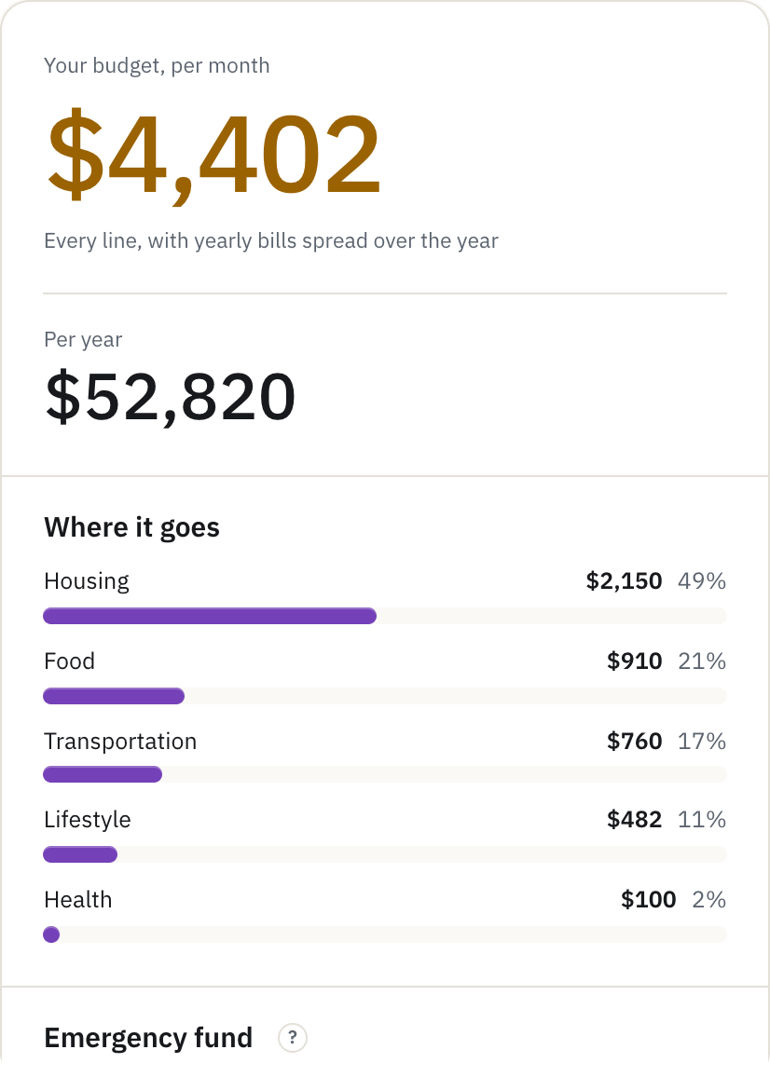
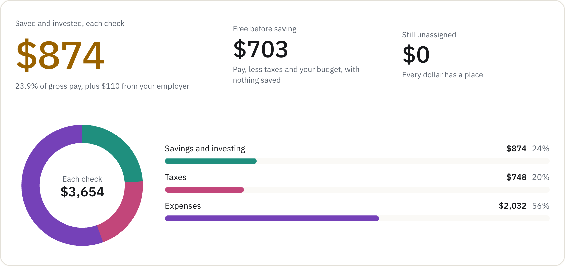
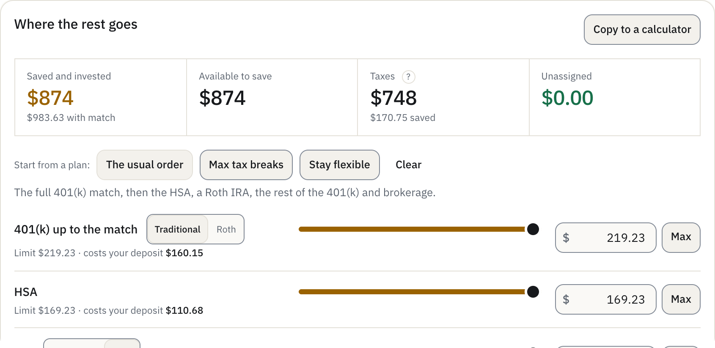
Budget and Paycheck
EVERYDAY MONEY
Where does my money go, and where should the rest go?
Two tabs
A budget of 18 lines in six groups, then a paycheck that pays it, line by line.
Taxes rerun live
Sliders move money into the 401(k) match, HSA, IRA and brokerage, capped at 2026 limits.
Two incomes
Each spouse with their own pay schedule, match and HSA limit.
Notes:
The Budget tab lays out spending. The Paycheck tab turns gross pay into taxes, bills and savings, and every slider reruns the tax math by deduction kind and by earner. Three one-click plans: the usual order, max tax breaks, or stay flexible. It can send the savings split straight into the Advanced or Stages calculator.

Slide 10
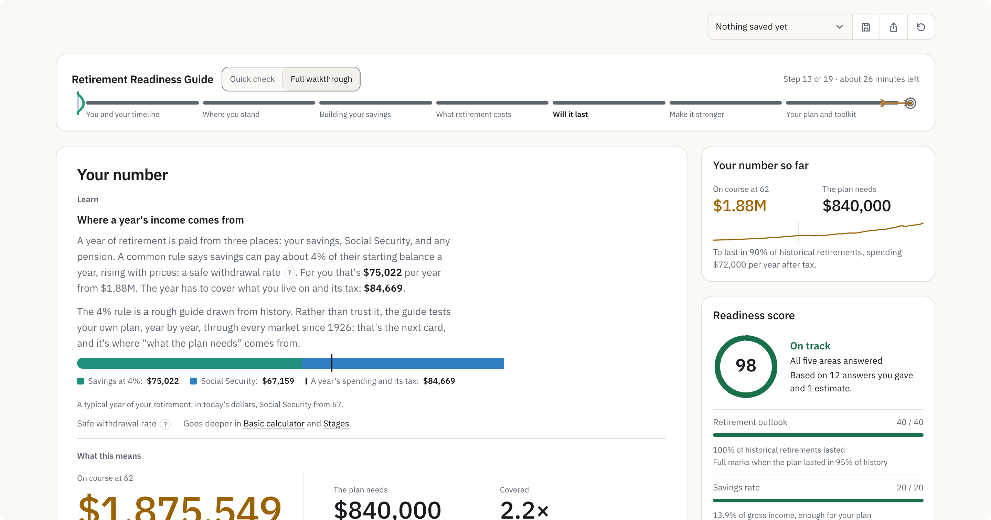
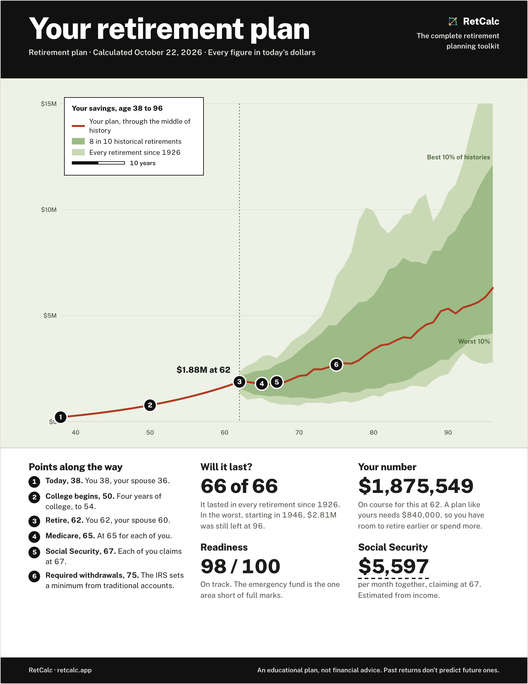
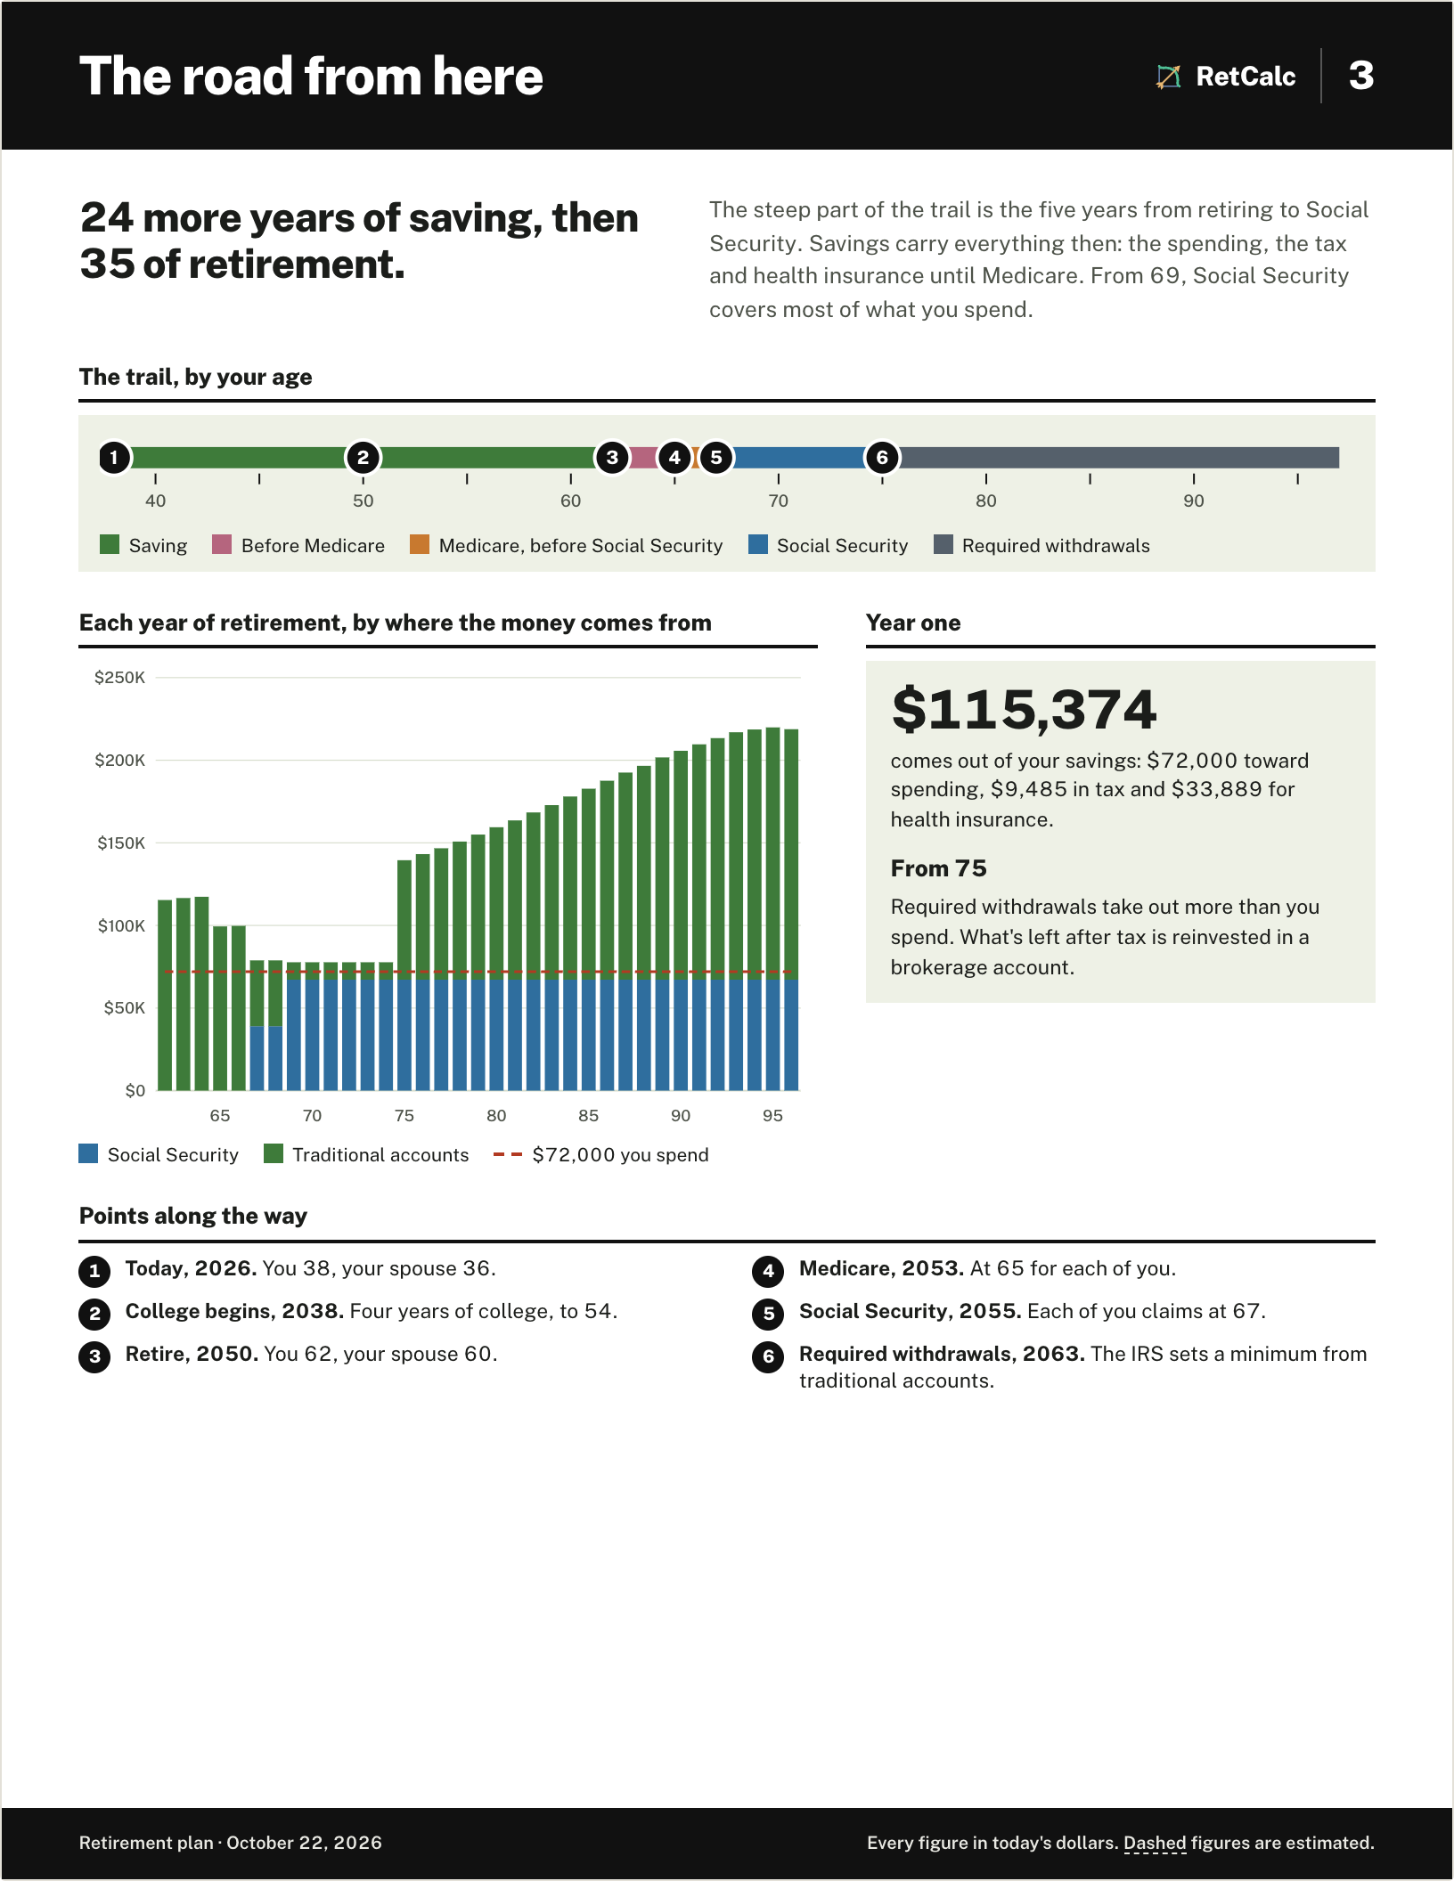
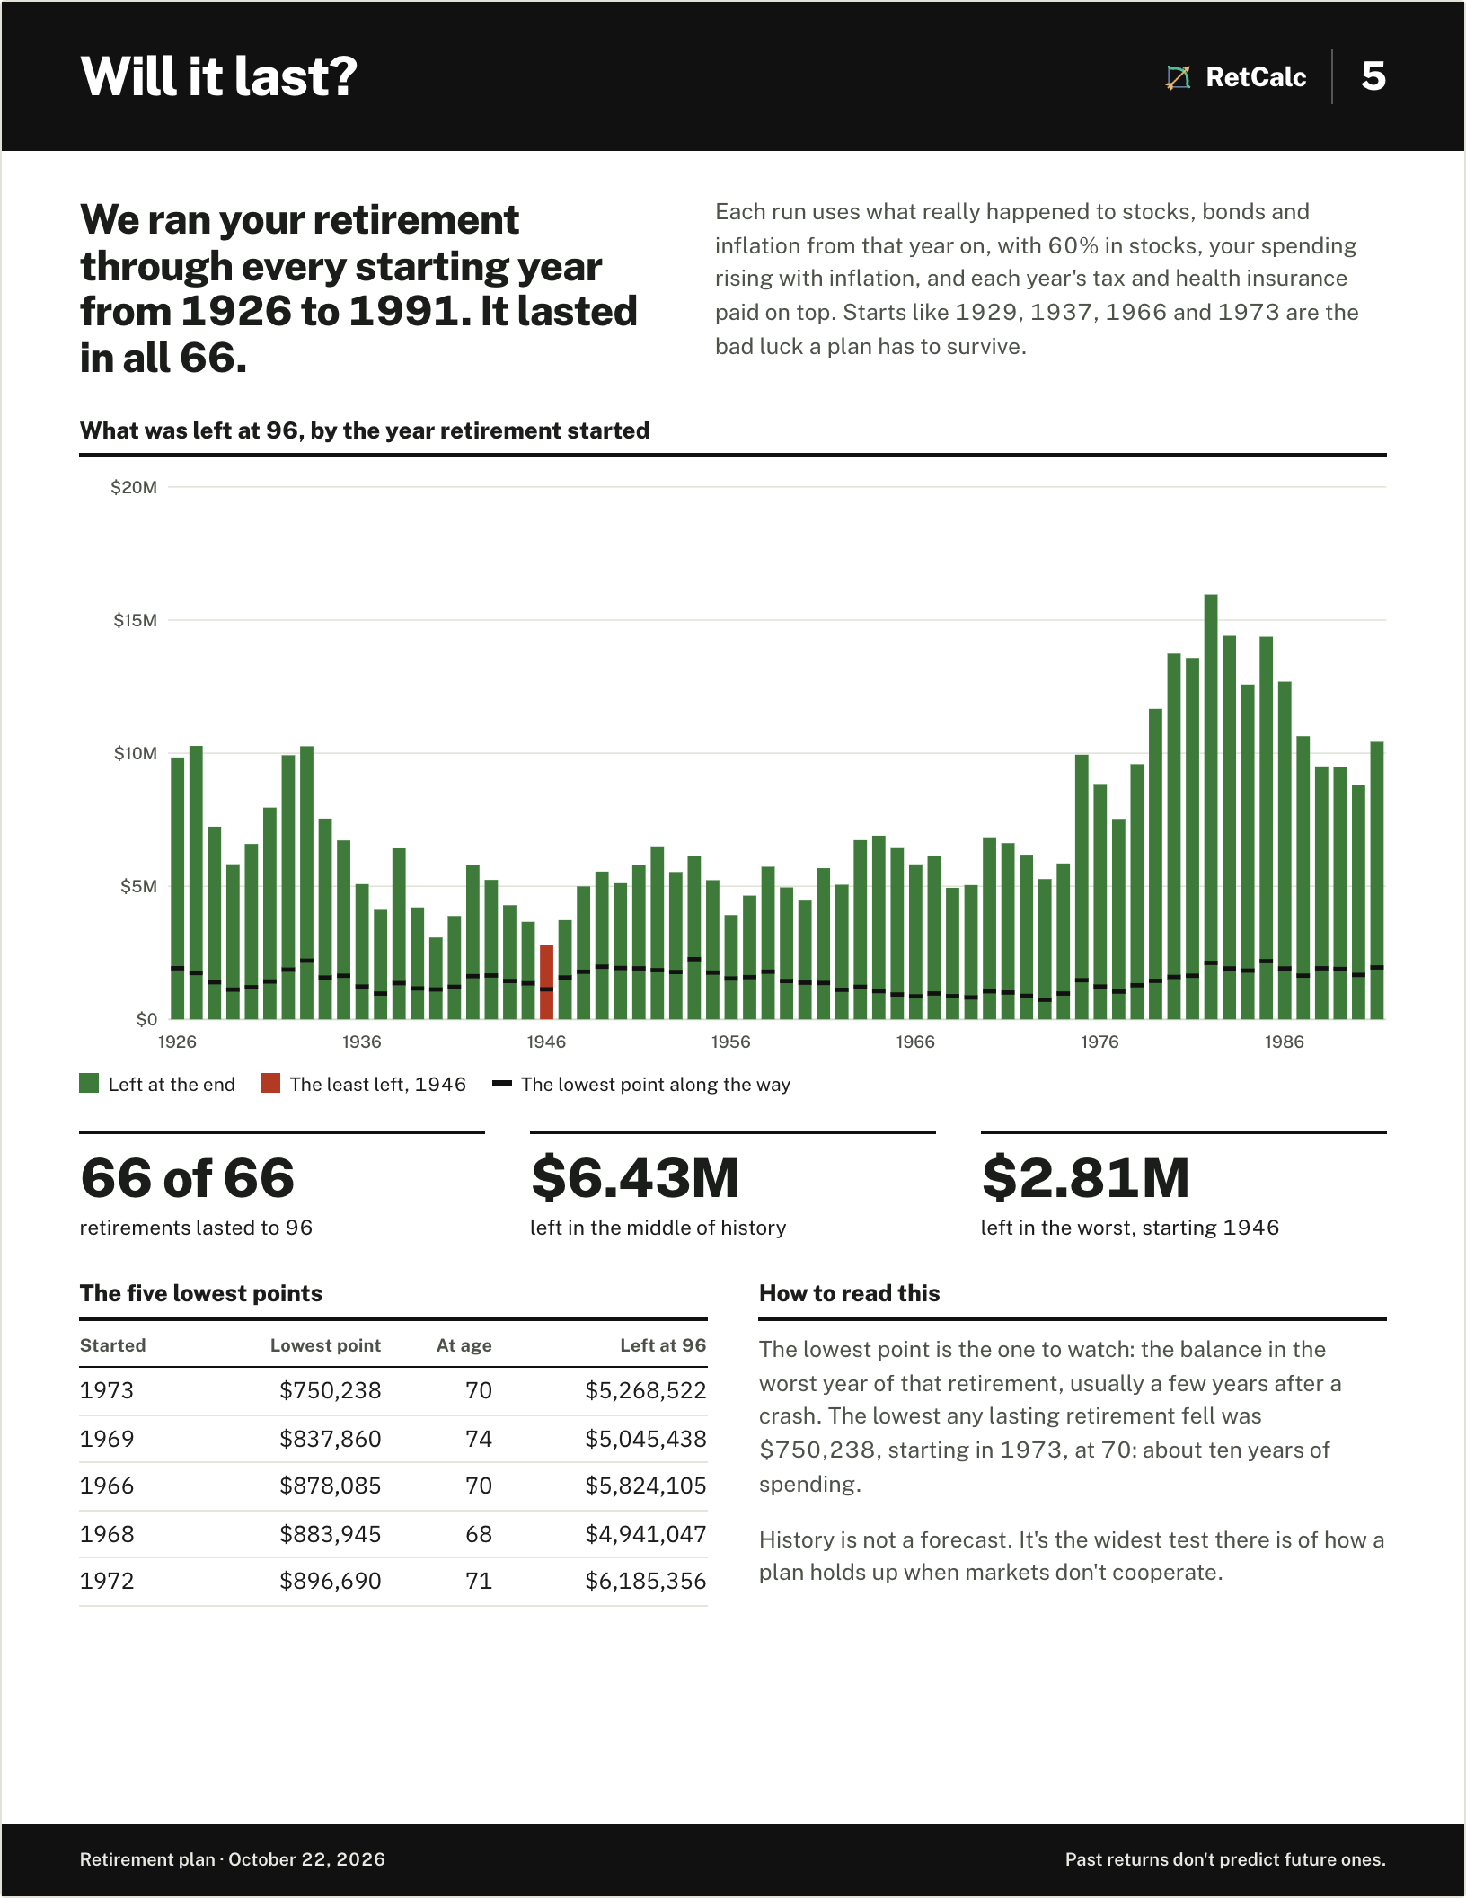
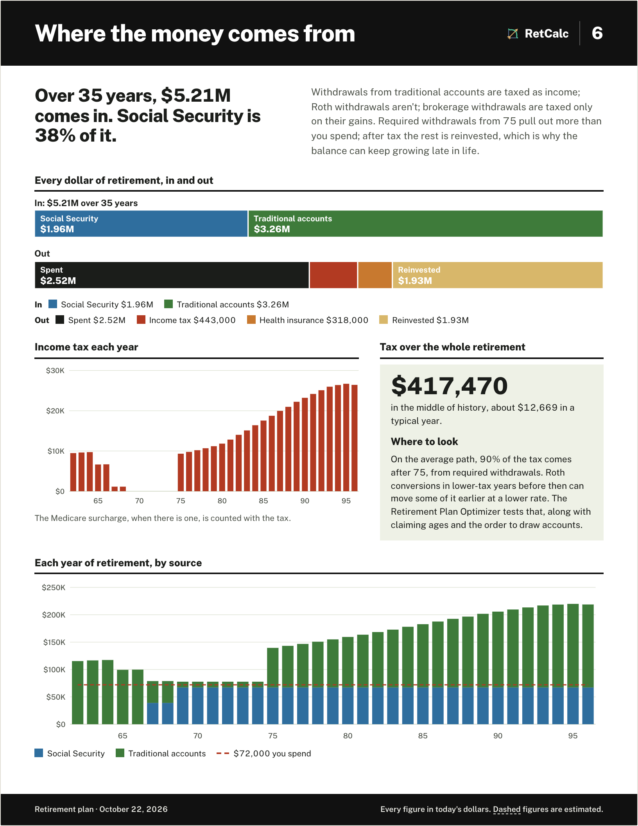
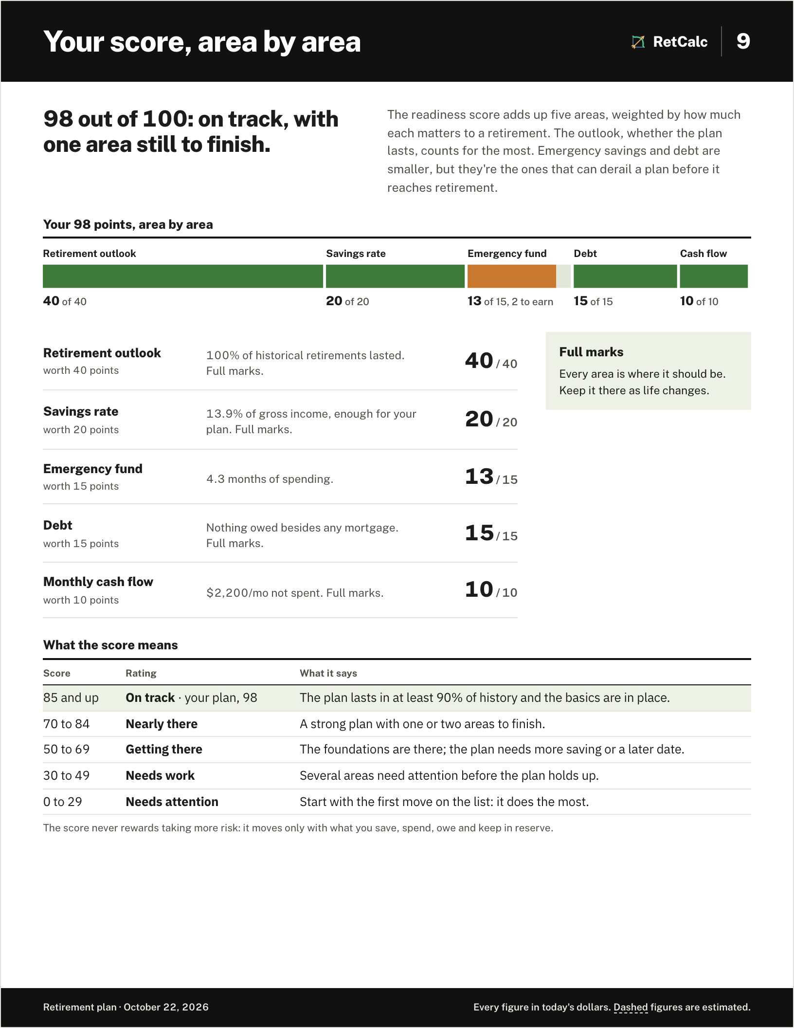
Retirement Readiness Guide
GUIDED WALKTHROUGH
How ready am I, and what should I do next?
A score out of 100
Outlook, savings rate, emergency fund, debt and cash flow, weighted.
Ten minutes or an hour
A twelve-card quick check, or the full walkthrough with trips into the tools.
A plan on paper
Ends in a full-color report of about a dozen pages, built in the browser.
Notes:
The Guide is a check-up. It finds the number to aim for, tests it against history, scores readiness out of 100 and lists the moves that matter. The sample couple here scored 98. It ends in a printable report; the pages on the right are that couple's report.

Slide 11
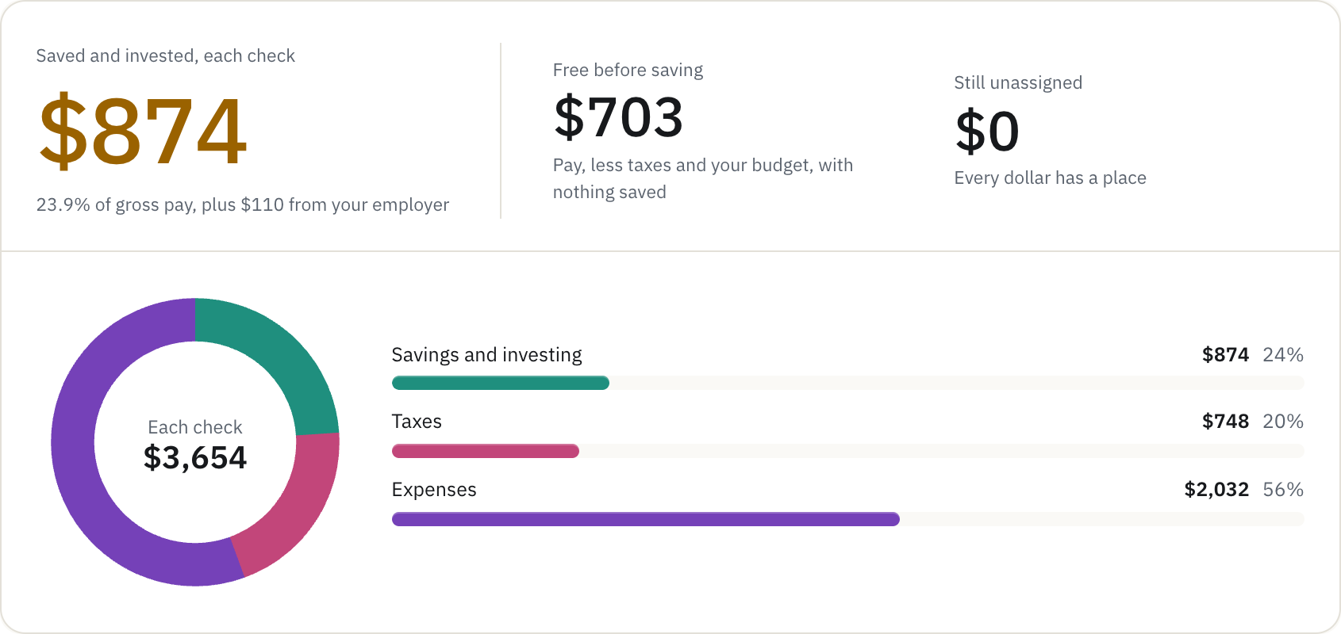
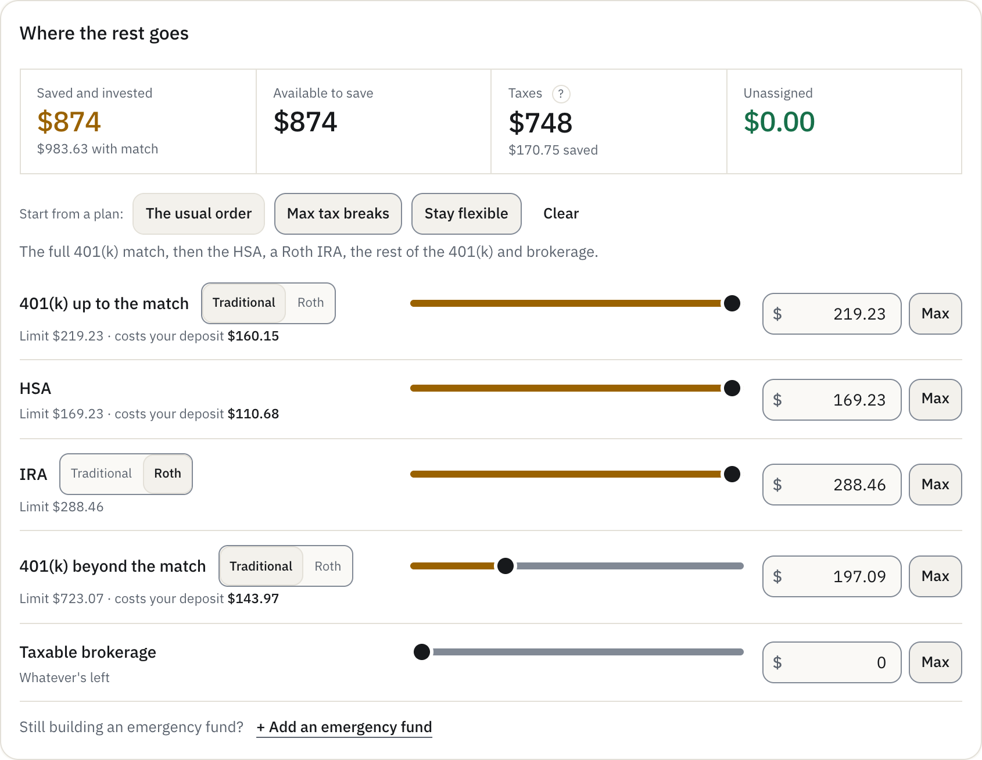
Paycheck to Retirement
GUIDED WALKTHROUGH
Start
Budget
Paycheck
Your plan
Life stages
Summary
Where should each paycheck go?
Five steps
Budget, paycheck, your plan, life stages, summary. About fifteen minutes.
The real tools inside
Budget, Advanced and Stages run in the walkthrough on its own copy of the numbers.
Copy into my tools
One click sends the results to Income Tax, Budget, Advanced and Stages.
Notes:
For people who would rather get straight to the numbers. Gross pay to take-home, a budget, where each paycheck goes, and where that saving leads by retirement, children included. It runs the real tools inside it and ends with a report.

Slide 12
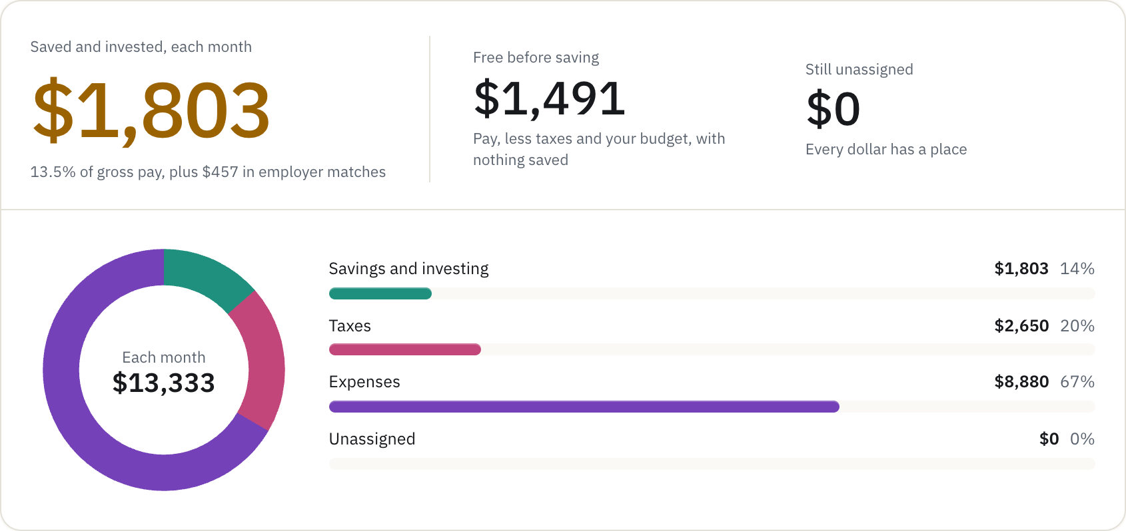
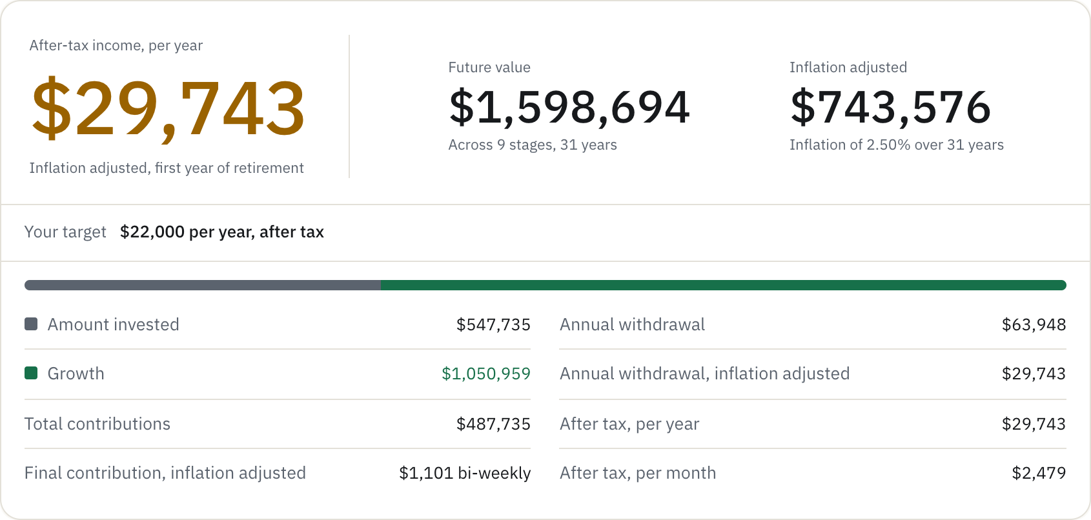
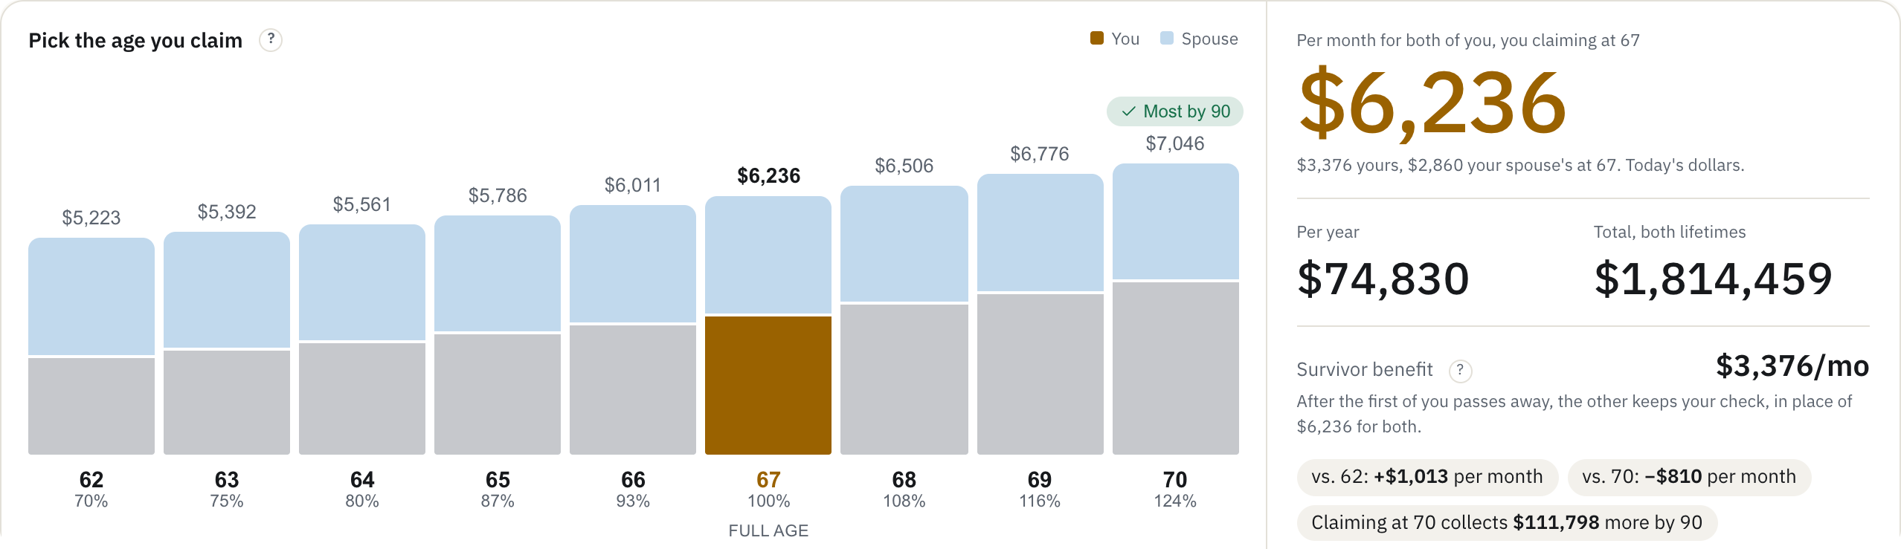
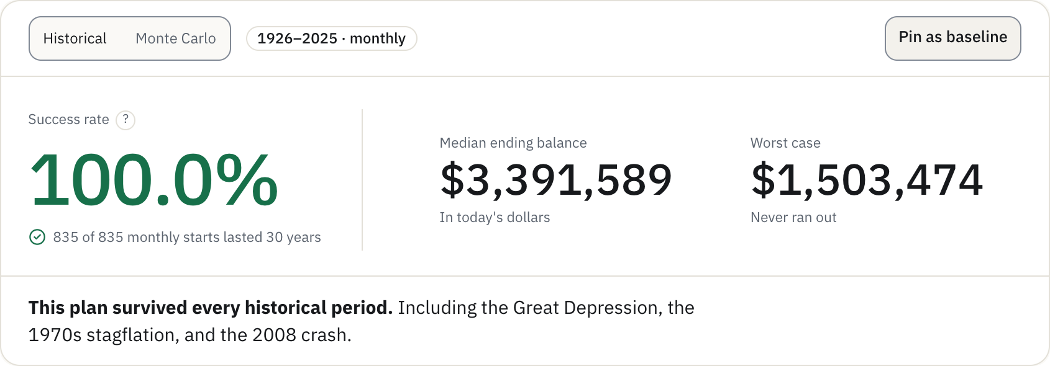
One household, from paycheck to retirement
PUTTING IT TOGETHER
A sample couple, Alex (34, $92,000) and Jordan (32, $68,000) in Illinois, with $60,000 saved and two children planned, carried through four tools by the tools' own buttons.
1 BUDGET
2 STAGES
3 SOCIAL SECURITY
4 DRAWDOWN
$1,803
$743,576
$6,236
100%
saved per month, 13.5% of pay plus $457 from employers
at 65 in today's dollars, saving paused for 18 years of children
per month together, both claiming at 67
of 835 historical retirements lasted 30 years
Copy to a calculator: $832.35 biweekly
Test withdrawals: the portfolio
Copy from the calculator: both benefits
$104,573 per year in retirement in today's dollars: $29,743 from savings and $74,830 from Social Security, through the Depression and the 1970s
Notes:
Every number here is from the live site, carried tool to tool by the hand-off buttons. Their budget and paycheck give $1,803 per month of saving. Stages, with the kids builder, gets them to $743,576 in today's dollars at 65. Social Security adds $6,236 per month from 67. The Drawdown Simulator says the plan lasted in all 835 historical retirements. Step-by-step screenshots are in the appendix.

Slide 13
A static site that does its thinking in the browser
UNDER THE HOOD
The visitor's browser
Supabase
optional accounts, each user's rows locked to them
Vercel
prerendered pages from main
Pages
Next.js 16 · React 19 · Tailwind · shadcn/ui
Calculation engine
in a Web Worker, with 100 years of data and 2026 tax rules
Resend
the 6-digit sign-in codes
Cloudflare
DNS and cookieless page counts
Local storage, first
household, scenarios and the Guide are saved here before anywhere else
Sentry
errors only, inputs stripped
39
~618
22
0
page routes
automated checks before every commit
tracked figures, each with a source
API routes taking your inputs
Notes:
Pages are prerendered on Vercel. All the math runs in a Web Worker in the browser, so the page never freezes. Saved data goes to the browser first; an optional Supabase account syncs it, with row-level security. Error reports go to Sentry with every input stripped. The appendix covers the engine, testing, hosting, accounts and every data source.

Slide 14
RetCalc
Find out where you stand.
Free, private, and tested against every market since 1926.
retcalc.app
Appendix: every tool, the full build, and where the numbers come from.
Notes:
That is RetCalc: free, private, and tested against a century of markets. The appendix that follows has a slide for every tool and the full story of the build.

Slide 15
Every tool, and the whole build
APPENDIX
16 Every tool at a glance
17 Basic and Advanced
18 Stages: around children
19 Drawdown: 15 strategies
20 Retirement Plan Optimizer
21 Social Security Calculator
22 Early Retirement Bridge
23 Roth Conversion Calculator
24 Healthcare Cost Planner
25 FIRE Calculator
26 Portfolio Backtest
27 College Savings
28 Rent vs. Buy
29 Income Tax: retirement mode
30 Budget: the itemized paycheck
31 Debt Payoff
32 Mortgage Calculator
33 The Guide's report
34 The household, step by step
35 The stack
36 The calculation engine
37 Checks before anything ships
38 Hosting and delivery
39 Accounts and privacy
40 Where the numbers come from

Slide 16
Every tool, and the question it answers
AT A GLANCE
CALCULATORS
RETIREMENT INCOME
SAVING AND INVESTING
Calculator: Basic
What will my savings grow to?
Drawdown Simulator
Will my money last?
FIRE Calculator
When does work become optional?
Calculator: Advanced
Will I reach my target, after fees and tax?
Retirement Plan Optimizer
Which plan leaves me the most?
Portfolio Backtest
What would this mix have done?
Calculator: Stages
What if my saving changes over the years?
Social Security Calculator
When should I claim?
College Savings
How much should I save for college?
GUIDED WALKTHROUGHS
Early Retirement Bridge
How do I pay for the years before 59½?
Rent vs. Buy
Should I rent or buy?
Readiness Guide
How ready am I, and what next?
Roth Conversion Calculator
Should I convert before RMDs start?
EVERYDAY MONEY
Paycheck to Retirement
Where should each paycheck go?
Healthcare Cost Planner
What will health insurance cost?
Income Tax
How much tax will I owe?
Budget
Where does my money go?
Debt Payoff
Which debt should I pay off first?
Mortgage Calculator
What will the house cost each month?

Slide 17
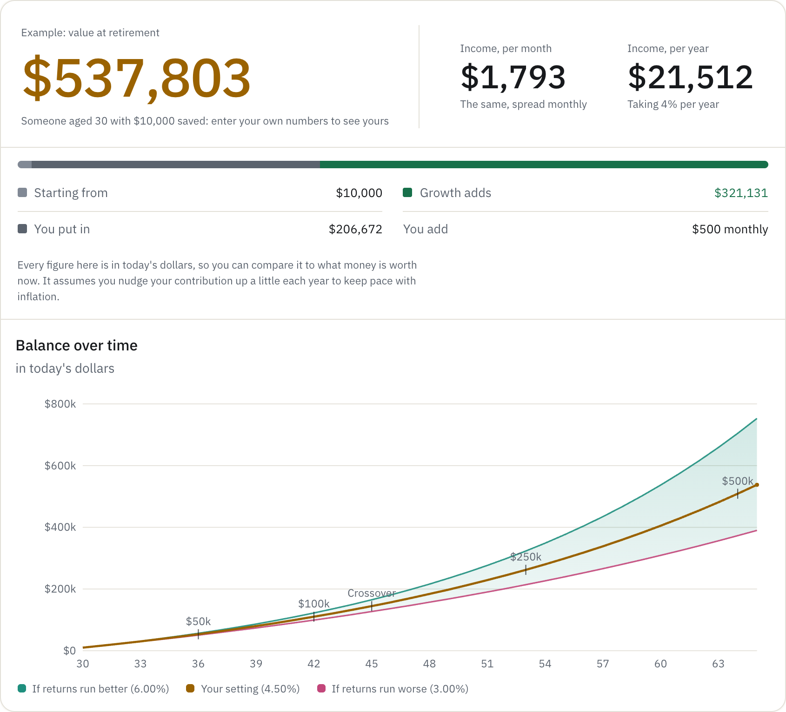
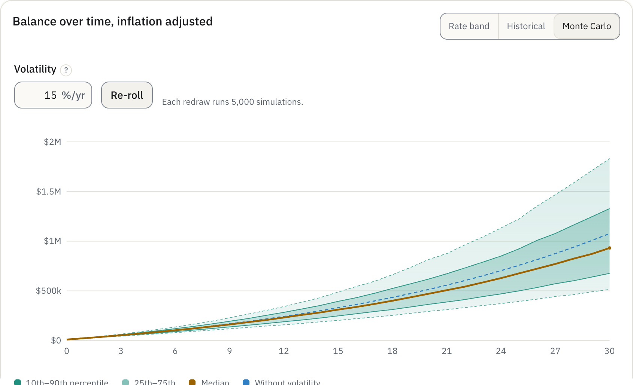
Basic and Advanced
CALCULATORS
What will my savings grow to, and is it enough?
Basic answers in six questions. Advanced adds what a real plan has to carry.
ADVANCED ADDS
Traditional, Roth, brokerage and HSA
Employer match, fees and a glide path
Taxes by filing status and state
Reach a target: the contribution or years it takes
Rate band, 1926 history or Monte Carlo
5,000
Monte Carlo runs on every redraw
retcalc.app/calculator

Slide 18
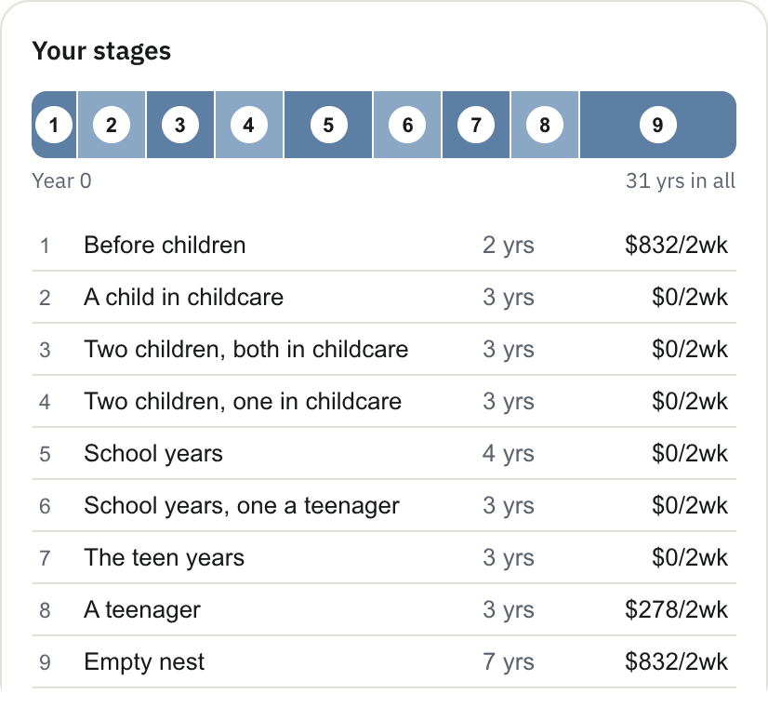
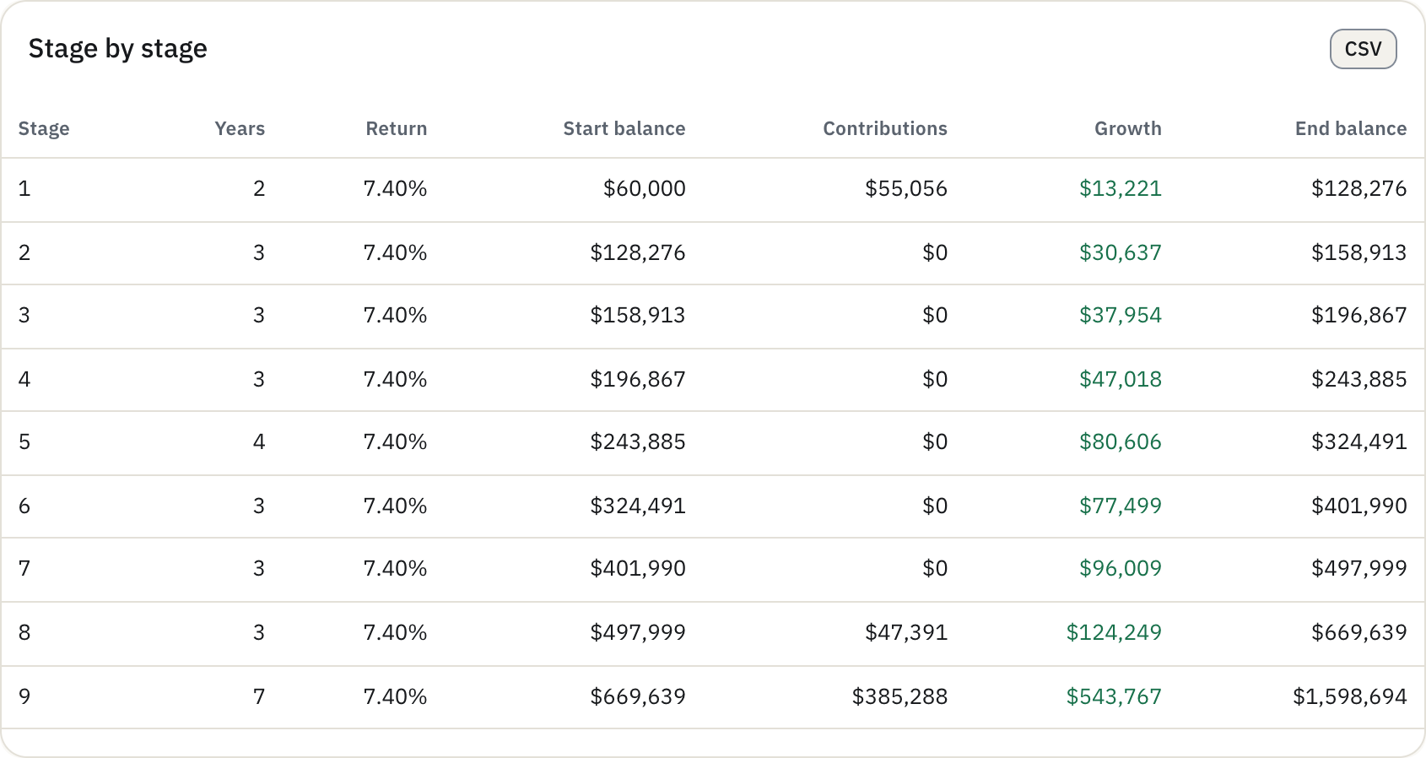
Stages: around children
CALCULATORS
Saving that pauses, then comes back
The kids builder turned the sample couple's single 31-year stage into nine, from Before children to Empty nest, with childcare and the teen years taking the saving for 18 years.
THE BUILDER ASKS
Children you have now, and their ages
Children planned, and how far apart
Paid childcare before school
Monthly cost by age band, or the defaults
9 stages
built from one, around two planned children
retcalc.app/stages

Slide 19
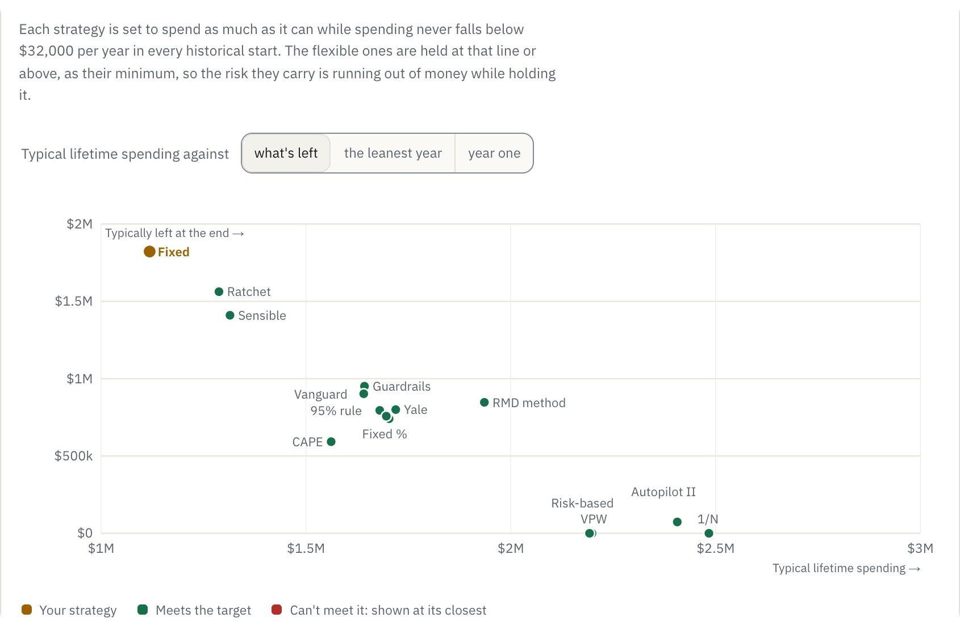
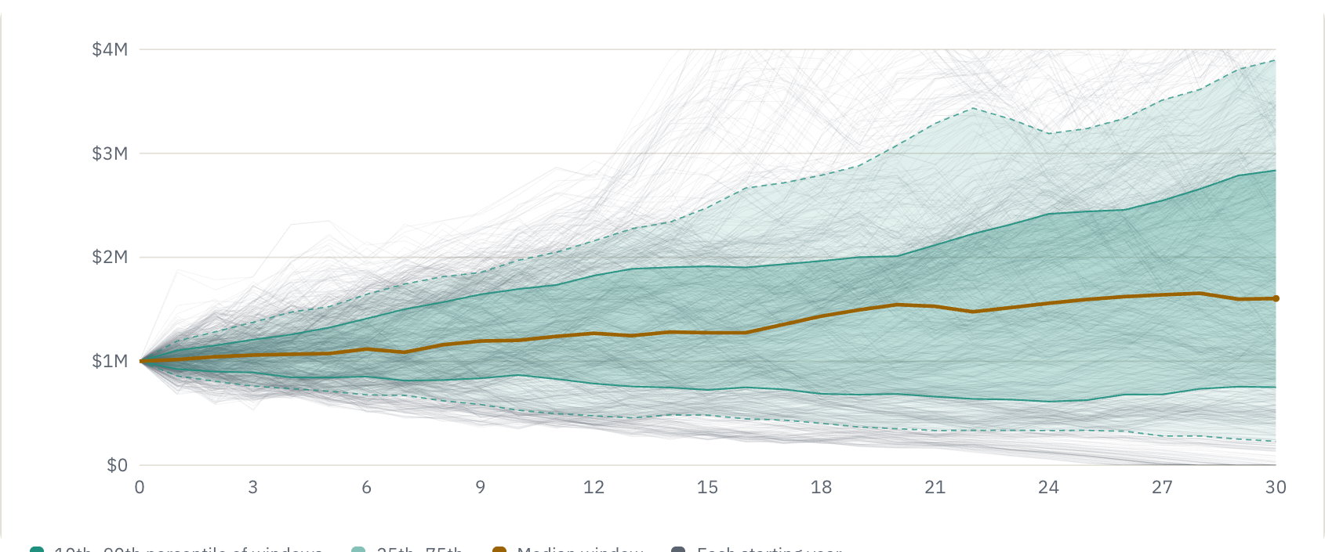
Drawdown: 15 strategies
RETIREMENT INCOME
Which withdrawal rule spends the most?
FIVE FAMILIES
Steady: fixed, Kitces ratchet
Share: fixed %, 95% rule, 1/N, RMD, VPW
Guardrails: Guyton-Klinger, risk-based
Smoothed: floor and ceiling, Vanguard, Yale, Autopilot II, Sensible
Valuation: CAPE-based
15
strategies, tuned to the same risk and compared
retcalc.app/drawdown

Slide 20
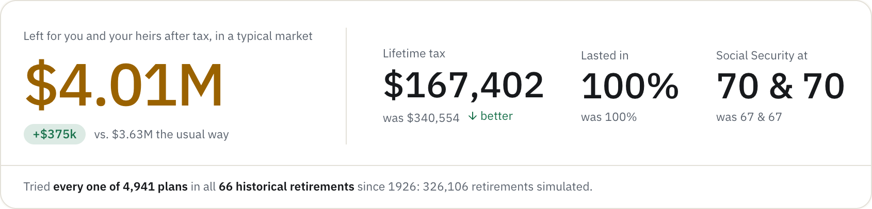
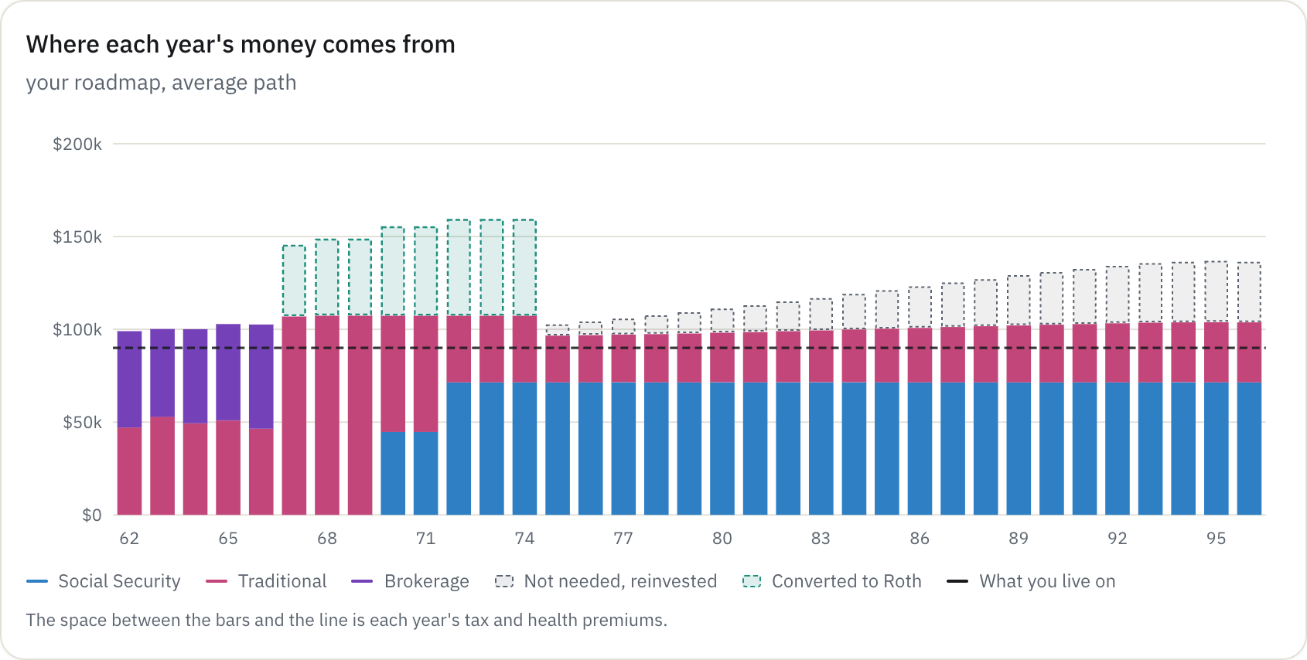
Retirement Plan Optimizer
RETIREMENT INCOME
Which plan leaves me the most?
Claiming ages, withdrawal order, Roth conversions and income guards, crossed and run through every market since 1926.
IN THE SAMPLE
4,941 plans in 66 historical retirements
+$375k left over the usual way
GOALS
Leave the most, make it last, or spend the most
326,106
retirements simulated in one search
retcalc.app/optimizer

Slide 21
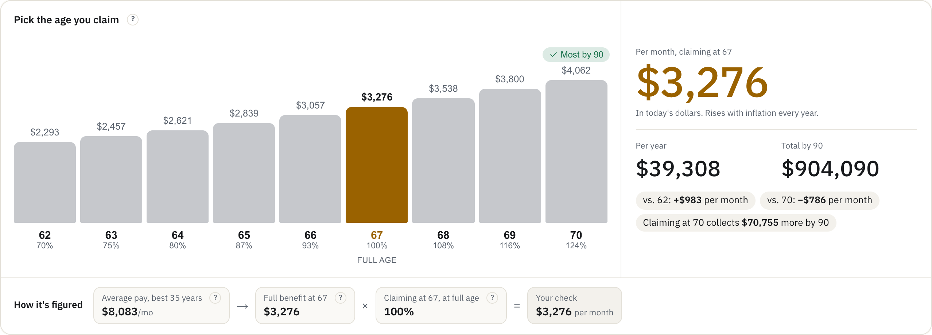
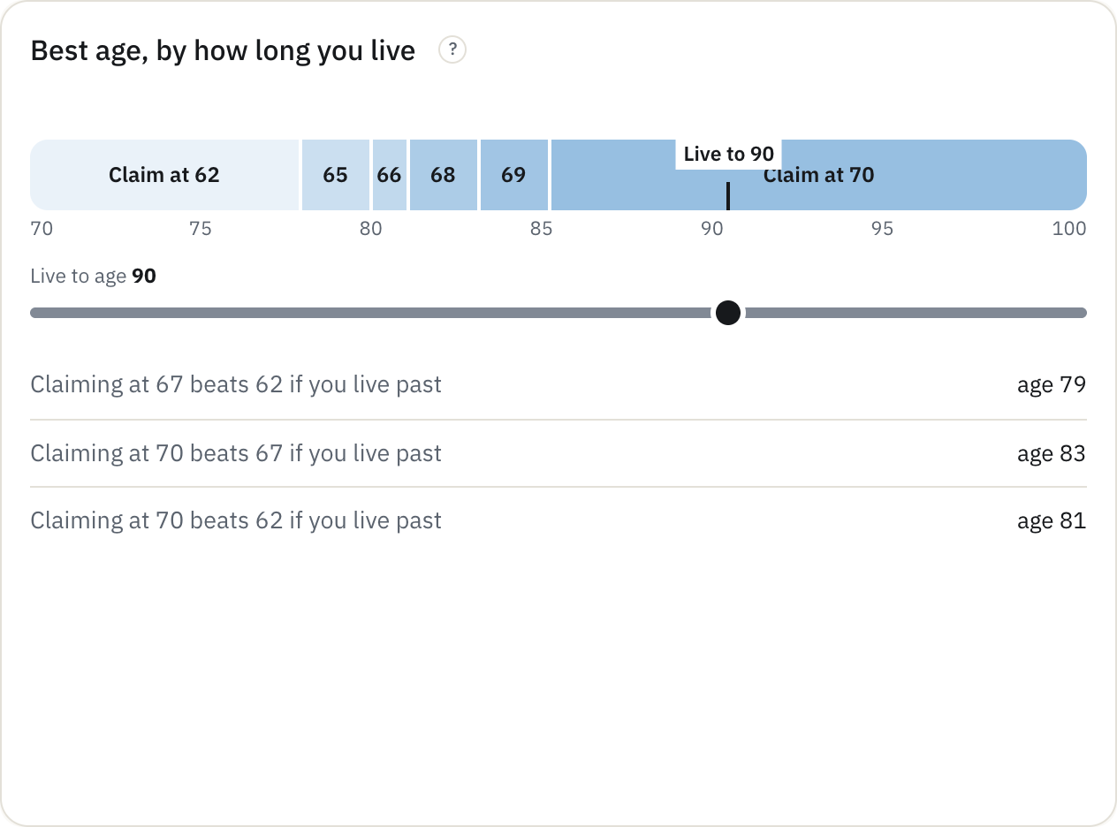
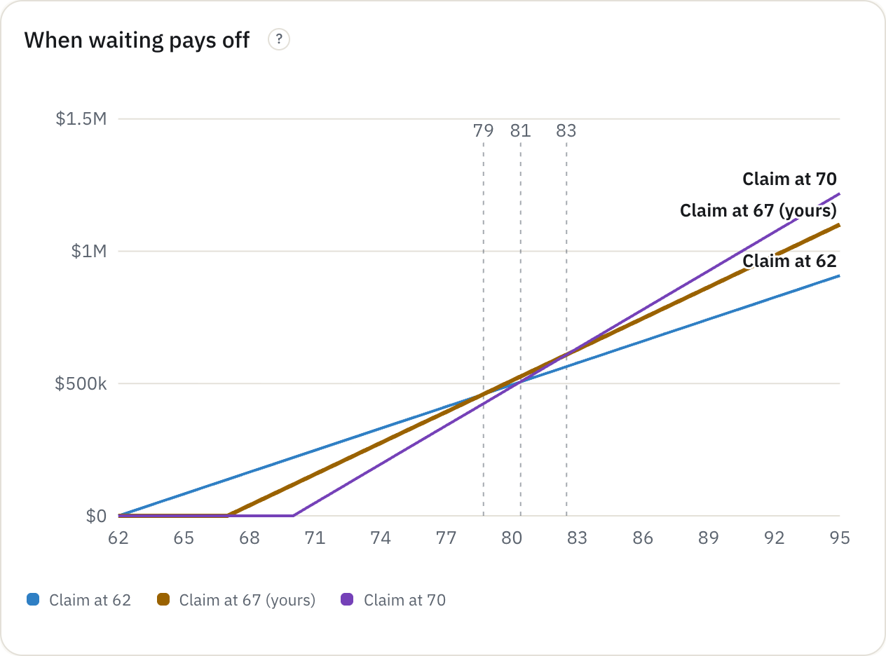
Social Security Calculator
RETIREMENT INCOME
When should I claim?
The check at every age from 62 to 70, how it is figured, and which age pays off best for how long you live.
FOR COUPLES
Every pair of claiming ages
The survivor benefit
How much of it is taxed
62 to 70
every claiming age, side by side
retcalc.app/social-security

Slide 22
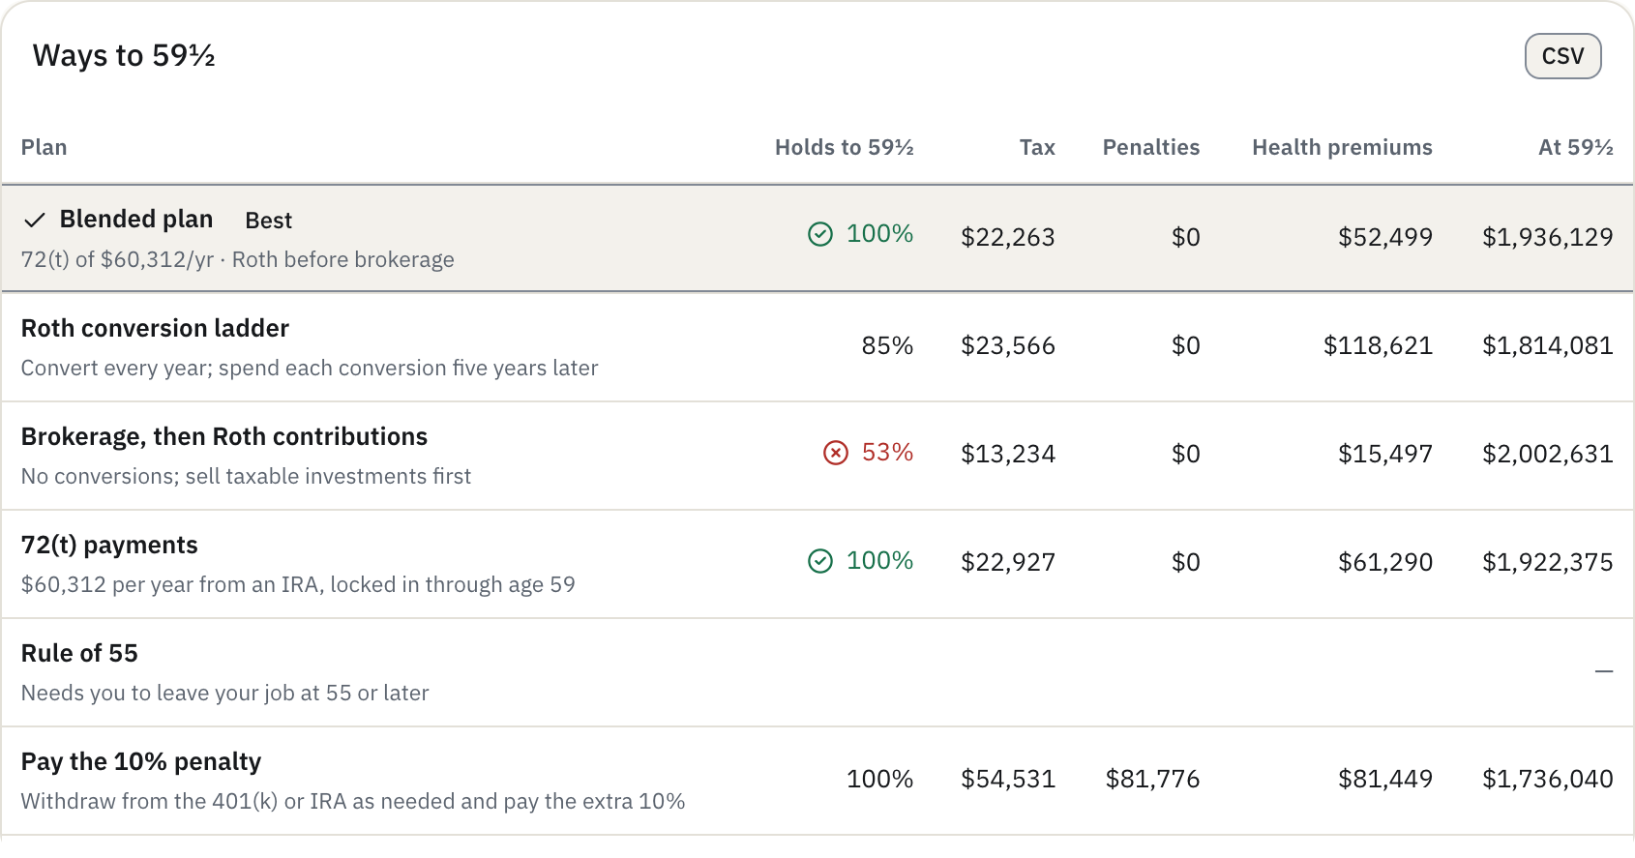
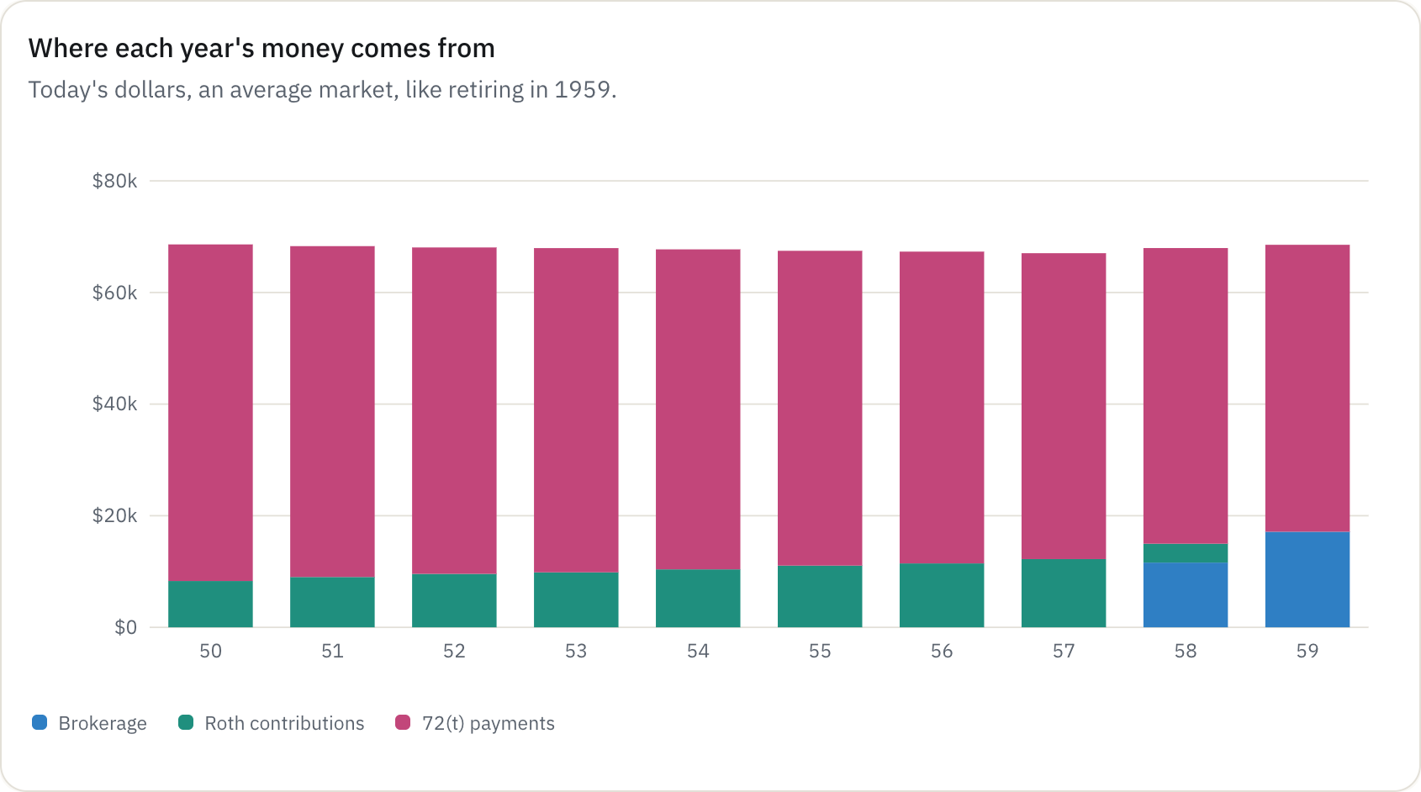
Early Retirement Bridge
RETIREMENT INCOME
How do I pay for the years before 59½?
Tax, penalties and ACA premiums for each route, and what is left at 59½.
ROUTES COMPARED
Roth conversion ladder
72(t) payments
Brokerage, then Roth contributions
Rule of 55 and part-time work
Paying the 10% penalty, as a benchmark
6 routes
to 59½, each tested since 1926
retcalc.app/bridge

Slide 23
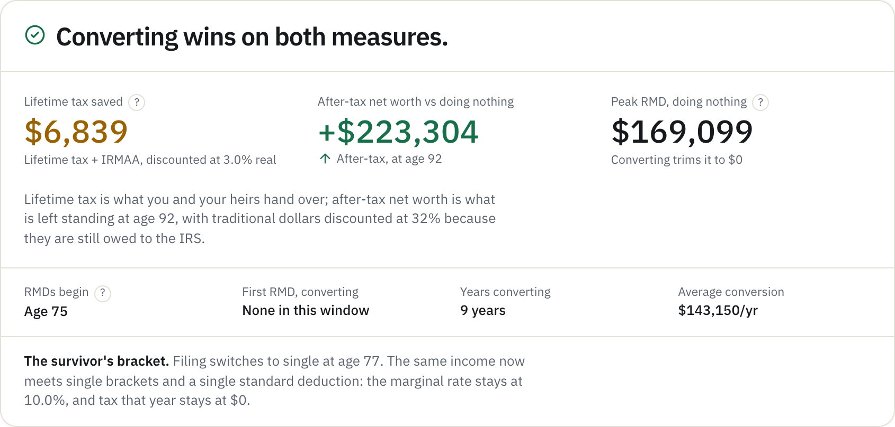
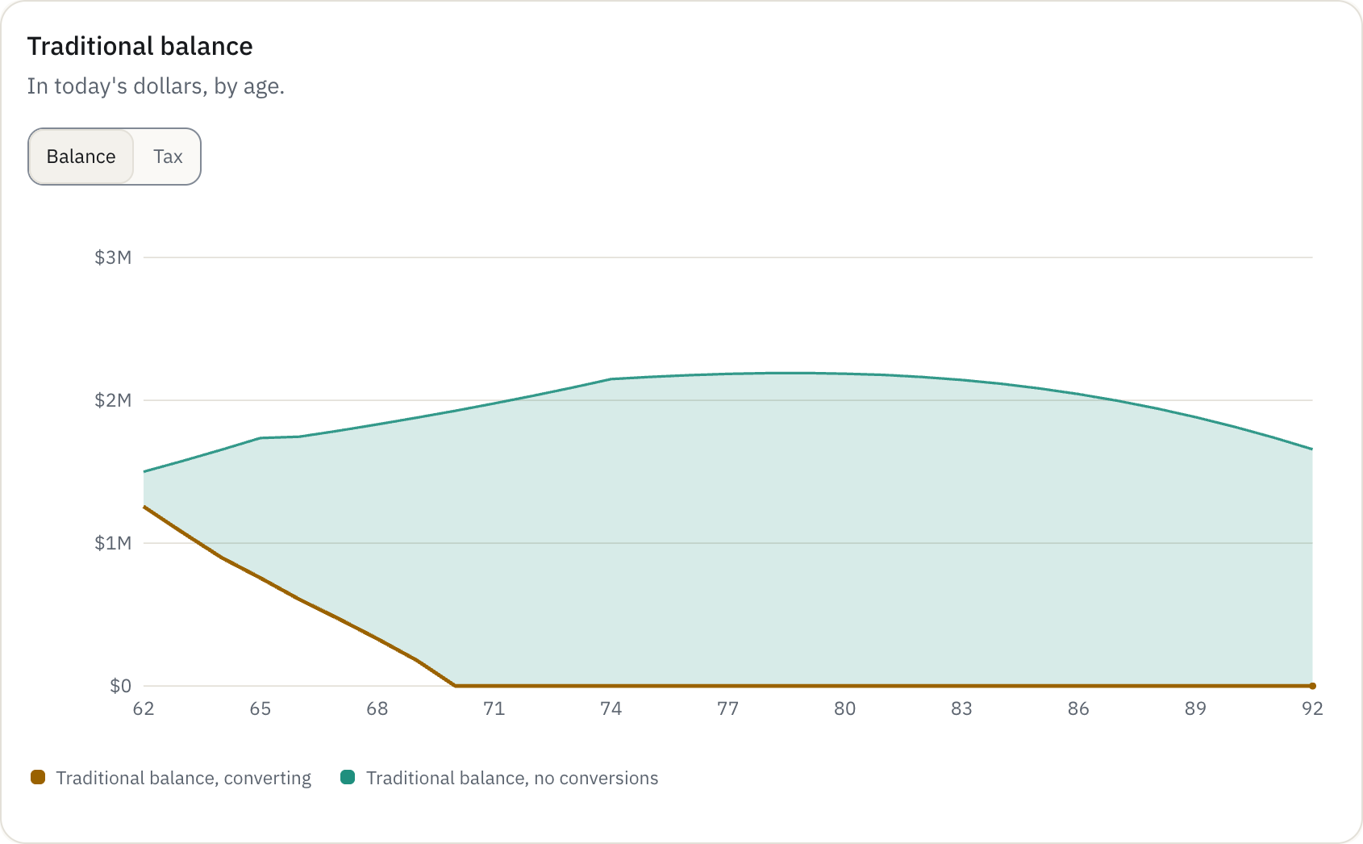
Roth Conversion Calculator
RETIREMENT INCOME
Should I convert before RMDs start?
Projects required distributions to age 100, then tests a conversion schedule against doing nothing.
STRATEGIES
Fill a bracket or an IRMAA threshold
A fixed amount or a share of the balance
None, for comparison
+$223,304
after-tax net worth from converting, in the sample
retcalc.app/roth

Slide 24
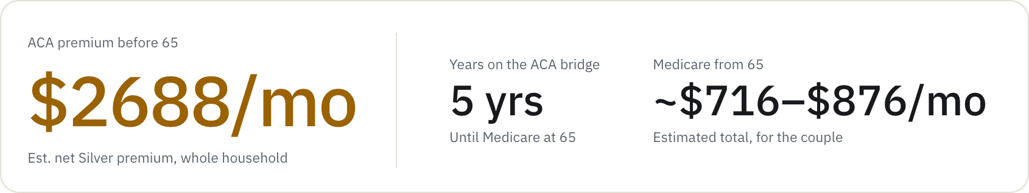
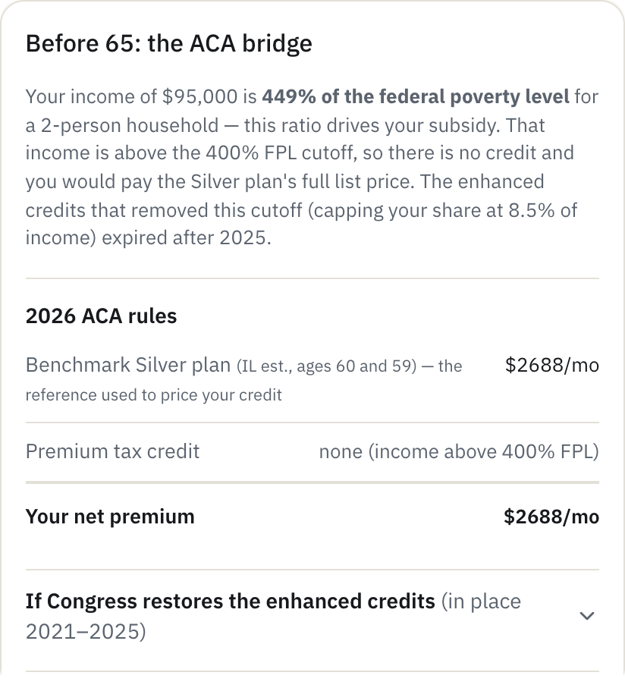
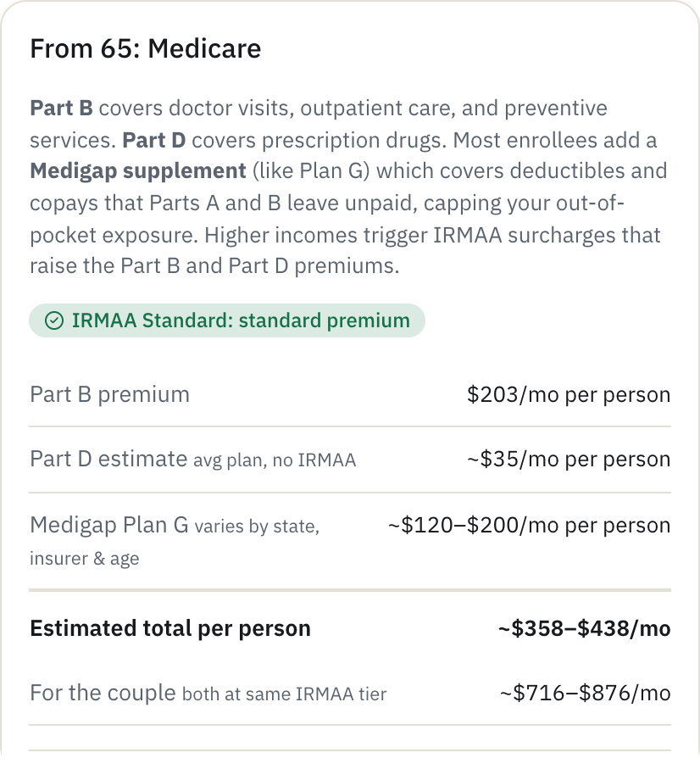
Healthcare Cost Planner
RETIREMENT INCOME
What will health insurance cost before and after Medicare?
ACA premiums and subsidies for the gap before 65, then Medicare Part B, Part D, Medigap and IRMAA.
THE SAMPLE
A couple retiring at 60 on $95,000
Just over the subsidy cliff: $2,688 per month
Then Medicare: $716–876 per month
$2,688
per month for the ACA, just over the subsidy cliff
retcalc.app/healthcare

Slide 25
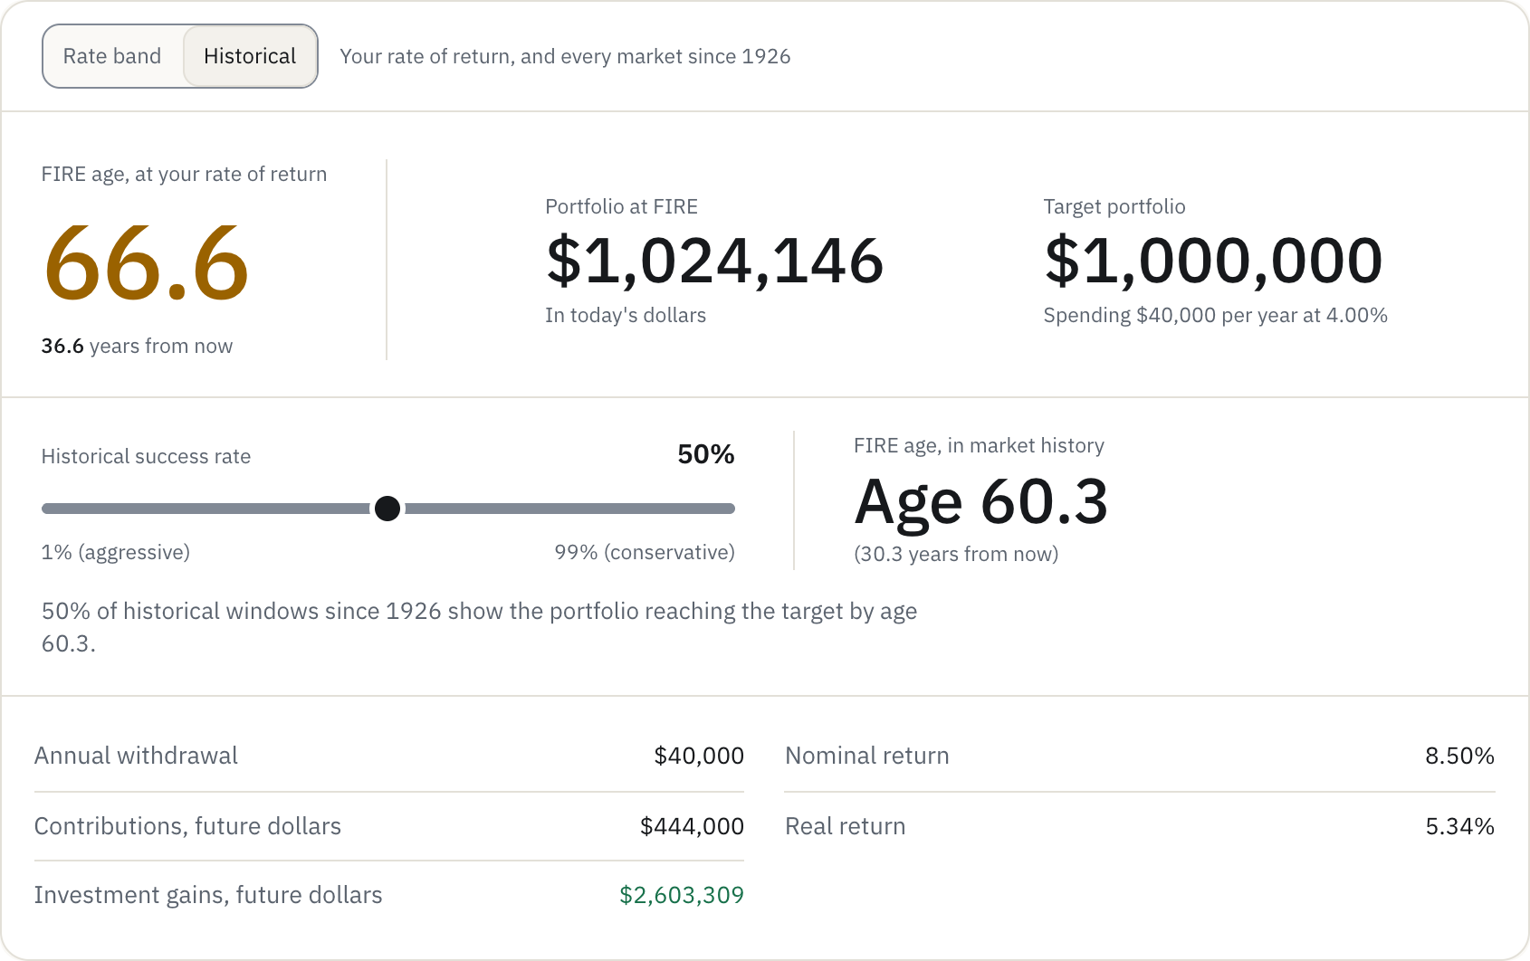
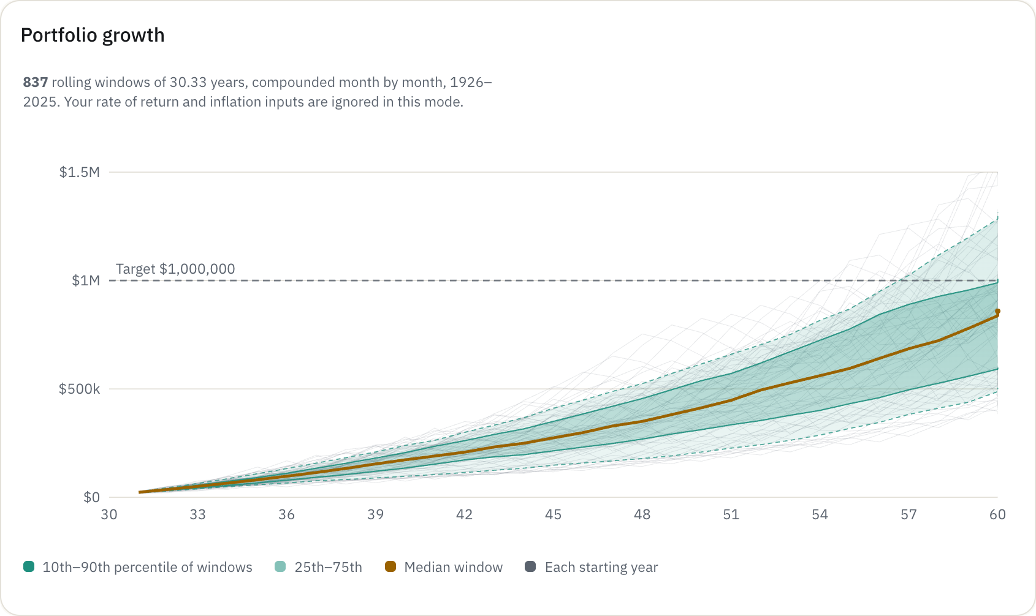
FIRE Calculator
SAVING AND INVESTING
When does work become optional?
The age a portfolio reaches financial independence, or with Coast FIRE, the age you could stop contributing.
HISTORICAL MODE
Every rolling window since 1926
A success-rate slider gives a second answer: the age reached in, say, 90% of history
Age 66.6
financial independence in the sample, at $1,024,146
retcalc.app/fire

Slide 26
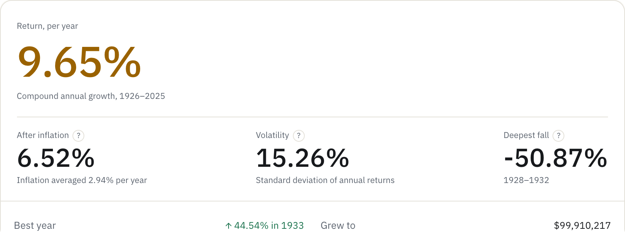
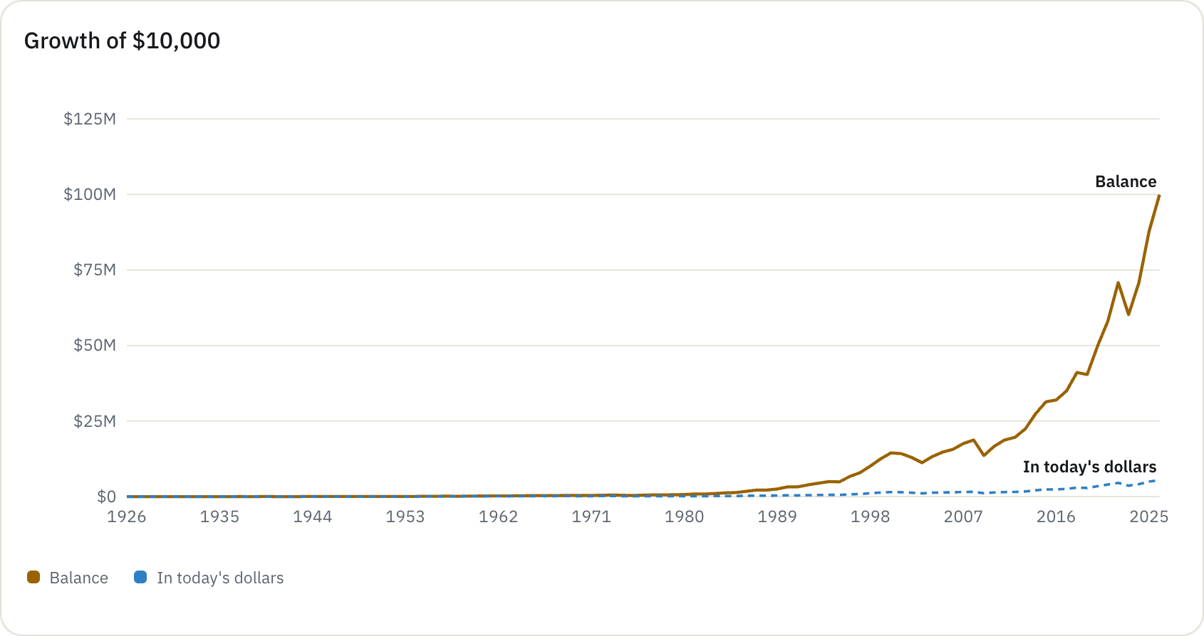
Portfolio Backtest
SAVING AND INVESTING
What would this mix have actually done?
YOU CHOOSE
Stocks, small-cap value, bonds and cash
How often to rebalance
Any span from 1926 to 2025
YOU SEE
Return, before and after inflation
Volatility and the deepest fall
Growth of $10,000 and rolling returns
9.65%
per year for 80/20 stocks and bonds, 1926–2025
retcalc.app/backtest

Slide 27
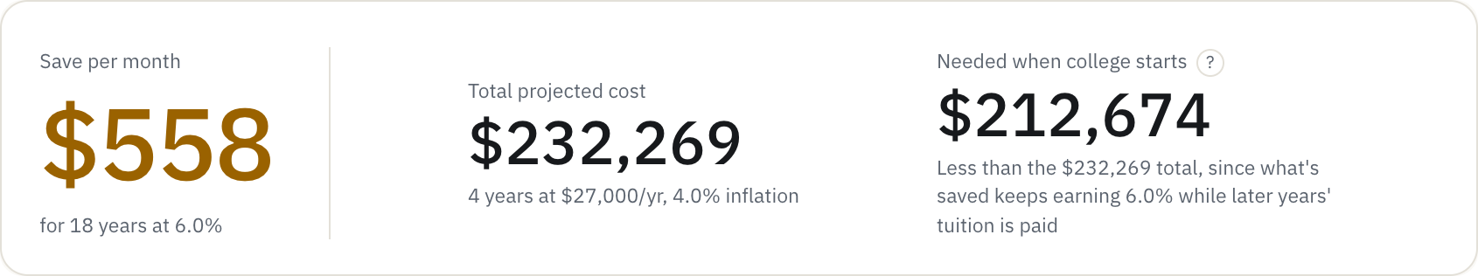
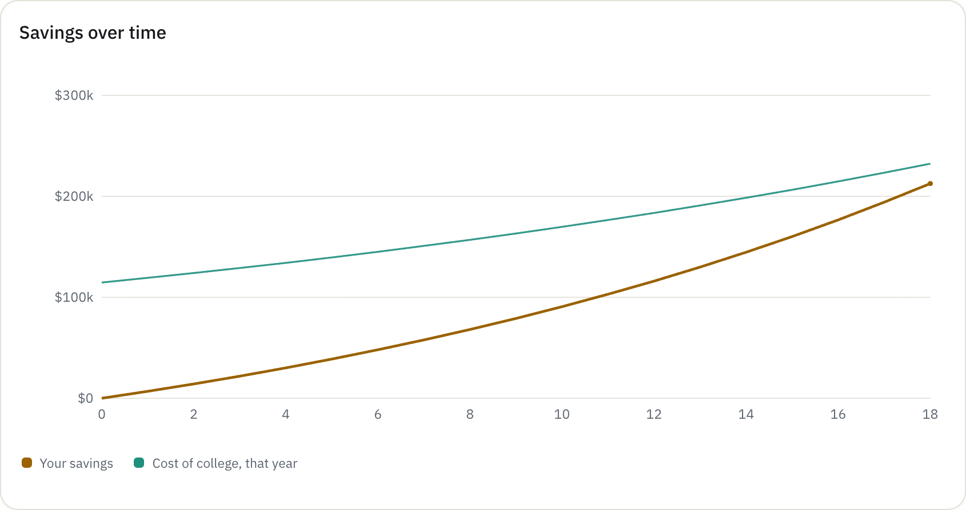
College Savings
SAVING AND INVESTING
How much should I save for college?
PRESETS, PER YEAR
Public in-state, about $27,000
Private non-profit, about $59,000
Elite, about $82,000
ALSO
Several children on one account
Tuition inflation and years in college
$558
per month for an in-state school, 18 years out
retcalc.app/college

Slide 28


Rent vs. Buy
SAVING AND INVESTING
Should I rent or buy?
Buyer and renter net worth over any horizon, counting what the down payment could have earned.
IT COUNTS
Price, down payment, rate and term
Tax, insurance, upkeep, closing and selling
Rent growth, appreciation and returns
$811,712
how far renting came out ahead after 30 years
retcalc.app/rentbuy

Slide 29


Income Tax: retirement mode
EVERYDAY MONEY
What does a year of withdrawals cost?
IT STACKS
Long-term gains into the 0/15/20% bands
The 3.8% net investment income tax
Social Security's 0/50/85% tiers
The 2026 senior deduction
State rules for pensions and withdrawals
4.9%
total tax on $100,000 of retirement income
retcalc.app/incometax

Slide 30


Budget: the itemized paycheck
EVERYDAY MONEY
Every line of every check
Per check, per month and per year: earnings, pre-tax lines, each tax, the deposit, the budget and where the rest goes.
THREE ONE-CLICK PLANS
The usual order
Max tax breaks
Stay flexible
$0
left unassigned: every dollar has a place
retcalc.app/budget
The itemized paycheck, in two halves: per check, per month and per year

Slide 31



Debt Payoff
EVERYDAY MONEY
Which debt should I pay off first?
YOU GET
The debt-free date and total interest
Avalanche against snowball, with a verdict
The payoff order
What $100 more per month would do
Sep 2030
debt-free in the sample, $10,167 saved
retcalc.app/debt

Slide 32


Mortgage Calculator
EVERYDAY MONEY
What will the house cost each month?
The full payment, how the balance falls, and amortization year by year.
WHAT-IFS, IN THE SAMPLE
$300 extra per month and $10,000 once
Paid off 9 years 7 months sooner
$201,179 less interest
A refinance to 6.25%: even in 1 year 7 months
$201,179
less interest with $300 extra per month
retcalc.app/mortgage

Slide 33







The Readiness Guide ends in a plan on paper
GUIDED WALKTHROUGHS
About a dozen US Letter pages, built in the browser and saved as a PDF. This is the report for a sample couple, 38 and 36, retiring at 62.

Slide 34

The household, step by step
PUTTING IT TOGETHER
1 · Budget, Paycheck tab
2 · Stages, after the kids builder
3 · Social Security, both at 67
4 · Drawdown, with both benefits

Slide 35
The stack
UNDER THE HOOD
Framework | Next.js 16 (App Router), React 19, TypeScript 5
Look | Tailwind CSS v4 and shadcn/ui on Base UI, Lucide icons, IBM Plex Sans served by the site
Engine | Plain JavaScript type-checked through JSDoc, behind typed TypeScript bridges, run in a Web Worker
Checks | ESLint with zero warnings allowed, tsc, @shadcn/lint, a calculation suite, unit and end-to-end tests
Design | A written design system: Graphite (dark, the default) and Paper (light), one amber accent, five chart hues
39
~55,600
page routes
lines of app code
~7,400
29
lines in the engine and its data
explanatory articles
THE PALETTE
Design rules are enforced by the linter: no raw colors, no one-off sizes, no inline styles.
Graphite
Raised
Amber
Paper
Amber, light

Slide 36
About 5,700 lines of finance in one engine
UNDER THE HOOD
Historical replay
Every starting month since 1926, run through what actually happened. 835 starts for a 30-year retirement.
Monte Carlo, calculators
5,000 lognormal runs per redraw, set so zero volatility draws the plain projection exactly.
Monte Carlo, drawdown
A block bootstrap of real history: runs of years drawn together, so the 1930s and 1970s keep their streaks.
Projections, Monte Carlo, federal and state tax, FICA, Social Security, RMDs, Roth conversions, ACA and Medicare, mortgages, debt, rent against buy, college, FIRE, the 72(t) bridge and historical withdrawal backtests.
One seed
Every simulation shares a seeded generator, so charts hold still; Re-roll moves them all at once.

Slide 37
A test for every claim, before anything ships
UNDER THE HOOD
A change
Pre-commit gate
On every push
Live
to the engine, a tool's defaults, an article or page text
~618 checks in 55 groups. A failure blocks the commit.
the suite again, numbers baselines, lint, typecheck, build, unit and end-to-end tests
main deploys to Vercel; every branch gets a preview first
~618
209
7
17
1,200
checks in the calculation suite
tie the 29 articles' worked examples to the engine
sample households with pinned Guide results
end-to-end browser specs
months of market history every engine walks
Worked examples in the articles are checked against the calculator, so the numbers in the writing always match the numbers in the tools.

Slide 38




Fast because there is almost nothing to serve
UNDER THE HOOD
Hosting | Vercel, building from main, with a preview for every branch
Rendering | Prerendered pages. No API routes: the one thing the site's own server receives is error reports, stripped of inputs
Domain | retcalc.app, DNS on Cloudflare
Analytics | Cloudflare and Vercel Web Analytics: cookieless, production only, no ads
Email | Sign-in codes through Resend, from the site's own domain
LINK PREVIEWS, DRAWN FOR EVERY PAGE
Error reports that can't leak a plan
Errors only, production only. Addresses cut to the path, so the # holding a tool's inputs never leaves the page. No breadcrumbs, user details or local variables.

Slide 39

Local first. An account is only a way to sync
UNDER THE HOOD
WHAT AN ACCOUNT STORES
WHAT IT NEVER STORES
SIGNING IN, AND OUT FOR GOOD
Email, and a first name if given
The household
Saved scenarios, by tool
Guide and Paycheck plan answers
Numbers typed but not saved
Browsing activity
Anything for advertisers: there are none
Share-link inputs, after the #
A 6-digit email code, or Google
Download everything, any time
Delete: sessions end, then the data goes
Changes save to the browser first and push shortly after; a two-way merge runs on sign-in. If both sides changed a scenario, both are kept. Each person reaches only their own rows, and backups run weekly, encrypted.

Slide 40
22 figures, each with a source and a due date
UNDER THE HOOD
TAXES
HEALTHCARE
MARKETS
HOUSING AND DEFAULTS
Federal brackets
IRS Revenue Procedure
Yearly
Medicare B, IRMAA
CMS
Yearly
Stocks, bonds, inflation
Shiller (Yale), BLS
Yearly
Mortgage rate
Freddie Mac survey
Quarterly
Contribution limits
IRS notices
Yearly
Part D, Medigap
CMS, KFF
Yearly
T-bills, small value
French Data Library
Yearly
Home price and rent
NAR, Census, Zillow
Yearly
Social Security figures
SSA fact sheet
Yearly
ACA premiums
KFF, HHS, IRS
Yearly
Today's CAPE
multpl.com
Monthly
College, children
College Board, USDA
Yearly
State tax, 50 + DC
Tax Foundation, states
Yearly
RMD tables
IRS Pub. 590-B
Yearly
Anything coming due is flagged at the start of every working session. Figures are never invented, each is cited beside it in the code, and a new tax year is added beside the old one, never over it.

