Slide 1
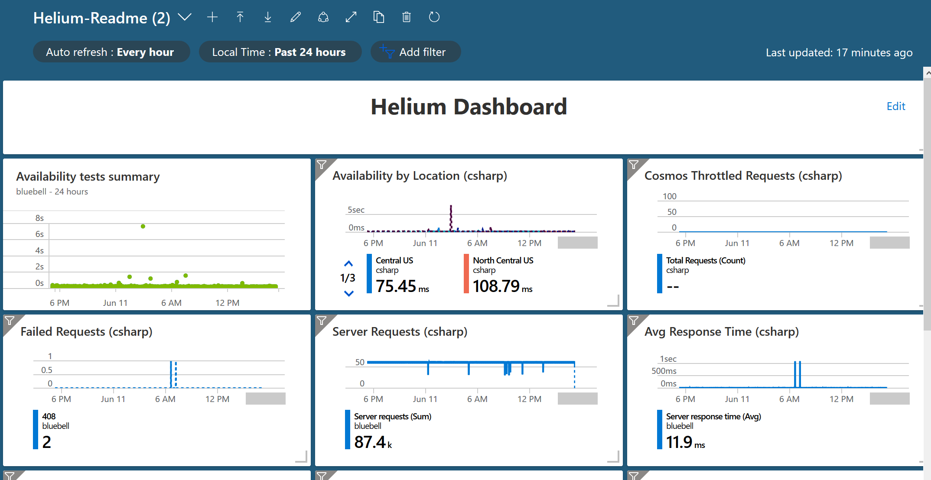
Provides average availability (every 5 minutes) by location for Application Insights Instance
Count of total requests against the Cosmos DB
Provides summary of availability of Application Insights instance
Combines 3 types of failures (requests, memory and closed channel)
Total Server requests
Average response time of webapp

Slide 2
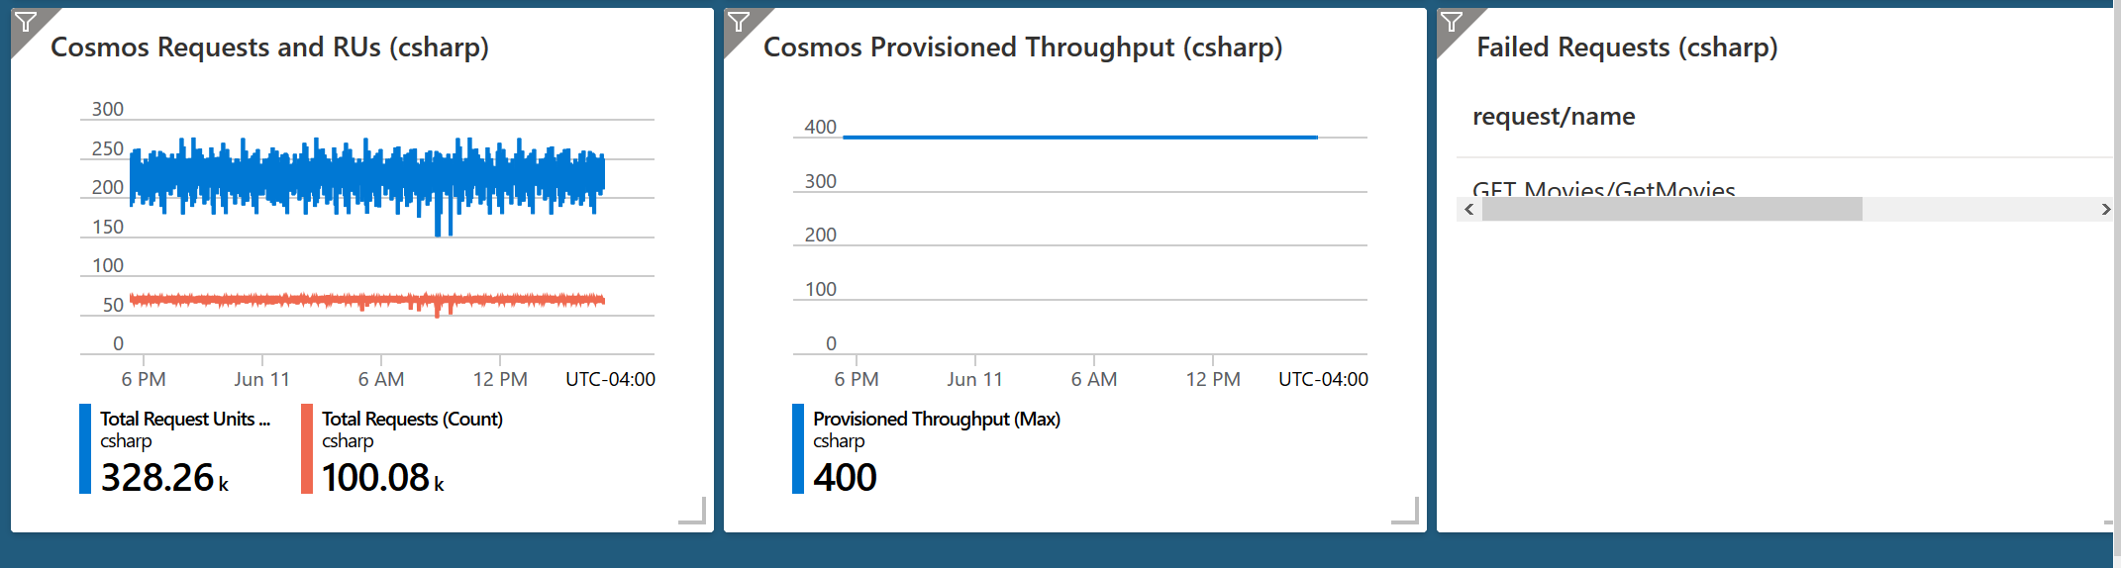
Total Cosmos Rus consumed and Total Cosmos requests
Cosmos Max RU throughput (will not exceed RU limit)
Total Failed requests by call to the webapp

