Slide 1




Tips Hindawi
HomeGuardian AI: Smart Appliance Care Assistant
Team Members:
Retaj Ali 95
Doha Mahmoud 108

Slide 2
problem statement
Home appliance manuals are often long and difficult to search, making it hard for users to quickly find troubleshooting, maintenance, and safety information.
Then add 3 short points:
Difficult to search appliance manuals.
Maintenance tasks can be forgotten.
Repair information is not always organized.
Smart appliance care using RAG • LangChain • Hugging Face • FAISS • Streamlit

Slide 3

Project Objectives
The main objective of HomeGuardian AI is to make appliance management easier using artificial intelligence.
Add 4 objectives:
Simplify appliance setup.
Provide manual-based AI assistance.
Manage maintenance reminders.
Organize appliance repair history.

Slide 4
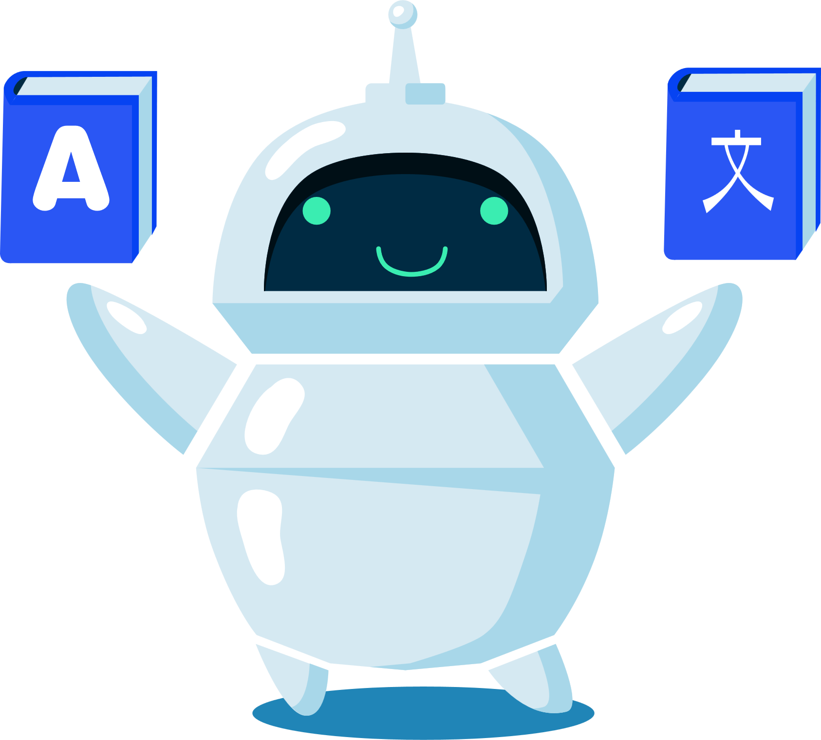
problem objectives
HomeGuardian AI combines appliance manuals, AI assistance, maintenance reminders, and repair tracking in one application.
The main features:
Dashboard
Overview of appliances and care status.
Add Appliance
Upload a manual and automatically detect appliance information.
AI Assistant
Ask questions based on the appliance manual.
Maintenance
Create and track care reminders.
Repair History
Store previous repairs and costs.

Slide 5
System Workflow
Upload PDF Manual
↓
Extract Manual Text
↓
Detect Appliance Information
↓
Split Manual into Chunks
↓
Generate Embeddings
↓
Store in FAISS
↓
Ask AI
↓
Retrieve Relevant Information
↓
Generate Final Answer

Slide 6
RAG
HomeGuardian uses Retrieval-Augmented Generation to retrieve relevant information from the selected appliance manual before generating an answer.
User Question
↓
FAISS Search
↓
Relevant Manual Chunks
↓
Qwen
↓
Final Answer

Slide 7

Models used
Embedding Model:
sentence-transformers/all-MiniLM-L6-v2
Used for embeddings and semantic search.
Generation Model:
Qwen/Qwen2.5-7B-Instruct
Used to generate the final response.

Slide 8

Technologies & System Architecture
Python
Streamlit
LangChain
Hugging Face
FAISS
PyMuPDF
HTML / CSS / JavaScript
User Interface
Streamlit
↓
Application Logic
Appliance / Maintenance / Repair
↓
AI Processing
PyMuPDF + LangChain + FAISS + Hugging Face
↓
Data Storage

