Slide 1



Qatma
Retaj Ali 231005689
Mohanad Waleed 231005430
Rawan Atef 231005789
Doha Mahmoud 231005333

Slide 2
Introduction
Qatma is a mobile application designed to make food ordering easy and convenient for users. In today’s fast-paced life, people often do not have enough time to visit restaurants or wait for long ordering processes. Many existing methods can be confusing, slow, and not user-friendly.

Slide 3
Problem Definition
The current food ordering process has many problems. Users may find it difficult to browse menus, place orders, and know the status of their orders. Some applications are complicated and not easy to use.
Users also may not have enough information about restaurants, such as reviews and delivery time. This makes the experience confusing and slow.

Slide 4


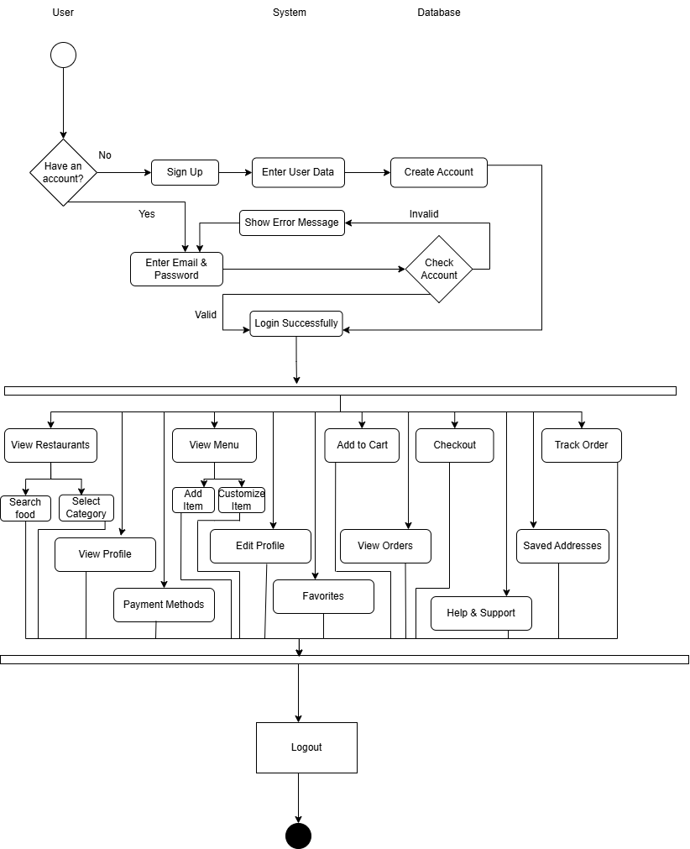

Conceptual Model

Slide 5
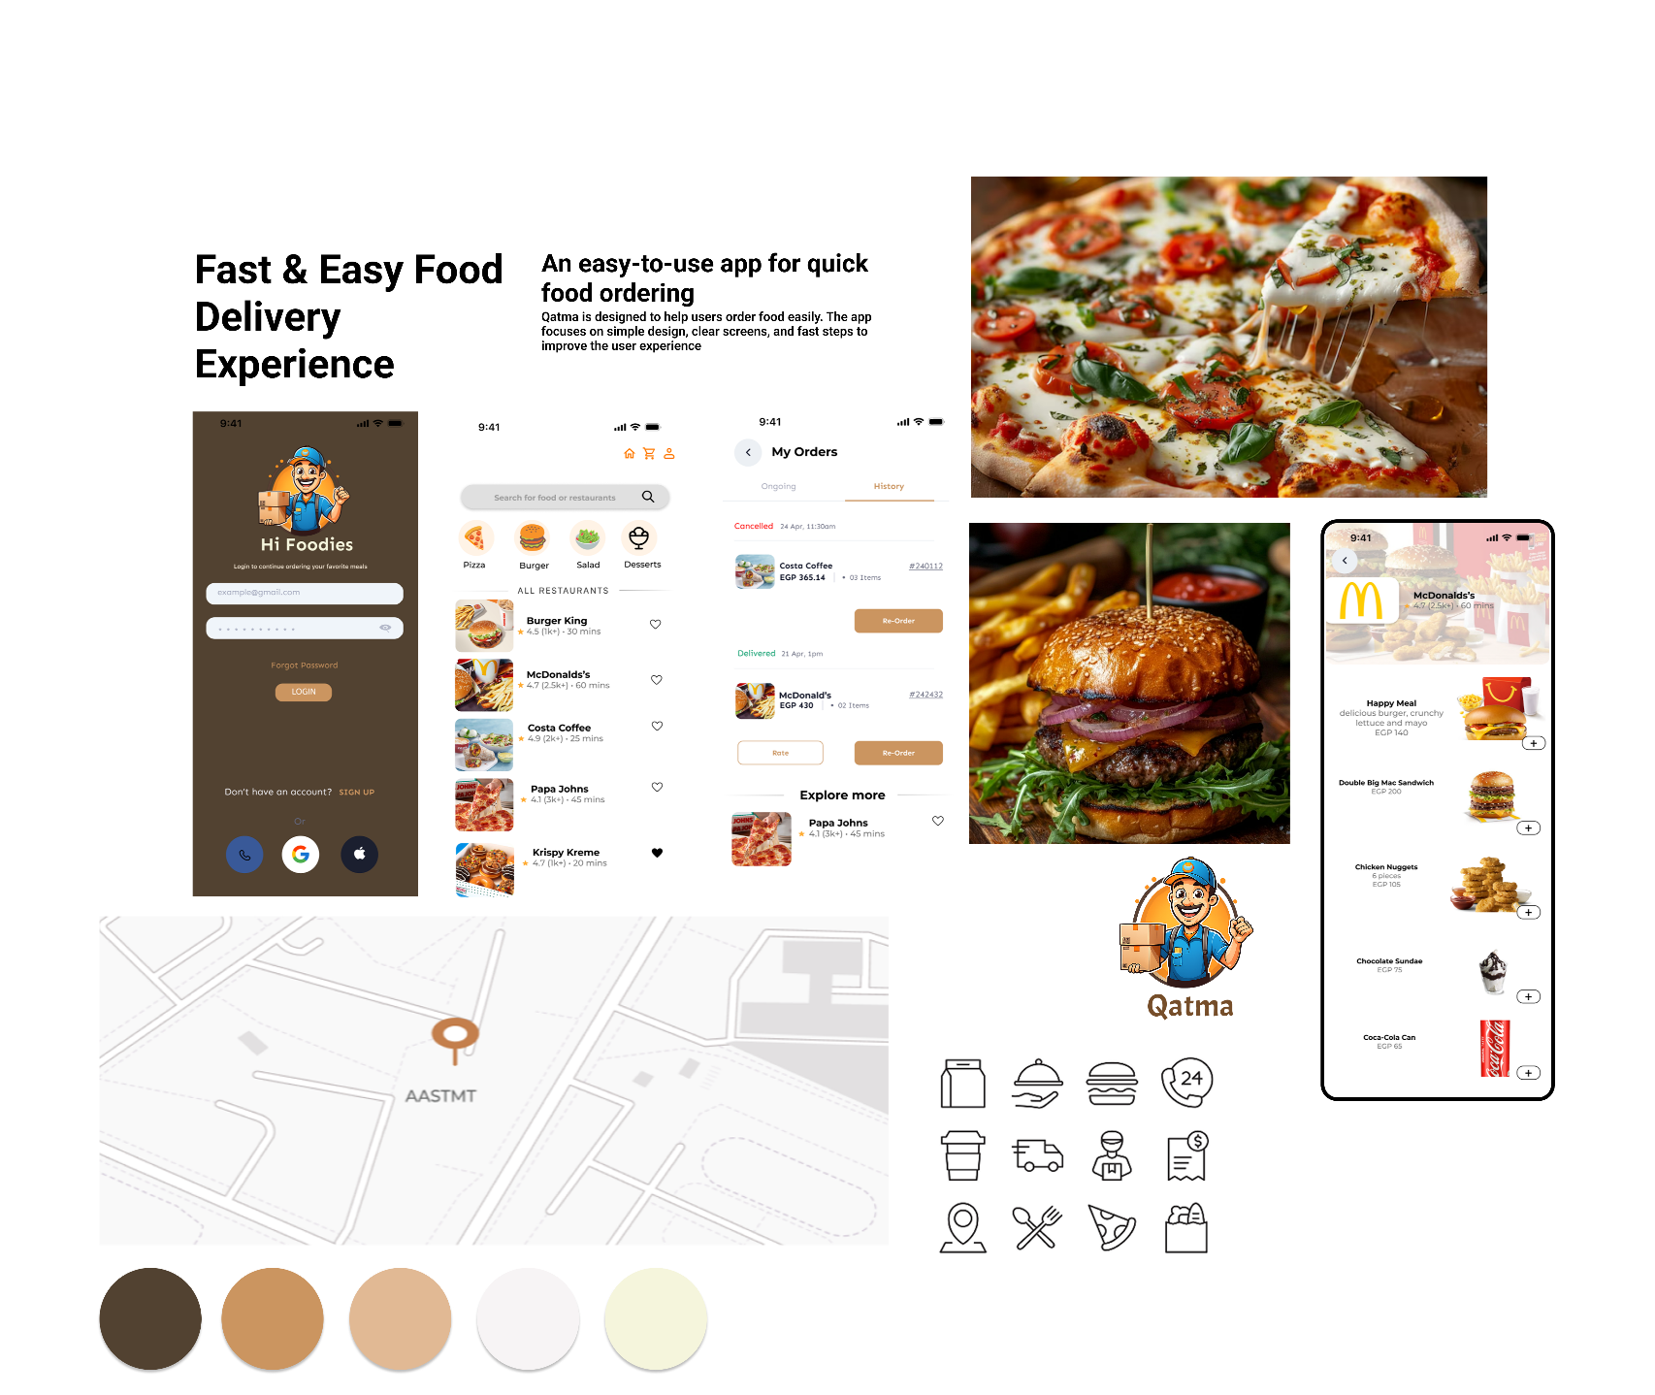
Mood-board

Slide 6
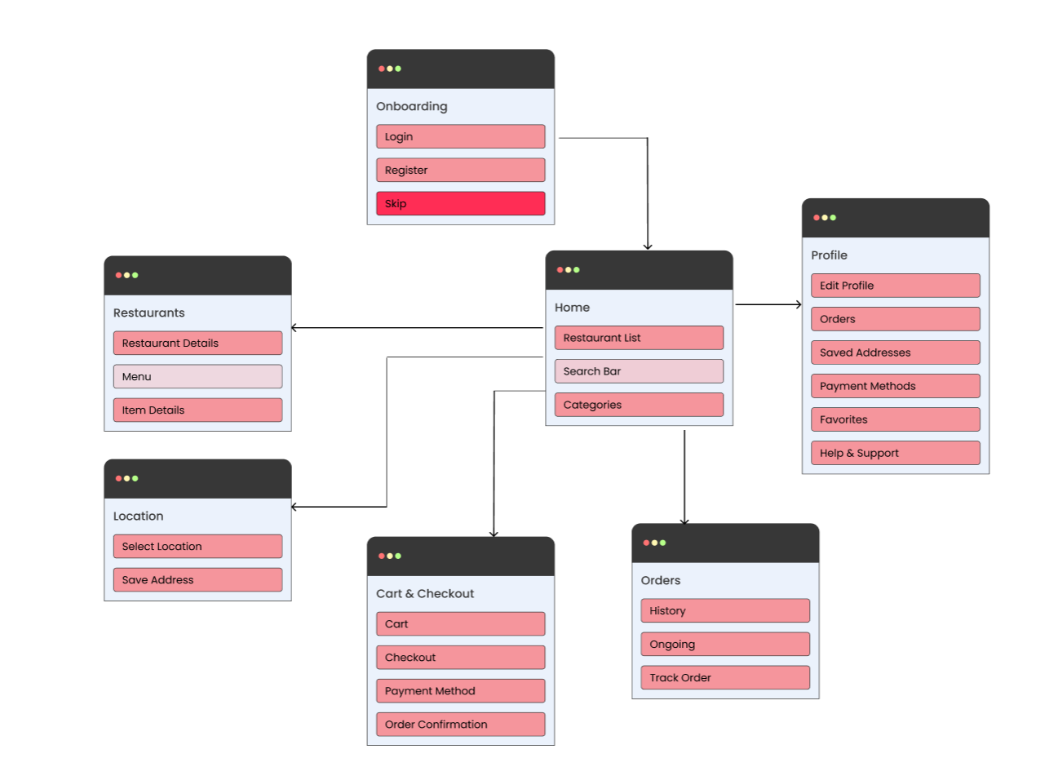
Site-Map

Slide 7
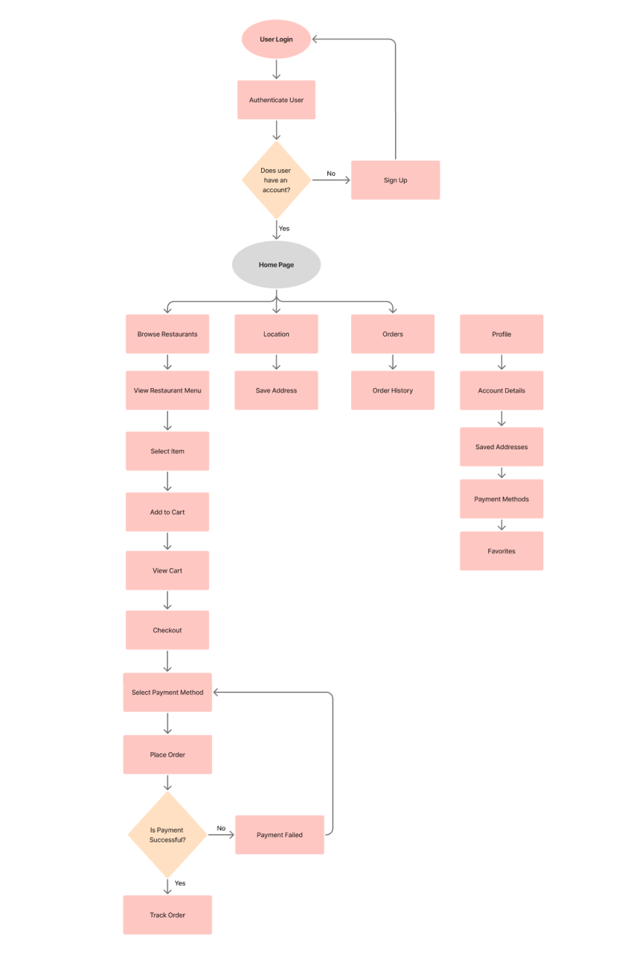
User Flow

Slide 8
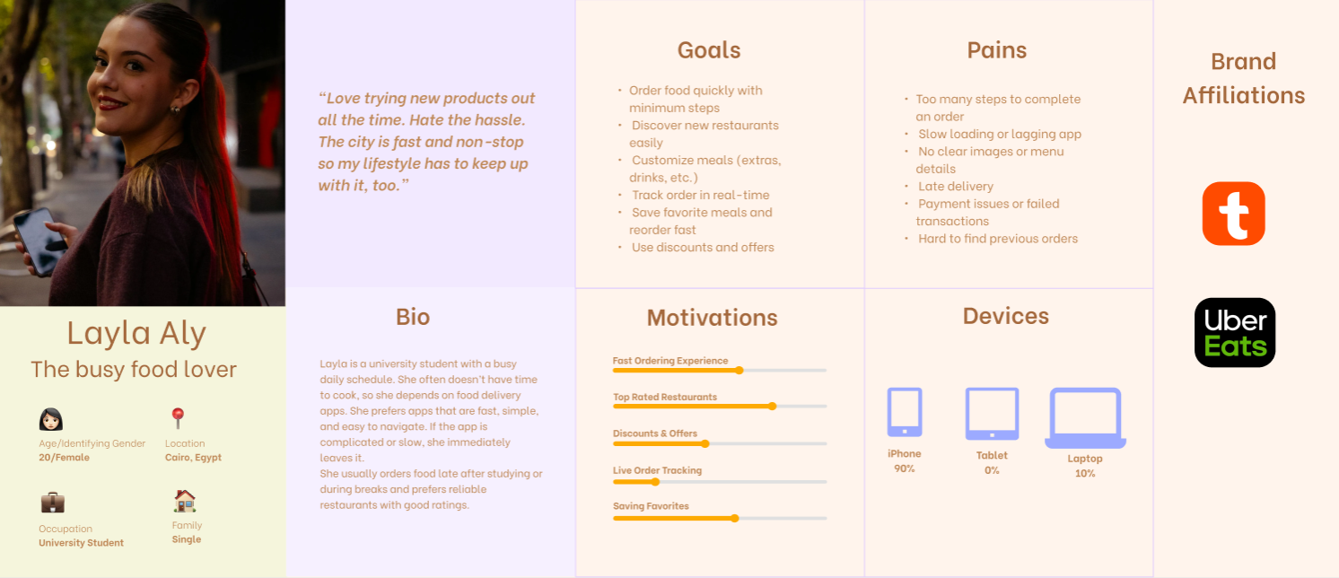
Personnas

Slide 9
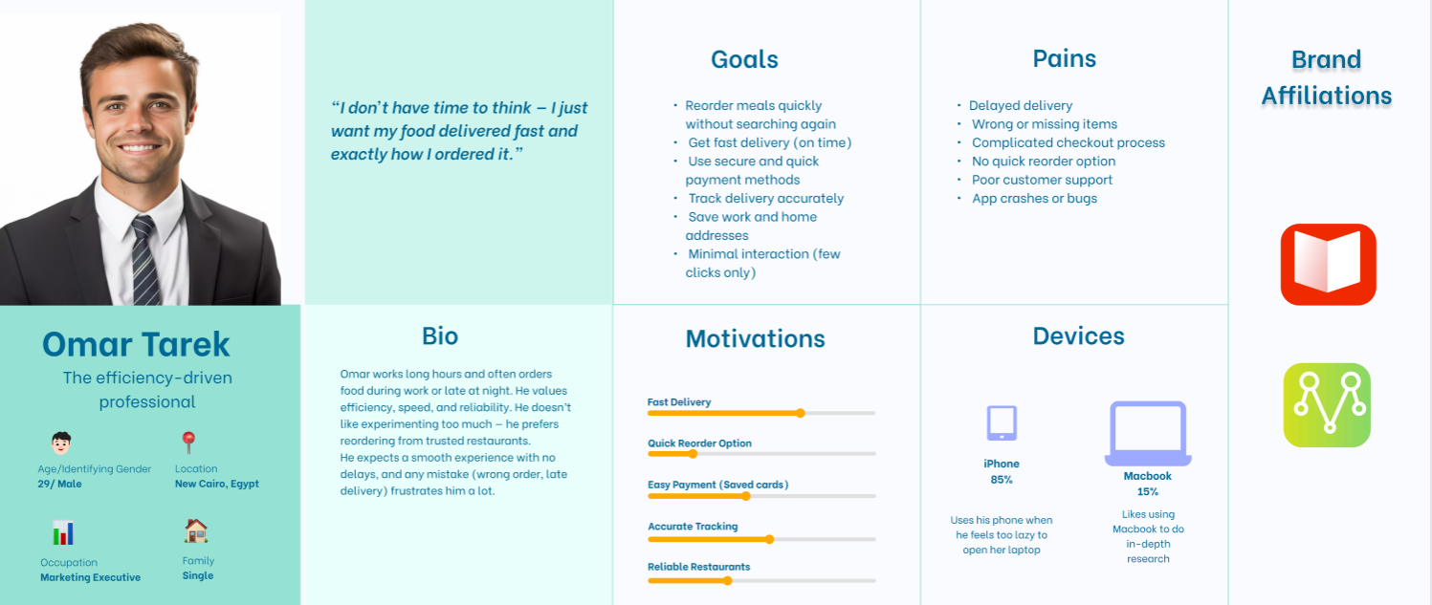
Personnas

Slide 10
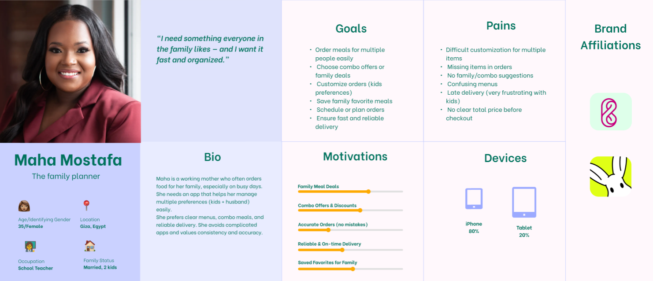
Personnas

Slide 11
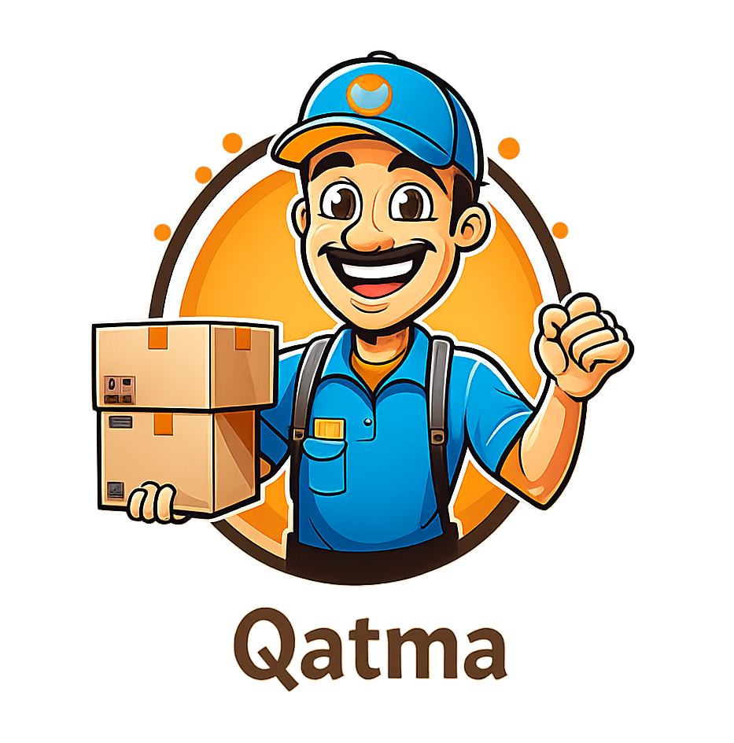
Identity Branding

Slide 12
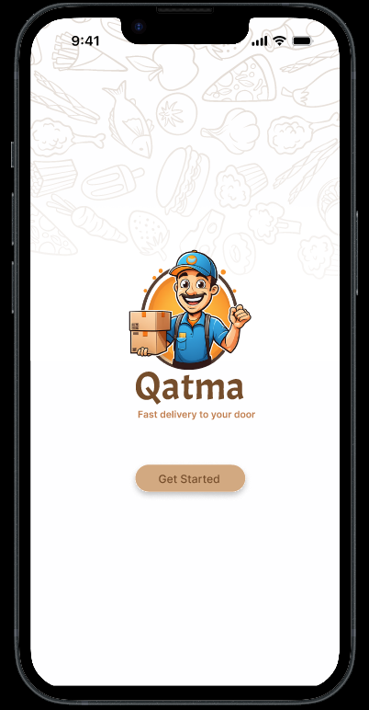
Figma

Slide 13
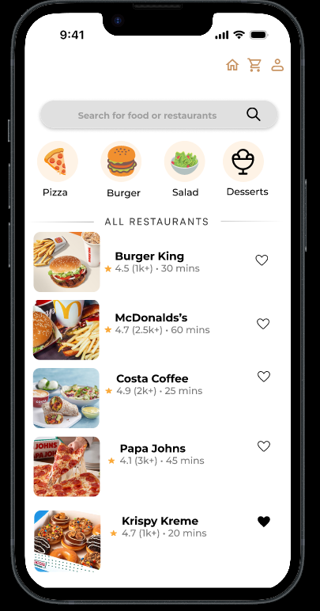
Figma

