Slide 1
Sales Data for users (Oct 2017)

Slide 2
Sales Performance(overall)
Total Sales: 101332
Total Revenue: 6699843.719999995
Average Revenue: 134.03976712548007
Average unique quantity per order: 1.9743517925736236

Slide 3
Sales and Revenue from high to low with respect days of the week
Day Total_products Revenue
Wednesday 20331 1268237.32
Tuesday 18247 1193035.83
Thursday 16656 1085146.10
Monday 14728 1030982.29
Sunday 11735 812797.52
Friday 10945 706237.58
Saturday 8690 603407.08

Slide 4
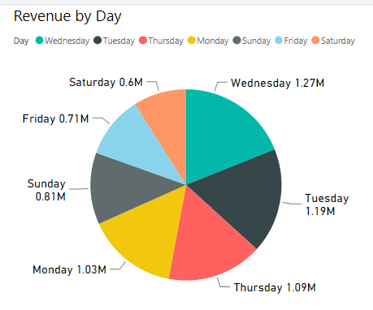
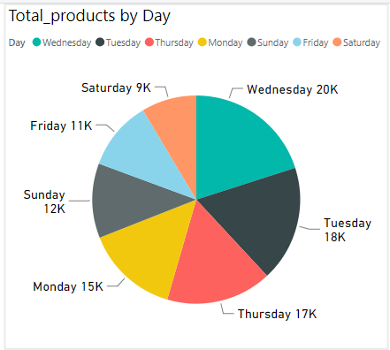

Slide 5
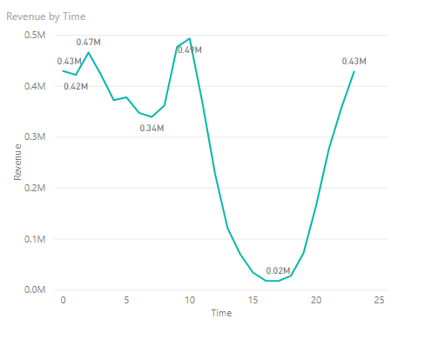
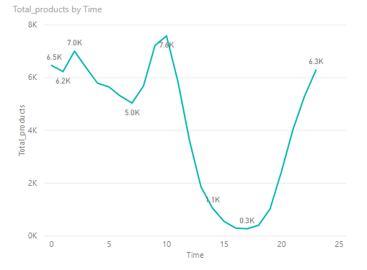
Sales and Revenue with respect time of the day

Slide 6
Sales and Revenue from high to low with respect country
Country | Total_products | Revenue
AU | 96518 | 6399612.89
NZ | 4814 | 300230.83

Slide 7
Sales and Revenue from high to low with respect payment type
Payment_Type | Total_products | Revenue
cc@braintree | 48790 | 3329143.2
pbi@afterpay | 26280 | 1825911.08
paypal@braintree | 24513 | 1544789.44
NoPayment | 1749 | 0

Slide 8
Overview of frequency (for entire first half of October 2017)
Total number of unique single purchasers (users who have purchased the products from the website once): 39778
Total number of unique multiple purchasers (users who have purchased the products from the website more than once): 4311
Average Frequency of multipurchases by a user(multiple purchaser user) in first half of October 17: 2.3674321503131526

Slide 9
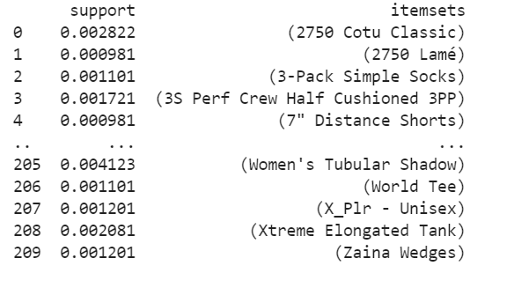
Product Affinity
With minimum threshold of 0.001 there seems to be no product.

Slide 10
Segmentation
Based on the total revenue generate by a user they have been classified into 5 categories (1 being the highest revenue generator):
super user
Potential super user
Attention needing user
Risk user
Lost User

Slide 11
Action Plan Based On User Category
User Type | Action Plan
super user | Reward them. Can be early adopters for new products. Will promote your brand.
Potential super user | Offer membership / loyalty program, recommend other products.
Attention needing user | Make limited time offers, Recommend based on past purchases. Reactivate them.
Risk user | Send personalized emails to reconnect, offer renewals, provide helpful resources.
Lost User | Revive interest with reach out campaign, ignore otherwise.

