Slide 1


Bank Analytics
GROUP 6
Project code : P538
PRESENTED BY:-
V.Retesh Kumar
Vikram Pandurang Channe
Repaka Madhu
Ajinkya Ram Bansode
Shaikh qaifalbara Hamid
Argula Sai Srujana

Slide 2
Contents
Project Overview
KPI 1 : Year wise loan amount Stats
KPI 2 : Grade and sub grade wise revol_bal
KPI 3 : Total Payment for Verified Status Vs Non Verified Status
KPI 4 : State wise and last credit pull d wise loan status
KPI 5 : Home ownership Vs last payment date stats

Slide 3
Project Overview
Customers Bank Loan Analysis Project
In this project, we analyzed the growth of Customers Bank over several years using two datasets in CSV and XLSX formats, each containing over 39,000 rows. Our objective was to gain insights into the bank's performance and growth trends.
We utilized MS Excel and MySQL for data cleaning, removing duplicates, and preliminary analysis. For visualization and interactive reporting, we employed Tableau, Power BI, and Excel. These tools helped us create comprehensive dashboards that provided valuable insights, enabling the bank to make informed decisions for future growth.

Slide 4
KPI - 1
Year wise Loan Amount Stats :
The line chart illustrates the growth in loan amounts over a five-year period, from 2007 to 2011.
Data shows a significant upward trend in loan amounts.
In 2007, the loan amount was $2.22 million.
By 2011, the loan amount had risen sharply to $260.51 million.
This trend indicates a substantial increase in loan distribution or borrowing.
The increase suggests either:A higher demand for loans.
Greater availability of funds over these years.

Slide 5
Year | Total_Loan_Amount | No of Loans Offered | Avg_Loan_Amount | Max_Loan_Amount | MIn_Loan_Amount | StdDev_Loan_Amount
2007 | $2.22 M | 251 | $8,841.73 | $25,000.00 | $500.00 | $6,447.77
2008 | $14.39 M | 1,562 | $9,212.72 | $25,000.00 | $500.00 | $5,774.29
2009 | $46.44 M | 4,716 | $9,846.55 | $25,000.00 | $1,000.00 | $5,934.10
2010 | $122.05 M | 11,532 | $10,583.61 | $25,000.00 | $1,000.00 | $6,602.36
2011 | $260.51 M | 21,656 | $12,029.30 | $35,000.00 | $1,000.00 | $8,159.40
Grand Total | $445.60 M | 39,717 | $11,219.44 | $35,000.00 | $500.00 | $7,456.67
From the above yearly loan statistics, we can infer that there are:
Increasing Trend in Total Loan Amount
Growth in the Number of Loans Offered
Rising Average Loan Amount
Consistent Maximum Loan Amount Until 2011
Minimum Loan Amount Stability
Variation in Loan Amounts
Grand Totals:
Over the five years, the grand total of the loan amount offered was $445.60 million.
A total of 39,717 loans were offered, with an overall average loan amount of $11,219.44, a maximum of $35,000, a minimum of $500, and a standard deviation of $7,456.67.

Slide 6
KPI - 2
Grade and sub grade wise revol balance
"Revolving balance" refers to the balance that carries over from one month to the next on a loan.
Issuing Loans are categorized into seven groups from A to G, with each group further divided into subgrades.
Among these groups, customers in group B have the highest revolving balance compared to others, while group G has the lowest.
The order of revolving balances from highest to lowest is B, A, C, D, E, F, and G.

Slide 7
KPI - 3
Total Payment for Verified Status Vs Non Verified Status
The verification process for total payments can be categorized into two main criteria: Verified and Non-Verified.
Total Payments Distribution:
Verified Payments: $153.54 million, accounting for 41% of the total payments.
Not Verified Payments: $219.89 million, making up 59% of the total payments.
Key Observations:
A larger proportion of the payments (59%) have not been verified, indicating potential issues in the verification process.
Verified payments constitute a significant portion (41%), suggesting that a considerable amount of payments have been validated.

Slide 8
KPI - 4
State wise and month wise loan status
California (CA) leads significantly: The highest number of fully paid loans is in California, with a count nearing 6000.
New York (NY) follows: New York comes next, with fully paid loans slightly above 3000.
Other significant states: Texas (TX), Florida (FL), New Jersey (NJ), Pennsylvania (PA), Illinois (IL), and Virginia (VA) also show notable numbers but are considerably lower than CA and NY.
Long tail distribution: The distribution shows a long tail, with many states having a much smaller number of fully paid loans.
Geographic concentration: There is a high concentration of fully paid loans in a few key states, indicating possible regional economic factors or population density impacts.

Slide 9
Consistent growth throughout the year: The number of fully paid loans shows a steady increase month over month.
Starting point: January starts with just over 2000 fully paid loans.
Gradual increase: Each month sees a gradual increase, with the numbers steadily rising through the year.
End of year peak: December ends with the highest number of fully paid loans, reaching approximately 3500.
Positive trend: This indicates an overall positive trend in loan repayments over the course of the year, which could suggest improving financial health or effective loan management strategies.

Slide 10
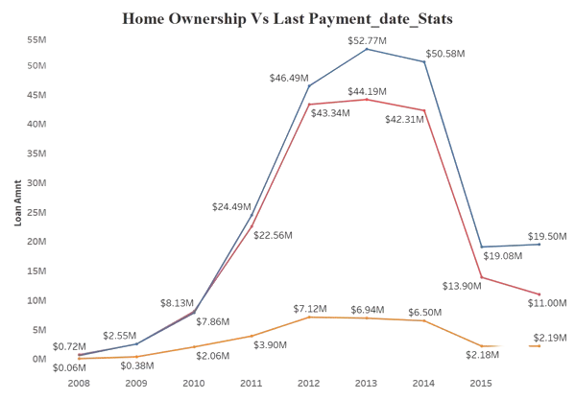
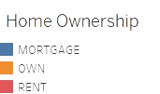
KPI - 5
Home ownership Vs last payment date stats
Peak Loan Amounts (2013-2014):
The loan amounts for home ownership peaked between 2013 and 2014, reaching their highest point at $52.77M in 2013 and slightly decreasing to $50.58M in 2014.
Comparison of Home Ownership and Last Payment Date:
The blue line represents the loan amounts for home ownership, which consistently rises until 2013 and then declines.The red and yellow lines, representing other statistics related to the last payment date, also show a rise and fall pattern but with different magnitudes and timelines.The red line peaks in 2013 at $44.19M and the yellow line peaks in 2013 at $43.34M.

Slide 11
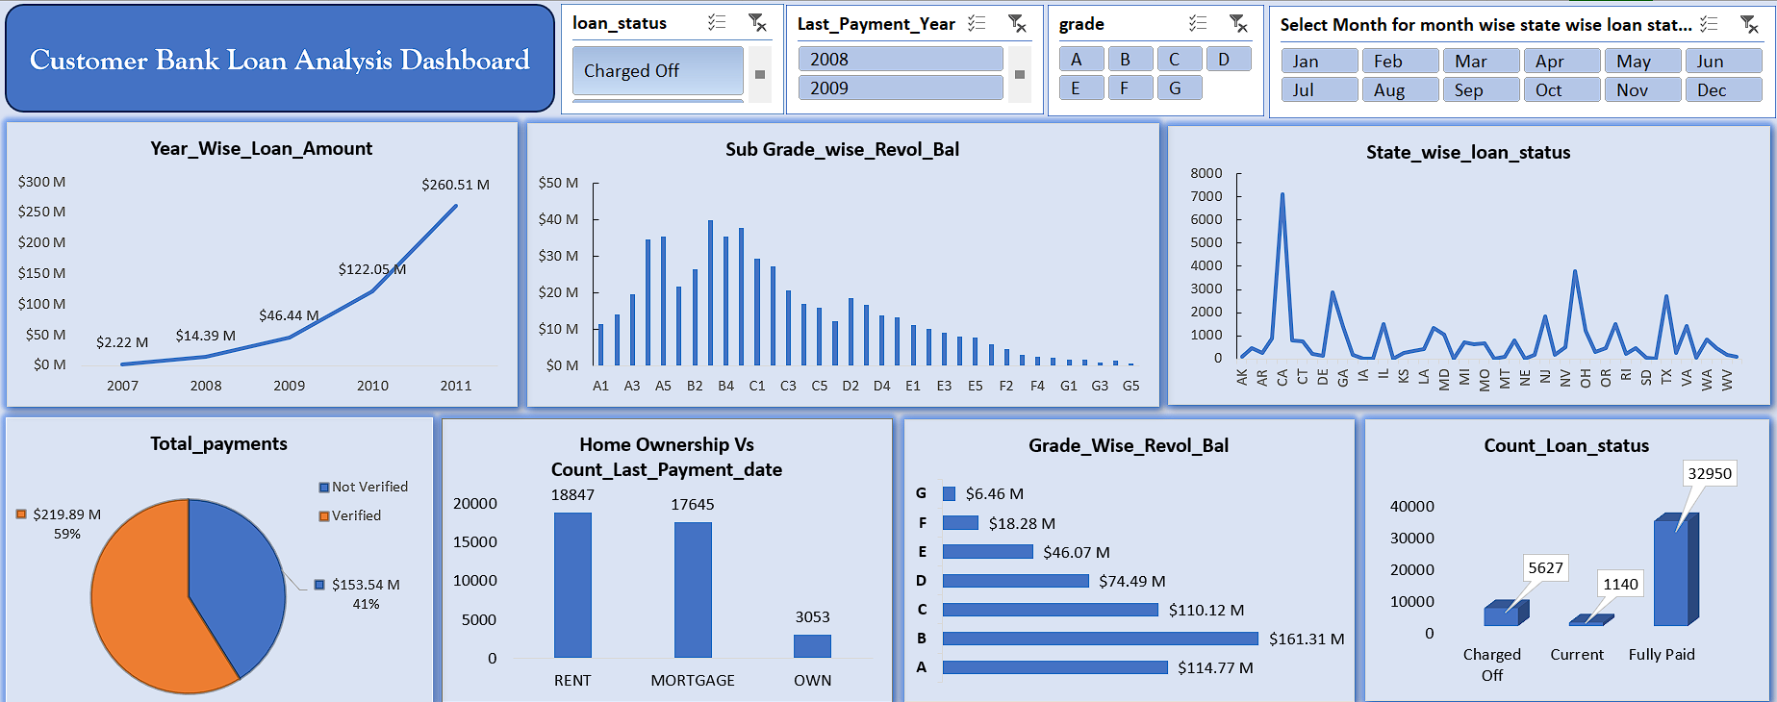
Excel Dashboard

Slide 12
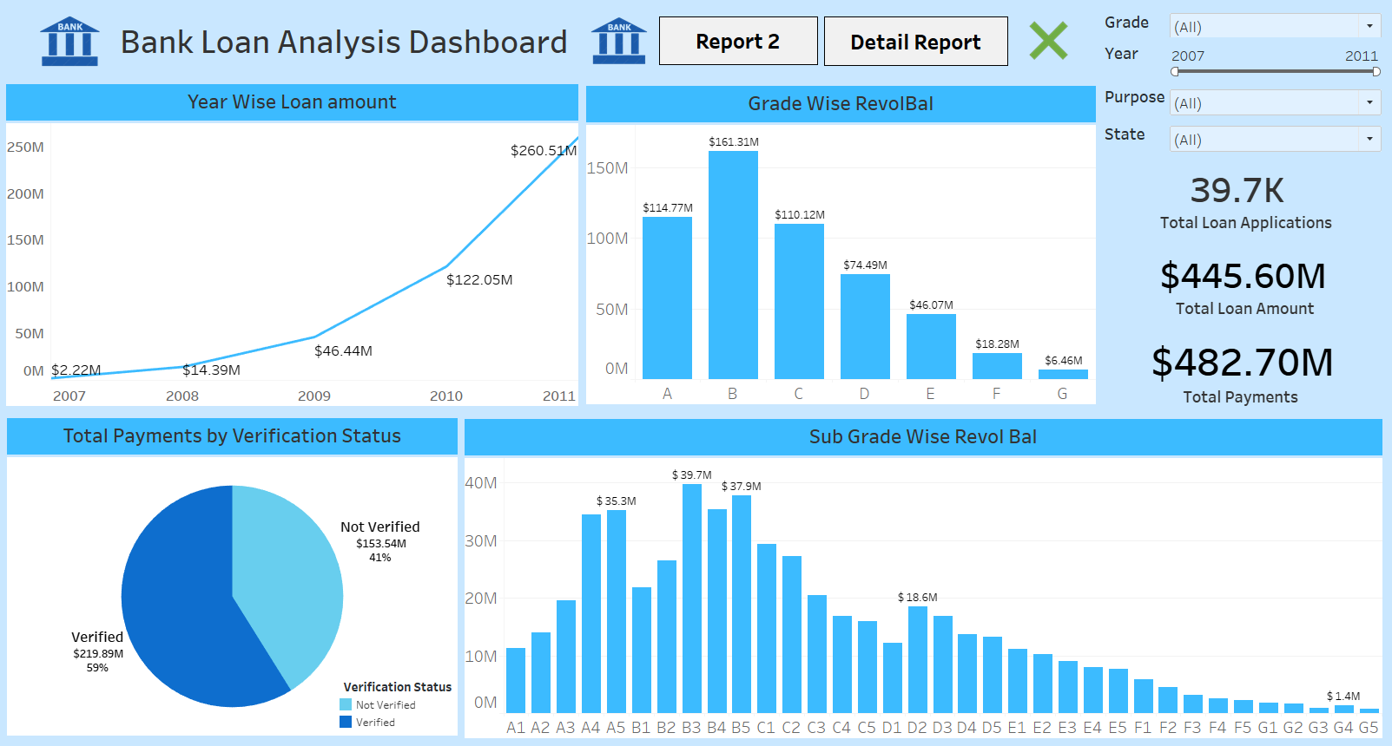
Tableau Dashboard

Slide 13
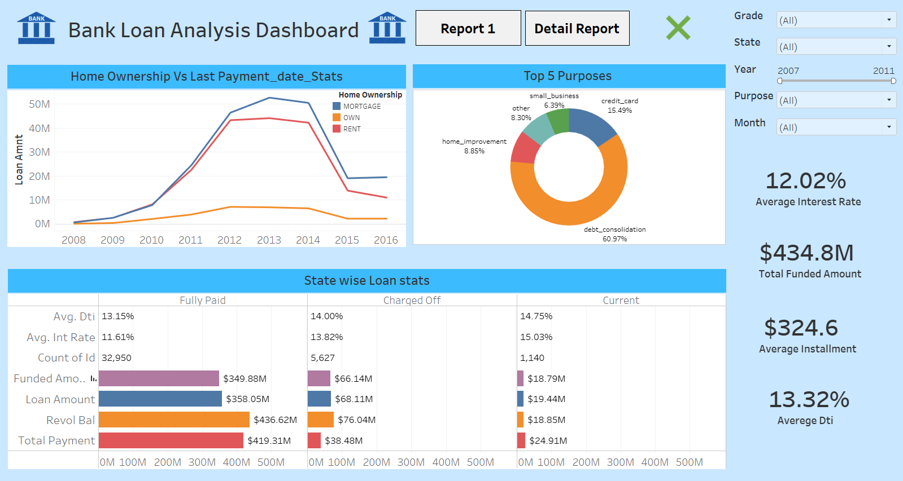

Slide 14
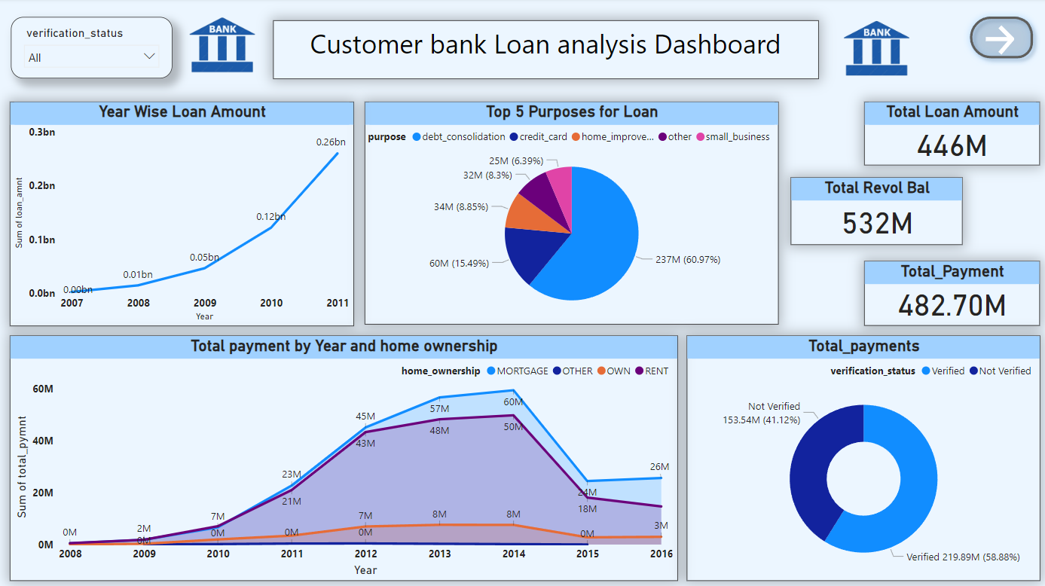
Power BI Dashboard

Slide 15
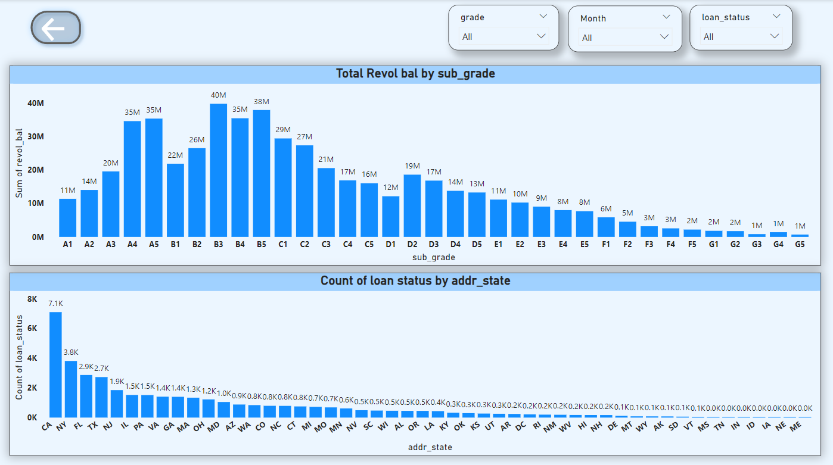

Slide 16


