Slide 1
Unauthorized System Access and Modification
Case ID: Group 3
Investigators: Rethick, Sreenivas, Rahgu, Bhargav
Date: 08-11-2024
Acquisition Date: 25-10-2024

Slide 2
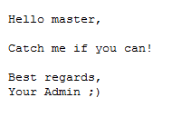
Given Statement
One day an IT dept. guy/gal came to work to find the message below written in a file on his/her system! He/Her immediately reported that to you. Now you must uncover how it happened
Obtained artifacts
System Image File
Hashes and password text file

Slide 3
Evidence Summary
OBJECTIVE
To investigate unauthorized access to a Windows 8.1 Enterprise Edition system, identify evidence of an attack, and analyze artifacts to determine the scope and actions of the attacker.
Image Information:
Acquisition started: Fri Dec 11 09:35:03 2015
Acquisition finished: Fri Dec 11 09:47:19 2015
Image Verification Results:
Verification started: Fri Oct 25 09:47:19 2024
Verification finished: Fri Oct 25 09:52:48 2024
MD5 checksum: 9a737b6a21ecbe979126c5661ca7b8db : verified
SHA1 checksum: ebef2bdc6329563ccf85769c3e5b8ceca852992b : verified

Slide 4
Tools & SOFTWARES Used
FTK Imager: Used for mounting and analyzing image files.
Shellbag Explorer: Used to analyze the UserClass.dat file.
Registry Explorer: Used for examining registry files.
Virus Total: Used for analyzing potentially malicious files.
VM: Sandbox Environment is used to safely examine suspicious executables.

Slide 5
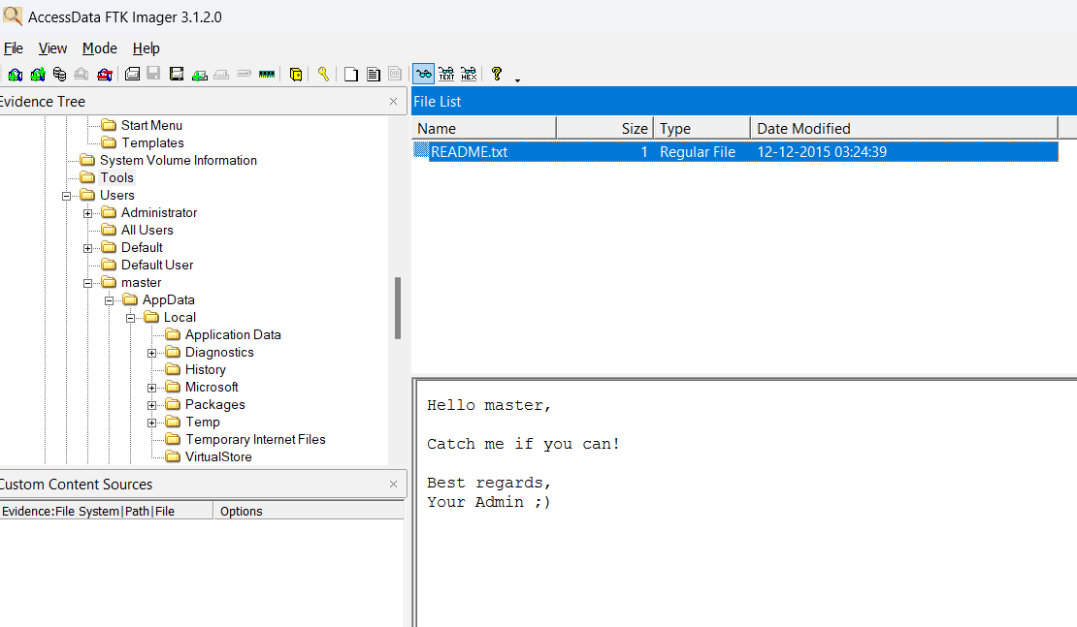
Forensic Investigation
Finding the text file the attacker created
File of Interest Located:
File name: README.txt
Path: root/tools/README.txt
Observation :
Timeline: 12-12-2015 (3:24:39)

Slide 6


Registry Forensics
Extracting system and user hives with FTK imager to perform Registry Forensics
SAM
SOFTWARE
SECURITY
SYSTEM
DEFAULT
NTUSER.DAT
USERCLASS.DAT

Slide 7
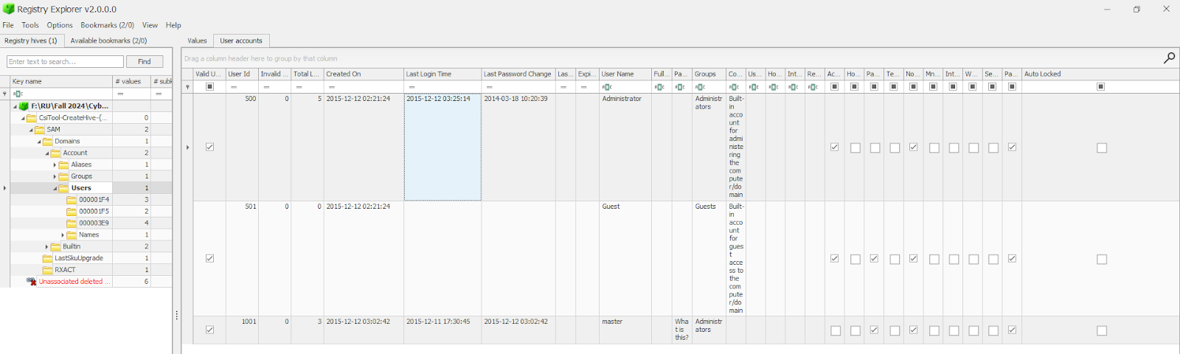
Registry Forensics
SAM is loaded in Registry Explorer to find the number of user accounts and login information
Path: SAM\Domains\Account\Users
Observation: The Admin Account was logged in multiple times, which makes the user account suspicious

Slide 8
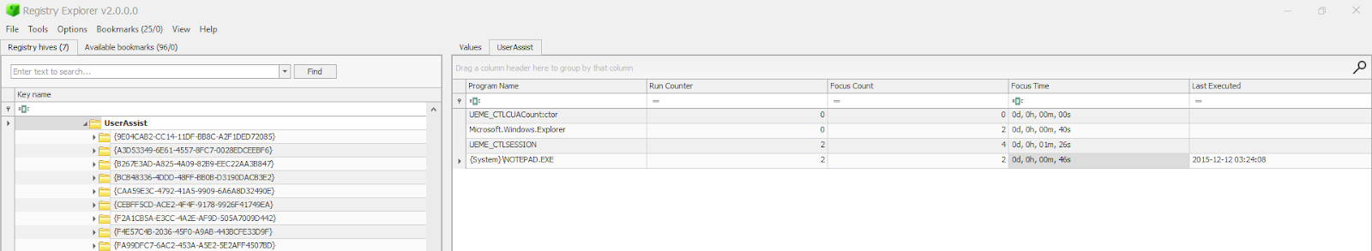
NTUSER.DAT
Path: NTUSER.DAT\Software\Microsoft\Windows\Currentversion\Explorer\UserAssist\{GUID}\Count
Observation: The NTUSER.DAT file of the Administrator account, Notepad was being accessed at the time of the attack by the Administrator at 12-12-2015 3:24:08

Slide 9
SYSTEM Analysis
System Information:
Computer Name: SENSEI
OS: Windows 8.1 Enterprise Edition,
Time Zone: PST (Pakistan Standard Time)
User Account Activities:
Active User: Administrator
Notepad.exe accessed during the attack.

Slide 10
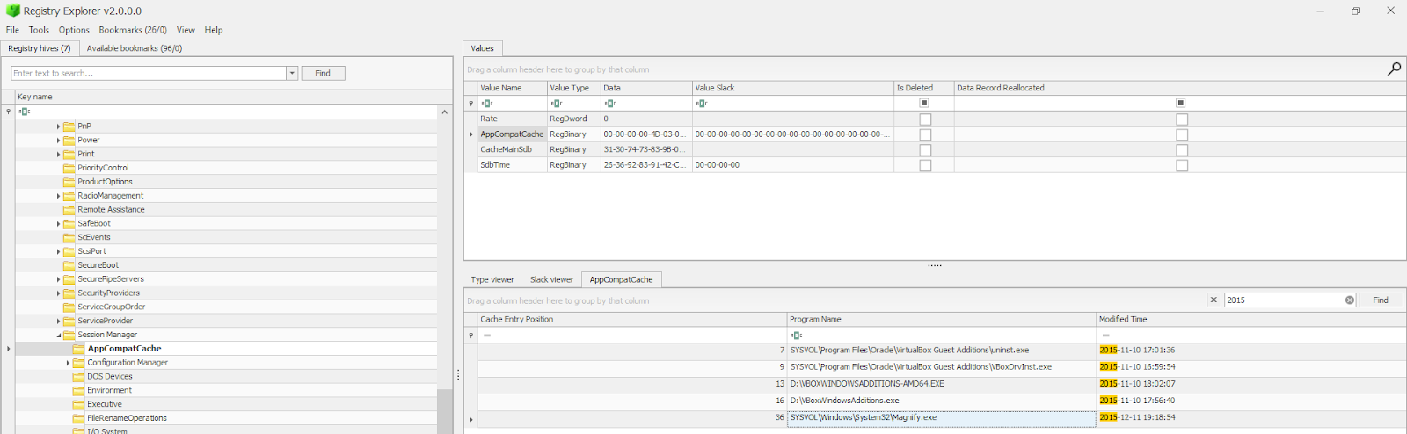
SYSTEM
ShimCache /AppCompatCache: Used to store the file name, file size, and last modified time of the executables.
Path : SYSTEM\CurrentControlSet\Control\Session Manager\AppCompatCache
Observation: Magnify.exe was the only executable used close to the time of the attack

Slide 11
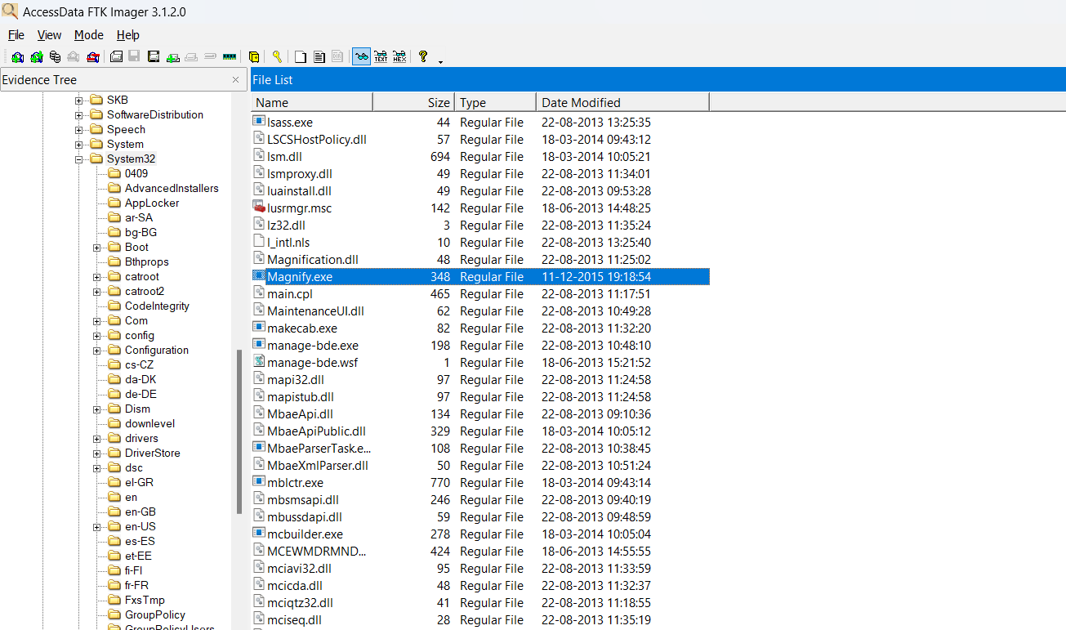
Analysis
Extracting Magnify.exe with the help of FTK imager to sandbox environment
Path: SYSVOL/Windows/System32/Magnify.exe
Observations:
Size: 346 KB
Date Modified: 11-12-2015
Time Modified: 7:18:54

Slide 12
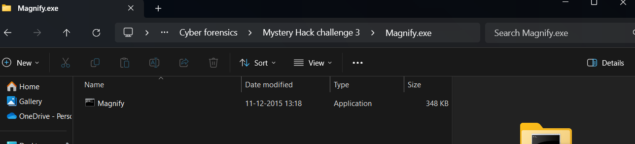
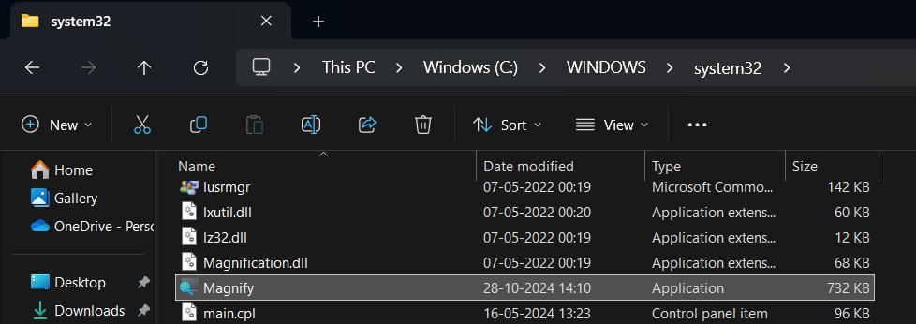
Initial Evidence
Comparing the downloaded executable with the preexisting magnify.exe in system32 directory
Observation
Difference in Size
Difference in Icon

Slide 13

Confirmatory Evidence
Uploading Magnify.exe in VirusTotal
Observation:
The file name is cmd
Obtained the hash of the file
Surprisingly Command Prompt And Magnify had the same icon and size

Slide 14
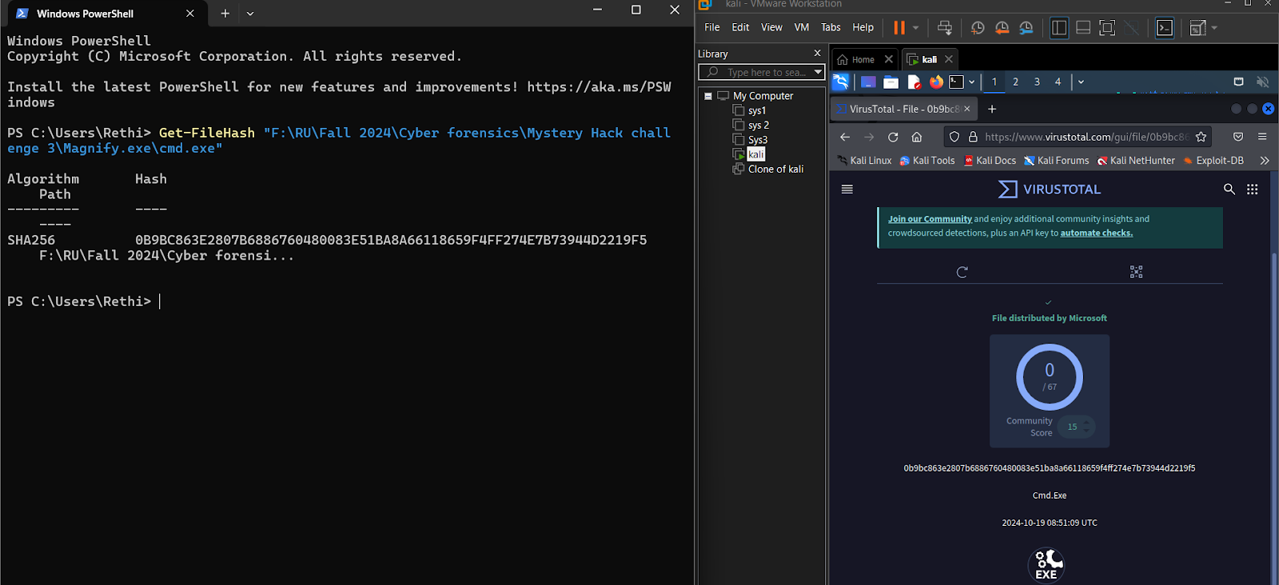
Verification
SHA256 0B9BC863E2807B6886760480083E51BA8A66118659F4FF274E7B73944D2219F5

Slide 15
Conclusion
Hypothesis: The attacker gained privileged access, and replaced Magnify.exe with cmd.exe.
Recommendations
Enforce stricter access policies and implement multi-factor authentication.
Regularly monitor and verify core executables' integrity.
Strengthen firewall and intrusion detection systems.

Slide 16
Questions | Feedback | FEELINGS
Thank you, guys

