Slide 1

DBMS Mini Project - Online Food Ordering System
By Roshini D and Rethinaath

Slide 2
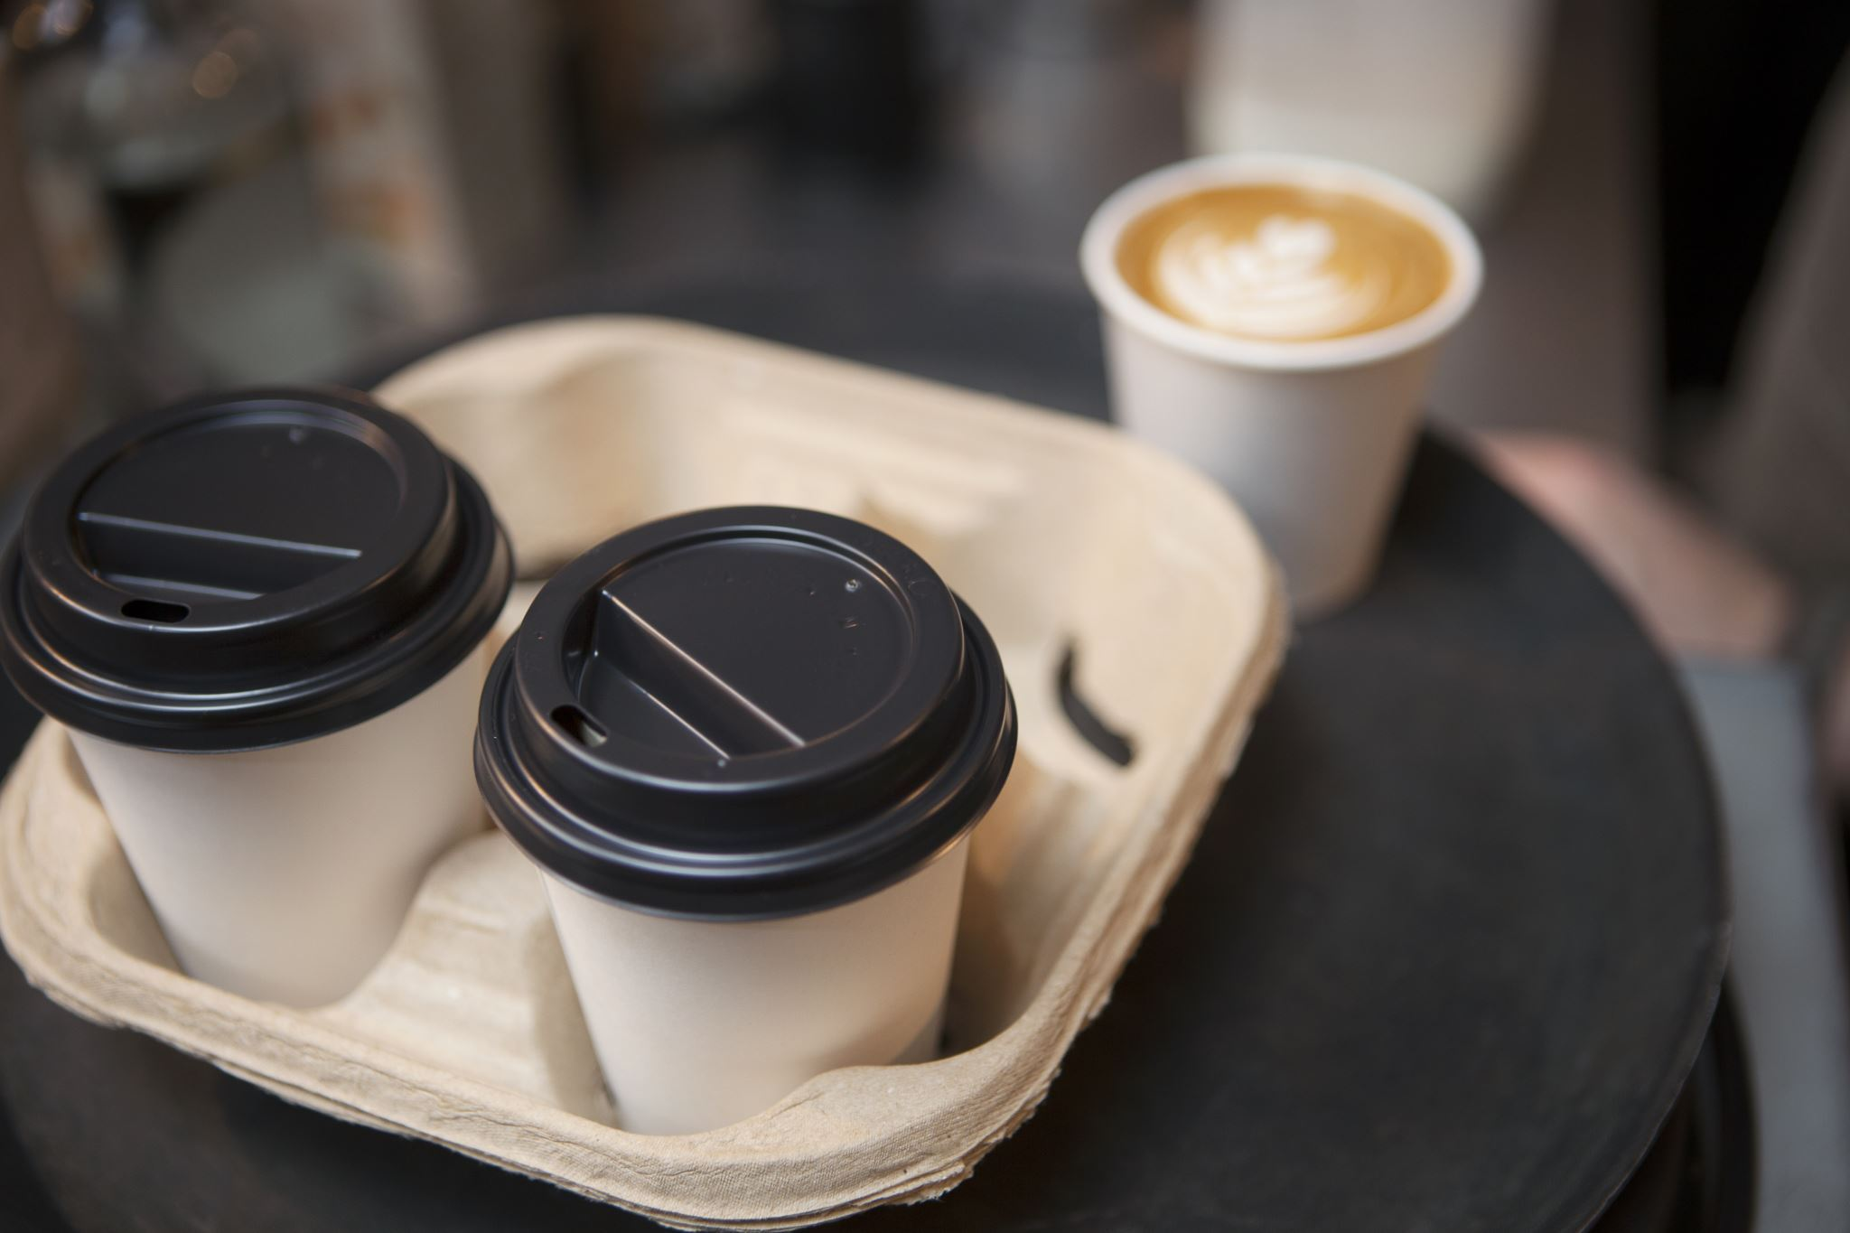
Abstract
The ever-growing demand for convenience has fueled the popularity of online food ordering systems. This project proposes the development of a comprehensive online food ordering system leveraging a relational database management system to manage customer data, restaurant information, and order details. The system will cater to both customers seeking a convenient way to order food and restaurants aiming to expand their reach through an online platform.

Slide 3

Functionalities:
Customer Management: Customers can conveniently submit their details for easy order processing.
Restaurant Selection: A user-friendly interface will allow customers to select their desired restaurant.
Detailed Menu Display: Restaurants will have the flexibility to showcase their menus with clear descriptions, enticing images, and accurate pricing information.

Slide 4

Dynamic Cart Management: Customers can effortlessly add and remove menu items from their cart, adjust quantities, and view the real-time total cost reflecting chosen items and their prices.
Seamless Order Placement: A streamlined process will enable customers to confirm their orders, with the system automatically transferring cart selections to the order database while generating a detailed bill for the chosen items.

Slide 5

Entities/Tables used
We have used 6 tables in our database schema:
Restaurants table
Customer_Details table
Menu_items
Cart_info
Cart_items
bills

Slide 6

Technologies used
Streamlit: This Python library is used to create the user interface (UI) of the online food ordering system.
Python: connectivity to the database is given using python
MySQL: Stores and manages all of the data

Slide 7
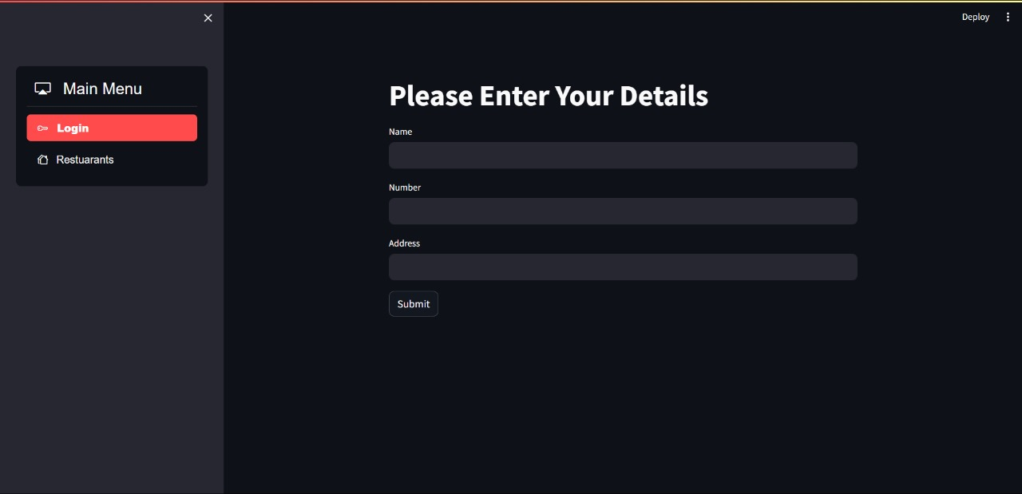

Slide 8
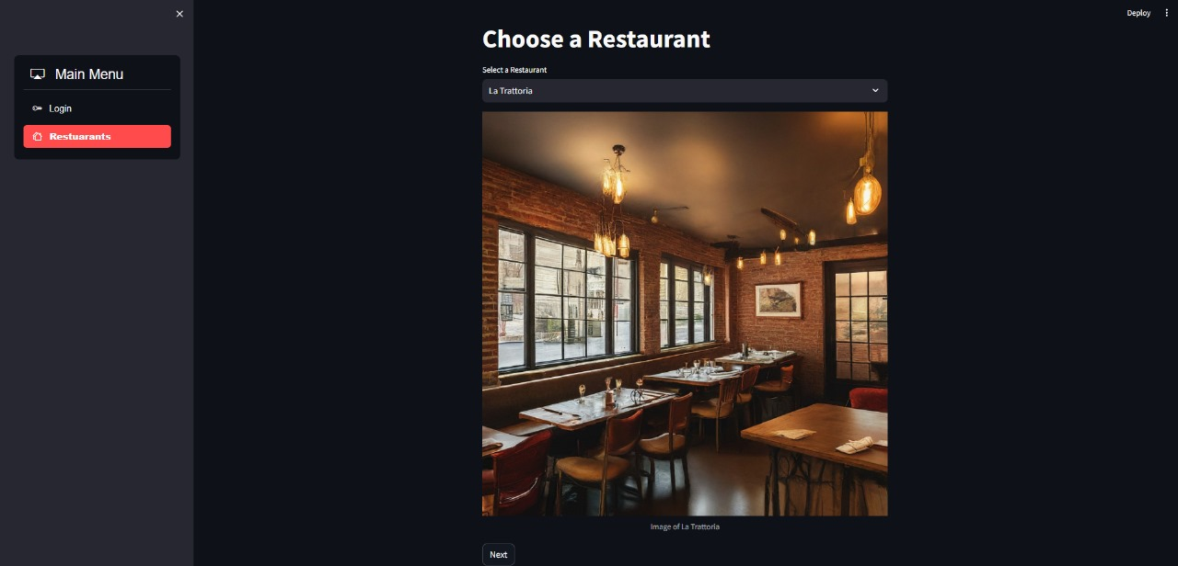


Slide 9
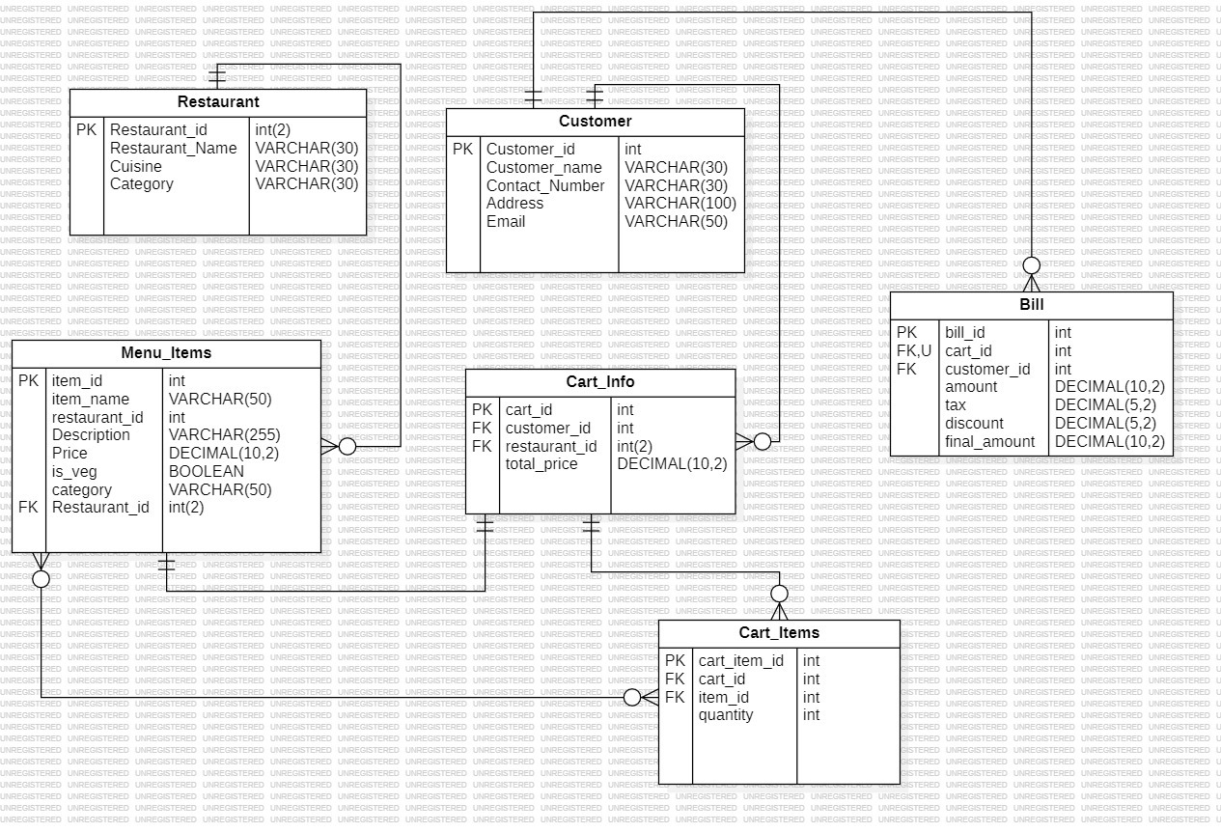

Slide 10
THANK YOU

