Slide 1


Department of Computer Science and Engineering
PHONEVISION: TEACHING MACHINES TO SEE AND READ PHONE NUMBERS
Mrs. M. Divya M.E.
Assistant Professor
Rethinaath S
2116220701222

Slide 2
Problem Statement and Motivation
Handwritten digit recognition is well-explored for single-digit classification. However, most real-world OCR tasks involve multi-digit numbers, such as phone numbers or postal codes. Segmenting and accurately recognizing such sequences presents a complex challenge, especially in cases with variability in spacing, handwriting style, and image quality. The goal is to build a robust CNN-based system that can segment and recognize full 10-digit phone numbers from synthetic images created by combining individual MNIST digits.

Slide 3
Existing System
Existing systems for handwritten digit recognition are generally limited to single-character classification using datasets like MNIST. They do not support sequence recognition or segmentation. Moreover, traditional OCR tools like Tesseract require fine-tuning and perform poorly on handwritten inputs. There is limited support for predicting full sequences like phone numbers, especially in real time or using synthetic training approaches.

Slide 4
Objectives
- Develop a synthetic dataset of handwritten phone numbers using the MNIST dataset. - Design and train a Convolutional Neural Network (CNN) for digit recognition. - Implement a preprocessing pipeline for segmenting digits from synthetic images. - Evaluate the system’s accuracy and ability to generalize across test data. - Deploy the trained model for real-time inference with a simple UI.

Slide 5
Abstract
PhoneVision is a system designed to recognize handwritten phone numbers using deep learning. Traditional handwritten digit recognition systems, typically based on the MNIST dataset, focus only on isolated single digits. This project extends that challenge by creating synthetic 10-digit phone numbers by horizontally concatenating individual MNIST digits. These images mimic real-world sequences that require segmentation and classification. A Convolutional Neural Network (CNN) is trained on digit crops to identify digits from 0–9. The trained model is then used to predict entire phone numbers from new images. With over 96.5% accuracy, this approach demonstrates the potential of synthetic data in practical OCR applications.

Slide 6
Proposed System
The proposed system consists of multiple components including dataset generation, digit segmentation, CNN training, and real-time inference. Synthetic images are created by concatenating MNIST digits. These are segmented into 10 parts and normalized. A CNN model with two convolutional layers and a dense classifier is trained on the cropped digit images. The trained model is deployed with a Flask backend that accepts image uploads and predicts phone numbers by classifying each digit segment.

Slide 7
List of Modules
- Dataset Generation: MNIST digits are stitched to simulate 10-digit phone numbers. - Preprocessing: Segments each image, normalized data, and one-hot encoded labels. - CNN Model Training: A two-layer CNN is trained on cropped digits. - Inference: Uploaded images are segmented and digits classified. - Evaluation: Model is evaluated on test data and validated for accuracy.

Slide 8
System Architecture
The architecture begins with synthetic dataset generation using the MNIST dataset. Each image consists of 10 randomly selected digits stitched horizontally (28x280 pixels).These images are segmented into 28x28 crops and preprocessed (grayscale normalization, one-hot label encoding). The CNN model is built using Keras and consists of two convolutional layers, max pooling, and a dense output layer with softmax. The model is trained on 90% of the data and validated on 10%.During inference, a user uploads a phone number image to the backend. The system segments the image, applies preprocessing, and classifies each digit using the trained model. Predicted digits are concatenated and returned to the user interface.

Slide 9
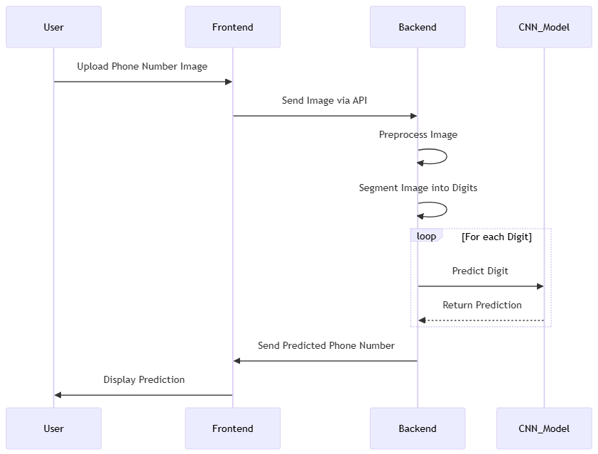
System Architecture

Slide 10
List of Modules
Dataset Generation Module
Image Preprocessing
CNN Model Training
Prediction and Inference
System Integration and Evaluation

Slide 11
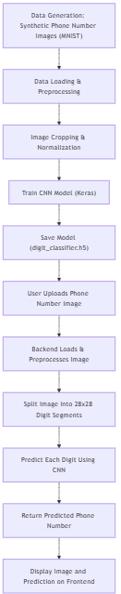
Dataset Genration Module
The dataset for this project is synthetically generated using the MNIST digit dataset. Each phone number image consists of 10 horizontally concatenated MNIST digits, simulating a real-world phone number. A mapping is maintained to associate each image with its corresponding 10-digit label. The synthetic dataset enables the model to train on a variety of digit combinations, ensuring robustness. Images are saved in PNG format with filenames indicating the label (e.g., 1234567890.png), making it easy to extract ground truth during training and testing.

Slide 12
Image Preprocessing
Image preprocessing plays a crucial role in digit segmentation and model performance. Each synthetic image is of fixed height (28 pixels) and width (10 × 28 = 280 pixels). The image is divided into 10 equal segments of 28×28 pixels, each representing one digit. The images are then normalized to values between 0 and 1 to match the input format expected by the CNN. The labels (digits 0–9) are one-hot encoded using to_categorical from Keras to suit the softmax output layer in the CNN.

Slide 13
CNN Model Training
A CNN architecture is built using Keras. The model consists of two convolutional layers with ReLU activation and max pooling, followed by a flatten layer and two dense layers. The final dense layer has 10 units with softmax activation to classify digits 0–9. The digit dataset extracted from synthetic images is split into training and testing sets using a 90:10 ratio. The model is compiled with the Adam optimizer and categorical crossentropy loss. Accuracy is used as the evaluation metric. Training is performed over multiple epochs with batch sizes optimized for performance.

Slide 14
Prediction and Inference
During inference, a phone number image is uploaded to the system. The backend splits the image into 10 digit segments, preprocesses them, and feeds them into the trained CNN model one-by-one. The predictions from the model are combined to form the full phone number.

Slide 15
System Integration and Evaluation
Users upload images, the program processes the image, uses the CNN model to predict digits, and returns the full phone number.
Comprehensive testing was conducted to verify model accuracy using a separate test dataset. The prediction flow was validated for consistency, accuracy, and robustness. The final model achieved high accuracy in digit recognition, resulting in correctly predicted phone numbers in the majority of test cases, demonstrating the system's effectiveness in digit-based sequence recognition.

Slide 16
Implementation & Results of Module
Implementation was done in Python using TensorFlow and Keras. Dataset generation used NumPy and OpenCV. Model was trained for 5 epochs achieving 96.5% accuracy. Results: - Training Accuracy: 97.5% - Validation Accuracy: 96.5% - Loss steadily decreased over epochs, showing stable training. On a test set of 50 images, the model correctly predicted 94% of phone numbers entirely. Precision and recall were above 95%. Sample Input: Synthetic image '6685260654.png' Output: Predicted phone number: 6685260654

Slide 17
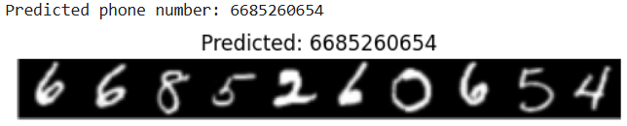
Output

Slide 18
Conclusion & Future Work
PhoneVision provides a high-accuracy, scalable solution for recognizing handwritten phone numbers using CNNs trained on synthetic data. The project demonstrates how synthetic data generation can simulate real-world OCR use cases, offering practical applications in digitizing forms, postal codes, and user-input fields.
Future Work: - Extend to variable-length numbers and alphanumeric sequences. - Add robustness through noise and rotation augmentation. - Deploy as mobile/web application with live camera input.

Slide 19
References
[1] LeCun, Y. et al. (1998). Gradient-based learning applied to document recognition. [2] Cireşan, D. et al. (2010). Deep big simple neural nets excel on handwritten digit recognition. [3] Simard, P. Y. et al. (2003). Best practices for CNNs applied to visual document analysis. [4] Zhang, H., & LeCun, Y. (2015). Character-level CNNs for text classification. [5] Goodfellow, I. et al. (2013). Multi-digit number recognition using deep CNNs.

Slide 20
Paper Publication Status
Not yet Published.

Slide 21
Thank You

