Slide 1


Introduction to
Robotic Process Automation
FILE MANAGEMENT AND LOG GENERATION AUTOMATION
2116220701222
Rethinaath S
Dr. N.Duraimurugan
Assistant Professor (SG) Department of Computer Science and Engineering

Slide 2
Abstract
In modern data management systems, efficient file handling and tracking are essential for maintaining organized and accessible records. "Automated File Renaming and Logging System," aims to streamline file management by automating the process of file renaming, organization, and activity logging within specified directories. Using UiPath Studio, the workflow monitors a target folder, retrieves file details, and dynamically renames each file with a timestamp or specified format to prevent duplicates and maintain consistency.
Additionally, the project includes a logging mechanism that records each file action, including timestamps, renamed files, and the processing status, enhancing traceability and auditability. The system is designed to reduce manual intervention, minimize file management errors, and improve operational efficiency, especially in data-intensive environments. This project demonstrates the practical applications of robotic process automation (RPA) in routine administrative tasks, with potential extensions in data handling, compliance, and file archiving.

Slide 3
Need for the Proposed System
Time-Saving: Reduces time spent on manual renaming.
Consistency: Ensures standardized file naming.
Error Reduction: Eliminates human mistakes in naming.
Scalability: Handles large datasets efficiently.
Improved Organization: Makes files easy to find and manage.
Automated Logging: Tracks file renaming with timestamps.
Resource Allocation: Frees up staff for higher-value tasks.
Cost Savings: Reduces labor costs and operational inefficiencies.

Slide 4
Advantages of the Proposed System
Automation: Eliminates manual effort, saving time and reducing human intervention.
Consistency: Ensures all files follow a standardized naming convention.
Accuracy: Minimizes errors in file renaming and tracking.
Efficiency: Speeds up the file management process.
Scalability: Easily handles an increasing number of files.
Improved Organization: Makes file retrieval and management more efficient.
Error Tracking: Detailed logs for auditing and troubleshooting.
Cost Reduction: Lowers labor costs and optimizes resource utilization.

Slide 5
Main Objective
•Automate File Renaming: Use a timestamped convention to rename files automatically.
•Enable Real-Time Logging: Log each file renaming action, capturing details for future auditing.
•Enhance Traceability: Provide a traceable log of file operations, improving compliance and accessibility.
Save Time: It helps to save time a lot when seen at a long term such as a month or a year.

Slide 6
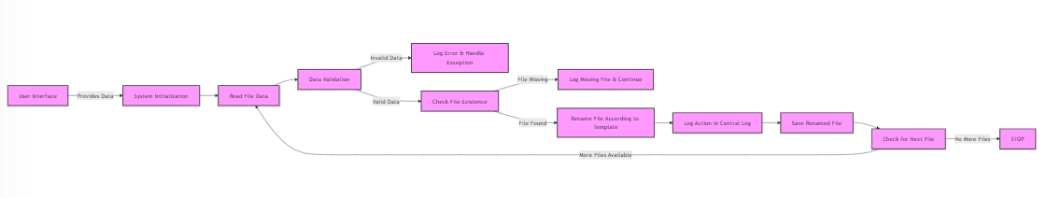
Architecture

Slide 7
System Requirements
Software:-
UiPath Studio:
Version: UiPath Studio 2024 (or latest version).
Operating System:
Windows 10/11 (recommended).
Text Editor:
Examples: Notepad++, Visual Studio Code
Hardware:-
Processor (CPU):
Recommended: Quad-core processor (Intel i5/i7 or equivalent).
RAM:
Recommended: 8 GB of RAM or more.
Storage:
Recommended: 250 GB or more.
Network:
Recommended: High-speed internet for efficient downloading and uploading of files.

Slide 8
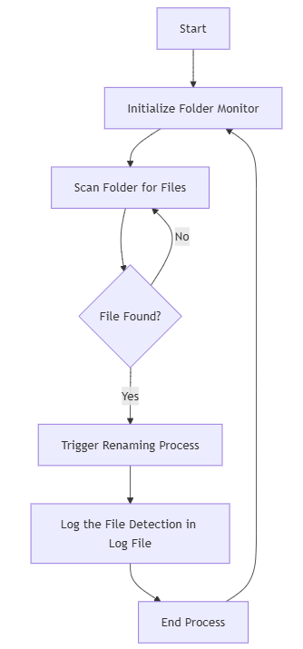
Functional Description
Module1:
Folder Monitoring and File Detection
This module is responsible for continuously monitoring a specified directory (folder) for any new files. It ensures that only new or modified files are processed, minimizing the unnecessary workload and preventing duplicate actions.

Slide 9
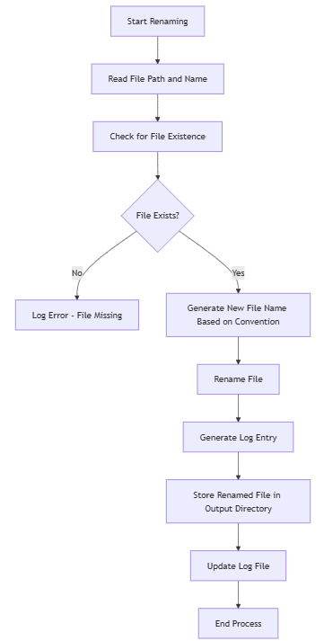
Functional Description
Module2:
File Renaming and Log Generation
This module handles the renaming of files based on a predefined naming convention (e.g., timestamp, file type). It ensures that the renamed files follow a standard format and are uniquely identified to prevent overwriting or duplication.

Slide 10
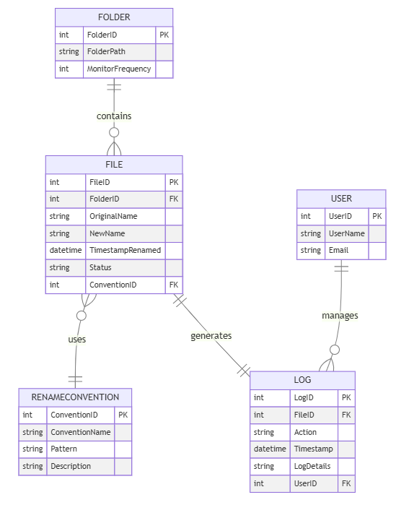
E-R DIAGRAM

Slide 11
Process Design
Main Process:
The Main Process in this project is to Automate File Monitoring, Renaming, and Logging. This involves the automated detection of files, renaming them based on a specified convention, and logging the actions for record-keeping and monitoring.
Sub-Processes:
Folder Monitoring
File RenamingData Validation
Logging
Error Handling

Slide 12
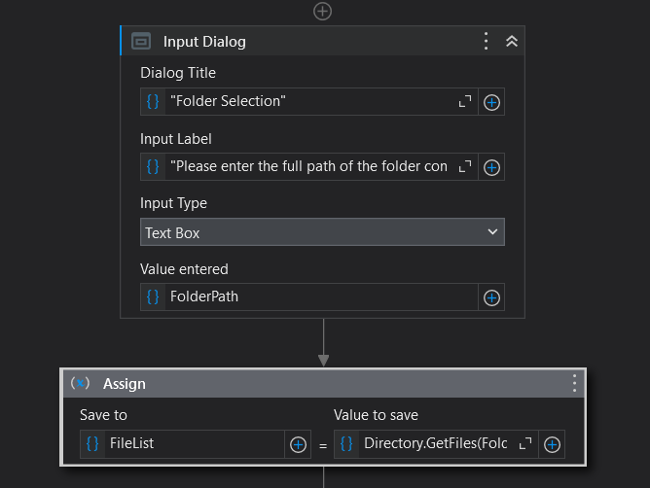
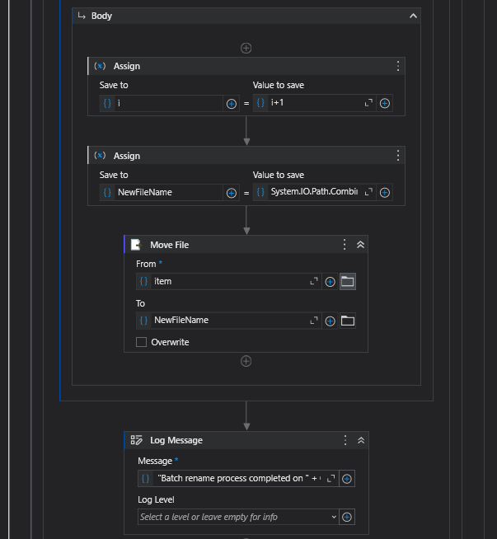
Implementation
Module1:
Folder Monitoring and File Detection
Module2:
File Renaming and Log Generation

Slide 13
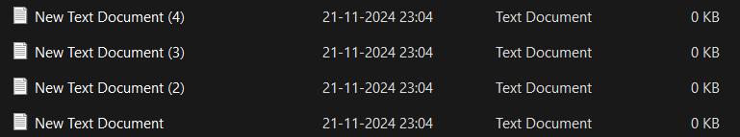
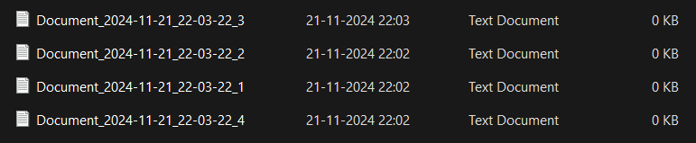
Testing
Before:-
After:-

Slide 14
Conclusions
The Automated File Renaming and Logging System effectively addresses the limitations of manual file handling by automating file renaming and logging using UiPath Studio. The system minimizes errors, reduces time spent on manual tasks, and enhances consistency and traceability in file management. This project showcases the practical applications of RPA in routine tasks and the potential for similar solutions in other areas of data management.

Slide 15
Future Enhancement
Enhanced Logging and Reporting
Version Control and File Backup
Advanced File Processing Options
Advanced Monitoring Capabilities
Security and Access Control
User Notification System
Machine Learning Integration
Customizable File Renaming Rules
Error Handling and Recovery Enhancements
User Interface (UI) Enhancements

Slide 16
References
UiPath Academy: "UiPath RE Framework Course." UiPath Academy, 2024.
UiPath Documentation: "Working with Files and Folders in UiPath." UiPath Documentation, 2024.
Microsoft Excel Automation: "Automating Excel Data Extraction with UiPath." Microsoft Office Automation Guide, 2024.
RPA Best Practices: John Doe, "Best Practices for Robotic Process Automation," RPA Journal, 2023.
File Management Strategies: "Automating File Management with RPA." Automation World, 2023.

Slide 17
Queries

Slide 18
Demonstration

Slide 19
Thank You

