Slide 1
Receipt & Invoice Digitizer System
Team A

Slide 2
Project Solution
Our system provides:
1️⃣ Upload receipts 2️⃣ Extract text using OCR 3️⃣ Structure data using AI model 4️⃣ Store invoice information 5️⃣ Generate analytics dashboard
This helps users digitize and analyze receipts efficiently.

Slide 3
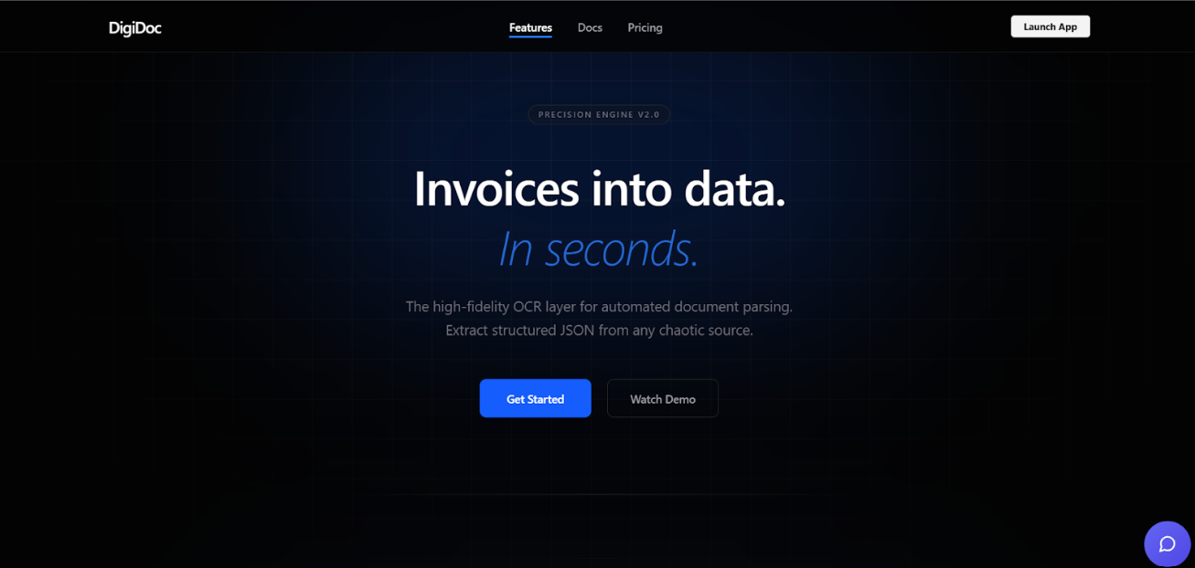
Landing Page
Features of Landing Page:
User friendly interface
Login / Register options
Project overview
Navigation to dashboard
Clean UI with modern design

Slide 4
Receipt Digitizer Module
This module performs:
✔ Upload receipt image ✔ OCR text extraction ✔ AI based data structuring
Extracted fields:
Vendor name
Date
Invoice number
Total amount
Purchased items

Slide 5
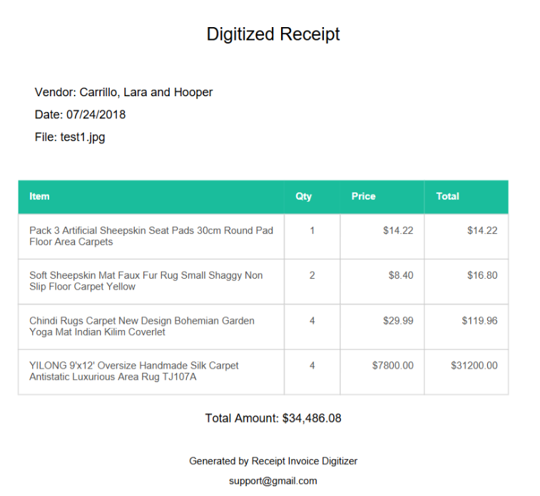
Example Extraction

Slide 6
Analytics Dashboard
The dashboard provides insights using charts.
Implemented charts:
📊 Monthly Spending Trend 📊 Top Merchants 📊 Spending Distribution
These help users understand spending patterns.

Slide 7
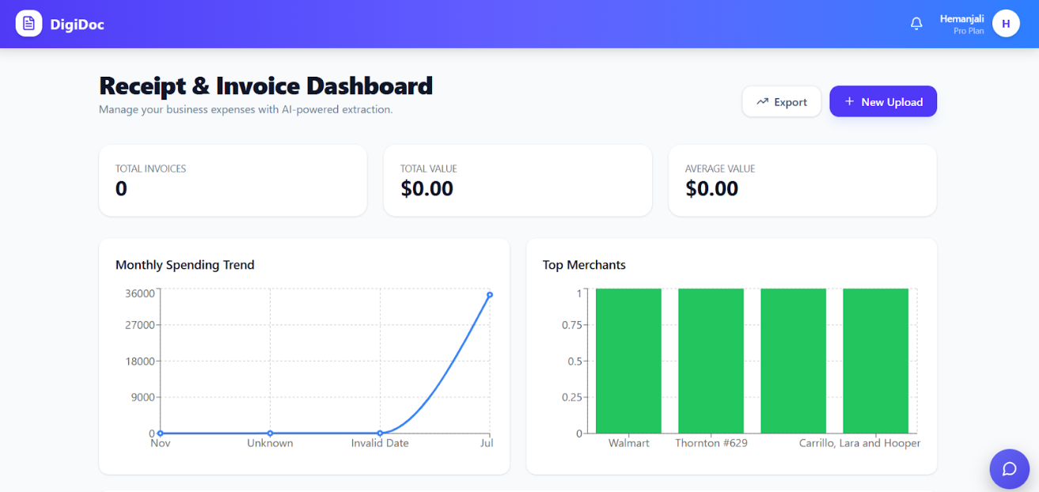
Analytics Example

Slide 8
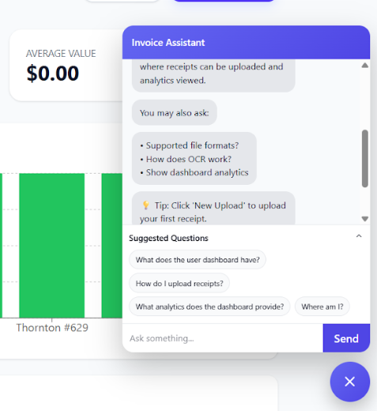
Chatbot Feature
The system also includes an AI chatbot.
The chatbot helps users:
Ask questions about receipts
Get expense information
Navigate the system easily

Slide 9
Milestone Progress
Completed in this milestone:
✔ Landing Page UI ✔ Receipt Upload System ✔ OCR Extraction ✔ AI Data Structuring ✔ Dashboard Analytics ✔ Chart Visualization

