Slide 1
Receipt & Invoice Digitizer Dashboard

Slide 2
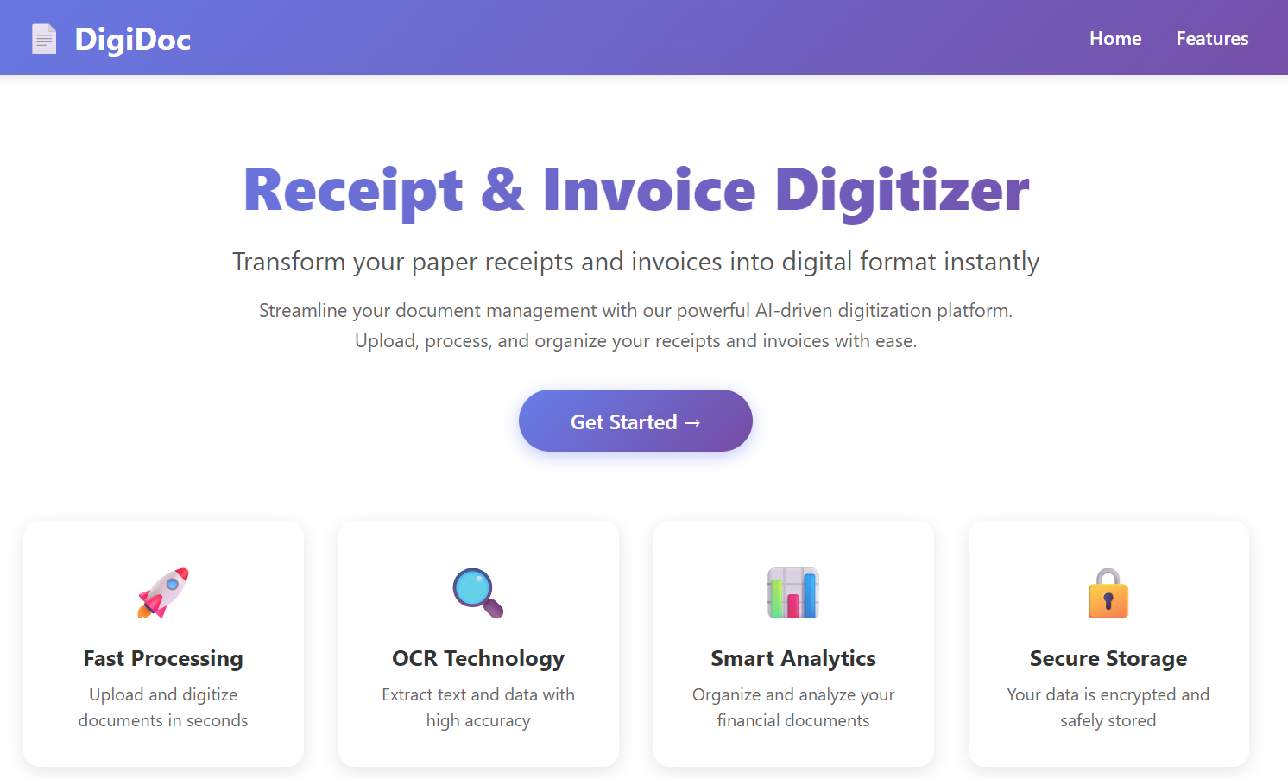
Full-Stack Web Application (React + Node.js + Express)
Drag & Drop File Upload
OCR Simulation
File Management Dashboard
Export & Analytics

Slide 3
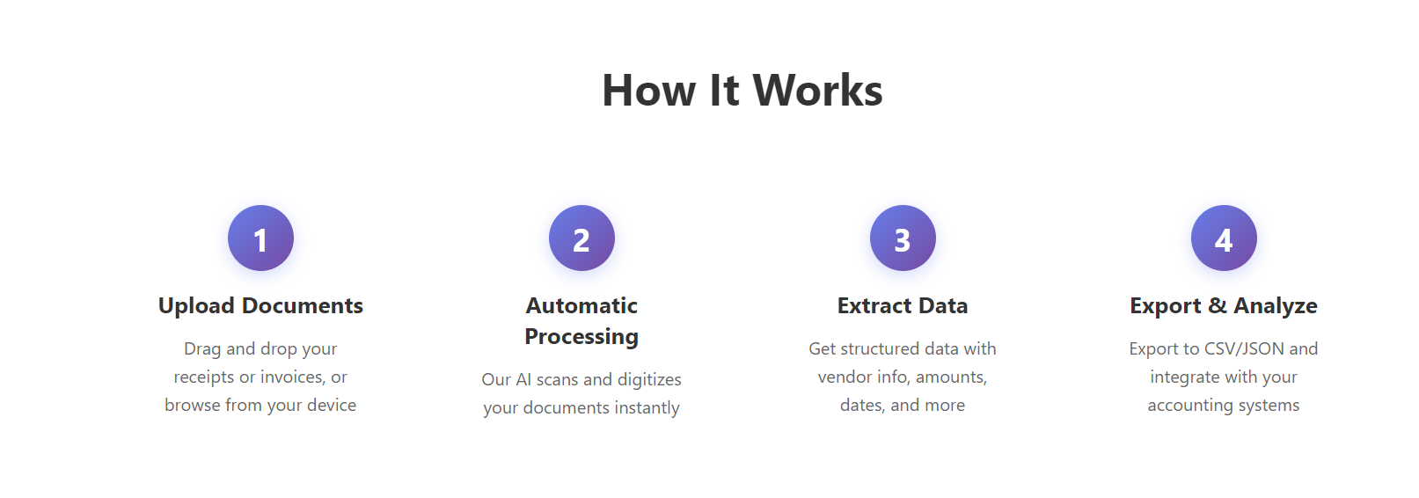
Full-Stack Architecture
Frontend (Port 3000) ⬇ HTTP Requests Backend (Port 5000) ⬇ File System (uploads/ folder)
React handles UI
Express handles APIs
Files stored locally

Slide 4
Frontend Technologies
React 18
React Router DOM
Vite (Build Tool)
Responsibilities:
User interface
Drag & Drop
Search & Filter
File Preview
Export feature

Slide 5
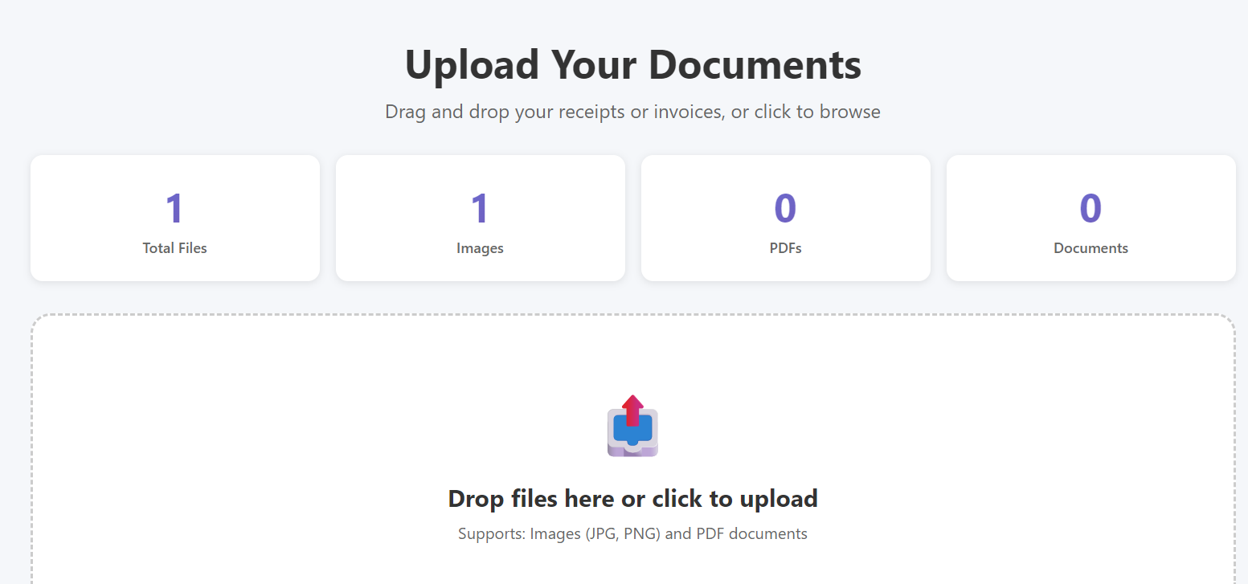
Frontend Core Features
1. Drag & Drop Upload
HTML5 Drag & Drop API
React useState
2. File Preview
Image tag for images
iframe for PDFs
3. Search & Filter
Real-time filtering using JavaScript
Controlled input fields
4. Statistics Dashboard
Array filter & reduce methods

Slide 6
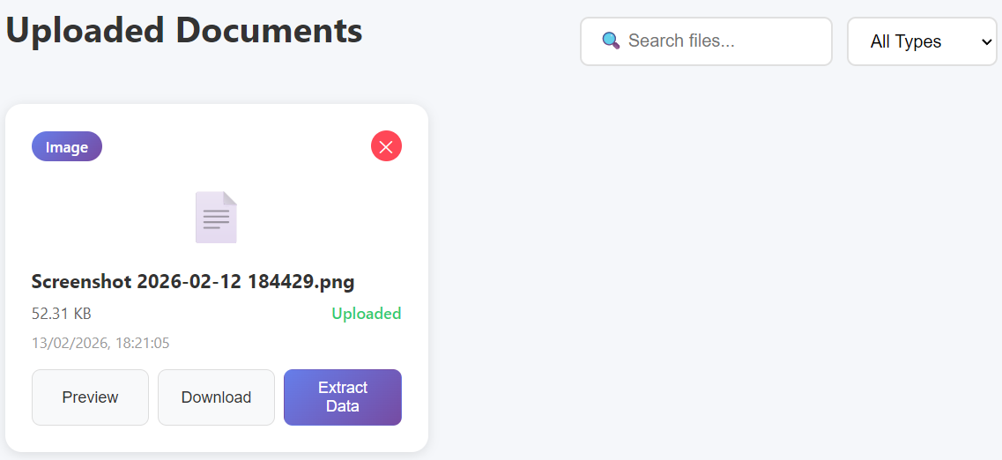
Frontend State & API Communication
React Hooks Used
useState – Manage UI data
useEffect – Load data on mount
API Communication
Fetch API
GET, POST, DELETE requests
FormData for file upload
Blob API for export
Frontend updates UI automatically when state changes.

Slide 7
Backend Technologies
Node.js
Express.js
Responsibilities:
File upload handling
Metadata generation
Data extraction (OCR simulation)
File deletion
Export API

Slide 8
Improvements
MongoDB for persistent storage
Real OCR (Tesseract / Cloud APIs)
THANK YOU

