Slide 1
Group No : 2 Section : 1 CSS-FLEXBOX

Slide 2




Team Members:
Akhitha Tumula
Mahender Reddy Surkanti
RethimaReddy Polam
Rohan Goud Bhandari

Slide 3
Agenda :
What is CSS Grid and CSS FlexBox
FlexBox
FlexBox Properties
Grid
Grid Properties
Demo
RethimaReddy Polam

Slide 4
WHAT IS CSS GRID and FLEXBOX:
CSS specifies how a web page looks its colors, fonts, formatting, layout, and styling.
CSS flex-box and Grid layout are particular ways to specify the layout of HTML pages.
Flex boxes can adjust in size either decreasing, to avoid unnecessarily monopolizing space, or increasing to make room for contents to be constrained within its boundaries.
RethimaReddy Polam

Slide 5
Terminology of FlexBox
The flex container properties are:
1. flex-directions
2. flex-wrap
3. justify contents
4. align-items
5. align-contents
6. flex
7. flex-grow
8. flex-shrink
RethimaReddy Polam

Slide 6
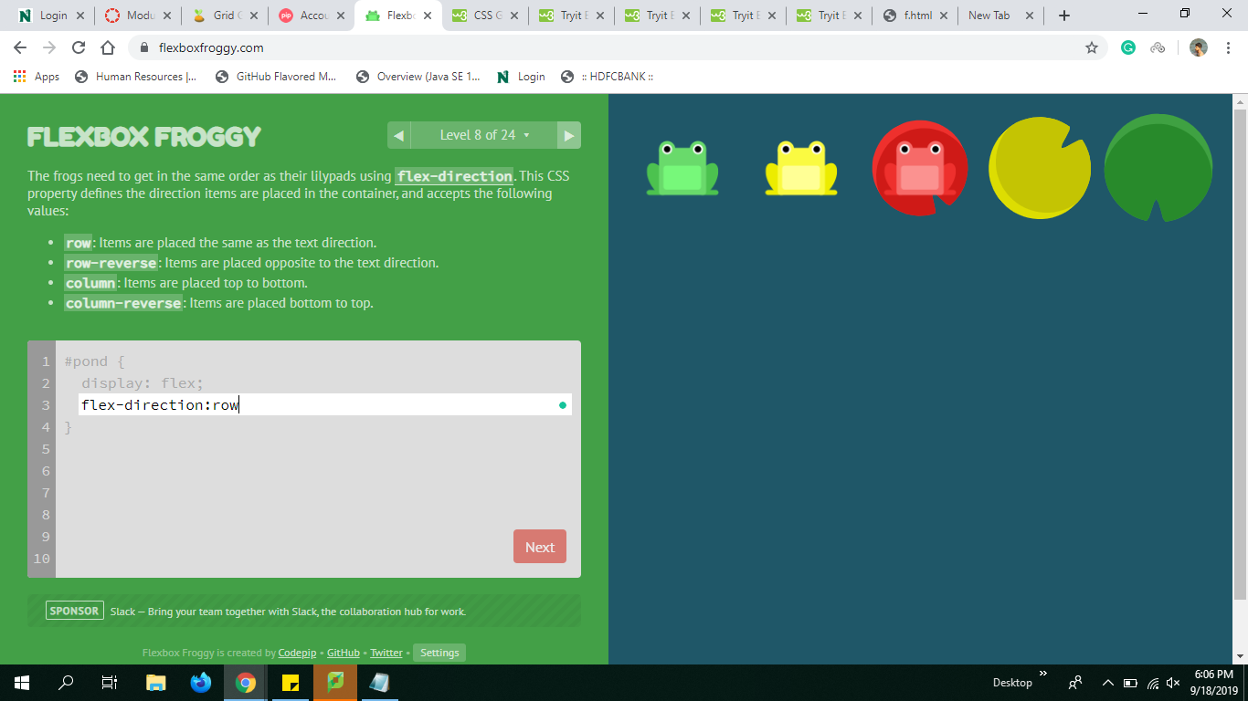
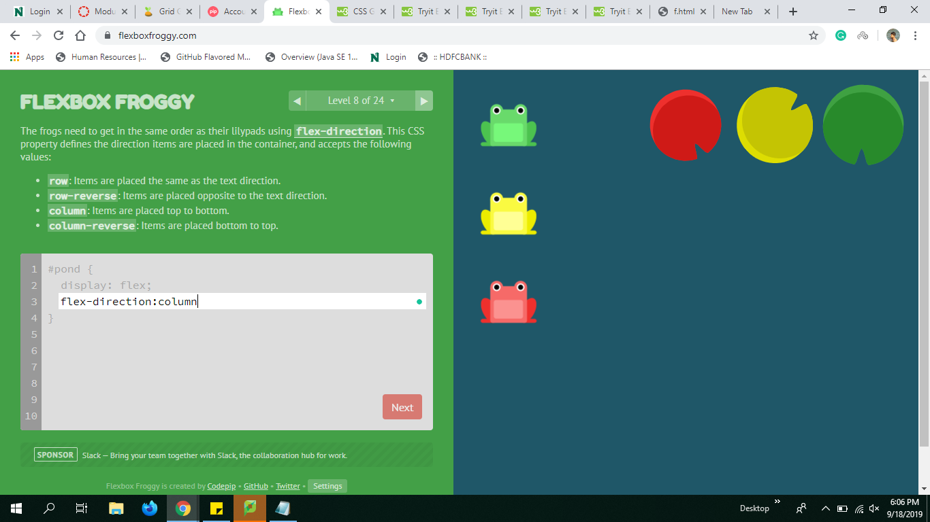
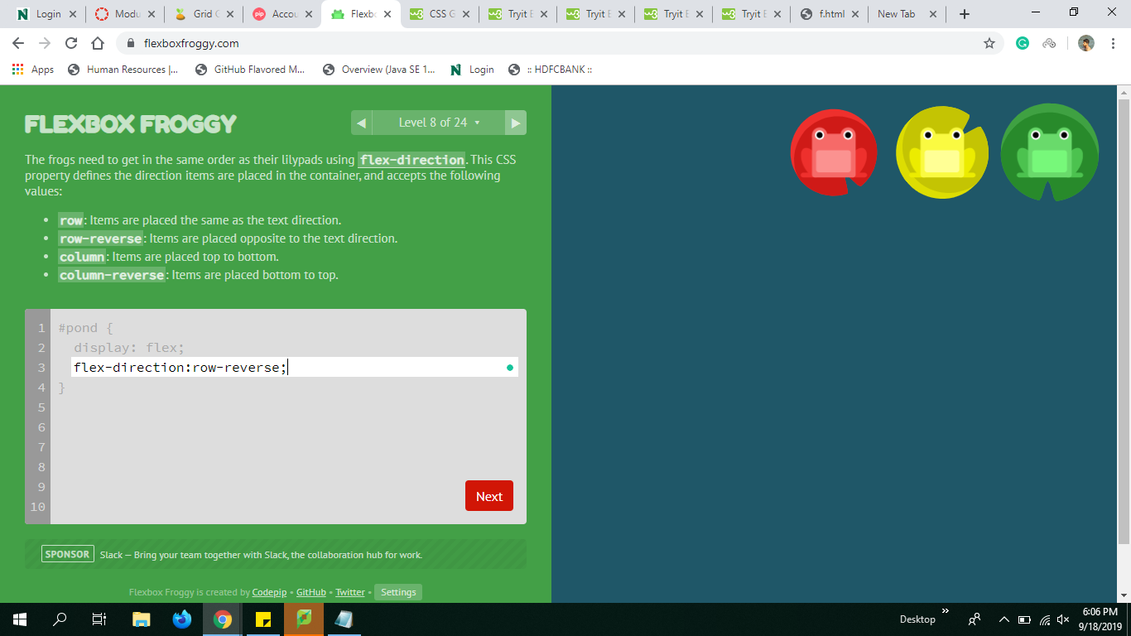
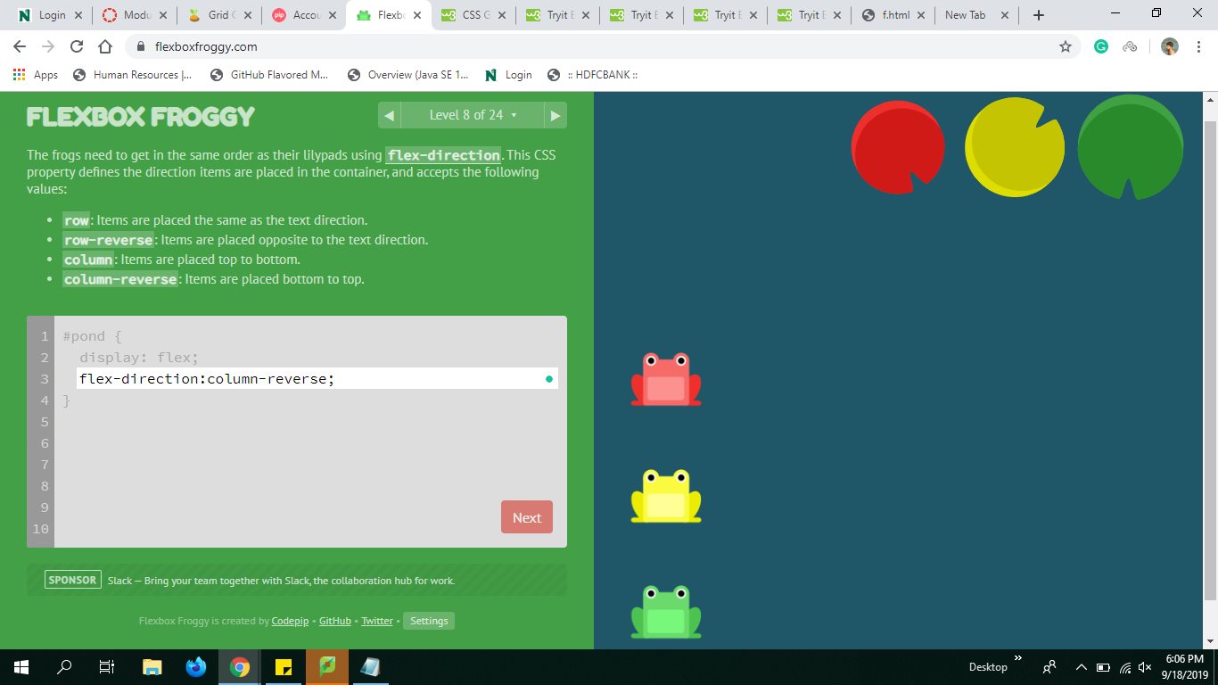
Flex-Direction
Row Column
Row-reverse Column-reverse
Mahender Reddy Surkanti

Slide 7
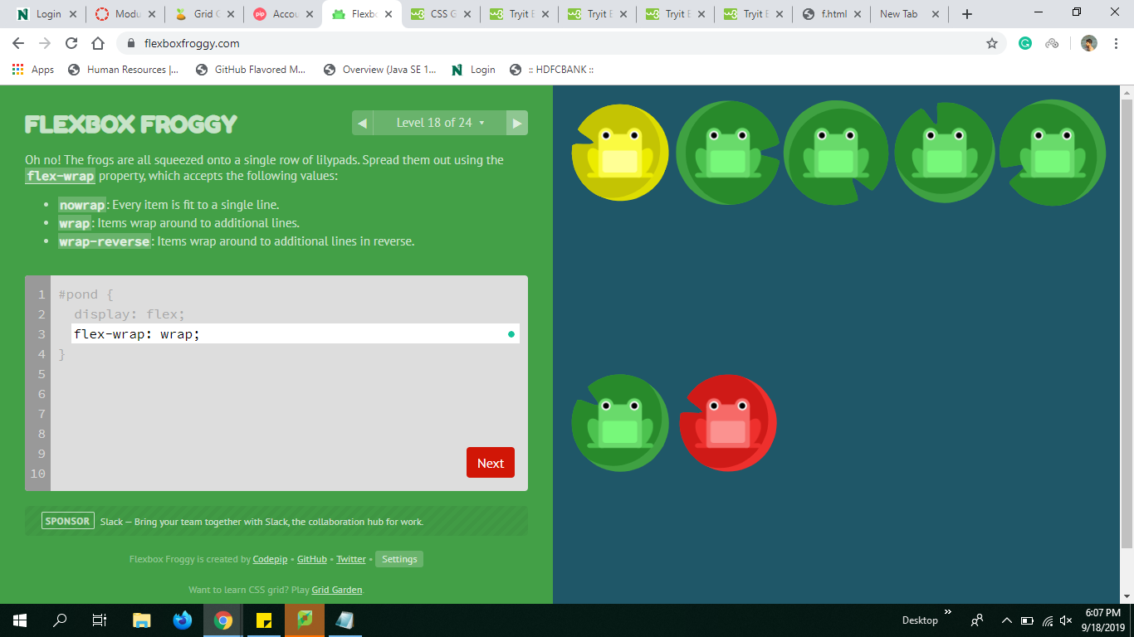
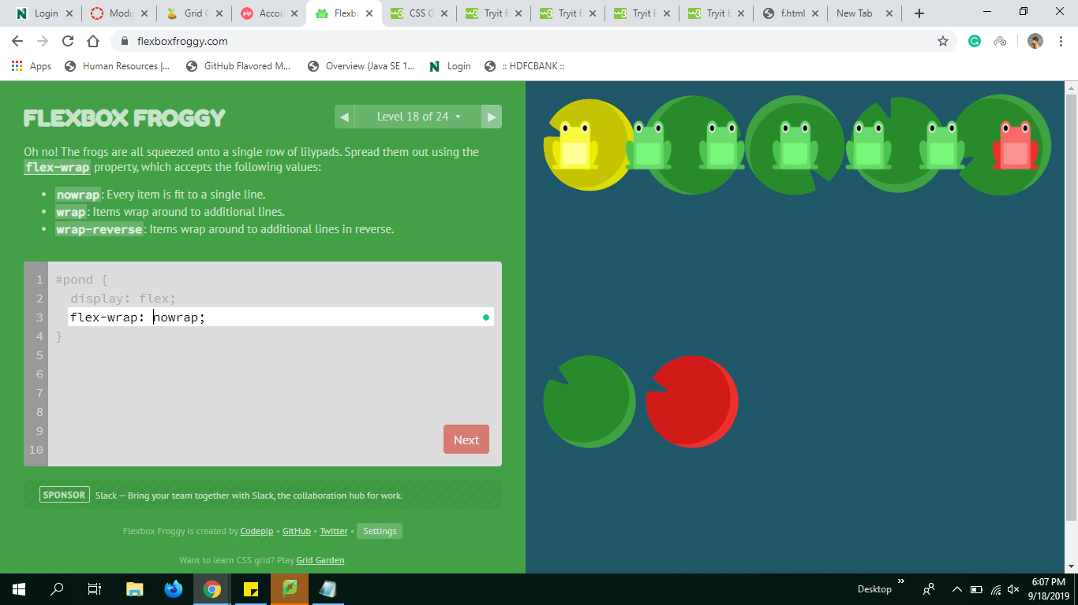
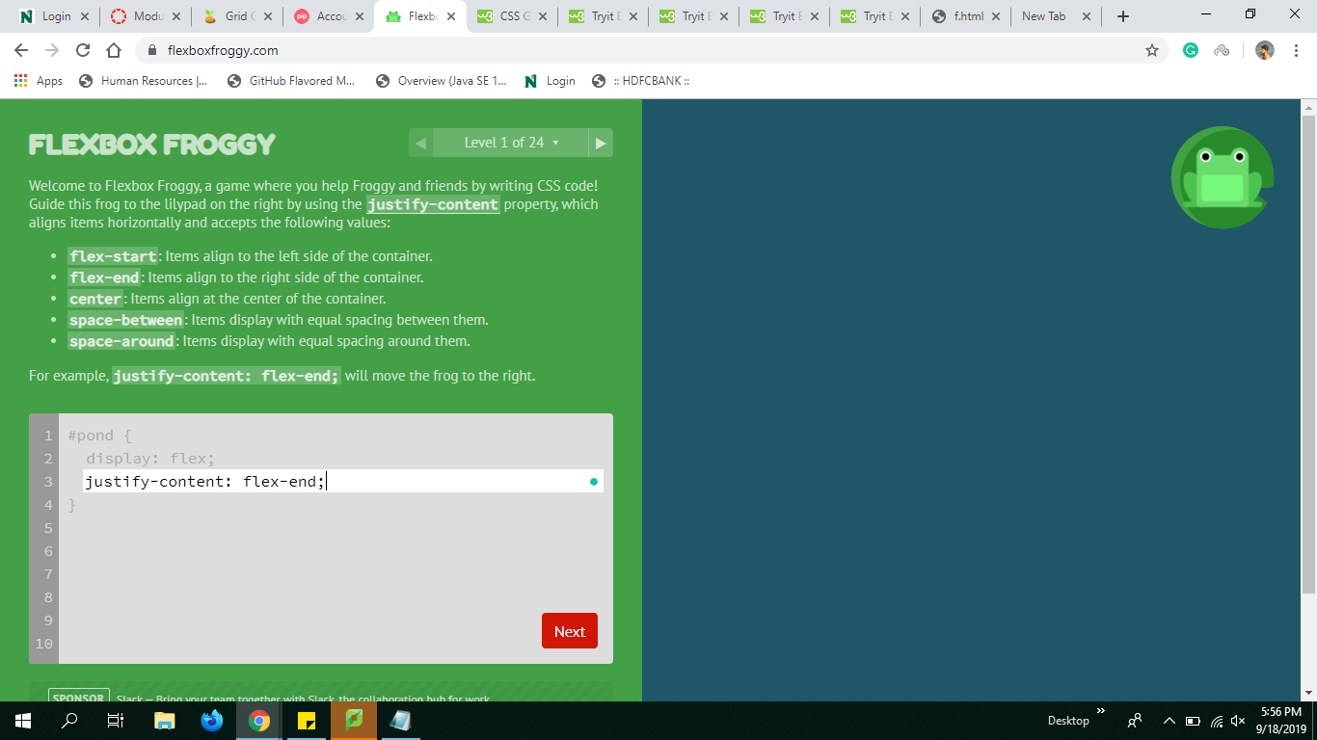
Flex-wrap
The flex-wrap property specifies whether the flex items should wrap or not.
a. wrap nowrap
wrap-reverse
Mahender Reddy Surkanti

Slide 8
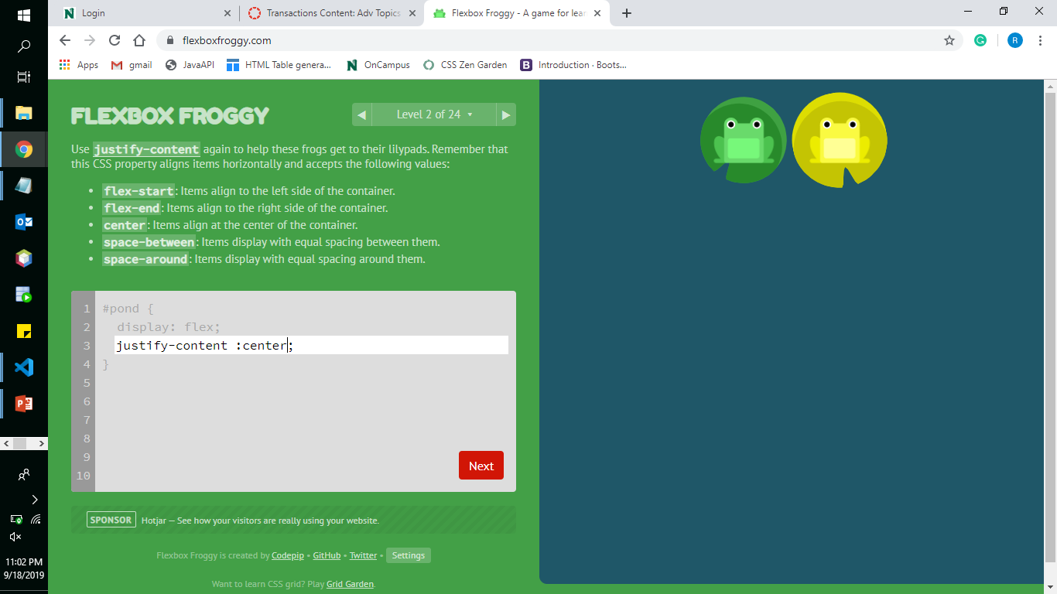
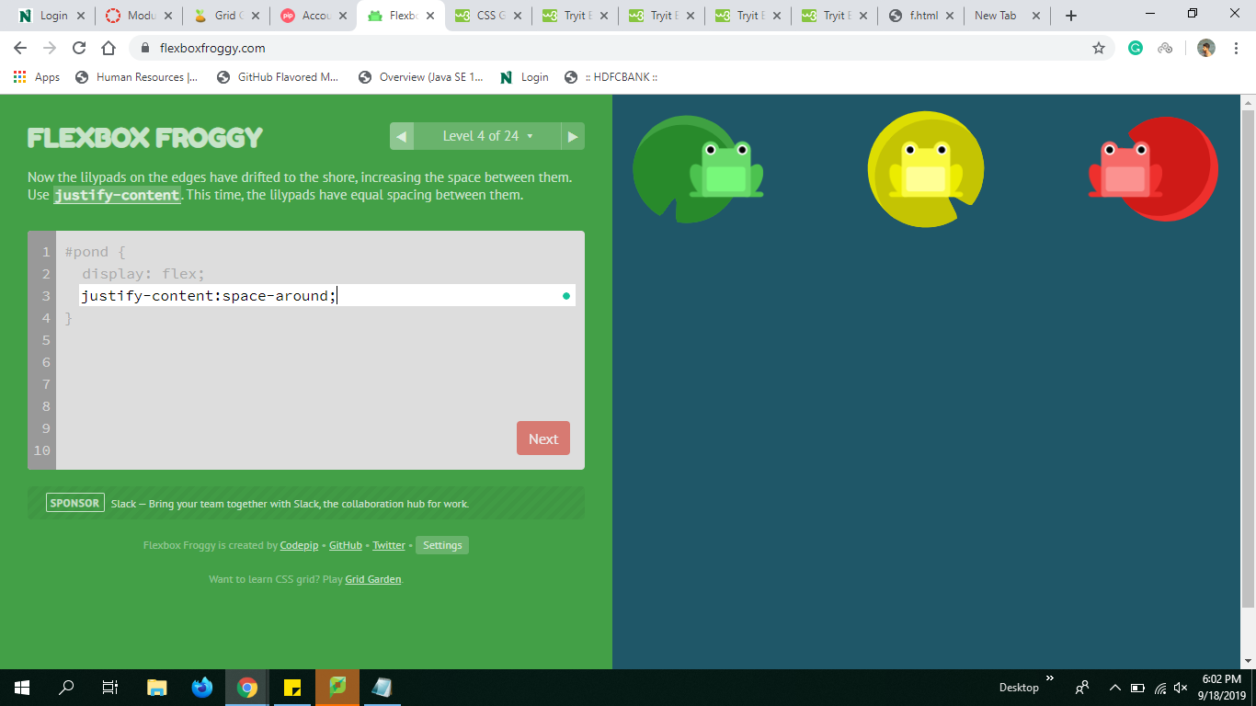
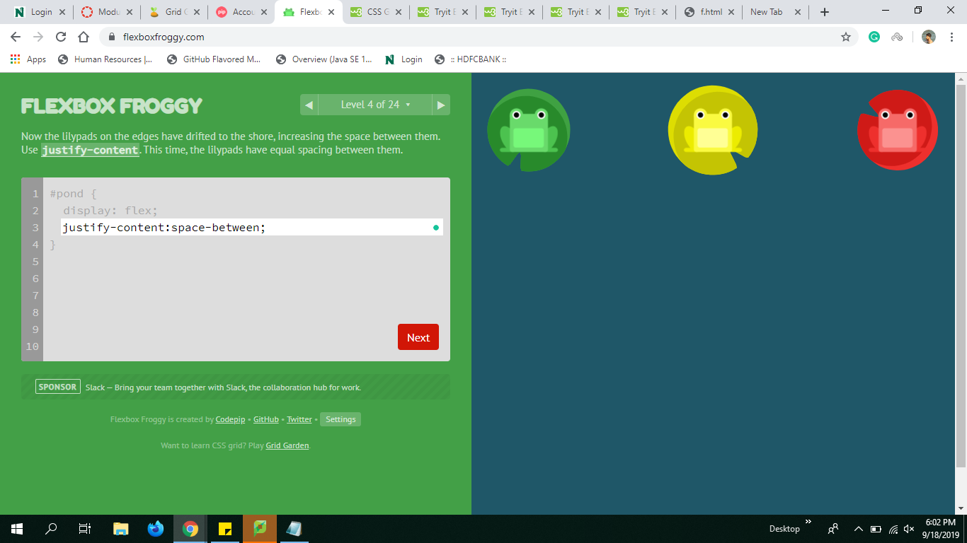
Justify contents:
flex-end center
space-around space-between
Mahender Reddy Surkanti

Slide 9
Few other properties are defined below:
align-items
Note: The difference between the flex-start and flex-end in justify-content and align-items is that justify-content will make adjustments column wise and align-items makes row wise.
align-contents
Flex
flex-grow
flex-shrink
Mahender Reddy Surkanti

Slide 10
What is CSS Grid?
The CSS Grid Layout Module offers a grid-based layout system, with rows and columns.
A grid layout consists of a parent element, with one or more child elements.
Grid Templates:
Grid Columns
Grid rows
Grid Gap
Grid Lines
Justify-content
Align-content
Akhitha Tumula

Slide 11
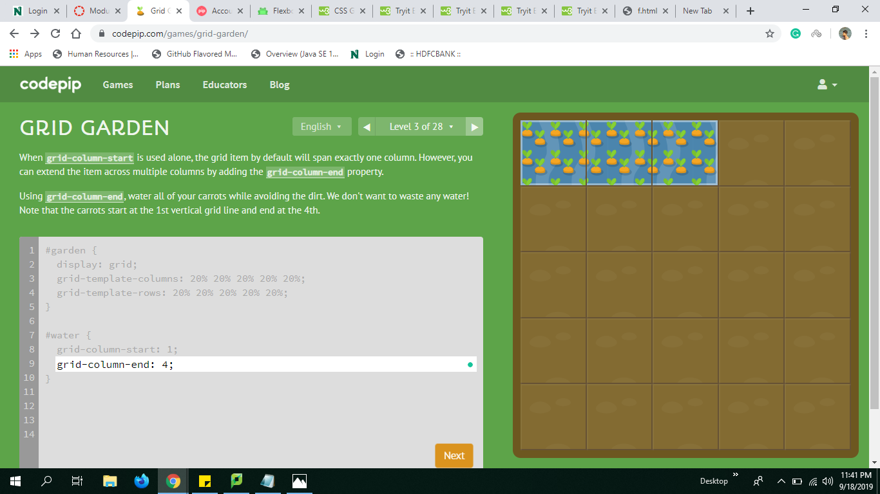
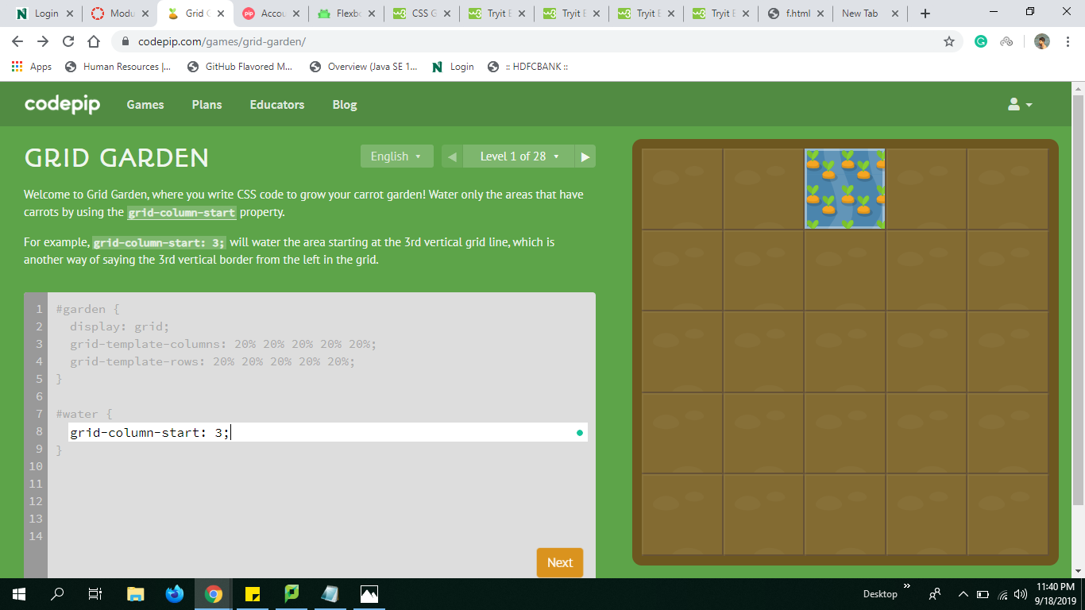
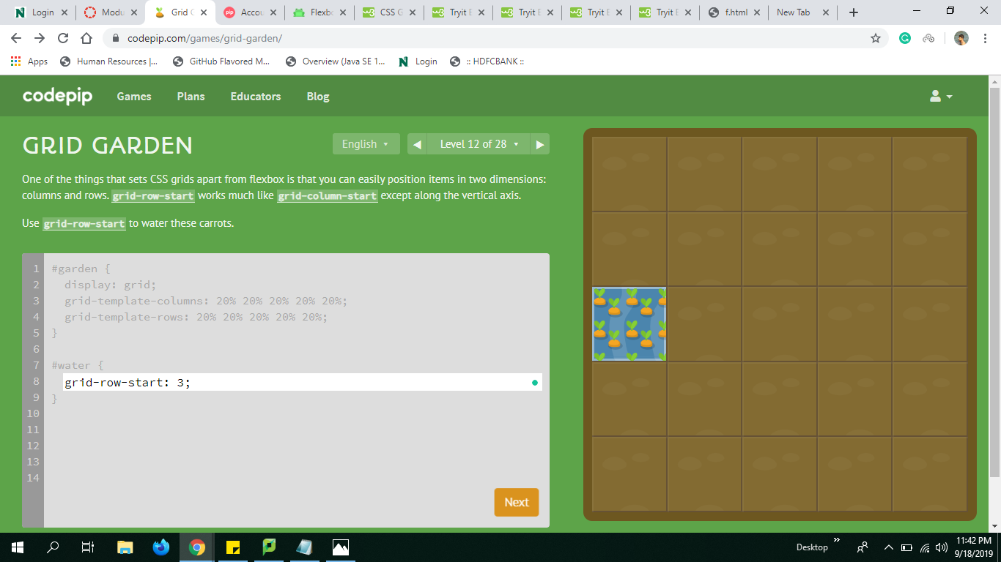
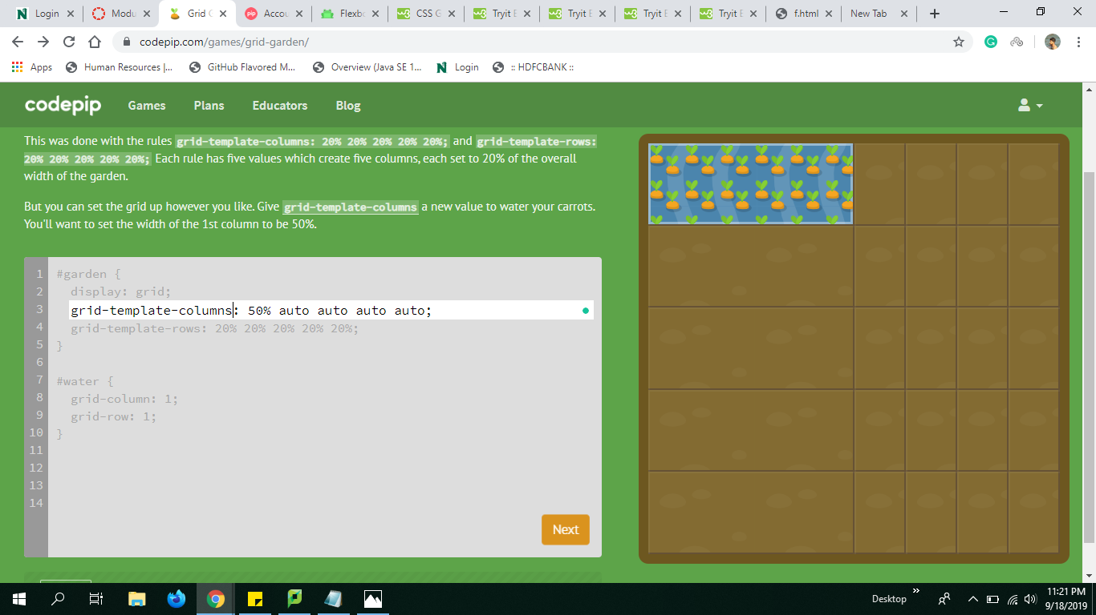
Gird Template
Column-end column-start
Row-start Template-column
Akhitha Tumula

Slide 12

https://rethima-reddy.github.io/CSS-FLEXBOX/

Slide 13
References
W3SCHOOL https://www.w3schools.com/
CSS-TRICK https://css-tricks.com/
QUICKIT https://www.quackit.com/css/

Slide 14


