Slide 1
Section : 1 Group No : 2 CSS-FLEXBOX and GRID

Slide 2




Team Members:
Akhitha Tumula
Mahender Reddy Surkanti
RethimaReddy Polam
Rohan Goud Bhandari

Slide 3
Agenda :
What is CSS Grid and CSS FlexBox
FlexBox
FlexBox Properties
Grid
Grid Properties
Demo
RethimaReddy Polam

Slide 4
CSS-FLEXBOX and GRID

Slide 5
WHAT IS CSS GRID and FLEXBOX:
CSS specifies how a web page looks like, its colors, fonts, formatting, layout, and styling.
CSS flex-box and Grid layout are particular ways to specify the layout of HTML pages.
Flex boxes can adjust in size either decreasing, to avoid unnecessarily monopolizing space, or increasing to make room for contents to be constrained within its boundaries.
RethimaReddy Polam

Slide 6
Properties of FlexBox
The flex container properties are:
1. flex-directions
2. flex-wrap
3. justify contents
4. align-items
5. flex-grow
6. flex-shrink
RethimaReddy Polam

Slide 7
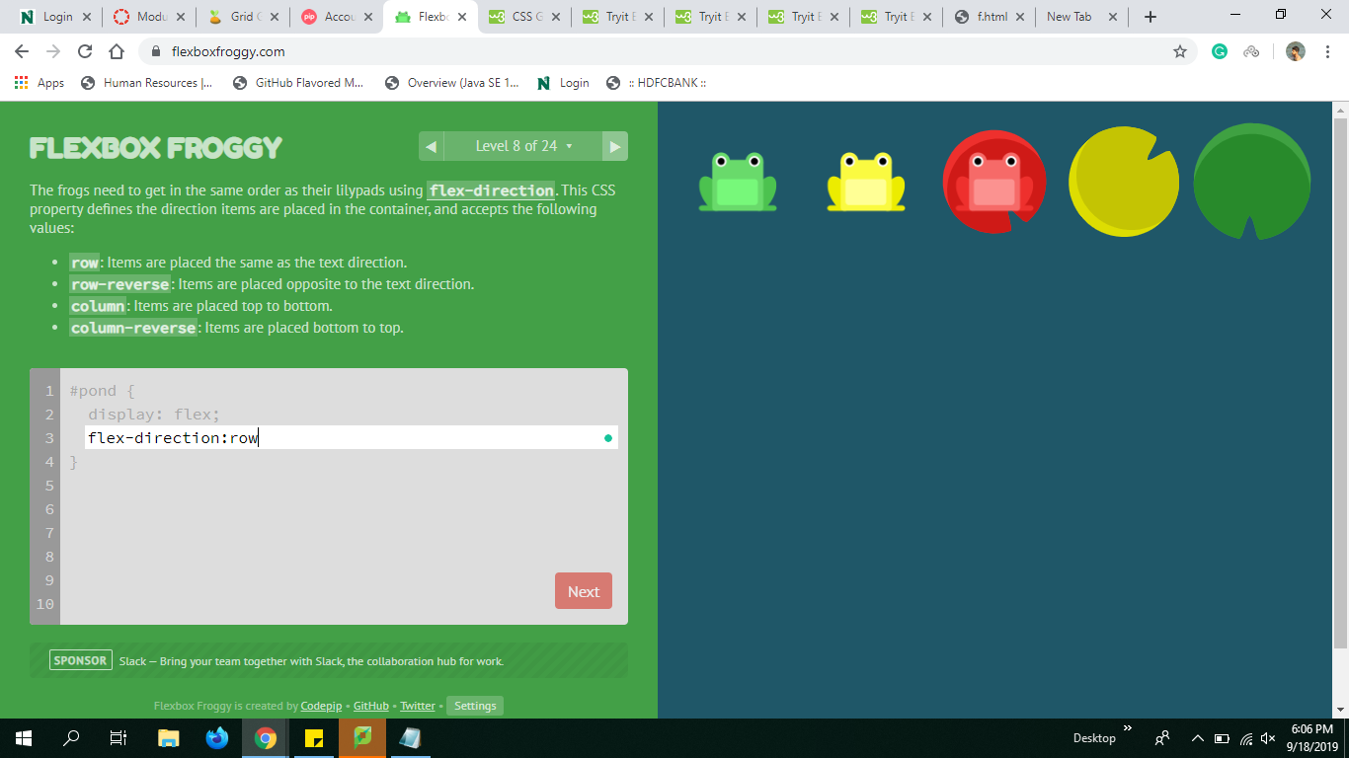
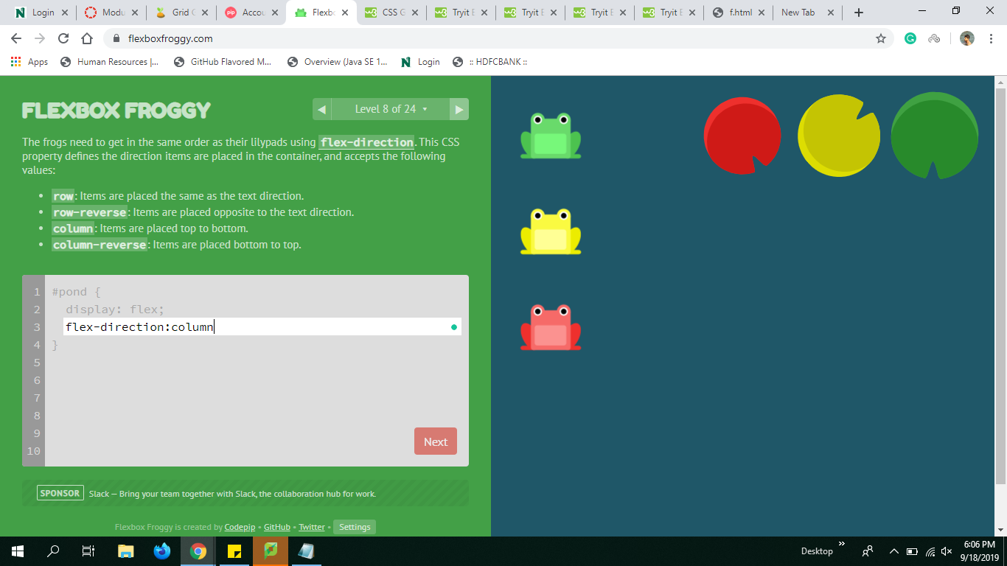
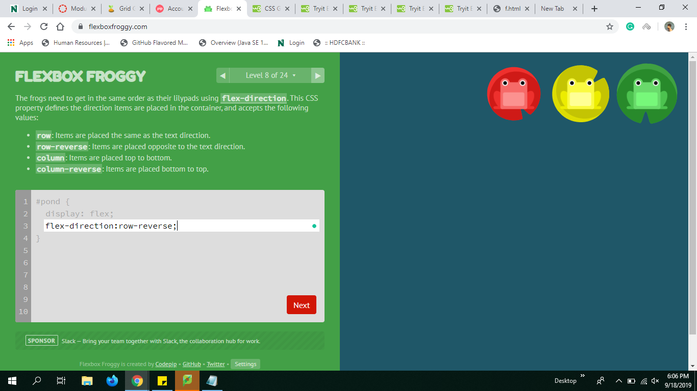
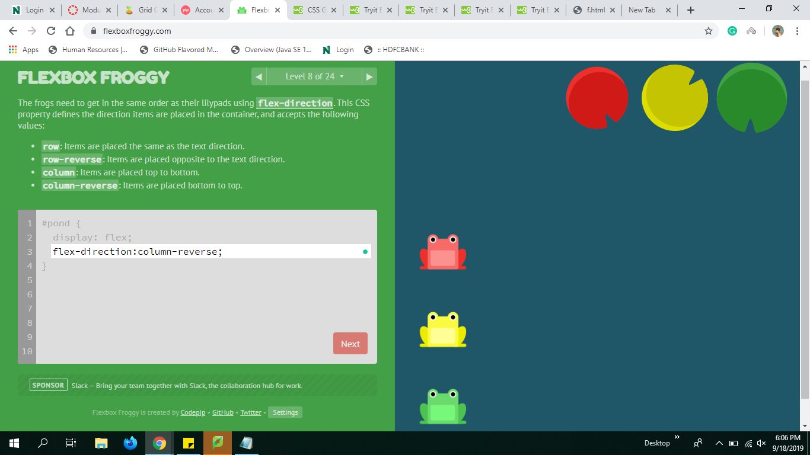
Flex-Direction
Row Column
Row-reverse Column-reverse
Rethimareddy Polam

Slide 8
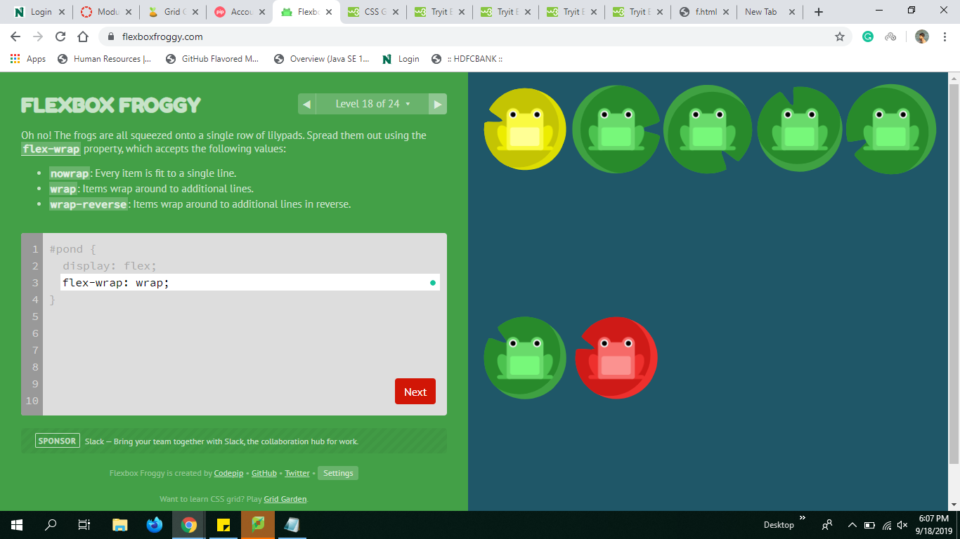
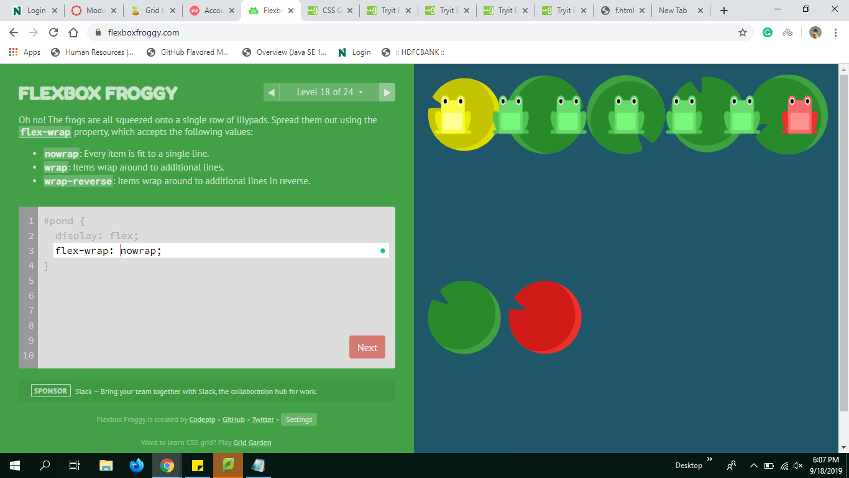
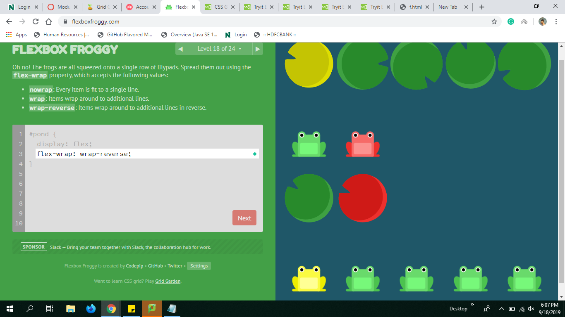
Flex-wrap
The flex-wrap property specifies whether the flex items should wrap or not.
a. wrap nowrap
wrap-reverse
Mahender Reddy Surkanti

Slide 9
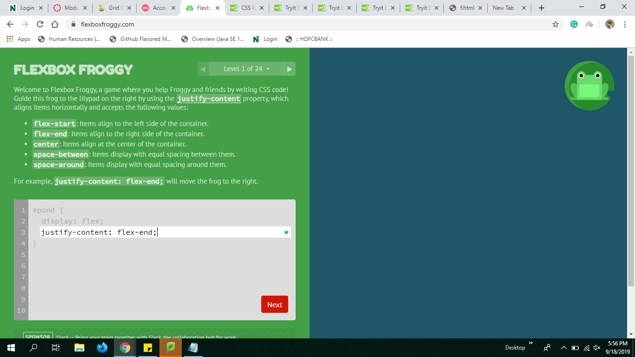
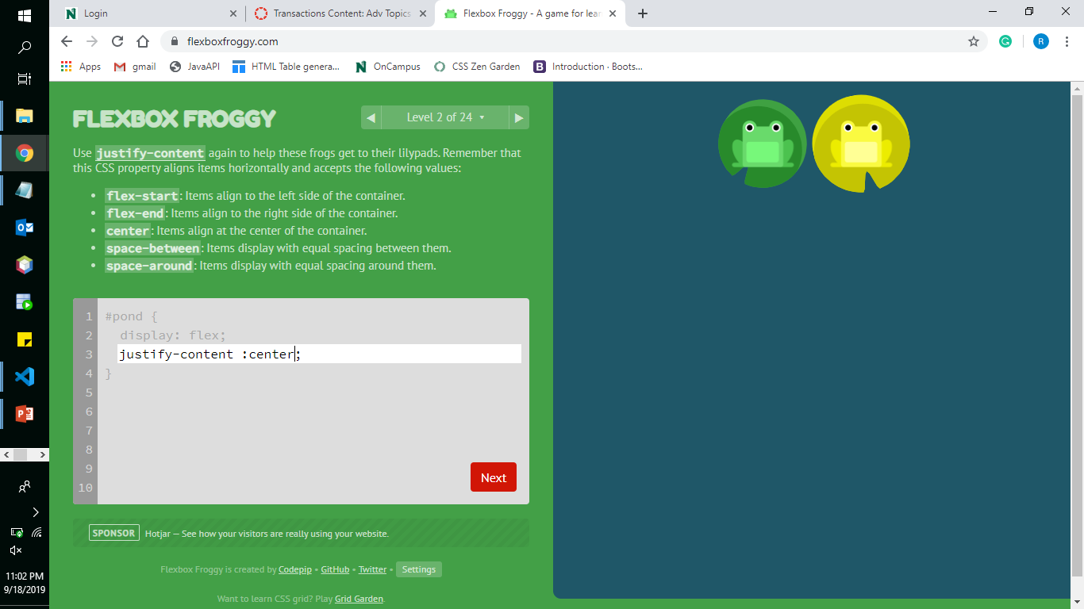
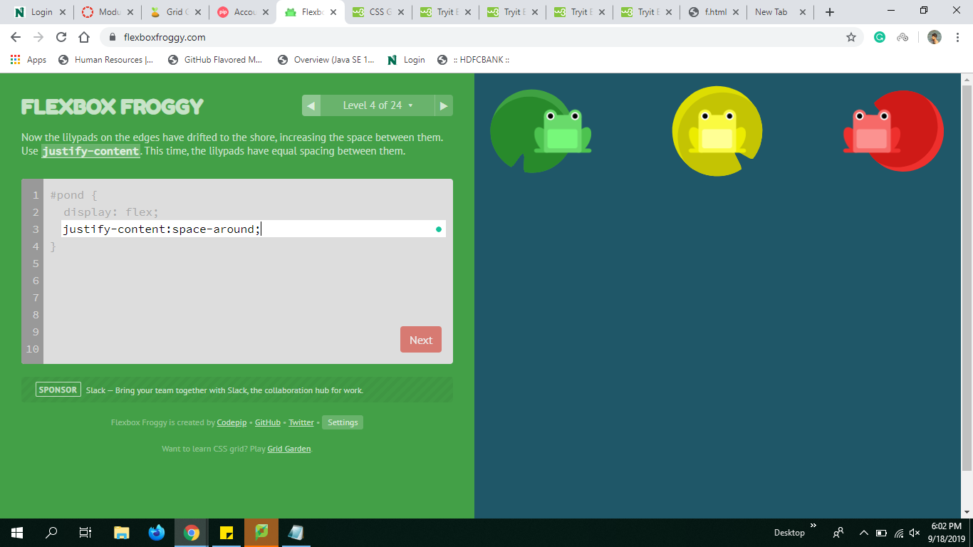
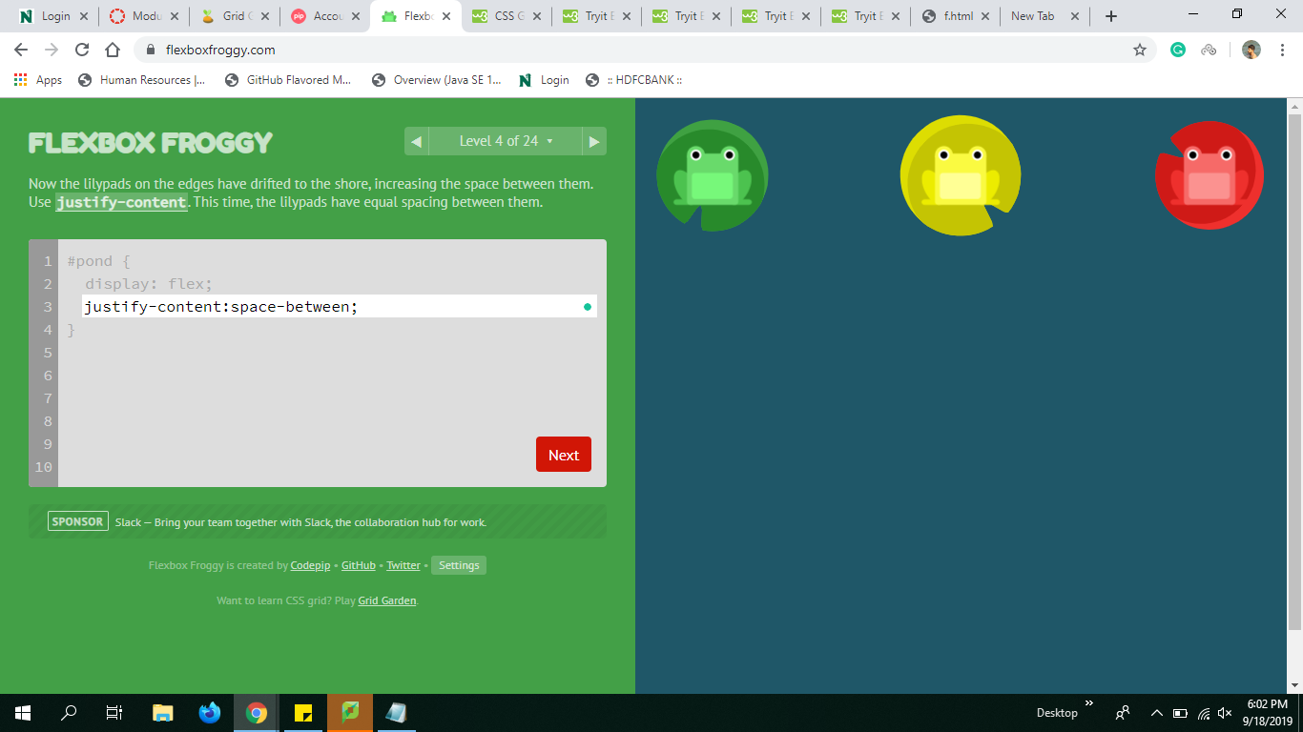
Justify contents:
flex-end center
space-around space-between
Mahender Reddy Surkanti

Slide 10
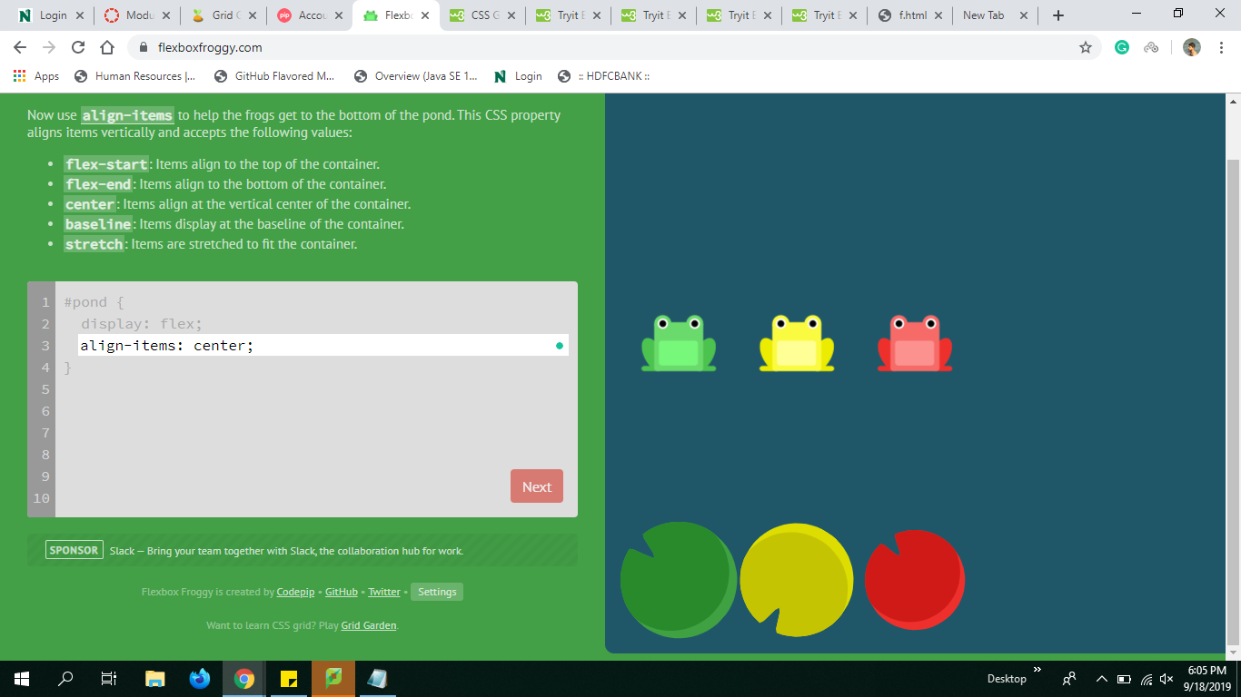
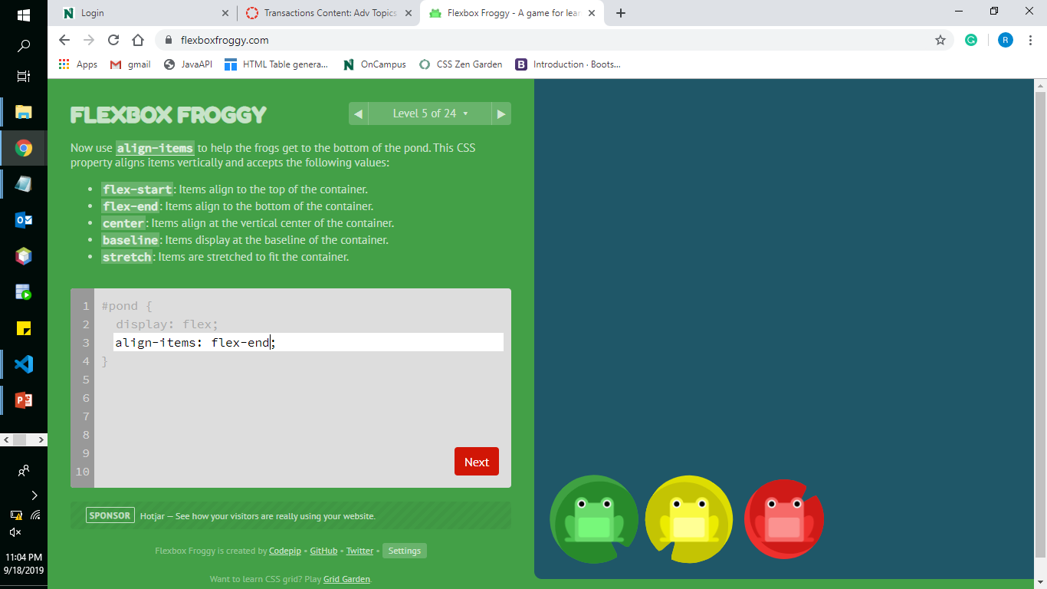
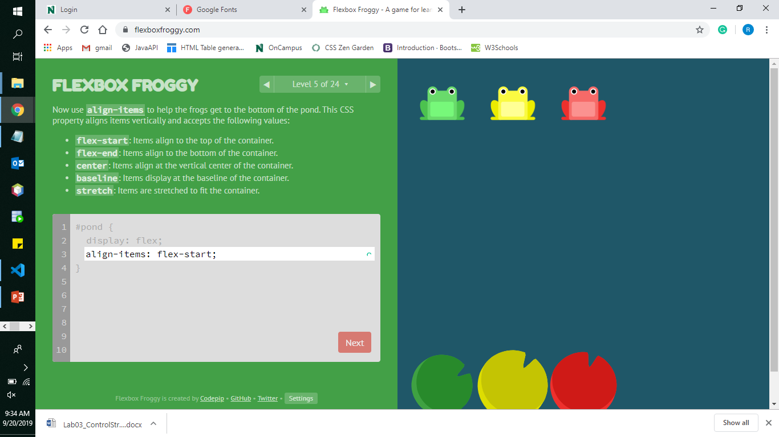
Align-items
Center Flex-end
Flex-start
Note: The difference between the justify-content and align-items is that justify-content will make adjustments column wise and align-items makes row wise.
Mahender Reddy Surkanti

Slide 11
Few other properties are
Flex-grow
The flex-grow property is a sub-property of the Flexible Box Layout module. It defines the ability for a flex item to grow if necessary.
It dictates what amount of the available space inside the flex container the item should take up
flex-shrink
It specifies the "flex shrink factor", which determines how much the flex item will shrink relative to the rest of the flex items in the flex container when there isn't enough space on the row
Mahender Reddy Surkanti

Slide 12
What is CSS Grid?
The CSS Grid Layout Module offers a grid-based layout system, with rows and columns.
A grid layout consists of a parent element, with one or more child elements.
Grid Templates:
Grid Columns
Grid rows
Grid Gap
Grid Lines
Justify-content
Align-content
Akhitha Tumula

Slide 13
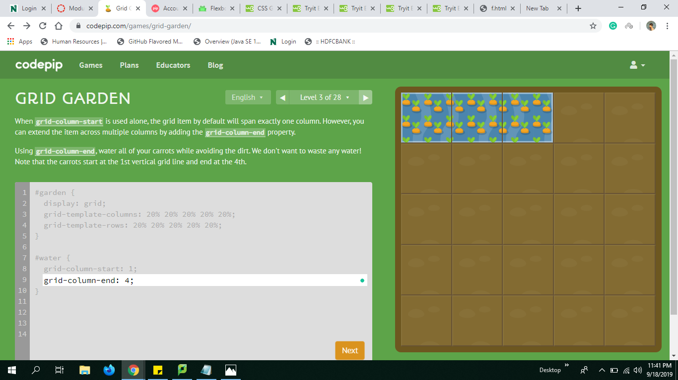
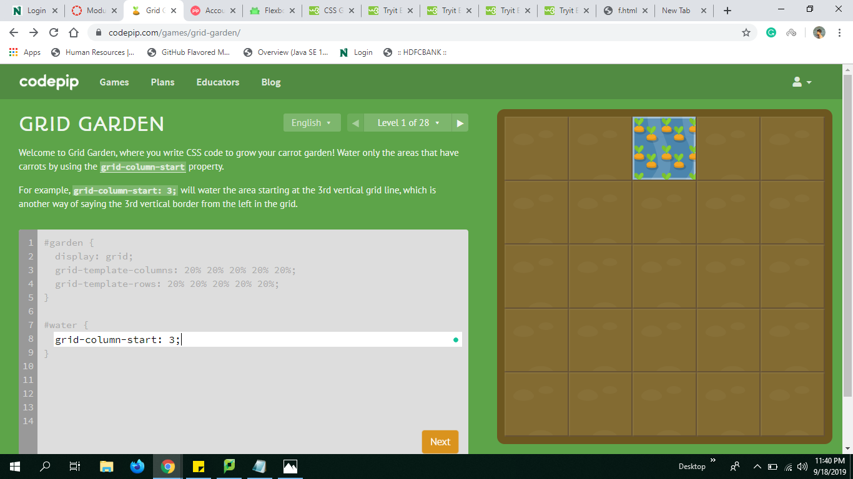
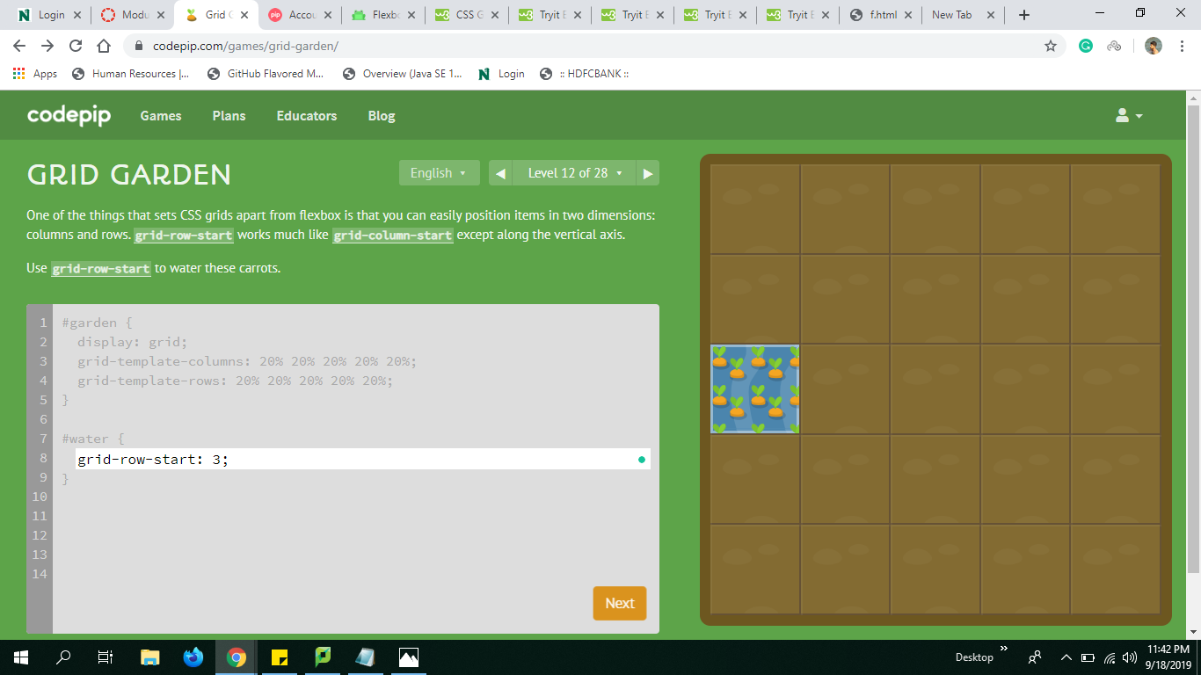
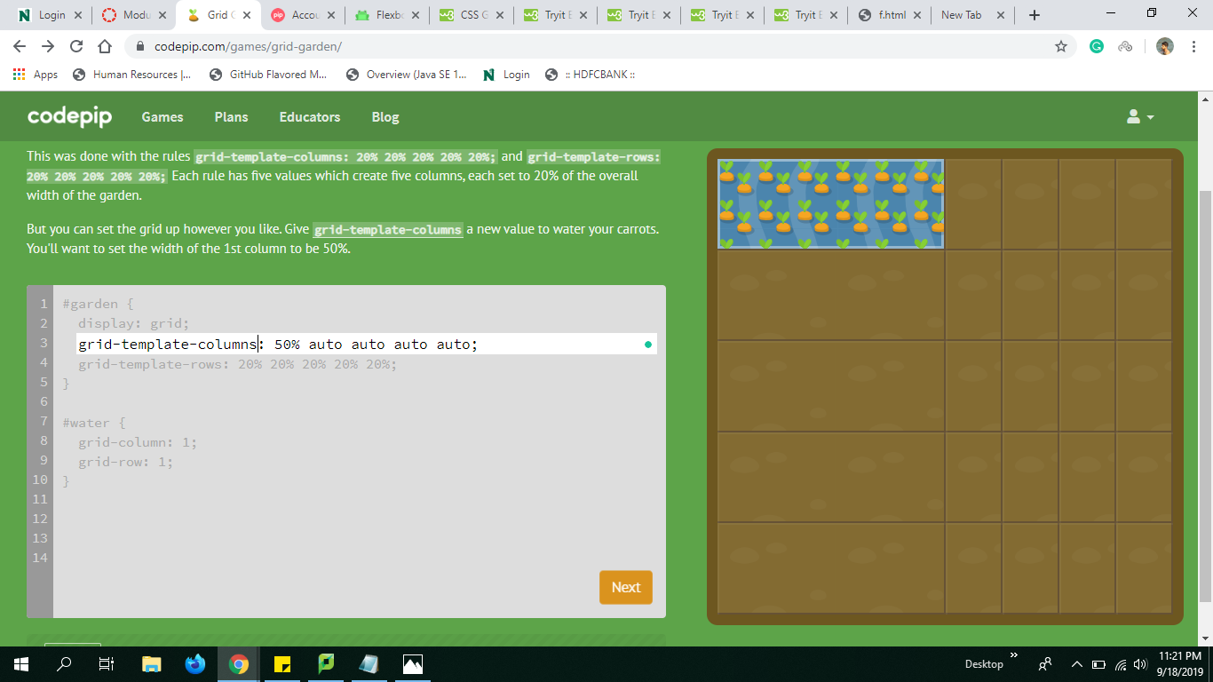
Gird Template
Column-end column-start
Row-start Template-column
Akhitha Tumula

Slide 14

https://rethima-reddy.github.io/CSS-FLEXBOX/

Slide 15
References
W3SCHOOL https://www.w3schools.com/
CSS-TRICK https://css-tricks.com/
QUICKIT https://www.quackit.com/css/

Slide 16


