Slide 1
00
PROJECT REPORT
OSINT·SENTRY
Rating who published a story, whether the site is safe to open,
and whether anyone else reported the same thing.
Utkersh sharma/Rethish kanth/Anvi pharande
Django 5.2 REST API · Celery · Vite + React analyst console · 129 tests, none touching the network
Notes:
OSINT-Sentry: a Django REST + React platform that rates who published a story, whether the site is safe to open, and whether anyone else reported the same thing.

Slide 2
01
What was built
Five modules planned · two built end-to-end · all five modelled, migrated, routed and audited
01
BUILT
02
BUILT
03
SCAFFOLD
Credibility engine
Content analysis
Social graph
RDAP registration scoring plus a separate site-safety inspection, each rated out of 10.
Feed-first fetcher, NER / topics / summary, and a corroboration rating out of 10.
Accounts, edges and posts behind a reciprocity + neighbourhood-overlap scorer.
04
SCAFFOLD
05
PENDING
··
BUILT
Media forensics
Reporting and GIS
Audit trail
MediaItem and TamperingResult with ELA / deepfake score placeholders.
GeoEvent PointField and Report; comes online once GDAL / GEOS are installed.
Every model write recorded — 507 events so far, actor and diff included.
The plan calls for trained models — GBT, BERT, spaCy, RGCN. None exist here, and nothing pretends otherwise.
Each is an interface with a dependency-free heuristic behind it, and every row it writes carries its own model_version — heuristic-v2, corroboration-v2, safety-v1. Swapping in a real model is a settings change with no call site moved.
Notes:
Five modules were planned. Modules 1 and 2 are built end to end and do real network work. Modules 3-5 have real models, tasks, endpoints and admin, with heuristic stand-ins where the plan calls for trained models.

Slide 3
02
How it is put together
One Django project, nine apps, a React console — and no service dependencies out of the box
Analyst console
frontend/
Vite + React; JWT client with transparent refresh, one view per module.
Settings seam | Default implementation | Plan wants
CREDIBILITY_SCORER | real RDAP registration age, TLD, publisher | GBT + BERT
CONTENT_ANALYZER | proper-noun NER, term-frequency topics | spaCy, BERTopic
CONTENT_FETCHER | real feed-first fetcher over urllib | Scrapy spiders
SOCIAL_GRAPH_SCORER | reciprocity + neighbourhood overlap | RGCN (PyG / DGL)
API
backend/ + */urls.py
DRF router, JWT auth, pagination, one shared exception shape.
Domain apps
core, credibility, content
Source, CredibilityScore, SiteInspection, ContentItem, Corroboration.
Async
backend/celery.py
Celery over a kombu filesystem broker — a real worker, no Redis needed.
Storage
db.sqlite3
SQLite by default; Postgres + PostGIS is a settings swap for Module 5.
Offline switches
NullFetcher, NullRegistryClient and NullSearch each report themselves unavailable rather than returning empty, so switching a backend off can never read as evidence of nothing being there.
Audit
security/
AuditLogEntry on every model write — actor, action, target, diff.
15 commits · 19 models · 9 apps · 6 console views
Notes:
The stack, and the seam where real models plug in. SQLite and a kombu filesystem broker are the defaults so the whole project runs with no services installed.

Slide 4
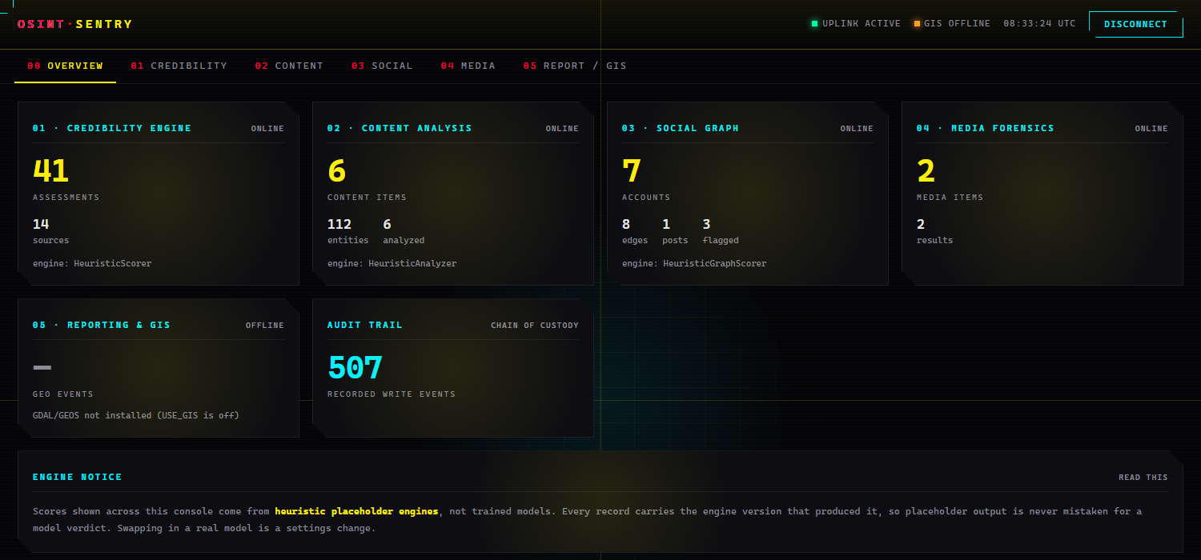
03
The analyst console
JWT-authenticated, one view per module — live screenshot of the running app
Notes:
The analyst console front page. Every module reports its own counts and the engine that produced them; the engine notice is on the first screen, not in a footnote.

Slide 5
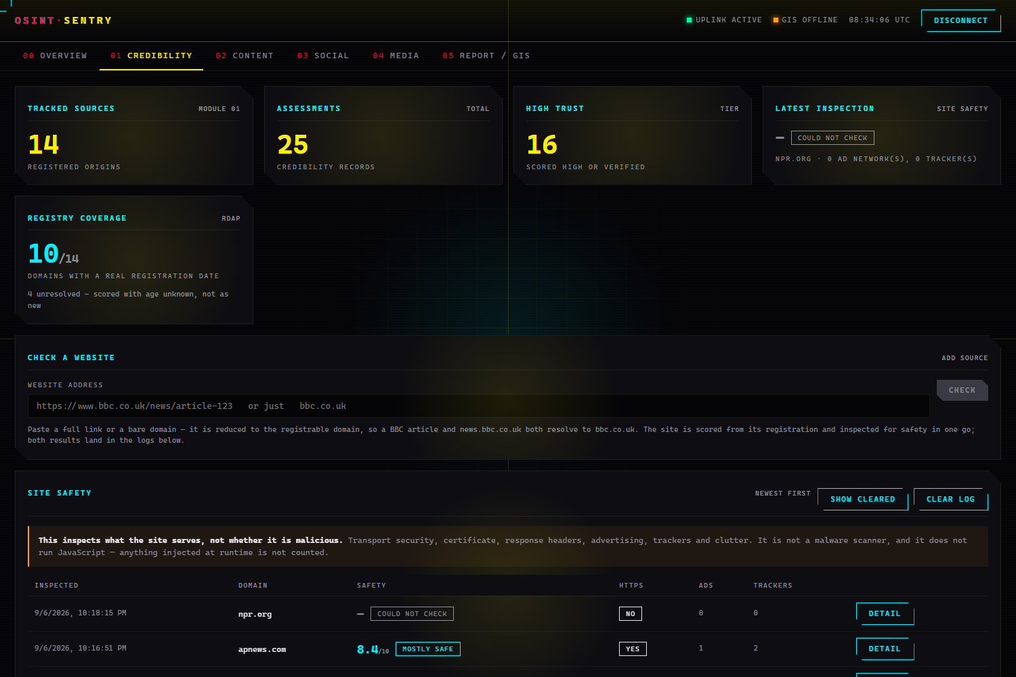
04
Module 1 · rating the publisher
Real RDAP registration data — the registries’ own JSON-over-HTTP successor to WHOIS. No API key.
The bug it fixes
v1 computed “domain age” from Source.first_seen — how long this database had known the source. Any row that sat in the table drifted upward, and every real newspaper added today scored as brand new.
Case | v1 | v2
bbc.co.uk, added today | −15 “new” | +18 registered 1994
Registered 5 days ago, in our DB a year | +15 “established” | −25
HTTPS earns nothing
“Known to us” is never scored
Metadata cannot reach VERIFIED
A failed lookup leaves age unknown
It is free, automatic and universal — every phishing site has it. An observed plaintext URL still costs 10.
Rewarding it is circular. Kept at weight zero so the provenance hash still covers it.
Capped at 82; the tier needs 85. No amount of clean WHOIS makes a publisher accurate.
Never “new” — an unreachable registry must not be able to condemn a domain.
Notes:
Module 1 reads real domain registration data over RDAP. The v1 heuristic had the age signal inverted: it measured how long our own database had known a source, so a 30-year-old newspaper added today was penalised as new.

Slide 6
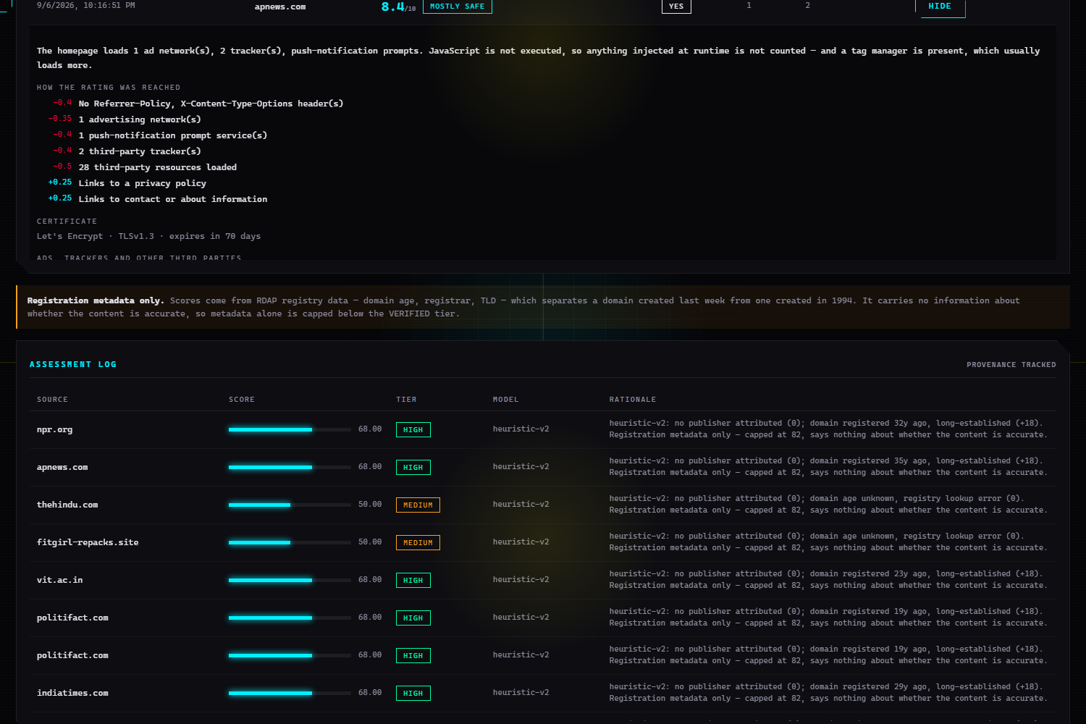
05
Module 1 · is the site itself safe?
apnews.com · 8.4/10 Mostly safe — every deduction shown and signed, above the assessment log
Transport
HTTPS, whether plain HTTP upgrades, and the certificate: issuer, protocol, days to expiry.
What it declares
HSTS, CSP, X-Content-Type-Options, clickjacking and referrer policy. Absence is inattention, not attack.
Monetisation and surveillance
Ad networks, pop-unders, trackers, session recorders, push nagware, crypto miners — matched against a readable list.
Clutter and mixed content
Interstitials, autoplay, embedded frames, meta-refresh, third-party volume, insecure forms.
A password field posting over plaintext HTTP caps the rating at 3/10 — however tidy the rest of the site is. That is not a hygiene issue.
A cryptocurrency miner is the heaviest single finding (−4) — ads are penalised lightly because advertising is normal publishing; a miner is not.
Unreachable is not unsafe — a site that will not answer gets no rating rather than a bad one.
Notes:
A second, separate rating: what the site actually serves. Deliberately not folded into the credibility score, because is this publisher reliable and is this site safe to open are different questions.

Slide 7
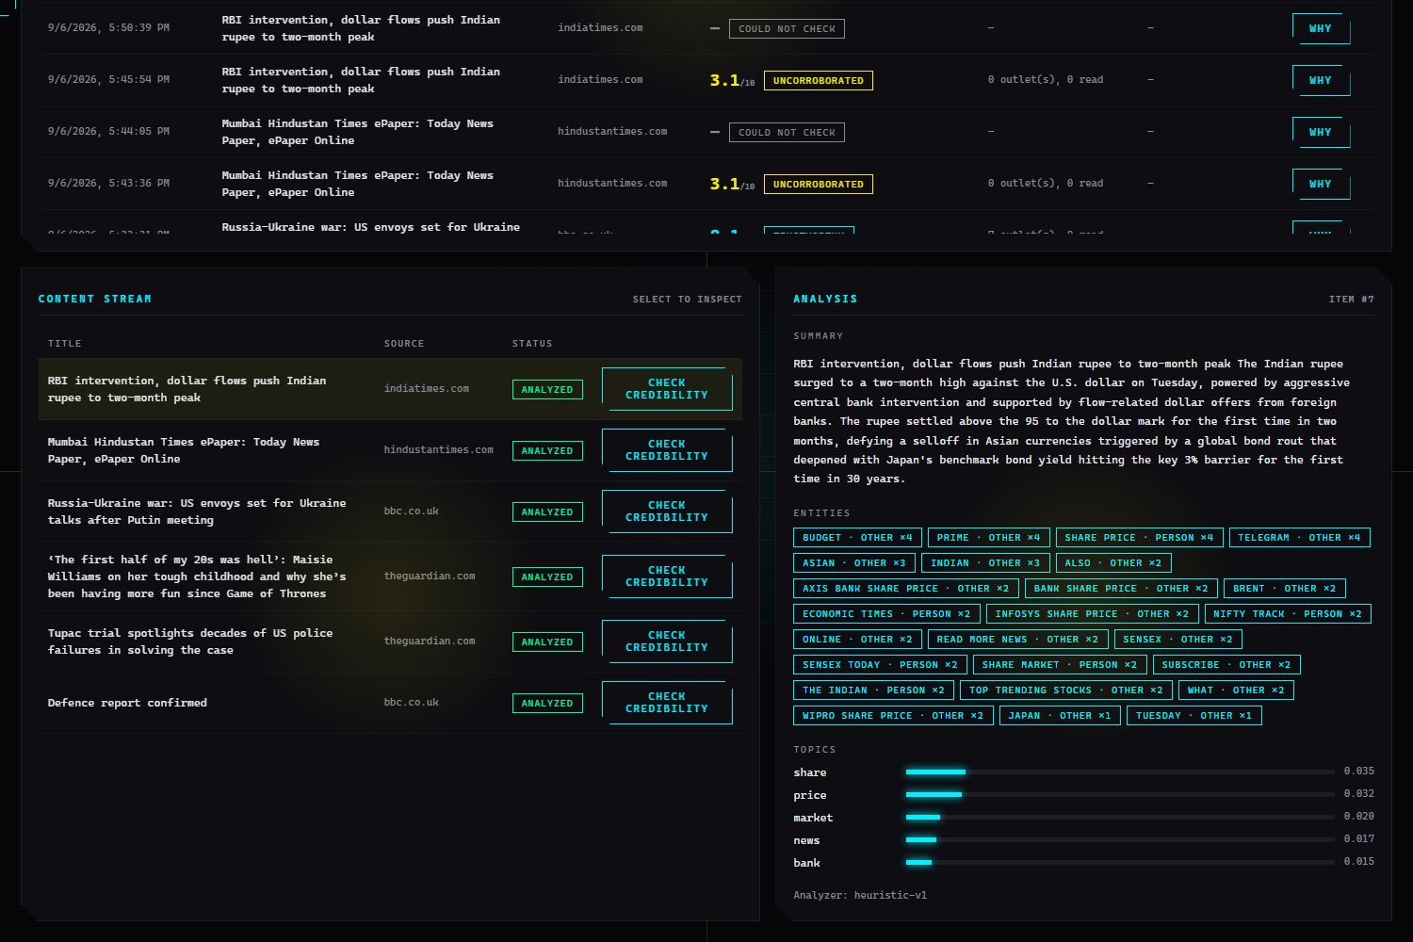
06
Module 2 · reading the web without being a nuisance
Feed-first: one request per new article rather than a crawl — the publisher decides what is in scope
Two checks run before any request goes out
The credibility gate first — a source below the threshold is never contacted at all.
robots.txt on every hop, redirect targets included, which is why redirects are followed by hand rather than by urllib.
robots.txt response | Behaviour
2xx | parsed and obeyed, Crawl-delay included
4xx | no file exists, so nothing is disallowed
5xx, timeout, DNS failure | disallow everything
“We could not ask permission” is not “permission granted” — and failing open there would crawl a site hardest exactly while it is struggling.
Extraction and NLP: strip the furniture, prefer the article body, read metadata from OpenGraph and JSON-LD. Entities, topics and a summary, stamped heuristic-v1.
SSRF refused
2 MB stream cap
No DOCTYPE in feeds
Hostnames resolving to private, loopback or link-local addresses are refused on every hop.
On the stream, not the Content-Length a server claims, and with identity encoding — no compression bomb behind the cap.
Every entity-expansion attack needs a DTD, so a feed carrying one is refused before the parser sees it.
Notes:
Module 2 is the part that goes and gets things. Feed-first, gated on credibility before any request, and obeying robots.txt on every hop including redirect targets.

Slide 8
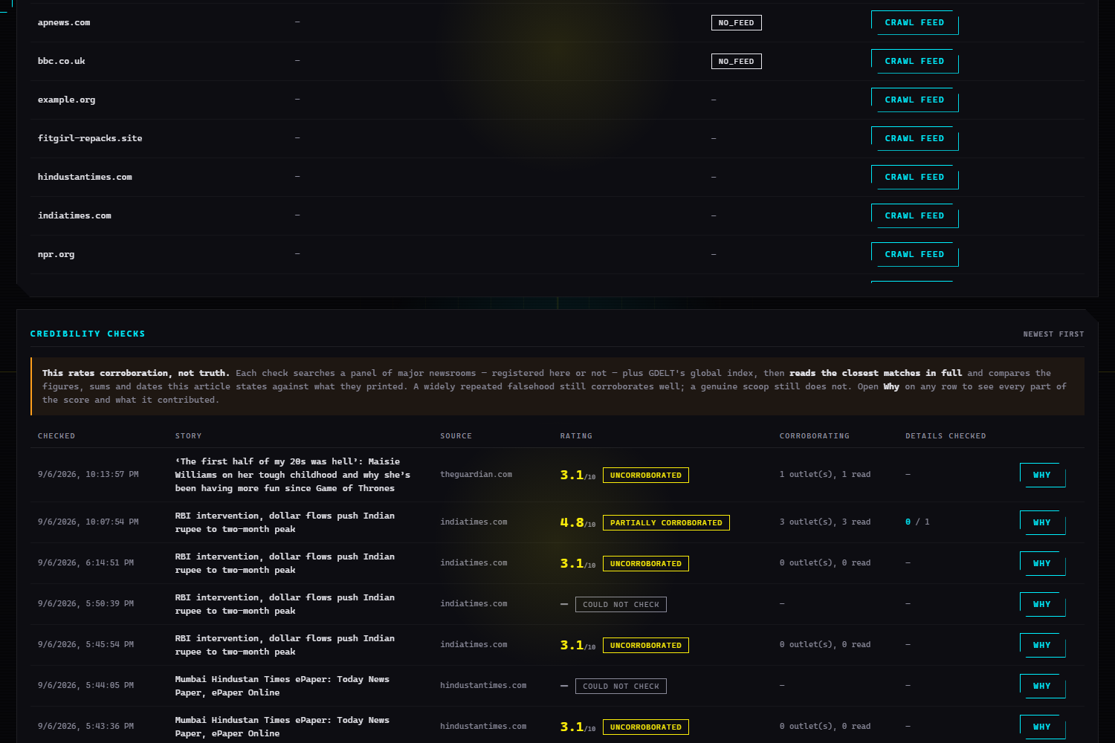
07
Module 2 · the 0–10 corroboration rating
This measures corroboration, not truth — a widely repeated falsehood corroborates beautifully
Component | Weight | What it measures
Who published it | 0.30 | the source’s Module 1 credibility
Who else reported it | 0.45 | independent outlets carrying a matching story
Do its details match | 0.25 | the article’s own figures, found in their text
When an article states nothing checkable the third share passes to the second rather than being lost. A conflicting figure costs 1.5, capped at 3.0.
Where it looks — four backends
What we have already ingested, and live feeds of other tracked outlets
17 major newsrooms in reference_outlets.py — consulted whether or not anyone registered them
GDELT DOC 2.0 — free and key-less; the only channel that discovers arbitrary domains
A failed search is not a negative result
COULD NOT CHECK is a real state — GDELT rate-limits hard, and a lookup that did not complete carries no rating.
Syndication is not corroboration
The best few candidates are then fetched in full — through the same robots-respecting fetcher — and matched on their actual text, not a nine-word headline.
the same wire copy on ten sites is one source, not ten.
Silence is not guilt
“Details checked 0 / 1” means a figure was not found in the coverage read. Not a contradiction.
Notes:
The corroboration rating: three weighted components, each returned as its own signed reason so the console shows a column that visibly adds up to the score.

Slide 9
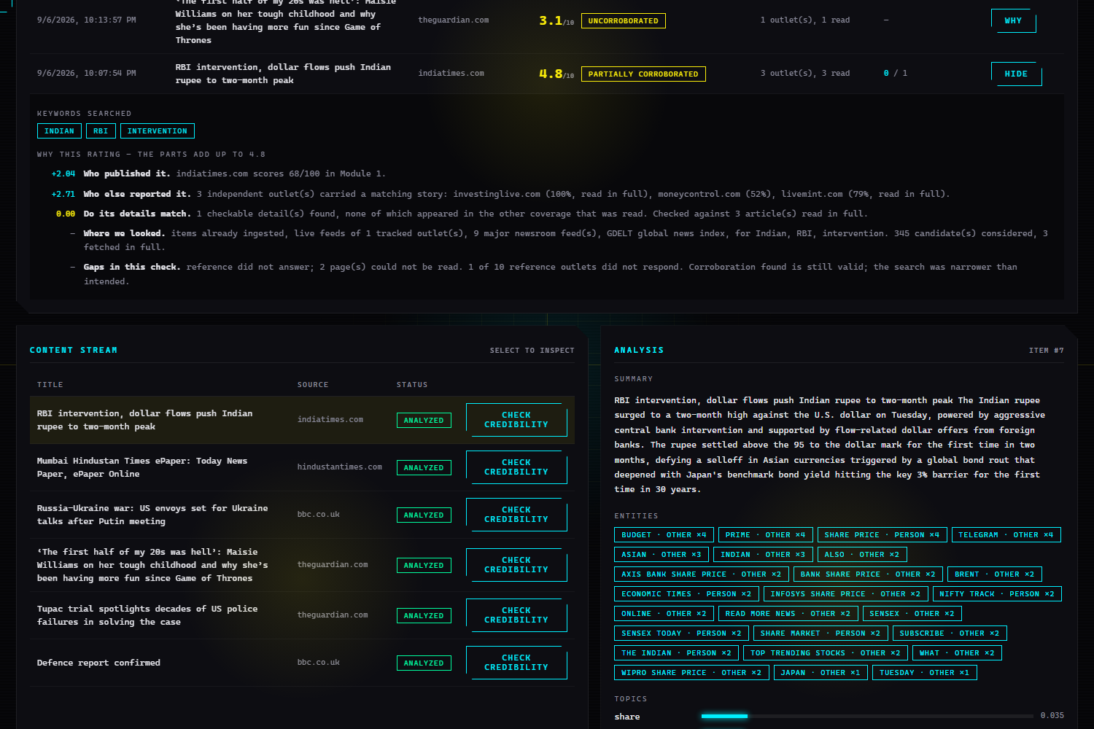
08
Why this rating — and the bug behind every 3.1
indiatimes.com · RBI intervention story · 2.04 + 2.71 + 0.00 = 4.8 / 10
SYMPTOM
Story after story came back 3.1/10 UNCORROBORATED — sources_checked 139, independent_sources 0. That is 0.45 × (68 ÷ 10): the publisher half alone, corroboration contributing exactly zero.
CAUSE
Search terms were ranked by how often a proper noun appeared anywhere on the page — so navigation menus and sidebar promos outvoted the story.
EVIDENCE
An article headlined “RBI intervention, dollar flows push Indian rupee to two-month peak” was searched for as Indian, Budget, share, price.
FIX
Rank by where a word appears, not how often. Terms a site prints on every article are discounted as furniture; weekdays and months are discarded outright.
Signed contributions in a fixed-width column that visibly sums to the rating, the keywords actually searched, a “Where we looked” line (345 candidates considered, 3 fetched in full), and “Gaps in this check” naming what the search could not reach.
RESULT
The same article now searches Indian, RBI, intervention. The Ukraine story that scored 3.1 scores 9.0 on eight independent outlets.
Notes:
The reasoning panel is the answer to give reasons for the rating. Beside it, the bug that made almost every article score exactly 3.1 - the arithmetic was never the problem, the search query was.

Slide 10
09
Verification, and what is next
Every outbound call sits behind one seam, so the whole pipeline runs on canned data
129
0
10,146
507
tests, all passing
touch the network
lines of Python
audit events
Bugs only live runs exposed — each now pinned by a test
a navigation bar outvoting a headline
a clock time (03:12) surfacing as two disputed statistics
a line break making a story about 47 people record itself as counting 47 officials
Modules 3 and 4 — Build out the social ingest and media forensics behind their existing models.
Module 5 · GIS — Install GDAL / GEOS, turn USE_GIS on, and the GeoEvent PointField comes online.
Real models at the seams — CREDIBILITY_SCORER, CONTENT_ANALYZER, SOCIAL_GRAPH_SCORER — no call site moves.
Deliberately absent: Google News RSS search would widen corroboration, and Google’s robots.txt disallows /rss/search. Module 2 does not get to obey robots.txt only when convenient.
Notes:
129 tests, none touching the network. Everything outbound sits behind content.http.request or a search backend, so the tests replace those and drive the whole pipeline on canned data.

