Slide 1
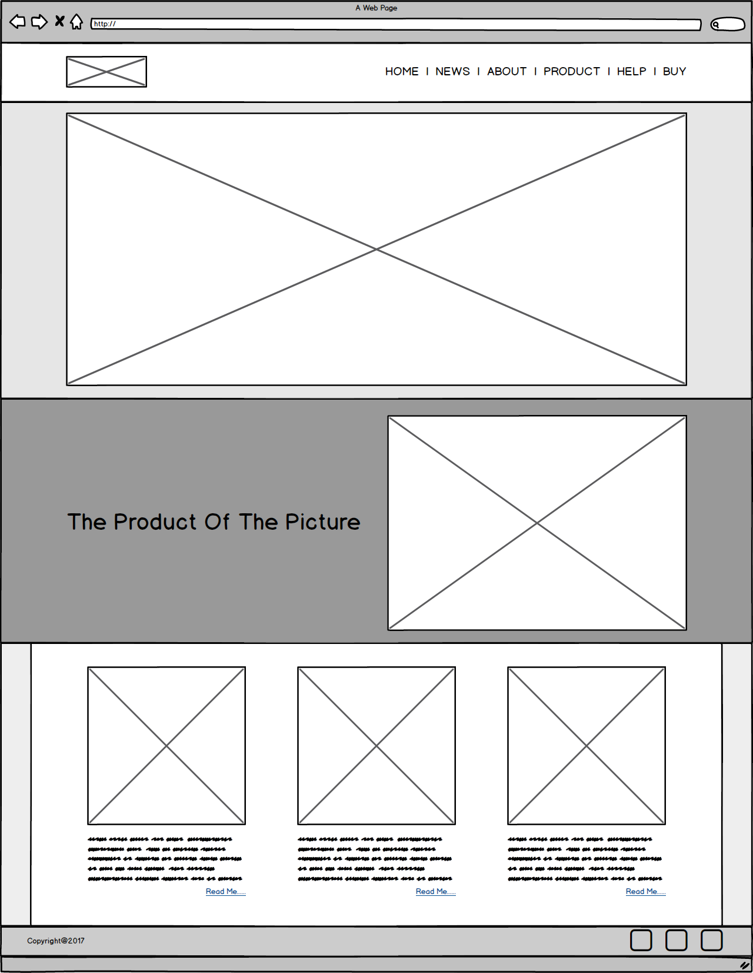
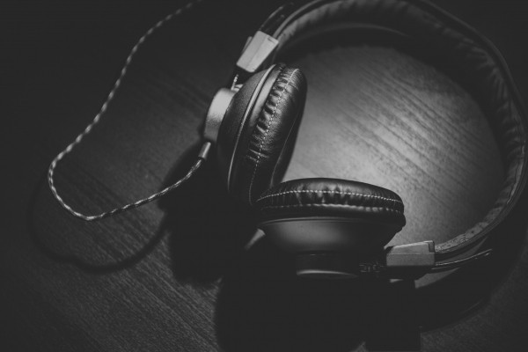
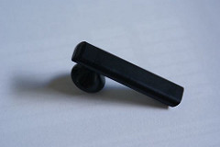
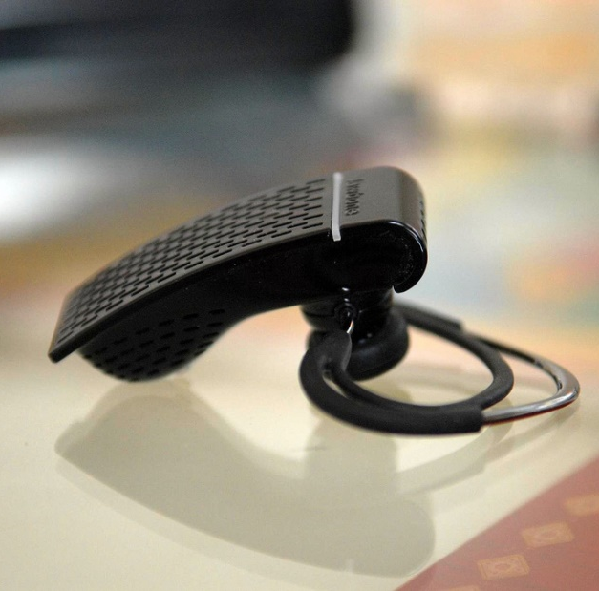
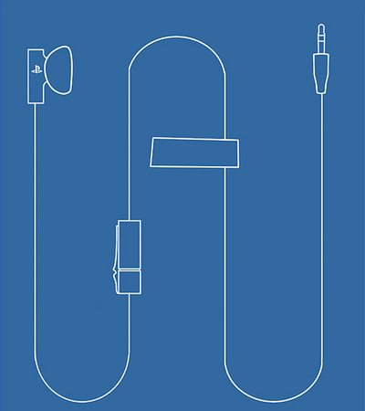




New Headphones
Coming soon
Is My Free Time
Wireless headphones
copyright@2017

Slide 2
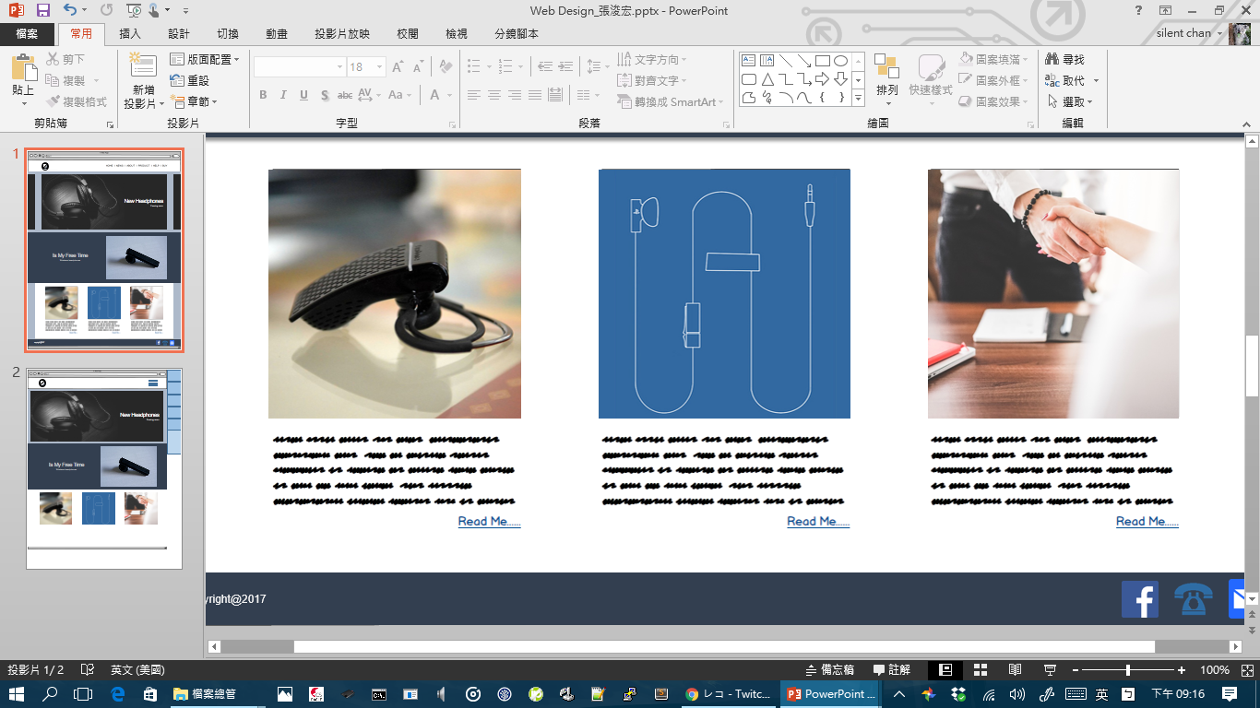
HOME
NEWS
ABOUT
New Headphones
Coming soon
PRODUCT
BUY
Is My Free Time
Wireless headphones
copyright@2017

Slide 3
HOME
NEWS
New Headphones
Coming soon
ABOUT
PRODUCT
Is My Free Time
Wireless headphones
BUY
copyright@2017

