Slide 1


Slide 2
We are Pedigree
Megan Els
Weich Malan
Retief Strydom
Danette Coetzee
Danielle Speek

Slide 3
Our Mission
Paws is aimed at improving the quality of life of homeless and mistreated cats and dogs in rural areas.
Our goal is to remove these animals from these harmful environments, rehabilitate them, and provide them with new loving and caring homes.
In order to achieve this, we rely on donations from the public and local businesses. We raise these funds by hosting events such as walks in the park with the animals, fun runs, and general donation drives. These funds enable us to have the means to locate and retrieve these animals.
We do this because we believe that our community work improves not only the life go the animal, but also gives humans the chance to experience the unconditional love a pet, by participating in our adoption program.
We thereby create a happier, healthier and more caring space for every person and animal involved.

Slide 4
Target Groups
Potential Pet Adopters
Potential Investors & Contributors
Our Personnel

Slide 5
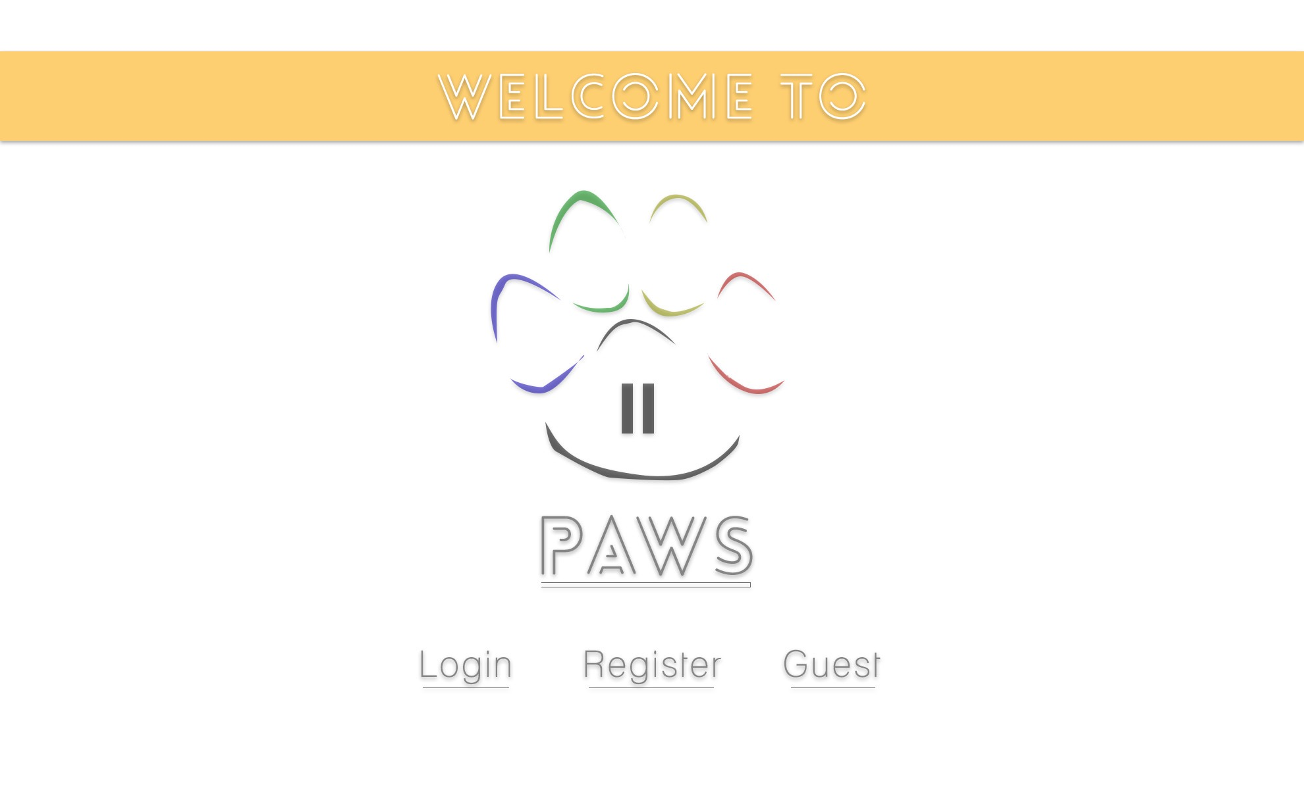
Website: Splash Page
Login
Register
Guest

Slide 6
Website: Home Page
5 badges with icons: Home, My Profile, Goodies, Donations, and About Us.
Subcategories for each e.g. Home: News, Events, and Calendar.

Slide 7
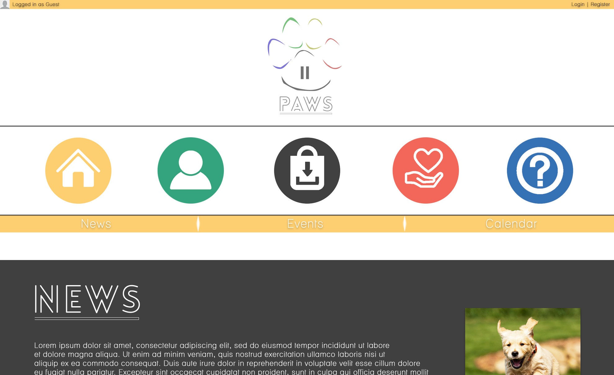

Slide 8
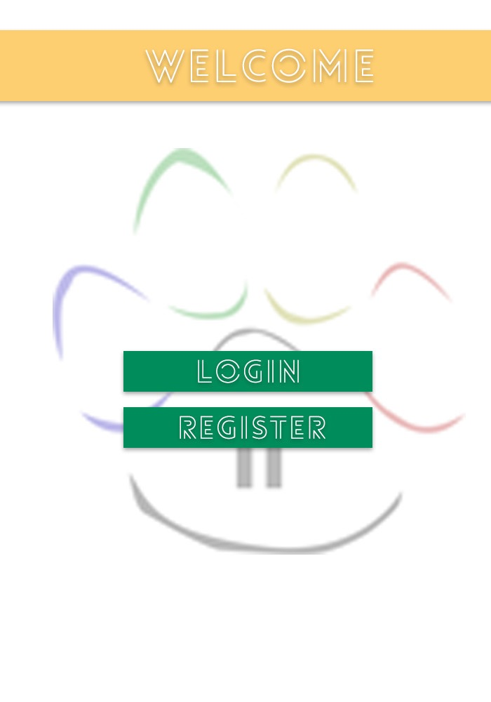
App: Splash Page
Login
Register

Slide 9
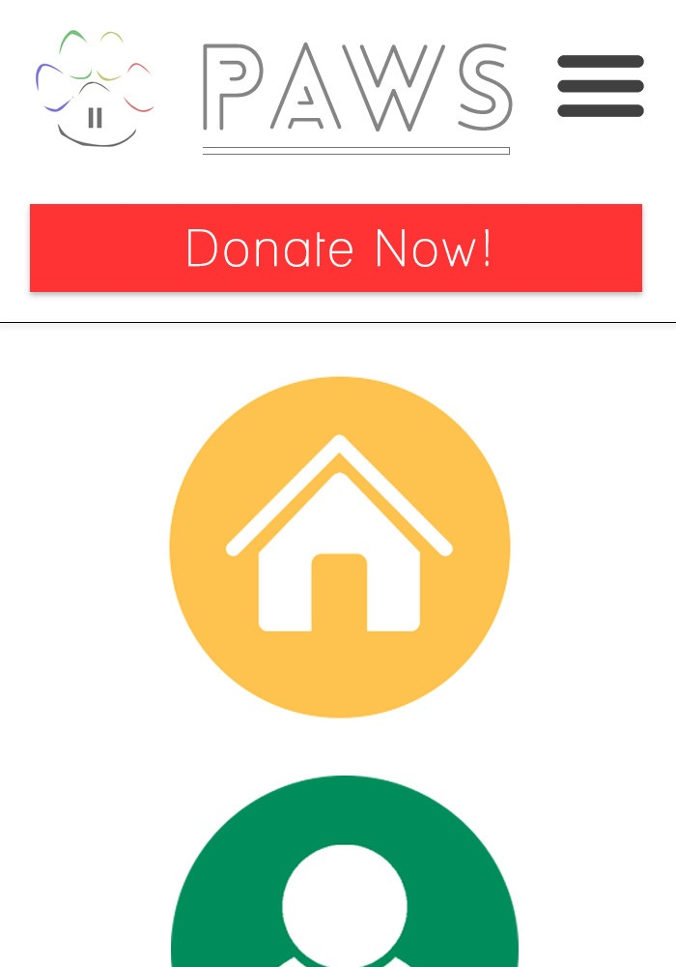
App: Home Page
Badges remain the same just like on website.
Donate Now button on each page.
Once clicked: navigates to show subcategories also as badges.
Drop-down menu in top right corner.

Slide 10
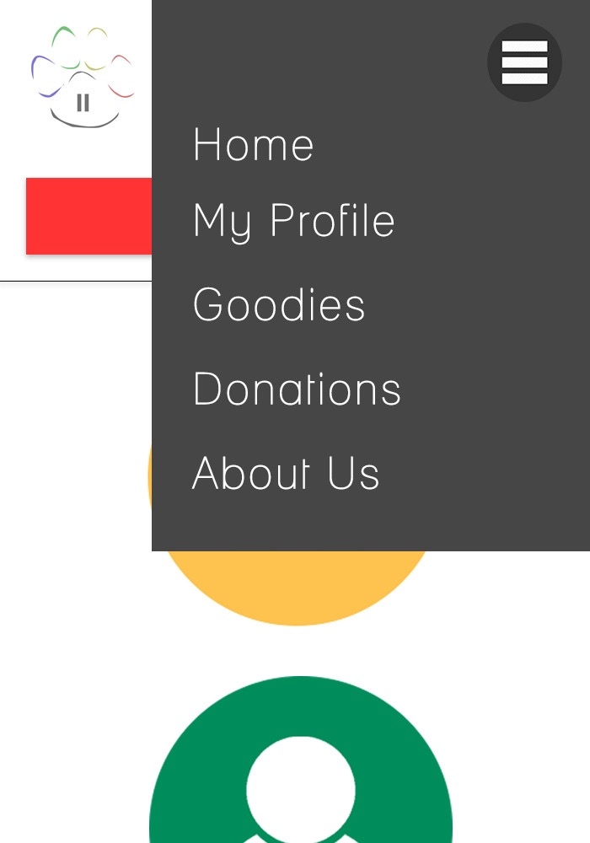
App: Drop-down Menu
Easy navigation to anywhere at any place

Slide 11
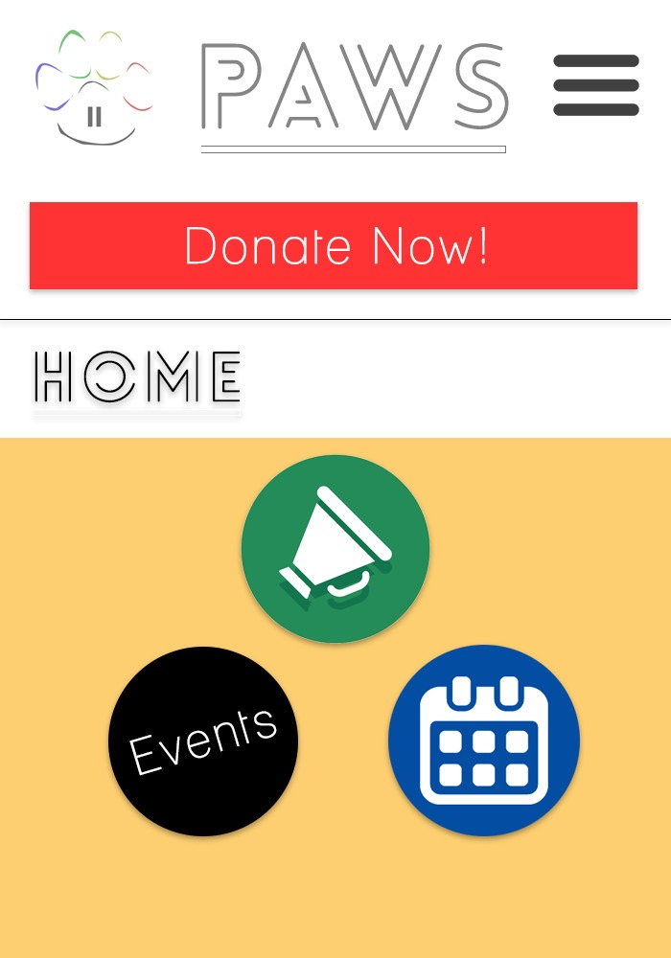
App: Sub-categories
Each sub category will have their own clickable badge instead of just a hyperlink.

Slide 12
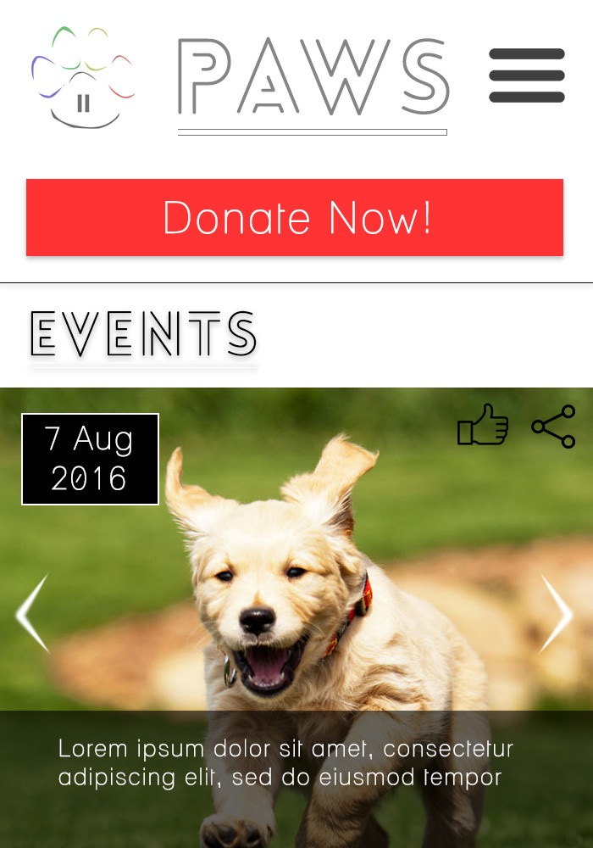
E.g. Events Page
Event carousel with automatic and manual navigation.
Date, time, description.
Link to more info modal and Facebook event.
Like and Share feature.
Admin can also add more events.

Slide 13
Technologies
HTML5: will be used to code the entirety of our website.
JQuery: will be used for client side validation during registration of new members and logging in of existing members.
PHP: will be used for server side validation during logging in of existing members.
MySQL: will be used to store our member database, as well as any other content.
Motion UI: will be used for smoother and more elegant transitions among pages, as well as small animations to make the website more lively and fun.
Bootstrap: will be used for layout purposes on different devices, as well the styling of certain elements such as forms etc.
CSS: will be used for the styling of our webpage.
PhoneGap: this software will be used to create our application.

Slide 14
Design: Colour Scheme
Red
Blue
Green
Gold/Yellow
Black
White

Slide 15
Design: Fonts
Lovelo Light: Headers and Titles.
Lane Light: General text.

Slide 16
Design: Other
Pages have continuous flow - categories separated by different coloured backgrounds.
Headers and titles enhanced with drop shadows etc.

Slide 17

“So Paws…collaborate and listen.”

