Slide 1

Do voters in India vote differently in state and national elections?
A case of Karnataka and Kerala

Slide 2
Project outline
Collect data of the constituencies for the states of Kerala and Karnataka and the parties that won in each constituency.
This was done for all state and national elections from 2009-2019.
The data was used to create a dodged bar plot representing the percentage of seats won by each party from 2009- 19.
A grid of donut charts representing the number of seats won by each party was made.
This was done for both the states in question.
The national elections held in the time period in question were in the years 2009, 2014, 2019
State elections held-
Karnataka- 2013, 2018
Kerala- 2011, 2016

Slide 3

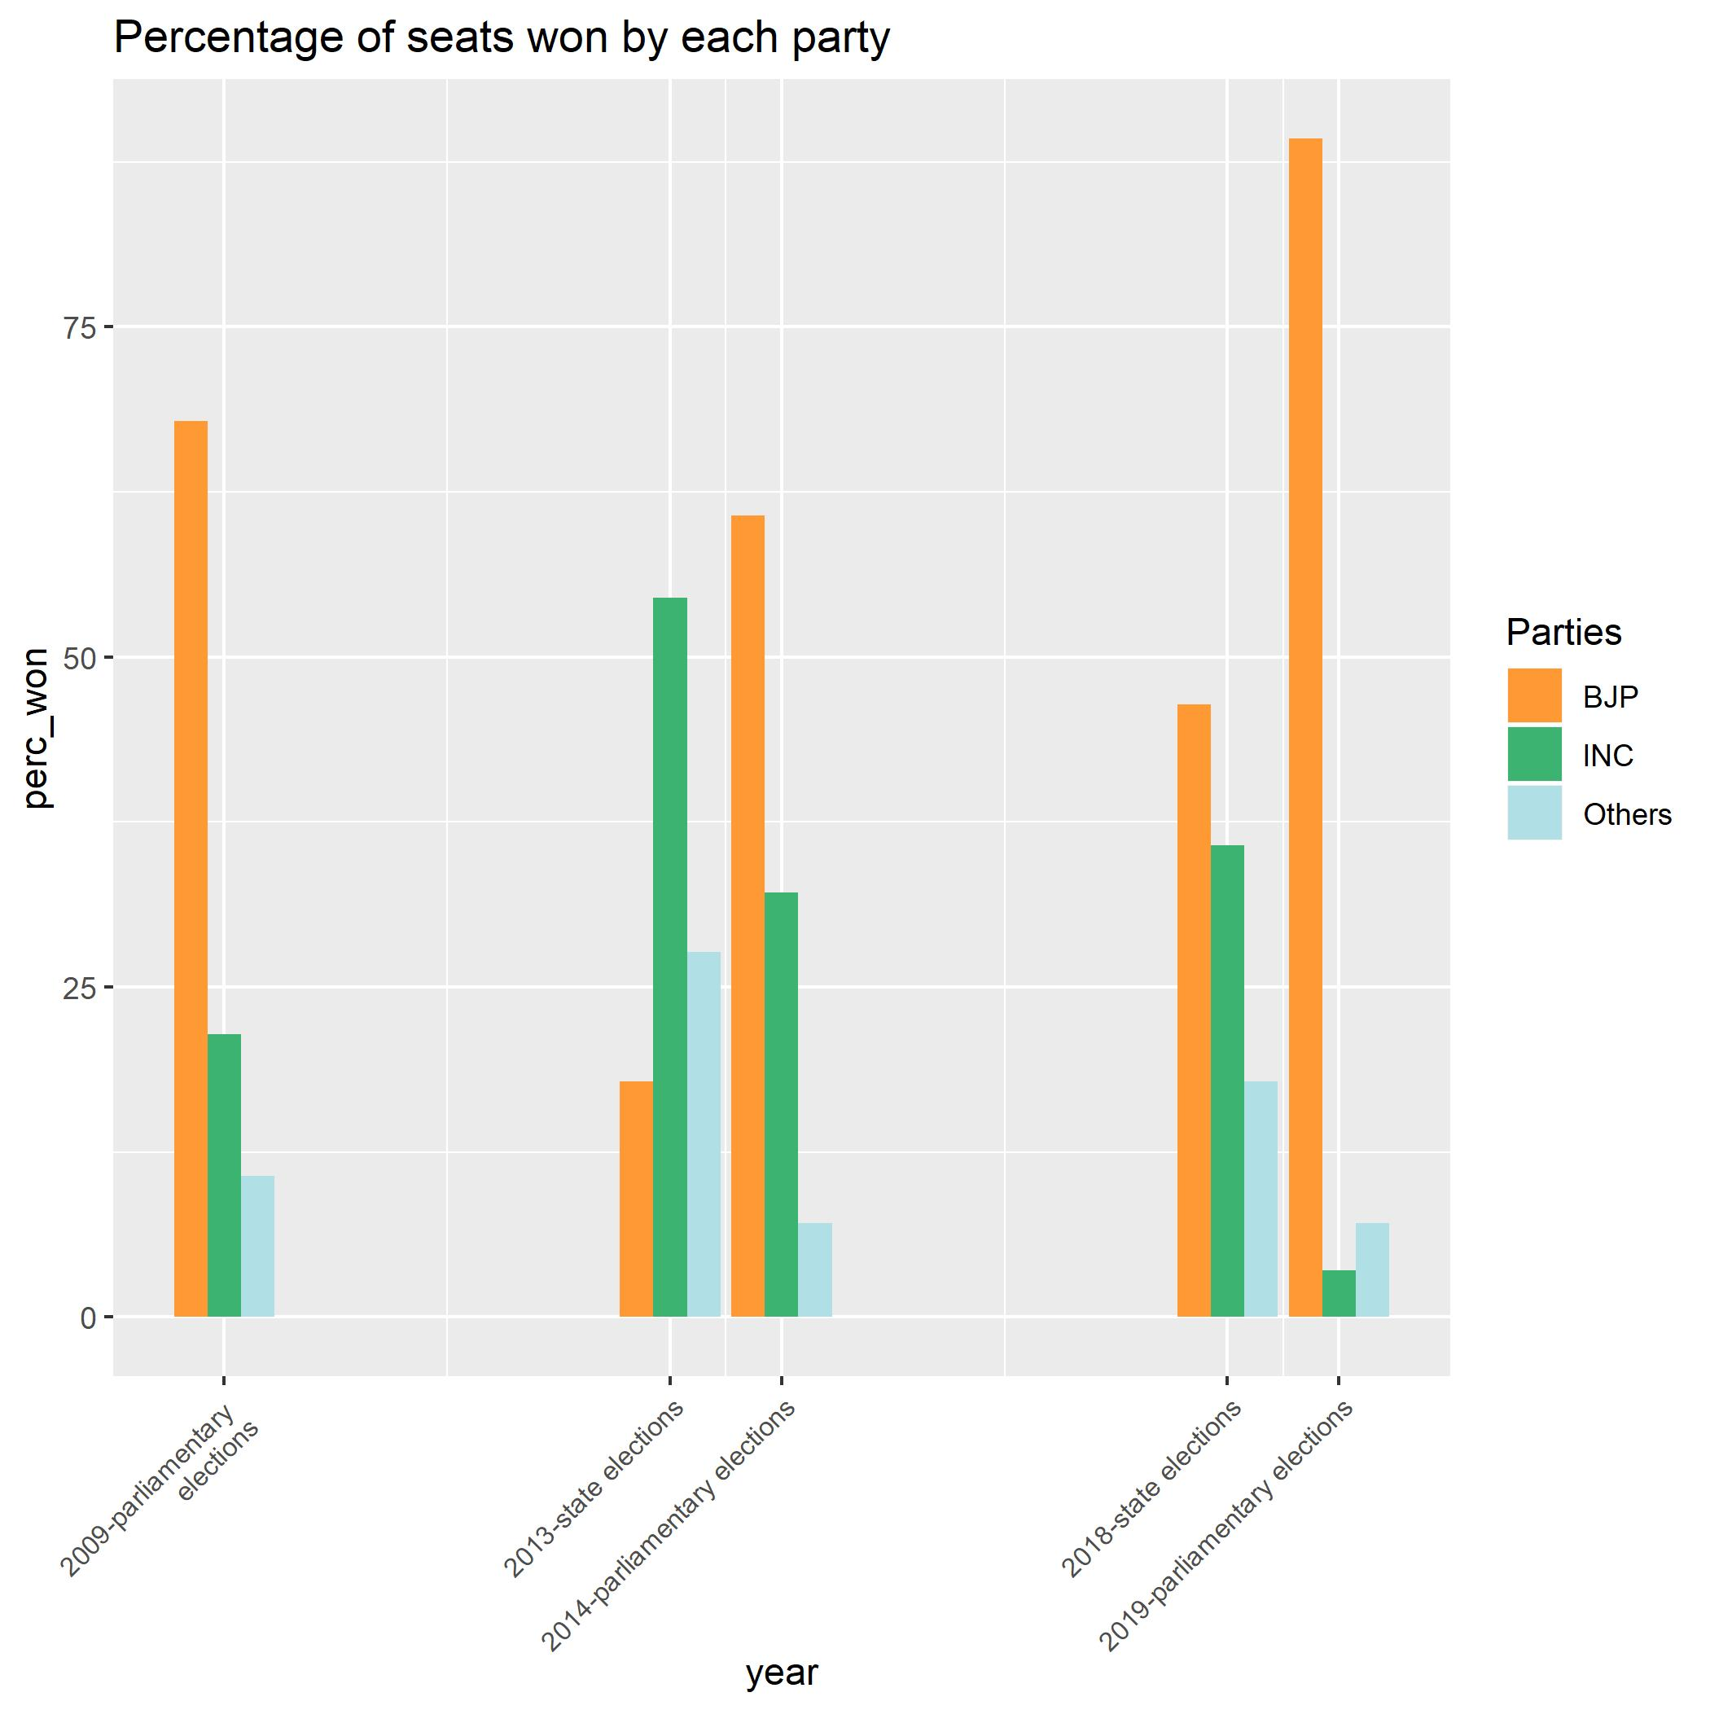

Slide 4
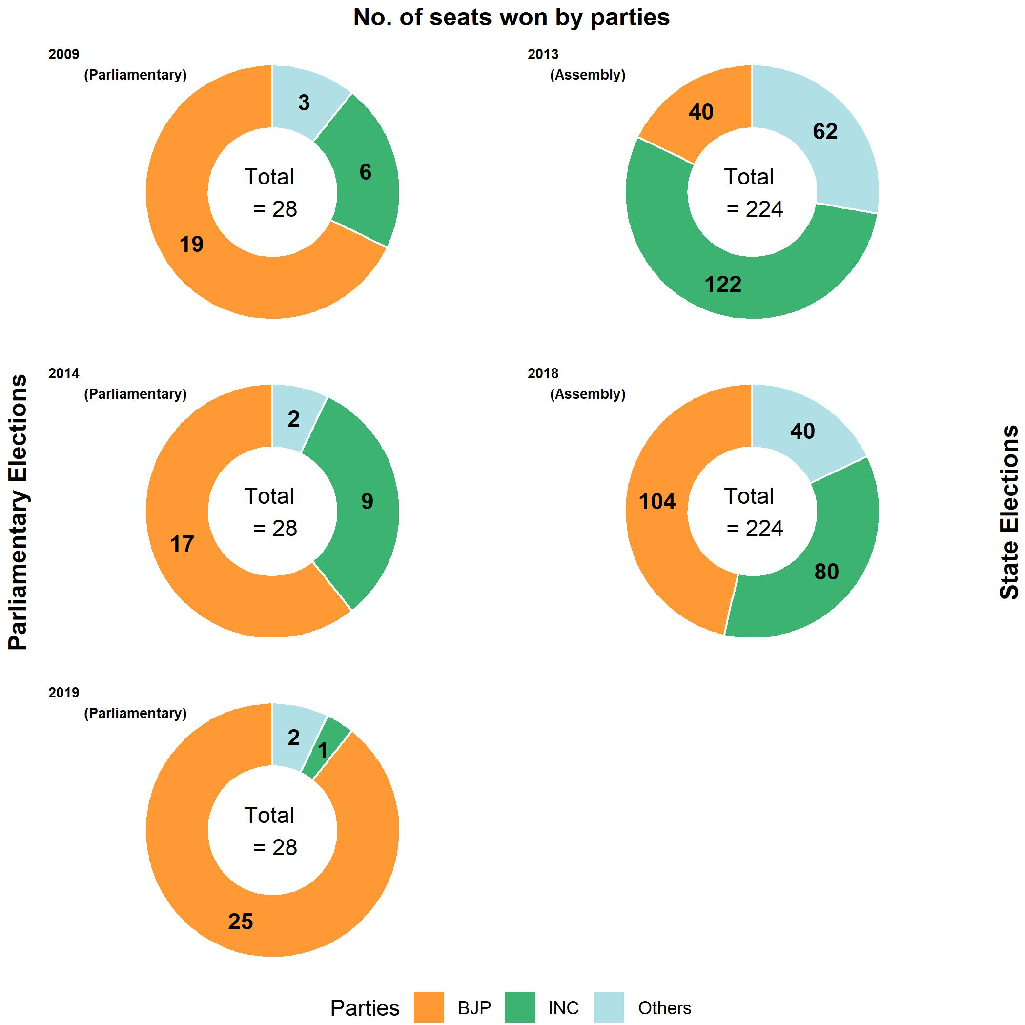

Slide 5
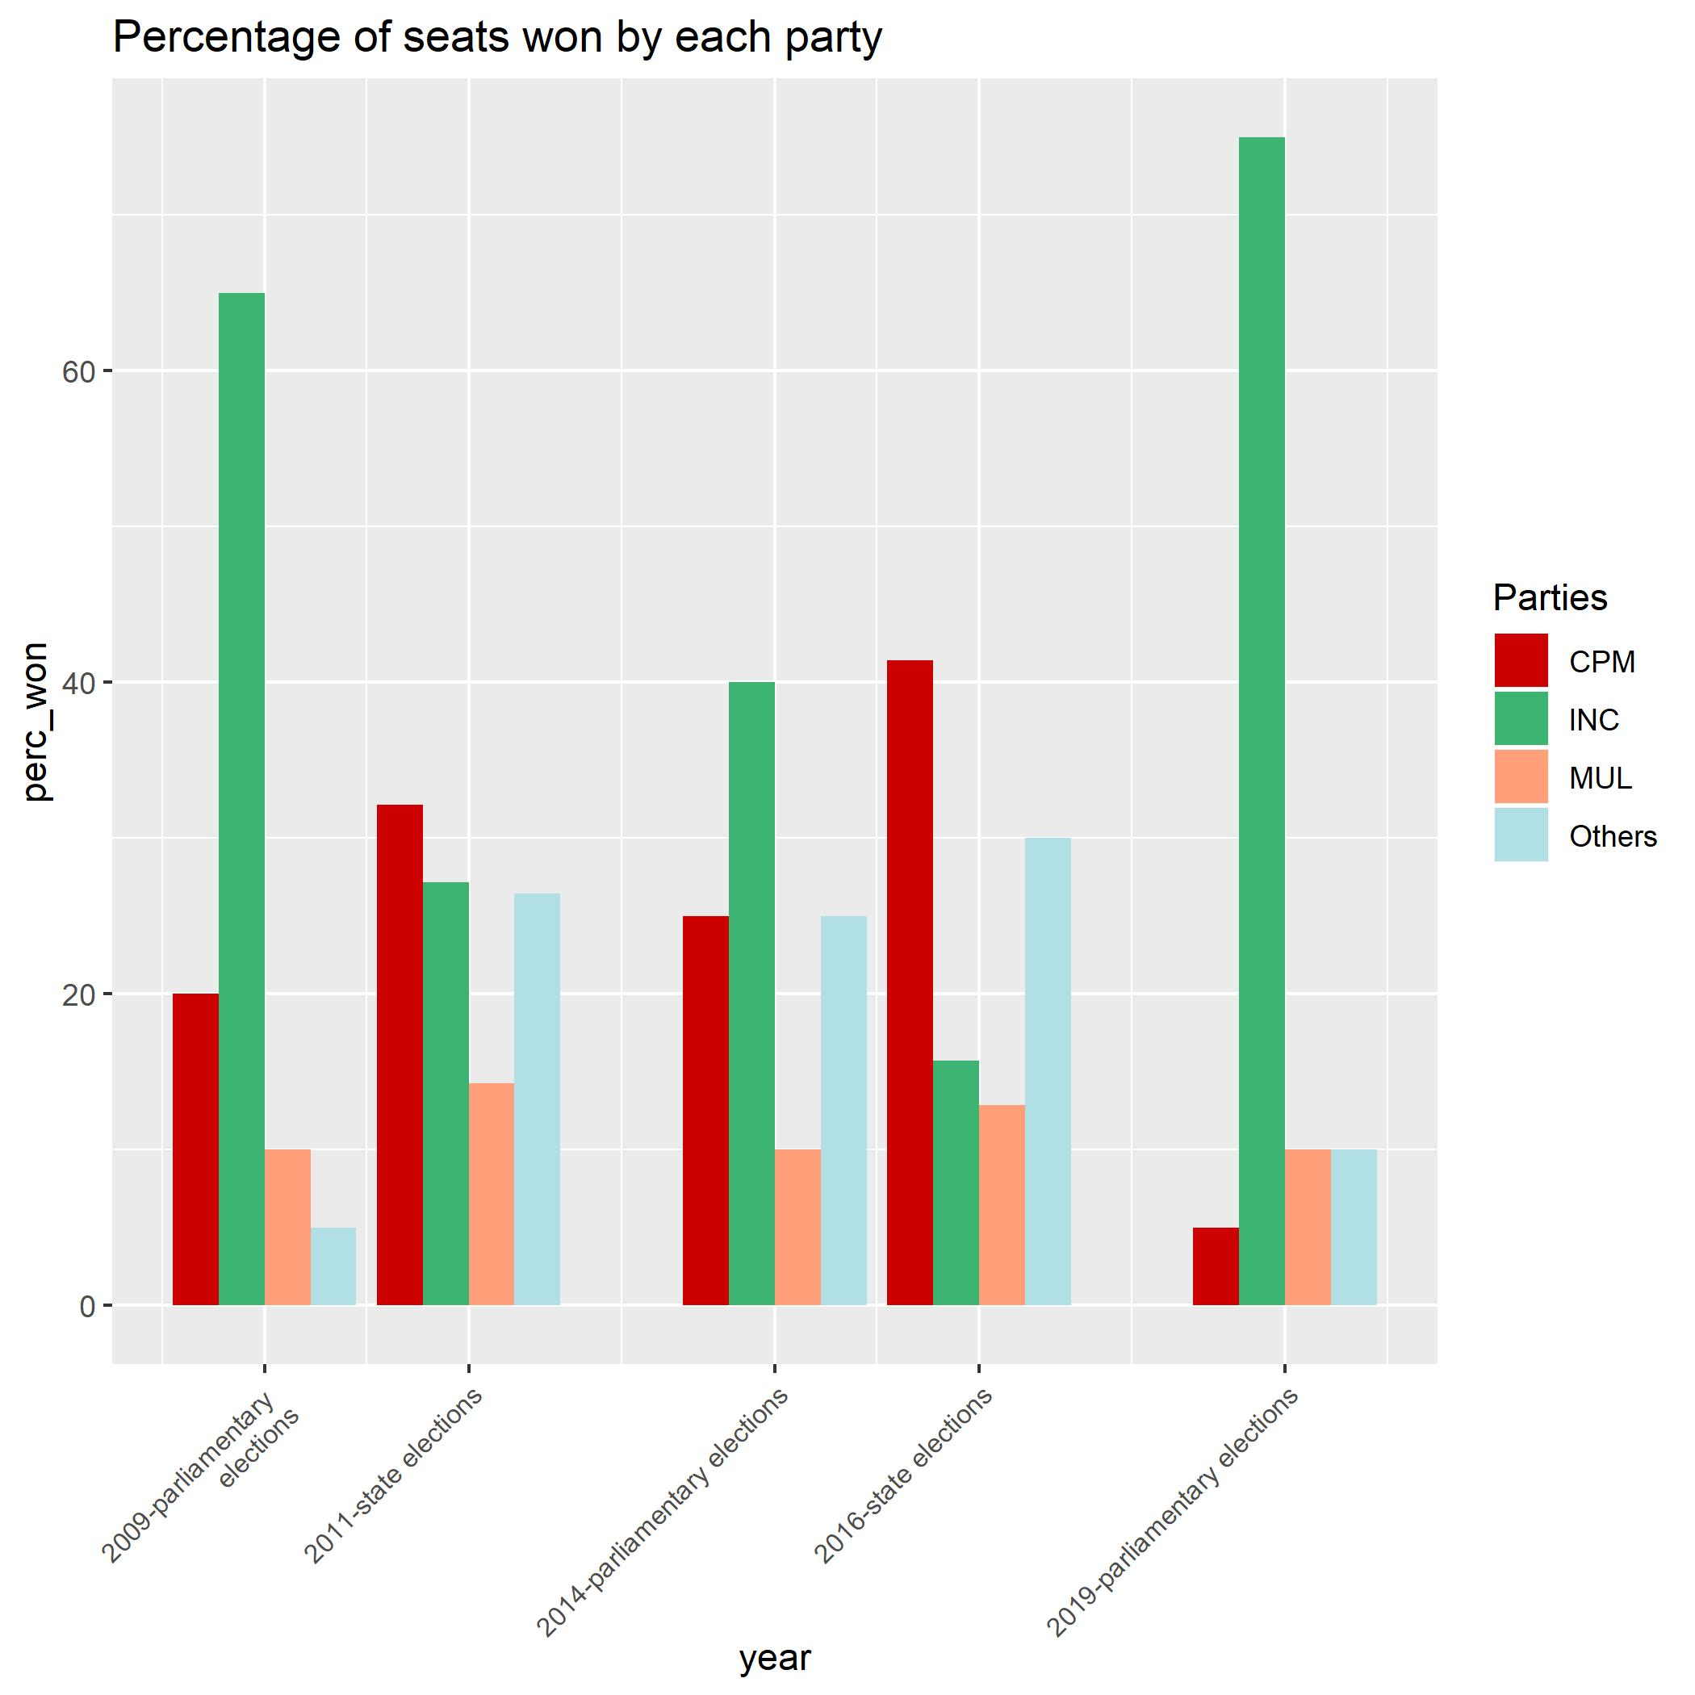

Slide 6
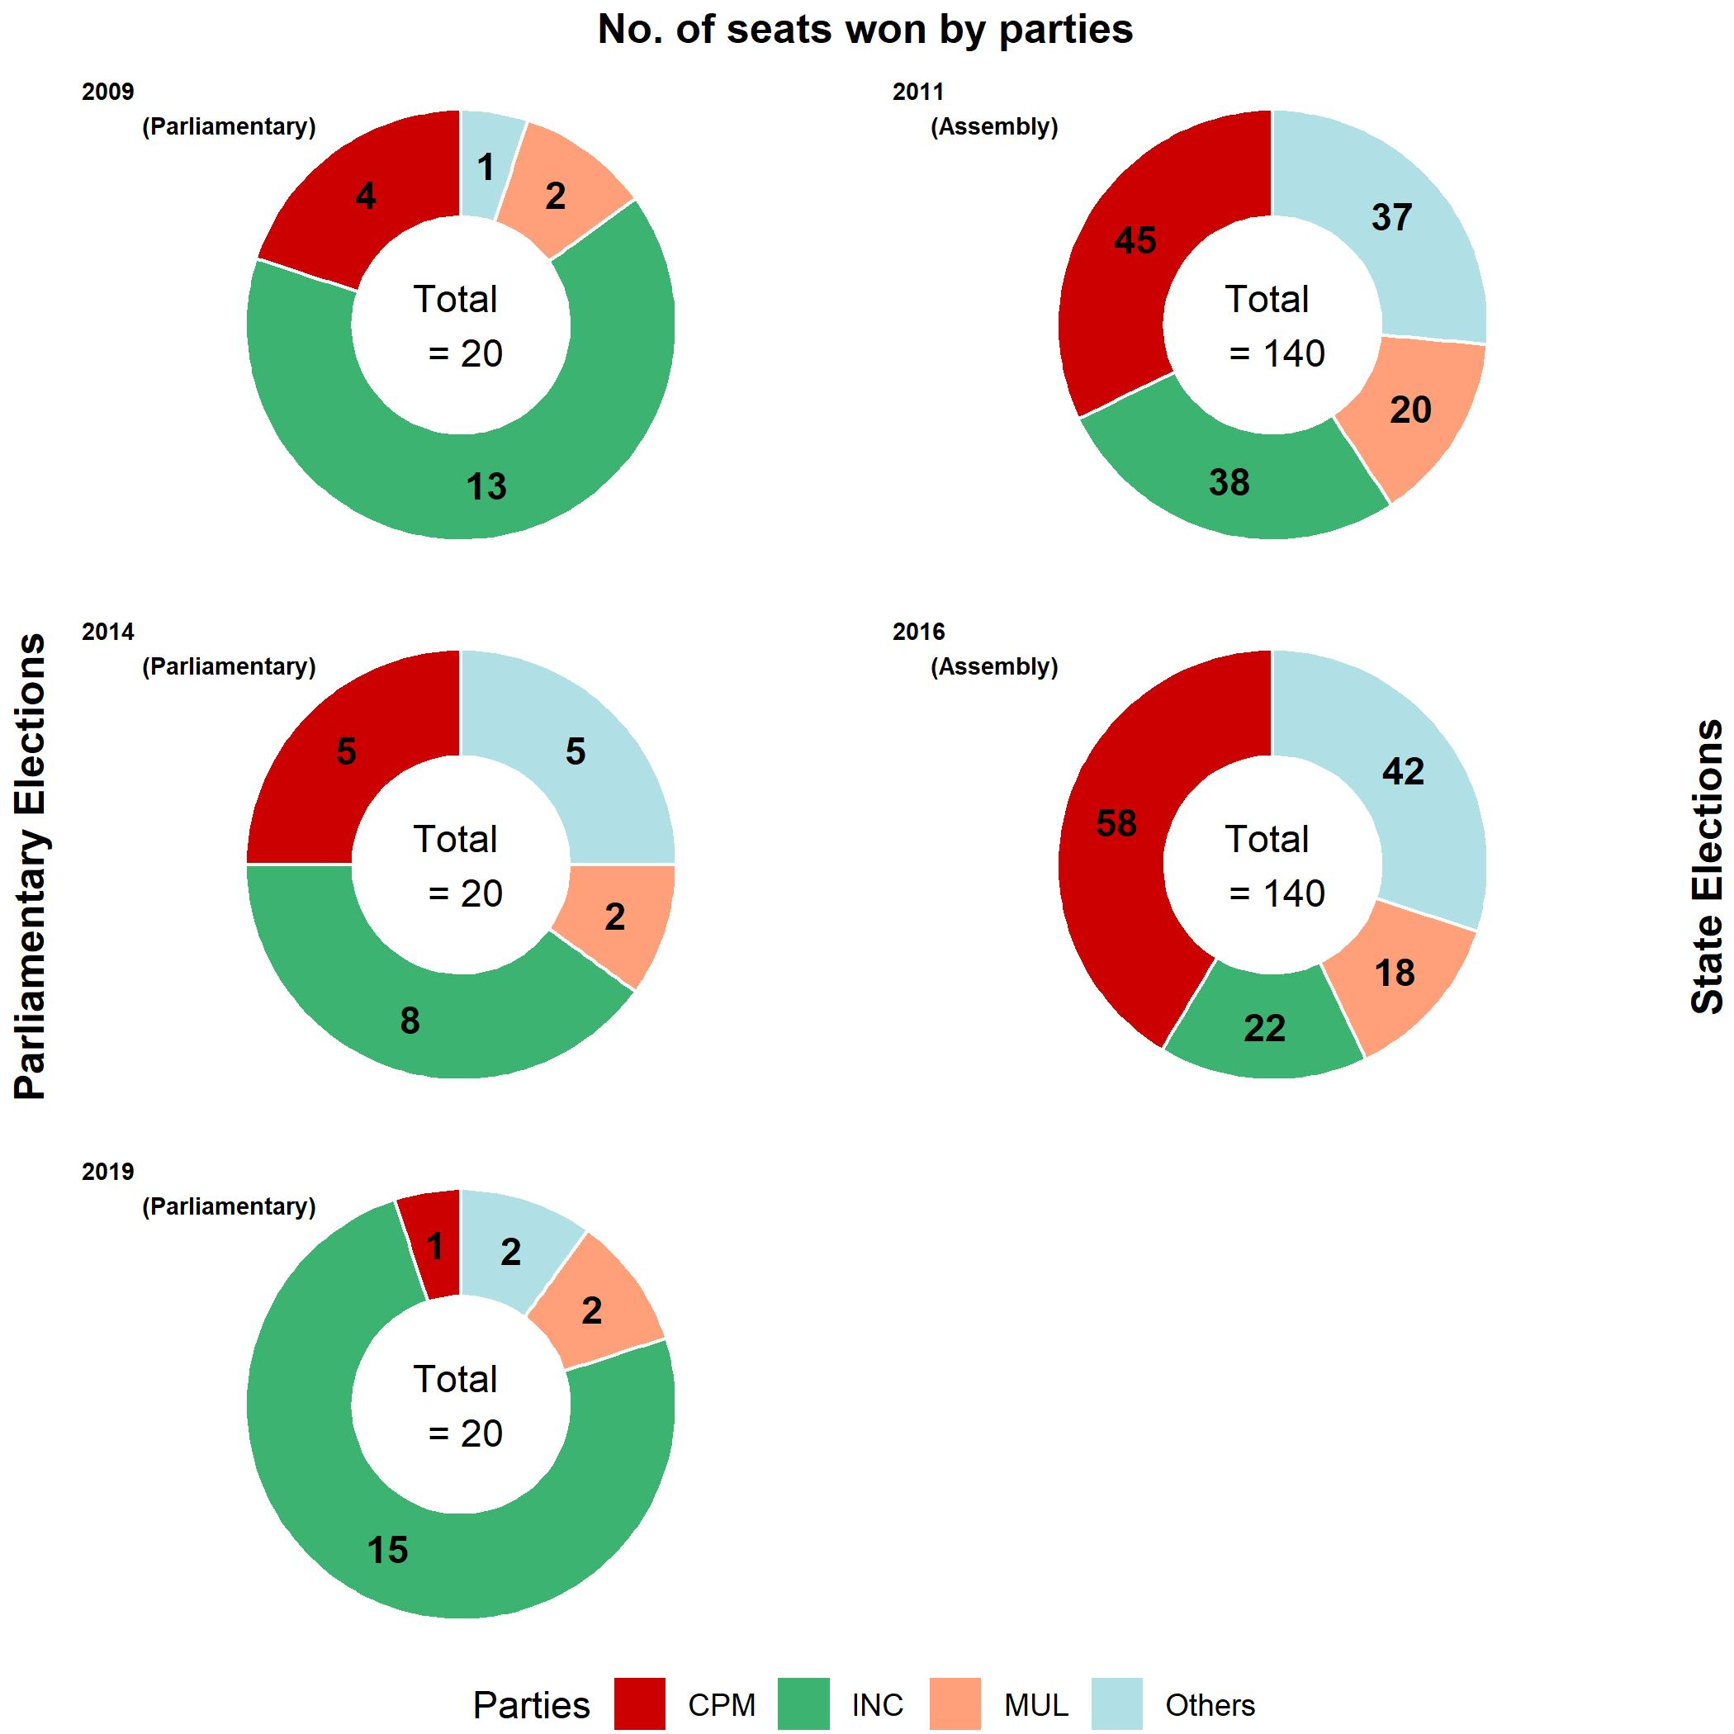

Slide 7
Computational challenge faced
Attempted to create a map using ggplot2.
Created an API and queried google maps to get the longitude and latitude of the constituency list.
Used geom_point to plot the points.
Had to plot the points on a map. However, the map of India with constituency level boundaries is not available.
Since a requirement to map on a shapefile is merging the metadata of the Spatial Polygon with the data to be mapped, I was unable to accomplish this, due to a mismatch of the geographical boundary to be mapped and the geographical boundary available.

