Slide 1

World Cup Football Tournament System
Group Name: Power Rangers
@author: Deenen Manikion, Anant Manoj Dwivedi, Daniil Rudkovskyi, Karam Mu Ness Qasem Obeidat, Luigi Moretti, Philip Effa

Slide 2
What is the World Cup Tournament System
This code simulates a soccer tournament by creating classes for teams, groups, round of 16 and quarter-final which enable adding teams, playing matches, and sorting teams by points and wins. The Team class has properties such as name, wins, losses, draws, and points. Group class enables adding teams, playing matches, sorting teams and playing all matches in the group. Round of 16 and quarter-final classes have similar functionality. Overall, the code allows for efficient management of a soccer tournament.

Slide 3
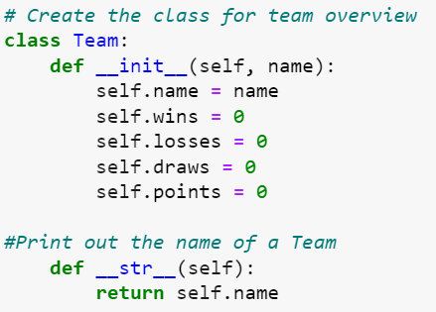
Class “Team”:
Properties:
name: A string variable that stores the name of the team.
wins: An integer variable that stores the number of matches the team has won.
losses: An integer variable that stores the number of matches the team has lost.
draws: An integer variable that stores the number of matches the team has drawn.
points: An integer variable that stores the number of points the team has earned.
Function:
__str__: This function allows to print the name of a team when called upon, it returns the name property of the team.
Example:
team = Team("Team A")
print(team) will print "Team A"

Slide 4
Class “Group”:
Properties:
name: A string that stores the name of the group.
group: A list that stores the teams in the group.
Function:
add_team: This function allows teams to be added to the group by taking a team object as an input and appending it to the group list.
print_teams: This function returns a list of the names of teams in the group, allowing to print teams properly.
play_match: This function takes two team objects as input and asks for the scores of the match. It updates the points, wins, losses, and draws for each team based on the match result.
sort_teams: This function sorts the teams in the group by their points, wins, losses and draws.
play_all_matches: This function plays all the matches in the group directly without repeating them manually.

Slide 5
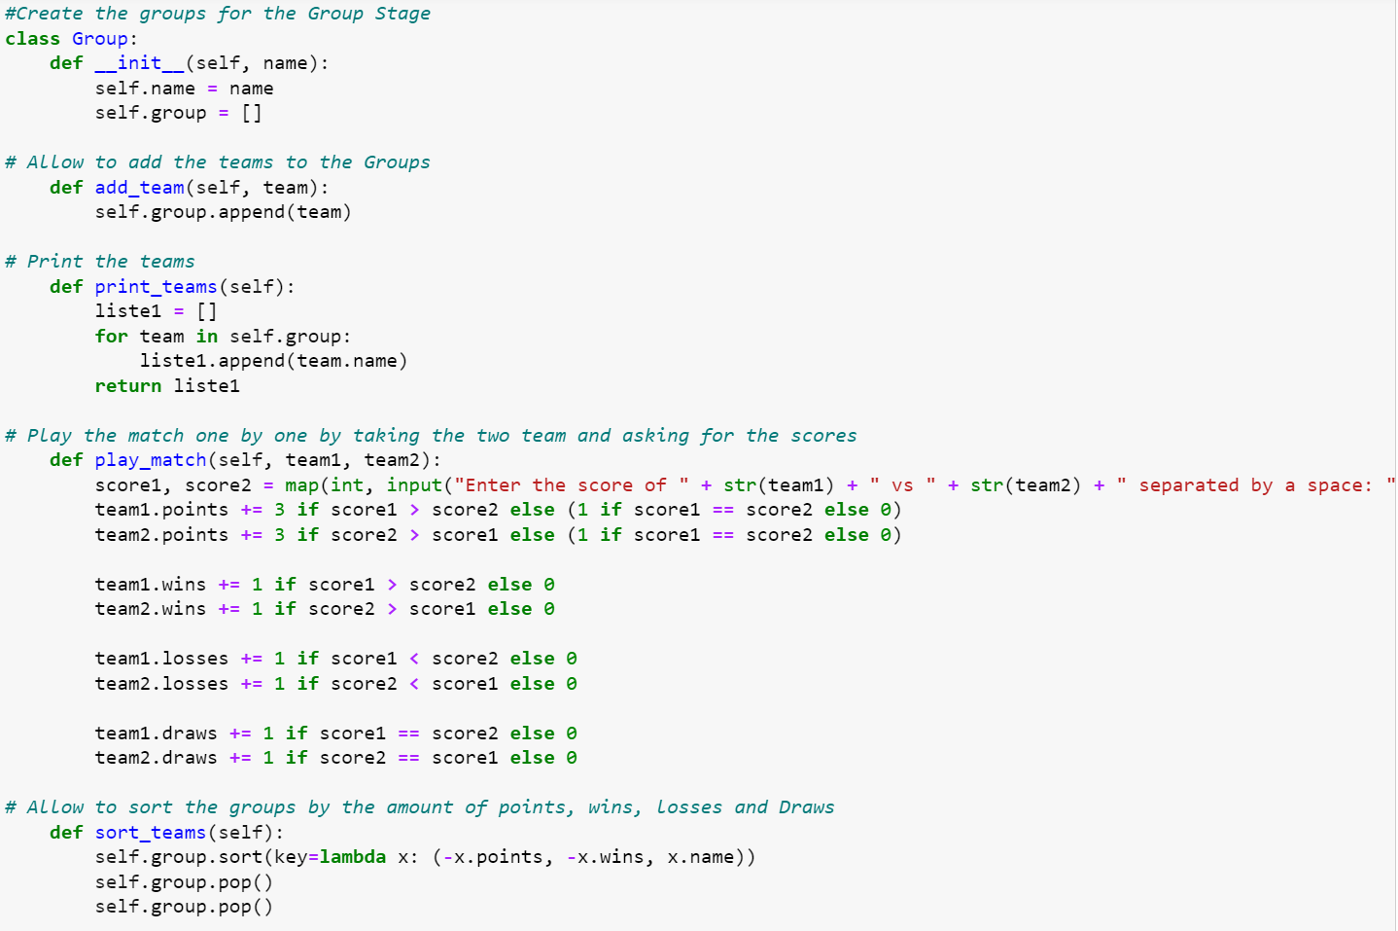

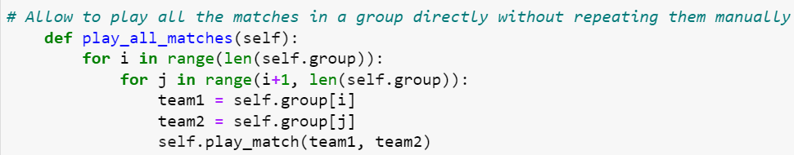

Slide 6
Class “Round16”:
Property:
matches: this provides a list of all matches after the Group stage and before the quarter finals.
Functions:
add_match: The function that allows to add the qualifying teams to a list so we know which team is playing who.
play_match: The function that allows to play the matches and eliminates the team which lost from the list.
print_teams: The function that allows to print the two opposite teams in a list.

Slide 7
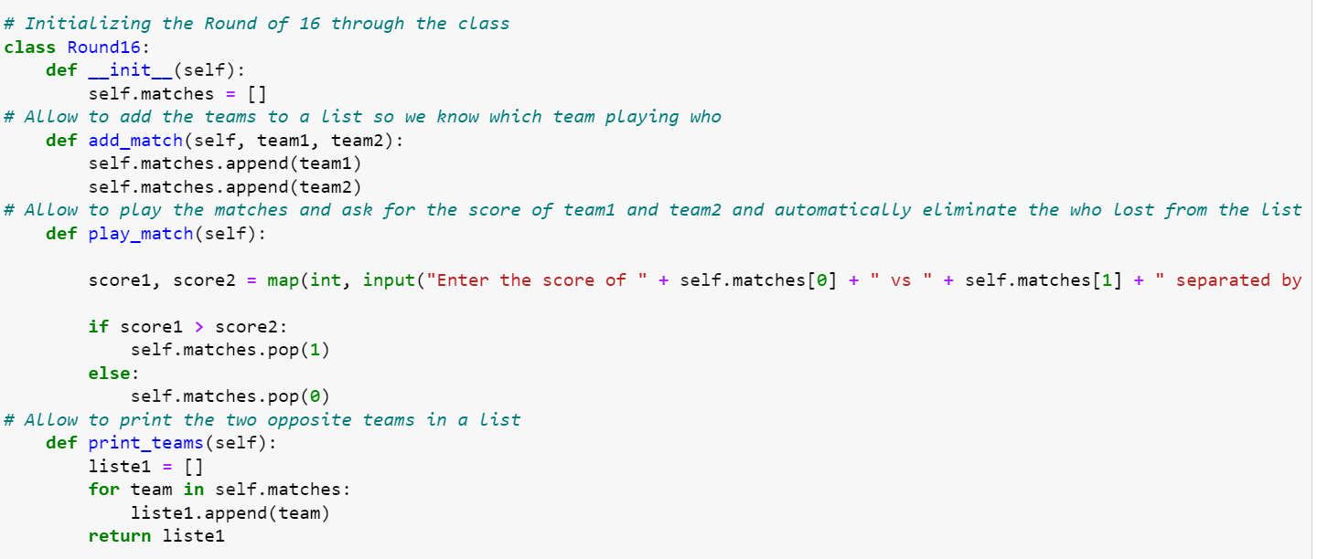


Slide 8
Classes “QuarterFinal” & SemiFinal:
Property: A list of matches containing qualifying teams from the Round of 16 and Quarter respectively.
Functions:
add_match: The function that allows to add the teams to a list so we know which team is playing who.
play_match: The function that allows to play the matches and eliminates the team which lost from the list.

Slide 9
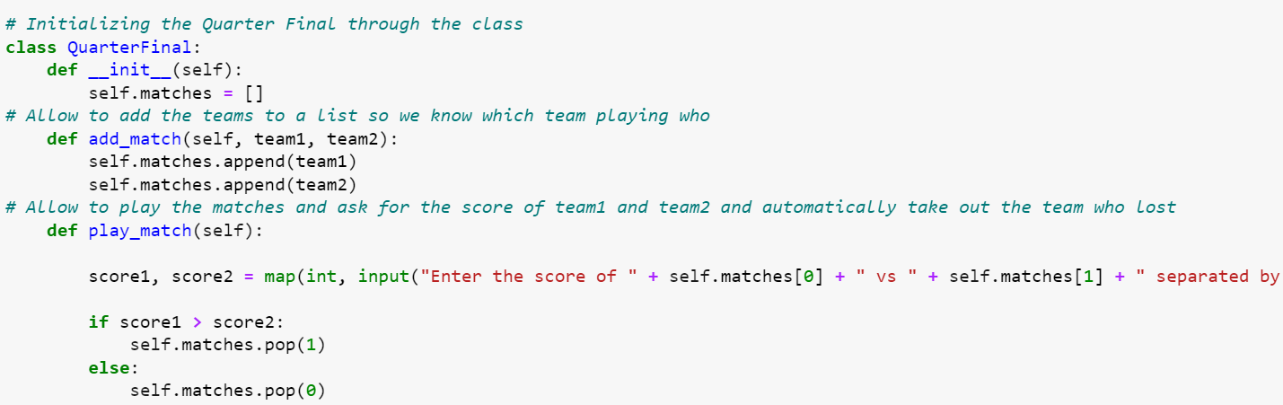

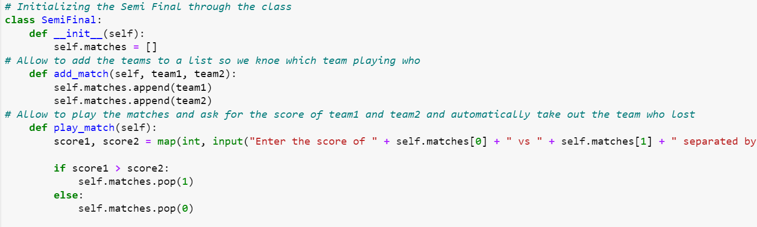


Slide 10
Class “Final”:
Property: The class can be used to simulate the final stage of the world cup tournament by adding additional classes and methods that can be used to manage the semi-finals and finals stages.
Functions:
add_match: The function that allows to add the teams to a list so we know which team is playing who.
play_match: The function that allows to play the matches and eliminates the team which lost from the list.

Slide 11
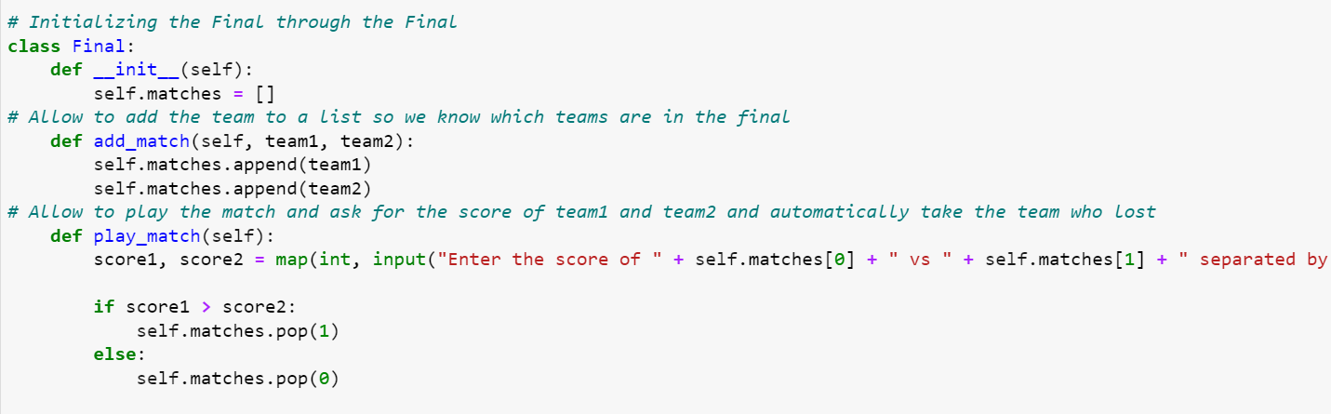


Slide 12
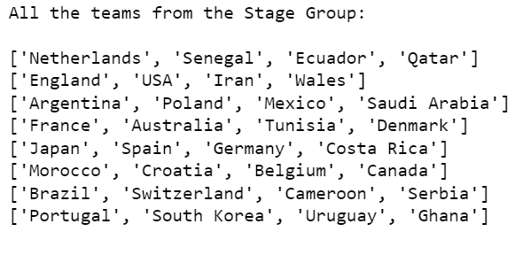
Adding Teams:
Using the class Team, we add 32 teams to the tournament and naming them according to country. eg. (Argentina = Team(„Argentina“)
We then create eight groups using the class group. eg. GroupA= Group(„A“)
Then we assign four teams to each of the eight groups. Eg. GroupA.add_team(Argentina)
Then we print all of the groups with the respective teams contained in each of them.

Slide 13
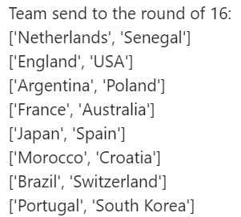
Group Stage:
We are playing all the matches in the group stage using the function play_all_matches() from class “Group”
After that we sort the teams according to the points and eliminating the bottom 2 teams from each group using the function sort_teams() from the class “Group”.
Then we print all the teams that qualified for the round of 16.

Slide 14

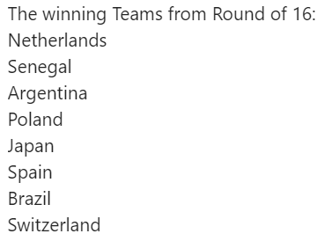
Round of 16:
We create 8 matches (8 empty objects)
Then we insert 2 teams in every match according to their groups
After that we play matches using play_match() function. It prompts user for the score and then it pops the loser.
Prints the winner of every match

Slide 15

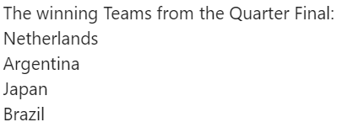
Quarter-finals:
We create 4 matches (4 empty objects)
Then we insert 2 teams in every match according to their groups
After that we play matches using play_match() function. It prompts user for the score and then it pops the loser.
Prints the winner of every match

Slide 16
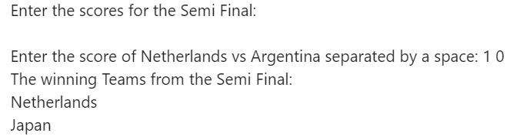
Semi-finals:
We create 2 matches (2 empty objects)
Then we insert 2 teams in every match according to their groups
After that we play matches using play_match() function. It prompts user for the score and then it pops the loser.
Prints the winner of every match

Slide 17
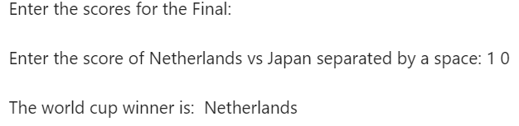
Final:
We create 1 match (1 empty object)
Then we insert 2 teams that are left in this object
After that we play match using play_match() function. It prompts user for the score and then it pops the loser.
Then we just print the winner of the tournament

