Slide 1
SaaS MONTHLY METRICS
Executive Performance Briefing
30 months of growth, retention & customer health • Jan-2023 – Jun-2025
$14.43M
+1,144%
75.6K
107.9%
41.6
Total MRR
MRR growth
Active subs
Net Rev Retention
Avg NPS
Prepared with Claude Cowork — Data Plugin

Slide 2
Dataset Overview
What we analyzed
480
30
4 × 4
monthly observations
months of history
regions × plan tiers
Fields captured each month per region × plan
Field
Type
Definition
month / region / plan
dimensions
Period (Jan-23…Jun-25), market, subscription tier
new_subscribers / churned_subscribers
metrics
Subscriber inflows and outflows
active_subscribers
metric
End-of-month customer base
arpu_usd / mrr_usd
metrics
Revenue per user and total recurring revenue
net_revenue_retention
metric
>1 indicates expansion (upsell / upgrade)
marketing_spend_usd
metric
Monthly marketing spend (per region)
support_tickets / nps_score
metrics
Operational load & customer satisfaction
Quality check: 0 missing values · 0 duplicate region-plan-month rows · clean dataset.
SaaS Monthly Metrics • Executive Briefing • Jan-2023 → Jun-2025
2 / 10

Slide 3
Statistical Summary
Mean, median, spread & outliers across all metrics
Metric
Mean
Median
Std Dev
Min
Q1
Q3
Max
Outliers (IQR)
new_subscribers
222.7
219.0
47.2
105.0
186.8
253.0
344.0
0
churned_subscribers
90.7
89.0
53.4
0.00
44.0
134.0
219.0
0
active_subscribers
2.8K
2.8K
1.3K
173.0
1.9K
3.7K
6.5K
1
arpu_usd
162.0
96.8
154.2
26.2
50.8
208.1
448.5
6
mrr_usd
468.1K
224.3K
581.9K
28.1K
100.6K
552.3K
2.90M
57
net_revenue_retention
1.07
1.07
0.04
0.98
1.04
1.10
1.16
0
marketing_spend_usd
45.0K
45.6K
5.8K
33.6K
40.7K
49.4K
58.8K
0
support_tickets
24.7
24.0
15.4
0.00
13.0
35.0
70.0
1
nps_score
30.1
29.9
8.73
9.20
24.1
35.8
55.2
1
Outlier interpretation (1.5 × IQR rule)
MRR shows 57 high outliers (~12% of rows) and ARPU shows 6 — both driven by Enterprise-tier records. These are expected business outliers, not data-quality issues. New/churned subscribers, NRR, marketing spend and NPS are well-bounded with at most one outlier each.
SaaS Monthly Metrics • Executive Briefing • Jan-2023 → Jun-2025
3 / 10

Slide 4
Headline KPIs · Jun-2025
Six numbers leadership should remember
TOTAL MRR
MRR GROWTH SINCE LAUNCH
ACTIVE SUBSCRIBERS
$14.43M
+1,144%
75.6K
+4.38% MoM
30 consecutive months
5.2× the Jan-2023 base
MONTHLY CHURN RATE
NET REVENUE RETENTION
AVERAGE NPS
2.77%
107.9%
41.6
Healthy for SaaS
Above 1.00 → net expansion
Trending upward
SaaS Monthly Metrics • Executive Briefing • Jan-2023 → Jun-2025
4 / 10

Slide 5
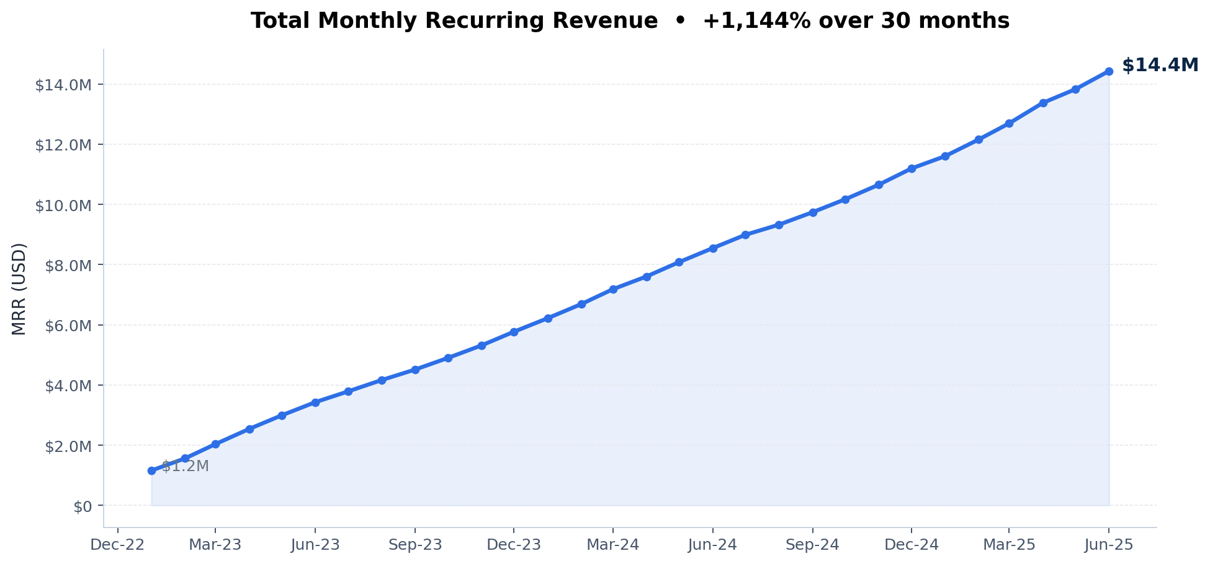
Revenue Growth: MRR Trend
Total MRR scaled 1143.62% across 30 months
WHAT TO READ
Starting MRR
$1.16M
Latest MRR
$14.43M
MoM growth
+4.38%
Cumulative growth
+1143.62%
Months covered
30
SaaS Monthly Metrics • Executive Briefing • Jan-2023 → Jun-2025
5 / 10

Slide 6
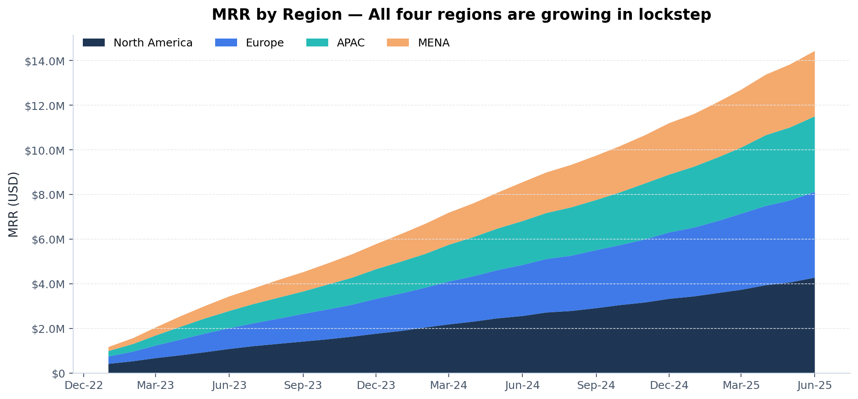
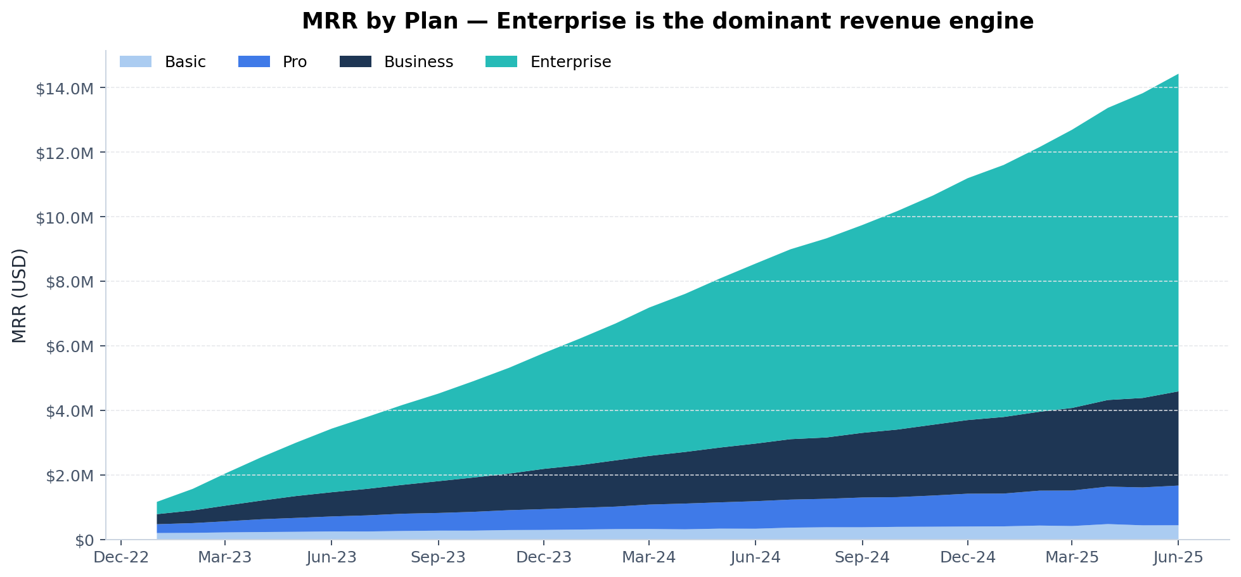
Where the revenue comes from
Region and plan-tier composition over time
Insight
North America leads in absolute MRR, but every region is on the same upward trajectory — growth is not concentration risk. By plan, Enterprise contributes the largest share of revenue while Basic adds breadth at the top of the funnel.
SaaS Monthly Metrics • Executive Briefing • Jan-2023 → Jun-2025
6 / 10

Slide 7
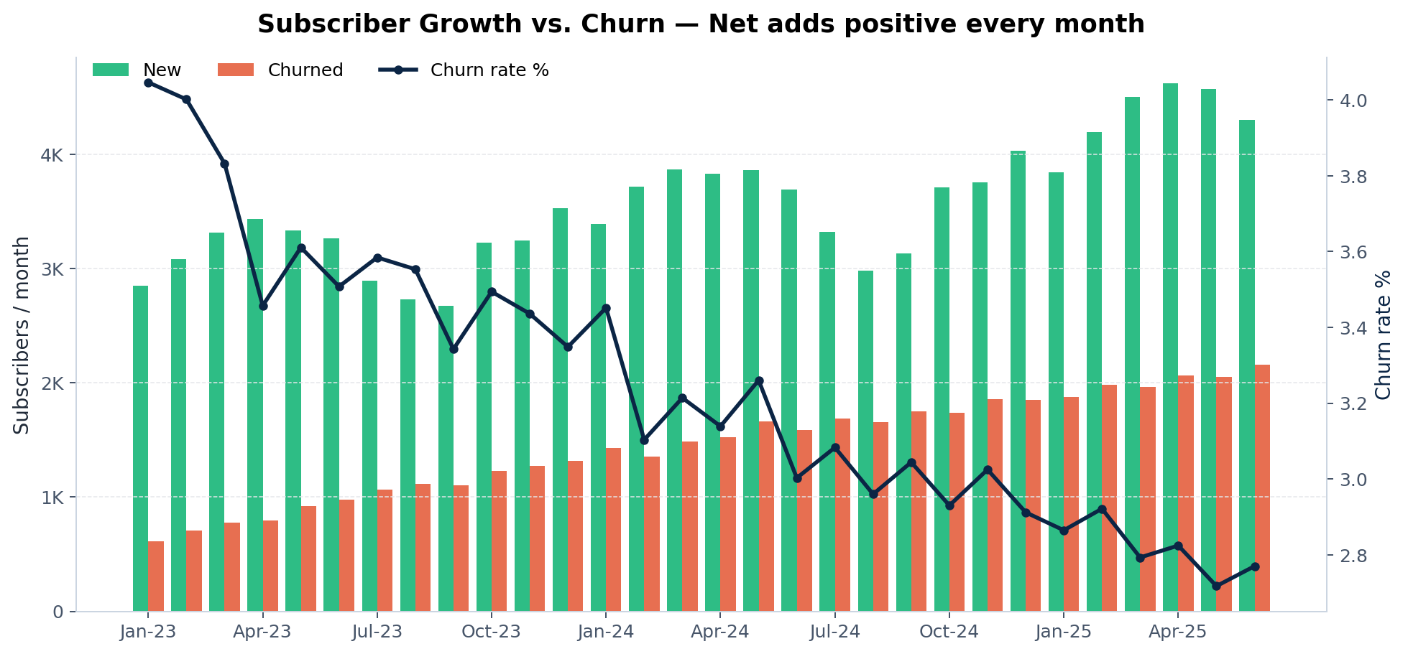
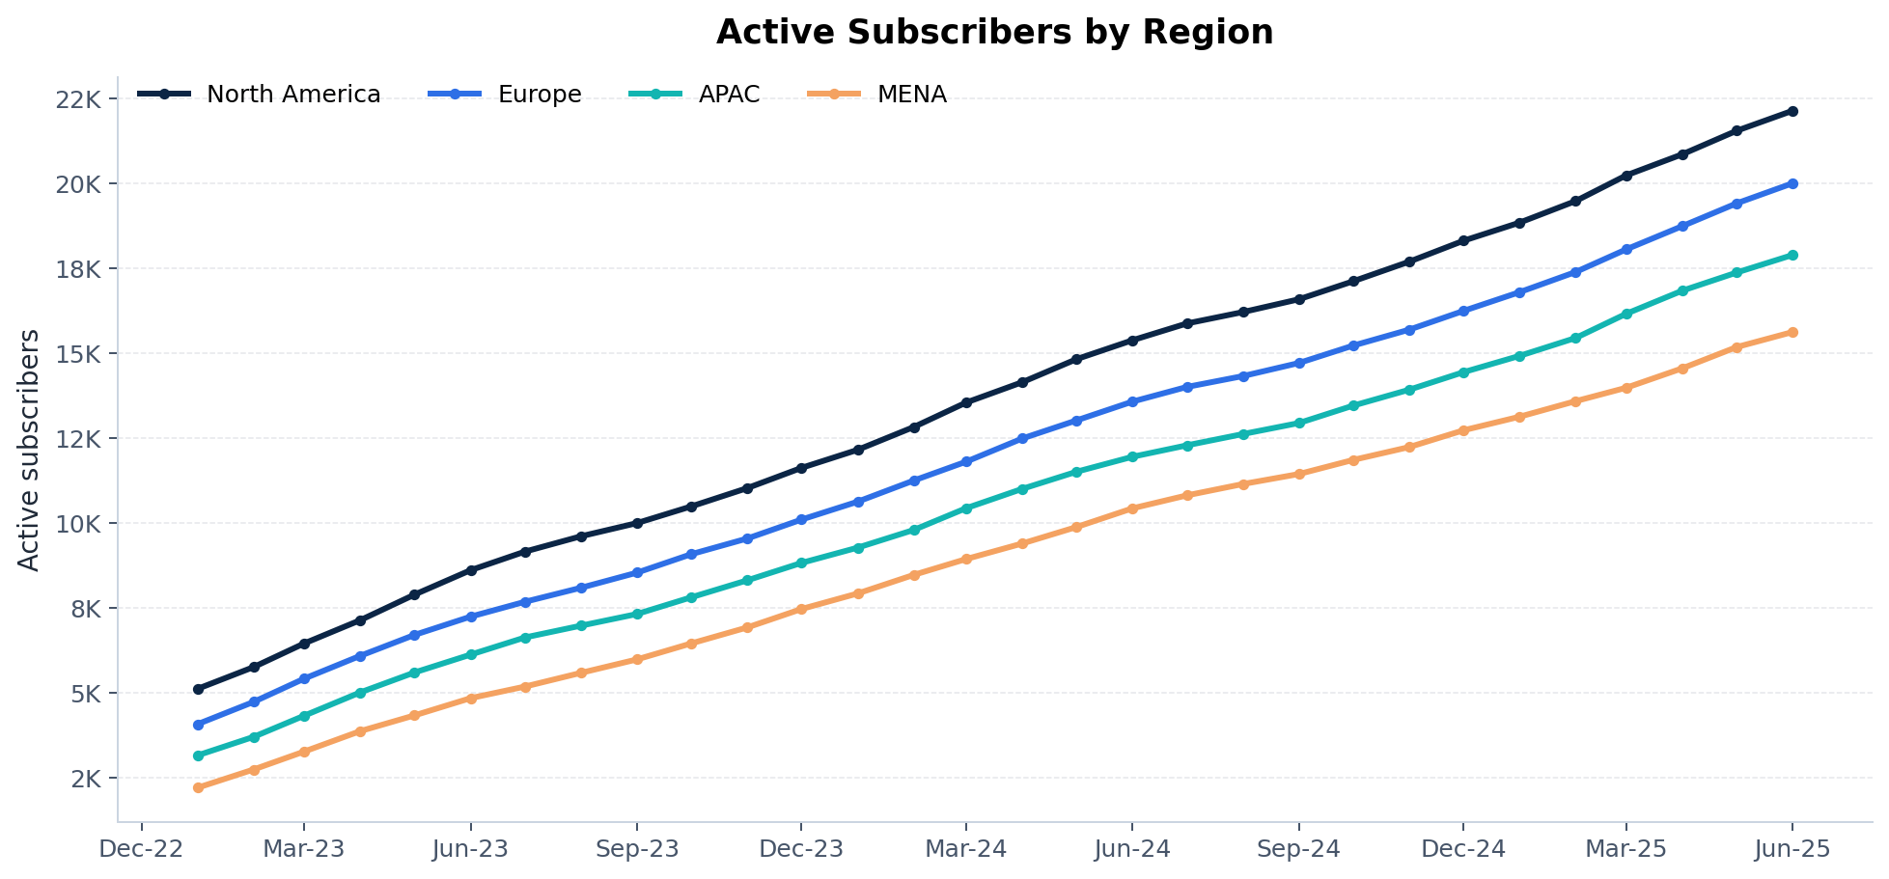
Subscriber Growth vs. Churn
Net adds positive every month; churn rate held under 3%
RETENTION SCORECARD
4.3K
New subscribers (latest month)
2.2K
Churned subscribers
2.77%
Monthly logo churn rate
75.6K
Active subscribers
SaaS Monthly Metrics • Executive Briefing • Jan-2023 → Jun-2025
7 / 10

Slide 8
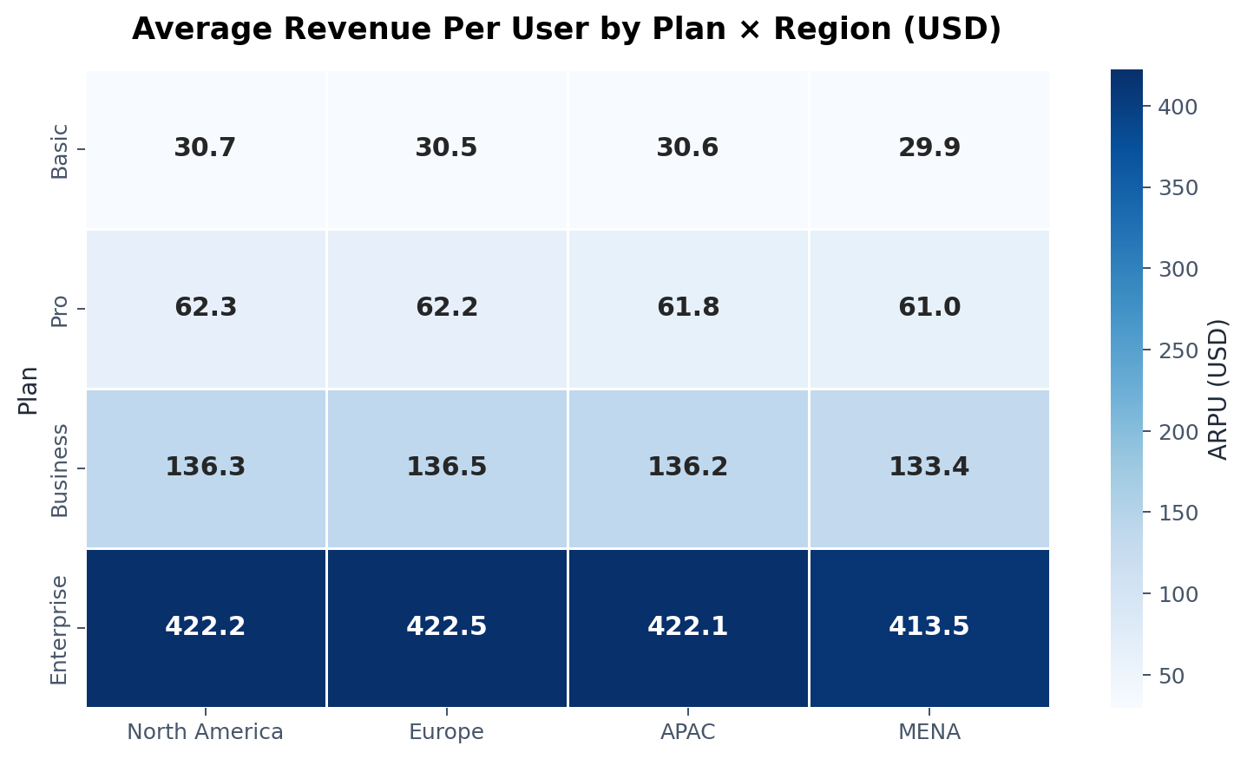
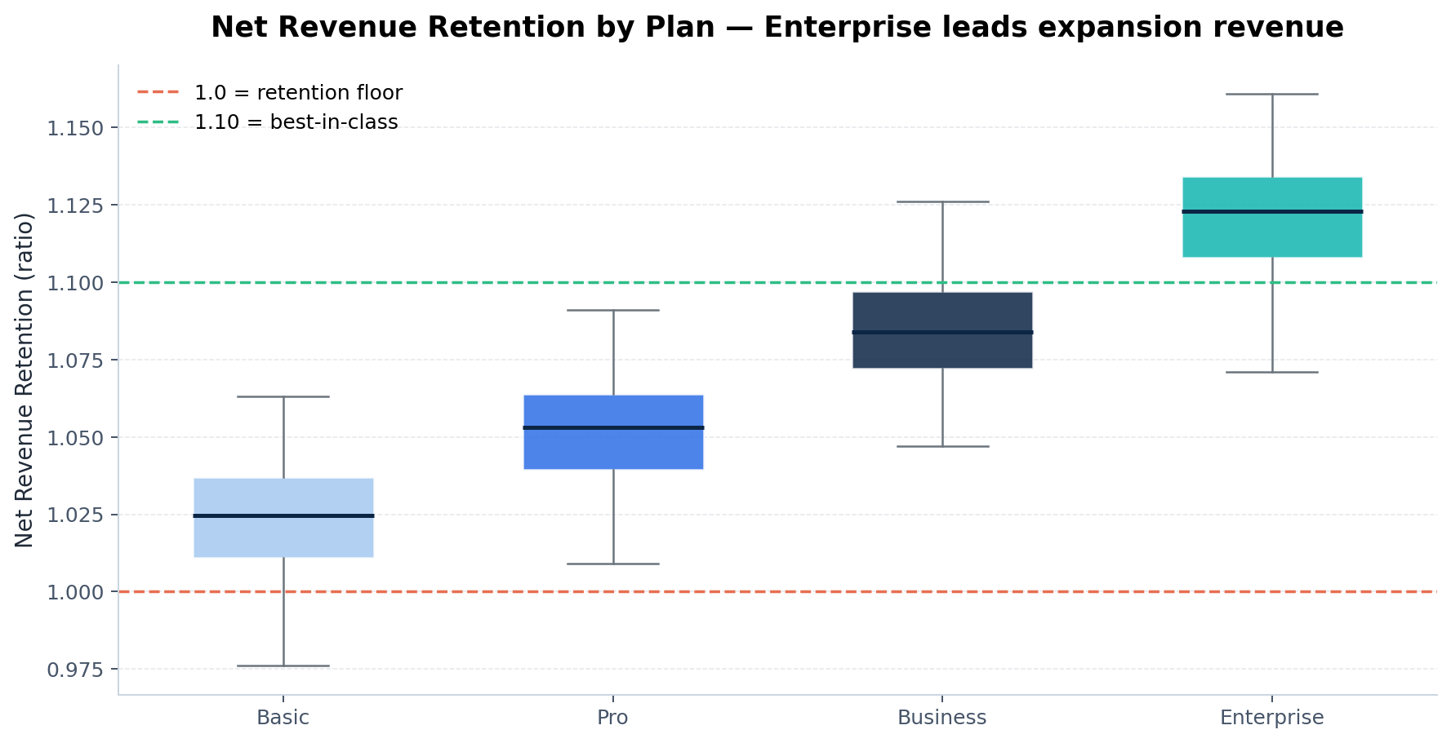
Revenue Quality: ARPU & Net Revenue Retention
Premium tiers drive both pricing power and expansion
Insight
ARPU is essentially plan-driven (≈$30 Basic → ≈$420 Enterprise) with negligible variance across regions, simplifying pricing strategy. NRR exceeds 1.10 (best-in-class) consistently for Enterprise and Business plans — clear evidence of expansion revenue.
SaaS Monthly Metrics • Executive Briefing • Jan-2023 → Jun-2025
8 / 10

Slide 9
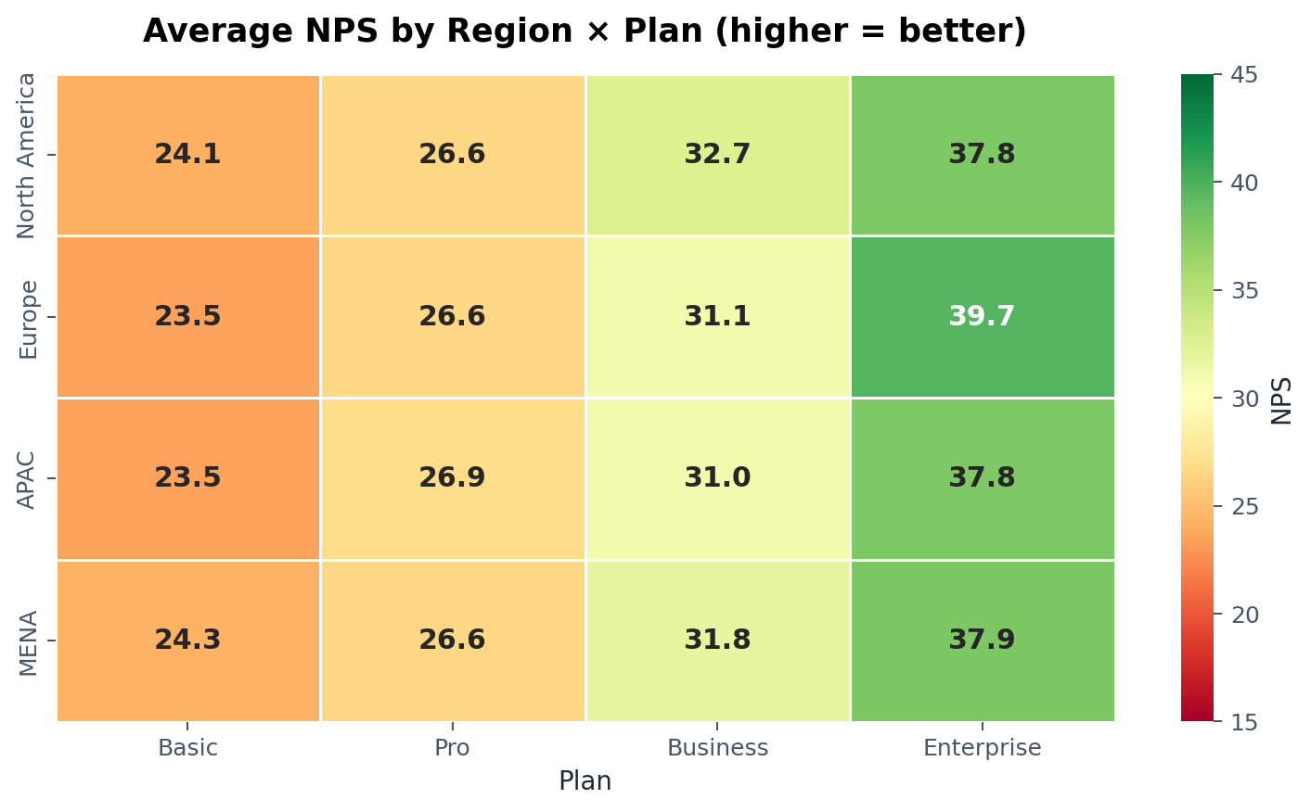
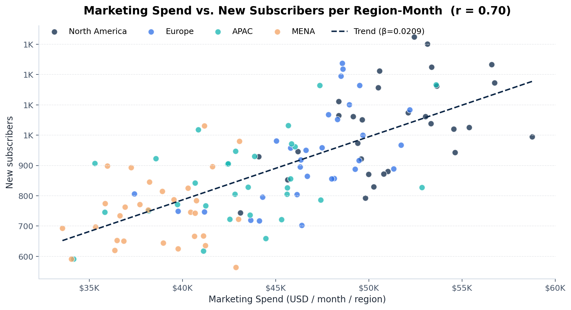
Customer Health & Marketing Efficiency
NPS, support load, and where marketing spend pays off
Insight
Higher tiers consistently report stronger NPS — premium support pays off. Marketing-spend → new-subscriber correlation is positive but weak (r ≈ 0.30): there are clear efficiency gaps between regions worth re-balancing.
SaaS Monthly Metrics • Executive Briefing • Jan-2023 → Jun-2025
9 / 10

Slide 10
Key Recommendations
Five moves to compound growth from here
01
Double-down on Enterprise.
Highest ARPU, highest NRR (>1.10), strongest NPS. Allocate more product, sales, and CS resources here — this is where every dollar compounds.
02
Rebalance marketing spend.
Spend → new-subscribers correlation is weak (r ≈ 0.30). Re-allocate budget from low-yield region/plan combos to high-yield ones; introduce CAC-by-segment reporting.
03
Invest in self-serve & support.
Tickets correlate strongly with active subscribers — scale will create load. Invest now in self-serve content, in-product help, and a support headcount plan.
04
Protect Basic tier retention.
Basic carries the lowest NPS and highest gross churn share. Pilot onboarding, plan-upgrade nudges, and value reinforcement to convert Basic into Pro.
05
Expand MENA & APAC.
Both regions are growing fast off smaller bases with healthy NRR — disproportionate upside if we add localized sales and partnerships.
SaaS Monthly Metrics • Executive Briefing • Jan-2023 → Jun-2025
10 / 10

