Slide 1


THE AGENTIC AI ENGINEERING BOOTCAMP

Slide 2













Instructor Introduction
520,000 Students
M.A.Sc., Ph.D., MBA
260,000+ Subs, 3.5M views
© All rights reserved for Dr. Ryan Ahmed @Stemplicity Inc.
Dr. Ryan Ahmed Professor & Best-selling Instructor
AI & EV/AV

Slide 3





Instructor Introduction
© All rights reserved for Dr. Ryan Ahmed @Stemplicity Inc.
Kukeshajanth Kodeswaran, M.Eng. Director of Engineering

Slide 4
Key Learning Objectives
This bootcamp teaches you how to design agent architectures, build RAG pipelines, orchestrate multi-agent workflows, and deploy reliable autonomous AI systems.
Understand agentic AI architectures and how agents use perception–reasoning–action loops to solve problems.
Design problem-first AI systems by decomposing workflows into agent tasks and defining clear success metrics.
Build agents with memory and context using short-term, long-term, and episodic memory along with effective context engineering.
Integrate tools and structured outputs through function calling, schema design, validation, and reliable error handling.
Architect multi-agent systems using sequential, parallel, and hierarchical orchestration patterns with safe coordination.
Implement retrieval-augmented generation (RAG) pipelines with embeddings and vector databases.
Develop agentic coding workflows to build real applications and ship an AI agent MVP using modern AI development tools (Claude Code & Codex).
Evaluate, test, and secure AI agents with automated evals, adversarial testing, debugging techniques, and guardrails.
Deploy and operate production-grade agent systems with monitoring, cost optimization, governance, and scalable cloud deployment.
© All rights reserved for Dr. Ryan Ahmed @Stemplicity Inc.

Slide 5
Success Tips
Build Every Week
Ship at least one working agent per week.
Block 3–5 Hours / Week
No multitasking. Deep work only.
Share & Demo
Post your builds. Demo in Q&A. Momentum compounds socially.
Ask Questions Live
Drop your errors.
Share your blockers. Debugging in public accelerates mastery.
© All rights reserved for Dr. Ryan Ahmed @Stemplicity Inc.

Slide 6
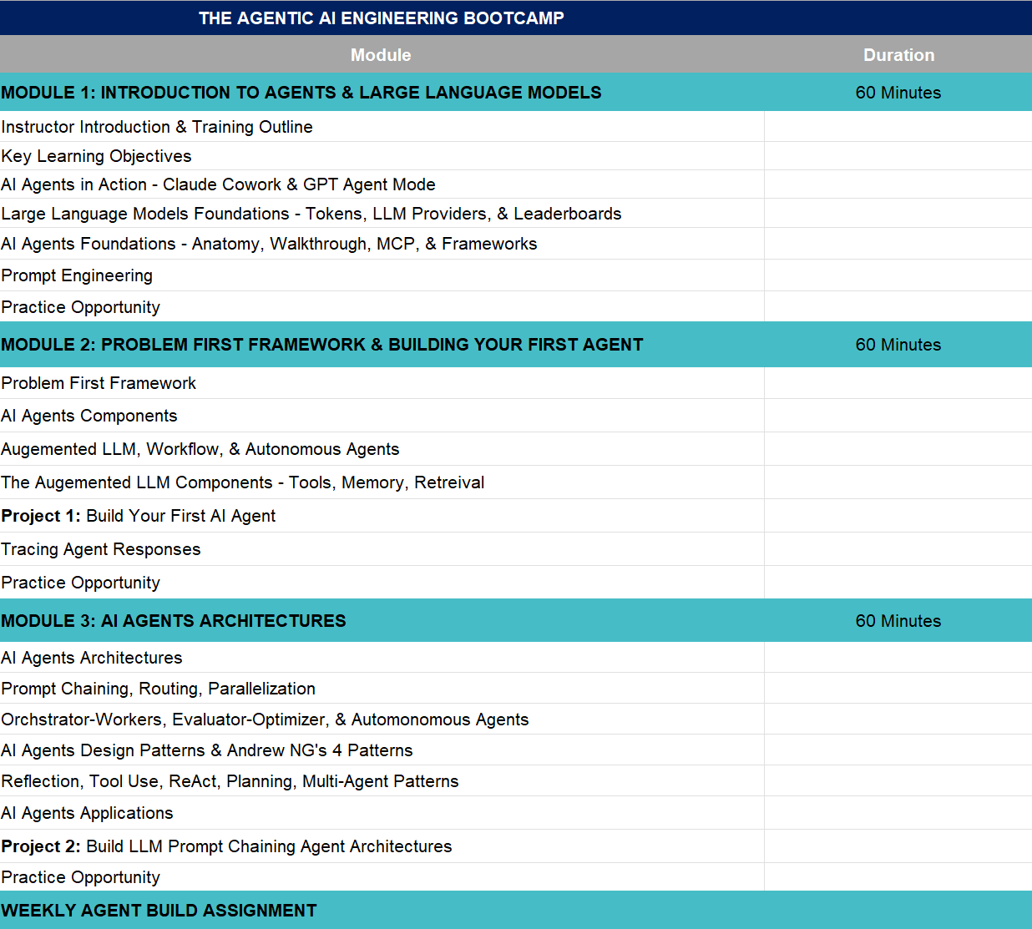
Week 1 Outline
Check Week 1 outline in “The Agentic AI Engineering Bootcamp - Week 1 Outline.xlsx”
© All rights reserved for Dr. Ryan Ahmed @Stemplicity Inc.

Slide 7
INTRODUCTION TO AI AGENTS & LIVE DEMO (CLAUDE & GPT AGENT MODE)

Slide 8



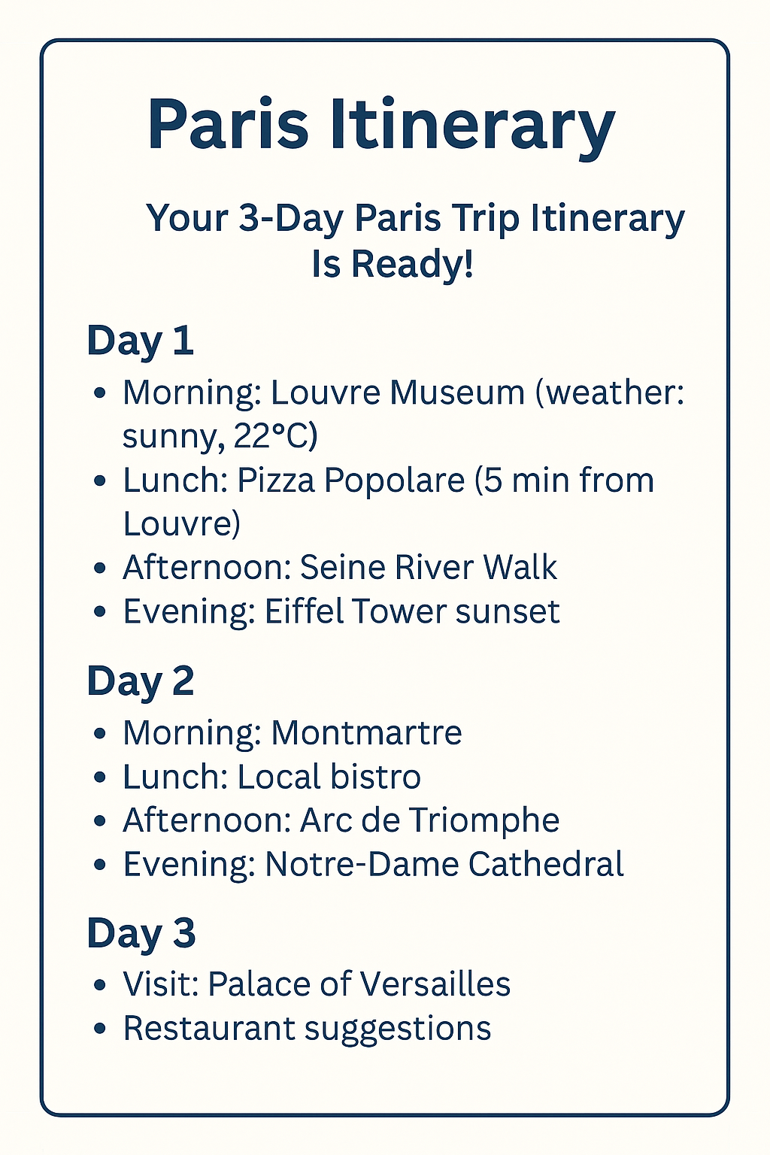






AI Agents 101
AI agents are intelligent systems that take a goal, plan the steps, and autonomously execute them using tools & knowledge with minimal human input.
Planning: schedule sightseeing, check weather
Memory: recalls that user likes museums
Tools: maps, hotel, weather
Guardrails: safe suggestions
Handoff: pass task to restaurant booking agent
AI Agent
Guardrails
“Plan my 3-day trip to Paris”
© All rights reserved for Dr. Ryan Ahmed @Stemplicity Inc.
Large Language Model
Handoffs
Planning
Tools
Memory

Slide 9
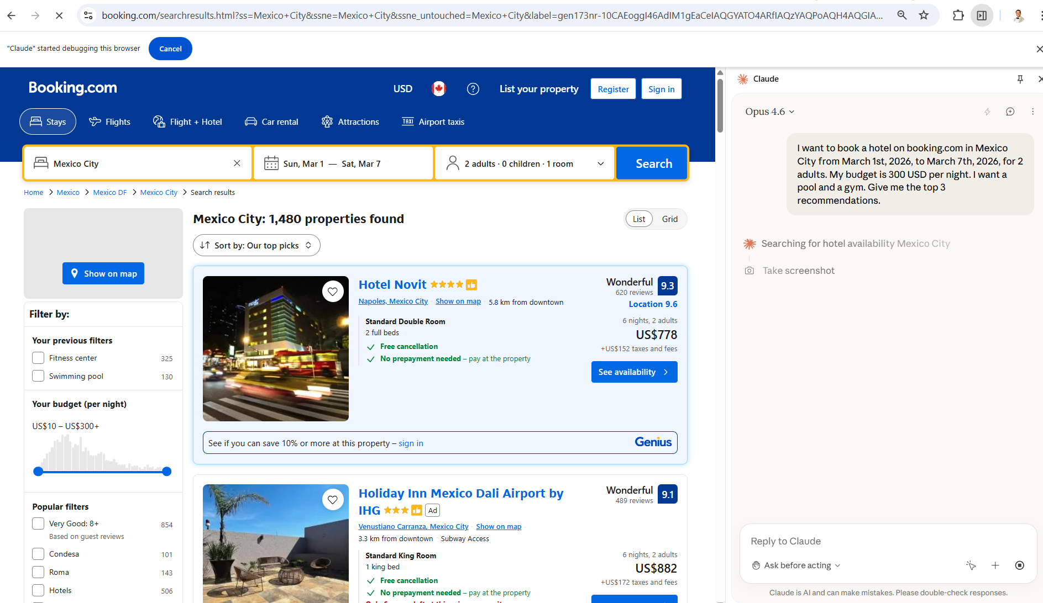
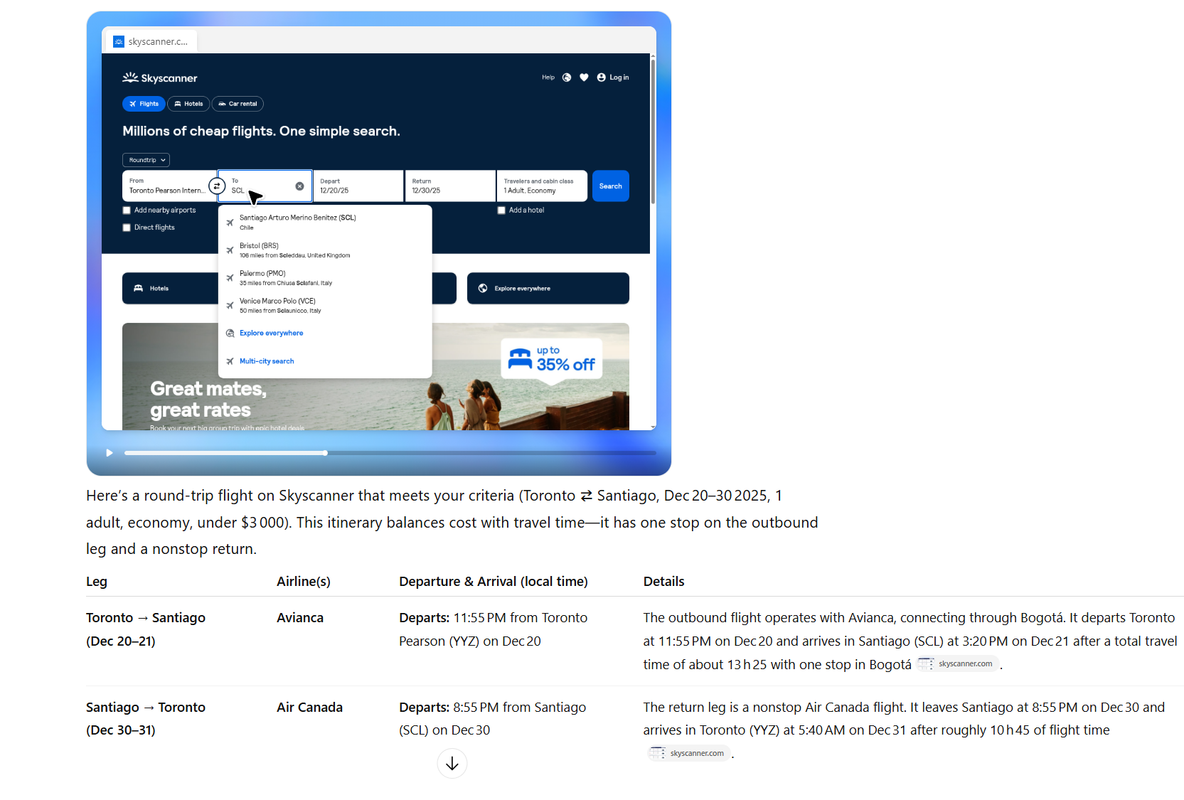
AI Agents in Action
Claude Agent in Chrome
ChatGPT Agent Mode
© All rights reserved for Dr. Ryan Ahmed @Stemplicity Inc.

Slide 10
LARGE LANGUAGE MODELS FOUNDATIONS

Slide 11

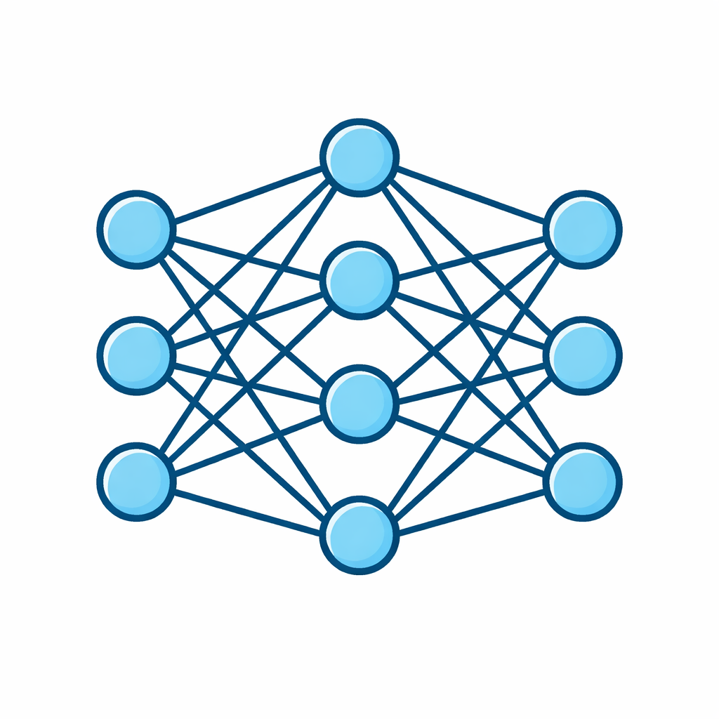

Large Language Models (LLMs)
A Large Language Model is a neural network trained on massive text datasets to understand and generate human language. At its core, it predicts the next most probable token in a sequence.
© All rights reserved for Dr. Ryan Ahmed @Stemplicity Inc.
Training Data
Parameters
Generation
Billions of learned weights that encode language patterns and knowledge
Produces text token-by-token using probability distributions
Billions of tokens from books, web pages, code, and conversations

Slide 12
How LLMs work?
Input Text
Tokenization
Transformer
Layers
Probability
Distribution
Output
Token
Input Text: The user provides a prompt in natural language.
Tokenization: The text is converted into numerical tokens the model can process.
Transformer Layers: The model analyzes token relationships using self-attention to understand context.
Probability Distribution: The model calculates the likelihood of every possible next token.
Output Token: The most likely (or sampled) token is selected and generated as output.
© All rights reserved for Dr. Ryan Ahmed @Stemplicity Inc.

Slide 13
Tokens
Tokens are chunks of text, typically words, subwords, or characters, that the model uses to process and generate language. Understanding tokens is key to managing costs and context limits.
The model doesn't "read" text like humans do. Instead, a tokenizer breaks down the input into these tokens and converts them into numerical IDs the model can understand.
The model then learns relationships between these tokens to predict the next one in a sequence.
Check OpenAI's Tokenizers here: https://platform.openai.com/tokenizer
Example
"Welcome to the Bootcamp!"
→ [“Welcome", “to", " the", " Boot", " camp", " !"] = 6 tokens
© All rights reserved for Dr. Ryan Ahmed @Stemplicity Inc.
~1 token
~750
1M tokens
≈ Entire works of Shakespeare OR
≈ 8 full-length novels
≈ 4 characters
in English
words per
1,000 tokens

Slide 14

Practice Opportunity: Understanding Tokens
Use the OpenAI Tokenizer Tool to analyze the following two prompts. Record the number of tokens for each of the following examples:
Example 1: "Explain the difference between supervised and unsupervised learning in AI."
Example 2: "Please explain the difference between supervised and unsupervised learning in AI. Thank You."
Which sentence had more tokens?
Reflect: Sam Altman once mentioned that people typing “thank you” and "please" to ChatGPT cost OpenAI millions of dollars. What does this tell you about the importance of token efficiency when designing prompts or building tools? (https://futurism.com/altman-please-thanks-chatgpt)
© All rights reserved for Dr. Ryan Ahmed @Stemplicity Inc.

Slide 15
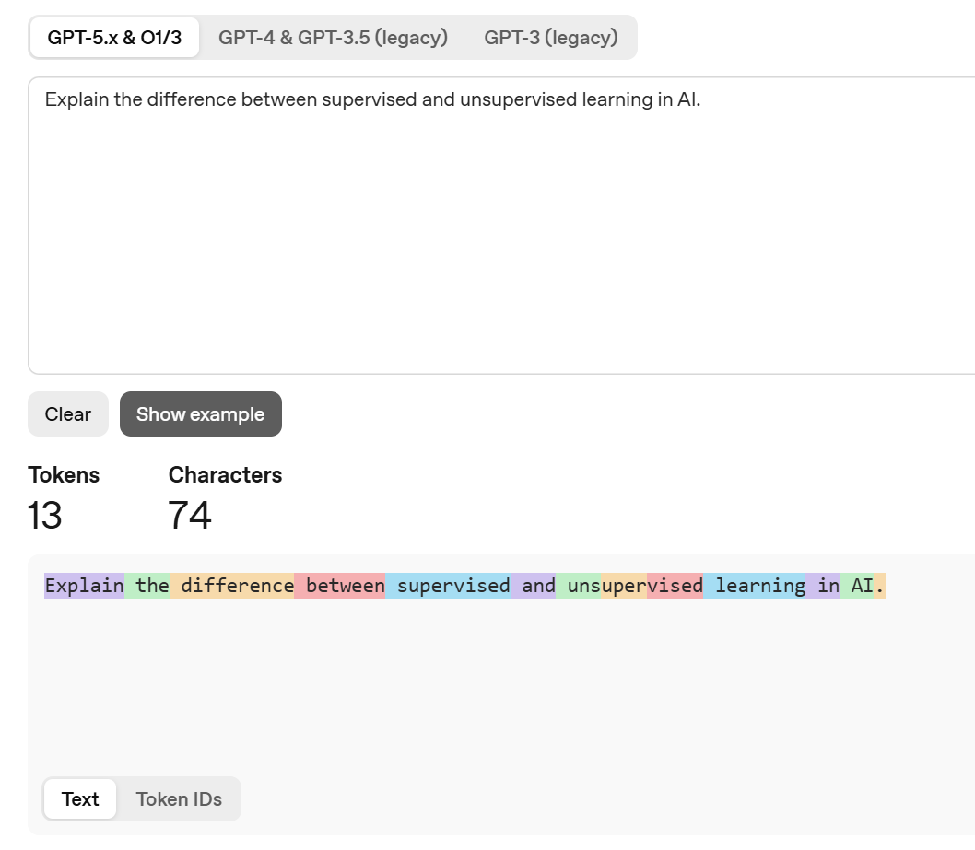
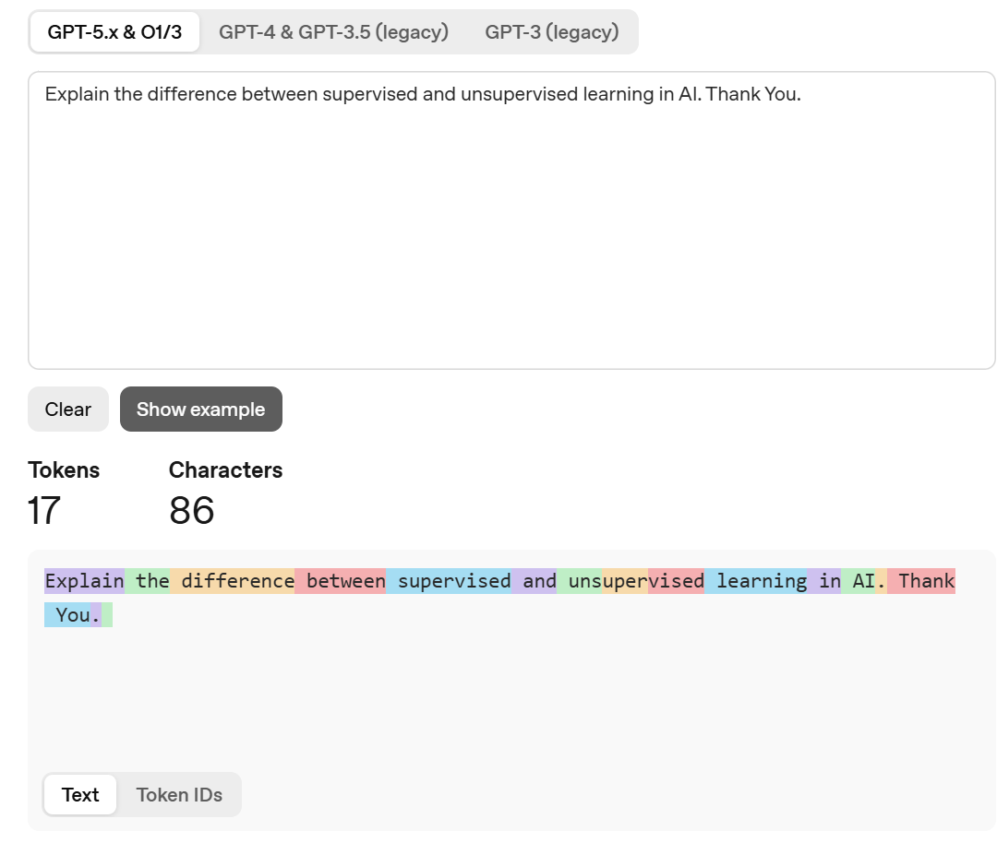
Practice Opportunity Solution
© All rights reserved for Dr. Ryan Ahmed @Stemplicity Inc.

Slide 16
The Context Window
The context window is the maximum number of tokens an LLM can process in a single interaction including both input and output. It defines how much information the model can "see" at once.
GPT-5
400K
Claude Opus 4.6
1M
Gemini 3.0
1M
Llama 4 Maverick
10M
© All rights reserved for Dr. Ryan Ahmed @Stemplicity Inc.
Why it matters
Larger context = more documents, longer conversations, and complex tasks.
Model | Tokens
128K | ~300 pages
400K | ~1,200 pages
1M | ~2,500–3,000 pages
10M | Entire codebase / archive

Slide 17






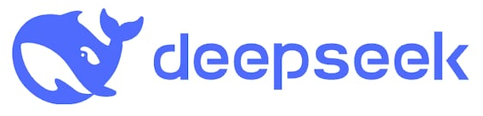



Top LLM Providers
OpenAI
Anthropic
Google
GPT-5, GPT-4.5, o1, o3
Claude 4.6 Opus, Sonnet, Haiku
Gemini 3 Flash / Pro
Market leader, ChatGPT ecosystem
Safety-focused, strong reasoning
Multimodal, deep search integration
© All rights reserved for Dr. Ryan Ahmed @Stemplicity Inc.
Meta
Mistral
xAI
Mistral Large, Mixtral
Grok 4
Llama 3.x (open source)
Strong benchmarks, real-time data
Leading open-weight models
EU-based, efficient architectures

Slide 18

Open Source Vs. Closed Source Models
Open Source / Open Weight
Closed Source / Proprietary
Weights publicly available for download
Can run locally or on your own infra
Full control & customization
Examples: Llama 3, Mistral, Gemma, Qwen
Lower cost at scale, data stays private
Community-driven innovation
Access via API only
Managed infrastructure & scaling
Often highest benchmark scores
Examples: GPT-5, Claude, Gemini Pro
Pay-per-token pricing model
Vendor lock-in & data privacy concerns
© All rights reserved for Dr. Ryan Ahmed @Stemplicity Inc.

Slide 19
How to Compare LLMs?
Open-source or Closed
Closed (e.g. GPT-5) usually offers better performance and ease of use via APIs.
Context Length
How much input/output the model can handle in one go.
For long documents or multi-turn conversations, longer context is better (e.g., Gemini 2.5 Flash has 1M Window).
Release Date & Knowledge Cut-off
Newer models are trained on more recent data (useful for current events) (e.g.: GPT-3.5’s cut-off is early 2023.
Parameters
More parameters usually = more capacity (e.g., GPT-3 has 175B).
But bigger isn’t always better for performance or cost, efficiency matters too.
Training Tokens
Refers to how much text the model was trained on.
More tokens = broader language understanding and generalization
Open-source (e.g. LLaMA) gives you flexibility, full control, and lower cost if self-hosted.
Cost
Cost is a critical parameter in deciding whether to deploy open- or closed-source models. It is typically priced per 1K/1M input and output tokens
© All rights reserved for Dr. Ryan Ahmed @Stemplicity Inc.

Slide 20
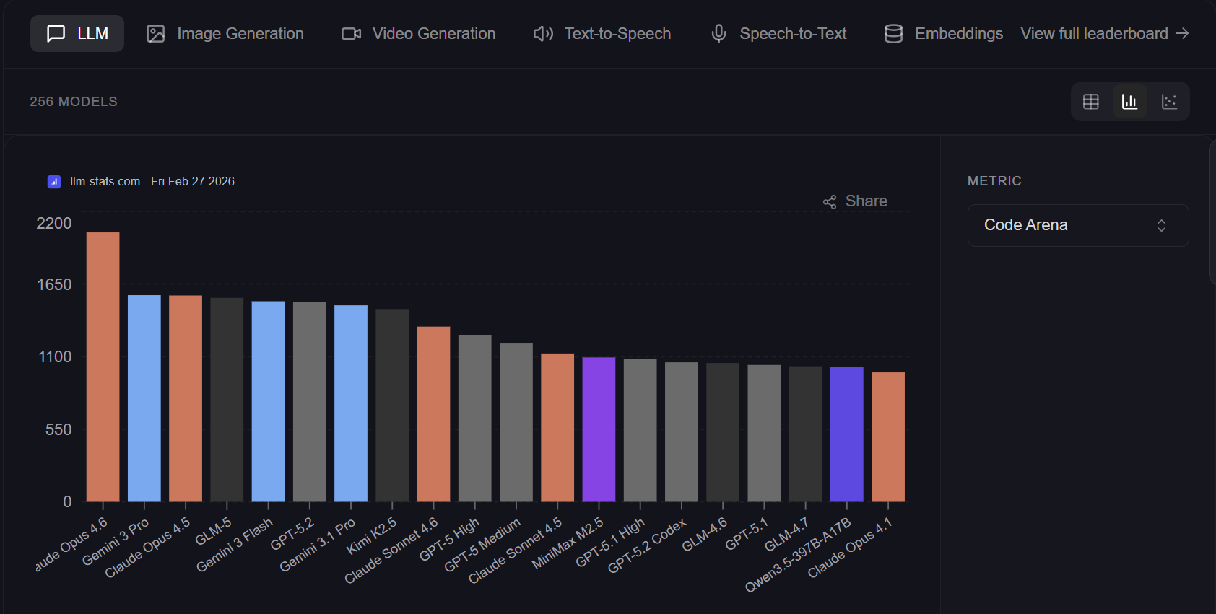
LLM Leaderboard
LLM Stats Leaderboard: https://llm-stats.com/leaderboards/llm-leaderboard
Vellum Leaderboard: https://www.vellum.ai/llm-leaderboard
© All rights reserved for Dr. Ryan Ahmed @Stemplicity Inc.

Slide 21

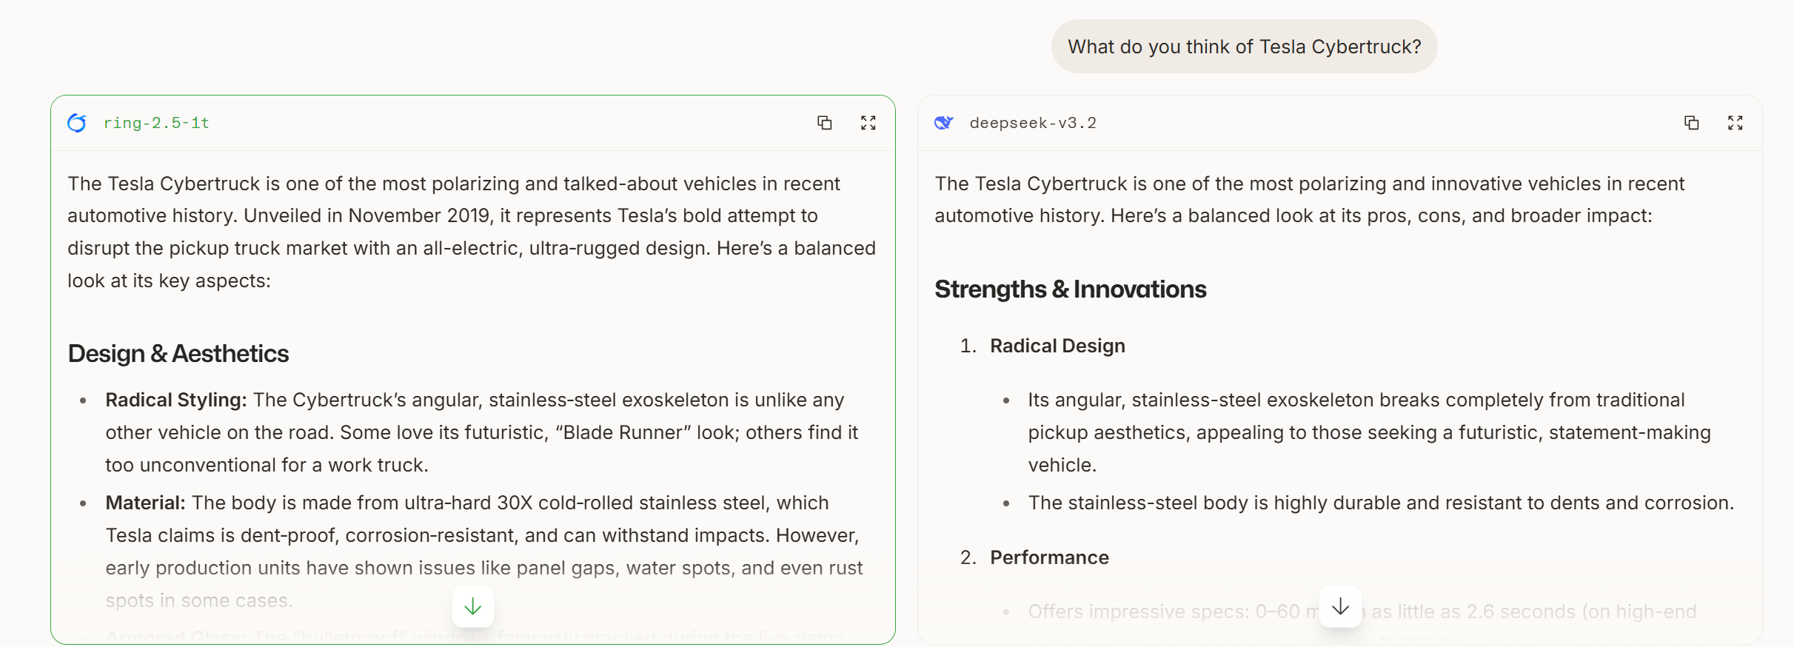
Chatbot Arena LLM Leaderboard & Blind Test!
Chatbot Arena is a public platform where users compare responses from two anonymous LLMs side-by-side and vote for the better one, creating a crowdsourced benchmark based on real human preferences.
Results are used to generate a live leaderboard that ranks top LLMs according to conversational quality, reasoning, and coding ability.
Chatbot Arena: https://arena.ai/
© All rights reserved for Dr. Ryan Ahmed @Stemplicity Inc.

Slide 22
Practice Opportunity: Blind Test Top LLMs in Chatbot Arena
Visit Chatbot Arena: https://arena.ai/
Enter a Strong Prompt
“Explain how interest rate hikes impact real estate prices over 5 years. Include a numerical example.”
Write a dad joke about AI agents.
3. Compare the Two Anonymous Responses
Evaluate for Clarity, Depth, Structure, and Practical usefulness
4. Vote + Reflect
Submit: Your prompt, Which answer you chose and explain why
© All rights reserved for Dr. Ryan Ahmed @Stemplicity Inc.

Slide 23
AI AGENTS FOUNDATIONS

Slide 24
What is an AI Agent?
An AI agent is a system that uses an LLM as its reasoning engine to autonomously plan, take actions, and adapt based on feedback to accomplish goals.
LLM (Chatbot)
AI Agent
Responds to a single prompt
No access to external tools
No persistent memory
Stateless interaction
Plans multi-step workflows
Uses tools (APIs, search, code)
Maintains context & memory
Autonomous decision-making
© All rights reserved for Dr. Ryan Ahmed @Stemplicity Inc.
An agent = LLM + Tools + Memory + Planning Loop

Slide 25
AI Agents Anatomy
An AI Agent is a system built around an LLM that can autonomously reason, plan, use tools, and learn from feedback to accomplish complex goals.
Planning
Tools
LLM
Reasoning Engine
Memory
© All rights reserved for Dr. Ryan Ahmed @Stemplicity Inc.
Observation
P
Planning
T
Tools
M
Memory
O
Observation
Breaks goals into sub-tasks, decides what to do next. Uses ReAct loops, chain-of-thought, and self-reflection.
Interacts with the world: APIs, code execution, web search, file I/O, databases, and MCP servers.
Short-term (conversation context) and long-term (vector DB, embeddings) to retain and recall information.
Interprets tool results and environment feedback to evaluate progress and decide next actions.

Slide 26

Weather Agent Walkthrough – Part 1
Agent Reasoning
Parse Intent:
User
User wants weather info
Context
You are an assistant that helps users with questions about weather.
Instruction
If the user asks about weather, use the Weather tool. Ask the user for additional details if the request is unclear.
Check Memory:
System Prompt
No city preference stored
Identify Gap:
Need a city to call API
Plan:
Ask user for city first, then call weather API
Instructions
User Prompt
What is the weather today?
Planning/
Reasoning
© All rights reserved for Dr. Ryan Ahmed @Stemplicity Inc.
Agent
LLM
Agent Response:
What is the city?
Storage/
Retrieval
Memory

Slide 27
Weather Agent Walkthrough – Part 2
Memory Updated:
{ user_city: "Toronto" }
Context
You are an assistant that helps users with questions about weather.
Instruction
If the user asks about weather, use the Weather tool. Ask the user for additional details if the request is unclear.
Tool Call:
get_weather("Toronto", "today")
System Prompt
{
"city": "Toronto, ON",
"temp": "-5°C",
"condition": "Light Snow",
}
API Response
Instructions
User Prompt
Toronto
User
Planning/
Reasoning
Agent
LLM
© All rights reserved for Dr. Ryan Ahmed @Stemplicity Inc.
Agent Response:
"Weather for Toronto :
-5°C, light snow, Bundle up!"
Storage/
Retrieval
Call Tool
Tools
Memory

Slide 28








Model Context Protocol (MCP)?
MCP is an open standard and open-source framework introduced by Anthropic to standardize how AI models interact with external tools, systems, and data sources.
Problem (Without MCP)
Solution (With MCP)
© All rights reserved for Dr. Ryan Ahmed @Stemplicity Inc.
MCP
AI Agent
AI Agent
MCP
MCP
Custom APIs
Standardized APIs

Slide 29
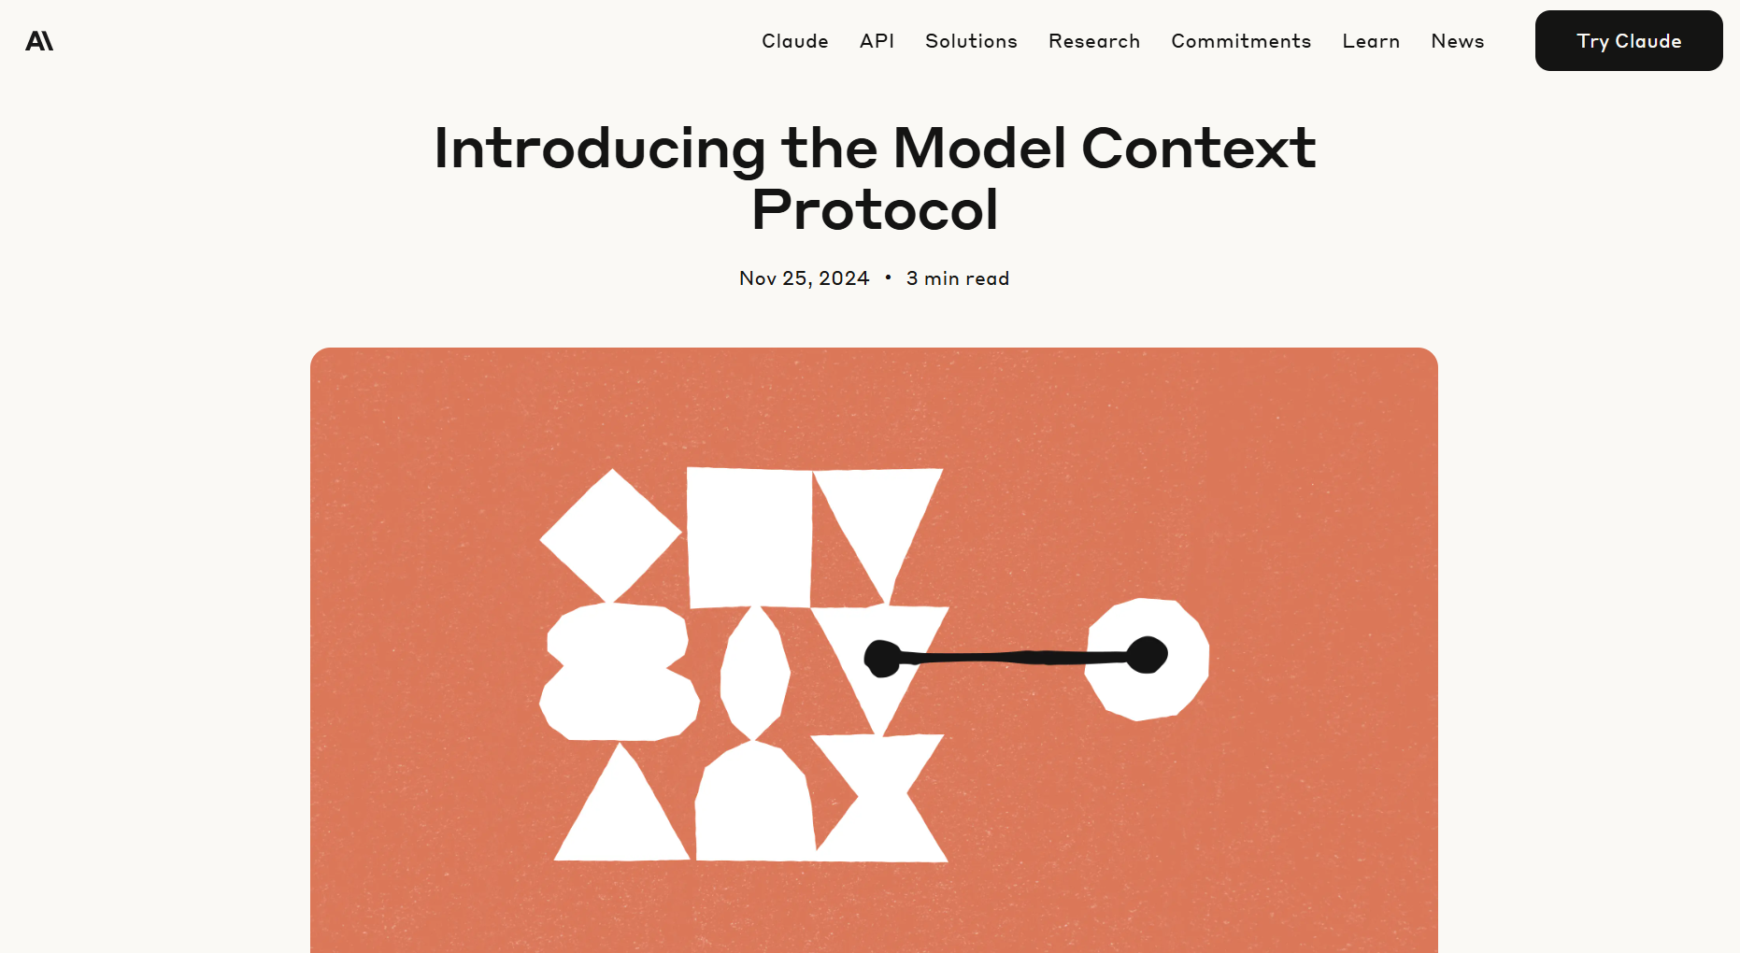
MCP by Anthropic Documentation
https://www.anthropic.com/news/model-context-protocol
© All rights reserved for Dr. Ryan Ahmed @Stemplicity Inc.

Slide 30

Real-world MCP Application
Assume we have a simple AI agent that utilizes a currency conversion tool.
The agent will use Model Context Protocol (MCP), which is a standardized protocol that connects LLMs and AI agents to various external tools and data sources.
MCP server
What is $1000 USD in CAD?
Currency Convertor Tool
© All rights reserved for Dr. Ryan Ahmed @Stemplicity Inc.
LLM
MCP
Client
C$1,370
MCP is an open protocol designed to be a standard way for models to discover & interact with tools. It’s like a universal plug adapter for AI tools!

Slide 31
Agentic Frameworks
Open-source and vendor frameworks for building agents programmatically.
LangGraph
Py / JS
CrewAI
Python
AutoGen (AG2)
Python
Graph-based workflows, cycles, persistence, human-in-the-loop
Role-based multi-agent crews, task delegation, sequential & parallel flows
Microsoft — multi-agent conversations, group chat, code execution
OpenAI Agents SDK
Python
Claude Agent SDK
Py / TS
Google ADK
Python
Native tool use, handoffs between agents, guardrails, tracing
Anthropic — tool use, MCP support, extended thinking, multi-turn
Google — multi-agent, A2A protocol, Vertex AI integration
© All rights reserved for Dr. Ryan Ahmed @Stemplicity Inc.
Semantic Kernel
Multi
Haystack
Python
Smolagents
Python
Microsoft — enterprise AI orchestration, .NET/Java/Python, plugins
Deepset — RAG & NLP pipelines, modular components, document processing
Hugging Face — lightweight, code-first agents, minimal abstractions
LlamaIndex
Py / TS
Agno (Phidata)
Python
Pydantic AI
Python
Data framework — RAG agents, knowledge graphs, multi-step query engine
Model-agnostic, multi-modal, built-in memory & knowledge, fast
Type-safe agent building, structured outputs, dependency injection

Slide 32
No-code/Low-Code Agentic Platforms
Visual builders and platforms that let you create agents without writing code.
n8n
Open
Flowise
Open
Langflow
Open
Open-source workflow automation, 400+ integrations, AI agent nodes
Open-source, drag-and-drop LLM flow builder, LangChain-based
Visual IDE for LangChain, supports custom Python components
Dify
Open
Zapier AI
SaaS
Botpress
SaaS
Open-source LLMOps platform, RAG pipeline builder, prompt IDE
AI-powered automation across 6,000+ apps, natural language setup
Conversational AI platform, visual flow builder, multi-channel
© All rights reserved for Dr. Ryan Ahmed @Stemplicity Inc.
Relevance AI
SaaS
Lindy
SaaS
Vertex AI Agent Builder
Ent.
No-code AI workforce, multi-step agent builder, tool integration
Personal AI assistants, trigger-based workflows, 3,000+ integrations
Google Cloud — enterprise agents, grounding, Gemini-powered
Azure Copilot Studio
Ent.
IBM Watsonx
Ent.
Stack AI
Ent.
Microsoft — enterprise copilots, Power Platform integration
Enterprise AI, governance, on-prem/cloud deployment, compliance
Enterprise no-code, SOC 2, HIPAA, custom model deployment

Slide 33
PROMPT ENGINEERING

Slide 34
What is Prompt Engineering?
Prompt engineering is the practice of designing and optimizing text input to generative AI models to obtain desired responses.
It is the art of communicating with a generative AI model.
“Recommend a book.”
High-quality prompts guide the AI model to generate better outputs.
“Recommend a fiction book.”
© All rights reserved for Dr. Ryan Ahmed @Stemplicity Inc.
“Recommend a historical fiction book set in World War II.”

Slide 35
Prompt Components
Context: Set the scene, who is the AI, what's the situation?
Context:
You are a Smart Home Energy Advisor who helps homeowners reduce energy use.
Instruction: When given a household prompt, provide practical, prioritized advice.
Input: You will receive a question about energy usage or device efficiency.
Output: Respond with (1) A short, clear recommendation list (2-4 bullets), (2) One quick win that can be done today
Instruction: A clear statement of the desired goal.
Context
Input Data: The data or content to analyze.
Instruction
© All rights reserved for Dr. Ryan Ahmed @Stemplicity Inc.
Output Indicator: Define the expected format and structure
Input Data
Output Indicator

Slide 36
Prompting Essentials
Guide behaviour with System Prompt
Set the persona, rules, constraints and output format
Ask for reasoning (Chain of thought):
“explain your steps” or “show the calculation before the result” to build trust and transparency.
Add constraints & boundaries:
Word limits, style guides, or examples help the model aim correctly. “Explain in 3 bullet points, max 15 words each.”
Iterate and refine
The first draft is rarely the final. Treat prompts like a conversation; tweak wording, add detail, narrow scope until the output clicks.
Anchor with examples (Few Shot Prompting):
Show the AI what “good” looks like. A sample answer, tone, or structure is worth paragraphs of instructions.
Structured Output
Request JSON, XML, or specific formats
Force Model to Avoid Hallucination
“Don’t hallucinate, ground your results in the provided data. If data is missing, say ‘not enough info’ instead of guessing.”
© All rights reserved for Dr. Ryan Ahmed @Stemplicity Inc.

Slide 37

Prompt Engineering Techniques: Zero-Shot Prompting
Zero-shot prompting refers to the ability of a generative AI model to generate responses without being provided with any prior examples.
The model relies on its broad general knowledge learned from its training data to complete the task.
User prompt:
“Tell me the sentiment of the following headline and categorize it as either positive, negative or neutral:
New airline between Seattle and San Francisco offers a great opportunity for both passengers and investors.”
Generative AI model
© All rights reserved for Dr. Ryan Ahmed @Stemplicity Inc.
Output:
Positive

Slide 38
Prompt Engineering Techniques: Few-Shot Prompting
Few-shot prompting (in-context learning) involves providing a few example pairs of input and desired output to the generative AI model to guide its responses.
User prompt:
“Tell me the sentiment of the following. Here are some examples:
Apple stock declined 2% today
Answer: Negative
Tesla stock gained 5% after successful self-driving demo
Answer: Positive
OpenAI expanded its userbase to 100 million
Answer:”
Generative AI model
Output:
Positive
© All rights reserved for Dr. Ryan Ahmed @Stemplicity Inc.

Slide 39
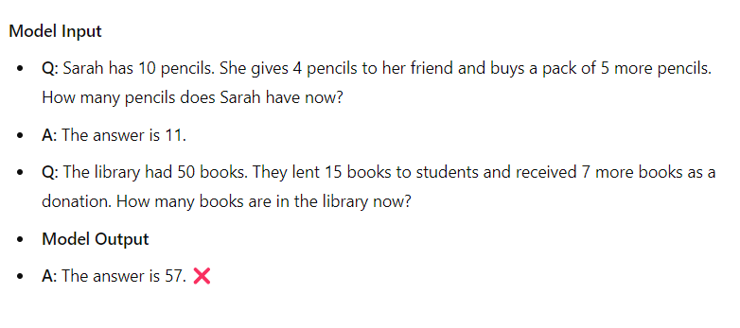
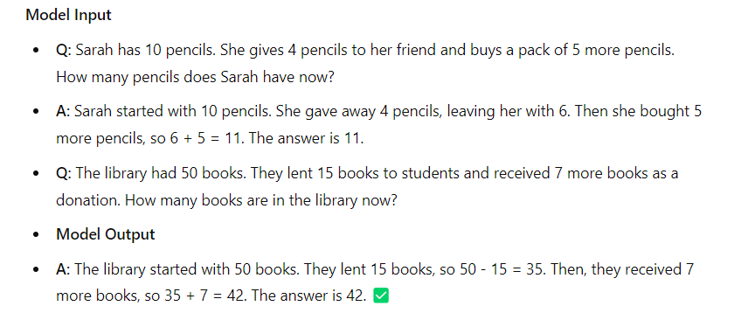
Prompt Engineering Techniques: Chain-of-Thought
Chain-of-thought prompting is a technique that improves the reasoning abilities of AI models by breaking down complex questions or tasks into smaller manageable steps.
It mimics how humans' reason and solve problems by systematically breaking down the decision-making process.
Standard Prompting
Chain-of-thought Prompting
© All rights reserved for Dr. Ryan Ahmed @Stemplicity Inc.

Slide 40
Thank you!

