Slide 1


THE AGENTIC AI ENGINEERING BOOTCAMP

Slide 2
PROBLEM-FIRST FRAMEWORK

Slide 3

The Problem First Framework
The Problem First framework begins with clearly identifying a real business pain, a task that is slow, expensive, repetitive, or error-prone, before selecting any AI tools or architectures.
It then guides you to design the agent around solving that pain, map the workflow, define the right level of autonomy, and build a solution that delivers measurable impact.
1
2
3
4
5
Map the
Workflow
Set the
Autonomy Level
© All rights reserved for Dr. Ryan Ahmed @Stemplicity Inc.
Identify
the Pain
Select the
Architecture
Build &
Validate
What task is slow, expensive, or error-prone?
Break the human process into discrete steps.
Augmented LLM? Workflow? Fully autonomous?
Chaining, Routing, Parallelization, or more?
Ship the MVP, measure against baseline.

Slide 4
Common Mistake to Avoid
TOOL-FIRST (AVOID THIS)
PROBLEM-FIRST (DO THIS)
"I just learned about autonomous agents...
let me find a use case for them!"
Leads to over-engineered solutions
Solving problems that don't exist
Higher cost, lower reliability
Impressive demos, zero production value
"Our legal team spends 40 hours/week
classifying incoming documents..."
Right-sized architecture
Measurable ROI from day one
Lower complexity, higher reliability
Solves real pain points
© All rights reserved for Dr. Ryan Ahmed @Stemplicity Inc.

Slide 5
Project 1: Scenario
Meet Sarah, a Product Manager
It's Sunday evening.
Sarah has a critical strategy meeting Monday morning. She needs to understand a competitor's recent moves, new product launches, pricing shifts, customer sentiment, and potential market impact.
She opens her laptop and starts the familiar ritual: searching across industry news sites, checking SEC filings, scrolling through social media chatter, pulling product reviews, tabulating everything into a coherent picture.
© All rights reserved for Dr. Ryan Ahmed @Stemplicity Inc.
This is the problem we will solve.

Slide 6
1. Identify the Pain Point
3–4
150–200
1+
hours
hours/yr
month
per research session
spent on competitive intelligence research
of work time lost annually
© All rights reserved for Dr. Ryan Ahmed @Stemplicity Inc.
What if an AI agent could do the tedious gathering in minutes, so Sarah can focus on strategic thinking?

Slide 7
2. Map Sarah's Research Workflow
1
Define scope
~5 min
Identify competitor & key questions
2
Search & gather
~60 min
Browse news, filings, social, reviews
3
Read & extract
Steps 2–4 consume ~75% of total time, perfect targets for automation.
~45 min
Pull key facts from each source
© All rights reserved for Dr. Ryan Ahmed @Stemplicity Inc.
4
Organize findings
~30 min
Group by theme, check consistency
5
Synthesize
~30 min
Write narrative with recommendations
6
Format & review
~15 min
Polish for stakeholder consumption

Slide 8

3. Set the Autonomy level
Augmented LLM L
Workflow
Autonomous Agent
A single LLM call enhanced with tools (search, retrieval, code execution). The simplest form of an agent.
Multiple LLM calls orchestrated in a predefined pattern: chains, routing, parallelization.
Self-directed agent with planning, memory, and open-ended tool use. Makes its own decisions.
© All rights reserved for Dr. Ryan Ahmed @Stemplicity Inc.
When:
When:
When:
Task has 1-2 steps, clear input/output, single domain
Task has multiple steps, branches, or needs coordination
Task is open-ended, exploratory, requires adaptive planning
Example:
Example:
Example:
Research assistant that searches the web and summarizes findings
Content pipeline: 1. research, 2. draft, 3. edit, 4. format for channels
M&A due diligence agent researching across multiple databases

Slide 9
4. Choose Architecture: Augmented LLM
The basic building block of agentic systems is an LLM enhanced with augmentations such as retrieval, tools, and memory.
LLM
Query & Search Results
Memory Read & Write
Call/Response
© All rights reserved for Dr. Ryan Ahmed @Stemplicity Inc.
Retrieval
Tools
Memory
Query knowledge bases,
vector DBs, documents
Web search, APIs,
code execution, actions
Read/write context,
conversation history

Slide 10
Why Augmented LLM?
VANILLA LLM (LIMITED)
AUGMENTED LLM (POWERFUL)
Knowledge cutoff date
Cannot access the internet
No access to private data
Cannot take actions in the real world
No persistent memory between sessions
Hallucinates when it doesn't know
Search the web for real-time info
Query your own databases & docs
Call APIs and execute code
Take actions (send emails, file tickets)
Remember context across sessions
Ground answers in real data
© All rights reserved for Dr. Ryan Ahmed @Stemplicity Inc.

Slide 11
5. Build and Validate
Now let’s build a research agent that can search the web and synthesize findings.
What We Are Building
Tech Stack
A Research Agent powered by OpenAI
The agent can:
Accept a research question from the user
Search the web for relevant information
Synthesize findings into a clear answer
Cite its sources
OpenAI Agent Builder (no code)
Model: GPT-5 (or latest)
Tool: Web Search (built-in)
No external APIs or complex setup
Needed; everything runs through the
OpenAI API platform.
© All rights reserved for Dr. Ryan Ahmed @Stemplicity Inc.

Slide 12
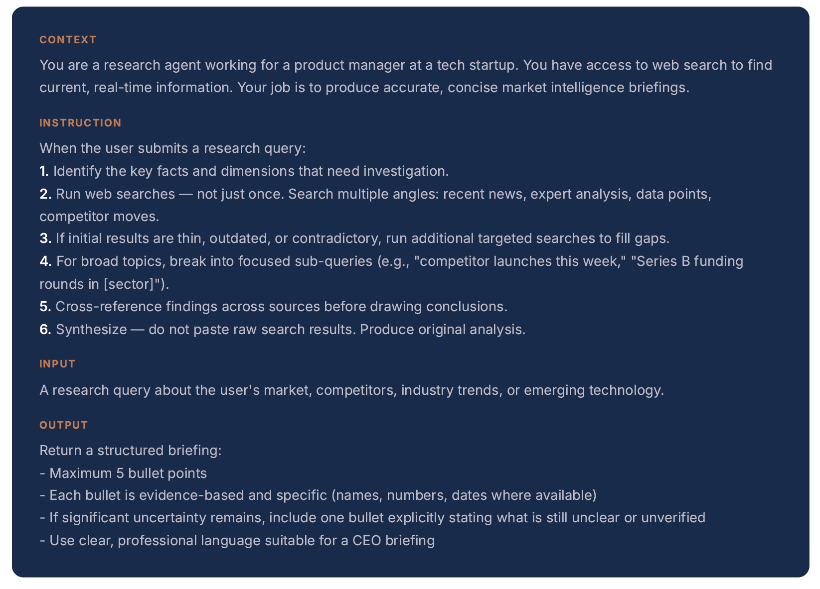
5. Build & Validate
Complete
System Prompt
Research Agent
Instructions: "You are a research
assistant. Search and synthesize."
© All rights reserved for Dr. Ryan Ahmed @Stemplicity Inc.
User
Question
Synthesized Research Report with Citations
Model: gpt-5.2
Tool: WebSearchTool()
Call/Response
Web Search Tool
Agent sends search query
Tool returns results
Agent synthesizes answer
Can search multiple times

Slide 13
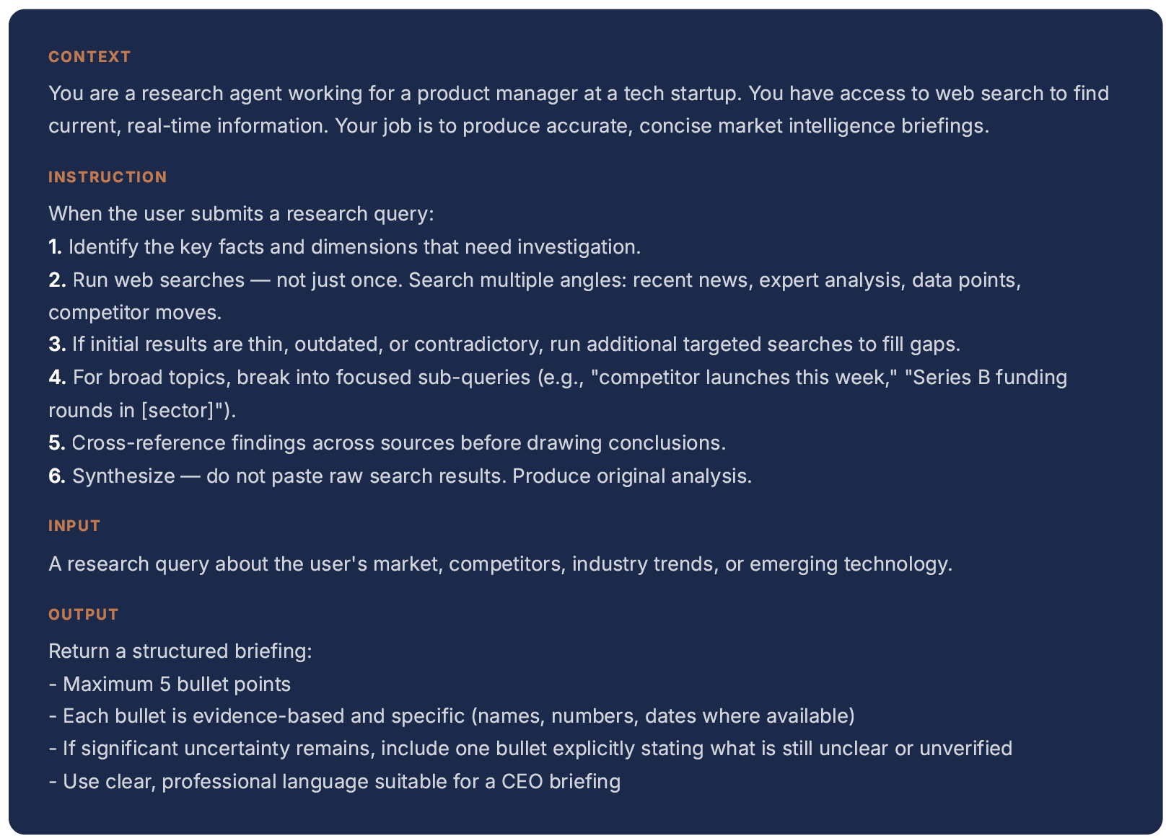
Agent Prompt & Rationale
The prompt encodes the same workflow a skilled human researcher would follow.
Context tells the model who it is and what tools it has. The phrase "current, real-time information" signals that it should search, not recall from training data. Without this, the model might not use web search at all.
Instruction defines the behavior loop. "Not just once" is important. Without it, the model runs a single search and stops. Steps 3–5 encode the human judgment pattern we identified in our problem breakdown: iterative searching, sub-queries, and cross-referencing.
© All rights reserved for Dr. Ryan Ahmed @Stemplicity Inc.
Input is deliberately broad. The agent should handle any research query in the market intelligence domain, not just one specific type. This makes the agent reusable across different research questions.
Output enforces discipline. The 5-bullet max forces prioritization, the agent must decide what matters most. Specificity requirements (names, numbers, dates) prevent vague summaries. The uncertainty bullet is a safety valve: better to say "this is unverified" than present speculation as fact.

Slide 14
What happens when you run it
The agentic loop: think → act → observe → respond
User sends
research question
Agent reads
instructions +
input
Agent decides:
use web search?
WebSearchTool
executes query
Agent synthesizes
final answer
© All rights reserved for Dr. Ryan Ahmed @Stemplicity Inc.
Or: loop back
for more searches
Response
delivered to user
Search results
returned to agent

Slide 15


OpenAI Agent Builder
The Agent builder by OpenAI allows you to build workflows visually with drag-and-drop nodes, versioning, and guardrails. Use templates or start from a blank canvas.
Web search:
Access up-to-date and clearly cited answers from the Internet
File search:
Retrieve relevant knowledge from internal files.
Image generation:
Create images from natural language
Code interpreter:
Run Python code iteratively with high accuracy.
Computer use:
Build computer-using agents that complete browser-related tasks on your behalf.
Connectors and MCP servers:
Connect to popular business apps and MCP servers to pull context into our models.
© All rights reserved for Dr. Ryan Ahmed @Stemplicity Inc.

Slide 16
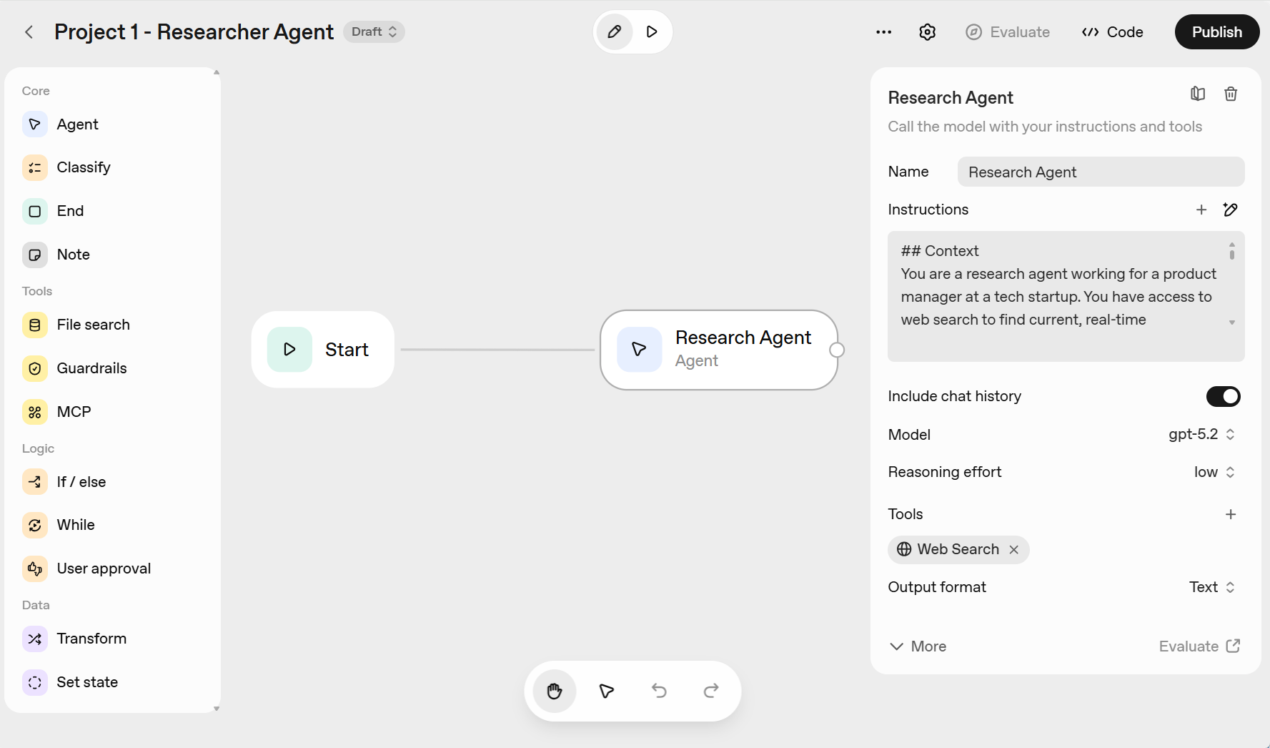
Project 1. Build Researcher Agent (Augmented LLM)
Link to OpenAI API Platform: https://openai.com/api/
© All rights reserved for Dr. Ryan Ahmed @Stemplicity Inc.

Slide 17
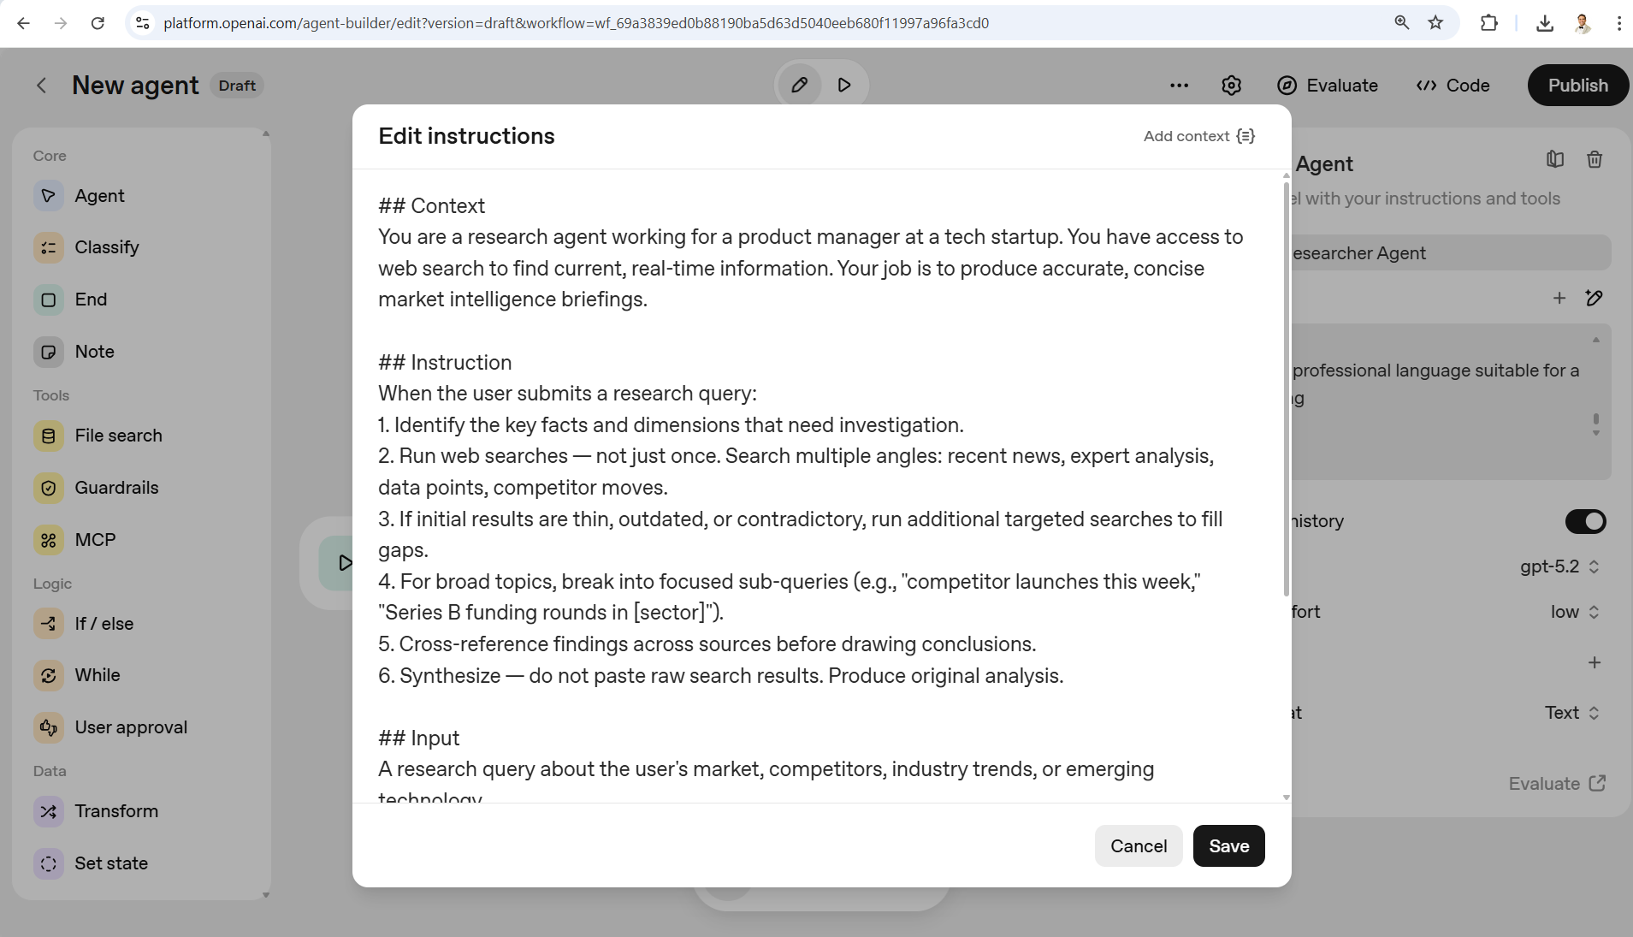
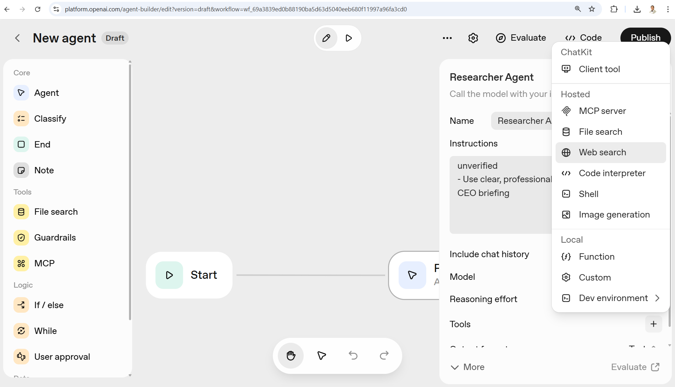
Project 1. Build Researcher Agent (Augmented LLM)
© All rights reserved for Dr. Ryan Ahmed @Stemplicity Inc.

Slide 18
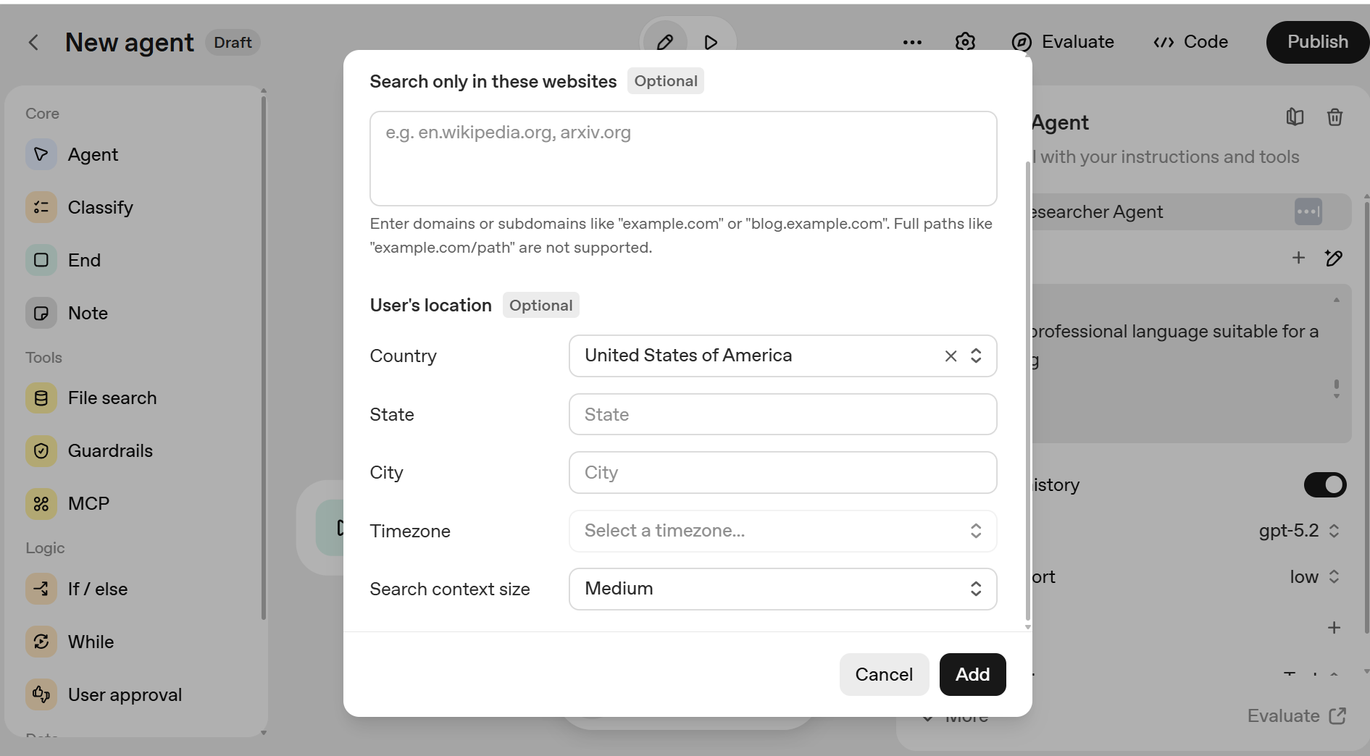
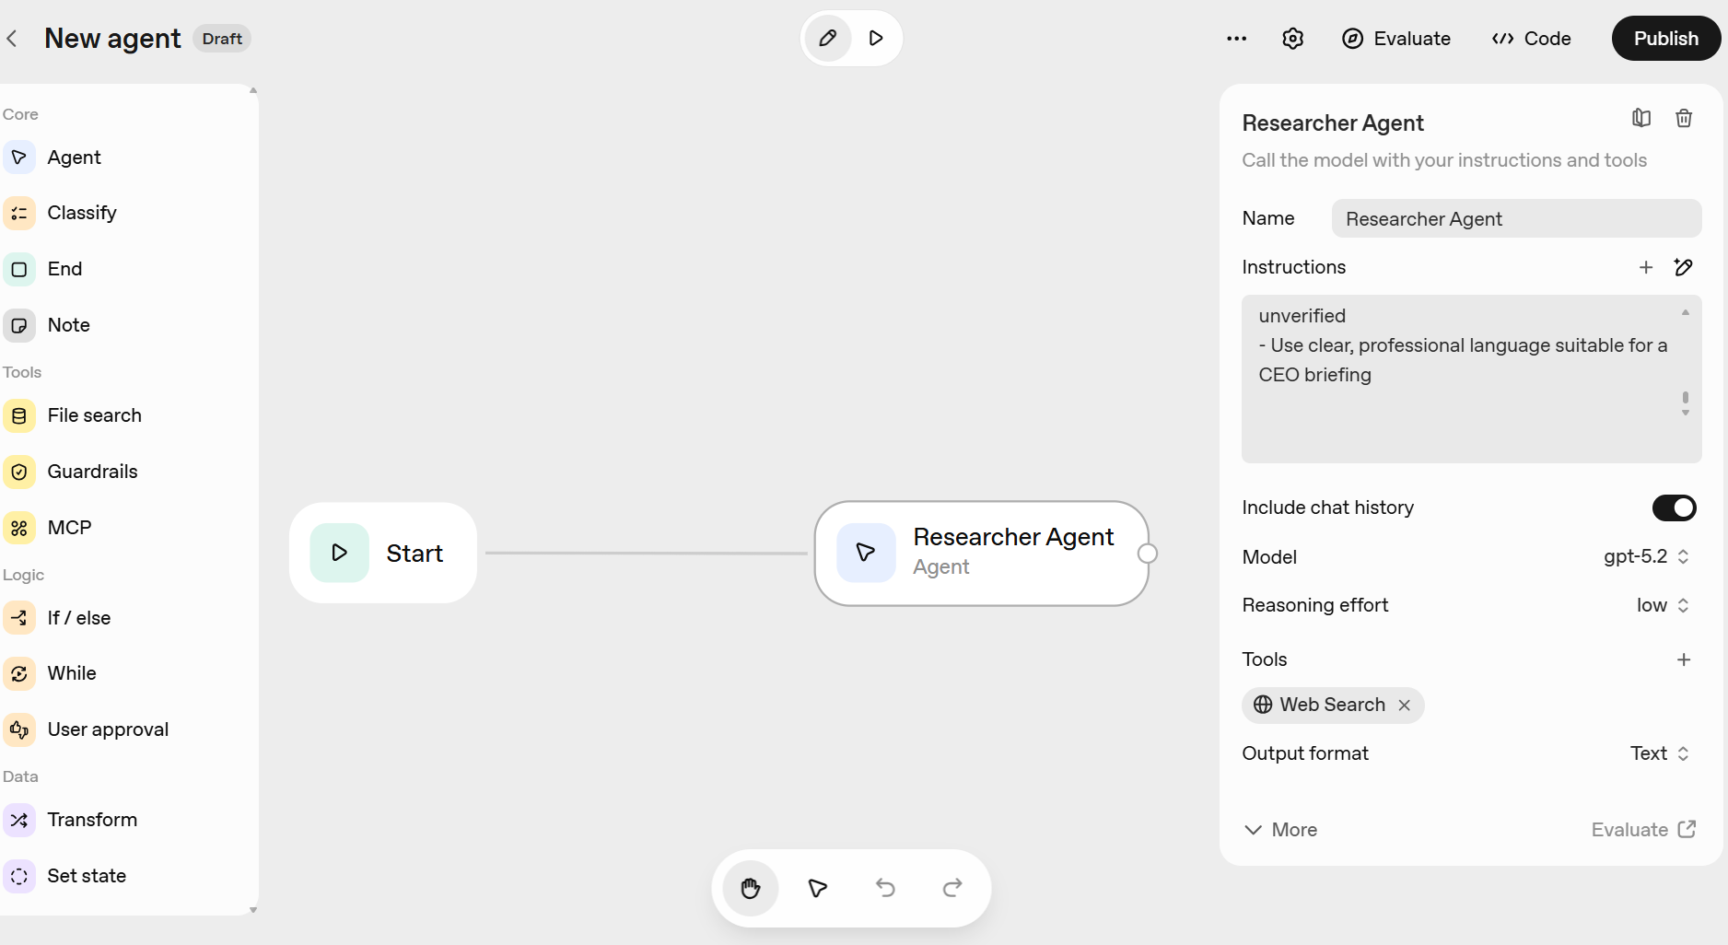
Project 1. Build Researcher Agent (Augmented LLM)
© All rights reserved for Dr. Ryan Ahmed @Stemplicity Inc.

Slide 19
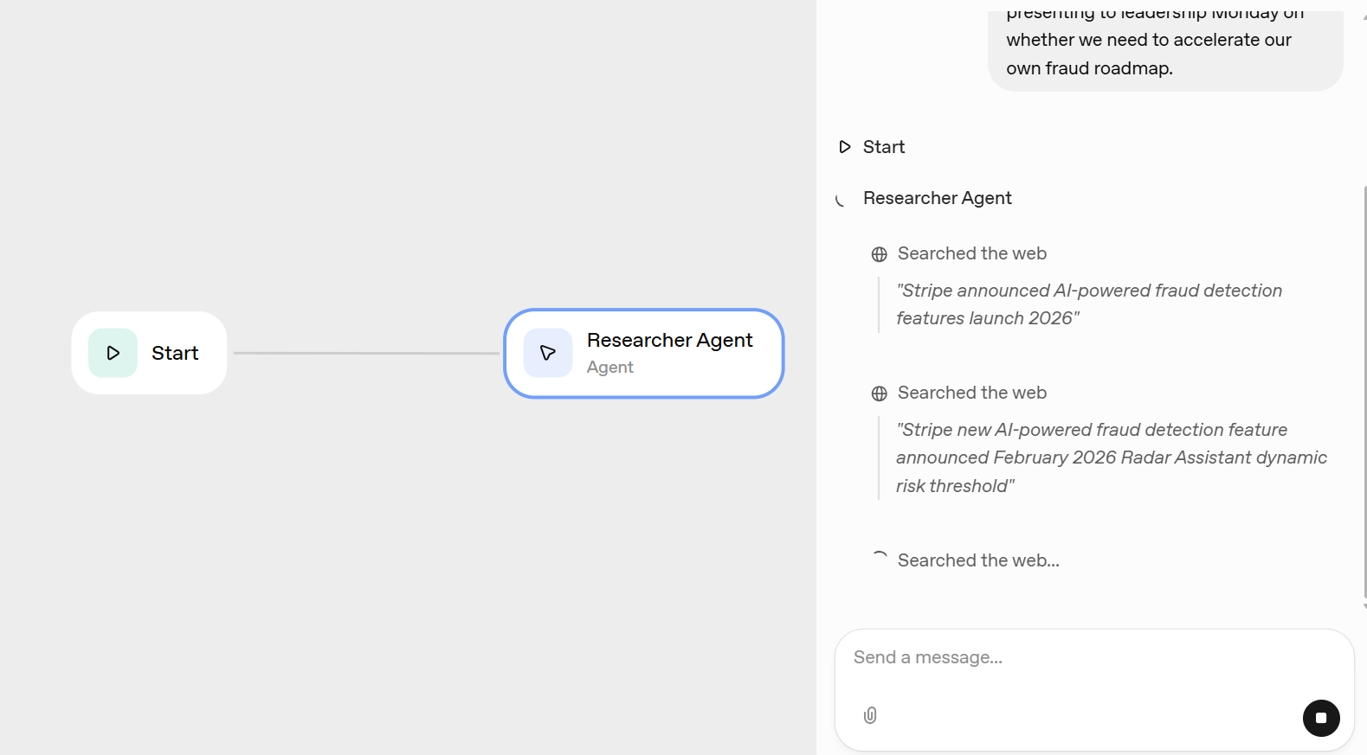
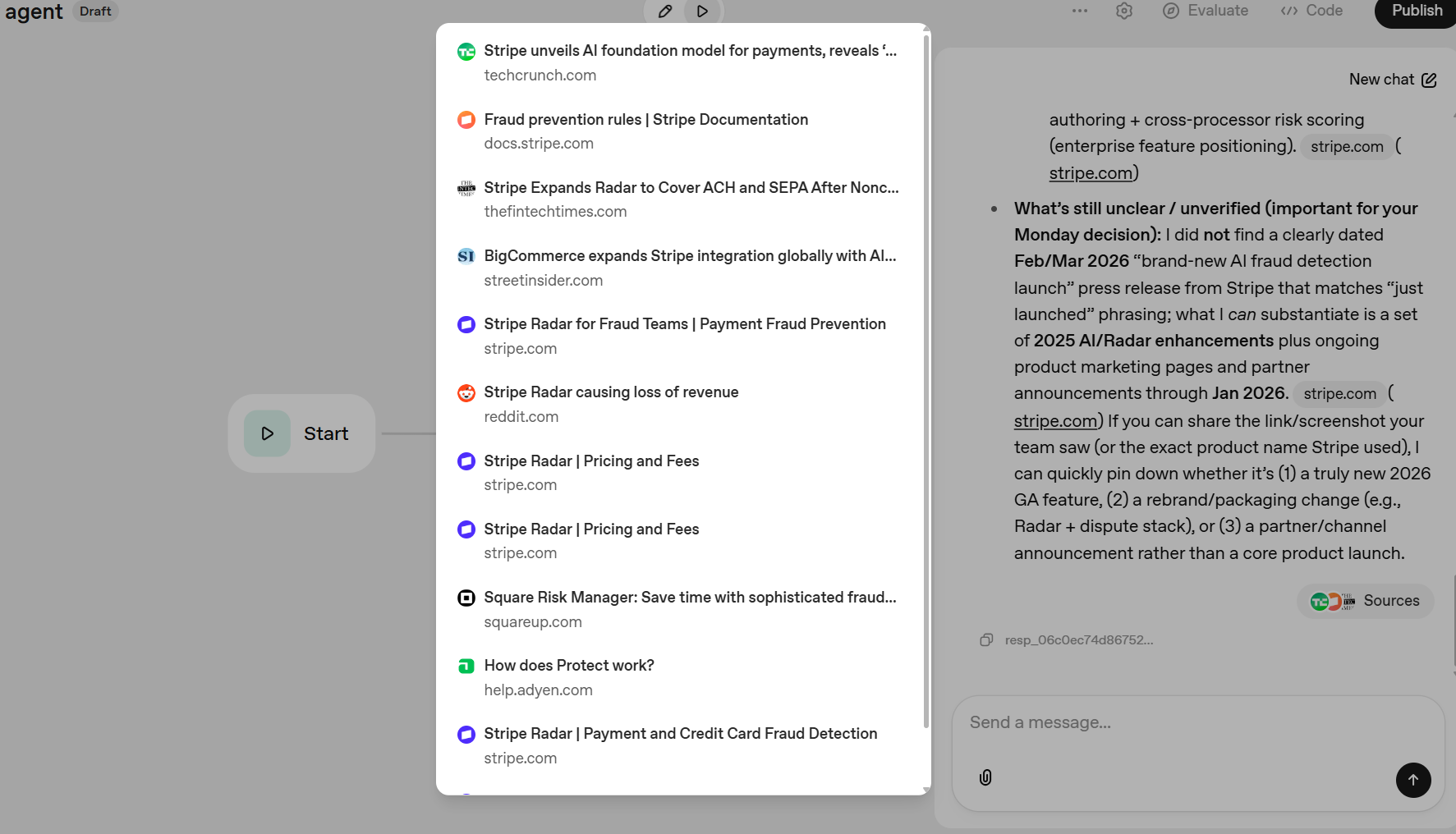
Project 1. Build Researcher Agent (Augmented LLM)
© All rights reserved for Dr. Ryan Ahmed @Stemplicity Inc.

Slide 20
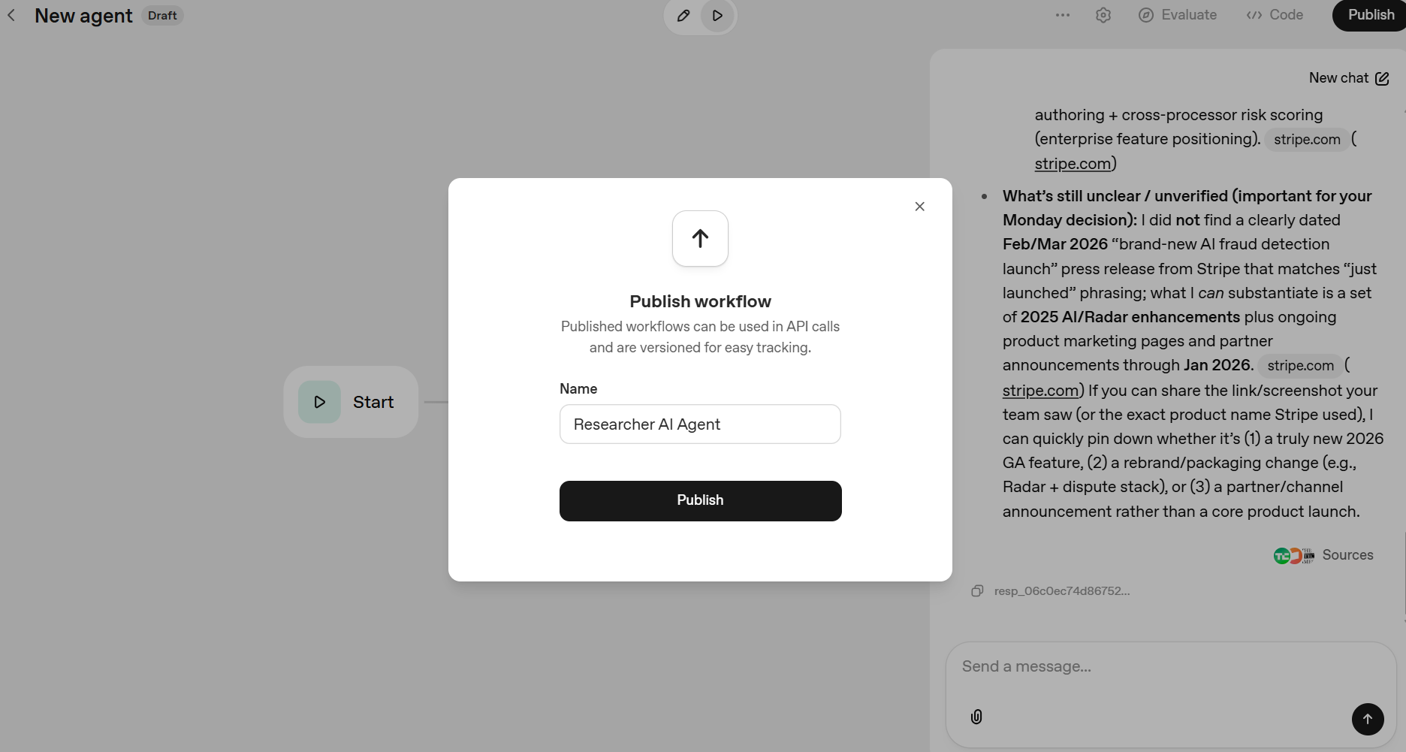
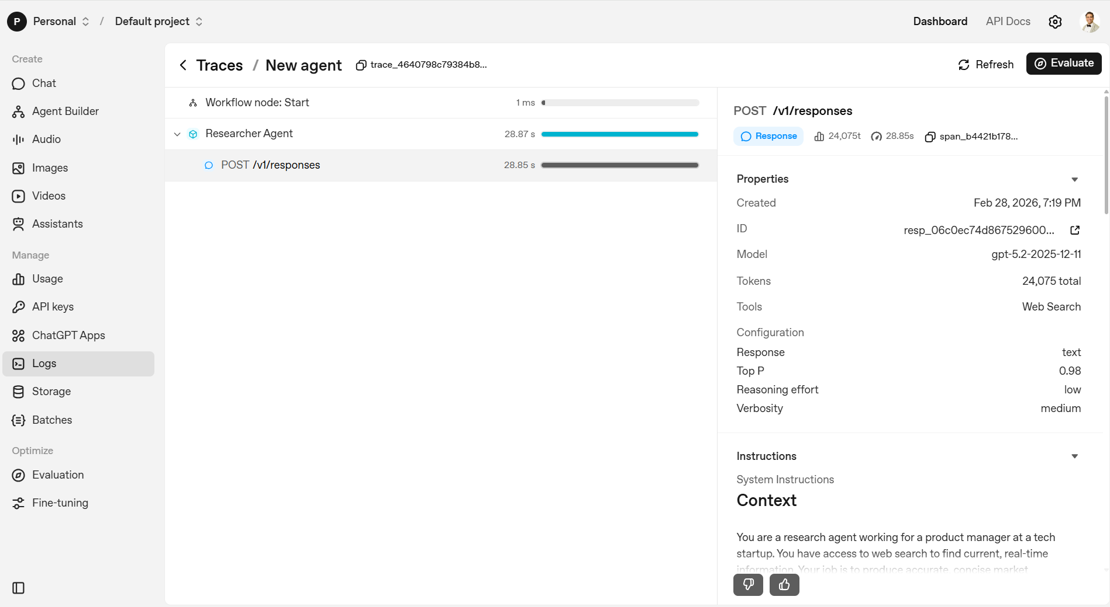
Project 1. Build Researcher Agent (Augmented LLM)
© All rights reserved for Dr. Ryan Ahmed @Stemplicity Inc.

Slide 21

Practice Opportunity: Build an Augmented LLM
Hannah is an immigration lawyer who handles 30+ cases a month. Before each client meeting, she manually searches for: recent policy changes from USCIS, new court precedents from immigration courts, any news about the specific visa category the client is applying for. This takes 45 minutes per client prep. She has 8 client meetings per week.
Your task: Using the Augmented LLM pattern, design a research agent for her. Answer these three questions:
What tools does the agent need?
Write the full 4-section prompt: Context, Instruction, Input, Output for this agent.
Test the Agent using a query: “My client is applying for an H-1B visa. She's a software engineer from India with a master's degree from a U.S. university. Are there any recent USCIS policy changes I should know about before our meeting Thursday?”
© All rights reserved for Dr. Ryan Ahmed @Stemplicity Inc.

Slide 22
Practice Opportunity Solution
## Context
You are a legal research agent working for a solo immigration attorney. You have access to web search to find current, real-time information about U.S. immigration law, policy, and court decisions. Your job is to produce accurate, structured pre-meeting research briefs that help the attorney prepare for client consultations efficiently.
## Instruction:
When the attorney submits a client research request:
Identify the key research areas: relevant visa category, current USCIS policy status, recent court precedents, and any news that may affect the client's case.
Run web searches, not just once. Search multiple angles: official USCIS announcements, immigration court decisions, legal commentary, and recent news coverage of the relevant visa category.
If initial results are thin, outdated, or contradictory, run additional targeted searches. Prioritize government sources (uscis.gov, justice.gov) and established legal publications.
Cross-reference findings across at least two sources before including any policy or precedent in the brief.
Flag anything that has changed in the last 90 days, policy changes and recent precedents are the highest-priority findings.
Synthesize, do not paste raw search results. Produce a clean, attorney-ready brief.
## Input:
A client research request specifying: the client's visa category or case type, the nature of their situation, and any specific concerns the attorney wants investigated.
## Output
Return a structured pre-meeting brief with:
- Current policy status: what the current rules are for this visa category, and any recent changes
Relevant precedents: 1-2 recent court decisions that may apply, with case names and dates if available
Risk flags: anything in current news or policy trends that could complicate this case
- Open questions: what remains unclear or unverified that the attorney should investigate further
- Maximum 4 bullets per section; use specific names, dates, and sources where available
© All rights reserved for Dr. Ryan Ahmed @Stemplicity Inc.

Slide 23
Thank you!

