Slide 1
THE HONG KONG POLYTECHNIC UNIVERSITY · DEPARTMENT OF COMPUTING
COMP3421 Web Application Design and Development
COMP3421
A Tour of the Web
Everything you will learn this semester — front-end, back-end, and the stack between them.
COMP3421 · LECTURE 01 · WEEK 1
Lecture 1 · Week 1 · Wed 12:30–14:20 · HHBUG06
Examples & code: tagsysx.github.io/comp3421/
Prof. Lei Yang

Slide 2
COMP3421
Classroom Recording & Sharing Policy
Please do not photograph, audio/video record, or upload any lecture content to the Internet or social media without prior permission from the instructor. Course materials are provided for personal learning only and should not be redistributed without authorization.
Do not photograph, record, reproduce, or upload classroom content without permission.

Slide 3
COMP3421 · LECTURE 01
Agenda — Today Is a Tour
01. The Big Picture
What a web application is, and the journey of one request.
02. Front-End
HTML, CSS, JavaScript — the three pillars of the browser.
03. Backend
HTTP, Node.js, Express, databases, real-time — and making it fast.
04. The Journey
From your personal site to the architecture behind a large one.
05. Wrap-Up & Takeaways
Your weekly roadmap, your final toolbox, and the five things to remember.

Slide 4
01
The Big Picture
What a web application actually is
One request, end to end
Clients, servers, and the layers between

Slide 5
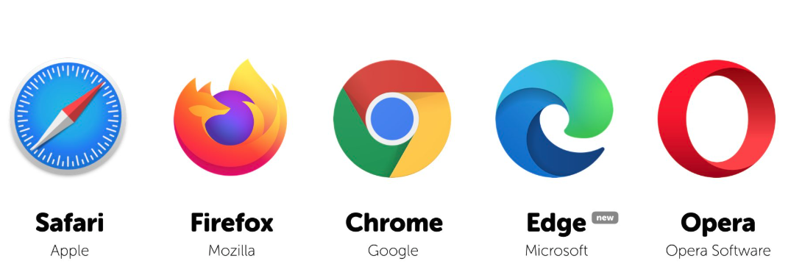
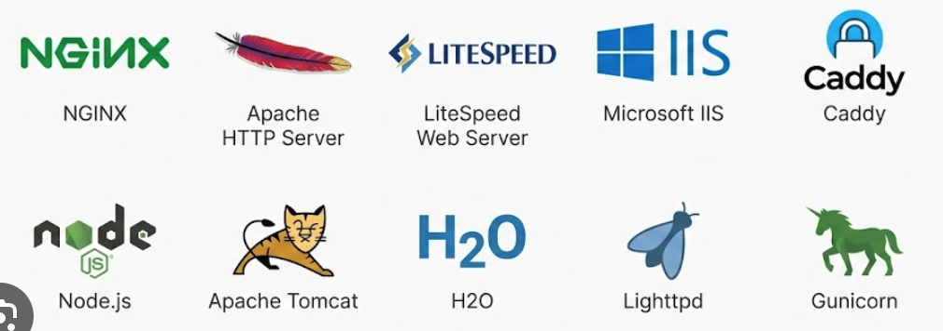
The Client–Server Model
COMP3421 · The Big Picture
Client — the browser
Server — the web server
↓ The five most popular browsers in the wild
↓ A small sample of the web servers in use today
Renders pages and runs JavaScript
HTML for structure, CSS for style, JS for behaviour.
One-to-many
Thousands of clients can talk to the same server.
Stores resources
Serves files and runs the application logic.
Answers every request
Client and server speak one language: HTTP.
Client and server speak one language: HTTP — you master it in Week 9.
Notes:
Built-in: diagrams and bullets here mirror the very first exposure students get to the web stack.

Slide 6
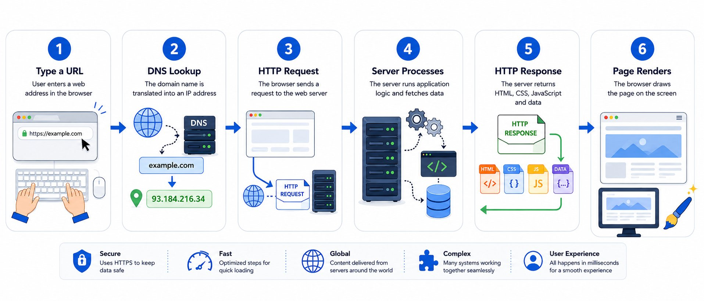
One Request, End to End
COMP3421 · The Big Picture
Six steps happen every time you type a URL — the web is this loop running millions of times per second, worldwide.
One loop, every time — request in, response out. HTTP is dissected in Week 9.

Slide 7
The Stack, Layer by Layer
COMP3421 · The Big Picture
Every web application is three layers talking to each other.
CLIENT
SERVER
DATABASE
Browser
→ HTTP request
Node.js / Express
→ SQL query
SQL / NoSQL
HTML · CSS · JavaScript
← HTTP response
logic · routes · APIs
← data rows
your application's data
renders pages · captures input
answers requests · runs code
stores, queries, returns rows
The web is distributed: client and server may be continents apart — they only need a network.
You build all three layers this semester — that is the whole course in one picture.

Slide 8
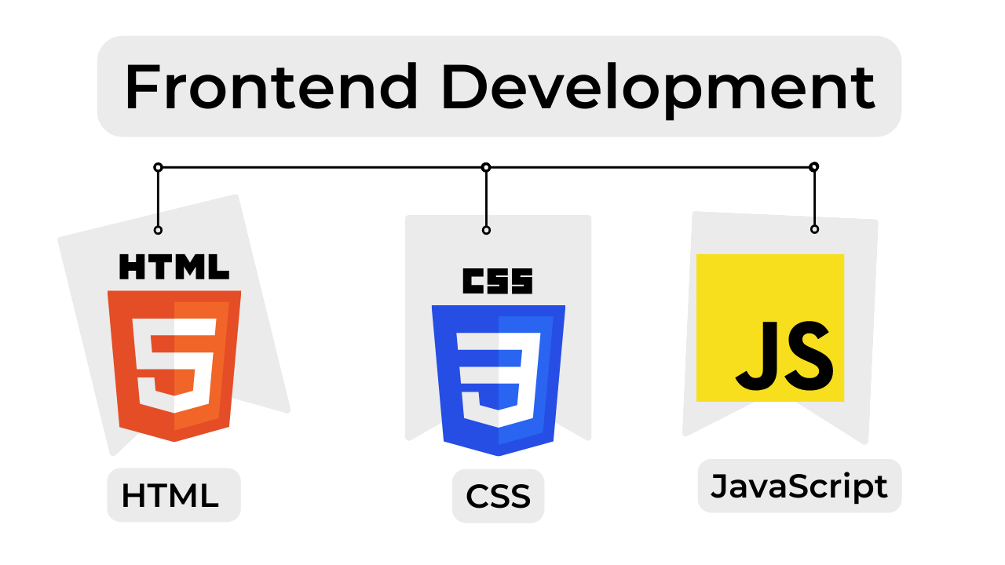
02
Front-End
HTML · CSS · JavaScript — three languages, one page
Each language answers a different question — about the web page.

Slide 9
HTML — Structure & Elements
COMP3421 · Front-End · HTML
What is HTML?
The language that gives a page its structure and meaning.
What problem does it solve?
Raw text has no shape — HTML turns it into a tree of elements the browser can render and search engines can read.
How do you write it?
Tags wrap content: <h1>, <p>, <a>, <img>… close in reverse order of opening to nest properly.
What can it do?
Forms, links, images, accessibility — even vector graphics with <svg>.
LOOK INSIDE — A TASTE
<!DOCTYPE html>
<html>
<head><title>My Page</title></head>
<body>
<h1 class="title">Hello, Web!</h1>
<p>This is <strong>HTML</strong>.</p>
<a href="https://polyu.edu.hk">PolyU</a>
</body>
</html>
example → editor.html?example=html/hello
Week 2: elements, the DOM, forms and SVG — with examples you edit live.

Slide 10
CSS — Presentation & Layout
COMP3421 · Front-End · CSS
What is CSS?
The language that controls how a page looks.
What problem does it solve?
Plain HTML looks the same everywhere — CSS separates presentation, so the same page can look any way you (or your designer) want.
How do you write it?
Rules of the form selector { property: value; } — one rule per style, stacked in cascade order.
What can it do?
Layout, colour, typography, motion, responsive design — Flexbox, Grid, media queries, custom properties.
LOOK INSIDE — A TASTE
h1 {
color: #1E4FA8; /* property: value */
font-size: 2rem;
}
.card {
display: flex;
gap: 1rem;
}
@media (max-width: 600px) { … }
example → editor.html?example=css-selectors/hello
Weeks 3–5: selectors & cascade, the box model, then Flexbox, Grid and animation.

Slide 11
JavaScript — Behaviour
COMP3421 · Front-End · JavaScript
What is JavaScript?
The language that makes a page interactive.
What problem does it solve?
Static pages can't react to users — JS listens, computes, and updates the page in place, without a full reload.
How do you write it?
Modern ES6+: const, arrow functions, template strings, modules, async/await — the language of the browser.
What can it do?
Click handlers, fetch data from servers, animate, build full single-page apps — anything a user can do.
LOOK INSIDE — A TASTE
const btn = document.querySelector('#btn');
btn.addEventListener('click', () => {
const msg = document.querySelector('#msg');
msg.textContent = 'Hello, JavaScript!';
});
const greet = (name) => `Hi ${name}!`;
console.log(greet('COMP3421'));
example → editor.html?example=js/dom
Weeks 6–8: ES6+, the DOM, events, then async & fetch.

Slide 12
DevTools — Your Microscope
COMP3421 · Front-End
Elements / Inspector
Console & Network
Inspect any element
See the HTML and the applied CSS together.
Edit live
Change styles in the panel — see it instantly.
Understand layout
The box model, Flexbox and Grid overlays.
Console
Run JS, see errors, log values while debugging.
Network tab
Watch every request and response your page makes.
The whole stack visible
Headers, status codes, timings — from Week 2 on.
If you learn one habit this semester, make it this: inspect everything.

Slide 13
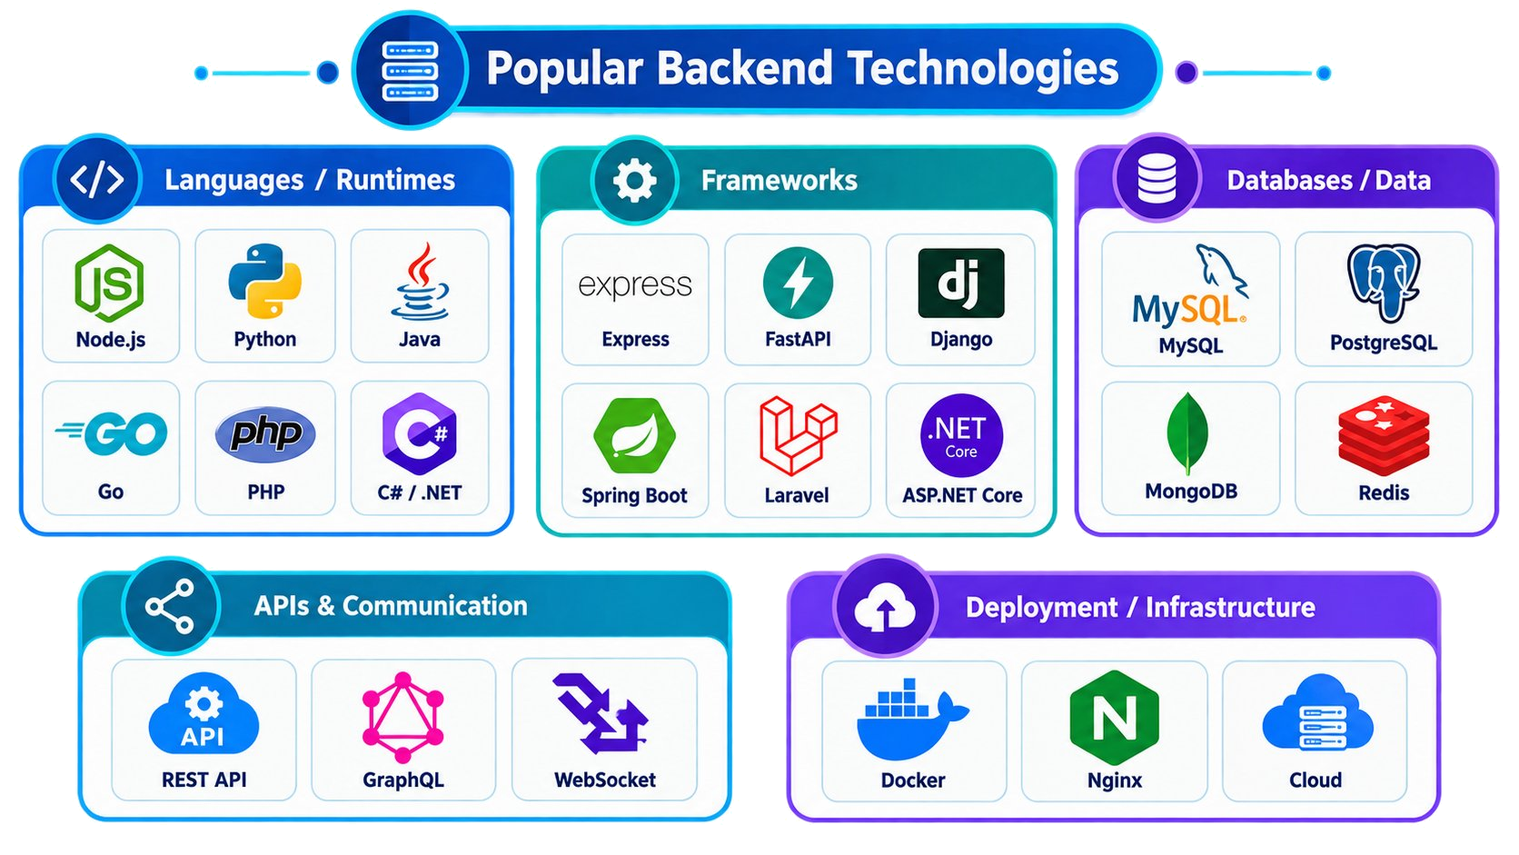
03
Backend
What is HTTP? Then the stack — Node · Express · Data · Real-Time · Cloud

Slide 14
HTTP — The Language of the Web
COMP3421 · Backend
A Request
A Response
Start line
GET /index.html HTTP/1.1
Headers
Host, User-Agent, Accept, Cookie…
Body (sometimes)
Form data, JSON — when you POST.
Status line
HTTP/1.1 200 OK — or 404, 500…
Headers
Content-Type, Set-Cookie, Cache-Control…
Body
The HTML, JSON, image, or file you asked for.
One protocol, every exchange, all semester — Week 9 goes deep.

Slide 15
URLs — The Address of Everything
COMP3421 · Backend
https://
www.polyu.edu.hk
:443
/comp3421/week1
?q=web
#top
scheme
host (domain)
port
path
query
fragment
Every piece has a job — and the browser hides it all in the address bar.
Scheme
Host & port
Path
Query
How to talk: https (secure), http, file…
Which machine, which door: polyu.edu.hk:443
Which resource: /comp3421/week1…
Extra parameters: ?q=web&lang=en
Week 9: URL anatomy in depth — and how to build them properly.

Slide 16
Part I — Node.js Runtime
COMP3421 · Backend
Runtime
Node.js is JavaScript outside the browser — the V8 engine plus libuv, an event-driven, non-blocking I/O model. One thread, many concurrent connections.
npm
The package manager: npm init creates a project, npm install <pkg> adds a library, package.json tracks every dependency.
Modules
Split code into reusable files — CommonJS require / module.exports, or modern ES modules import / export.
HTTP server
The built-in http module turns any machine into a web server — no framework needed for the basics.
LOOK INSIDE — A TASTE
const http = require('http');
const server = http.createServer((req, res) => {
res.writeHead(200, { 'Content-Type': 'text/plain' });
res.end('Hello from Node.js!');
});
server.listen(3000, () => {
console.log('Server running on :3000');
});
example → editor.html?example=node/hello-http
Week 10 — the runtime, npm, modules, and your first real server.

Slide 17
Part II — Express · REST · CRUD & Data
COMP3421 · Backend
Express
The de-facto web framework for Node. app.get('/path', handler) maps a URL to a function; middleware chains reusable steps (logging, auth, JSON parsing).
REST API
Resources exposed over HTTP: GET /notes lists, POST creates, PUT /notes/1 updates, DELETE /notes/1 removes — the URL names the thing, the verb names the action.
CRUD
Create, Read, Update, Delete — the four operations every app performs, mapped one-to-one onto database actions.
Database integration
Routes talk to SQL (SQLite, Postgres) or MongoDB. Drivers query, models shape, schemas validate — your data finally persists.
LOOK INSIDE — A TASTE
const express = require('express');
const app = express();
app.use(express.json());
app.get('/api/notes', (req, res) => {
res.json([{ id: 1, text: 'Hello' }]);
});
app.post('/api/notes', (req, res) => {
// create a note in the database…
});
example → editor.html?example=node/express-hello
Week 11 — Express, REST, CRUD, and wiring it all to a database.

Slide 18
Part III — Advanced Integration
COMP3421 · Backend
WebSocket
A persistent, full-duplex connection — the server can push updates any time, not only when asked. It starts as HTTP, then upgrades.
Real-time
Chat, live scores, collaborative editing. Socket.IO wraps WebSocket with rooms, reconnection and fallbacks.
SPA
Single-Page App — one HTML page, JavaScript swaps the views. The app fetches data and re-renders, never whole pages.
Deployment
Ship the same Node app to the cloud — static on Netlify/Vercel, servers on Render/Fly, plus a real domain and HTTPS.
LOOK INSIDE — A TASTE
// server pushes a message — client just listens
const ws = new WebSocket('wss://chat.example.com');
ws.onmessage = (ev) => renderMessage(ev.data);
// SPA — swap the view without reloading the page
history.pushState({}, '', '/notes'); renderView();
// deploy — push to git, the cloud builds and serves
git push origin main → auto-deploy
Week 12 — real-time, SPA, and putting your app in front of real users.

Slide 19
Part IV — Performance & Optimization
COMP3421 · Backend
Caching
Keep answers close: Cache-Control headers, ETags, and server-side caches (Redis) — repeat visits skip the work.
CDN
Content Delivery Network — copies of your static files on edge servers worldwide, served from the one nearest each user.
HTTP/2 & HTTP/3
Multiplexing — many requests over one connection; header compression; HTTP/3 goes even further over QUIC/UDP.
Measure first
Lighthouse and the Network tab give you numbers — optimize what the data says, not what you guess.
LOOK INSIDE — A TASTE
// one header tells the browser: cache this for a day
Cache-Control: max-age=86400
// CDN — serve static files from the nearest edge
<script src="https://cdn.example.com/app.js"></script>
// HTTP/2 — one connection, many parallel requests
GET /style.css GET /app.js GET /logo.png (in parallel)
Week 13 — caching, CDN, HTTP/2 — the final polish on your project.

Slide 20
04
From Personal Sites to Web Scale
A simple personal site — just a few moving parts
When traffic grows: DNS, load balancers, caches, queues, CDNs, …
By Week 13, you ship a web application of your own

Slide 21
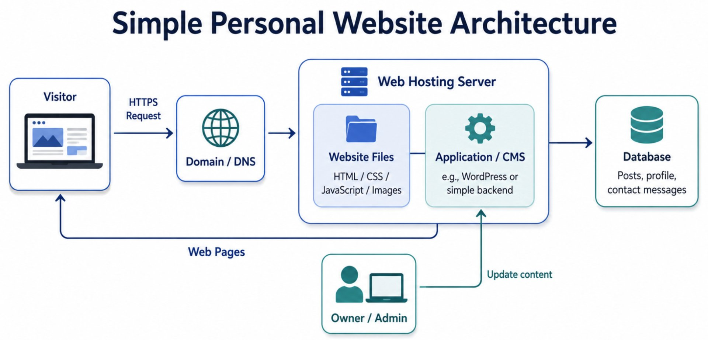
Simple Personal Website Architecture
COMP3421 · The Journey
Before we look at the giants, here is the simplest real website one person can run.
Just one of each — one browser, one domain, one server (files + CMS), one database. Visitor → HTTPS → DNS → Website files → Database

Slide 22
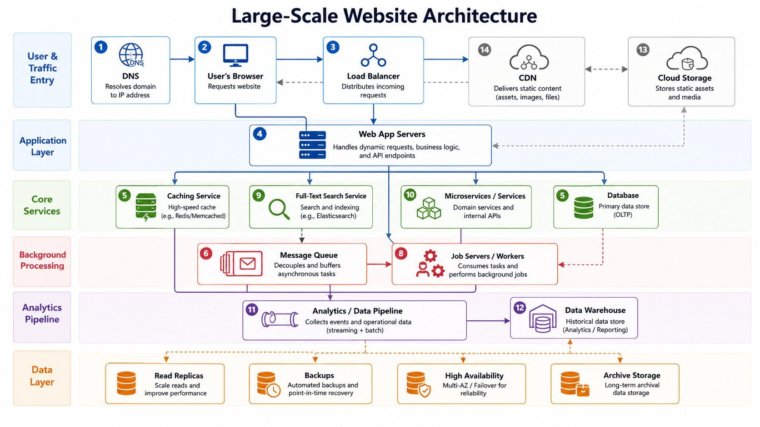
Large-Scale Website Deployment
COMP3421 · The Journey
Now scale that idea up: a large website is not one program on one machine — it is a collection of distributed services working together for scale, availability, and speed.
The thirteen numbered components
1. DNS
2. User's Browser
3. Load Balancer
4. Web App Servers
5. Caching Service
6. Message Queue
8. Job Servers / Workers
9. Full-Text Search Service
10. Microservices / Services
11. Analytics / Data Pipeline
12. Data Warehouse
13. Cloud Storage
14. CDN
Five layers — User → Traffic Management → Application → Data & Services → Cloud & CDN

Slide 23
Five Layers — How a Request Travels
COMP3421 · The Journey
A request visits them one layer at a time — each one with its own job and its own scaling knob.
1 User's browser
2 Traffic management
3 Application
4 Data & services
5 Cloud & CDN
Your computer, phone, IoT — anything HTTP speaks.
Renders HTML/CSS/JS, runs JavaScript, talks to servers.
DNS resolves the domain to an IP.
Load balancer spreads traffic across web servers.
CDN serves static files from edge servers near users.
Web app servers run your code.
Job queues + workers handle async tasks.
Full-text search service for keyword queries.
Database stores persistent state.
Caching service for hot data (Redis).
Microservices: auth, payment, messaging, …
Object storage for files and backups.
Data warehouse for analytics.
Pipeline streams events to BI dashboards.
Origin of every request
Spread, secure, accelerate
Execute the business logic
Persist, retrieve, search
Bytes at scale, insights
Eleven moving parts, five layers, one journey per request.

Slide 24
The Key Idea — Scale Each Piece Independently
COMP3421 · The Journey
Web traffic increases
Database is the bottleneck
Add more web app servers behind the same load balancer — applications are stateless.
Introduce a caching service (Redis) or database replicas — reads fan out, writes stay.
Latency for far-away users
Async or heavy work piles up
Push a CDN to the edge — static assets (and even API responses) hit from a nearby node.
Move it to a job queue + job servers — the user-facing path stays fast.
Each component grows on its own
web: +1 server | data: +Redis | edge: +CDN node | async: +1 worker
Notes:
A large website is a tunable system, not a fixed program.

Slide 25
05
Wrap-Up & Takeaways
Your weekly roadmap — what you build each week
Your final toolbox — what you'll be able to do by Week 13
The five things to take away from today

Slide 26
Week by Week — What You Build
COMP3421 · Wrap-Up & Takeaways
W2–5 · HTML + CSS
W6–8 · JavaScript
W9–11 · HTTP + Node
W12–13 · Full-stack
Week 2 HTML: structure & forms
Week 3 CSS: selectors & cascade
Week 4 CSS: layout & responsive
Week 5 CSS: Flexbox, Grid & motion
Week 6 ES6+ & DOM
Week 7 functions, closures, classes
Week 8 async, fetch, AJAX
Week 9 HTTP protocol & URLs
Week 10 Node.js & npm
Week 11 Express, REST & databases
Week 12 WebSocket, SPA, deploy
Week 13 performance & optimization
Tentative — the lab column in the course overview has the full list.

Slide 27
By the End of Week 13
COMP3421 · Wrap-Up & Takeaways
You will be able to build a complete web application — and explain every layer of it.
Design the stack
Build the front-end
Choose front-end, back-end, database — and justify it.
Semantic HTML, modern CSS, interactive JavaScript.
Build the back-end
Connect them
Node.js + Express REST API, talking to a database.
Fetch, JSON, and HTTP done properly.
Ship it
Make it fast
Deploy to the cloud with a real URL.
Caching, CDN, and performance fundamentals.
Your final project proves all of it — see the course overview for details.

Slide 28
Key Takeaways
COMP3421 · Lecture 1
The web is three layers — browser, server, database — talking HTTP.
Front-end is HTML (structure) + CSS (presentation) + JS (behaviour).
Back-end is Node.js + Express + a database — the same JavaScript.
A real website is many distributed services, each scaling on its own.
This semester you build every layer and ship a real app.
Next week: HTML — structure, DevTools, and forms.

Slide 29
COMP3421 · LECTURE 01 · WEEK 1
Thank You
Questions & Discussion
Prof. Lei Yang · ray.yang@polyu.edu.hk
Next: Week 2 — HTML: structure, DevTools & forms

