Slide 1
THE HONG KONG POLYTECHNIC UNIVERSITY · DEPARTMENT OF COMPUTING
COMP3421 Web Application Design and Development
COMP3421
Colour Theory
How colour is made, how we describe it, and how to combine it into a palette that works.
COMP3421 · TUTORIAL 01
Tutorial 1 · Companions: Lecture 3 (CSS I) · Lab 2
Examples & code: tagsysx.github.io/comp3421/
Prof. Lei Yang

Slide 2
COMP3421
Classroom Recording & Sharing Policy
Please do not photograph, audio/video record, or upload any lecture content to the Internet or social media without prior permission from the instructor. Course materials are provided for personal learning only and should not be redistributed without authorization.
Do not photograph, record, reproduce, or upload classroom content without permission.

Slide 3
COMP3421 · TUTORIAL 01
Agenda
01. Why we see colour
Subtractive and additive colour — pigment versus light.
02. The colour wheel
Hue, saturation and value — the three parameters.
03. Writing colour in CSS
Names, hex, rgb(), hsl() — and what each is good for.
04. Building a palette
Seven ways to combine hues on the wheel.
05. Using colour well
Contrast, readability and the mistakes that hurt.

Slide 4
01
Why We See Colour
Two theories — pigment and light
Why a screen and a printer disagree
Which one the browser actually uses

Slide 5
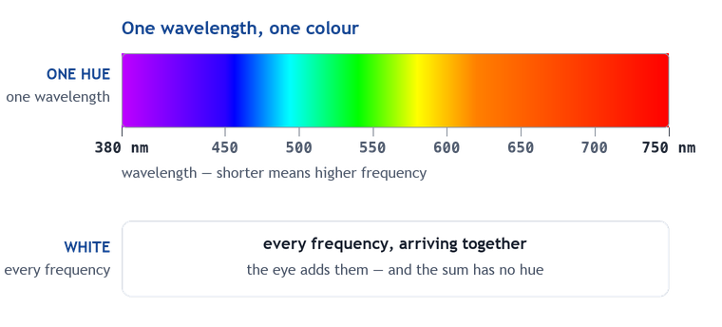
What Is Colour?
COMP3421 · TUTORIAL 01
Colour is a wavelength
Visible light is an electromagnetic wave. Change its wavelength and you change the colour: about 380 nm is violet, about 750 nm is red.
Frequency is the same fact
A shorter wavelength is a higher frequency, and the eye sorts light by frequency — that sorting is the whole of colour.
The eye adds, it cannot separate
Two wavelengths arriving together are not seen as two colours. The eye sums them and reports a single result.
All of them at once is white
Send every visible wavelength together and the sum is white light — which is exactly what sunlight is.
So white is not a wavelength
There is no white in the spectrum and no single wavelength produces it. White is what the eye reports when nothing is missing.
Nothing on this page is pigment — this is light itself, and light adds up.
Notes:
Start on the band, not on a prism. The single idea is that a colour is a frequency; ask the class what white has to be, and the answer is all of them at once. Only then does it follow that a green leaf is not green because green was added to it.

Slide 6
Two Theories of Colour
COMP3421 · TUTORIAL 01
Subtractive — pigment
White light falls on a surface; the surface absorbs some wavelengths and reflects the rest. What you see is what was left over. Mixing pigments removes light, so the more you mix, the darker it gets.
Subtractive primaries: cyan, magenta, yellow
Cyan + magenta + yellow absorbs everything and approaches black. This is why printers use CMYK — the K is added because mixed CMY ink gives a muddy dark brown, not a true black.
Additive — light
Light is emitted, not reflected. Adding wavelengths together makes the result brighter. Fully saturated red, green and blue light together give white.
Additive primaries: red, green, blue
Every screen you own mixes these three. A pixel is three tiny lights; the colour is the sum.
Pigment takes light away. Light adds up. Every colour question in CSS starts here.

Slide 7
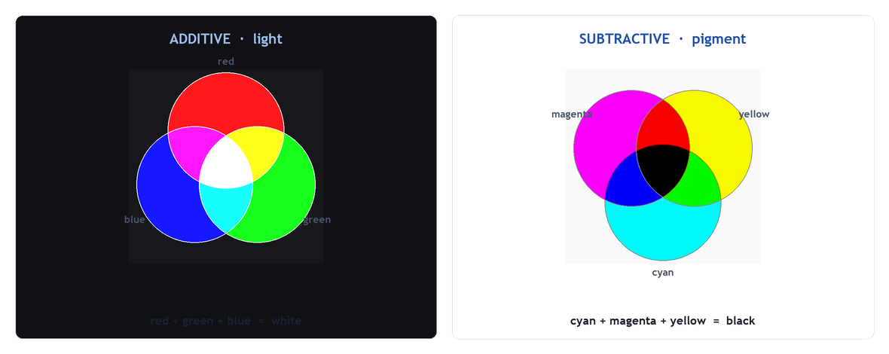
Pigment and Light — Two Sets of Primaries
COMP3421 · TUTORIAL 01
Left: red, green and blue light add up to white. Right: cyan, magenta and yellow pigment multiply down to black.
A screen and a printer cannot reproduce the same colours — they build them the opposite way round.
Notes:
Ask students which model a monitor uses, then which their home printer uses. The mismatch is the reason a printed photo never quite matches the screen, and it is worth one sentence of explanation.

Slide 8
02
The Colour Wheel
Bend the spectrum into a circle
Hue, saturation and value
Primary, secondary and tertiary

Slide 9
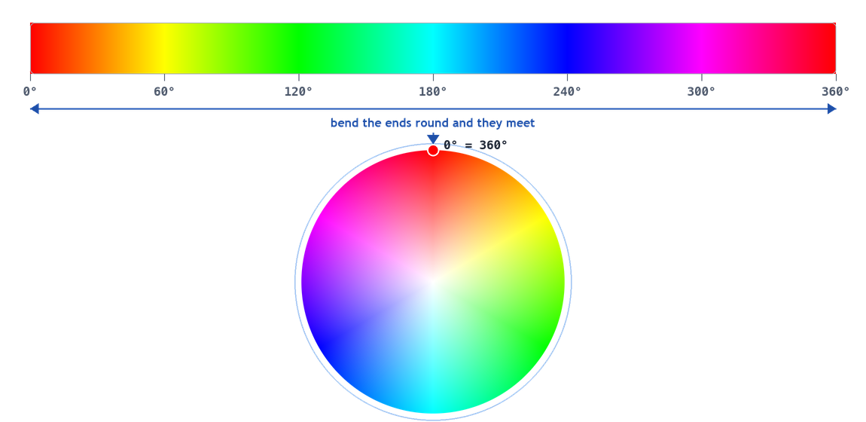
From Spectrum to Wheel
COMP3421 · TUTORIAL 01
The visible spectrum has two ends. Bend it round until they meet and you get the colour wheel.
The wheel is a convenience, not physics — but it is the right tool for choosing colours.

Slide 10
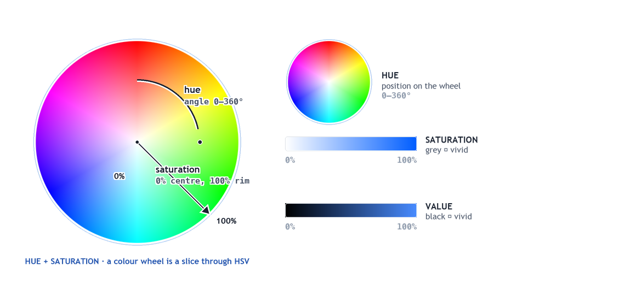
Three Parameters Describe Any Colour
COMP3421 · TUTORIAL 01
Hue is the angle, saturation is the distance from the axis, value is the height. A colour wheel is a horizontal slice through that solid.
This trio is the HSV model — and its third channel, value, is not the one CSS writes.
Notes:
Do not say here that CSS 'has' hue, saturation and value: hsl() is hue, saturation, LIGHTNESS, and CSS has no hsv() function at all. The next few pages draw that distinction properly.

Slide 11
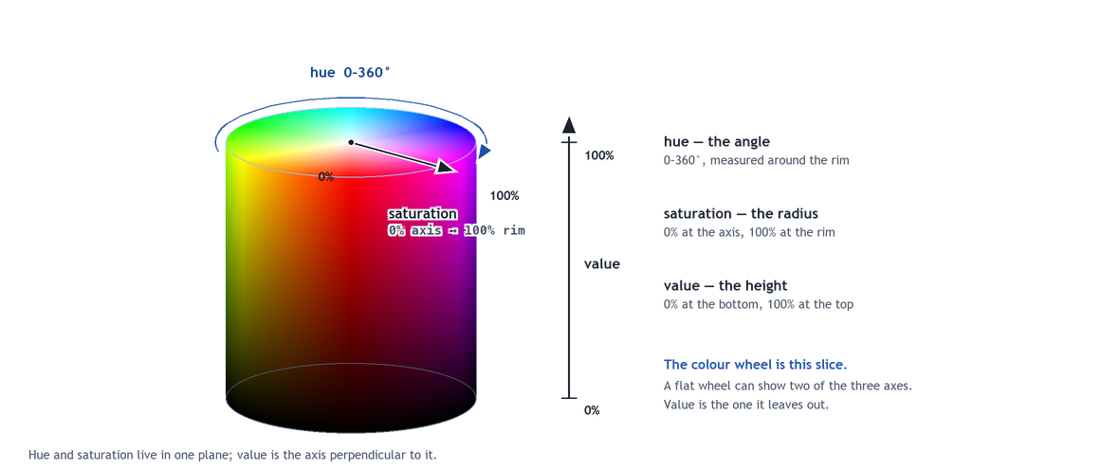
The Same Model in Three Dimensions
COMP3421 · TUTORIAL 01
Hue is the angle, saturation is the radius, value is the height. The flat wheel on the previous page is the shaded top cap — one slice, taken at value = 100%.
Notes:
This is the page the flat wheel cannot replace: two of the three axes live in a plane, and value is the axis perpendicular to it, so a wheel shown on its own can never display the model. Point at the rim on the cap and follow it straight down: that line is value falling from vivid to black, with the hue never changing and saturation staying at 100%. Then rotate to the axis in the middle: that is saturation at 0, which is why the centre is grey and why nothing there has a hue at all.

Slide 12
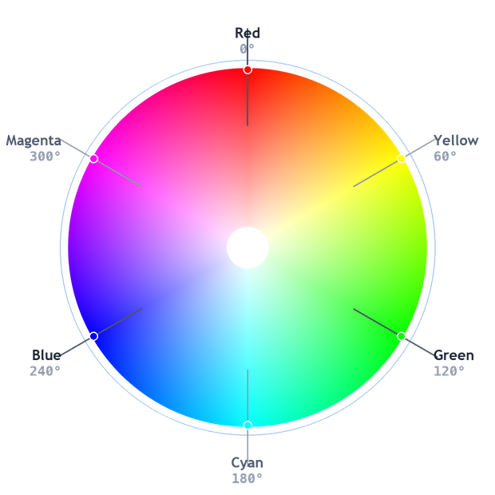
Hue — Position on the Wheel
COMP3421 · TUTORIAL 01
Hue is an angle
0° to 360°, measured around the wheel.
Primary colours
Red 0°, green 120°, blue 240° — they mix to white light.
Secondary colours
Yellow 60°, cyan 180°, magenta 300° — each mixes two primaries.
Tertiary colours
The six hues in between — red-orange, yellow-green and so on.
Same wheel, different names
Red, yellow, blue is the artist's pigment wheel; CSS and your screen use red, green, blue.
Hue answers “which colour”. It says nothing about how bright or how vivid.

Slide 13
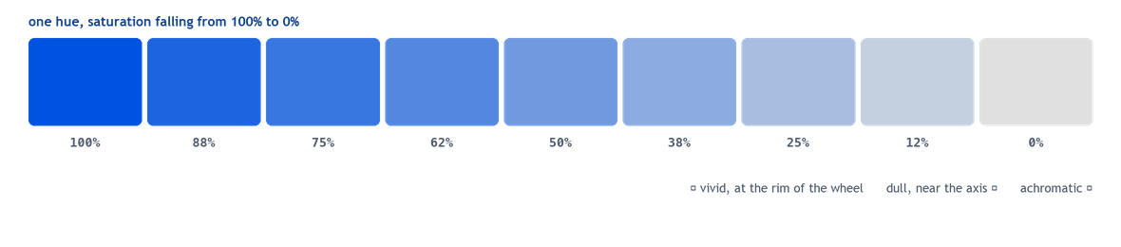
Saturation — How Vivid
COMP3421 · TUTORIAL 01
Saturation is intensity
Also called chroma. It is the distance from the grey axis.
High saturation
Vivid, and it sits near the rim of the wheel.
Low saturation
Dull and muted — closer to grey.
Zero saturation
Achromatic: pure grey scale, no hue at all.
Saturation is the dial that takes a colour from shouting to whispering.

Slide 14
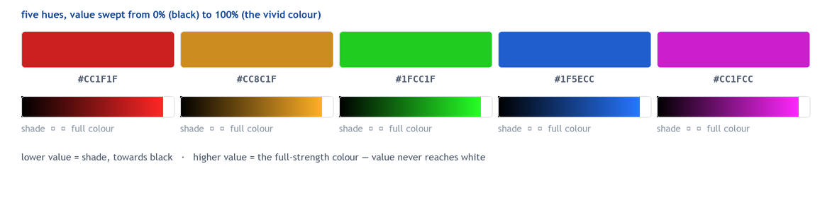
Value — How Light or Dark
COMP3421 · TUTORIAL 01
Value is brightness
The axis runs from black up to the vivid form of that hue. Raising value never brings white in.
Lower value gives a shade
The colour moves towards black. Those are the only two ends: black, and the full-strength colour.
Why it matters most
Value carries the contrast. Two hues at the same value are hard to tell apart, so a page can only be as readable as its values allow.
Squint, or desaturate the screenshot: if the page still reads, the values are doing their job.

Slide 15
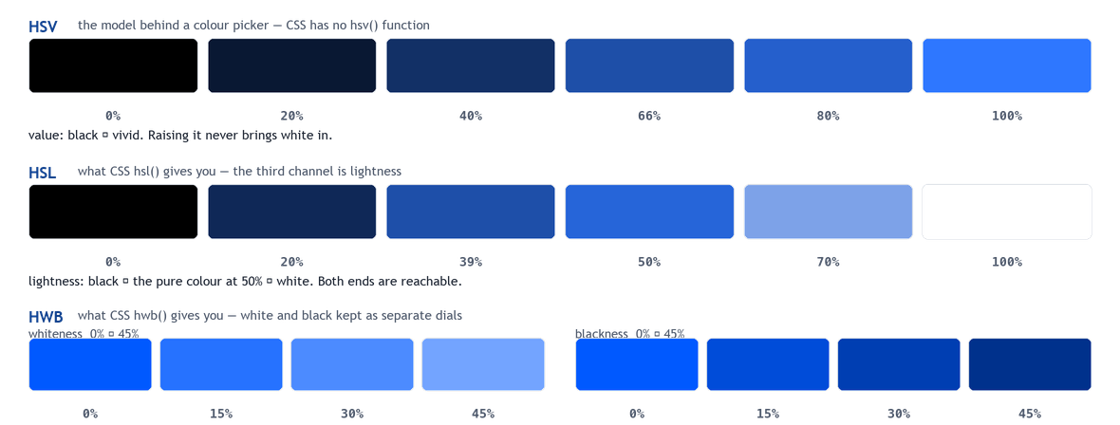
HSV, HSL and HWB — Which Third Channel Does CSS Use?
COMP3421 · TUTORIAL 01
The same hue three times. Value and lightness are different axes, and hwb() keeps white and black apart as two dials.
In a stylesheet you write hsl() or hwb(). There is no hsv() in CSS — that S × V square is the picker's, not the language's.
Notes:
The distinction students trip over: hsl()'s third channel is lightness, which runs black -> pure colour at 50% -> white. HSV's value runs black -> vivid and stops there, so raising it can never produce a tint. Analogy that works: saturation is 'how much grey is mixed in', value is 'how much black'; hsl()'s lightness mixes black at one end AND white at the other. If asked for the exact hwb() bridge to HSV, it is whiteness = value x (1 - saturation) and blackness = 1 - value, not simply 1 - saturation.

Slide 16
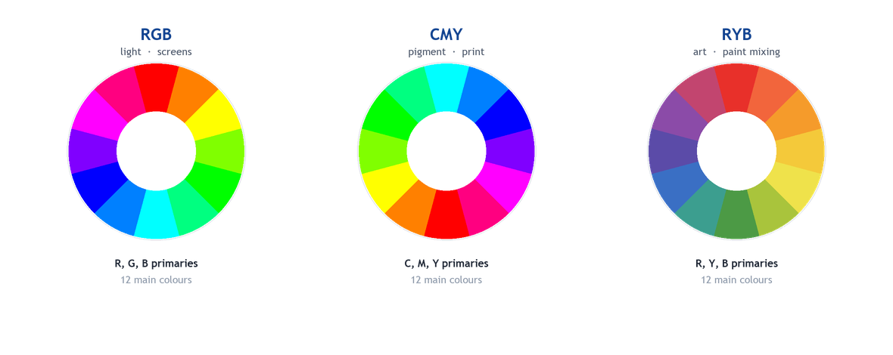
Three Wheels, Three Primaries
COMP3421 · TUTORIAL 01
Same idea, different primaries. RGB for screens, CMY for print, RBY for mixing paint by hand.
Your CSS works in RGB. Knowing the others stops “why does the print look different?”

Slide 17
03
Writing Colour in CSS
Names, hex, rgb() and hsl()
The same colour, four notations
Which notation to reach for

Slide 18

One Colour, Four Notations
COMP3421 · TUTORIAL 01
Hex and rgb() are the same number
Two hex digits per channel, 00–FF — or the same value in decimal, 0–255.
hsl() is the one for designing
Hue, saturation and lightness, so a tint or a shade is a single edit instead of a recalculation.
Named colours are for prototypes
The list is short and fixed, and several names share a value — most colours you want have no name.
follow along → ↗ editor.html?example=css-styling/colors
#1E4FA8 · rgb() · hsl() · rgba()
Notes:
The fourth notation is alpha — rgba(..., 0.5) or #RRGGBBAA — which is a separate idea from picking the hue.

Slide 19

A Colour Picker Is Just These Three Sliders
COMP3421 · TUTORIAL 01
Hue along one axis, saturation and value across the other. Whatever the picker shows, the browser is storing an RGB triplet.
Open DevTools, inspect any coloured element and click the swatch — the same picker appears.

Slide 20
Rules Worth Remembering
COMP3421 · TUTORIAL 01
Reach for hsl() when you are designing
Changing lightness is one number, so a tint or shade is a single edit. Reach for hex when copying from a design tool.
Named colours are for prototypes
They read clearly in a quick test, but the palette is arbitrary — several names share a value, and half of them fail contrast on white.
Do not write colour twice
The same hex pasted into twenty rules drifts apart the moment you rebrand. Define it once as a CSS variable, then use the variable.
Alpha is not a colour
rgba() lets the background show through, which is how overlays and scrims work — it is a separate idea from picking the hue.
variables → ↗ editor.html?example=css-layout/variables
--brand: #1E4FA8; color: var(--brand);

Slide 21
04
Building a Palette
Seven schemes, one wheel
What each one is good for
And when each one goes wrong

Slide 22
Seven Ways to Combine Hues
COMP3421 · TUTORIAL 01
1 · Monochromatic
One hue, varied by lightness and saturation. Nothing can clash.
2 · Complementary
Two hues opposite each other. Maximum contrast and impact.
3 · Analogous
Neighbours on the wheel. Harmonious, and easy to make look flat.
4 · Triadic
Three hues, evenly spaced. Bold, but better balanced than complementary.
5 · Split-complementary
One hue plus the neighbours of its opposite. Strong, yet easier to balance.
6 · Tetradic
Two complementary pairs — four hues. Rich and easy to get wrong.
7 · Warm / Cool
The wheel cut in half. Temperature as structure rather than hue.
see them in CSS → ↗ editor.html?example=css-styling/color-schemes
Every scheme is a geometric rule for picking points on the same wheel.
seven palettes, inline styles only

Slide 23
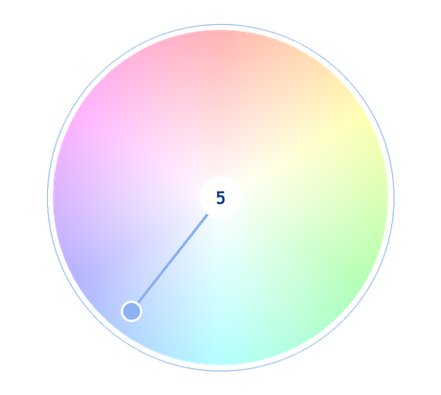
Scheme 1 · Monochromatic
COMP3421 · TUTORIAL 01
#05255C
#0F3880
#2253A8
#477AD1
#8DB2F2
One hue at five points between the darkest shade and the lightest tint.
One hue, varied by value
Lightness and saturation change; the hue never does.
Coherent by construction
Nothing can clash, which makes it the safest place to start.
Contrast is the hard part
With one hue, contrast has to come from value — check it rather than assume.
Reach for it when
You want a restrained, editorial or corporate feel.

Slide 24
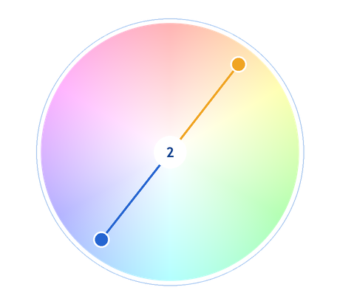
Scheme 2 · Complementary
COMP3421 · TUTORIAL 01
#2665D1
#F0A422
Two hues 180° apart on the wheel.
Opposite sides of the wheel
The pair sits 180° apart.
Maximum contrast
Each colour makes the other look brighter and more prominent.
Let one dominate
Two full-strength complements compete and fatigue the eye — keep one for accents.
Reach for it when
A call to action has to jump off the page.

Slide 25
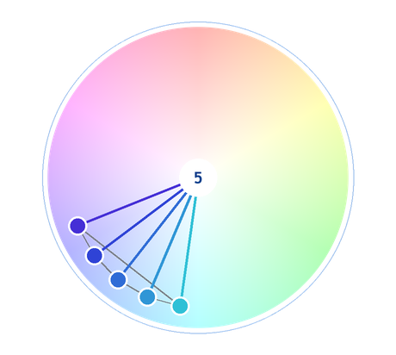
Scheme 3 · Analogous
COMP3421 · TUTORIAL 01
#2FC0D6
#2F96D6
#2F6CD6
#2F43D6
#452FD6
Three hues that sit side by side on the wheel.
Neighbours on the wheel
Typically three hues within about 30° of each other.
Harmonious and natural
Reads as a family — which is why it turns up in landscape photography.
It can go flat
With so little hue contrast, choose one dominant and use the others as accents.
Reach for it when
You want calm and cohesion without the flatness of a single hue.

Slide 26
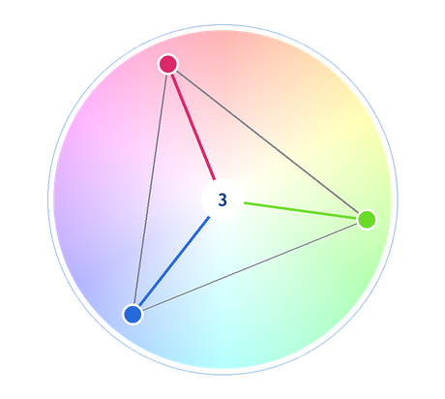
Scheme 4 · Triadic
COMP3421 · TUTORIAL 01
#2769DB
#DB2769
#69DB27
Three hues, evenly spaced 120° apart.
Evenly spaced
120° between each pair, so no hue wins on symmetry.
Bold but balanced
Less aggressive than complementary, and more versatile.
One dominant, two accents
Used equally, all three fight — the eye has nowhere to land.
Reach for it when
You want vivid and playful, and you have a clear hierarchy.

Slide 27
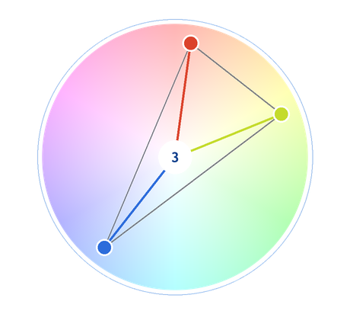
Scheme 5 · Split-Complementary
COMP3421 · TUTORIAL 01
#2C6CDB
#DB432C
#C4DB2C
One base hue plus the two hues either side of its opposite.
Not a straight opposite
Take one base colour and the two neighbours of its complement.
Strong, but softer
Most of the contrast of a complementary pair, with less visual vibration.
Easier to balance
Three hues give you room for a dominant colour and an accent.
Reach for it when
Complementary feels too aggressive but you still want punch.

Slide 28
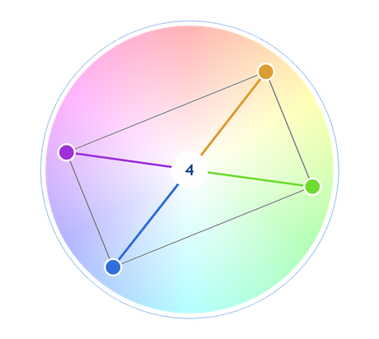
Scheme 6 · Tetradic
COMP3421 · TUTORIAL 01
#306FDB
#9D30DB
#DB9D30
#6FDB30
Two complementary pairs — a rectangle on the wheel.
Four hues, two opposite pairs
A rectangle on the wheel, each pair 180° apart.
Rich, and hard
The more hues in a palette, the harder the balance — four is genuinely difficult.
Hierarchy is not optional
Without one clearly dominant colour this reads as noise.
Reach for it when
An illustration or a playful brand can carry four colours.

Slide 29
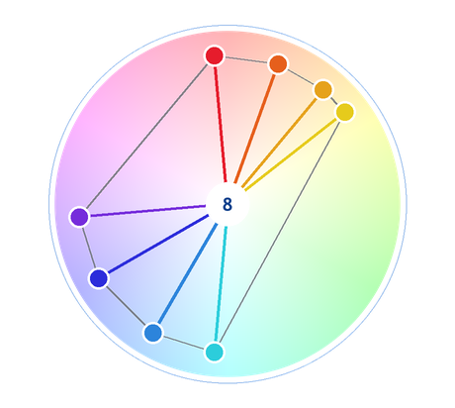
Scheme 7 · Warm and Cool
COMP3421 · TUTORIAL 01
#E61C2C
#E65F1C
#E6A21C
#E6CB1C
#2CCDDB
#2C84DB
#2C2CDB
#752CDB
The wheel cut in half: warm runs red to yellow, cool runs green to violet.
The wheel in two halves
Warm runs red through to yellow; cool runs green through to violet.
Warm advances, cool recedes
Warm elements feel nearer and more active; cool ones settle back.
Temperature is structure
A cool background with a warm accent builds hierarchy without changing hue count.
Reach for it when
You want depth and mood more than contrast.

Slide 30
The Seven Schemes at a Glance
COMP3421 · TUTORIAL 01
Scheme
Shape on the wheel
Character
Reach for it when
Monochromatic
One point, varied
Calm, coherent
Restrained or corporate look
Complementary
Two, 180° apart
Maximum contrast
One element must dominate
Analogous
Neighbours
Harmonious, natural
Calm cohesion, low risk
Triadic
Three at 120°
Bold, balanced
Vivid and playful
Split-complementary
One + two flanking
Strong but softer
Punch without the clash
Tetradic
Rectangle
Rich, difficult
Illustration or playful brand
Warm / Cool
Half the wheel
Depth and mood
Structure from temperature
None of these is a rule — they are starting points you then adjust.
all seven in CSS → editor.html?example=css-styling/color-schemes

Slide 31
05
Using Colour Well
Contrast is a number, not an opinion
Why colour alone is never enough
The mistakes that cost you marks

Slide 32
Contrast — a Number, Not an Opinion
COMP3421 · TUTORIAL 01
What the ratio measures
Relative luminance of the lighter colour divided by the darker one — a computed number, not a judgement.
The formula
(L1 + 0.05) / (L2 + 0.05), where L runs from 0 for black to 1 for white, and the +0.05 keeps the dark end finite.
The two ends
1:1 is a colour against itself: no contrast at all. 21:1 is pure black on pure white, the most the scale allows.
Even our own greys fail
The footer grey measures 2.96:1 on white — below every level on the scale, including large text.
Check it, never guess
DevTools prints the ratio on any colour swatch and flags a failure.
THE SCALE — our own colour pairs, placed by measured ratio
7:1 – 21:1
AAA
enhanced contrast
Aa
9.96:1
Aa
7.67:1
4.5:1 – 7:1
AA
normal body text
3:1 – 4.5:1
AA
large text and UI parts
Aa
4.17:1
1:1 – 3:1
—
below every level
Aa
2.96:1
The definition → ↗ atmos.style/glossary/contrast-ratio
SC 1.4.3 Contrast (Minimum) · SC 1.4.11 Non-text Contrast

Slide 33
The Contrast Thresholds
COMP3421 · TUTORIAL 01
Ratio
Level
Where it applies
1:1
—
A colour against itself: no contrast at all — the floor of the scale.
3:1
AA · large text and UI
18 pt or 14 pt bold; and UI parts you must see — buttons, icons, borders (SC 1.4.11).
4.5:1
AA · normal text
The everyday requirement for body copy — and the AAA level for large text.
7:1
AAA · normal text
Enhanced contrast; worth aiming for in long passages of body copy.
21:1
—
Pure black on pure white — the highest the scale allows.
Our own mid blue measures 4.17:1 on white — fine for a large heading, below AA for body text.
the specification → w3.org/WAI/standards-guidelines/wcag/

Slide 34
Colour Alone Is Never Enough
COMP3421 · TUTORIAL 01
WCAG 1.4.1
Colour must not be the only way you convey information. If red means an error, add an icon and a word.
Colour vision deficiency
Around one in twelve men and one in two hundred women see some colours differently. Red and green are the usual casualties.
Check in greyscale
Desaturate the page. If a chart, a status or a button stops carrying meaning, the colour was doing too much work.
Warm on cool, not red on grey
Temperature contrast survives desaturation better than hue contrast does.
Accessibility is not a constraint on the design — it is the design being legible.

Slide 35
Designing with a Palette
COMP3421 · TUTORIAL 01
The 60 / 30 / 10 rule
Mistakes that cost marks
60% dominant
Background and large surfaces. Usually the most restrained colour.
30% secondary
Supporting panels, cards, headings — a related hue.
10% accent
Buttons, links, the single thing you want noticed.
Not a law
A rule of thumb for proportions, not a formula. What matters is that the proportions are deliberate.
Too many colours
Five equally weighted hues read as noise. Most good pages use two or three.
Pure black and pure white
#000 on #fff is 21:1 — harsh. A very dark grey on off-white is easier to read.
Colour as the only signal
A red border and nothing else fails WCAG 1.4.1 at the lowest level.
Inconsistent greys
Six slightly different greys look like a mistake. Pick two and reuse them.
Decide the proportions before you decide the colours. inline-style colour work → editor.html?example=css-styling/colors

Slide 36
Where to Go Next
COMP3421 · TUTORIAL 01
Adobe Color — build a wheel or a scheme and read off the hex values
↗ color.adobe.com
Coolors — generate and lock palettes until one sticks
↗ coolors.co
DevTools colour picker — contrast ratio on any colour, plus an eyedropper
↗ developer.chrome.com/docs/devtools/css/color
WebAIM Contrast Checker — paste two colours, get the ratio and the pass/fail
↗ webaim.org/resources/contrastchecker
LEARNING PRINCIPLE
You do not need a tool to start. Pick a hue, then pick its complement, then vary value until the page reads. The tools are for checking, not for replacing a decision.
Pick a hue. Vary the value. Check the contrast.

Slide 37
COMP3421 · TUTORIAL 01
Thank You
Questions & Discussion
Prof. Lei Yang · ray.yang@polyu.edu.hk
Next: Lab 2 — put a palette to work on your poster

