Slide 1
Optimistic Concurrency Control
OCC allows transactions to proceed without locking objects, checking for conflicts only at commit time. It assumes conflicts are rare, making it suitable for low-contention scenarios. Transactions have three phases: working, validation, and update.

Slide 2
1. Phases of OCC
a. Working Phase:
  Read operations: Access committed versions of objects.
  Write operations: Create tentative versions (invisible to other transactions).
  Track sets: Each transaction keeps a read set (objects read) and write set (objects modified).

Slide 3
1. Phases of OCC
Example (Banking transfer):
Transaction T:
read(A) → $100, read(B) → $200
tentative A = $0, tentative B = $300

Slide 4
1. Phases of OCC
b. Validation Phase
When a transaction requests to commit:
  Check for conflicts with other concurrent transactions.
  Conflict rules: Ensure serial equivalence using:
  Backward validation: Check against already committed transactions.
  Forward validation: Check against active (still running) transactions.

Slide 5
1. Phases of OCC
c. Update Phase:
• If validated, tentative versions become permanent.
• If aborted, discard tentative versions and restart the transaction.

Slide 6
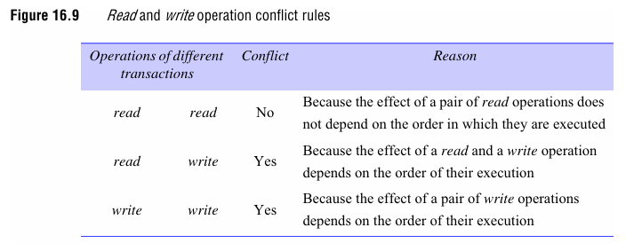
2. Conflict Direction

Slide 7
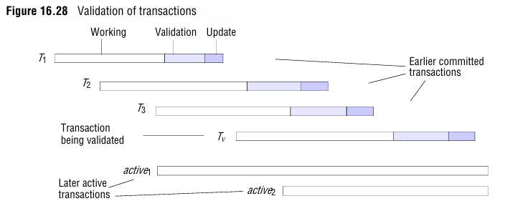
3. Validation Methods

Slide 8
3. Validation Methods
Example:
Transaction Tv started at time t1 and committed at t3.
Validate against transactions that committed between t1 and t3.

Slide 9
3. Validation Methods
b. Forward Validation
  Check against active transactions that started before Tv commits.
  Example:
  Transaction Tv checks active transactions (still running) to ensure no conflicts.
Conflict Resolution:
  Abort conflicting transactions (e.g., Amazon Dynamo’s "last write wins").
  Delay validation until conflicts resolve.

Slide 10
4. Example: Lost Update Problem
Scenario:
Transaction T: Reads balance $200, writes $220.
Transaction U: Reads $200 (before T commits), writes $220.
Result: Final balance $220 (incorrect; should be $242).
Solution with OCC:
During validation, detect overlapping write sets and abort one transaction.

Slide 11
5. Advantages & Disadvantages
Advantages:
  No locking overhead: Reduces delays in low-contention systems.
  Higher concurrency: Allows parallel execution until validation.
  Strict executions: Avoids dirty reads and premature writes.
Disadvantages:
  Aborts and restarts: High contention increases abort rates.
  Starvation: A transaction may abort repeatedly (solved by prioritization or timeouts).
  Validation complexity: Requires tracking read/write sets and managing versions.

