Slide 1
Peer-to-Peer Middleware
Based on 'Distributed Systems: Concepts and Design'
Presented by: P. Kruthik Reddy
Roll no: 22B81A0587

Slide 2
Introduction to Peer-to-Peer Middleware
Definition: Middleware enabling decentralized resource access across distributed networks.
Key Problem: Efficiently locating and accessing distributed resources.
Early Solutions:
Napster: Centralized index for file locations.
Gnutella/Freenet: Distributed, partitioned indexes.
Pre-P2P Examples:
Sun NFS: Virtual file system with manual configuration.
AFS: Similar limitations for scalability.

Slide 3
The Location Problem
P2P applications require efficient mechanisms for locating resources.
Napster used a centralized directory (single point of failure).
Gnutella introduced decentralized query flooding (high network overhead).
Distributed Hash Tables (DHTs) improve scalability and efficiency.
Virtual file systems (Sun NFS, AFS) require significant pre-configuration.

Slide 4
Functional Requirements of P2P Middleware
Simplify service construction across distributed hosts.
Enable clients to locate/communicate with any resource.
Support dynamic addition/removal of resources and hosts.
Provide a programming interface independent of resource types.
Ensure transparency in resource management.

Slide 5
Non-Functional Requirements
Global Scalability: Support millions of objects across 100,000+ hosts.
Load Balancing: Random resource placement + replication.
Local Interaction Optimization: Reduce latency via proximity-based placement.
Dynamic Host Availability: Handle frequent joins/leaves.
Security & Anonymity: Ensure data integrity, privacy, and resistance to censorship.

Slide 6
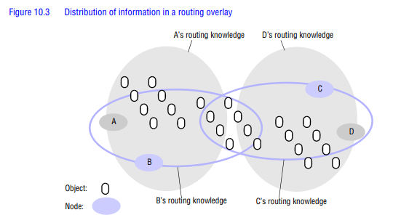

Slide 7
Global Scalability
Goal: Exploit hardware across large-scale networks (e.g., Internet).
Challenges:
Managing millions of objects.
Maintaining performance with 100,000+ hosts.
Example: Overnet (85,000 hosts) with high churn rate.
Solution: Distributed knowledge partitioning.

Slide 8
Load Balancing
Random Placement: Distribute resources evenly.
Replication: Create copies of heavily used resources.
Benefits:
Prevents bottlenecks.
Enhances fault tolerance.
Improves response times.

Slide 9
Dynamic Host Availability
Session Length Variability:
Overnet: Avg. 135 mins (median 79 mins).
Microsoft Corporate: Avg. 37.7 hours.
Challenges:
Host turnover (260–650 hosts available at any time in Overnet).
Redistribution of load/resources upon host departure.

Slide 10
Security & Anonymity
Heterogeneous Trust:
Authentication and encryption for data integrity/privacy.
Anonymity:
Protect data holders/recipients.
Plausible deniability for hosts.
Resistance to Censorship:
Achieved via decentralized architecture.

Slide 11
Data Distribution Challenges
No Centralized Database: Infeasible for global scale.
Partitioned Knowledge:
Each node maintains detailed info for a namespace portion.
General knowledge of overall topology.
Replication: Critical for dependability (e.g., replication factor = 16).

Slide 12
Thank You

