Slide 1
IPC in Distributed Systems

Slide 2
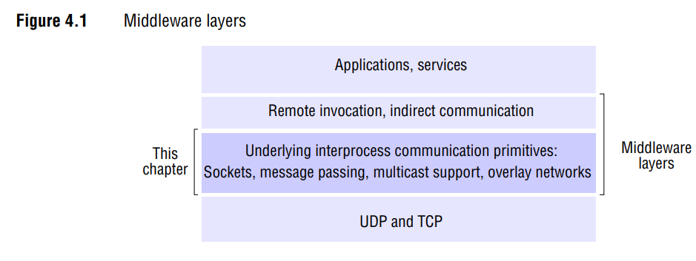

Slide 3
Protocol Interfaces
UDP (User Datagram Protocol)
  Provides message passing abstraction
  Uses datagrams (independent packets)
  Accessed through sockets
  Requires destination specification using ports

Slide 4
Protocol Interfaces
TCP (Transmission Control Protocol)
  Provides two-way stream communication
  No message boundaries
  Supports producer-consumer communication
  Includes queuing mechanism for data
  Has flow control (waiting mechanisms when queue full/empty)

Slide 5
The API for the Internet protocols: The Characteristics of IPC
Message Passing Basics
  Uses two main operations: send and receive
  Involves data communication between processes
  May involve process synchronization
  Messages are sequences of bytes

Slide 6
The API for the Internet protocols: The Characteristics of IPC
Thread Considerations
  In multi-threaded environments (like Java)
  Blocking receive is practical as other threads remain active
  Non-blocking receive adds complexity
  Modern systems generally prefer blocking receive

Slide 7
The API for the Internet protocols: The Characteristics of IPC
Message Destinations
  Uses (Internet address, local port) pairs
  Ports are integer-based message destinations
  One receiver per port (except multicast)
  Multiple senders allowed per port
  Processes can use multiple ports
  Servers publish port numbers for clients

Slide 8
The API for the Internet protocols: The Characteristics of IPC
Location Transparency
  Achieved through name servers or binders
  Allows service relocation
  Clients refer to services by name
  Names translated to locations at runtime
  Doesn't support runtime migration

Slide 9
The API for the Internet protocols: The Characteristics of IPC
Reliability Characteristics
  Validity: Guaranteed delivery despite reasonable packet loss
  Integrity: Messages arrive uncorrupted and without duplication
  Unreliable service: No delivery guarantee even with single packet loss
Message Ordering
  Some applications require sender order delivery
  Out-of-order delivery considered a failure for such applications

Slide 10
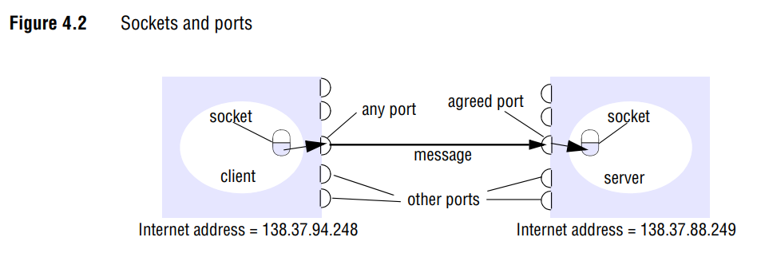

Slide 11
The API for the Internet protocols: Sockets
Sockets:
  A socket is an endpoint for communication between processes/computers.
  Acts as an interface for network communication.
  Can be thought of as a "plug point" for network communication.
  Provides a way for applications to connect to the network and communicate

Slide 12
The API for the Internet protocols: Sockets
Key Socket Characteristics:
Communication Interface
  Enables two-way communication
  Can send and receive data
  Works across network boundaries
Implementation
  Present in most operating systems
  Can use different protocols (TCP/UDP)
  Must be bound to an IP address and port
  Can be used for both client and server programs

Slide 13
The API for the Internet protocols: Sockets
Ports:
A port is a numerical identifier for a specific process/service on a computer.
Think of it as an "apartment number" in a building (where the IP address is the building)
Range: 0-65535 (16 bits = 216 possible ports)

Slide 14
The API for the Internet protocols: Sockets
Port Categories:
Well-Known Ports(0-123)
  Reserved for Standard services.
  Examples:
    http: port 80
    https: port 443
    ftp: port 21
    Ssh: port 22
Registered Ports(1024-49151)
  Used by applications
  Can be registered with IANA
  Often used by specific applications/services
Dynamic Private Ports (49152-65535)
  Available for temporary use
  Used for client-side connections
  Dynamically assigned

Slide 15
The API for the Internet protocols: Sockets
Port Characteristics
Usage Rules
      One receiving process per port
      Multiple processes can send to same port
      Ports can't be shared (except in multicast)
      Processes can use multiple ports
2. Security Considerations:
    Ports can be blocked by firewalls.
    Lower numbered ports require admin privileges
    Important for network security configuration

Slide 16
The API for the Internet protocols: Sockets
Relationship Between Sockets and Ports:
    Socket = IP Address + Port + Protocol
    Ports are used to identify specific sockets
    Multiple sockets can use different ports on same IP
    Creates unique communication endpoints

Slide 17
The API for the Internet protocols: Sockets
Socket Communication Basics
    Used by both UDP and TCP
    Provides endpoint for inter-process communication
    Originated from BSD UNIX
    Available in Linux, Windows, and Macintosh OS
Binding Requirements:
    Must be bound to a local port
    Each socket associated with either UDP or TCP protocol
    Must be bound to computer's Internet address

Slide 18
The API for the Internet protocols: Sockets
Java InetAddress Class
    1. Core Features
        Represents Internet addresses
        Uses DNS hostnames for reference
        Encapsulates address representation details
        Protocol-independent (works with IPv4 and IPv6)
    2. Usage Example
    InetAddress aComputer = InetAddress.getByName("bruno.dcs.qmul.ac.uk");
    Can throw UnknownHostException
    Automatically resolves DNS names to IP addresses
    Hides complexity of IP address representation

Slide 19
The API for the Internet protocols: Sockets
Key Benefits
  Abstracts network addressing details
  Provides protocol independence
  Simplifies hostname resolution
  Supports both IPv4 (4 bytes) and IPv6 (16 bytes)

Slide 20
The API for the Internet protocols: UDP datagram communication
Basic Properties
  Transmitted without acknowledgment or retries.
  No guarantee of delivery.
  Requires socket bound IP address and local port.
  Returns sender’s address and port with message.

Slide 21
The API for the Internet protocols: UDP datagram communication
Key Issues
  Message Size
    Limited by array size at receiver
    Maximum IP packet length: 216 bytes
    Typical limit: 8 Kilobytes
    Large messages need fragmentation
  Blocking Behavior
    Non-blocking sends
    Blocking receives (default)
    Messages queued at destination
    Separate threads recommended for servers
  Timeouts
    Can be set to avoid infinite waiting
    Should be longer than messages transmission time
    Important for handling crashes/ lost messages.

Slide 22
The API for the Internet protocols: UDP datagram communication
Failure Model
  Types of failures
    Omission failures(dropped messages)
    Out-of-order delivery
    Checksum errors
    Buffer space issues
  Integrity Protection
    Checksum prevents corruption.
    No built-in duplication protection
    Applications must implement own reliability checks

Slide 23
The API for the Internet protocols: UDP datagram communication
UDP Usage Benefits
  Advantages
    Lower overhead
    Suitable for applications tolerating occasional failures.
    Used in DNS and VOIP
  Reduced Overhead Areas
    No state information change
    Few extra messages
    Lower sender latency

Slide 24
The API for the Internet protocols: UDP datagram communication
Java API Implementation
  1. DatagramPacket Class
    Handles message content
    Contains destination information
    Provides message retrieval methods
  2. DatagramSocket Class
    Core methods
      Send() and receive()
      SetSoTimeout()
      connect()
    Constructor options:
      Specific port number
      System-assigned port

Slide 25
The API for the Internet protocols: UDP datagram communication
Java API Implementation
  3. Key Features
    Exception handling for various scenarios
    Timeout capabilities
    Connection option to specific addresses
    Port binding functionality
  Usage Examples:
    Client: Creates socket, sends message, waits for reply.
    Server: Binds to specific port, receives messages, sends replies.
    Both use port 6789 example
    Requires DNS hostname conversion to IP address.

Slide 26
The API for the Internet protocols: TCP Stream communication
1. Core Features
  Provides byte stream abstraction
  Originated from BSD UNIX
  Hides network complexities
  Bidirectional communication
2. Key Abstractions
  Flexible message sizes
  Lost message handling
  Flow control
  Message Ordering
  Destination Management

Slide 27
The API for the Internet protocols: TCP Stream communication
Connection Management
Setup Process
  Requires connection establishment before communication
  Client-server roles during connection
  Peer-to-peer after connection
  Uses listening sockets for servers
2. Socket Operations
  Client: Create a socket, connects to server port
  Server: Creates listening socket, accepts connections
  Each connection gets a new socket pair
  Two streams per connection (input/output)

Slide 28
The API for the Internet protocols: TCP Stream communication
Reliability Features
Data Integrity
  Checksums for corruption detection
  Sequence numbers for duplicate detection
  Acknowledgment scheme
  Automatic retransimission
Flow Control
  Matches reader/writer speeds
  Blocks fast writers
  Queues data at destination
  Handles broken communication

Slide 29
The API for the Internet protocols: TCP Stream communication
Java Implementation
Main Classes
  ServerSocket: For server-side listening
  Socket: For actual communication
  DataInputStream/DataOutputStream: For data handling
Key Methods
  Accept(): handles connection requests
  getInputStream()/getOutputStream()
  writeUTF()/readUTF()
  close()

Slide 30
The API for the Internet protocols: TCP Stream communication
Common Applications
  HTTP(Web browsing)
  FTP(File Transfer)
  Telnet(Remote access)
  SMTP(Email)

Slide 31
The API for the Internet protocols: TCP Stream communication
Error Handling
Types of Failures
  Network severance
  Congestion
  Process Failures
  Connection breaks
Exception Handling
  UnknownHostException
  IOException
  EOFException
  Connection termination detection

Slide 32
The API for the Internet protocols: TCP Stream communication
Threading Considerations
  Servers typically use thread per client
  Prevents blocking of multiple clients
  Alternative: Select call in non-threaded environments
  Separate threads for I/O operations

Slide 33
External Data Representation and Marshalling
Data Representation Basics:
1. Core Concepts
  Programs use structured data/objects.
  Messages use byte sequence.
  Data must be “flattened” for transmission.
  Must be rebuilt at destination

Slide 34
External Data Representation and Marshalling
Data Representation Basics:
2. Storage Challenges
  Different integer ordering (big-endian vs little-endian)
  Varying floating-point representations
  Different character encodings(ASCII vs Unicode)

Slide 35
External Data Representation and Marshalling
External Data Representation Approaches
1. CORBA
  Language-independent
  Focuses on method invocation data
  Contains only value information
  No type information included

Slide 36
External Data Representation and Marshalling
External Data Representation Approaches
2. Java Serialization
  Java-specific
  Handles object trees
  Includes complete type information
  Binary format

Slide 37
External Data Representation and Marshalling
External Data Representation Approaches
3. XML
  Text-based format
  Self-describing data
  Uses external namespaces for types
  Common in web services

Slide 38
External Data Representation and Marshalling
External Data Representation Approaches
4. Newer Approaches
  Google Protocol Buffers
  JSON (JavaScript Object Notation)
  More lightweight than XML
  Growing in popularity

Slide 39
External Data Representation and Marshalling
Key Considerations
1. Implementation Aspects
  Automated vs manual marshalling
  Error prevention
  Data Compactness
  Type information inclusion

Slide 40
External Data Representation and Marshalling
Key Considerations
2. Format choices
  Binary vs textual representation
  Type information handling
  Storage efficiency
  Transmission efficiency

Slide 41
External Data Representation and Marshalling
Usage Contexts
  Remote Method Invocation(RMI)
  Remote Procedure Call(RPC)
  Message Transmission
  File storage
  Web services

Slide 42
Multicast Communication
Multicast Basics
  Alternative to pairwise message exchange
  Sends single message to multiple process
  Group membership transparent to sender
  Simpler than multiple individual messages

Slide 43
Multicast Communication
Key Applications of Multicast
1. Fault Tolerance
  Supports replicated services
  Client requests sent to all group members
  Servers perform identical operations
  Service continues despite partial failures

Slide 44
Multicast Communication
Key Applications of Multicast
2. Service Discovery
  Used in spontaneous networking
  Helps servers register interfaces
  Enables clients to find services
  Facilitates dynamic service location

Slide 45
Multicast Communication
Key Applications of Multicast
3. Data Replication
  Improves service performance
  Maintains data copies across locations
  Updates propagated to all replicas
  Supports local data access

Slide 46
Multicast Communication
Key Applications of Multicast
4. Event Notification
  Propagates status changes
  Used in social media updates
  Supports publish-subscribe systems
  Enables real-time notifications

Slide 47
Multicast Communication
Implementation Characteristics
1. Basic Properties
  No guaranteed delivery
  No guaranteed ordering
  Group-based communication
  Transparent membership

Slide 48
Multicast Communication
Implementation Characteristics
2. Protocol Considerations
  IP multicast as foundation
  May need additional properties
  Varies by application needs
  Different reliability requirements

Slide 49
Multicast Communication
Usage Examples
  Facebook status updates
  Distributed system coordination
  Service redundancy
  Real-time data synchronization

Slide 50
Network Virtualization: Overlay networks
1. Challenge of Internet Protocols
  Internet protocols provide effective building blocks for distributed software.
  Many different types of applications (P2P, Skype, Streaming service) use these protocols.
  Modifying protocols to suit each application is impractical
  Changes benefiting one application might harm another

Slide 51
Network Virtualization: Overlay networks
2. Need for Network Virtualization
  Driven by two main factors:
  a) Diverse application requirements
  b) Growing number of network technologies implementing IP transport

Slide 52
Network Virtualization: Overlay networks
3. Network Virtualization Concept
  Creates multiple virtual networks over existing networks like the Internet.
  Each virtual network can be customized for specific applications
  Example: One virtual network for multimedia streaming (BBC iPlayer, Hulu)
  Another virtual network simultaneously supporting online gaming

Slide 53
Network Virtualization: Overlay networks
4. Solution to End-to-End Argument
  Allows optimization for specific applications.
  Maintains integrity of underlying network
  No need to modify base network infrastructure

Slide 54
Network Virtualization: Overlay networks
5. Components of Virtual Networks
Each virtual network can have its own:
  Addressing Scheme
  Protocols
  Routing Algorithms
  All customized for specific application needs

Slide 55
Network Virtualization: Overlay networks
6. Benefits
  Flexibility in Network design
  Application-specific optimization
  Coexistence of different network requirements.
  Preservation of underlying network stability

Slide 56
Network Virtualization: Overlay networks
Definition of Overlay network
  Virtual network of nodes and virtual links
  Built on top of existing networks(like IP networks)
  Provides additional services or features not available in the underlying network

Slide 57
Network Virtualization: Overlay networks
Main Purposes
  Application-specific services (e.g., multimedia content distribution)
  Enhanced operational efficiency (e.g., ad hoc network routing)
  Additional features (e.g., multicast or secure communication)

Slide 58
Network Virtualization: Overlay networks
Key Advantages
  Enables new network services without modifying underlying network
  Facilitates experimentation with network services
  Allows customization for specific applications
  Supports multiple coexisting overlays
  Creates more open and extensible network architecture

Slide 59
Network Virtualization: Overlay networks
Disadvantages
  Introduces extra level of indirection
  May cause performance penalties
  Increases complexity compared to simple TCP/IP networks

Slide 60
Network Virtualization: Overlay networks
Relationship to Network Layers
  Overlays are layers outside standard architecture
  More flexible than traditional layers
  Can redefine core network elements:
    Addressing Schemes
    Protocols
    Routing Approaches

Slide 61
Network Virtualization: Overlay networks
Technical Implementation Example
  Distributed Hash Tables (DHT) showcase:
    Keyspace-based addressing
    Key-based routing
    Ring topology structure

Slide 62
Network Virtualization: Overlay networks
Practical Applications
  Skype (VoIP communication)
  Peer-to-peer file sharing
  Wireless ad hoc networks
  Disruption-tolerant networks
  Multimedia streaming

Slide 63
Network Virtualization: Overlay networks
Architectural Freedom
  Developers can implement radical approaches
  Can be tailored to specific application needs
  Operates independently of underlying network constraints

