Slide 1
Elections

Slide 2
1. Introduction
Elections in distributed systems are algorithms designed to select a unique coordinator from a group of processes, ensuring consensus even if multiple elections occur concurrently. The section discusses two primary algorithms: the ring-based election algorithm and the bully algorithm.

Slide 3
2. Ring-Based Election Algorithm(Chang & Roberts)
Overview
Setup: Processes are arranged logically in a ring. Each process knows its successor.
Goal: Elect the process with the highest unique identifier (ID).
Steps:
Initiation
Message Forwarding
Termination

Slide 4
2. Ring-Based Election Algorithm(Chang & Roberts)
Initiation :
A process detects the need for an election (e.g., coordinator failure).
Sends an election message containing its ID to the next process in the ring.
Message Forwarding
When a process receives an election message:
If the received ID is lower than its own, it replaces the ID with its own and forwards the message.
If the received ID is higher, it forwards the message as-is.
Termination

Slide 5
2. Ring-Based Election Algorithm(Chang & Roberts)
2. Message Forwarding
When a process receives an election message:
If the received ID is lower than its own, it replaces the ID with its own and forwards the message.
If the received ID is higher, it forwards the message as-is.
A Process becomes a “participant” once it forwards a message.
3. Termination:
When a process receives its own ID back, it declares itself the coordinator.
Sends an elected message to inform others.

Slide 6
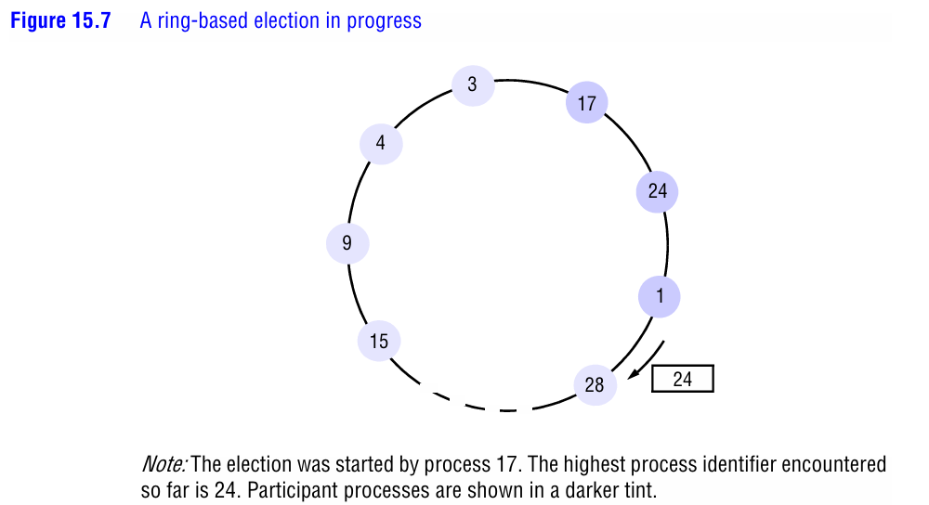
2. Ring-Based Election Algorithm(Chang & Roberts)

Slide 7
2. Ring-Based Election Algorithm(Chang & Roberts)
Processes with IDs 3, 17, 4, 24, 9, 1, 15, 24, 28 participate.
The message with ID 24 is circulated until process 28 replaces it.
Eventually, process 28 becomes the coordinator.

Slide 8
2. Ring-Based Election Algorithm(Chang & Roberts)
Key Properties:
Safety: Ensures only one coordinator (the highest-ID process).
Deadlock Handling: The original algorithm is deadlock-prone (e.g., three processes with cyclic dependencies). An adapted version by Sanders (1987) queues requests in happened-before order to resolve this.
Performance: Requires up to 3N−1 messages for N processes. Synchronization delay is one round-trip time.

Slide 9
2. Ring-Based Election Algorithm(Chang & Roberts)
Key Properties:
Safety: Ensures only one coordinator (the highest-ID process).
Deadlock Handling: The original algorithm is deadlock-prone (e.g., three processes with cyclic dependencies). An adapted version by Sanders (1987) queues requests in happened-before order to resolve this.
Performance: Requires up to 3N−1 messages for N processes. Synchronization delay is one round-trip time.

Slide 10
3. Bully Algorithm(Gracia-Molina)
Overview:
Assumptions:
Synchronous system (timeouts detect failures).
Processes know IDs of all higher-ID processes.
Communication is reliable.
Steps:
Initiation
Response Handling
Coordinator Announcement

Slide 11
3. Bully Algorithm(Gracia-Molina)
Steps:
Initiation :
A Process detects coordinator failure and starts an election by sending election messages to all higher-ID processes.
2. Response Handling :
Higher-ID processes respond with answer, take over the election, and send their own election messages.
If no response is received within a timeout, the process declares itself coordinator.

Slide 12
3. Bully Algorithm(Gracia-Molina)
Steps:
3. Coordinator Announcement :
The winner sends coordinator messages to all lower-ID processes.

Slide 13
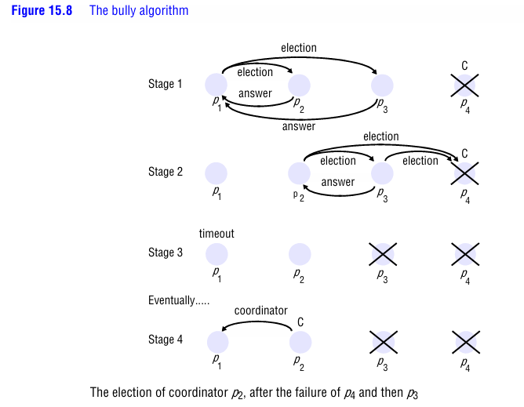
3. Bully Algorithm(Gracia-Molina)
Example:

Slide 14
3. Bully Algorithm(Gracia-Molina)
Example:
Processes p1, p2, p3, p4.
P4 (original coordinator fails).
P1 initiates an election:
P2 and p3 respond, but p3 crashes before sending coordinator.
P2 becomes the new coordinator.

Slide 15
3. Bully Algorithm(Gracia-Molina)
Key properties:
Safety: Ensures the highest-ID non-crashed process wins.
Liveness: Recovers from crashes; new elections restart if a higher-ID process recovers.
Drawbacks:
High message overhead (up to O(N²) messages).
Vulnerable to temporary network partitions.

Slide 16
Comparison
Ring-Based vs. Bully:
Criteria | Ring-Based | Bully
Topology | Logical ring | Any connected graph
Message Complexity | O(N)O(N)O(N) | O(N2)O(N^2)O(N2)
Fault Tolerance | Tolerates message loss, not process crashes | Tolerates process crashes
Use Case | Small, stable networks | Networks with frequent coordinator changes

Slide 17
Summary
Elections ensure a unique leader is chosen, critical for tasks like mutual exclusion or clock synchronization.
Ring-based algorithms are efficient but require a ring topology.
Bully algorithms handle crashes dynamically but incur higher overhead.
Both ensure safety (no two leaders) and liveness (eventual election completion).

