Slide 1
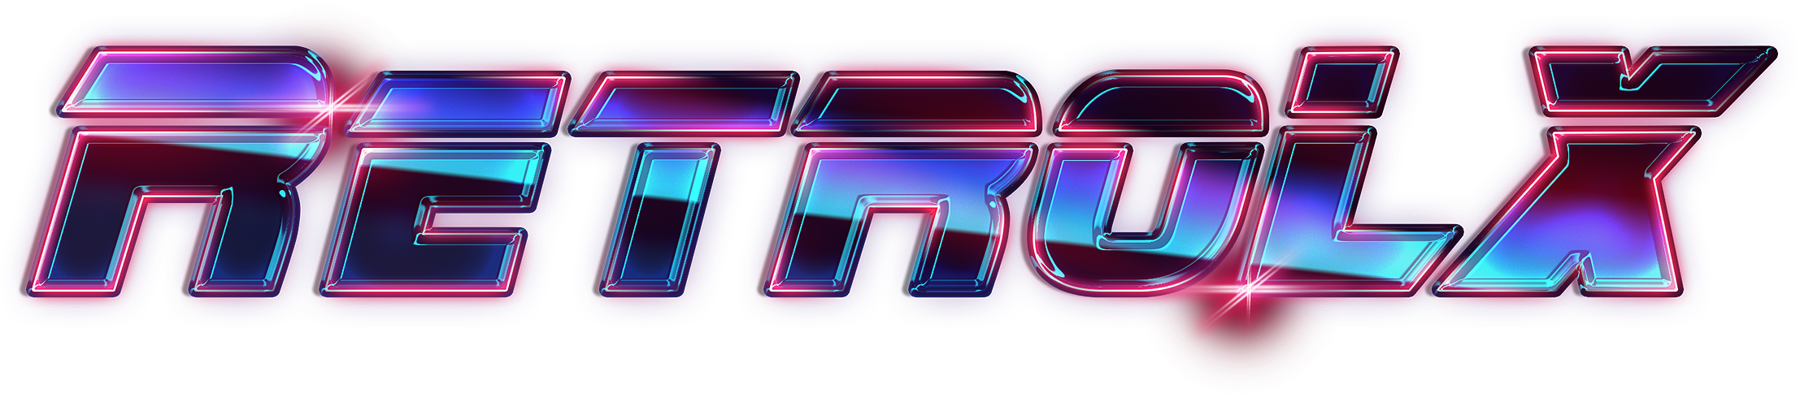
RETRO LINUX
USER GUIDE

Slide 2




Introduction.
RetroLX is an open-source and completely free retro-gaming distribution that can be copied to a USB stick or an SD card with the aim of turning any computer/nano computer into a gaming console during a game or permanently.
RetroLX does not require any modification on your computer. Note that you must own the games you play in order to comply with the law.
Features
Themes, Shaders, Bezels, Rewinding ... and much more to discover!
Powerful
RetroLX is built from the best emulators and the best cores!
Plug And Play
No need to configure your system for hours! RetroLX is ready for use! Download, flash, connect and play!
Open Source
RetroLX is 100% open source! All our works are freely available from a GitHub repository

Slide 3
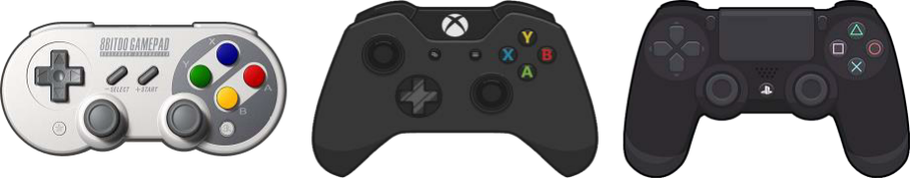
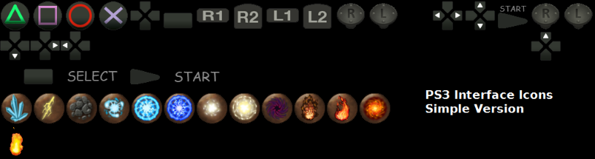




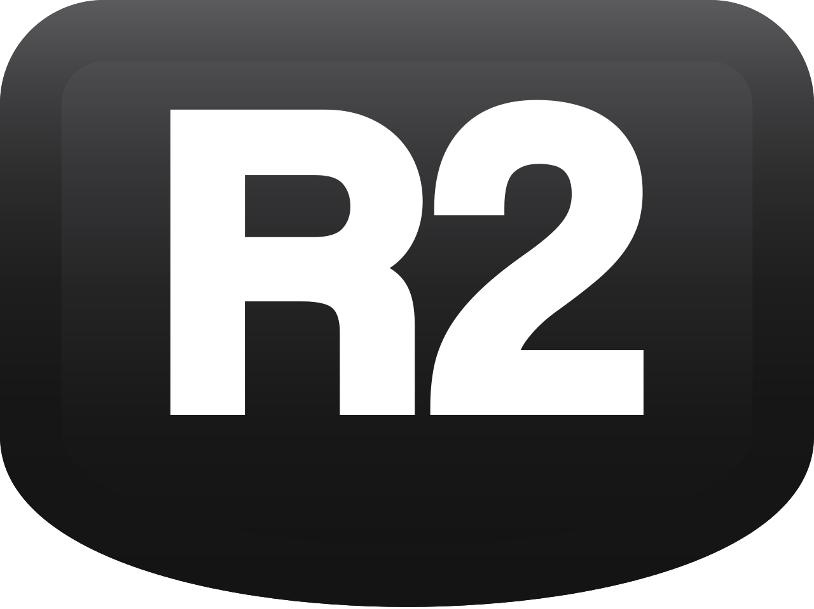





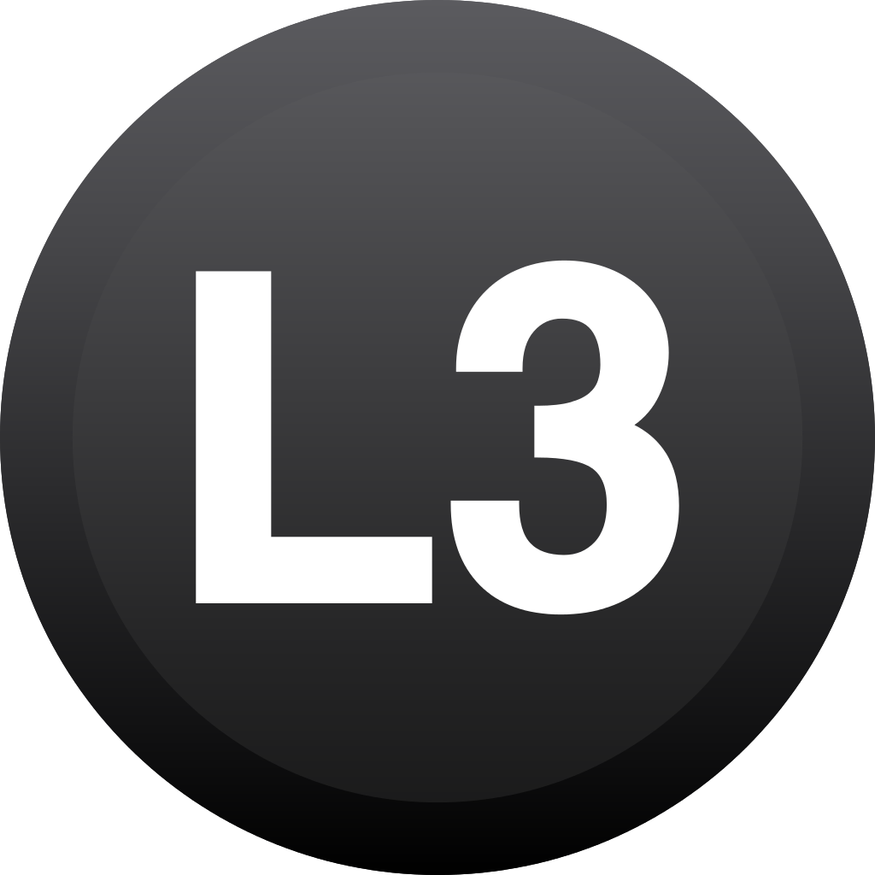
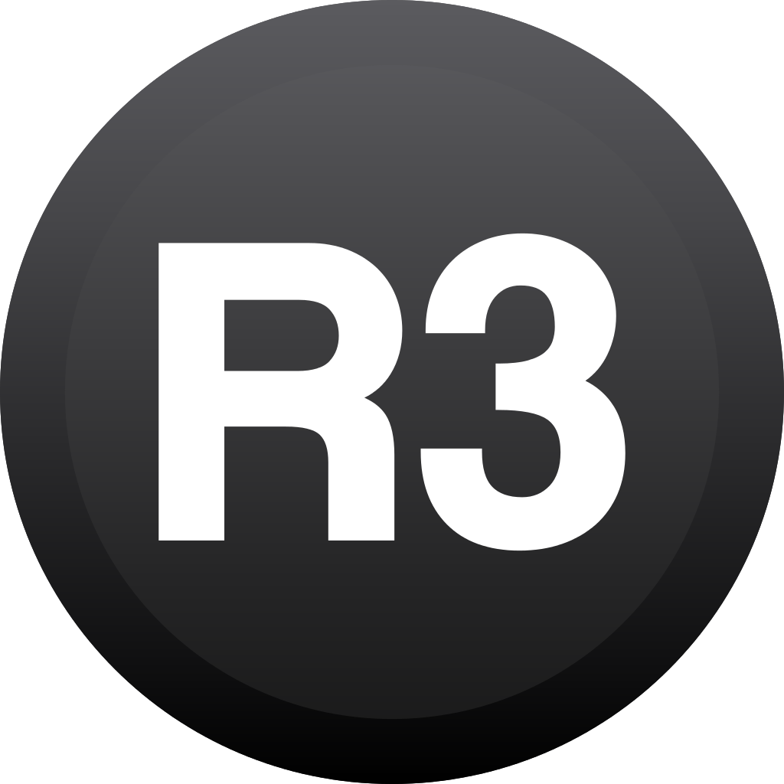
System Menu – Main menu
NAVIGATE
Buttons | Action
or | Previous / next system
or | Previous / next manufacturer
 | Select system (to Game menu)
 | Back / manufacturers bar
OPTIONS
Buttons | Action
 | Main menu
 | Quick access menu
 | Netplay
 | Short press: quick search menu
 | Long press: random system
 | Skip to next background song

Slide 4
Game Selection Menu.
NAVIGATE
Buttons | Action
 | Previous / next game
 | Jump up / down in the games list
or | Previous / next system
 | Short press: launch game
 | Long press: game options
 | Back (and back to systems menu)
OPTIONS
Buttons | Action
 | Main menu
 | View options menu
 | Short press: save snapshots
 | Long press: mark as favorite game
 | Short press: quick search menu
 | Long press: random game

Slide 5
In-Game Hotkeys (for most systems).
OPTIONS
Buttons | Action
+ | Open emulator menu (pause)
+ | Exit system
+ | Reset emulator
+ | Auto translate
+ | Take a screenshot
 | Add a credit (arcade)
SAVE & REWIND
Buttons | Action
+ | Select save slot number
+ | Rewind / Fast forward
+ | Quick save slot
+ | Quick load slot

Slide 6




Netplay.
Netplay is a feature enabled by RetroArch and some libretro cores to play games with multiple players over the network. If you want to play Double Dragon on NES with your buddy who sits several miles away from you… using netplay you can play both as Player 1 and Player 2 over the Internet, like if you were both playing on the same console, sitting next to each other.
Kodi.
Kodi is a free and open-source media player software application developed by the XBMC Foundation, a non-profit technology consortium. Kodi is available for multiple operating systems and hardware platforms, with a software 10-foot user interface for use with televisions and remote controls or gamepads. It allows users to play and view most streaming media, such as videos, music, podcasts, and videos from the Internet. It supports all common digital media files from local and network storage media.
RetroAchievements.
RetroLX offers support for RetroAchievements allowing you to earn custom-made achievements in classic games through emulation. By registering your retroachievements account and password, you can play and unlock achievements by completing various challenges. Later you can check and compare your progress to all your friends.
Built-in Scraper.
RetroLX integrates a built-in image scraper, which helps you organize the system interface by downloading the metadata of each game, as well as all the images and videos of the games you have. Easy and simple, just add your user account and password, choose the systems you want to recover the media, and voila ... everything will be downloaded automatically.

