Slide 1
MonoScript
Building a versatile JS mono repository
Notes:
Hello everyone, welcome to my talk about Monorepos and more specifically JS monorepos.
Now a days developers can pretty much do anything and everything they want with Javascript or one of its many libraries, frameworks or packages.
I am one of those developers, and I am going to talk about my journey as a developer, why I’ve become impartial to the mono repo setup.
I will talk you through the cartesian plane of project setup strategies, do some comparing and contrasting of 2 major mono repo build tools, Lerna and Turbo repo
And will close out this evening with a short demo using the aforementioned tools.

Slide 2




Introduction
My formal education background is in Geography & Geographical Information Systems.
I moved to Columbus 7 years ago from Dayton, after graduating from Sinclair Community College to pursue my BA at Ohio State.
In 2018, I made a pivot from GIS to CSE via a We Can Code IT Bootcamp.
Since the graduation I’ve worked at several companies:
Nationwide
Smart Cosmos / Bibliotheca
NetJets

Slide 3
My Technological background
Nationwide
Smart Cosmos
NetJets
Nationwide Mobile
Angular, Cordova, Ionic
Nationwide Internal Resource tracker
Microservices / Polyrepo
Angular, Java, AWS, Docker, K8s
Nationwide Cybersecurity
Angular, Azure, IAM
Physical Asset Management
Microservices
React, AWS, Docker, K8’s
Cloud Library 2.0 (Bibliotheca)
Microservices
React, Java, AWS, K8’s
Owner Portal
React Native web
Owner Web
Monorepo
React, .NET, jQuery, AWS
Design System
Monorepo
React Native, Lerna, NodeJS, CI/CD
Design System 2
Monorepo
React Native, Turbo Repo, NodeJS, CI/CD
Notes:
Across my time at several companies I’ve been lucky enough to work in over 50 code bases
Microservices for the API service layer but overall a poly repo
Monorepos
Monolithic projects.
Single page apps.

Slide 4


So what is a monorepo?
Monorepo
Until joining NetJets, I believed that poly repos were the best practice for code.
At its core a monorepo is a software strategy for containing any number of projects in a single VCS.
This practice dates back to the turn of the millenia thru the strategy of shared codebases.
Defined by having multiple distinct projects with well-defined relationships.
This level of organization and strategy is how we avoid a monolithic repo. A large repo lacking encapsulation and division of parts.
Modular
Monolith
Most Enterprise projects
Polyrepo
Notes:
Companies that use monorepos:
Google - Bazel, Twitter (X), Meta (F.B.), Microsoft - Rush & Lage, Uber, AirBnB
Helps in improved scalability, build speed, code consistency and quality.
Monoliths are common among developers working on a solo project. They become very tedious to untangle and change the architecture at a later date usually requiring a company to spend millions to rebuild projects.
Easy small repos with a very granular set of code
Kept in a container and usually utilized by cloud services and tools like Docker and K8s
Easy disaster recovery as if one service drops, other aspects of the app can still operate. It’s easy to quickly restart and instance and it separates your app into small logical pieces
Small logical piece of code
Can deploy a single package or the entire thing
Still in a container
We are going to focus on the Y-axis primarily

Slide 5
Poly Repos
Pros:
Team autonomy,
Tech stack choice
Smaller logical code repos.
Cons:
Difficulty in code sharing
Duplicate code
Difficulty with shared libs and versions
Inconsistent tooling
Overhead in creating, configuring and connecting new projects.
Many repositories usually consisting of singular build artifacts. Where each team has a repo(s) for each package, app or project.
This is a personal opinion
Notes:
Team Autonomy: Allowing each team in each project to build their own app at their own discretion and choice of packages. I.e. one team uses
Example:
Acme Project (microservices)
Inventory system
Auth service -> depends on AWS incognito
Items service -> depends on Auth service, MERN
Warehouse service -> depends on Items and Auth, MERN
Employee service -> depends on Auth
Opposum Inc. (mono repo)
Same product
Root { Auth, Items, Warehouse, Employee } service.
Can hoist all dependencies to the root, can set peer dependencies once.
Can avoid node_module bloat
Can still deploy each service as its own package.

Slide 6

Monorepo
Pros:
Reduced breaking changes and easier versioning.
Ease of setting up new projects
Quicker on boarding
Smaller logical code packages and apps.
Code consistency and quality.
Rapid access of code across teams
Cons:
Team autonomy
Duplicate code
Regulated tech stack
Personal experience, kind of hard to deploy without the use of a manager.
More PR emails from parts of the repo you might not be involved in
Numerous distinct projects in single VCS repo. With well defined organization, code sharing and project structure.
This is my personal opinion
Notes:
Team Autonomy: Allowing each team in each project to build their own app at their own discretion and choice of packages. I.e. one team uses
Example:
Acme Project (microservices)
Inventory system
Auth service -> depends on AWS incognito
Items service -> depends on Auth service, MERN
Warehouse service -> depends on Items and Auth, MERN
Employee service -> depends on Auth
Opposum Inc. (mono repo)
Same product
Root { Auth, Items, Warehouse, Employee } service.
Can hoist all dependencies to the root, can set peer dependencies once.
Can avoid node_module bloat
Can still deploy each service as its own package.

Slide 7

WHICH WILL YOU CHOOSE?!?

Slide 8
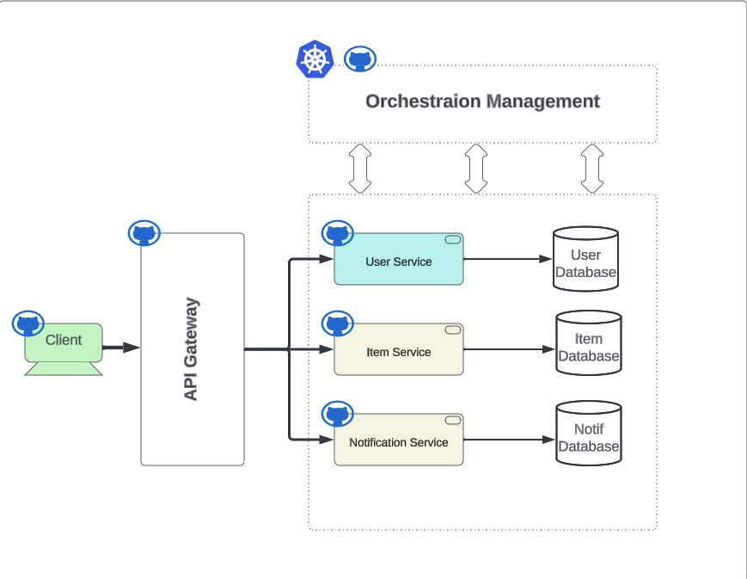
Notes:
Polyrepo:
Many repos with singular build artifacts. Where each team has a repo(s) for each package, app or project.
Pros: Team autonomy
Cons: Difficulty in code sharing, tons of duplicate code, issues with shared libraries, inconsistent tools, overhead in creating, configuring and connect new projects.

Slide 9
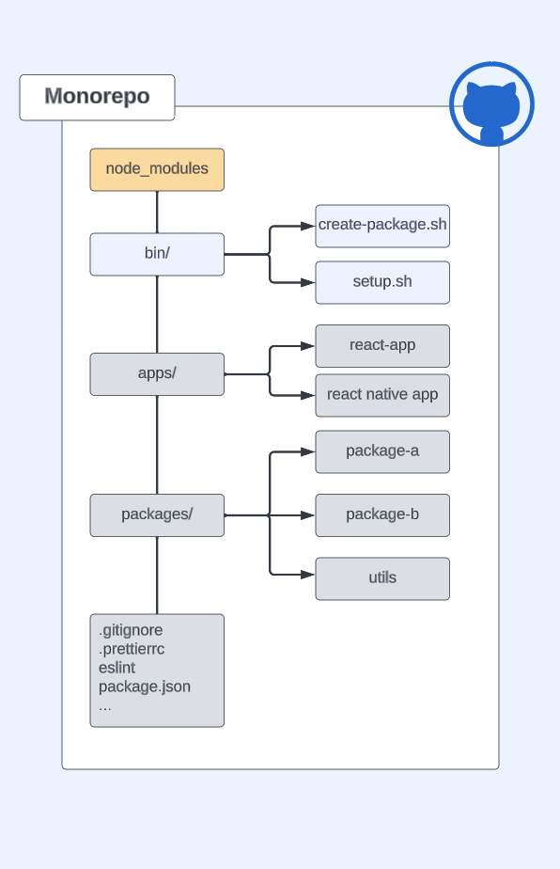
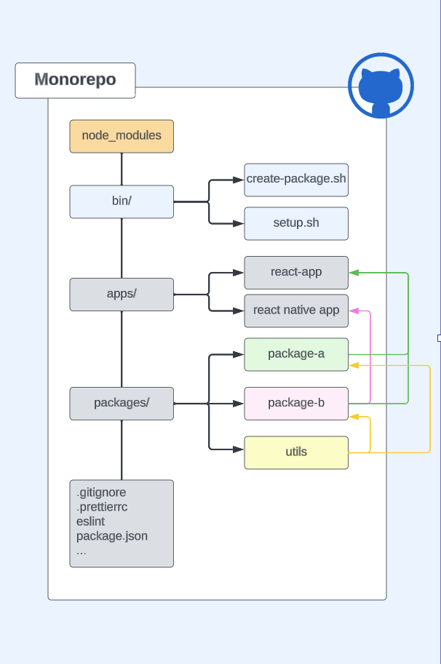
Notes:
Monorepo:
Numerous distinct projects in single VCS repo. With well defined organization, code sharing and project structure.
Pros: Ease of setting up new projects, reduced breaking changes, easier versioning, multiple teams with multiple technologies can easily work across the project rapidly
Cons: Lack of autonomy, regulated tech stack.

Slide 10
Monorepo Managers
Turbo
Lerna
Pros:
Very easy to get started with a new repo in minutes
Great documentation
Scaliable
Caching
Parallelization of task execution
Pick dependency manager.
Cons:
Creates a “bloated” base project
Pushes devs to use typescript
Pros:
Targeted dependency scripts
Efficient parallelization of order execution
Scaliable
Workspace graphic visualization
Caching
Cons:
Minimal preconfiguration
Lerna takes no responsibility for symlinking
Limited Documentation

Slide 11

Pros for both
Dependency Hoisting
Add dependencies and devDependencies at the root of the mono, and they’re accessible through out.
Have a dependency that’s only used once? You can declare it at the package level package.json
Using React Native or Expo in a monorepo? You can limit hoisting to the package level.
Notes:
In yarn berry its adding a “installConfig”: { “hoistingLimits”: “none” | “workspace” | “dependency” }
Like the “noHoist”: boolean

Slide 12
Dependency Managers
NPM
Yarn
PNPM
This is at the discretion of the architects or developers and which fits their needs.
I know this can be a touchy subject with some JS developers.

Slide 13

A quick Lerna demo

Slide 14
Starting a new Lerna monorepo.
$ mkdir lerna-demo
$ cd lerna-demo
$ npx lerna init
$ mkdir packages
$ mkdir packages/utils packages/pkg-a
$ cd packages/utils && npm init
$ mkdir src
$ touch index.js src/index.js
Create a new blank directory
Move to that directory
Use NPX to run lerna commands
Generates a package.json, .gitignore & lerna.json
Now create your desired project structure.
Creating a util package that can be shared across all apps and packages as easy as adding a new dependency to dependencies or devDependencies in that projects package.json
This is a very basic project setup.
Lerna leaves all of the project structure setup to the developer
Developers could create scripts to quickly build out general project structure.
Utilizes dependency managers workspace config in the root package.json
Easy publishing and versioning with built in lerna CLI tools.

Slide 15
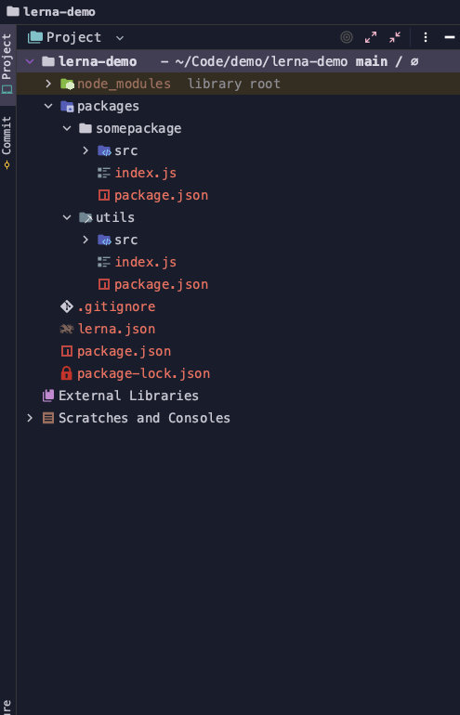
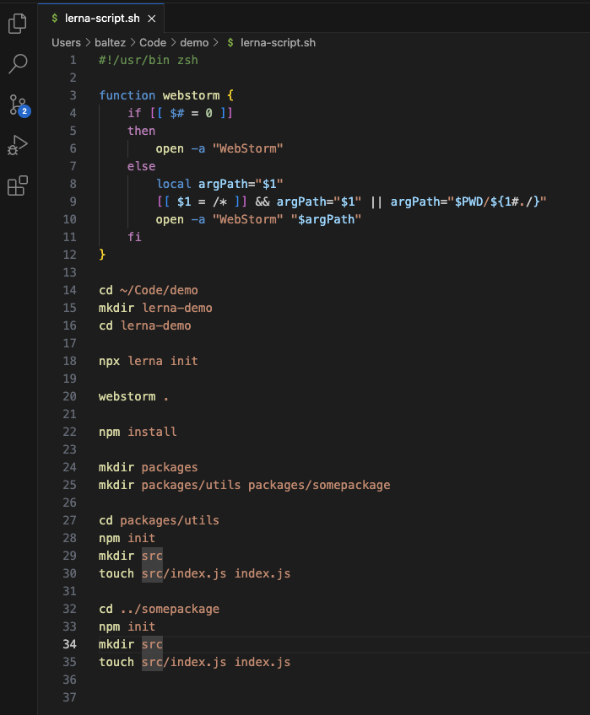

Slide 16

A quick Turbo repo demo

Slide 17
Starting a new Turbo repo.
$ cd code/
$ yarn dlx create-turbo@latest
$ cd turbo-demo
$ webstorm .
Move to the desired directory
Use Yarn dlx to run turbo commands
Generates a package.json, .gitignore, turbo.json, packages/, apps/, tsconfig, and more.
The project is ready to go. All that needs to be done is add additional packages
If using typescript add a tsconfig.json to the new package and add the dependency package.
This is a very basic project setup.
Turbo out of the box creates a project with Typescript already configured with a base and extended for Next.js and React
apps/ with a Next.js app
packages/ with a eslint, tsconfig & UI package that are modules to keep
Feels like it forces the developer to use Typescript
Well documented and numerous demo repos for different use cases.
Easy publishing and versioning with built in lerna CLI tools.

Slide 18
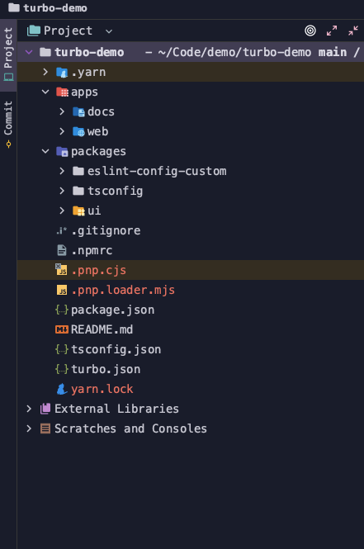
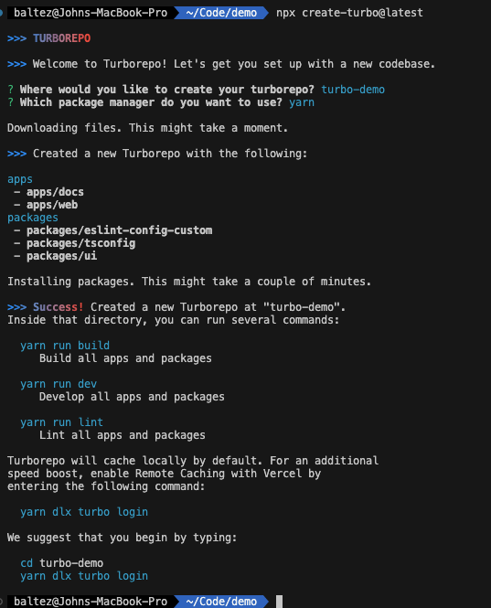

Slide 19
Any Questions?

Slide 20






Contact me
GitHub: retrojb
X: @johnbaltes6
LinkedIn: john-baltes
Email: baltescartography@gmail.com
Huge shout out to Reddit for the memes in r/programming
Turbo Repo, Lerna, QR Code Generator, monorepo.tools,

Slide 21
https://monorepo.tools/#what-is-a-monorepo
https://medium.com/tech-bits-pub/why-you-should-consider-monorepo-and-nx-for-your-project-f4993e95de3f
https://lerna.js.org/docs/introduction
https://turbo.build/repo/docs/installing

Slide 22
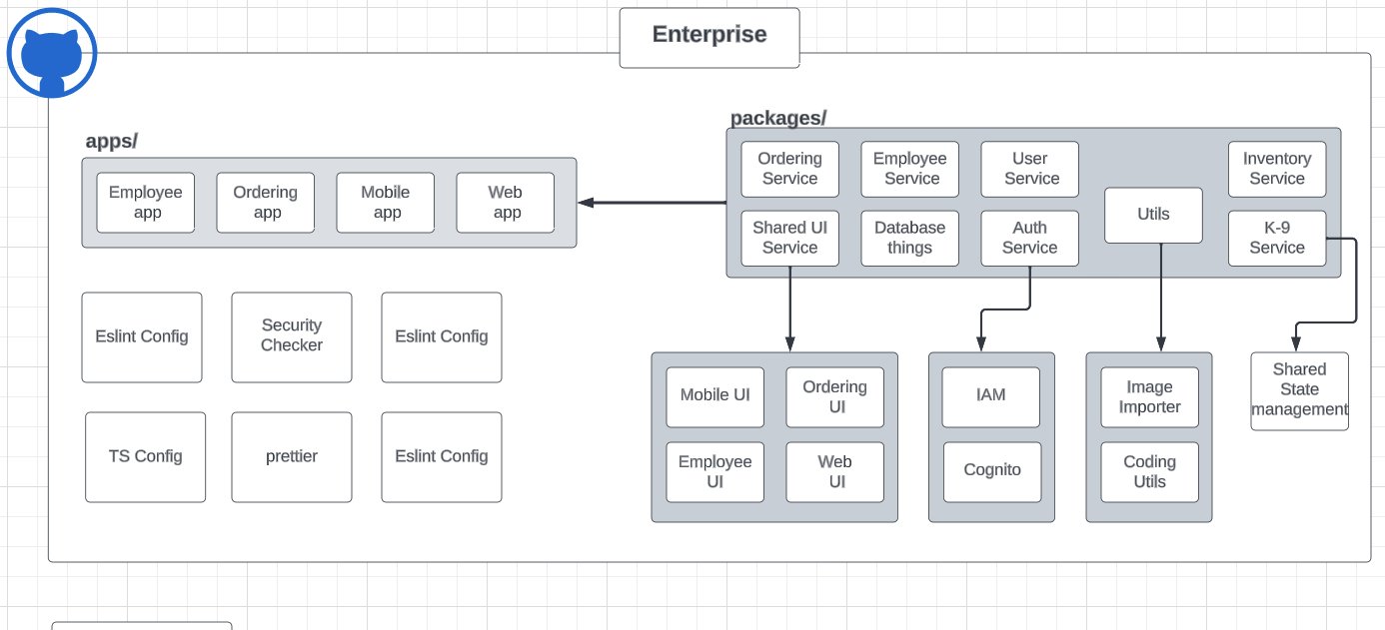
Notes:
Monorepo:
Numerous distinct projects in single VCS repo. With well defined organization, code sharing and project structure.
Pros: Ease of setting up new projects, reduced breaking changes, easier versioning, multiple teams with multiple technologies can easily work across the project rapidly
Cons: Lack of autonomy, regulated tech stack.

