Slide 1
GTD-PLANNER
<p> by Sergey Kozinov </p>

Slide 2
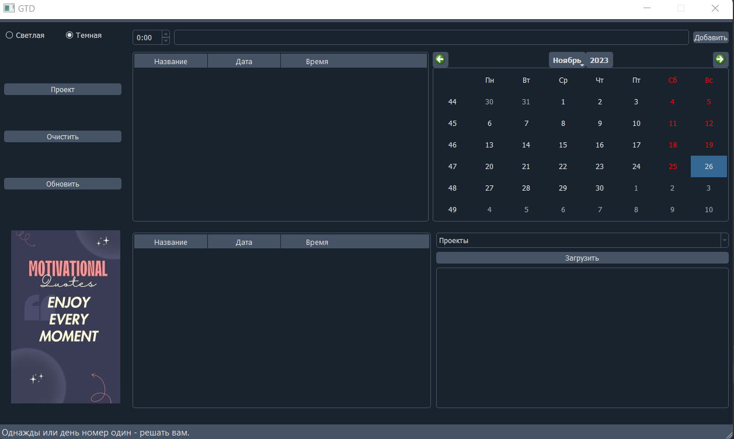
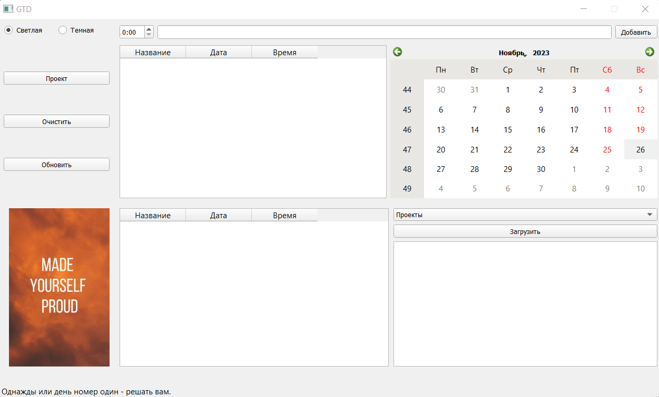

Slide 3
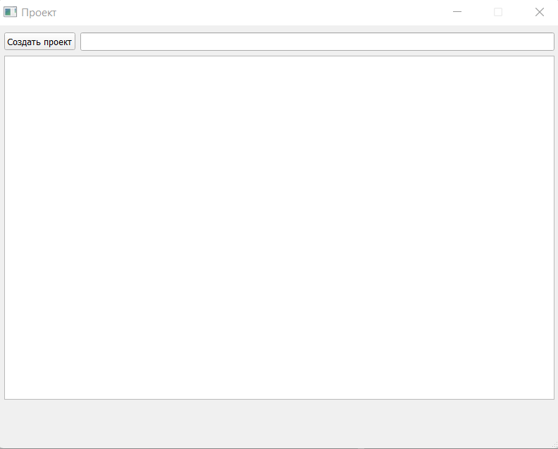

Slide 4
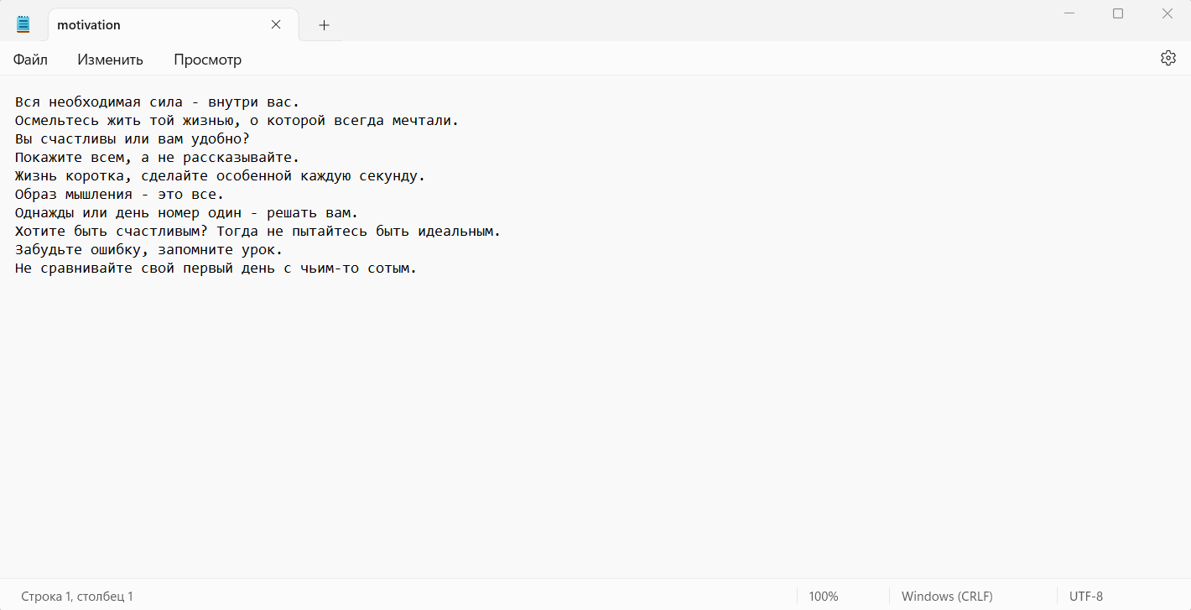

Slide 5
THANK YOU!

