Slide 1
EXPLORING CITIBIKE DATA: INSIGHTS AND TRENDS
By Reuben Rinu

Slide 2
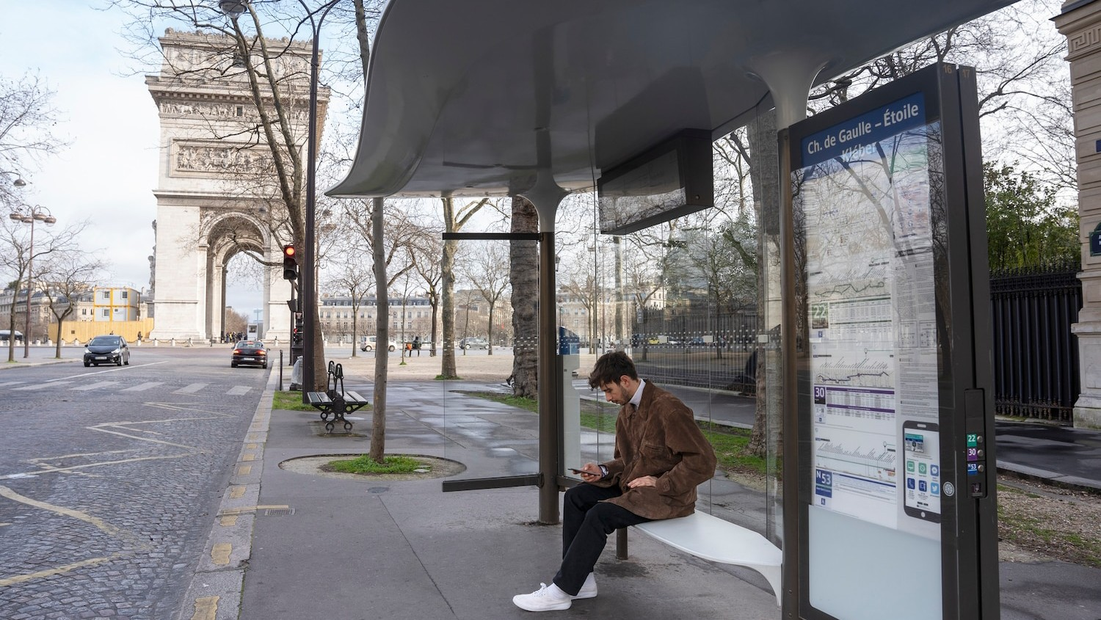
Introduction
CitiBike is a bike sharing service in NYC. The company has been collecting data on bike rides since 2013. The data is publicly available and can provide valuable insights into bike usage patterns and trends.

Slide 3

RIDERSHIP TRENDS
First we can track the peak hours for Citi bike rides. This is important because it helps optimize resource allocation, improve operational efficiency, and enhance user experience by aligning available bikes and infrastructure with the demand during the busiest periods.

Slide 4
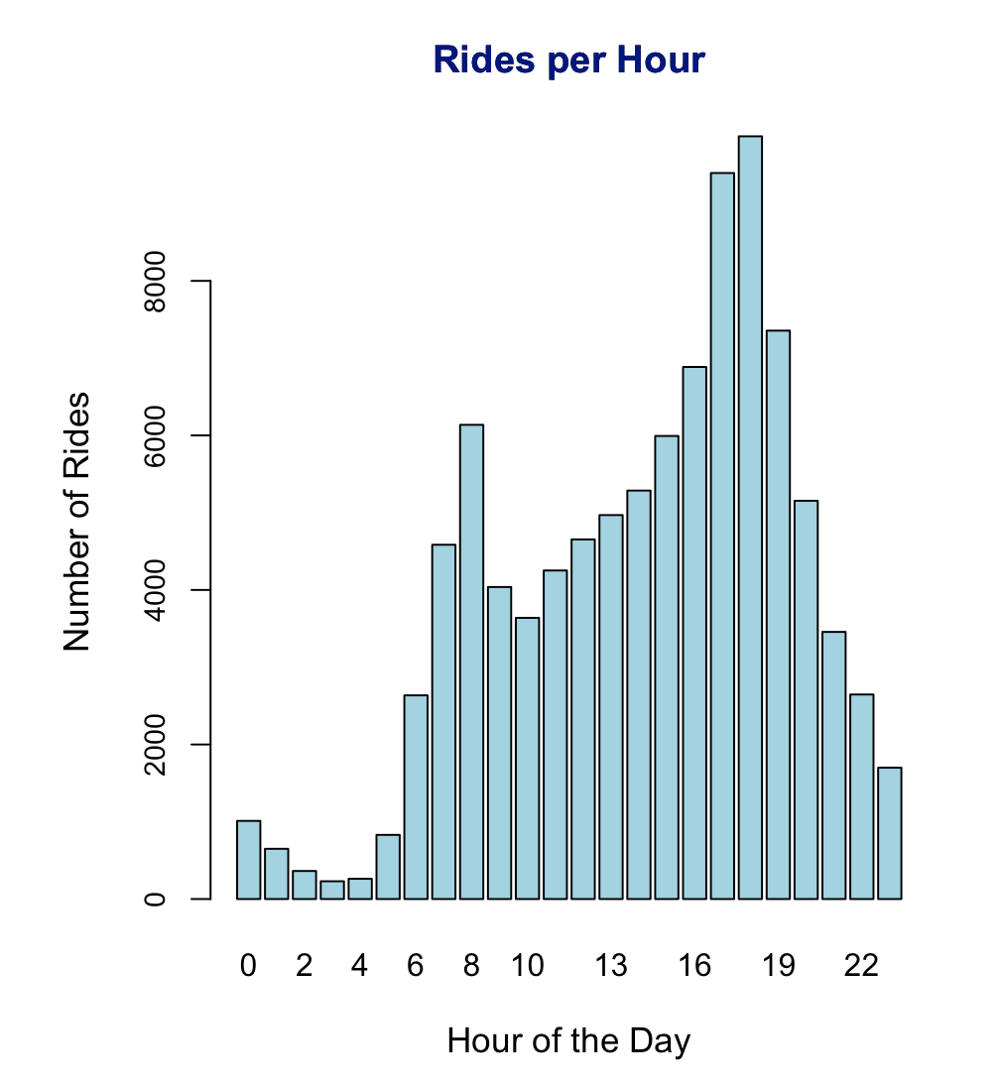
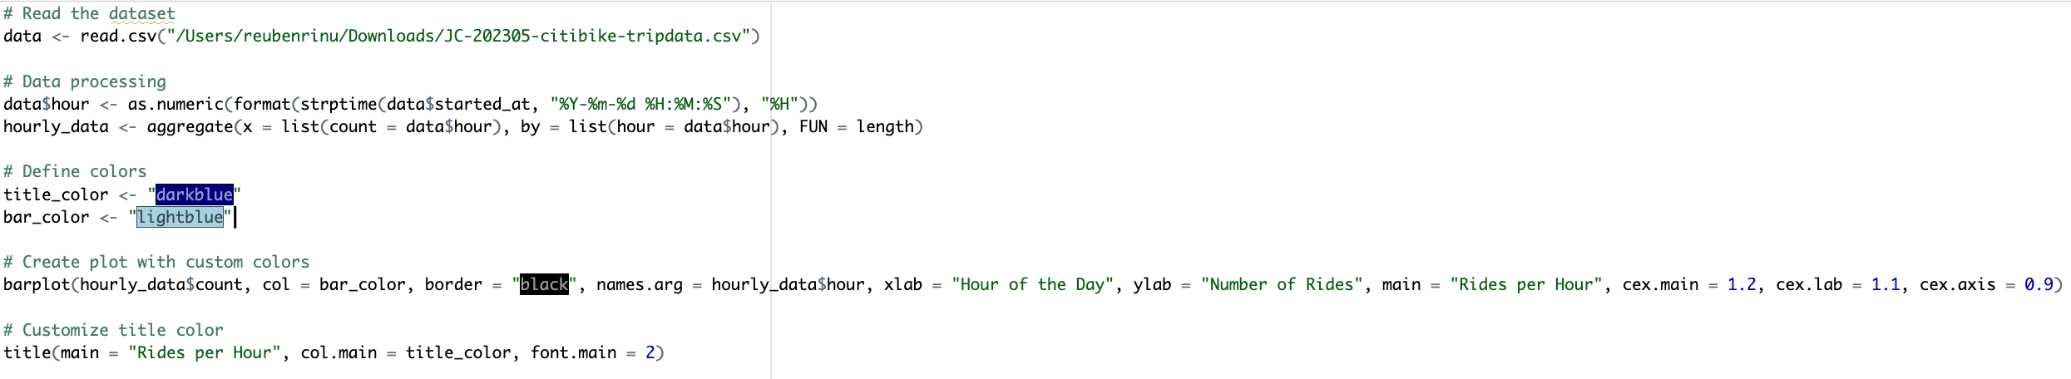
Peak Hours Analysis Using R
This code shows that the most rides in a day occur during 5PM and 6PM. Citi bike can utilize this data to charge more during those hours, as users would still pay and this would maximize profits

Slide 5

Ride Start Stations
Tracking the start stations of Citibike rides is important as it provides valuable insights into user preferences, popular locations, and potential infrastructure needs, allowing for targeted improvements and efficient allocation of resources.

Slide 6

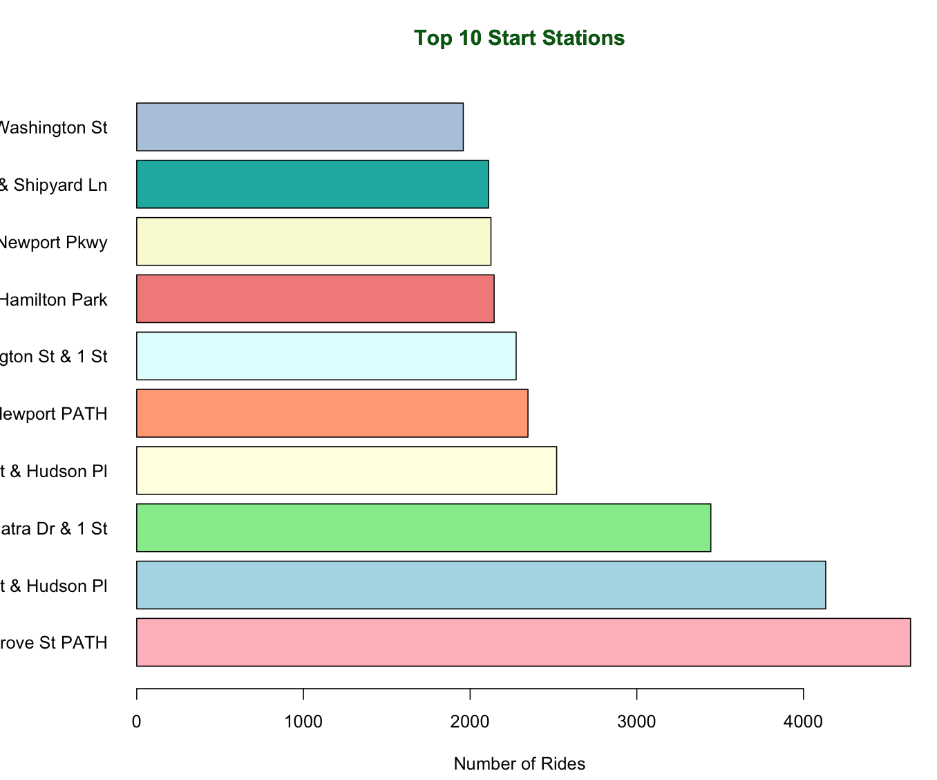
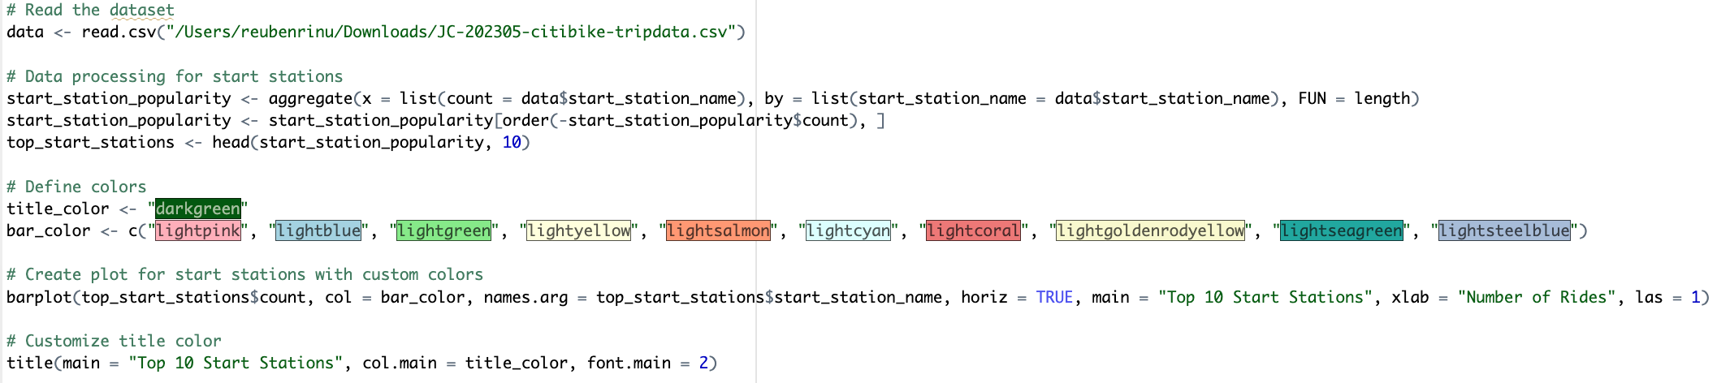
Tracking Popular Start Stations Using R
Certain stations are more active than others. This can prove useful as Citibike can focus more resources for bike maintenance at these stations, and It could add vending machines that refresh users before their bike, again increasing profits.

Slide 7

Casual vs. Members
Data on user behavior shows that many riders use CitiBike for commuting purposes. Some users have yearly memberships while others opt for day passes. Further Analyzing this data could allow Citibike to increase revenue by having more people switch to a membership, or having casual members pay more .

Slide 8
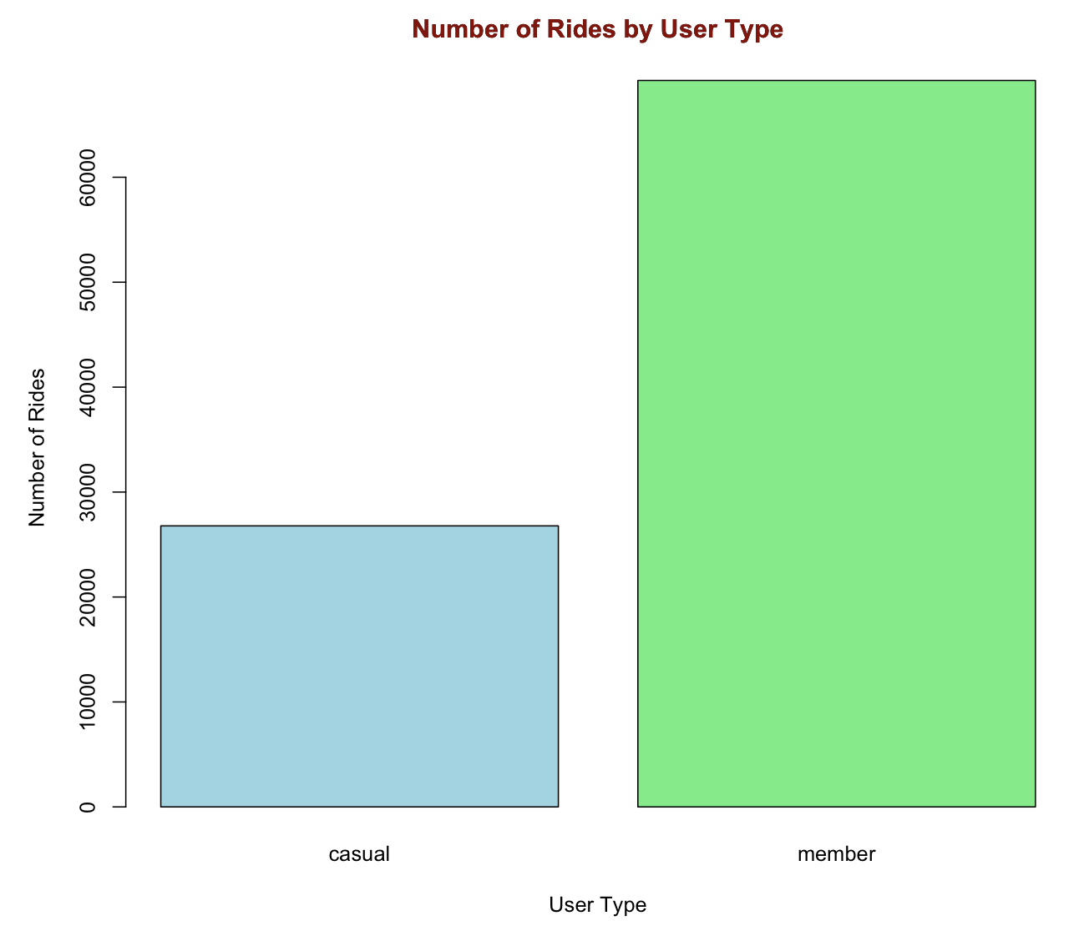
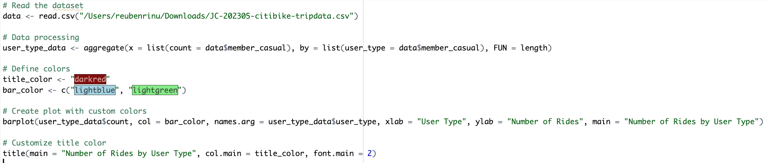
Tracking Popular Start Stations Using R
This shows that most riders are members. Citi bike can thus ensure membership increases by making it more expensive for a daily commuter to be a casual user, thereby increasing profits.

Slide 9
CONCLUSION
The CitiBike data provides valuable insights into bike usage patterns and trends in NYC. Understanding these patterns can help improve the bike sharing service and encourage more people to use bikes as a means of transportation.

Slide 10

THANKS
Do you have any questions? youremail@freepik.com
+91 620 421 838
yourcompany.com

