Slide 1
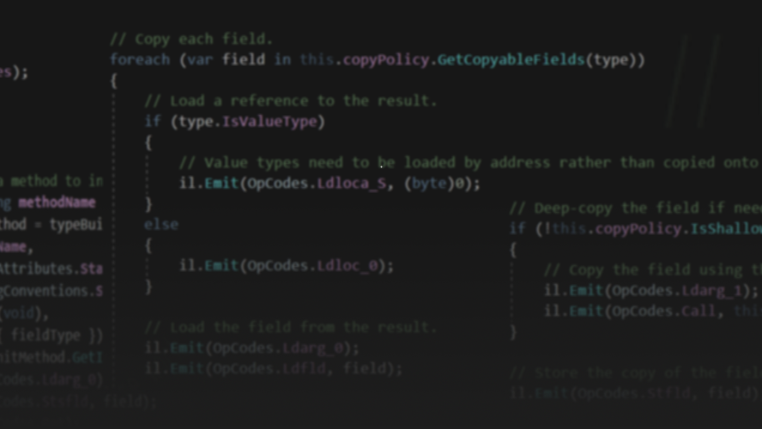
Code Generation on .NET
@ReubenBond
👍 interrupt me whenever.

Slide 2

It’s not a story the Jedi would tell you

Slide 3
Goals
What
Why
Intro to
Expression Trees
IL
Roslyn

Slide 4
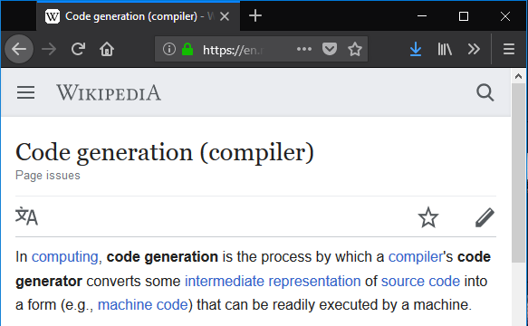
Code Generation is…
Not this kind!
What

Slide 5
Code Generation is…
in this context
A tool which takes some input and generates output which is intended to be later executed
Input can be:
Source code
Executable
Some other file (eg, .proto file)
Output is typically:
Source code
Executable (either on disk or in-memory)
What

Slide 6
Seems obscure…
Serializers (JSON.NET, protobuf-net)
RPCs (gRPC, Orleans)
ORMs (EF, Dapper)
Mocks (NSubstitute, Moq)
UI tooling (XAML, Razor)
Dependency Injection
Who

Slide 7
Code gen is crucial, but it is not magic

Slide 8
.NET

Slide 9
Expression Trees
Using LINQ Expression Trees to compile expressions at runtime
✔ Easy to use, expressive API
✔ Allows level of access to private members
❌ Not fully supported on AOT-only platforms like iOS
❌ Not all language constructs are supported

Slide 10
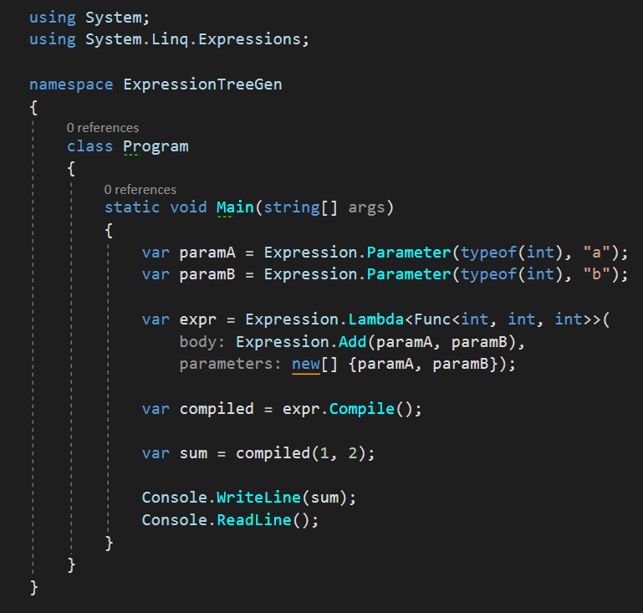
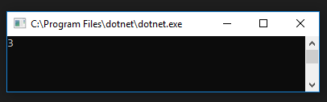
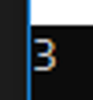
👍

Slide 11
IL Generation
Using Reflection.Emit to dynamically create types/methods
✔ Can produce code which cannot be expressed in C#
❌ Very verbose
❌ Very difficult to debug
❌ No higher level abstractions (async, enumerators, loops)
❌ Not supported on AOT-only platforms like iOS

Slide 12
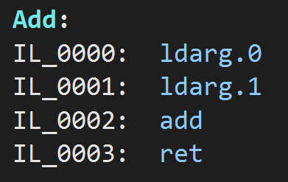
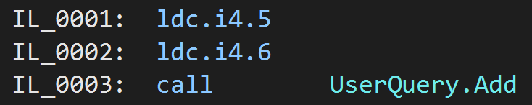
First: What is IL

Slide 13
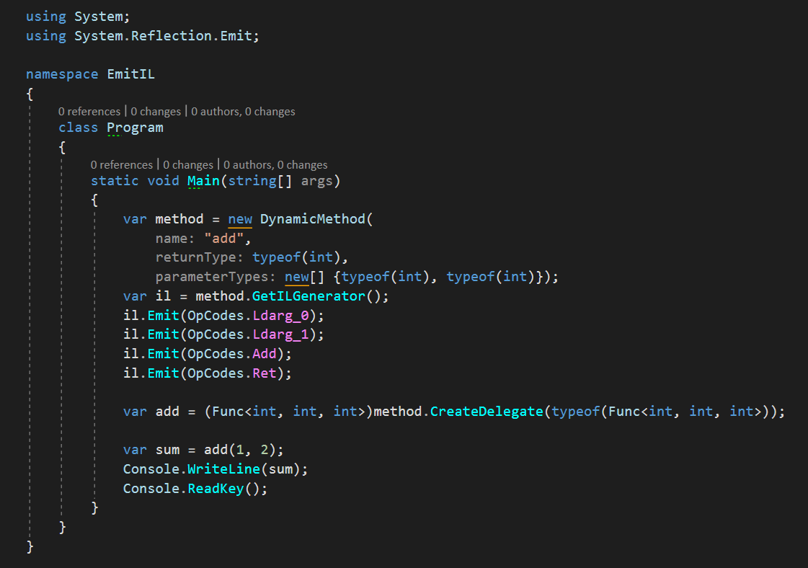

Slide 14
Example: CreateGrainReferenceCaster
More complex example from Orleans codebase

Slide 15
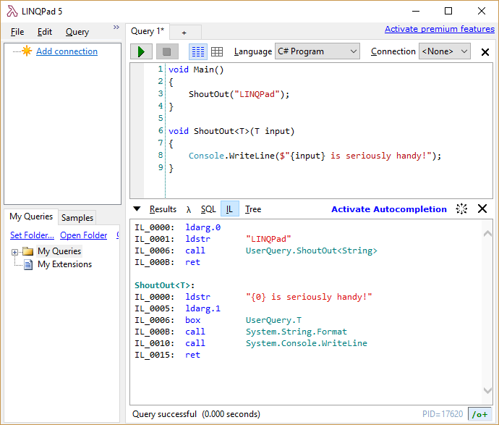

Slide 16
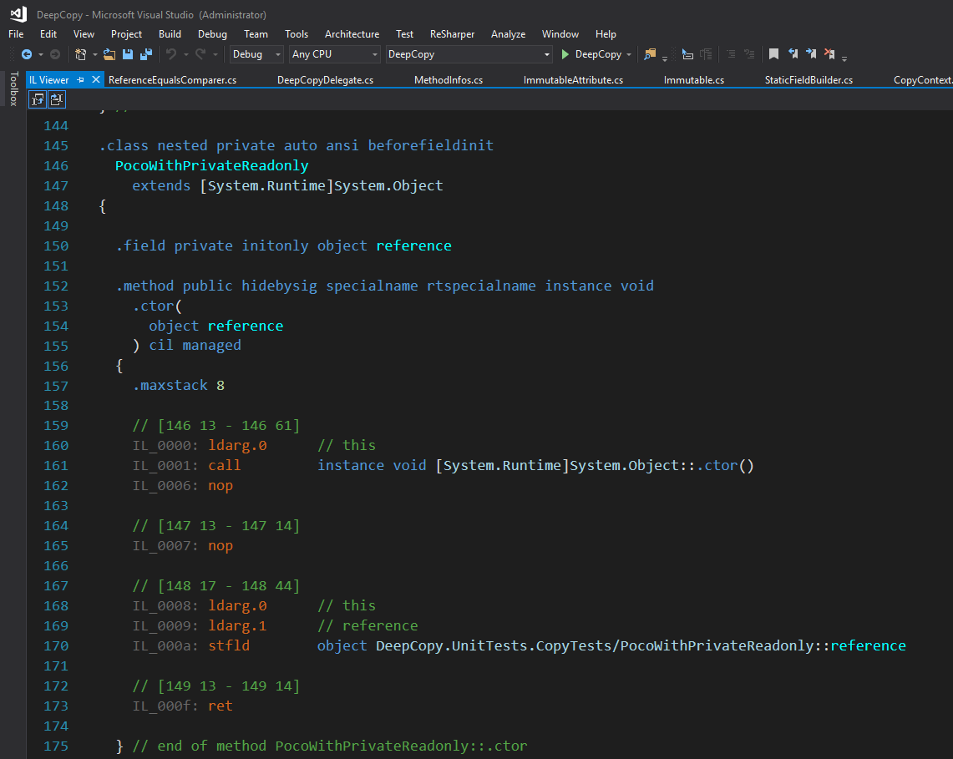

Slide 17
Syntax Generation
Using Roslyn to generate C# syntax trees in code
✔ Access all C# features (async!)
✔ Supported on AOT platforms
✔ Debuggable output
✔ Human-readable output (kinda)
❌ API isn’t always obvious
❌ Code must obey C# rules (no privates, can’t write to readonly)

Slide 18
Roslyn is a compiler

Slide 19
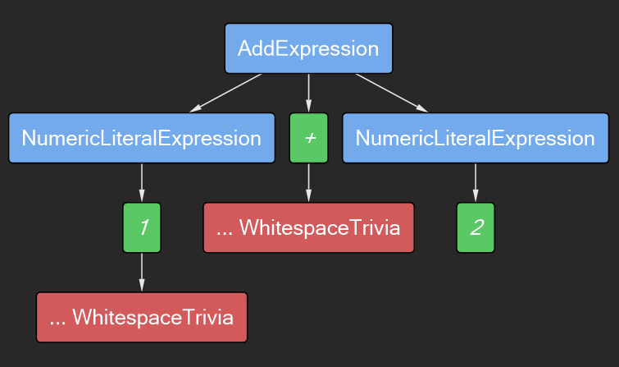
Syntax Trees

Slide 20
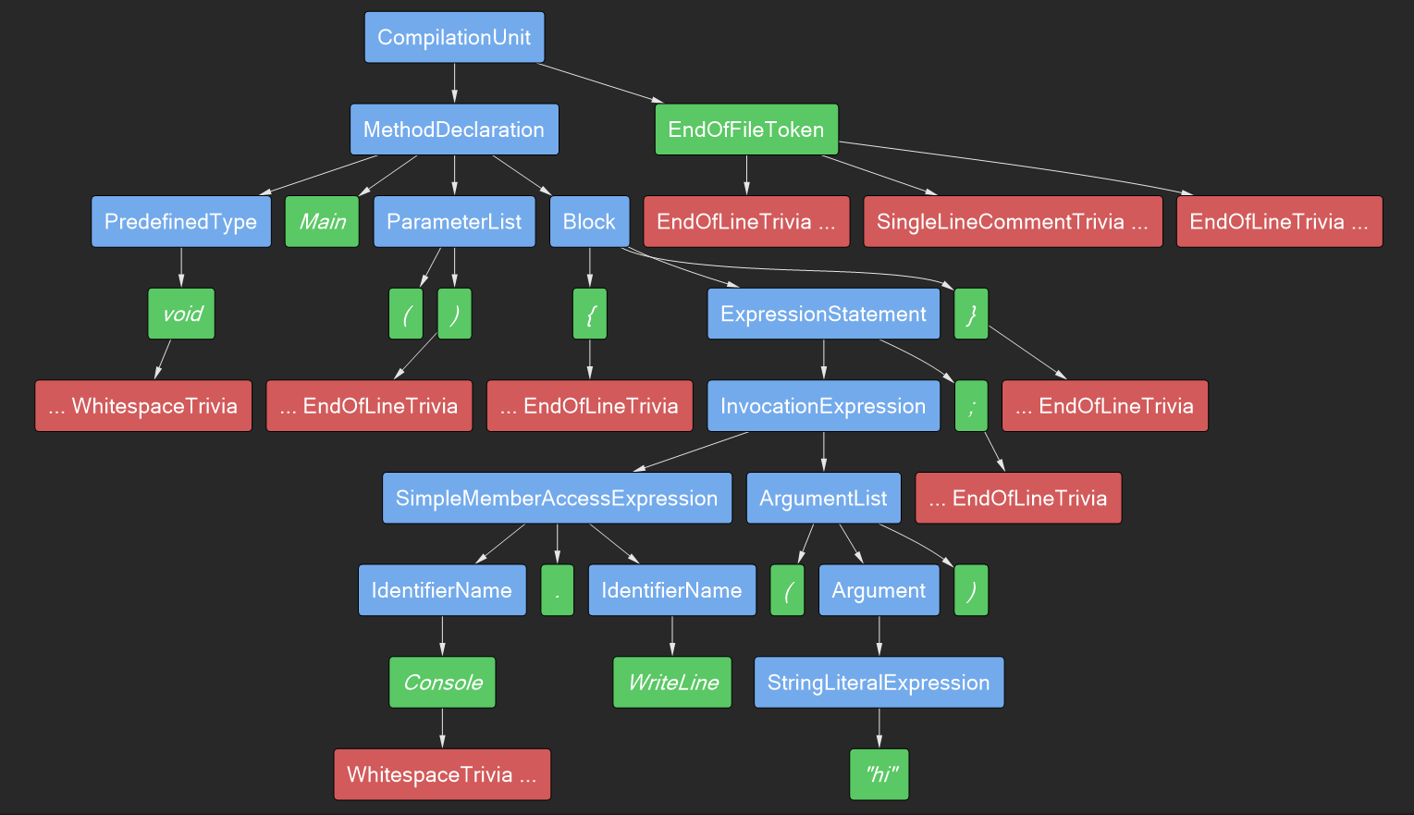

Slide 21
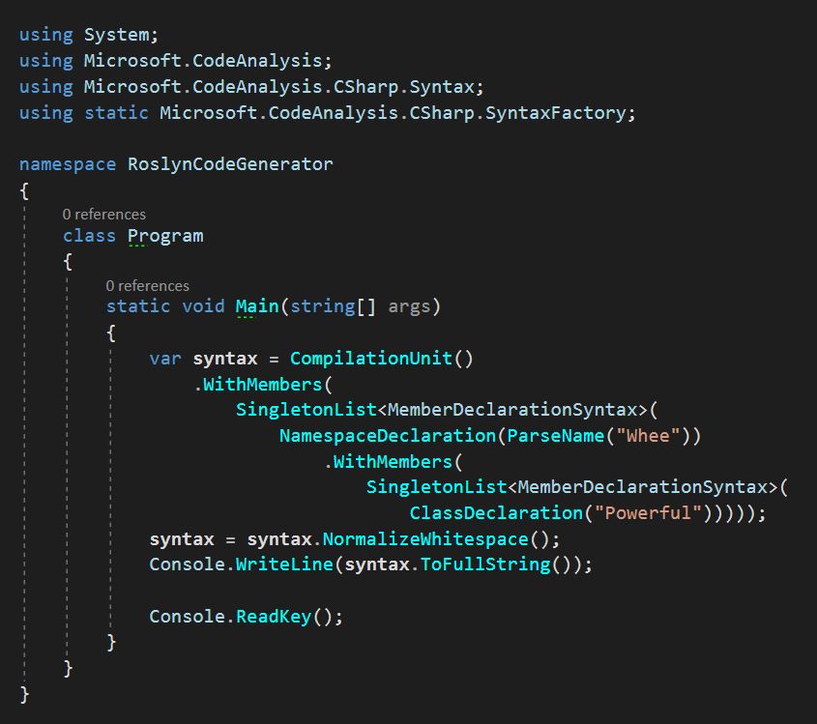
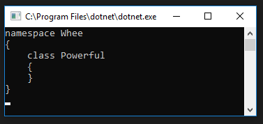

Slide 22
General strategy
Input
Model
Generated Code
Phase 1: Build model from input
Phase 2: Generate code from model

Slide 23
Choices….
Input
Compiled Binary
.NET Reflection APIs
System.Reflection.Metadata
Source Code
Roslyn code analysis APIs
.proto file, etc
Custom parser
Output
Compile at runtime?
Write source to disk?

Slide 24
Example: Hagar
Source-to-source serializer generator
Notes:
Show Model: TypeDescription, PropertyDescription, FieldDescription
Show GenerateCode

Slide 25
Which one do you use?
Usually: Roslyn
When necessary: IL

Slide 26

Thank You
https://reubenbond.github.io/posts/codegen-1
https://reubenbond.github.io/posts/codegen-2-il-boogaloo

Slide 27
What

